Slide 1
NPP Microwave Sounder-Based Tropical Cyclone Products
Andrea Schumacher, CIRA, Ft. Collins, CO
Mark DeMaria and John Knaff, NOAA/NESDIS/StAR
Limin Zhao, NOAA/NESDIS/OSPO/SPSD, Camp Springs, MD
Tom Schott, NOAA/NESDIS/OSD, Suitland, MD
Interdepartmental Hurricane Conference, 28 Feb – 3 Mar 2011, Miami, FL

Slide 2
Microwave Imagery and Tropical Cyclones
Satellite remote sensing important resource for monitoring TCs, especially in data sparse regions
Passive microwave remote sensing suited to observing TCs
Penetrates beyond the top layer of cloud (use in CDO)
Less sensitive to hydrometeor contamination
Available day or night
Has been used for decades
Microwave Sounding Unit (MSU)
1978 – 1998, ~2.5 degree latitude footprint
Advanced Microwave Sounding Unit (AMSU)
1998 – present, ~50km footprint
NOAA-15/16/17/19, Aqua, Metop

Slide 3
AMSU TC Products
CIMSS
Uses MLR scheme to estimate MSLP and MSW using 3 channels AMSU-A, 1 channel AMSU-B
Correction made to MSLP using eye size from ADT or ATCF
CIRA
Uses AMSU temperature retrieval, hydrostatic and gradient balance to solve for T(r,z) and V(r,z), and then applies statistical MLR scheme to solve for
Intensity (MSW and MSLP)
Wind radii (r34, r50, r64)
3D horizontal winds (non-linear balance)
CIMSS and CIRA intensity estimates inputs to SATCON
CIRA AMSU TC product input to Multi-platform TC Surface Wind Analysis

Slide 4
AMSU TC Products (cont…)
Hurricane Igor
17 Sep 2010, 12z
Intensity Estimates (red line NHC)
AMSU non-linear balance winds at 850 hPa
Multi-platform TC surface wind analysis

Slide 5
Motivation
These products all rely on AMSU, which has limited lifetime
Next generation: Advanced Technology Microwave Sounder (ATMS)
NPOESS Preparatory Project (NPP)
Satellite launch planned for Oct 25, 2011
35% smaller footprint than AMSU (~33km)
Improved spatial coverage (no gaps between swaths)
MIRS processing → temperature retrievals
Preparation for Joint Polar Satellite System (JPSS)
Goal: Adapt CIRA AMSU-based TC products to use ATMS
Continuity of guidance products
Make use of enhanced capabilities

Slide 6
Overview of CIRA AMSU-based TC products - AMSU Data
AMSU cross-track swath ~ 2200km
To use swath for this algorithm, TC must be within 600 km of swath center
Resolution ranges from ~ 48 to 80 km from center to 600 km
Too course for direct intensity estimates (sub-sampling near core)
CIRA uses MLR bias correction
UW-CIMSS correction based on core size
2200 km
1200 km

Slide 7
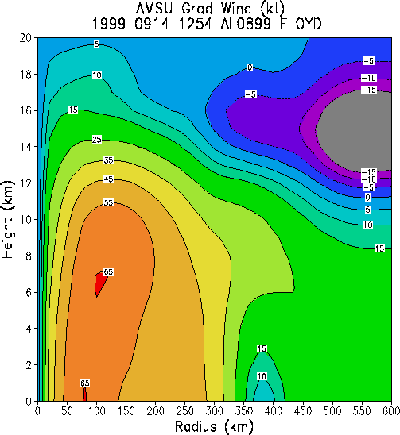
Azimuthal Mean Radial-Height Cross Sections
Corrected, normalized T at 23 pressure levels interpolated to radial grid (r ≤ 600km), azimuthally averaged
Hydrostatic Integration, T(r,z) and p(r,z)
Assume gradient balance, solve for V(r,z)
Boundary conditions from NCEP analyses
MSW from azimuthal mean V tend to be weaker than observed due to
Course resolution of AMSU
Smoothing of data
Operational since 2003
Sample r/z tangential wind
cross-section from AMSU
retrieval

Slide 8
Intensity and Structure Estimates
Statistical prediction scheme
Dependent variables: MSW, MSLP, and azimuthal average r34, r50, r64
Best track data
Tested 19 potential predictors (18 AMSU-based)
MLR (backward stepping)
Fit parametric wind model to r34, r50, r64 and storm speed to get asymmetric radii
Intensity estimates: MAE of 11 kt / 7 hPa
Structure estimates: MAE of 30 nmi / 24 nmi / 14 nmi for r34 / r50 / r64
See Demuth et al. 2004 and 2006
Operational since 2003

Slide 9
Area Average Wind Shear and Mean Layer Winds
Solve non-linear balance equations at standard pressure levels to get 3D winds
Bessho et al. 2006, Zehr et al. 2008
Use average wind over TC-centered 600-km radius to calculate
Vertical shear
850-200 hPa and 850-500 hPa
Mass-weighted deep layer mean wind
850-200 hPa and 850-500 hPa
Correlates well with NCEP VWS
Provide timely, independent estimates
Operational at NCEP since 2005
2004-2007 Atlantic cases
From Zehr et al. 2008

Slide 10
Multi-Platform TC Surface Wind Analysis

Slide 11
Product Update Plan
Use existing methodology, new dataset
ATMS data
22-channel passive microwave radiometer (AMSU-A/B)
35% smaller footprint than AMSU
Improved spatial coverage (no gaps between swaths)
Anticipated advantages
Generalizing current algorithms to use ATMS data ensures continuity of microwave-based TC products used by TC agencies
Enhanced resolution and coverage may improve accuracy of TC products
MIRS processed temperature retrievals…

Slide 12
Project Update Plan (cont…) MIRS Temperature Retrievals
Microwave Integrated Retrieval System (MIRS)
Upgrade to the MSPPS (Microwave Surface and Precipitation Products System)
Based on an assimilation-type scheme (1DVAR) capable of optimally retrieving atmospheric and surface state parameters simultaneously
Anticipated advantages
Eliminates duplication of effort (start with temperature retrievals)
Improves product reliability
Impacts on accuracy?
Impacts of using MIRS retrievals vs. Goldman/Barnett statistical temperature retrievals on TC products subject of current CIRA Cal/Val project

Slide 13
Timeline for Updates
May 2011: Development begins
Oct 2011: NPP satellite launch
Oct 2011 – Jan 2013: Collect MIRS processed temperature retrievals
Jan 2013 – Mar 2013: Develop final product algorithms (same methodology, new data)
Mar 2013 – Jul 2013: Pre-operational testing
Aug 2013: NPP microwave sounder-based TC products declared operational

Slide 14
References
Bessho, K., M. DeMaria, J.A. Knaff, 2006: Tropical Cyclone Wind Retrievals from the Advanced Microwave Sounder Unit (AMSU): Application to Surface Wind Analysis. J. of Applied Meteorology. 45, 399 - 415.
Demuth, J., M. DeMaria, and J.A. Knaff, 2006: Improvement of Advanced Microwave Sounding Unit Tropical Cyclone Intensity and Size Estimation Algorithms, Journal of Applied Meteorology and Climatology, 45, 1573-1581.
Demuth, J. M. DeMaria, J.A. Knaff and T. H. Vonder Haar, 2004: Validation of an advanced microwave sounder unit (AMSU) tropical cyclone intensity and size estimation algorithm, J. App. Met., 43, 282-296.
Zehr, R., J. Knaff and M. DeMaria, 2008: Tropical Cyclone Environmental Vertical Wind Shear Analysis Using a Microwave Sounder. Conference on Hurricanes and Tropical Meteorology, 2008.

