Slide 1
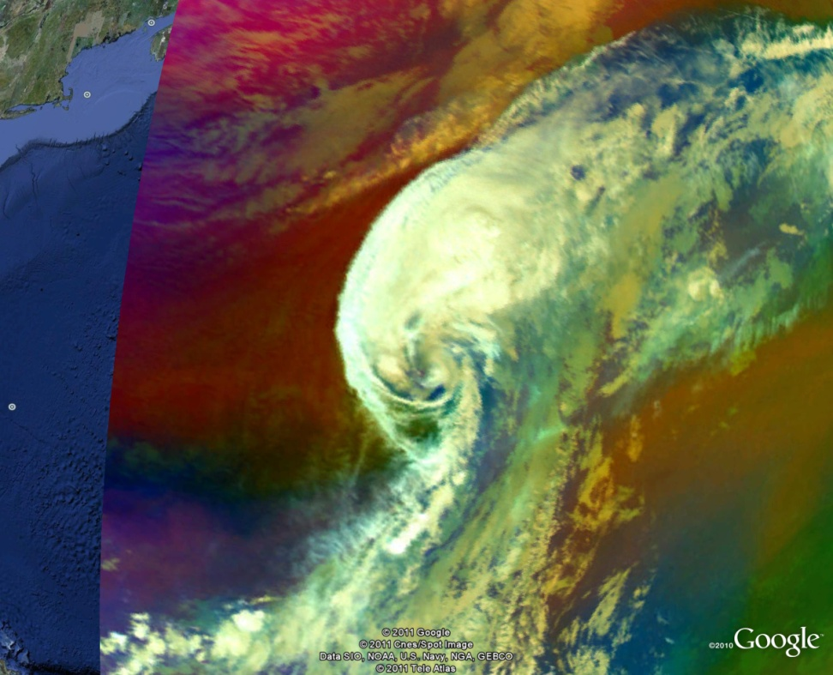
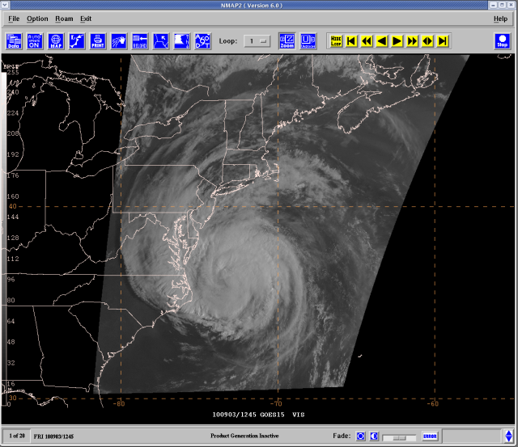
The 2010 GOES-R Proving Ground at the National Hurricane Center
Jack Beven¹, Michael Brennan¹, Mark DeMaria², John Knaff², Christopher Velden³, and Jason Dunion⁴
¹NOAA/NWS/NCEP National Hurricane Center, Miami, FL
²NOAA/NESDIS, Fort Collins, CO
³CIMSS/UW, Madison, WI
⁴NOAA/AOML/HRD, Miami, FL

Slide 2
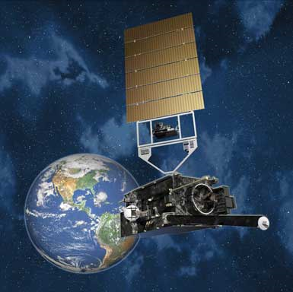
Overview of GOES-R
Next generation of GOES satellites
Planned launch in late 2015
Advanced Baseline Imager (ABI)
16 channels, improved spatial and temporal resolution
Geostationary Lightning Mapper
Near continuous monitoring of total lightning
Space Weather Instruments
Communications capabilities

Slide 3
GOES-R Preparation Activities
Algorithm Working Group (AWG)
Develop Day 1 algorithms
NESDIS/STAR, cooperative institutes, universities, NASA
Work with contractor on product generation systems
GOES-R Risk Reduction (R3)
Develop new ideas, Day 2 algorithms
GOES-R Proving Ground
Test AWG and R3 products with proxy input
Made available to NWS forecasters for feedback
AWIPS format when possible
Product providers include CIRA, CIMSS, SPoRT, NESDIS
In progress at many WFOs and National Centers

Slide 5
Schedule for 2010 NHC GOES-R Proving Ground
Jun 17, 2010 – Operations Plan completed
Jul 28, 2010 – Project training conference call
Aug 1, 2010 – Proving Ground starts
Sep 9, 2010 – Mid-project review at NHC
Nov 30, 2010 – Proving Ground ends
Jan 13, 2011 – Debriefing conference call
Feb 2011 – Final report due
Mar 2011 – Presentation at the IHC

Slide 6
GOES-R Products Evaluated
Official GOES-R Baseline product
Hurricane Intensity Estimate (HIE) [CIMSS]
GOES-R Decision Aids/Imagery Products
Red-Green-Blue (RGB) Air Mass Product [CIRA/RAMMB]
RGB Dust Product [CIRA/RAMMB]
Saharan Air Layer (SAL) Product [HRD + CIMSS]
Super Rapid Scan Imagery [CIRA + NHC + CIMSS]
Rapid Intensity Index (RII) [CIRA/RAMMB]

Slide 7
Product Feedback
Feedback was provided by NHC forecasters to Mike Brennan and Jack Beven
Mid-season proving ground meeting on 8-9 September was opportunity to provide feedback to proving ground product developers
HIE and GLM rapid intensity forecast product are quantitative and can be evaluated statistically following the experiment

Slide 8
Hurricane Intensity Estimate (HIE)
HIE was routinely consulted for storms east of about 50ºW, and compared to Automated Dvorak Technique (ADT) and TAFB subjective Dvorak estimates
HIE and ADT maximum wind estimates were generally comparable, but HIE minimum sea level pressures were unrealistically low at times
CIMSS recognized the problem and a new version of the HIE was re-run for the 2010 season
Quantitative comparison of HIE with other intensity estimates is underway and should be completed before the 2011 Hurricane Season

Slide 9
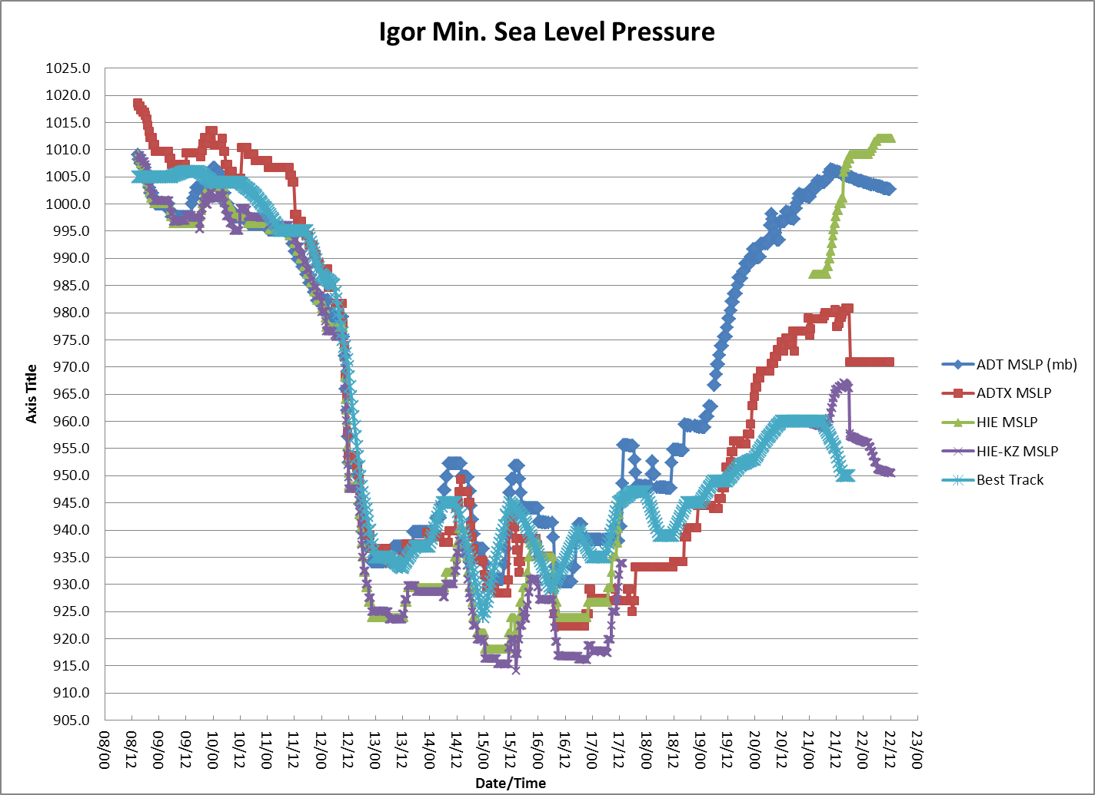
Hurricane Intensity Estimate (HIE)
Comparison of HIE minimum sea-level pressure estimates from two versions of the HIE product, NHC best track, and two operational ADT versions for Hurricane Igor

Slide 10
Super Rapid Scan Operations (SRSO)
GOES-15 Post-Launch Test provided many opportunities for data collection
Nearly continuous 1-minute imagery
Danielle, Igor, Earl, & Karl
Several days of consecutive 5-minute imagery
NHC Infrastructure tests
Operational ingest and display systems
Test of pulling data via land line (WAN) vs. local ground station
Simulated landfall scenarios created with different landfall points

Slide 11
N-AWIPS Display of SRSO Imagery
5-minute imagery (Sep. 2)
1-minute imagery (Sep. 3)

Slide 12
GOES-15 SRSO Hurricane Earl 3 September 2010

Slide 13
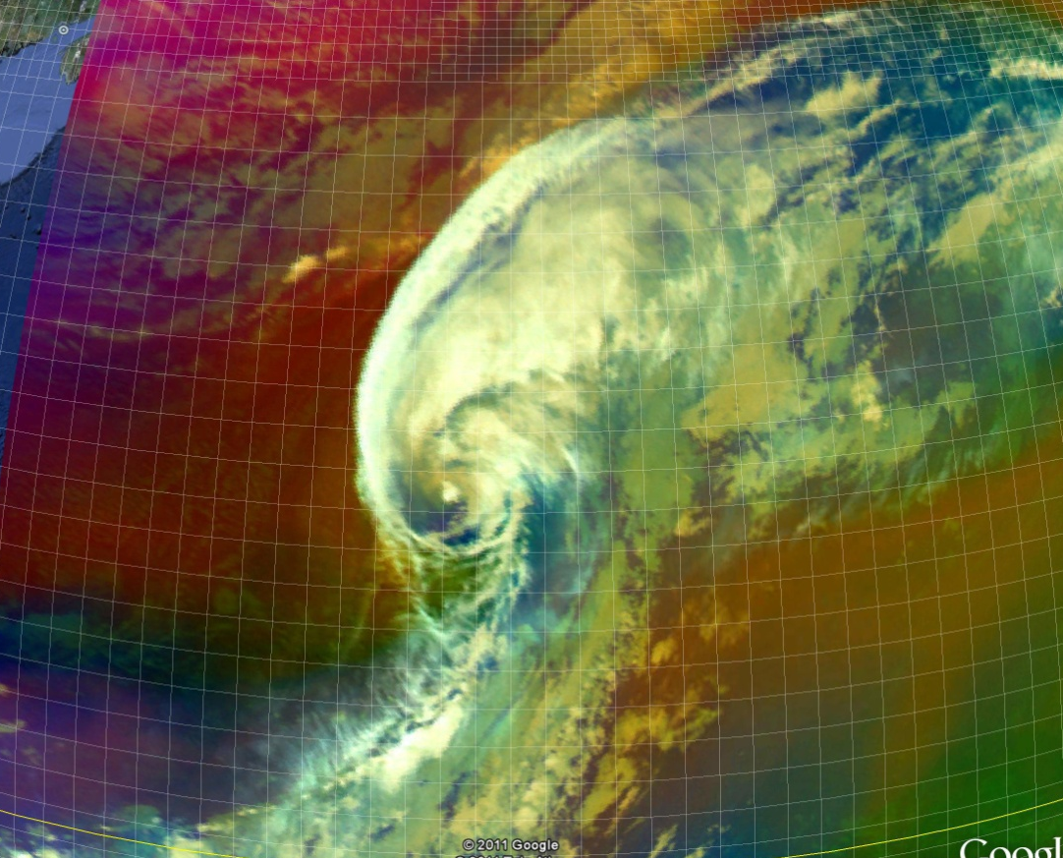
RGB Airmass Product
Tropical Storm Otto Undergoing ET
Low-level cloud in cold airmass
Deeper moisture in warm airmass
Mid-latitude high PV air approaching the core
METEOSAT-9 IR– 00Z 10 Oct. 2010
METEOSAT-9 RGB Airmass Product – 00Z 10 Oct. 2010
Application to extra-tropical transition
Complements dust product
Better delineates moist and dry regions
Polar air detected erroneously indicated at very low latitudes
Limb effects apparent

Slide 14
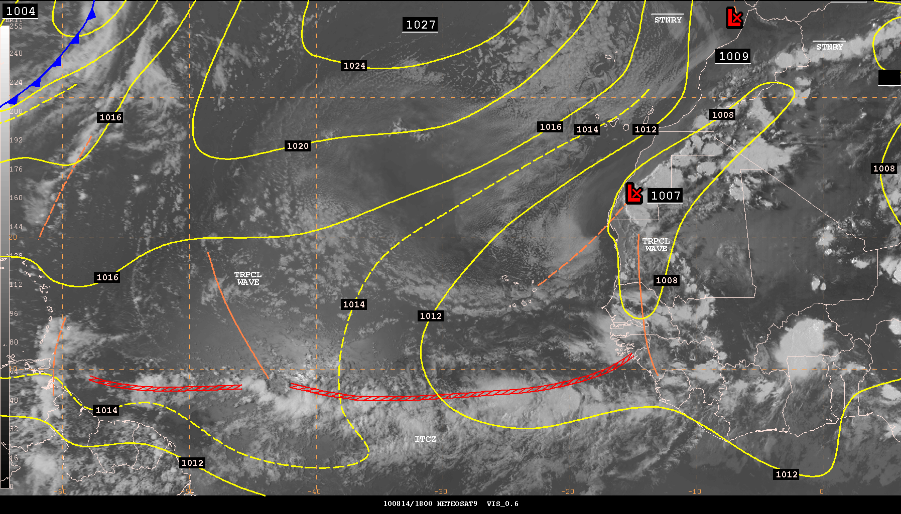
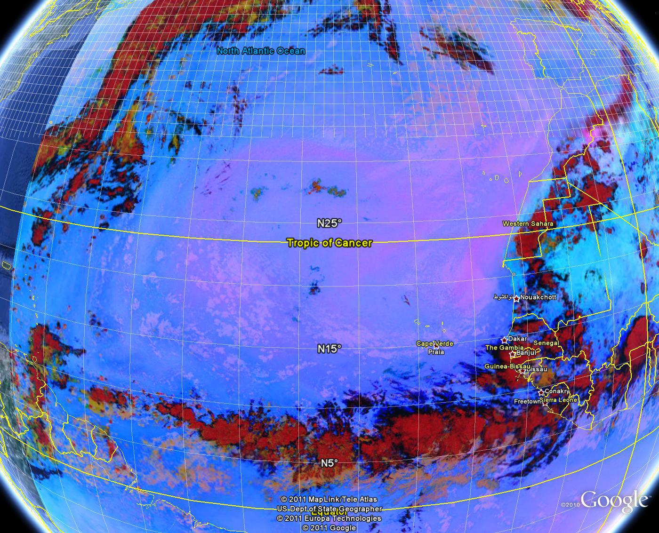
RGB Dust Product
1800 UTC 14 Aug 2010
Dust clearly visible in pink/purple colors
METEOSAT-9 0.6-μm visible imagery with surface analysis
METEOSAT-9 RGB dust product
Complements visible imagery
Cloud contamination issues near stratocumulus
False alarm noted in very low latitudes

Slide 15
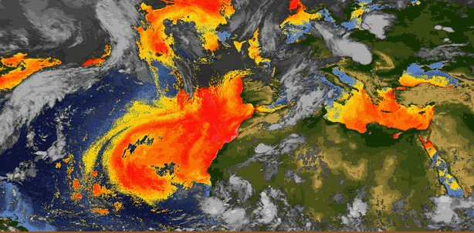
Saharan Air Layer Product
14 August 2010
Ability to animate is a big improvement over previous static SAL imagery
Ability to view in N-AWIPS will increase utility
Contamination noted near stratocumulus

Slide 16
Lightning-based Rapid Intensity Index (RII)
More experience needed with this data
Lightning time series useful supplement to quantitative probability product
Inner core versus rainband
CIRA should provide quantitative evaluation in the post-season
Real time runs with Vaisala feed
Re-runs with WWLLN data
WWLLN more consistent with developmental data

Slide 17
Verification of Lightning-Based RII
Discriminant analysis technique for probability of RI in next 24 hr
Experimental version no lightning
Experimental version with lightning
Experimental version developed from 5 year WWLLN sample, but run with adjusted GLD-360 in 2010
Real time runs implemented 26 June 2010
Early season east Pac cases re-run later

Slide 18
RII Verification Metrics
Bias = ( ΣP_{f}/N_{obs} ) - 1
Brier Score = (1/N_{f})Σ[P_{f} – P_{obs}]²
Threat Score = a/(a+b+c) from 2 by 2 contingency table
Area of overlap between forecast and observations
Find max TS for range of probability thresholds

Slide 19
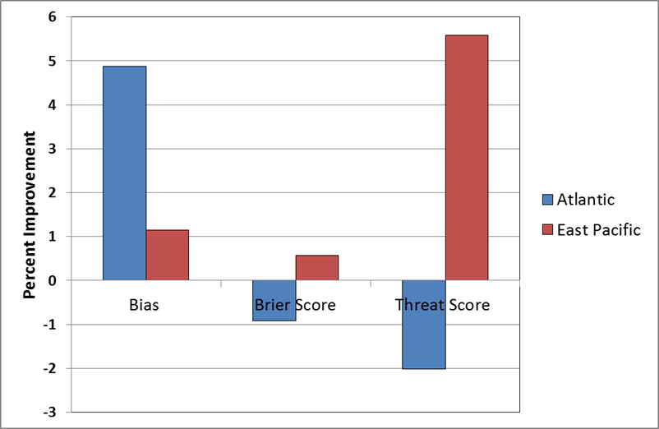
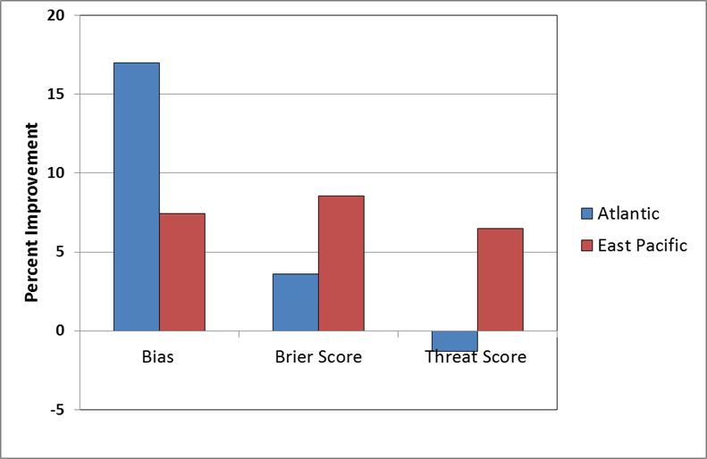
RII Improvements with Lightning Input
Real time runs in 2010 with Vaisala Data
Re-runs of 2009-2010 with WWLLN data
(fully independent and with operational input)

Slide 20
Preliminary Plans for 2011 NHC Proving Ground
Continue evaluation of HIE and Lightning-based RII
Use WWLLN lightning data if possible
Additional testing of RGB products
N-AWIPS format in collaboration with SPoRT
Possible tuning of RGB recipes
Try to collect SRSO data for U.S. landfalling hurricane
Possible new products
GOES-R true color algorithm in MODIS
Overshooting tops
Cloud top thickness

Slide 21
Conclusions
2010 GOES-R Proving Ground was learning experience
Several seasons needed for adequate GOES-R preparation
N-AWIPS (and later AWIPS-II) format preferred
SRSO data useful for infrastructure tests
Useful feedback obtained on HIE, RGB imagery products, lightning algorithms
Other GOES-R products have potential utility
Forecaster availability and time constraints limit number of products that can be tested per season

