Slide 1
Development and validation of a capability for wide-swath storm observations of ocean surface wind speed
Timothy L. Miller¹ (tim.miller@nasa.gov), M. W. James¹, W. L. Jones², C. S. Ruf³, E. W. Uhlhorn⁴, C. D. Buckley⁵, S. Biswas², G. Shah², and R. E. Hood⁶
¹NASA Marshall Space Flight Center, Huntsville, AL
²University of Central Florida
³University of Michigan
⁴NOAA/AOML/HRD
⁵Universities Space Research Association
⁶NOAA/UAS Program

Slide 2
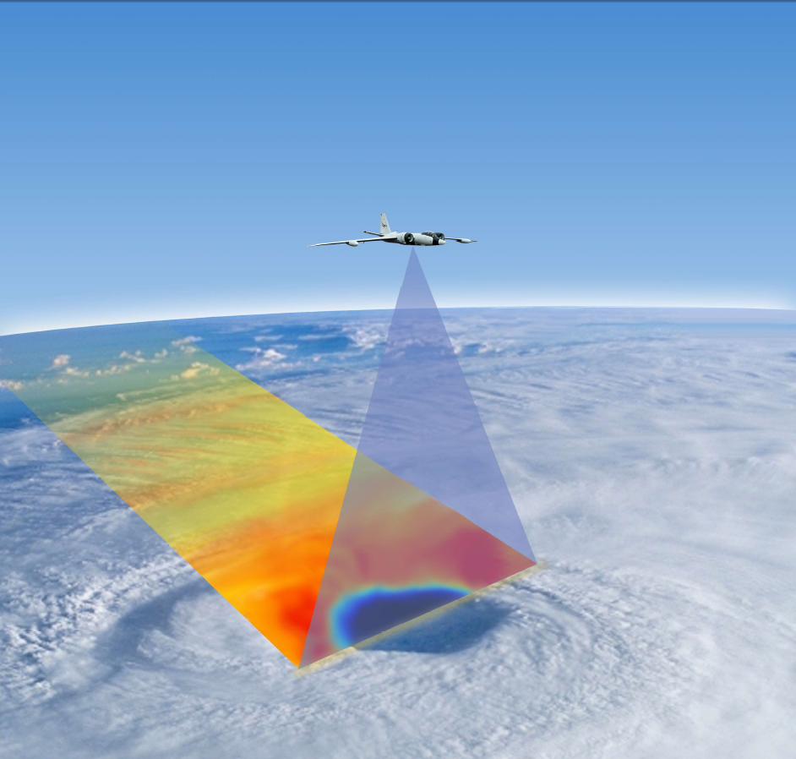
Hurricane Imaging Radiometer (HIRAD)
Passive microwave (C-band, 4 – 6.6 GHz) radiometer to infer wind speed over ocean surface
HIRAD’s unique contribution: Swath measurement of rain rate and hurricane-strength winds, even through heavy rain
  Wind speed ~10 – 85 m/s
  Rain rate ~ 5 – 100 mm/hr
Operations: Improved definition of maximum wind speed and vortex structure
Science hypothesis: Understanding of TC processes and short-term forecasts of intensity and structure will be improved by assimilation of HIRAD data

Slide 3
HIRAD physical principles
Emissivity of ocean surface is increased by the presence of sea foam generated by wind
Brightness temperature (Tb) measured by radiometer affected by:
  Wind speed over the ocean surface
  Rainwater column
  Sea surface temperature and salinity
  Earth incidence angle (EIA) – for H-pol, Tb drops off away from nadir
  Weaker effects: Water vapor, cloud water, atmosphere temperature
Note: SFMR (Stepped Frequency Microwave Radiometer) uses similar frequencies, makes same measurement, but only at nadir
  Flies operationally on NOAA and USAF aircraft
  Wind speed relationship to Tb has been well validated
HIRAD makes cross-track scan using no moving parts
  Synthetic thinned array radiometer (STAR) technology
  Cross-track resolution ~2 km at nadir, ~6 km at 60º

Slide 4
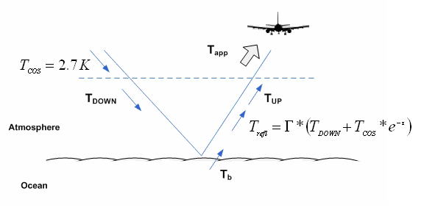
Forward Model - RTM
Atmospheric T_{ap} has three components: upwelling radiance (T_{UP}), reflected down-welling radiance (T_{refl}) & surface emission (T_{b})

Slide 5
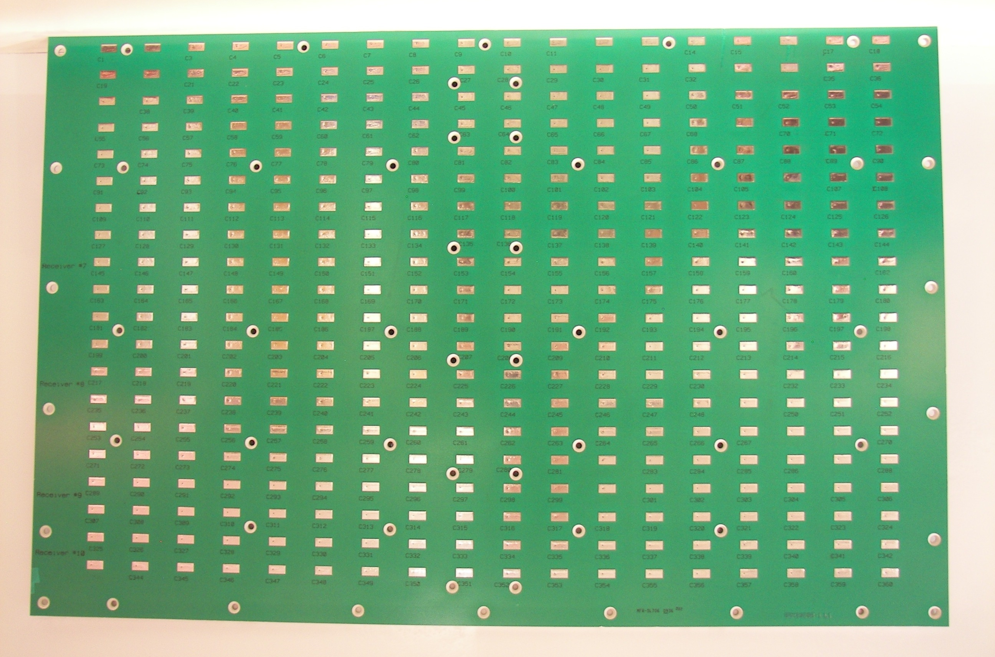
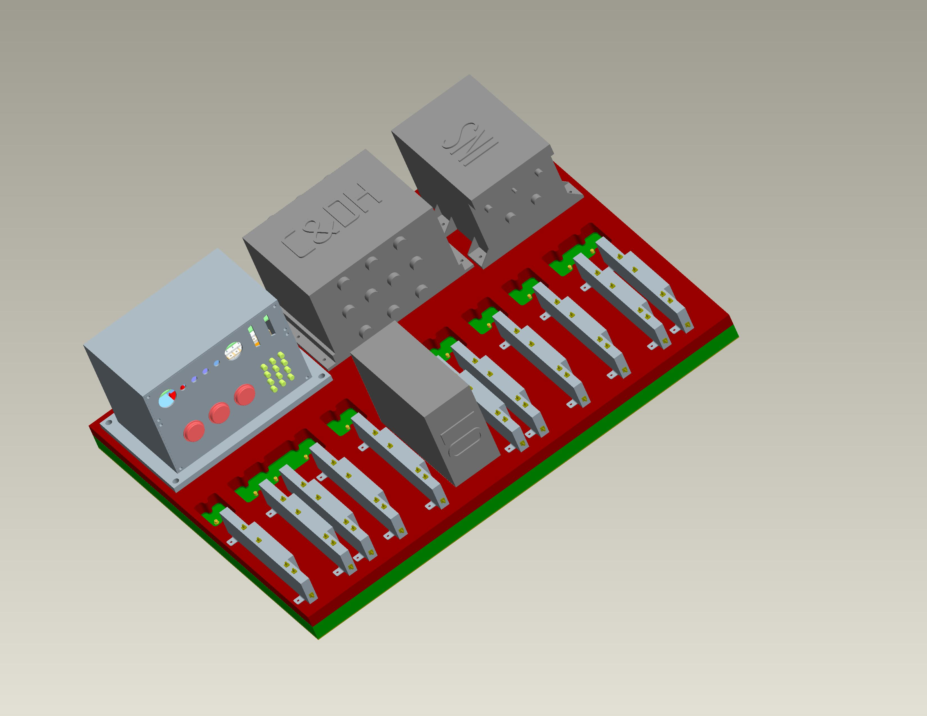
Cross-correlation of signals from 10 linear antennae to produce cross-track resolution
Synthetic Thinned Array Radiometer (STAR) approach
HIRAD’s 10 linear antenna elements (oriented along-track) each observe a “fan beam” of radiation with fields of view which are narrow along-track, wide cross-track
Correlating amplitude + phase observations from pairs of antenna elements (interferometric analysis) produces cross-track Fourier components, which are combined to resolve cross-track brightness temperatures
Receiver cards (10 + 1 used only for alignment in chamber), coaligned with linear antennae

Slide 6
HIRAD Calibration Procedure
Calibration measurements required:
  Compact range anechoic chamber measurements with known emissions source, including both cross-track and along-track scans to fully characterize the antenna
  Ground-based open sky and blackbody absorber measurements, including those with the antenna elements partially covered with a blackbody (BB) absorber, and partially open to the sky
  Open, calm (or known wind), rain-free observations of the sea surface (with known SST, salinity) from aircraft. This will generally be done on each flight.
Calibration procedure:
  Calibrate internal noise diode (warm and cold references) TBs and antenna/radome insertion loss using ground sky cal plus BB absorber data.
  Individually calibrate each of ten receivers (viewed as ten individual real aperture radiometers with fan beam antennas) using open water and BB absorber data plus modeled fan beam TB.
  Calibrate all visibility (cross-correlation) data in anechoic chamber to generate interference patterns.
  Derive pseudo-inverse of interference pattern “G-matrix”. This is the image reconstruction algorithm.
  Perform antenna pattern correction to individual pixels in TB image (corrects for sidelobe contributions to TB) using open water and BB absorber data plus modeled TB in cross-track field of view vs. swath position.

Slide 7
First HIRAD flights: GRIP
NASA Aircraft:
Global Hawk – Unmanned Aerial System based at Dryden Flight Facility, California
  Instruments: Lightning Instrument Package (LIP), High-Altitude Imaging Wind and Rain Airborne Profiler (HIWRAP), and High Altitude MMIC Sounding Radiometer (HAMSR)
DC-8 – Based in Fort Lauderdale
  Dropsondes, LASE, DAWN, APR-2, MMS, CAPS, CSI, PIP
WB-57 – Based in Houston, Tampa
  Hurricane Imaging Radiometer (HIRAD)

Slide 8
Hurricane Earl Best Track
HIRAD flight

Slide 9
Hurricane Earl Max Wind Speed
HIRAD flight

Slide 10
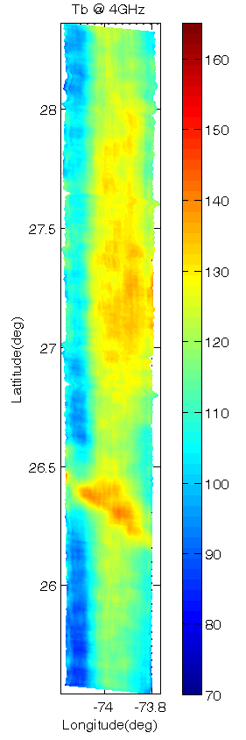
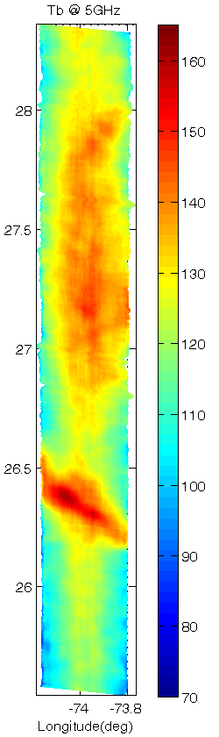
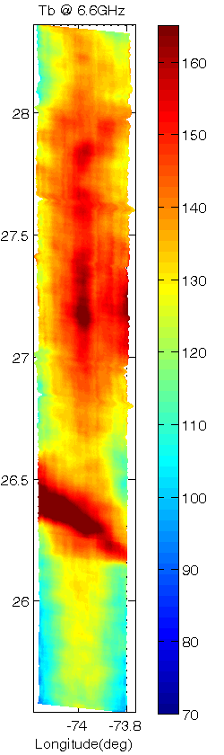
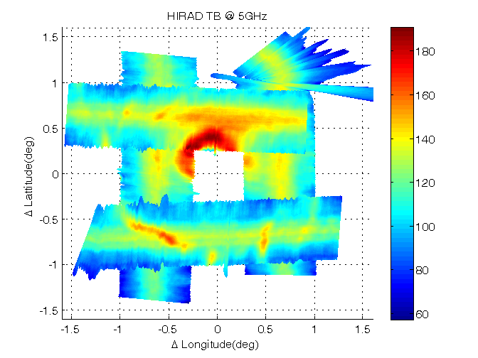


HIRAD TB Images at 4.0, 5.0 and 6.6 GHz along Northbound Earl Overpass
Preliminary data
4.0 GHz
5.0 GHz
6.6 GHz
UCF

Slide 11
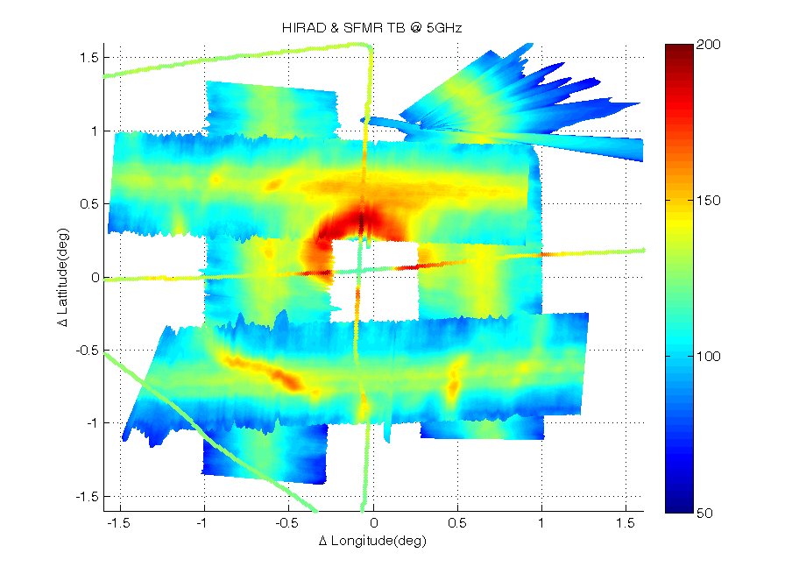
SFMR passes over HIRAD swath
Storm-centric coordinate system
SFMR
SFMR
HIRAD and SFMR should match at HIRAD’s nadir point
UCF

Slide 12
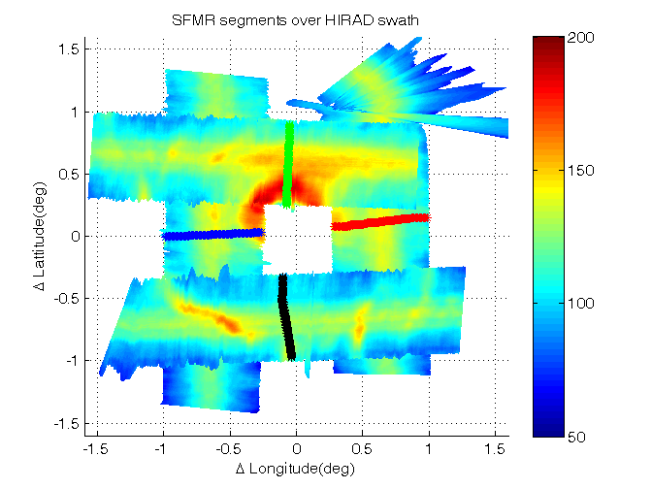
HIRAD/SFMR West Leg Overpass
HIRAD Tb@ 4GHz
HIRAD Tb@ 5GHz
Model Tb@ 4GHz
Model Tb@ 5GHz
SFMR Wind +50 (m/s)
SFMR Rain +50 (mm/hr)
SFMR Flt Dir
stop
start
“Model” data are Tb’s computed from SFMR wind & rain fields
UCF
Notes:
Note: 100 sec ~ 10 km P-3 travel

Slide 13
Karl Best Track
HIRAD flights

Slide 14
Hurricane Karl Max Wind Speeds
HIRAD flight
HIRAD flights

Slide 15
Summary
The WB-57, with HIRAD aboard, flew once over Earl, 3 times over Karl during GRIP
Preliminary data analysis of the Earl case indicates excellent performance and comparison with SFMR
Currently developing data processing methodology to eliminate radio frequency interference (RFI) and to maintain calibration in all channels and sub-bands
Targeting release of Tb and wind/rain data in 2 months
We hope in the future to develop HIRAD II, a fully polarimetric system that will detect wind direction
This technology has potential for space flight as a complement to scatterometers, lidars, and higher-frequency radiometers

