Slide 1
Review of the 2010
Central Pacific Tropical Cyclone Season
and Preliminary Verification
National Weather Service
Central Pacific Hurricane Center
Honolulu, Hawaii
Raymond Tanabe
Deputy Director, CPHC
Interdepartmental Hurricane Conference
28 February 2011

Slide 2
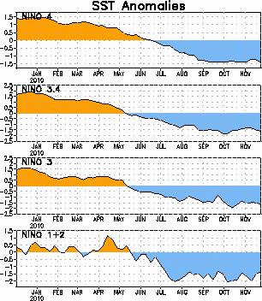
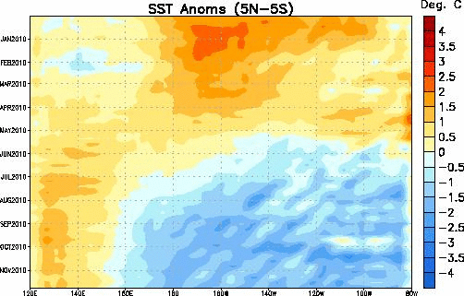
La Nina Keeps Pacific Cool During the 2010 Tropical Cyclone Season

Slide 3
Tropical Storm Omeka December 20-21
Latest forming tropical cyclone in the central or eastern Pacific since reliable records began in 1949.
Started as a subtropical cyclone, transitioned into a tropical cyclone, then became extratropical.
5 tropical cyclone forecast packages issued by CPHC.

Slide 4
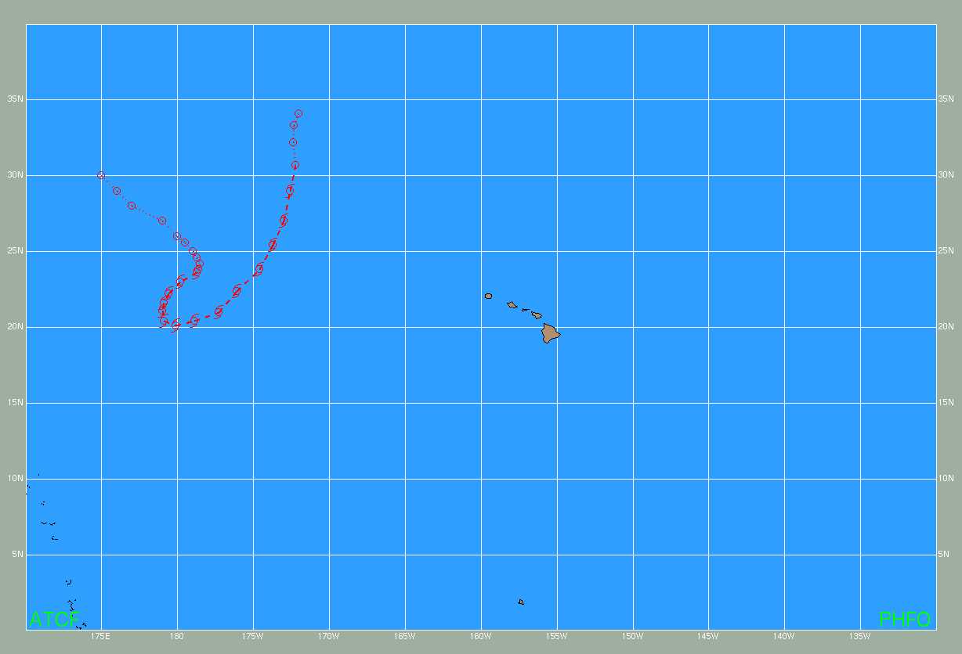
2010 Central Pacific Tropical Cyclones
Tropical Storm Omeka
20-21 December
West Pacific
Central Pacific
East Pacific

Slide 5
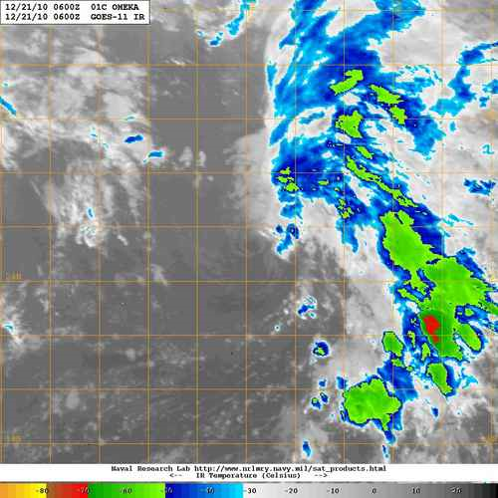
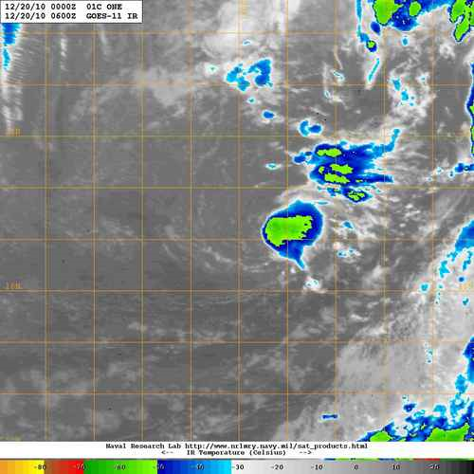
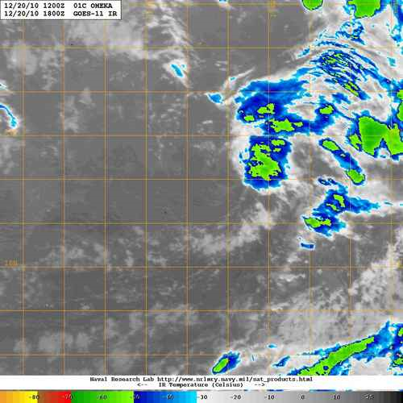
Tropical Storm Omeka
20-21 December

Slide 6
Central Pacific Tropical Cyclone Season
Central Pacific Average per Year
4-5 Tropical Cyclones
1970 to 2010: 175 Tropical Cyclones
37% Hurricanes, 30% Tropical Storms,
33% Tropical Depressions

Slide 10
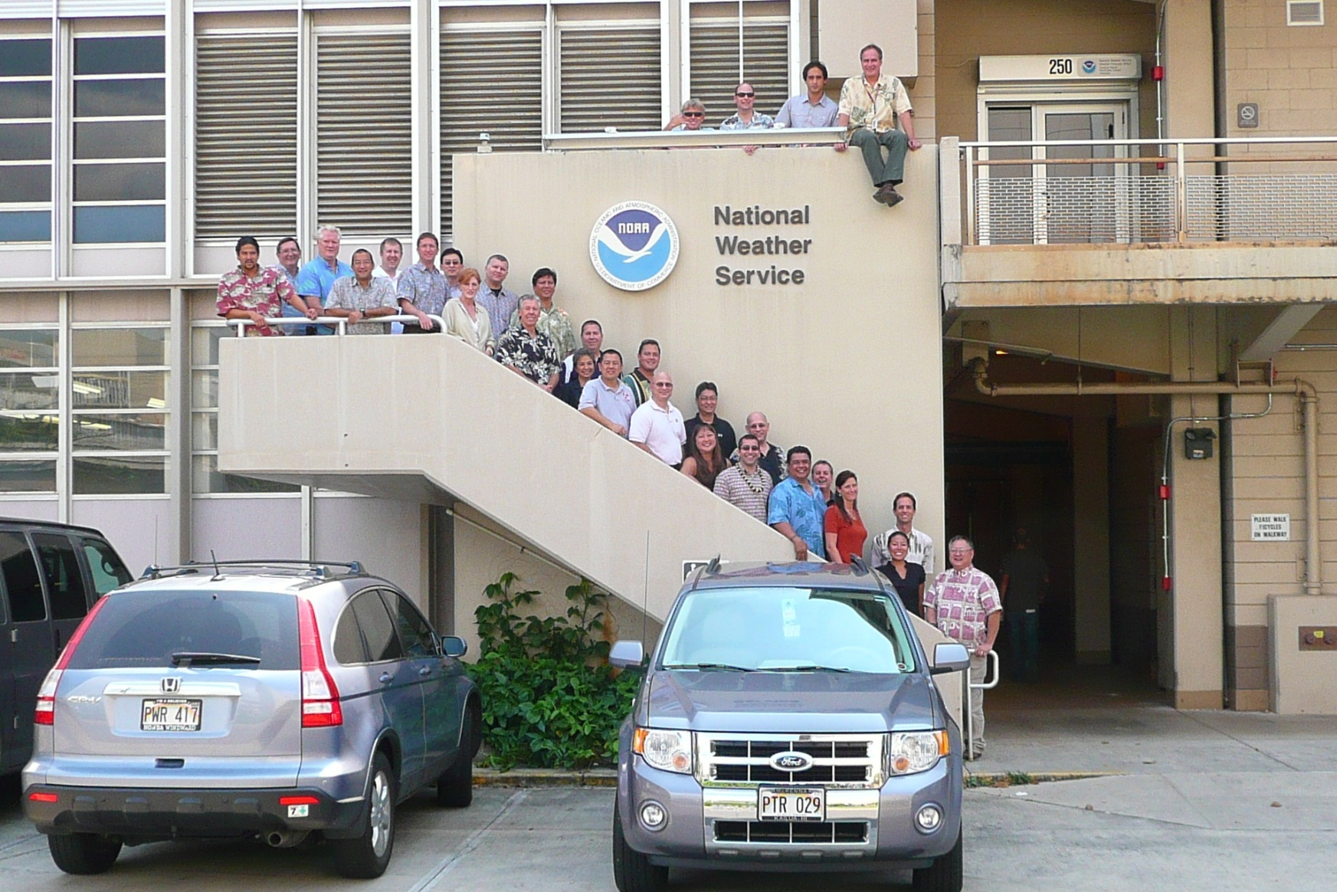
CPHC/FEMA L324 Hurricane Preparedness Course

Slide 11
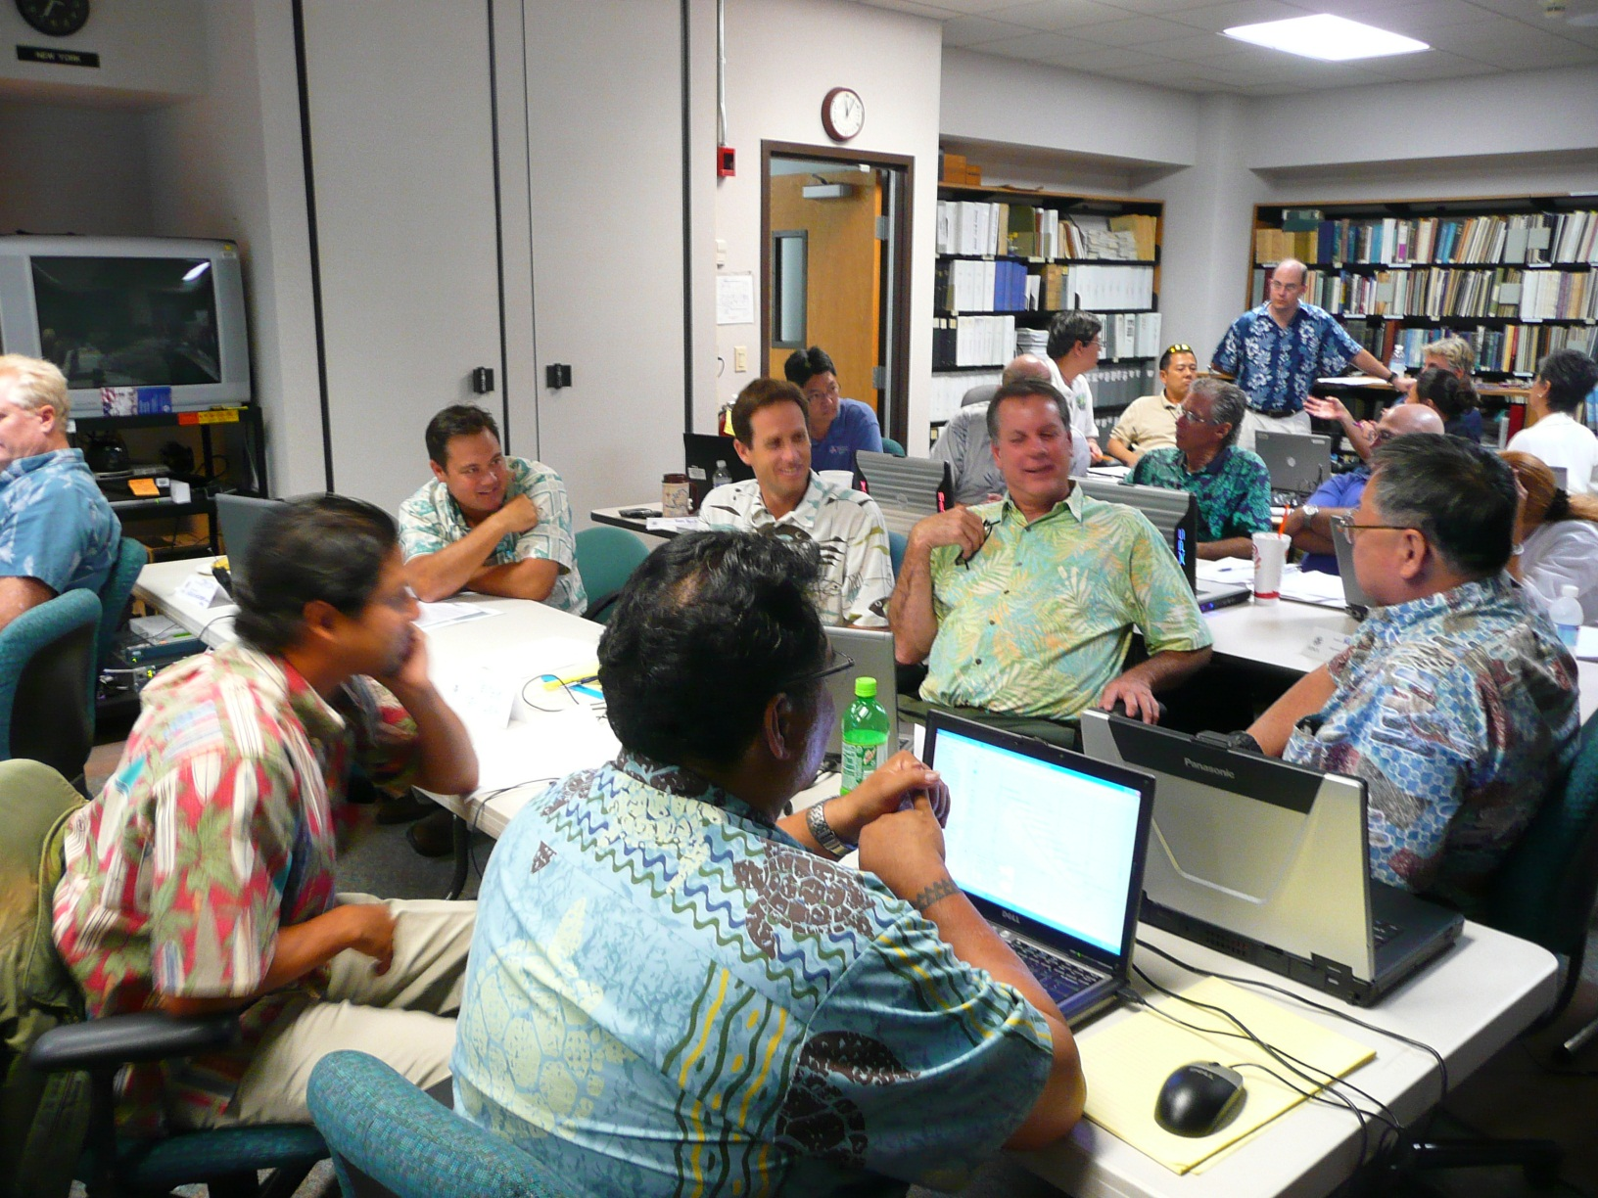
CPHC/FEMA L324 Hurricane Preparedness Course

Slide 12
2010 CPHC/WFO Honolulu Musical Chairs
CPHC Deputy Director → TWC
Dr. Rick Knabb moves to Atlanta
HFO WCM → CPHC Deputy Director
Raymond Tanabe “promoted”?
WFO Caribou WCM → HFO WCM
Honolulu welcomes Mike Cantin

Slide 13
Aloha !

