Slide 1


National Hurricane Center
2010 Forecast Verification
James L. Franklin and John Cangialosi
Hurricane Specialist Unit
National Hurricane Center
2011 Interdepartmental Hurricane Conference

Slide 2
Verification Rules
Verification rules unchanged for 2010. Results presented here in both basins are final.
System must be a tropical or subtropical cyclone at both forecast initial time and verification time. All verifications include depression stage except for GPRA track goal verification.
Special advisories ignored (original advisory is verified.
Skill baselines are recomputed after the season from operational compute data. Decay-SHIFOR5 is the intensity skill benchmark.

Slide 3
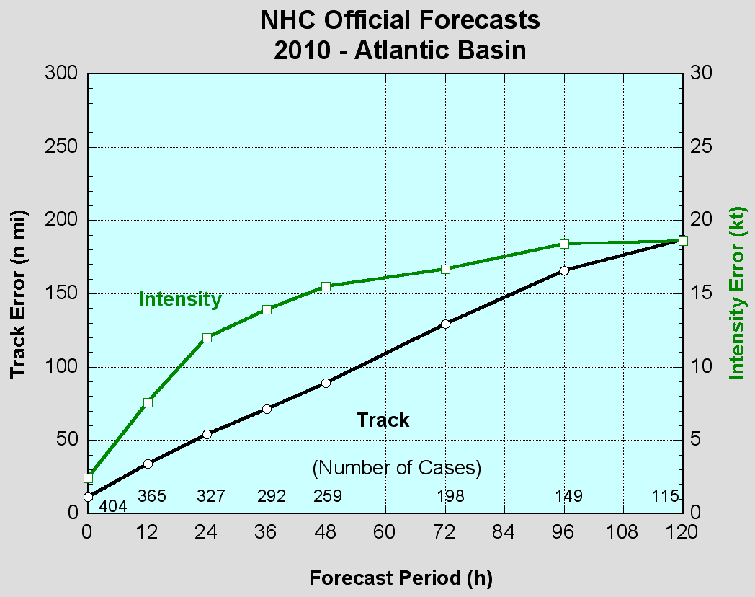
2010 Atlantic Verification
VT NT TRACK INT
(h) (n mi) (kt)
============================
000 404 11.2 2.4
012 365 34.2 7.6
024 327 54.2 12.0
036 292 71.6 13.9
048 259 89.1 15.5
072 198 129.4 16.7
096 149 166.0 18.4
120 115 186.7 18.6
Values in green exceed all-time records.
GPRA track goal (48 h error <= 90 n mi) was met.
GPRA intensity goal (48 h error <= 13 kt) was (yet again) not met.

Slide 4
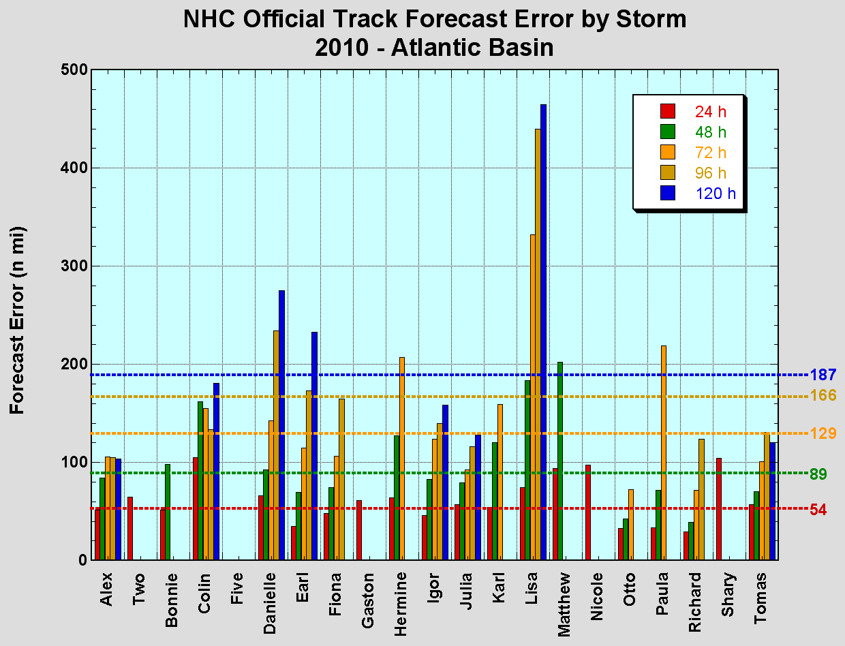
Atlantic Track Errors by Storm
Igor, Richard and Tomas notable successes. Danielle (sharper recurvature than forecast) and Lisa (moved unexpectedly eastward for two days) presented challenges.

Slide 5
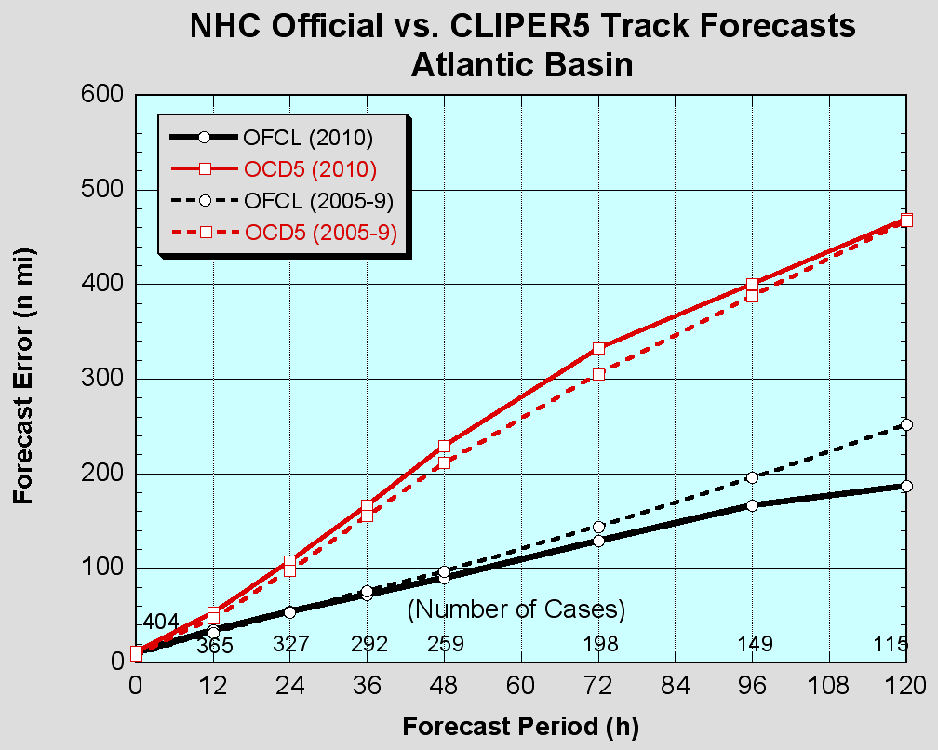
Atlantic Track Errors vs. 5-Year Mean
Official forecast was mostly better than the 5-year mean, even though the season’s storms were “harder” than normal.

Slide 6
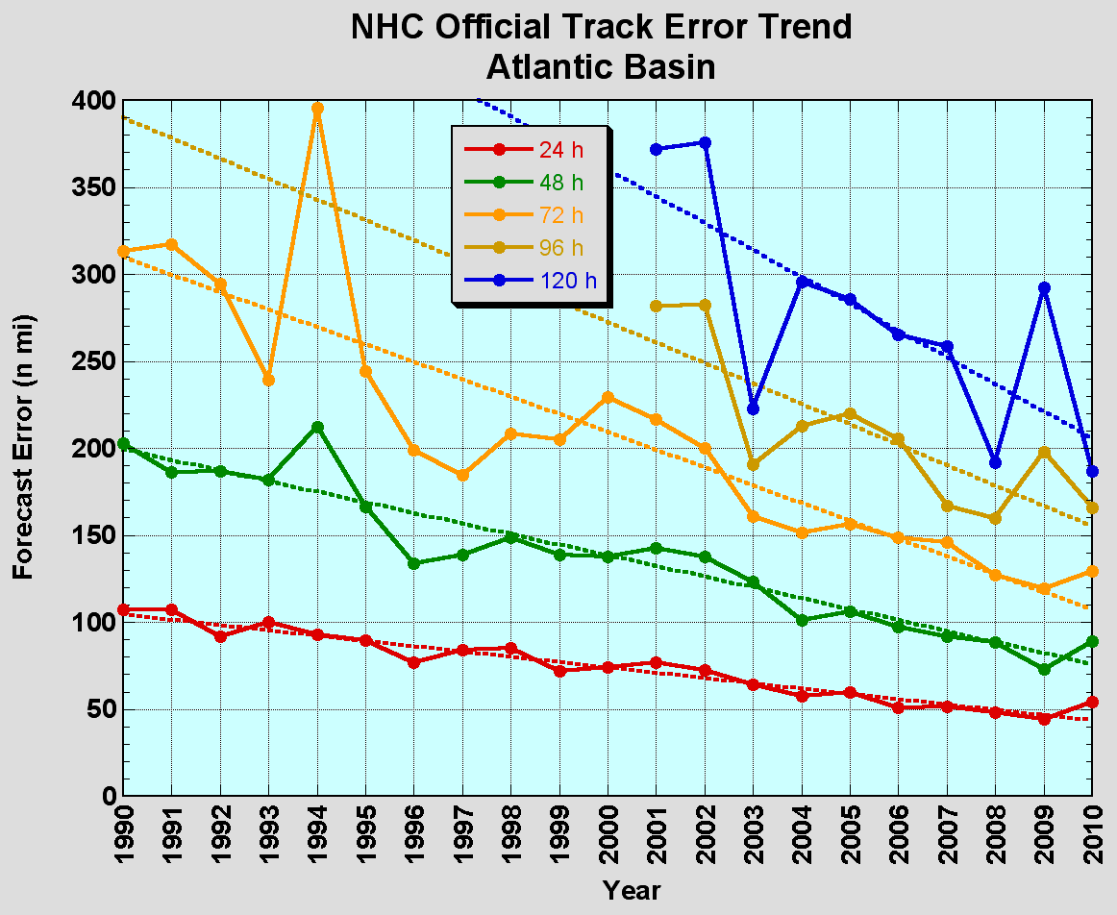
Atlantic Track Error Trends
Since 1990, track errors have decreased by about 60%. Current five-day error is as large as the 3-day error was just 10 years ago.

Slide 7
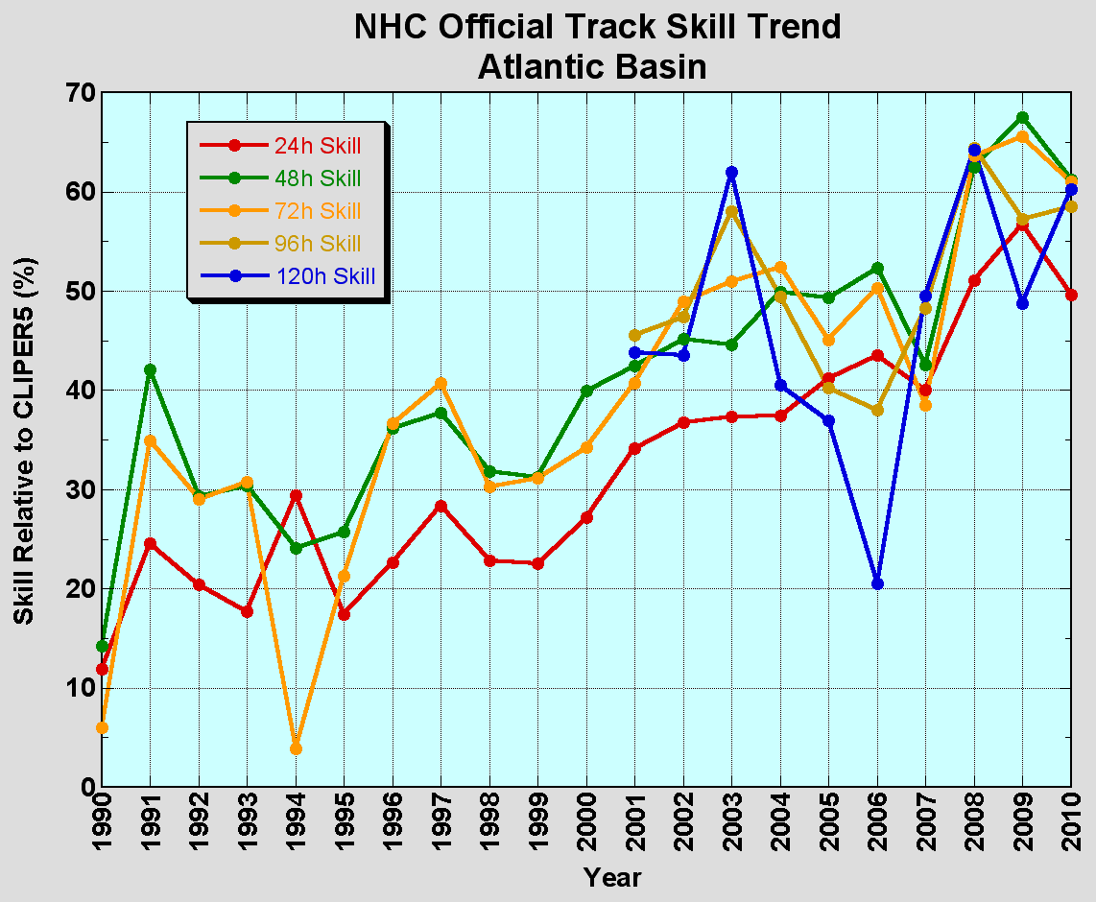
Atlantic Track Skill Trends
Another leveling off of skill?

Slide 8
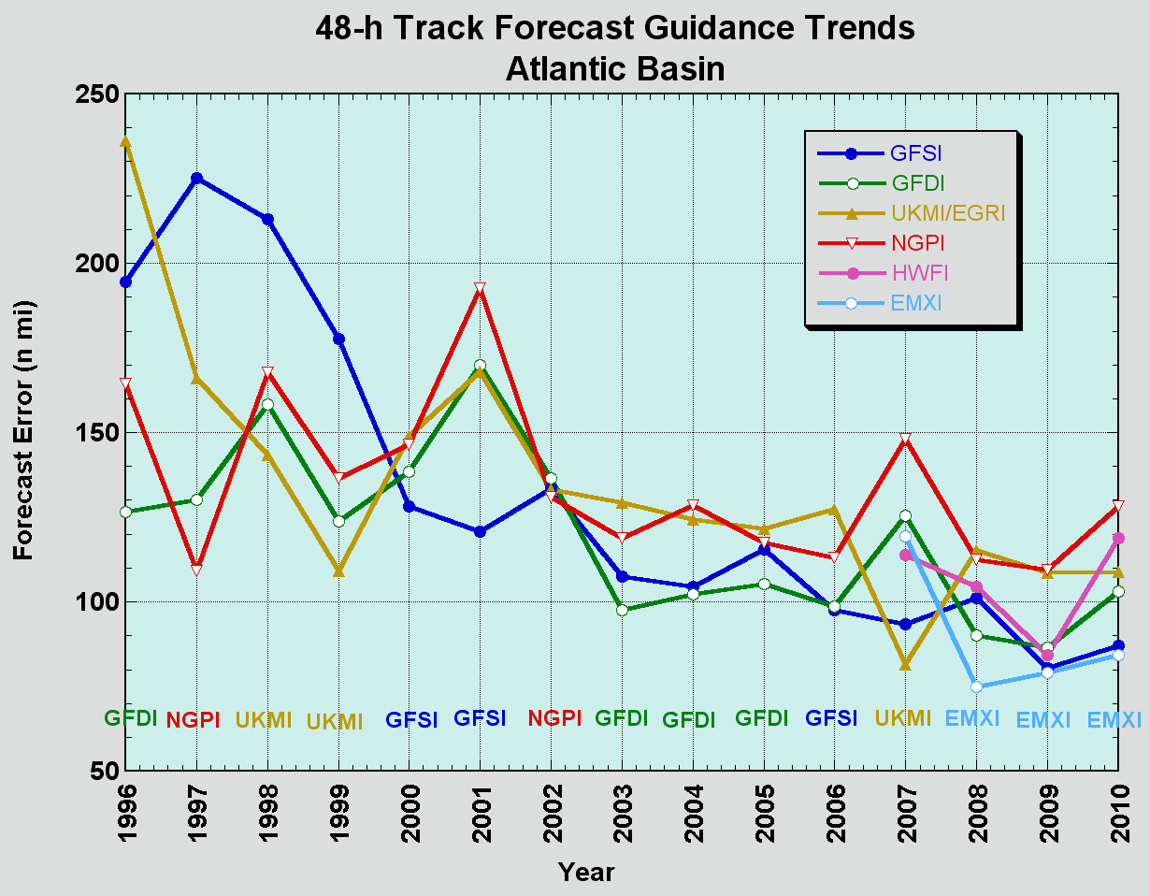
Atlantic Model Trends
Improvements in skill from 2000-2 due to improvements to the GFS and formalization of consensus aids (GUNS, GUNA)? Skill increases in 2008 can be attributed to enhanced availability and performance of ECMWF.
UKMET, NOGAPS consistently trail other models. EMXI best model for the third year in a row.

Slide 9
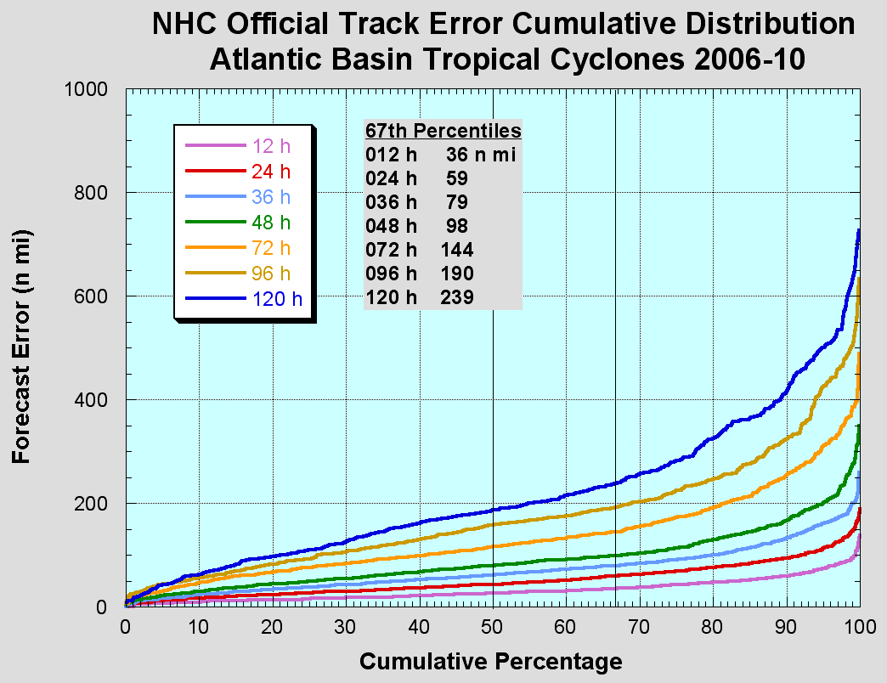
2011 Atlantic “Cone”
2010
36
62
85
108
161
220
285
Substantial reduction in track cone size for 2011 due to 2005 season dropping out of the sample.

Slide 10
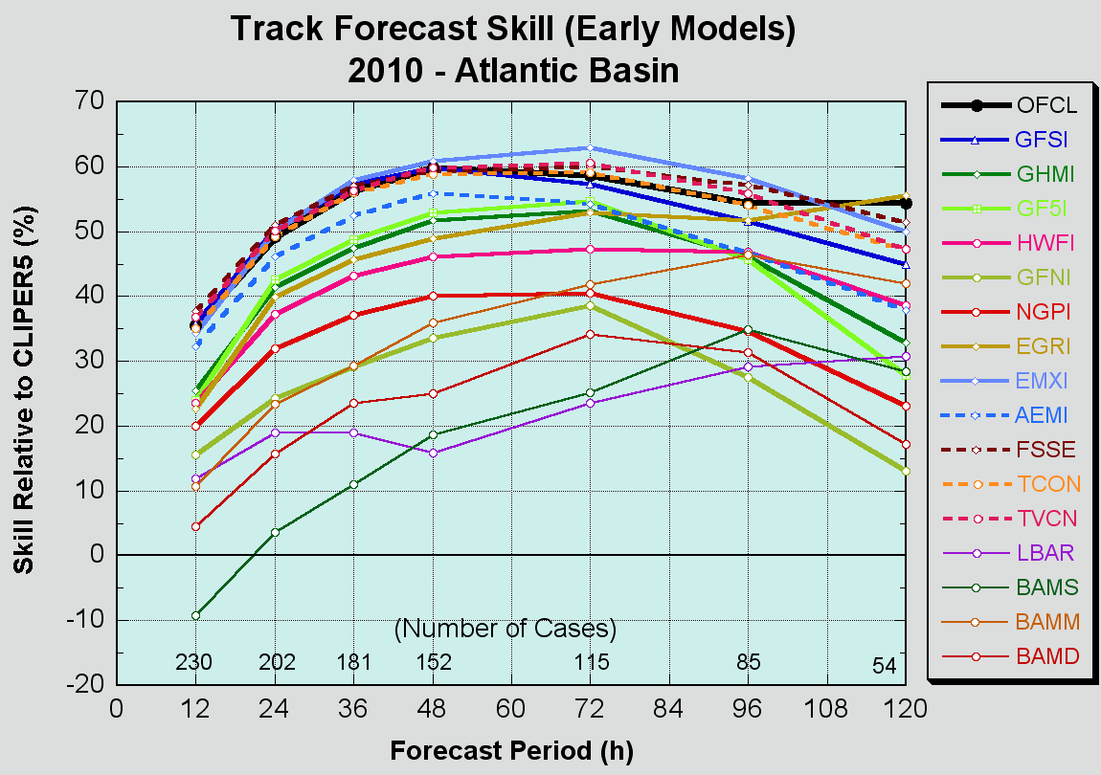
Atlantic Early Track Guidance
Official forecast performance was very close to the consensus models. Another good year for FSSE.
Best dynamical models were ECMWF and GFS.
EGRI had the most skill at 120 h.
GF5I performed better than the GHMI through 72 h.

Slide 11
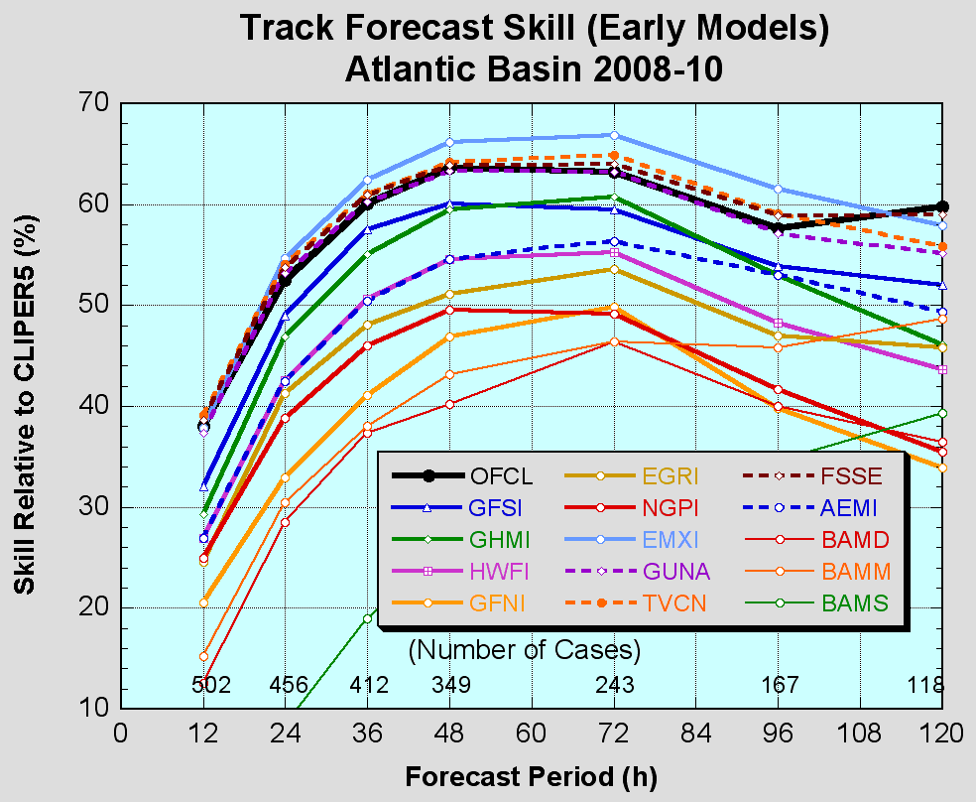
Atlantic Early Track Guidance

Slide 12
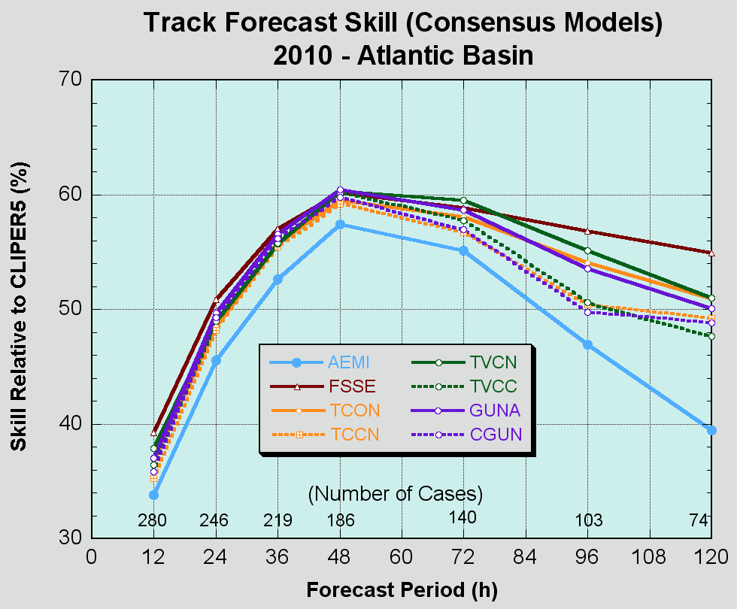
Atlantic Consensus Guidance
With the exception of AEMI, models are tightly clustered with skill varying only a few percent among models through 72 h.
FSSE was the best consensus model at 96 h and 120 h.
Corrected consensus models TCCN, TVCN, CGUN did not do as well as their uncorrected counterparts. This was also true in 2008 and 2009.

Slide 13
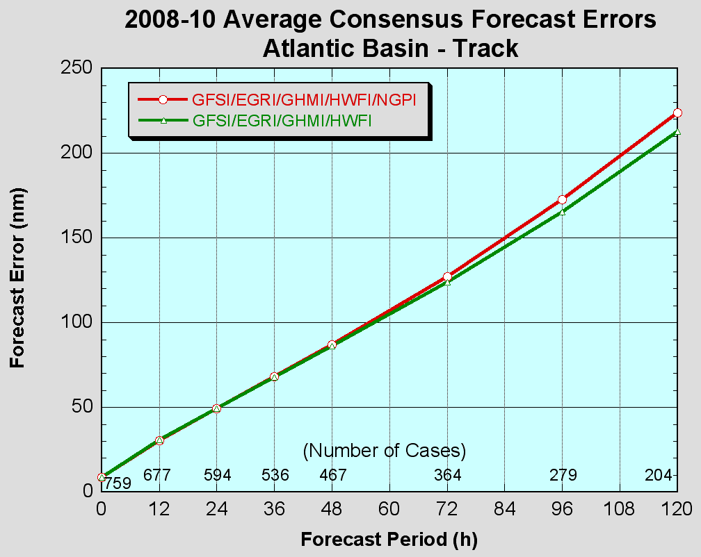
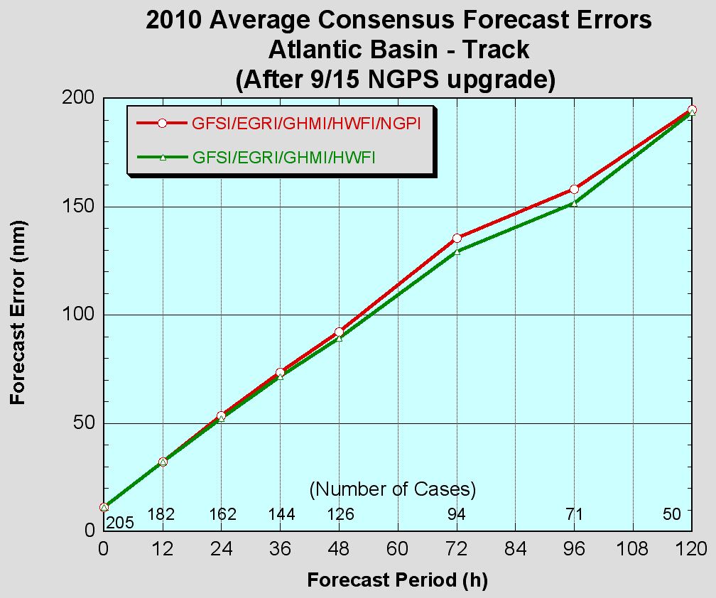
NGPI impact on Consensus (TCON)
Removing NGPI from the TCON consensus improves the consensus in the Atlantic basin, even after the mid-season NOGAPS upgrade. NGPI still contributes positively to TCON in the eastern Pacific, however.
NHC is strongly considering removing NGPI from TCON and TVCN consensus models for 2011. Probably will want to create an “NCON” and “NVCN” for use in the eastern Pacific.

Slide 14
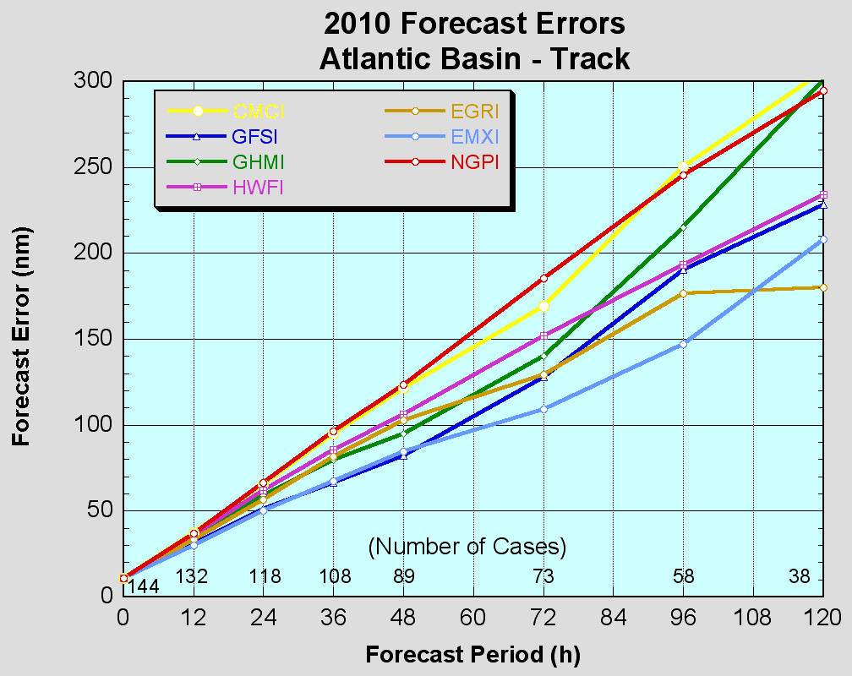
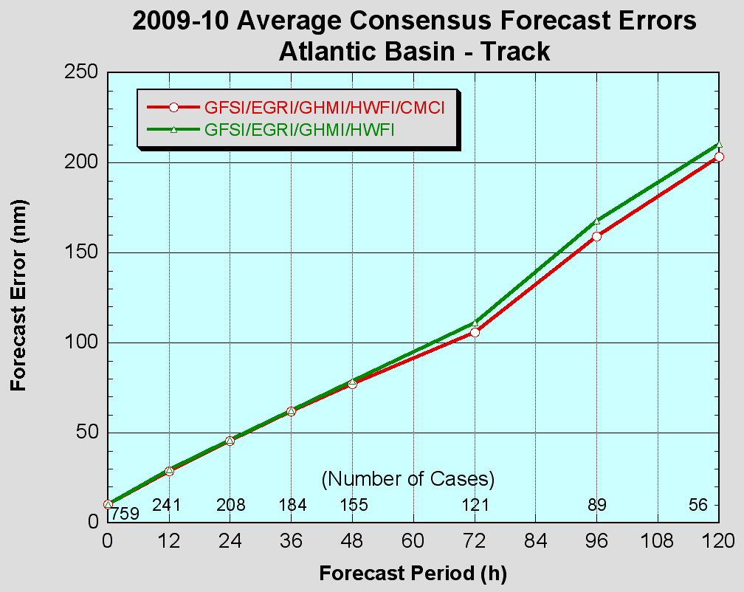
CMCI impact on Consensus (TCON)
Although CMCI errors are comparable to those of NGPI, CMCI did contribute positively to the TCON in the Atlantic. Also contributed positively in the eastern Pacific when NGPI not included in the consensus.
Availability is somewhat limited, so best option may be to add CMCI to TVCN.

Slide 15
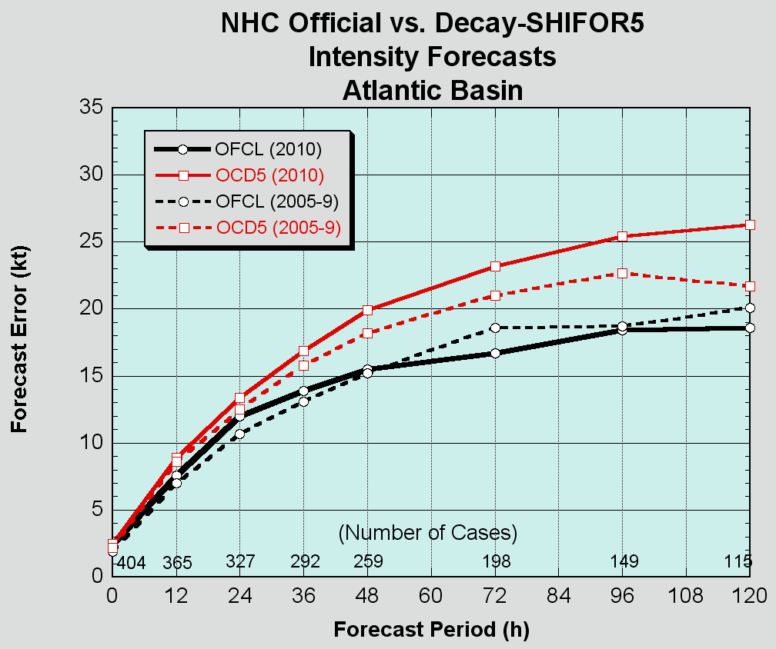
Atlantic Intensity Errors vs. 5-Year Mean
OFCL errors in 2010 were close to the 5-yr
means, but the 2010 Decay-SHIFOR errors
were above their 5-yr means indicating
that the season’s storms were “harder” than
average to forecast.

Slide 16
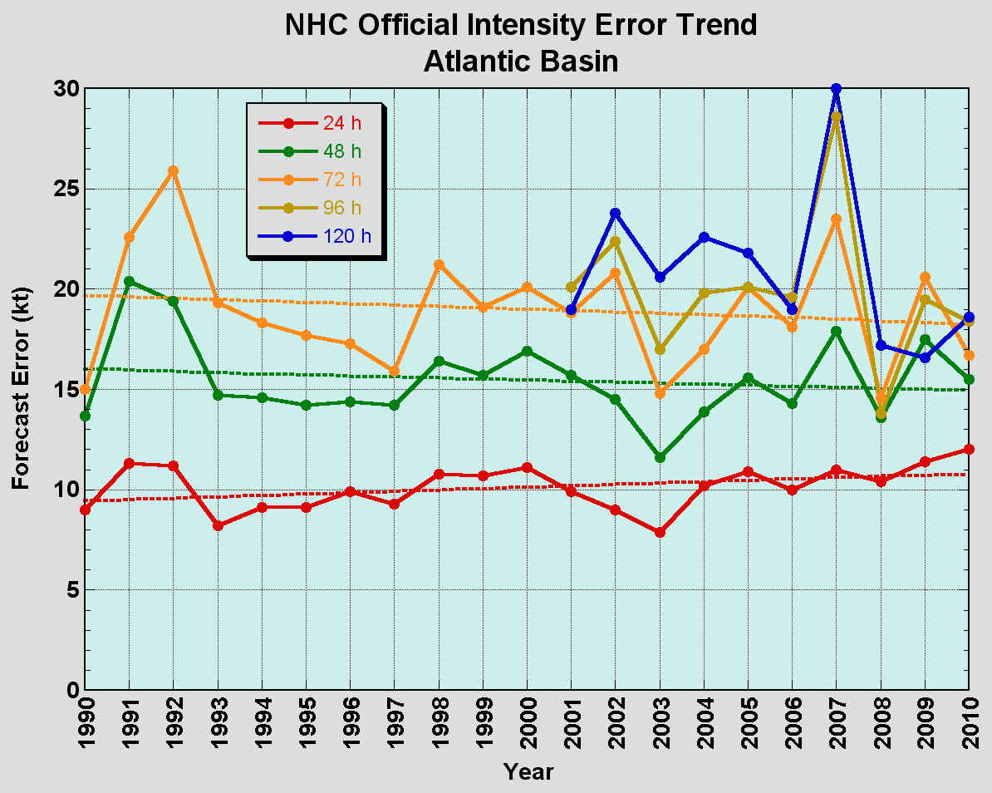
Atlantic Intensity Error Trends
No progress with intensity

Slide 17
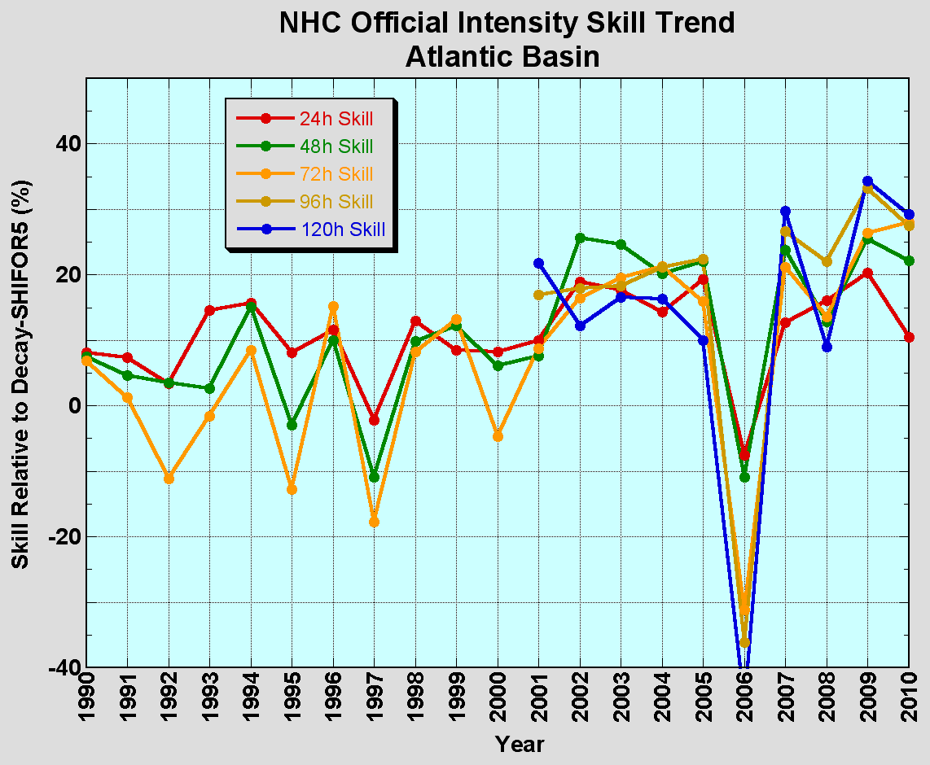
Atlantic Intensity Skill Trends
Little net change in skill over past several years, although
skill has been higher recently compared to the 90s.

Slide 18
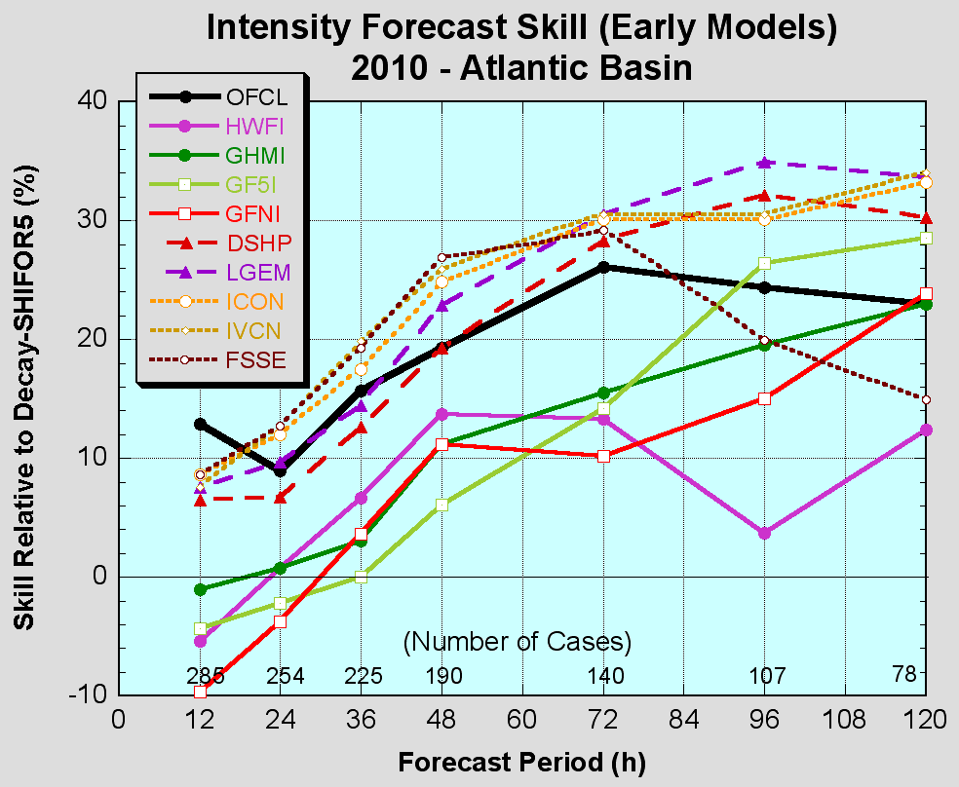
Atlantic Early Intensity Guidance
Statistical and consensus models were competitive. FSSE was the best model through 48 h and LGEM performed best beyond that.
Official forecasts paying too much attention to the dynamical guidance, especially late?

Slide 19
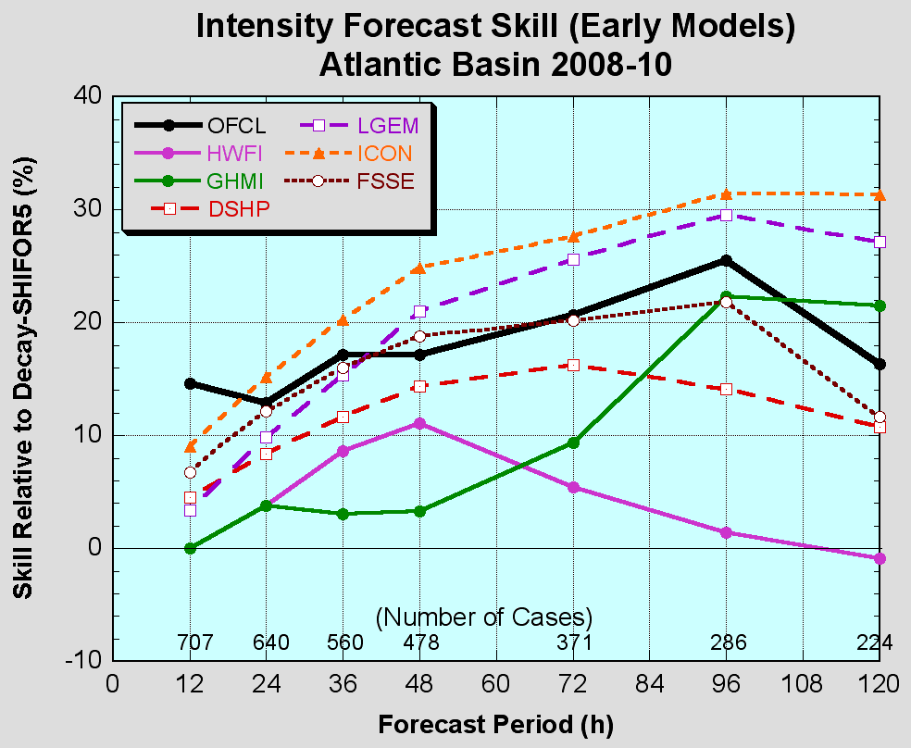
Atlantic Early Intensity Guidance

Slide 20
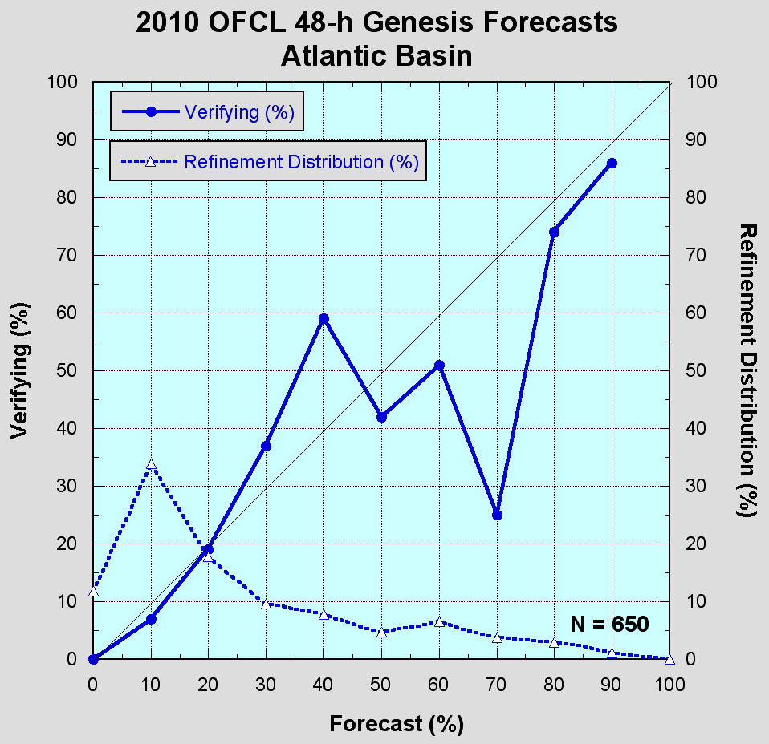
Atlantic Genesis Forecasts
Forecasts at the high end and low end were very well calibrated (reliable) with minimal bias.
However, this year’s forecasts could not distinguish gradations in likelihood between 30% and 70%.

Slide 21
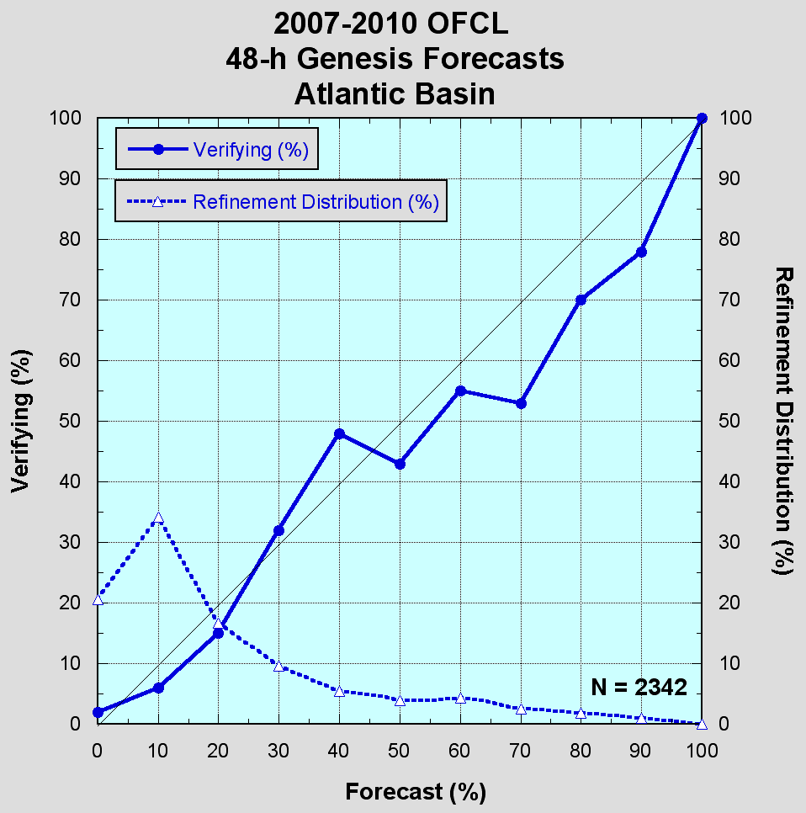
Atlantic Genesis Forecasts
Results for the overall sample do show some ability in the mid-range, but it’s clearly an area that could be improved.

Slide 22
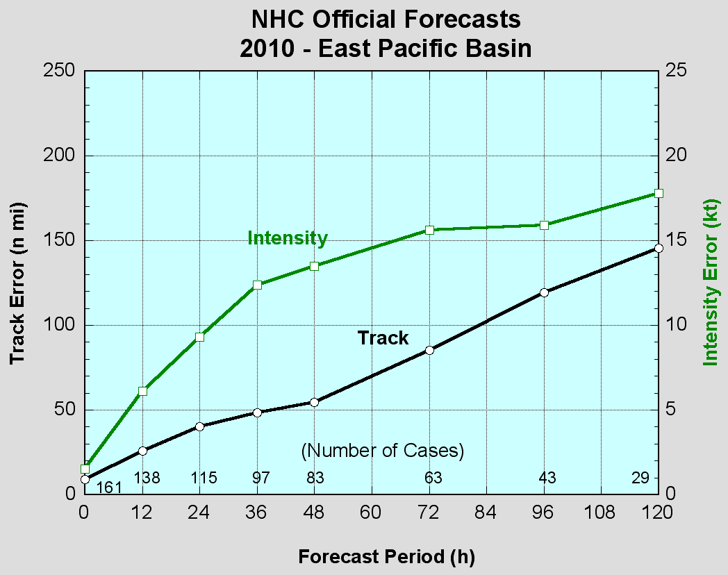
2010 Eastern Pacific Verification
VT NT TRACK IN
(h) (n mi) (kt)
============================
000 161 9.0 1.5
012 138 26.0 6.1
024 115 40.1 9.3
036 97 48.6 12.4
048 83 54.7 13.5
072 63 85.3 15.6
096 43 119.3 15.9
120 29 145.4 17.8
Values in green exceeded all-time lows.

Slide 23
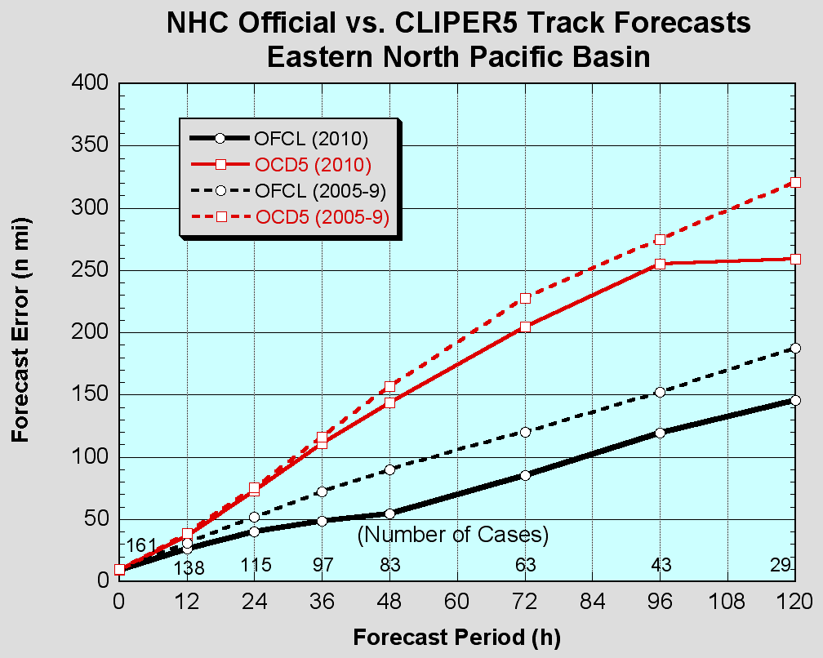
Eastern Pacific Track Errors vs. 5-Year Mean
Official forecasts were considerably
better than the 5 yr mean, although the season’s storms were “easier” than normal. Substantial ENE bias at days 4-5.

Slide 24
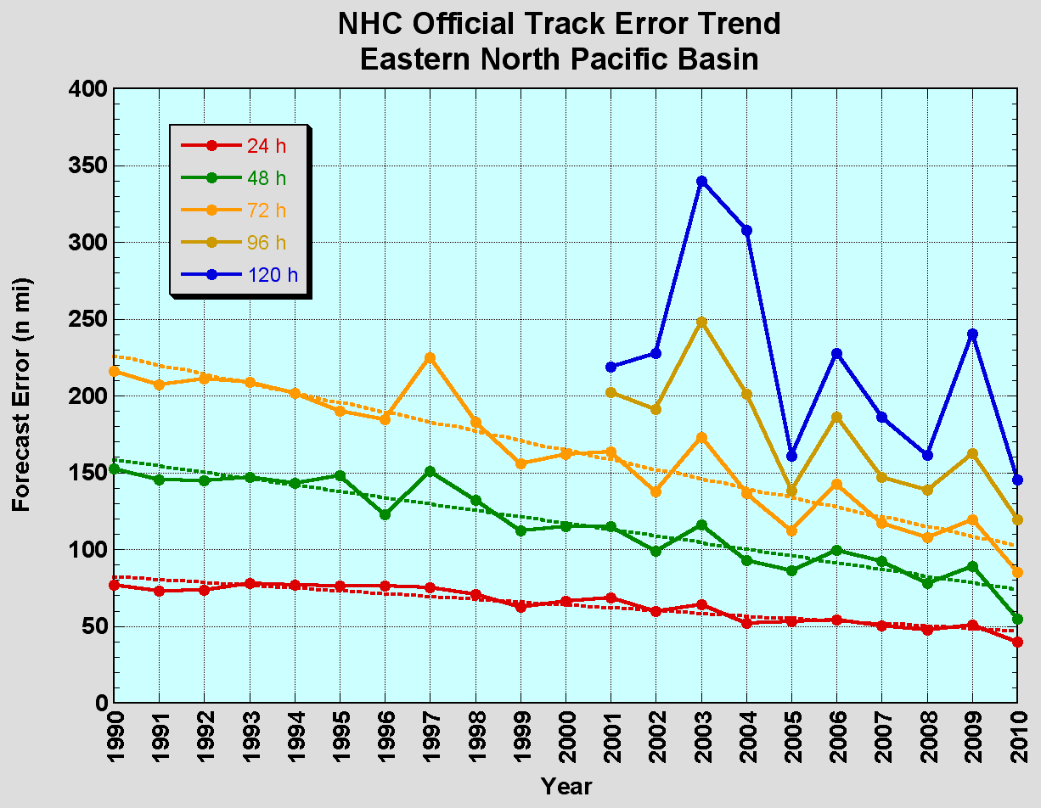
Eastern Pacific Track Error Trends
Since 1990, track errors have decreased by 35%-60%

Slide 25
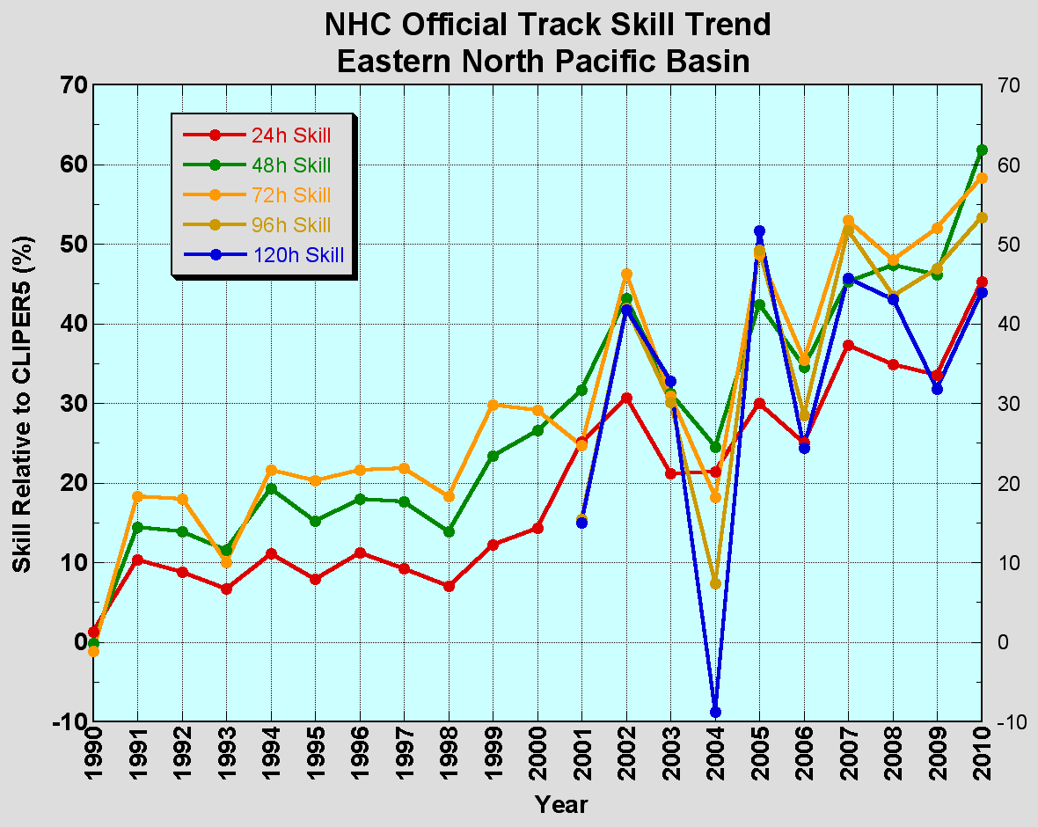
Eastern Pacific Track Skill Trends
Skill is at all-time highs from 24-96 h.

Slide 26
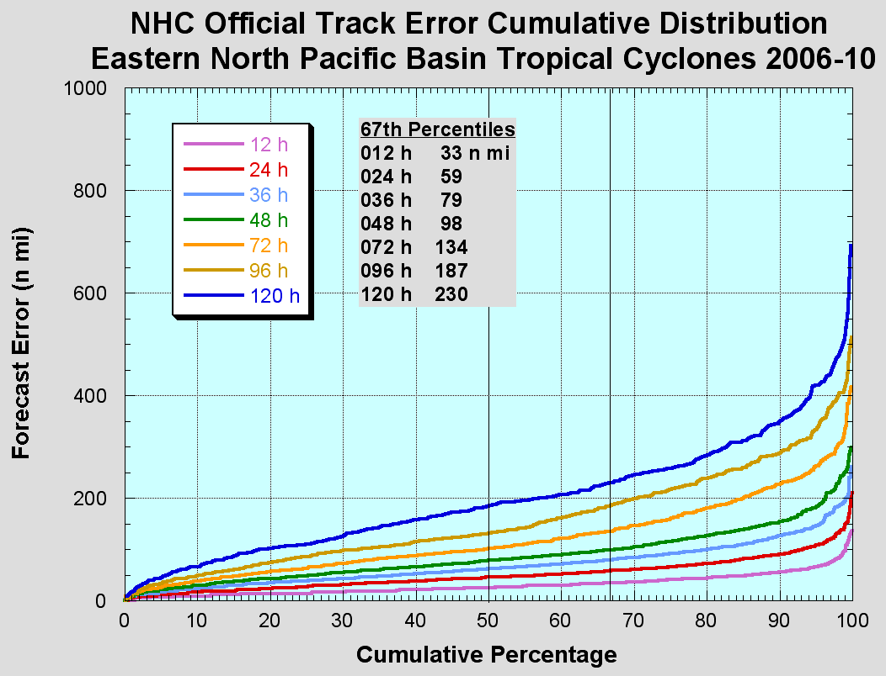
2011 Eastern Pacific “Cone”
2010
36
59
82
102
138
174
220
Only modest changes in cone size but portions of the cone will actually get larger.

Slide 27
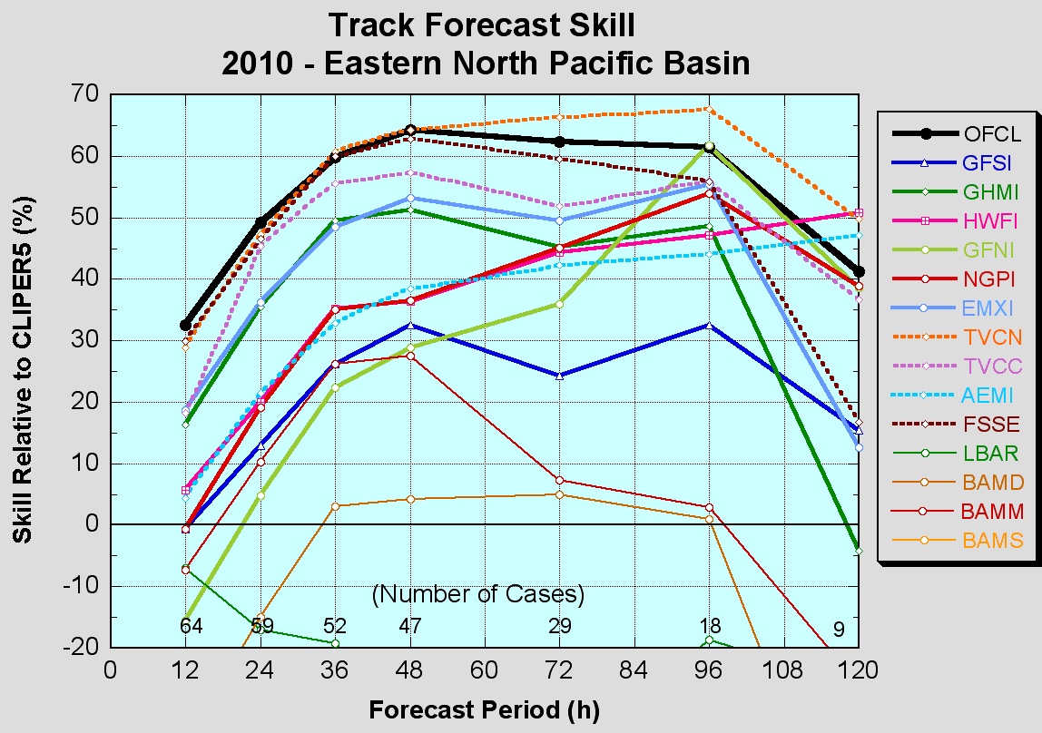
Eastern Pacific Early Track Guidance
Official forecast performance was very close to the TVCN
consensus model. OFCL
beat TVCN at 12–24 h.
FSSE among the best models through 96 h.
EMXI best individual model from 12–72 h.
GFNI, NGPI are best individual models at 96-120 h.

Slide 28
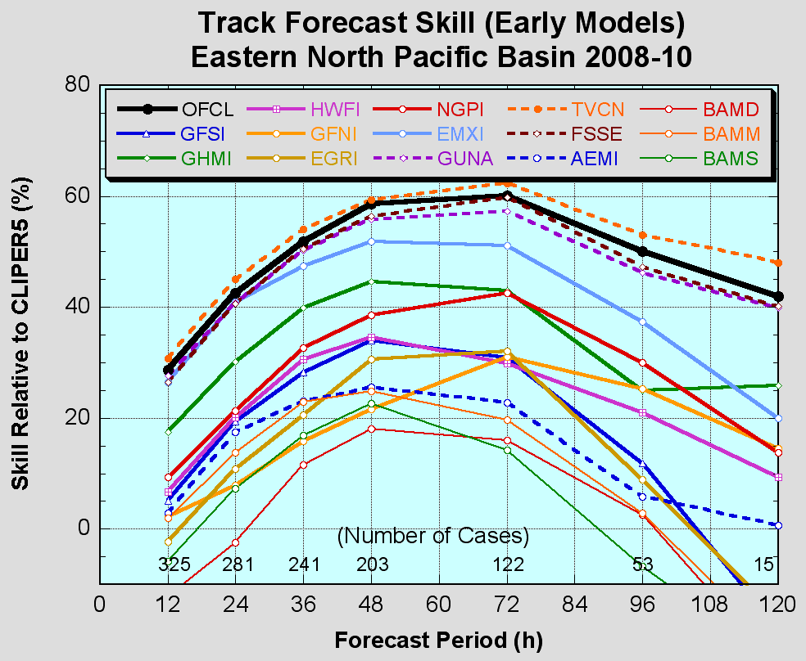
Eastern Pacific Early Track Guidance

Slide 29
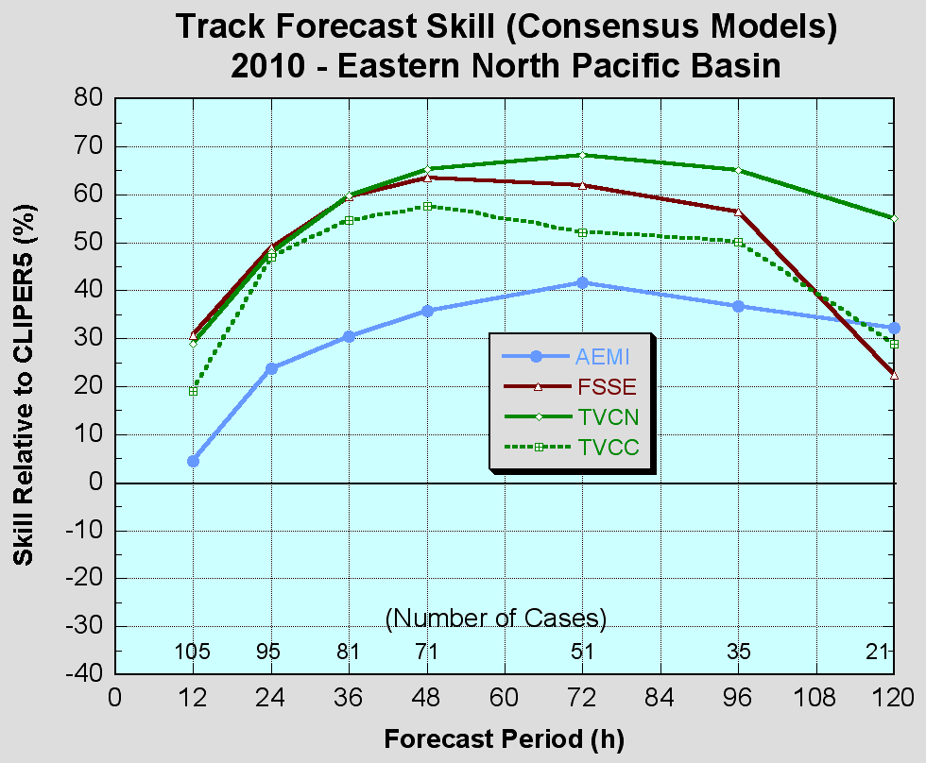
Eastern Pacific Consensus Guidance
FSSE is close to TVCN from 12 h - 48 h. TVCN better beyond that time.
Single-model ensemble not as effective as multi-model ensemble.
Corrected model consensus model TVCC did not perform as well as the uncorrected version.

Slide 30
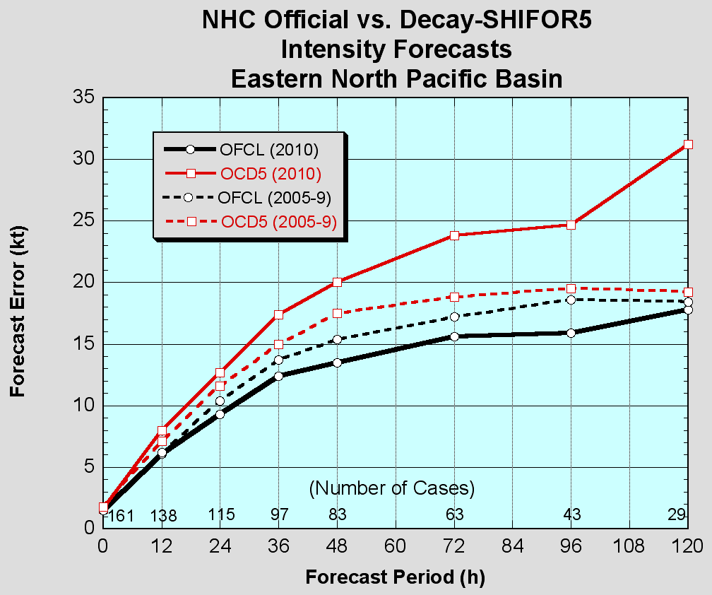
Eastern Pacific Intensity Errors vs. 5-Year Mean
Official forecasts were better
than the 5 yr mean, even though the season’s storms were “harder” than average.

Slide 31
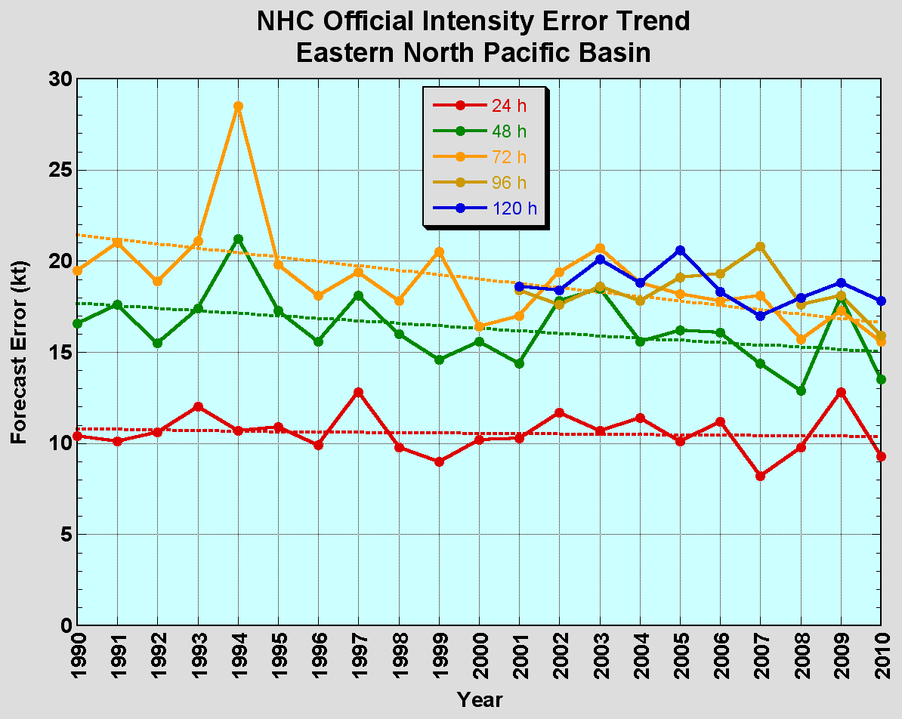
Eastern Pacific Intensity Error Trends
Intensity errors have decreased slightly at 48 h and 72 h
but have remained about the same otherwise.

Slide 32
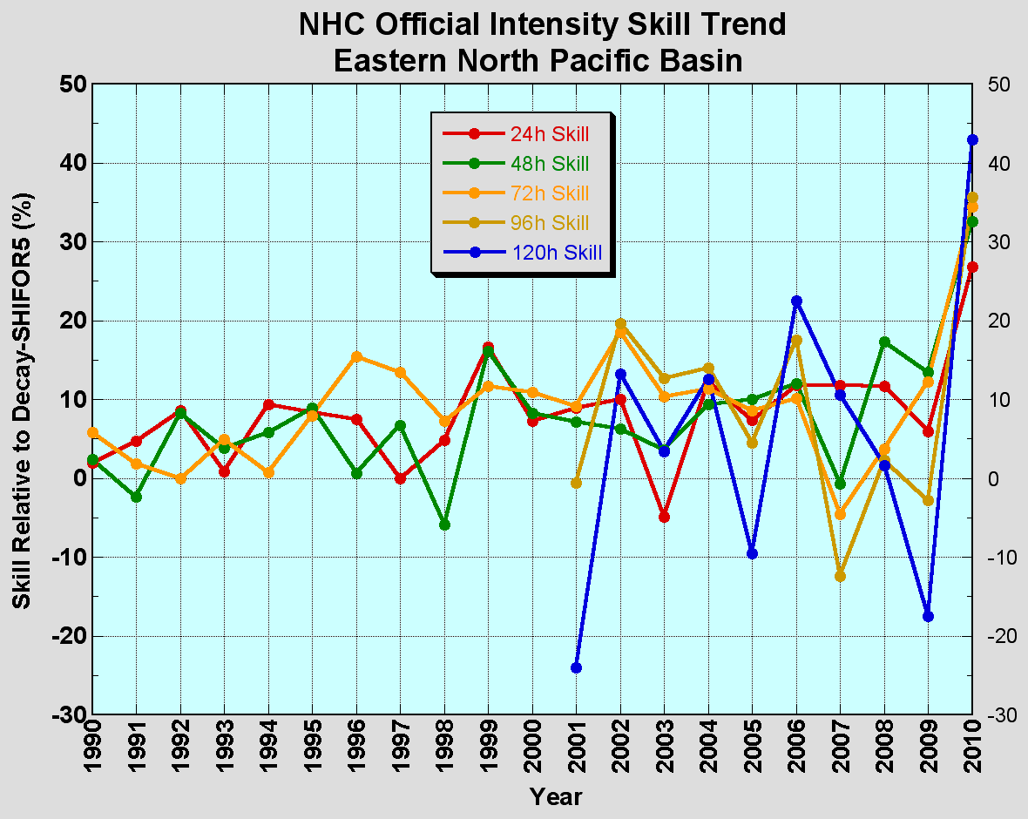
Eastern Pacific Intensity Skill Trends
Skill hit all-time highs at all forecast times in 2010 after many years with little change. Most likely an anomaly due to small sample size.

Slide 33
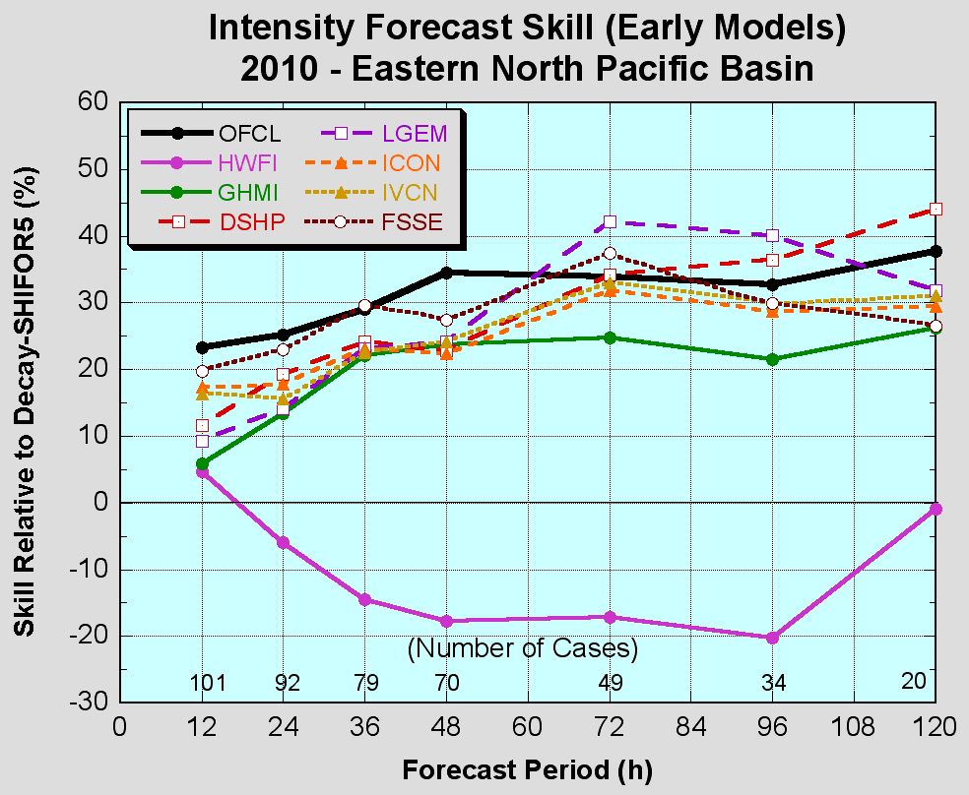
Eastern Pacific Early Intensity Guidance
Official forecasts beat the consensus (ICON, FSSE) at most time periods.
Best model was statistical at all time periods. LGEM and DSHP were better than the consensus from 72-120 h, likely due to the less-than-skillful HWRF.
FSSE is the best model from 12–48 h.
GHMI was competitive with statistical and consensus models.

Slide 34
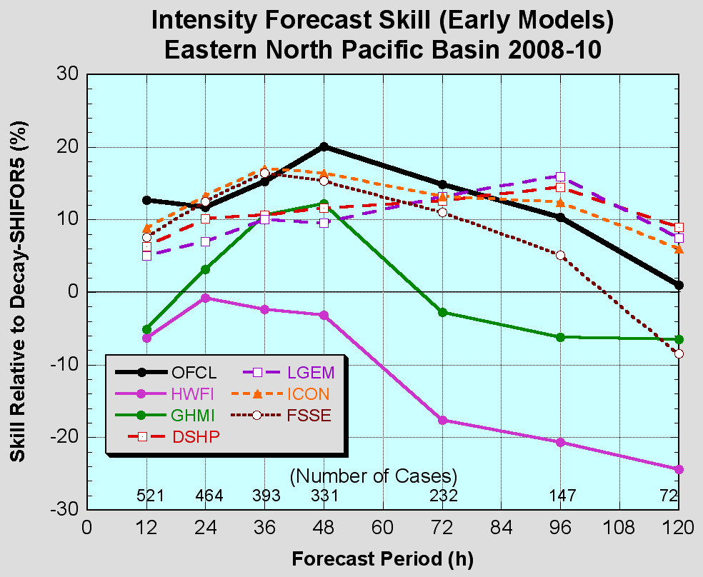
Eastern Pacific Early Intensity Guidance

Slide 35
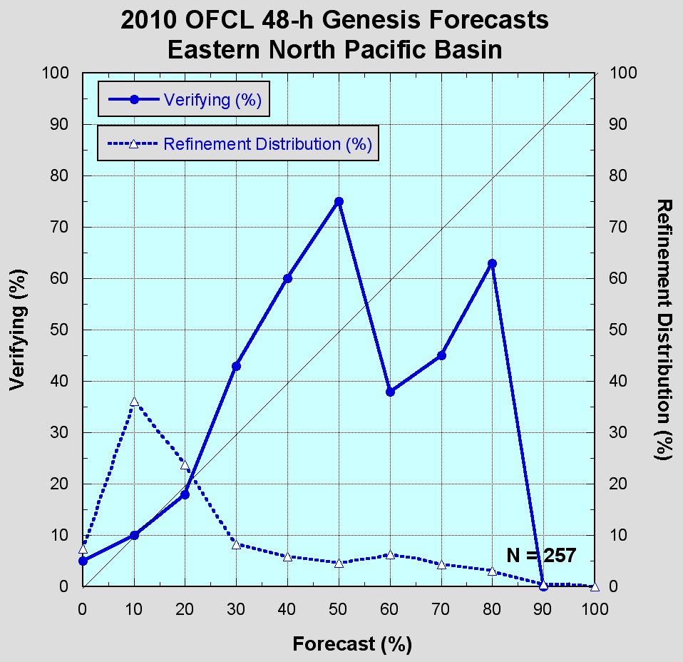
Eastern Pacific Genesis Forecasts
Inability to distinguish the high from the medium likelihood of development (essentially no information conveyed except at 0-20%).

Slide 36
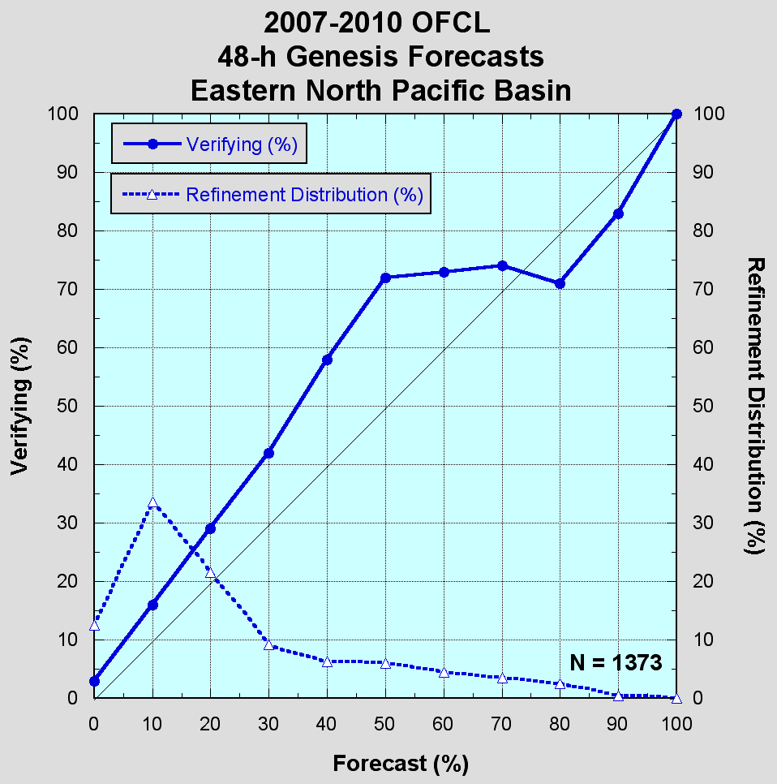
Eastern Pacific Genesis Forecasts
Four-year sample is better, but still trouble in the 50-80% range, and under-forecast bias overall persists.

