Slide 1
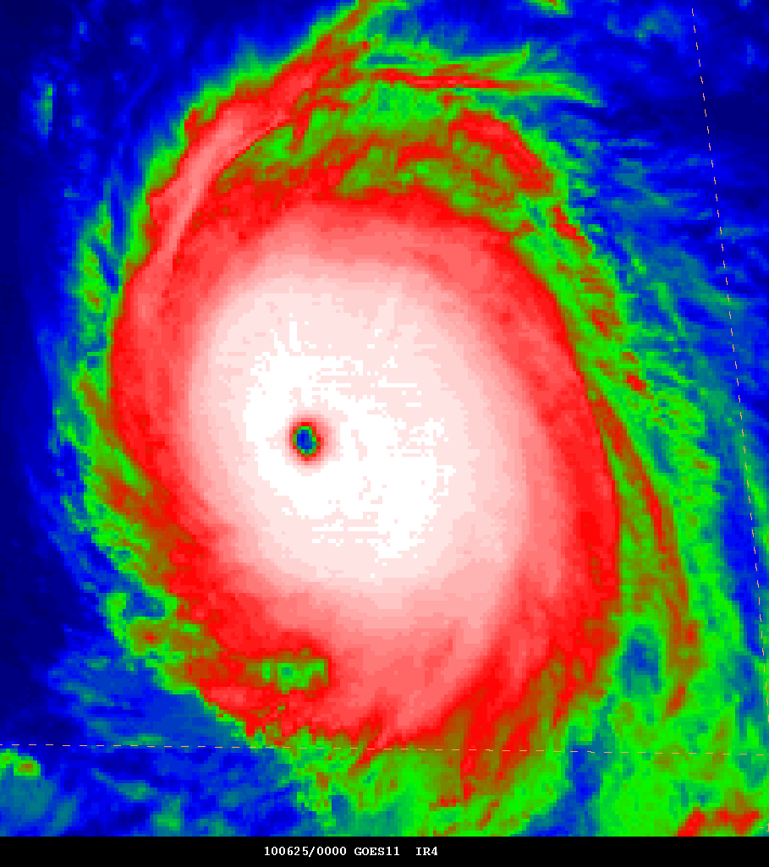
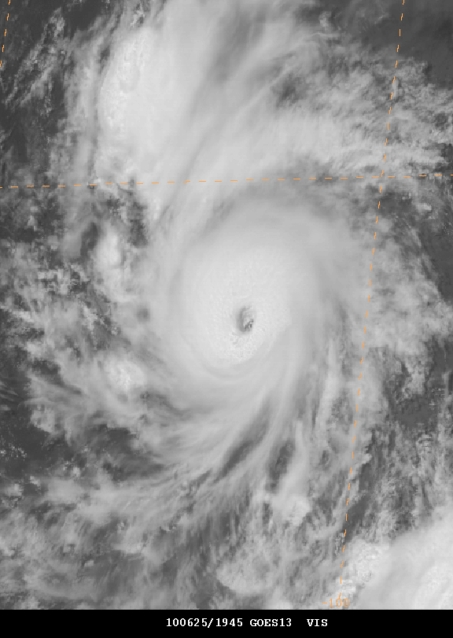
2010 East Pacific Hurricane Season
John Cangialosi and Stacy Stewart
National Hurricane Center
2011 Interdepartmental Hurricane Conference
Miami, Florida
28 February 2011

Slide 2
Summary Table
Name | Dates | Min Pressure (mb) | Max Winds (kt) | Direct Deaths
TS Agatha | 29-30 May | 1001 | 40 | 190
TS Blas | 17-21 Jun | 994 | 55 | 0
MH Celia | 18-28 Jun | 921 | 140 | 0
MH Darby | 23-28 Jun | 959 | 105 | 0
TS Estelle | 6-10 Aug | 994 | 55 | 0
H Frank | 21-28 Aug | 978 | 80 | 0
TS Georgette | 20-23 Sep | 999 | 35 | 0
* Five short-lived unnamed tropical depressions

Slide 3
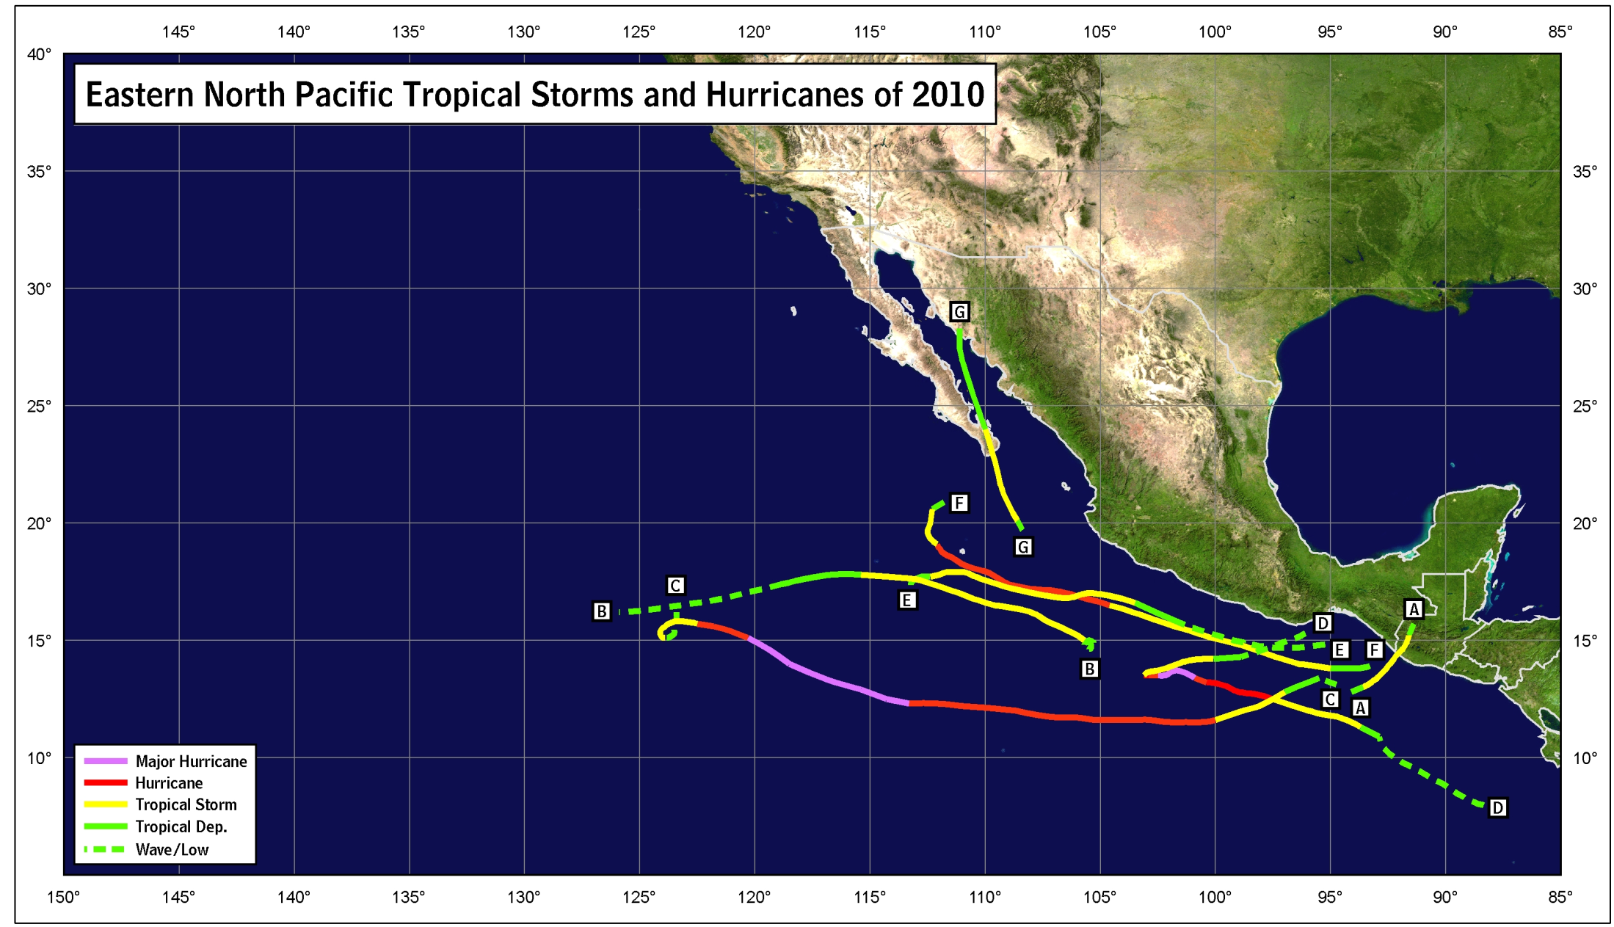
2010 East Pacific Track Map

Slide 4
Seasonal IR Loop

Slide 5
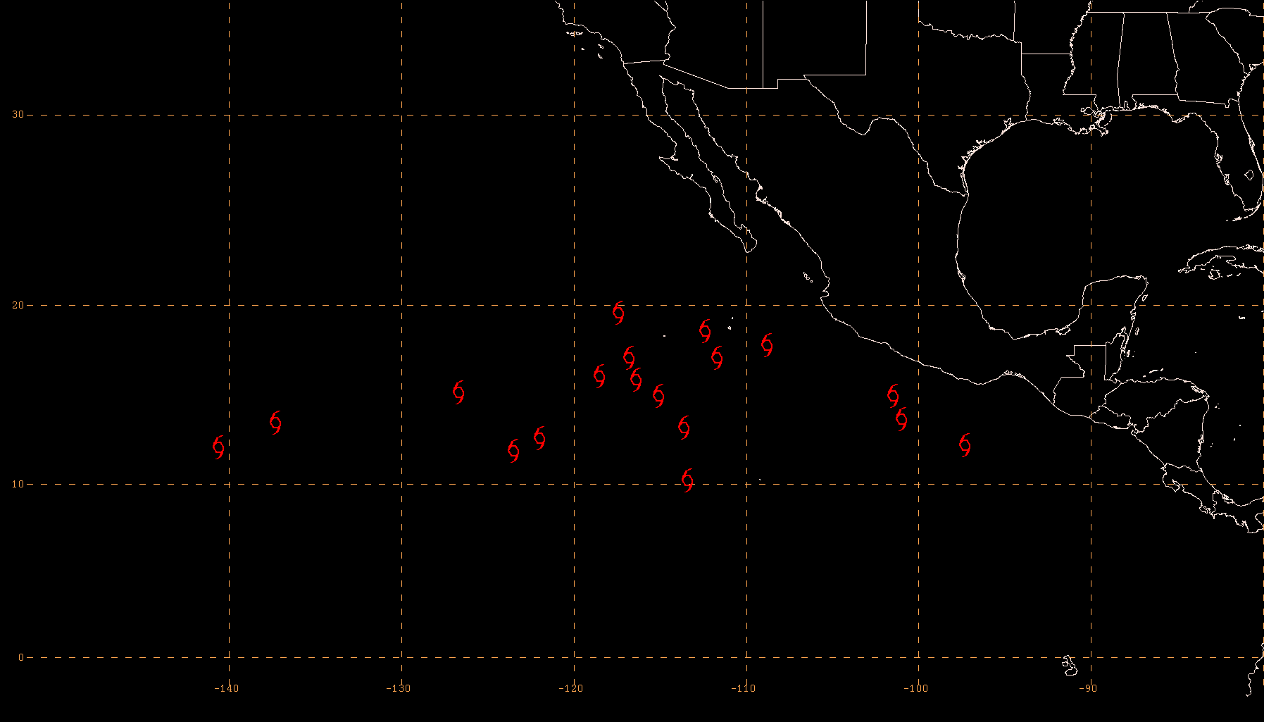
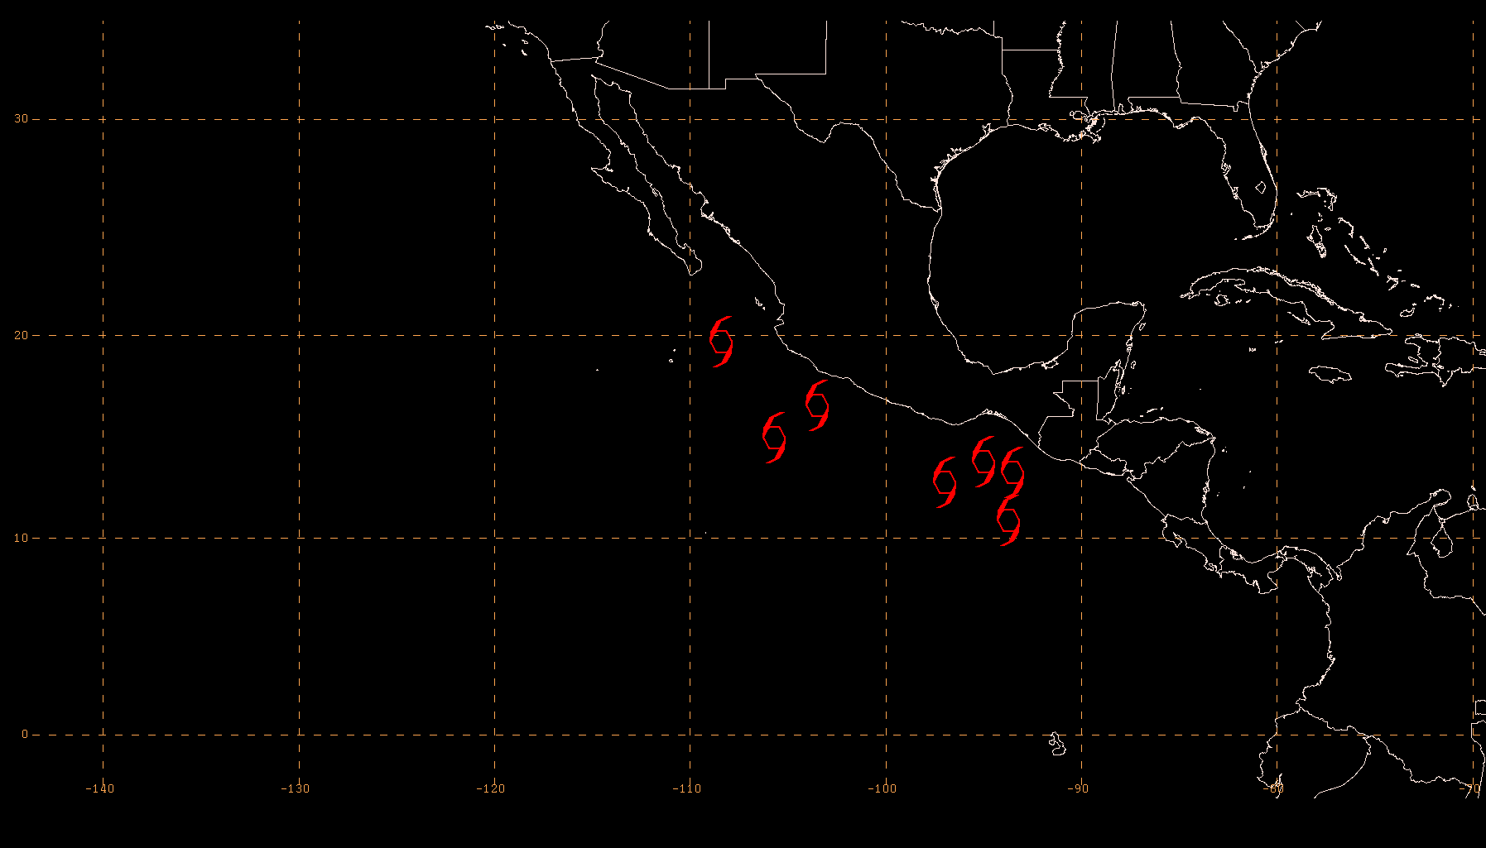
Genesis Locations
2009
2010
76 % of TS genesis occurred west of 110 W
57 % of TS genesis occurred near the
Gulf of Tehuantepec

Slide 6
Comparison with Climatology
Tropical Storms
Hurricanes
Lowest number of named storms and hurricanes
on record during the satellite era
 | Tropical Storms | Hurricanes | Major Hurricanes
Average | 15.3 | 8.5 | 3.8
2010 | 7 | 3 | 2

Slide 7
Comparison with Climatology
Accumulated Cyclone Energy
Celia and Darby account
for ~70 % of the ACE
1996
2003
2007
1977

Slide 8
Verification of NOAA’s 2010 Eastern Pacific Hurricane Outlook
Season and Climatological
Activity Type Outlook Observed Mean
Chance Above Normal 5% 33%
Chance Near Normal 20% 33%
Chance Below Normal 75% Below Normal 33%
Tropical Storms 9-15 7 15
Hurricanes 4-8 3 9
Major Hurricanes 1-3 2 4
ACE % of Median 45-95 ~ 46

Slide 9
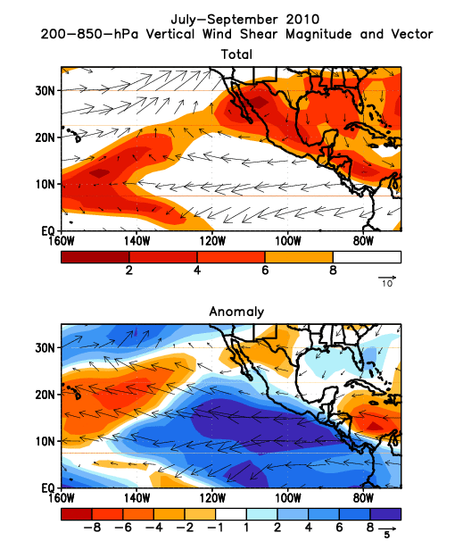
Vertical Wind Shear
Strong shear existed across much
of the East Pacific region during
the peak of the hurricane season.

Slide 10
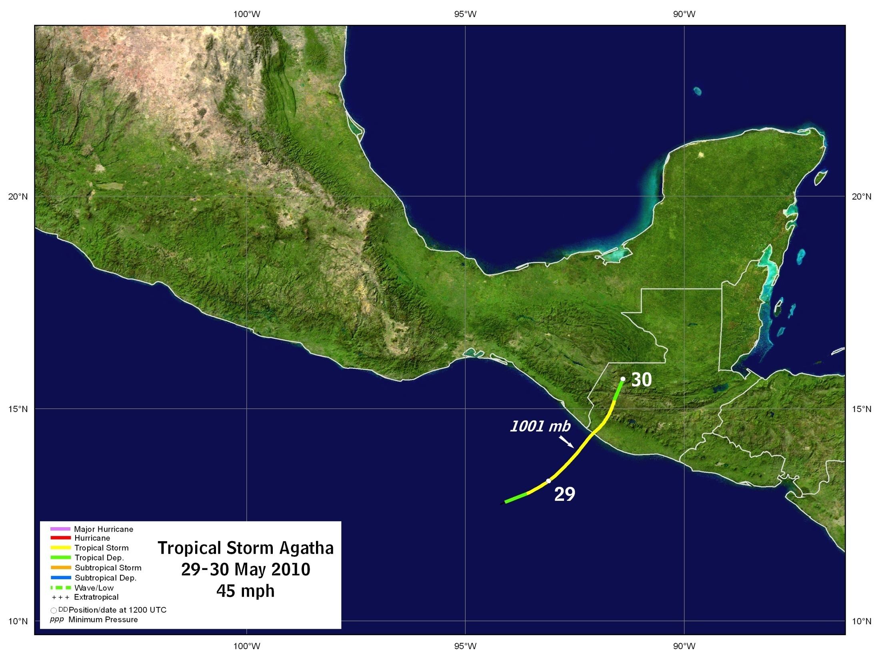
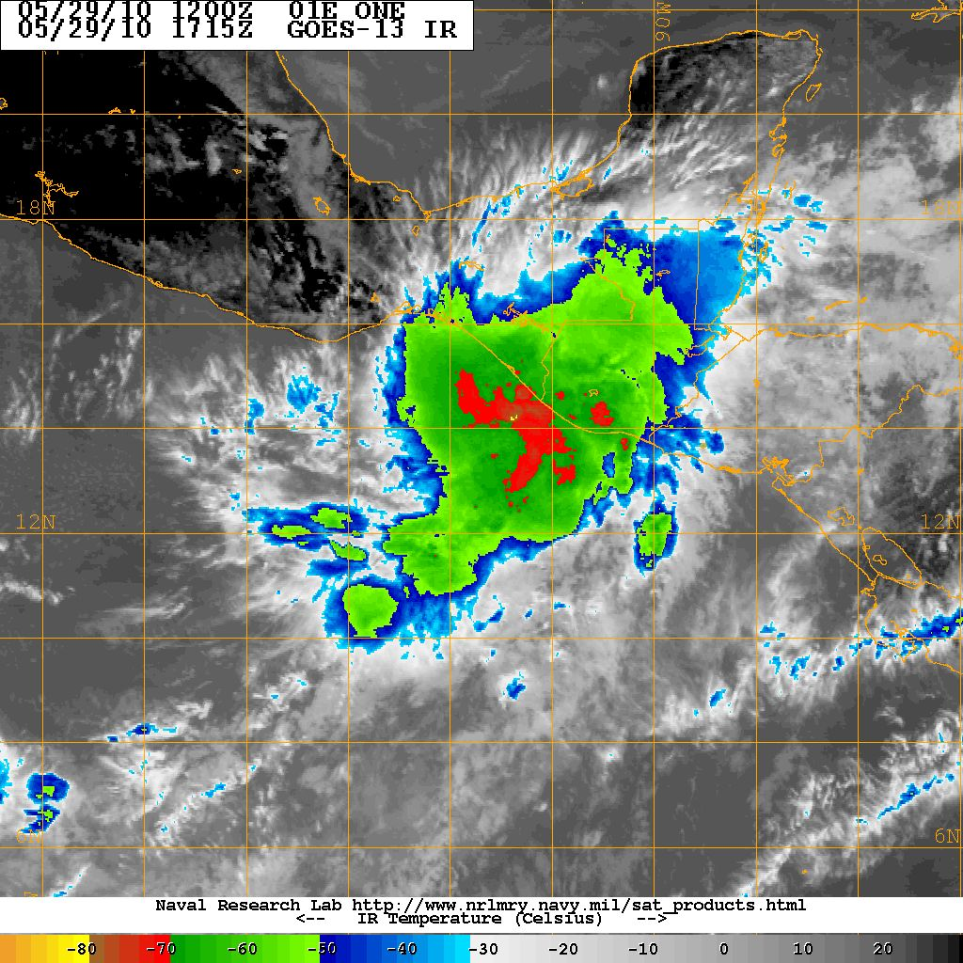
Tropical Storm Agatha

Slide 11
Tropical Storm Agatha Impacts
Flooding rains and mud slides caused 190 deaths: 160 in Guatemala, 18 Honduras, and 12 in El Salvador
Caused a 20-m sink hole in Guatemala City, destroying several building in the process
1.1 billion USD of damage overall
- 982 million USD in Guatemala

Slide 12
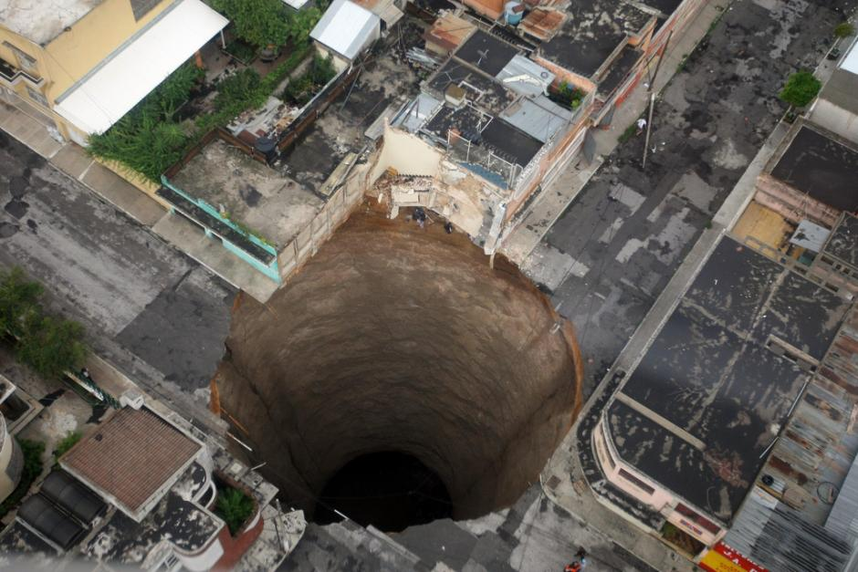
Tropical Storm Agatha

Slide 13
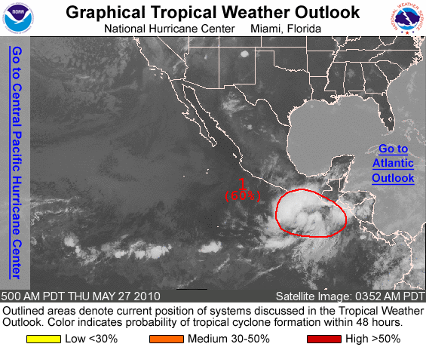
Agatha: Genesis Prediction
* The genesis of Agatha was
well anticipated.
* This is a case where the
issuance of watches/warnings
before initiating advisories
could have been beneficial
36 h prior to formation

Slide 14
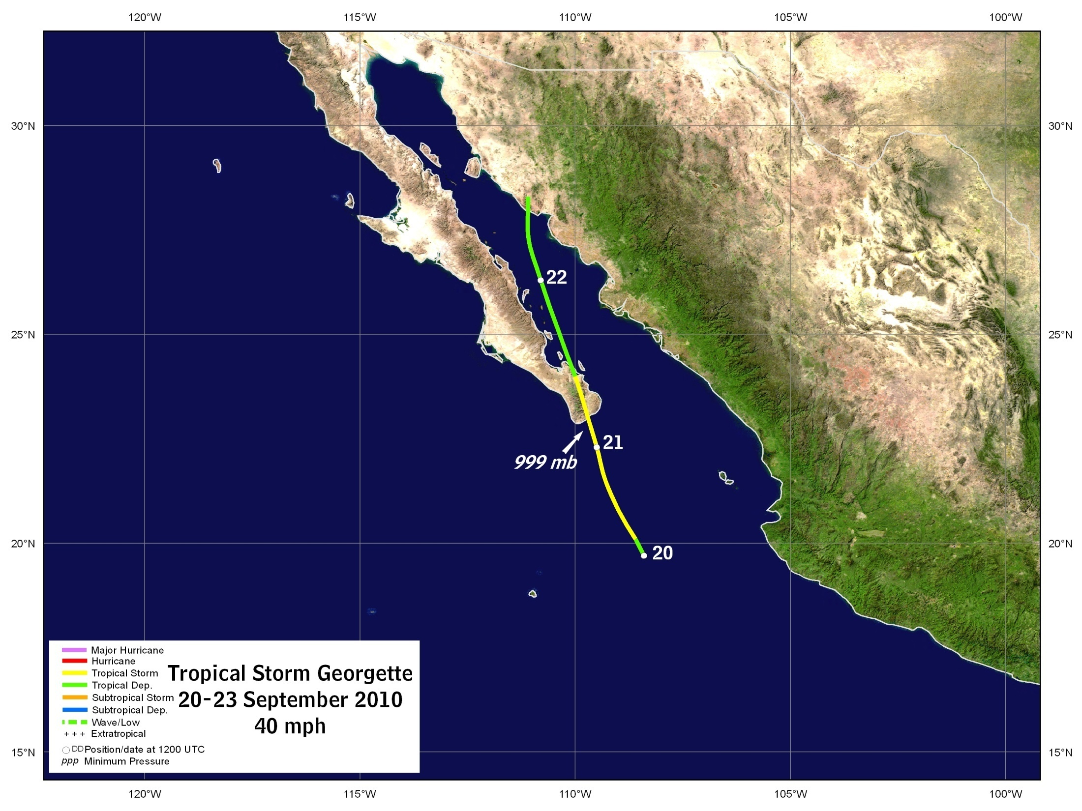
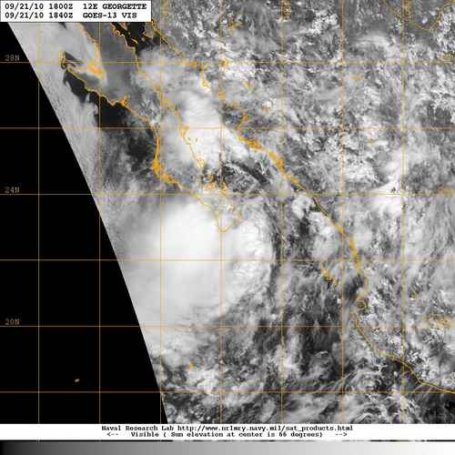
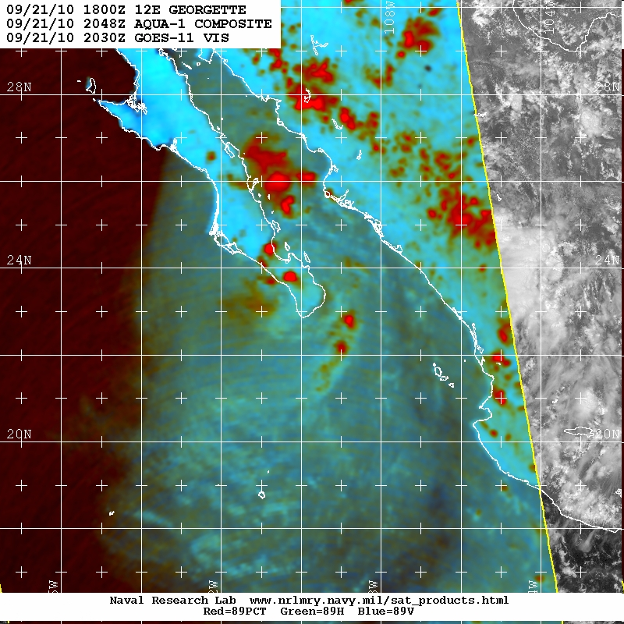
Tropical Storm Georgette

Slide 15
Tropical Storm Georgette Impacts
Flooding was reported in Emphalme, Etchojoa, Navojoa, and Guaymas in the state of Sonora in Mexico.
500,000 people were evacuated in the state.

Slide 16
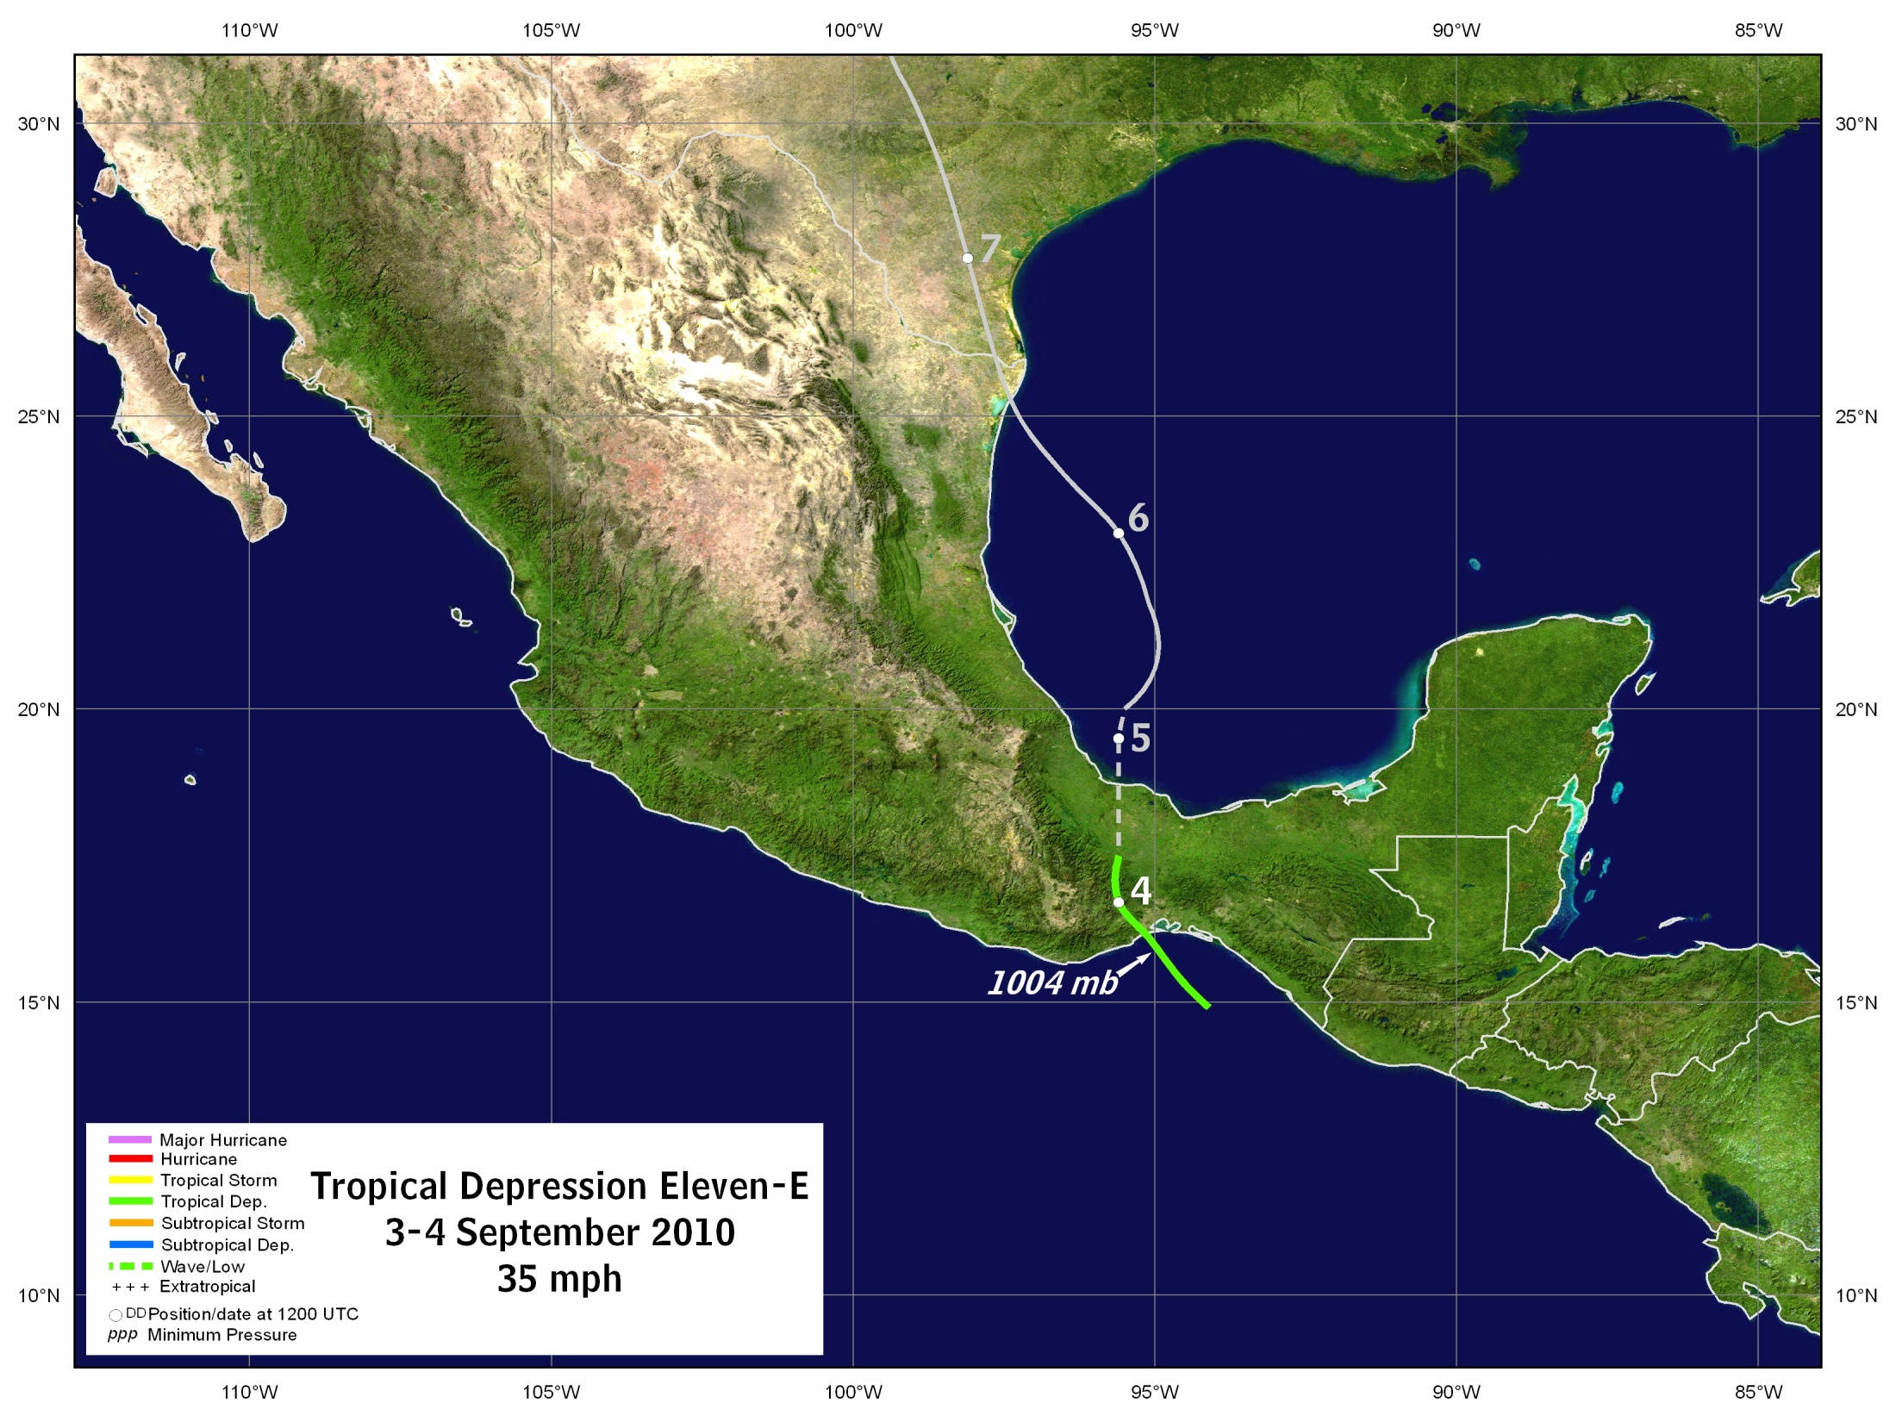
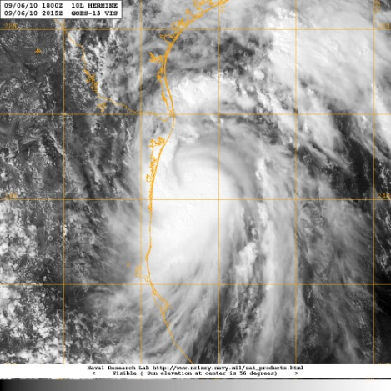
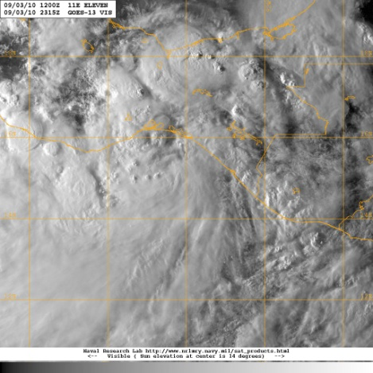

Slide 17
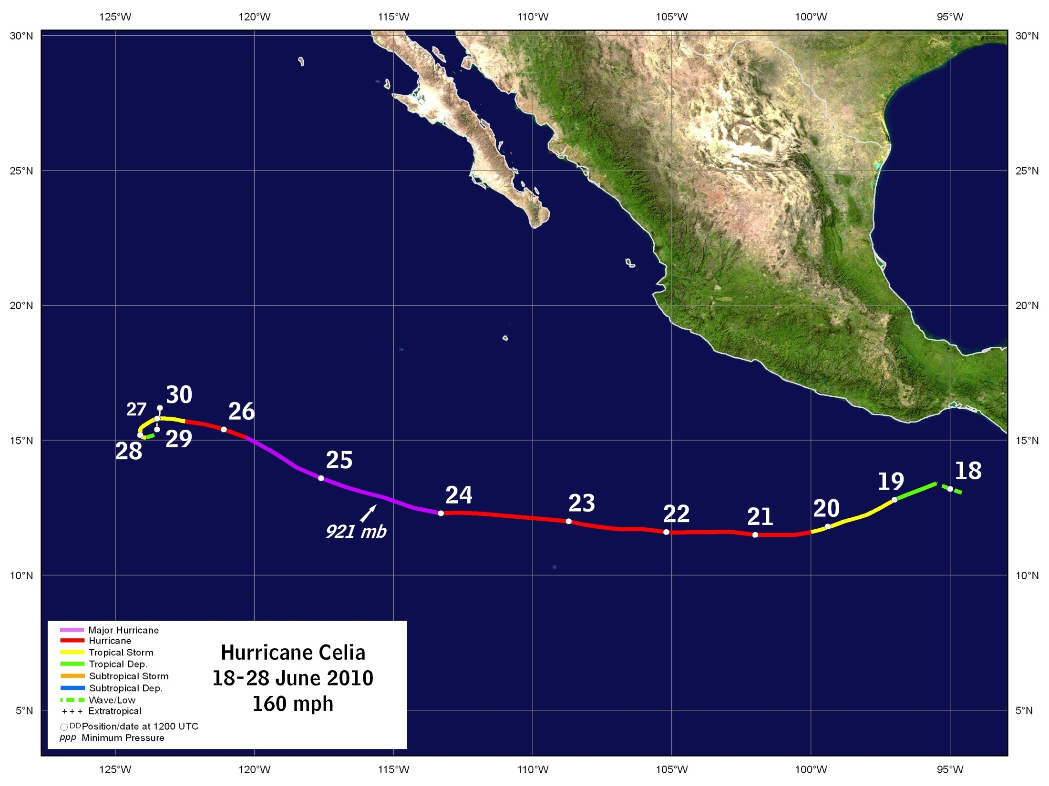
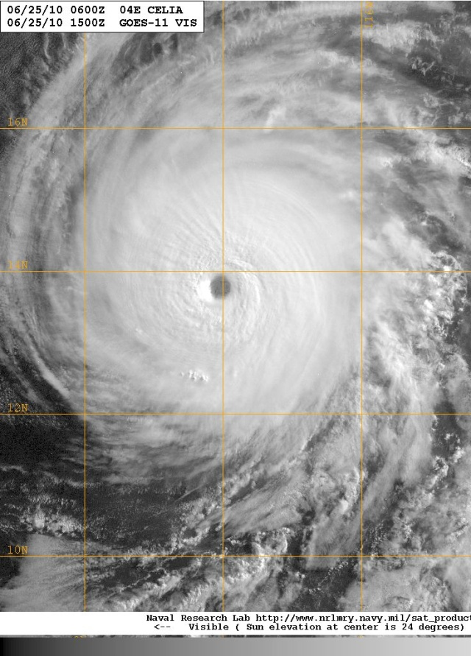

Slide 18
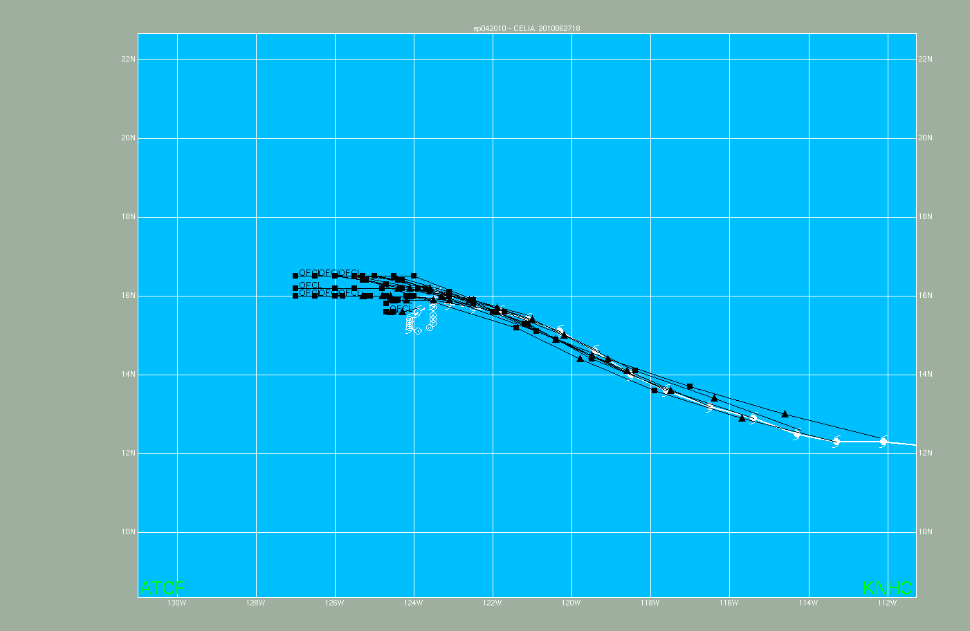
Celia Track Errors
Official forecasts did not anticipate the
slow down and cyclonic loop of Celia

Slide 19
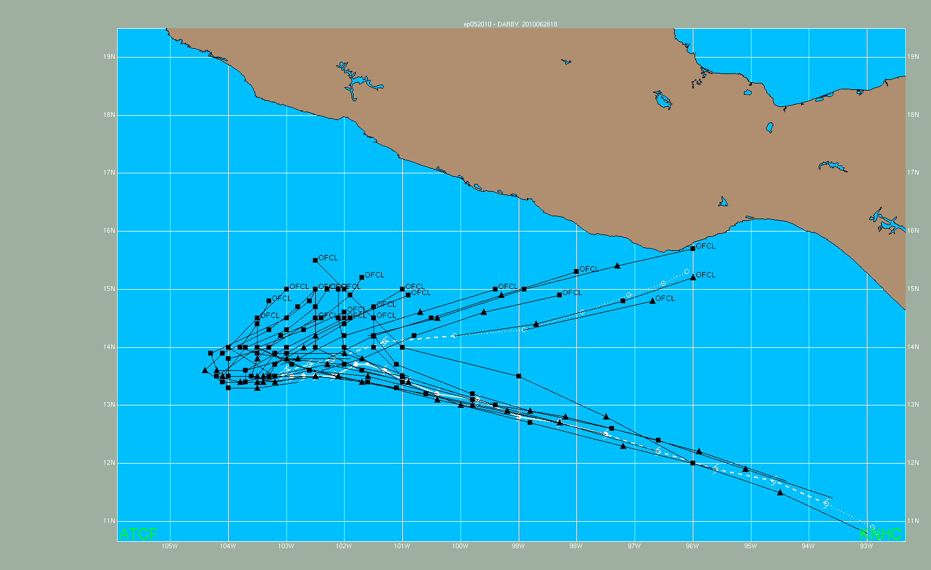
Darby Track Errors
Track forecasts had left bias
and did not anticipate Darby’s
sharp turn

Slide 20
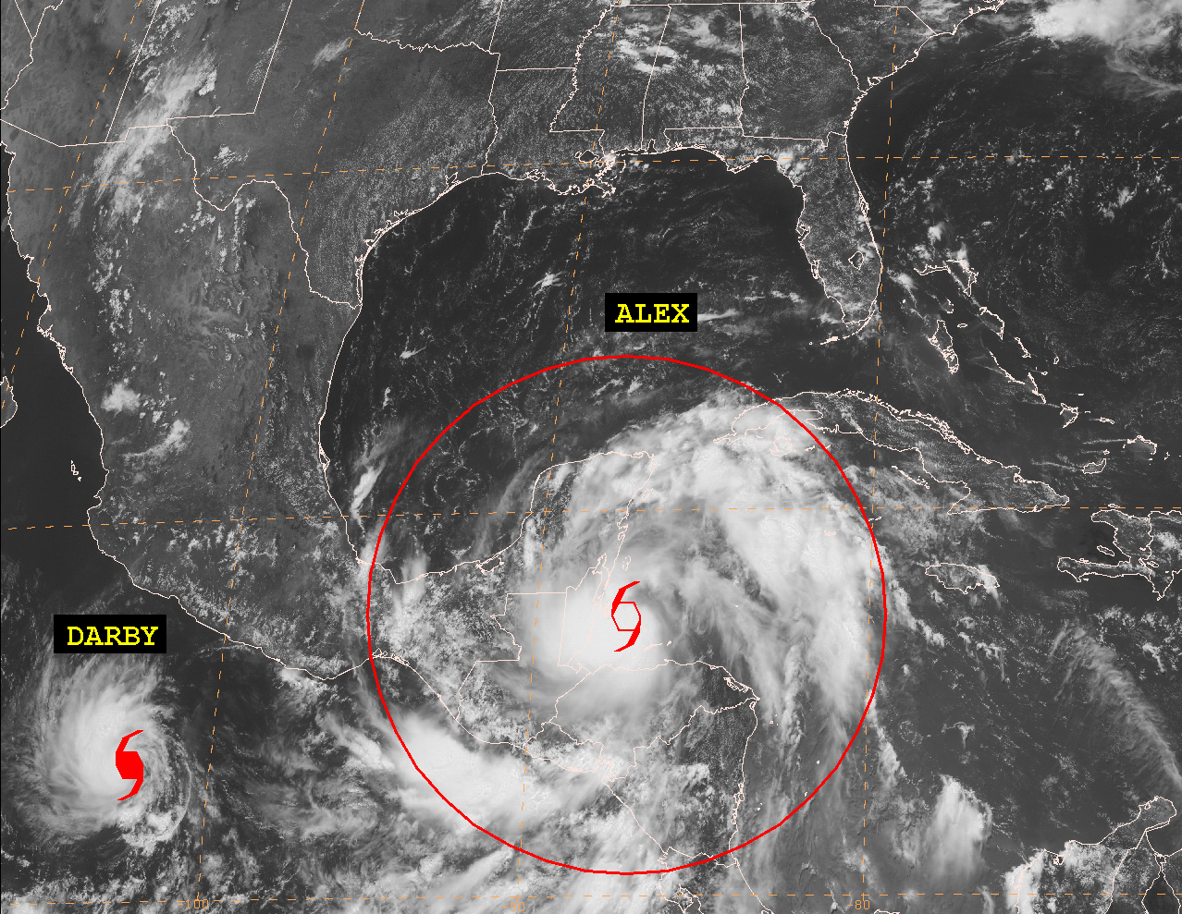
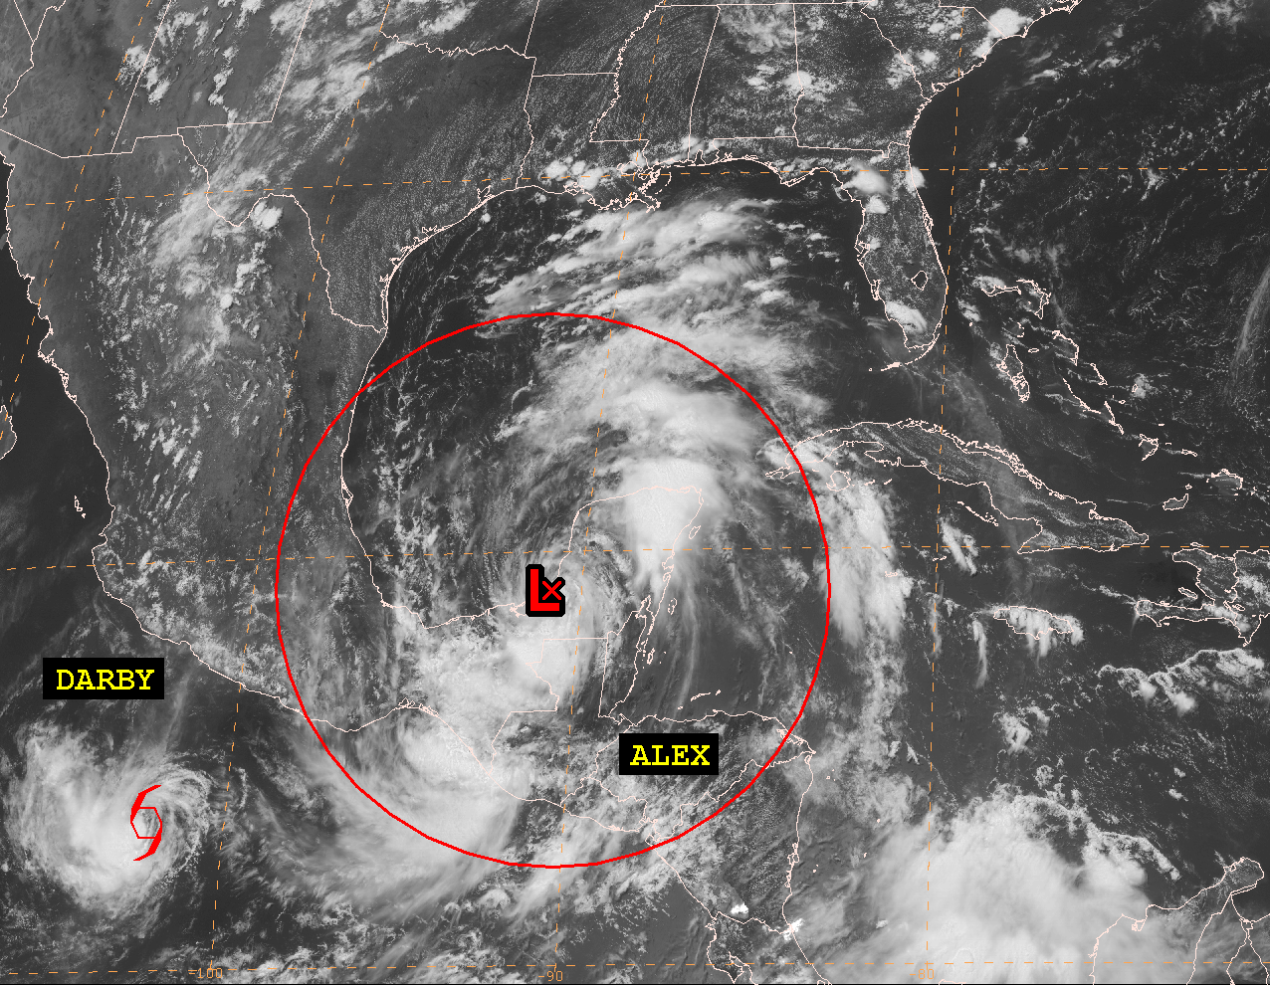
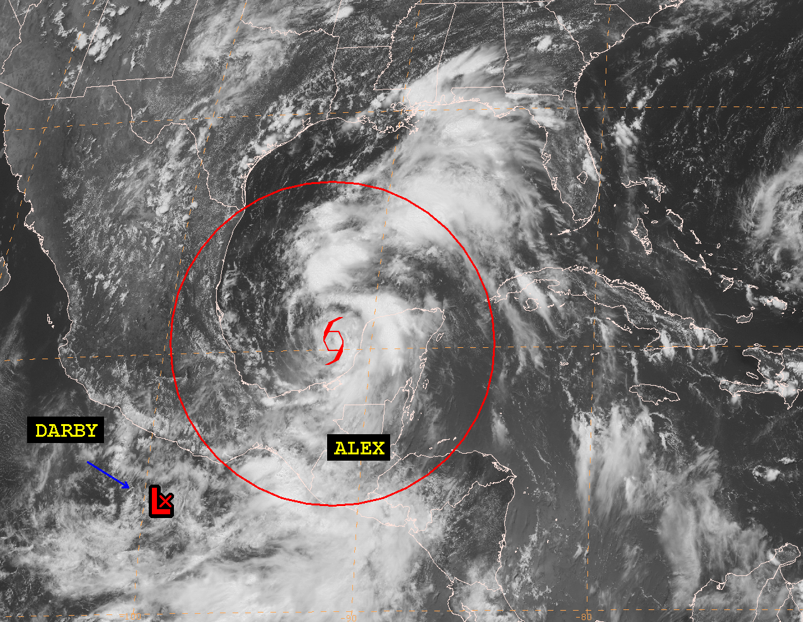
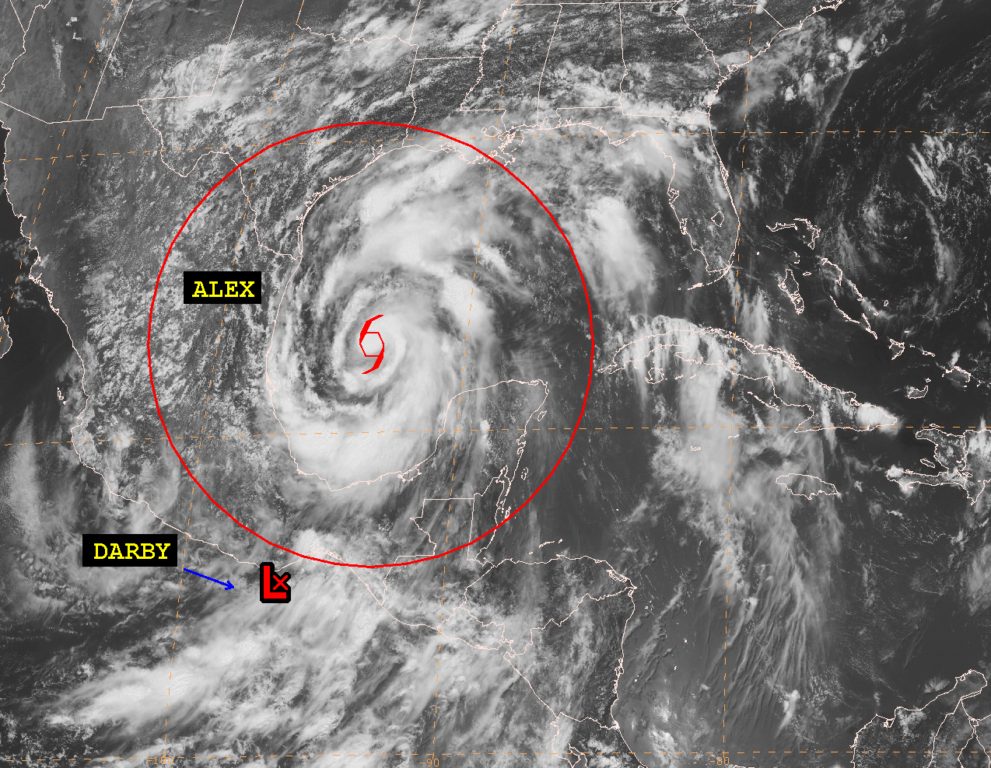
1800 UTC 26 June
1800 UTC 27 June
1800 UTC 28 June
1800 UTC 29 June

Slide 21
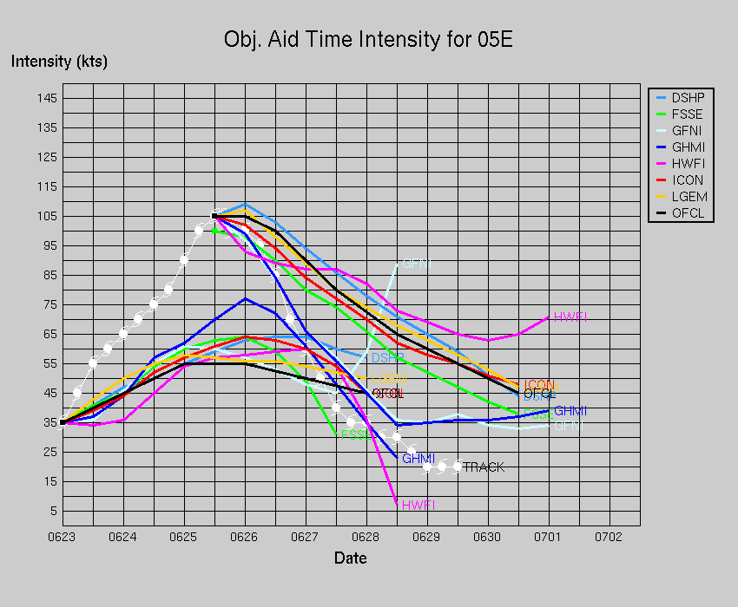
Darby Intensity Errors
The official forecasts and intensity
guidance missed the rapid
intensification and weakening of Darby

Slide 22
Acknowledgements
Ethan Gibney of IMSG/NCDC provided the seasonal track map
Hurricane Specialists Unit

