Slide 1
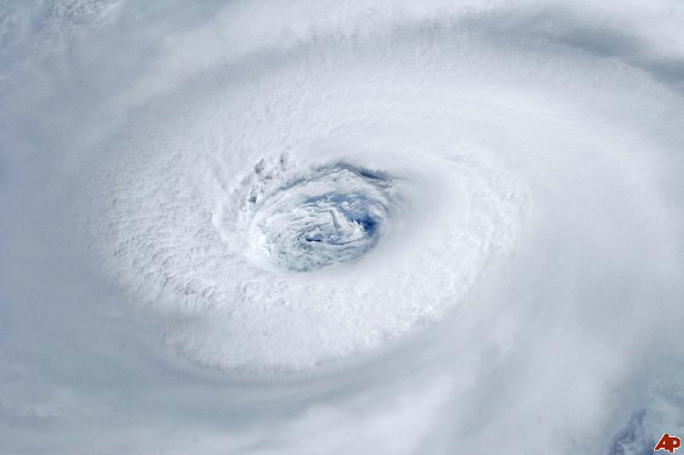

The 2010 Atlantic Hurricane Season
Eric Blake
National Hurricane Center
2011 Interdepartmental Hurricane Conference
Miami, Florida
28 February 2011

Slide 2
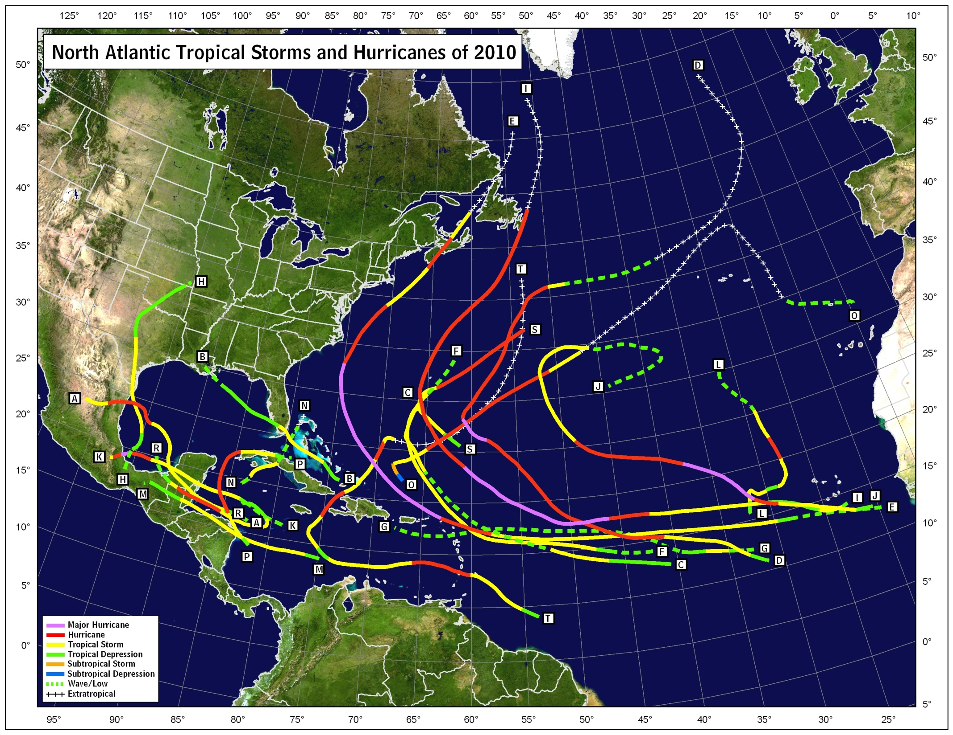
Seasonal Track Map

Slide 3
2010 ATLANTIC HURRICANE SEASON STATISTICS
NAME | DATES | MIN. PRESS (MB) | MAX. WINDS (MPH) | DIRECT DEATHS | US DAMAGE ($MIL)
H ALEX | 25 JUN - 2 JUL | 946 | 110 (2) | 12 | 10
TS BONNIE | 22 - 24 JUL | 1005 | 45
TS COLIN | 2 - 8 AUG | 1005 | 60
MH DANIELLE | 21 - 30 AUG | 942 | 135 (4) | 1
MH EARL | 25 AUG - 4 SEP | 927 | 145 (4) | 5
TS FIONA | 30 AUG - 3 SEP | 998 | 65
TS GASTON | 1 - 2 SEP | 1005 | 40
TS HERMINE | 5 - 9 SEP | 989 | 70 | 6 | 240
MH IGOR | 8 - 21 SEP | 924 | 155 (4) | 3
MH JULIA | 12 - 20 SEP | 948 | 140 (4)
MH KARL | 14 - 18 SEP | 956 | 125 (3) | 5
H LISA | 20 - 26 SEP | 982 | 85 (1)
TS MATTHEW | 23 - 26 SEP | 998 | 60 | 73
TS NICOLE | 28 - 29 SEP | 995 | 45
H OTTO | 6 - 10 OCT | 976 | 85 (1)
H PAULA | 11 - 15 OCT | 981 | 105 (2) | 1
H RICHARD | 20 - 25 OCT | 977 | 100 (2)
H SHARY | 28 - 30 OCT | 989 | 75 (1)
H TOMAS | 29 OCT – 7 NOV | 982 | 100 (2) | 49
Notes:
28 total storms (Twenty-seven named tropical storms and one unnamed subtropical storm), breaking the record of twenty-one set back in 1933
Fifteen hurricanes, breaking the record of twelve set back in 1969
Seven major hurricanes, one short of the record of eight set back in 1950
The deadliest U. S. hurricane season since 1928
The costliest U. S. hurricane season of record
Four Category 5 hurricanes observed in one season for the first time ever
Wilma’s minimum central pressure of 882 mb is the lowest ever measured in an Atlantic hurricane

Slide 4

2010 Season Facts
19 named storms, 12 of which became hurricanes, including 5 major hurricanes
  Well above the long-term averages of 11/6/2
  Extremely busy late season, with 11 hurricanes after 22 August (tied with 2005 for most after that date.
  Two additional tropical depressions
Third-most number of named storms and second-most number of hurricanes (2005 had 28 and 15, respectively)
The Accumulated Cyclone Energy (ACE) index for the season was 190% of the long-term median (a “hyperactive” season)
Three tropical storm impacts in the U.S. (Bonnie and Hermine, with Earl bringing sustained TS conditions to the Outer Banks)
Alex was the strongest June hurricane since Alma of 1966
Julia became the strongest hurricane so far east (previous was Fred 2009)
Most number of hurricanes without a U.S. landfall in the historical record.

Slide 5
NOAA’s 2010 Atlantic Hurricane Outlook
Season and May 2010 Aug 2010 Observed
Activity Type Outlook Outlook Activity Climatology
Chance Above Average 85% 90% Above Average 33%
Chance Near Average 10% 10% 33%
Chance Below Average 5% 0% 33%
Named Storms 14-23 14-20 19 11
Hurricanes 8-14 8-12 12 6
Major Hurricanes 3-7 4-6 5 2
Acc. Cyclone Energy 155-270% 170-260% 190% 100%
Notes:
5
Verification of the 2010 NOAA Atlantic seasonal forecast. All forecast parameters verified within ranges

Slide 6
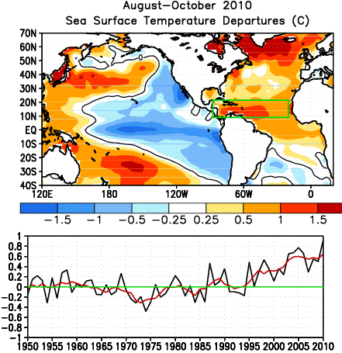
Warmest tropical Atlantic SSTs of all-time

Slide 7
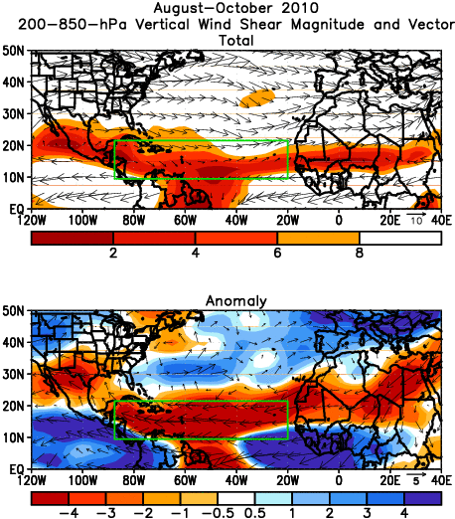
Exceptionally low shear in the deep tropics during the heart of the season.
Higher shear anomalies in mid-latitudes lead to very few genesis points from non-tropical sources

Slide 8
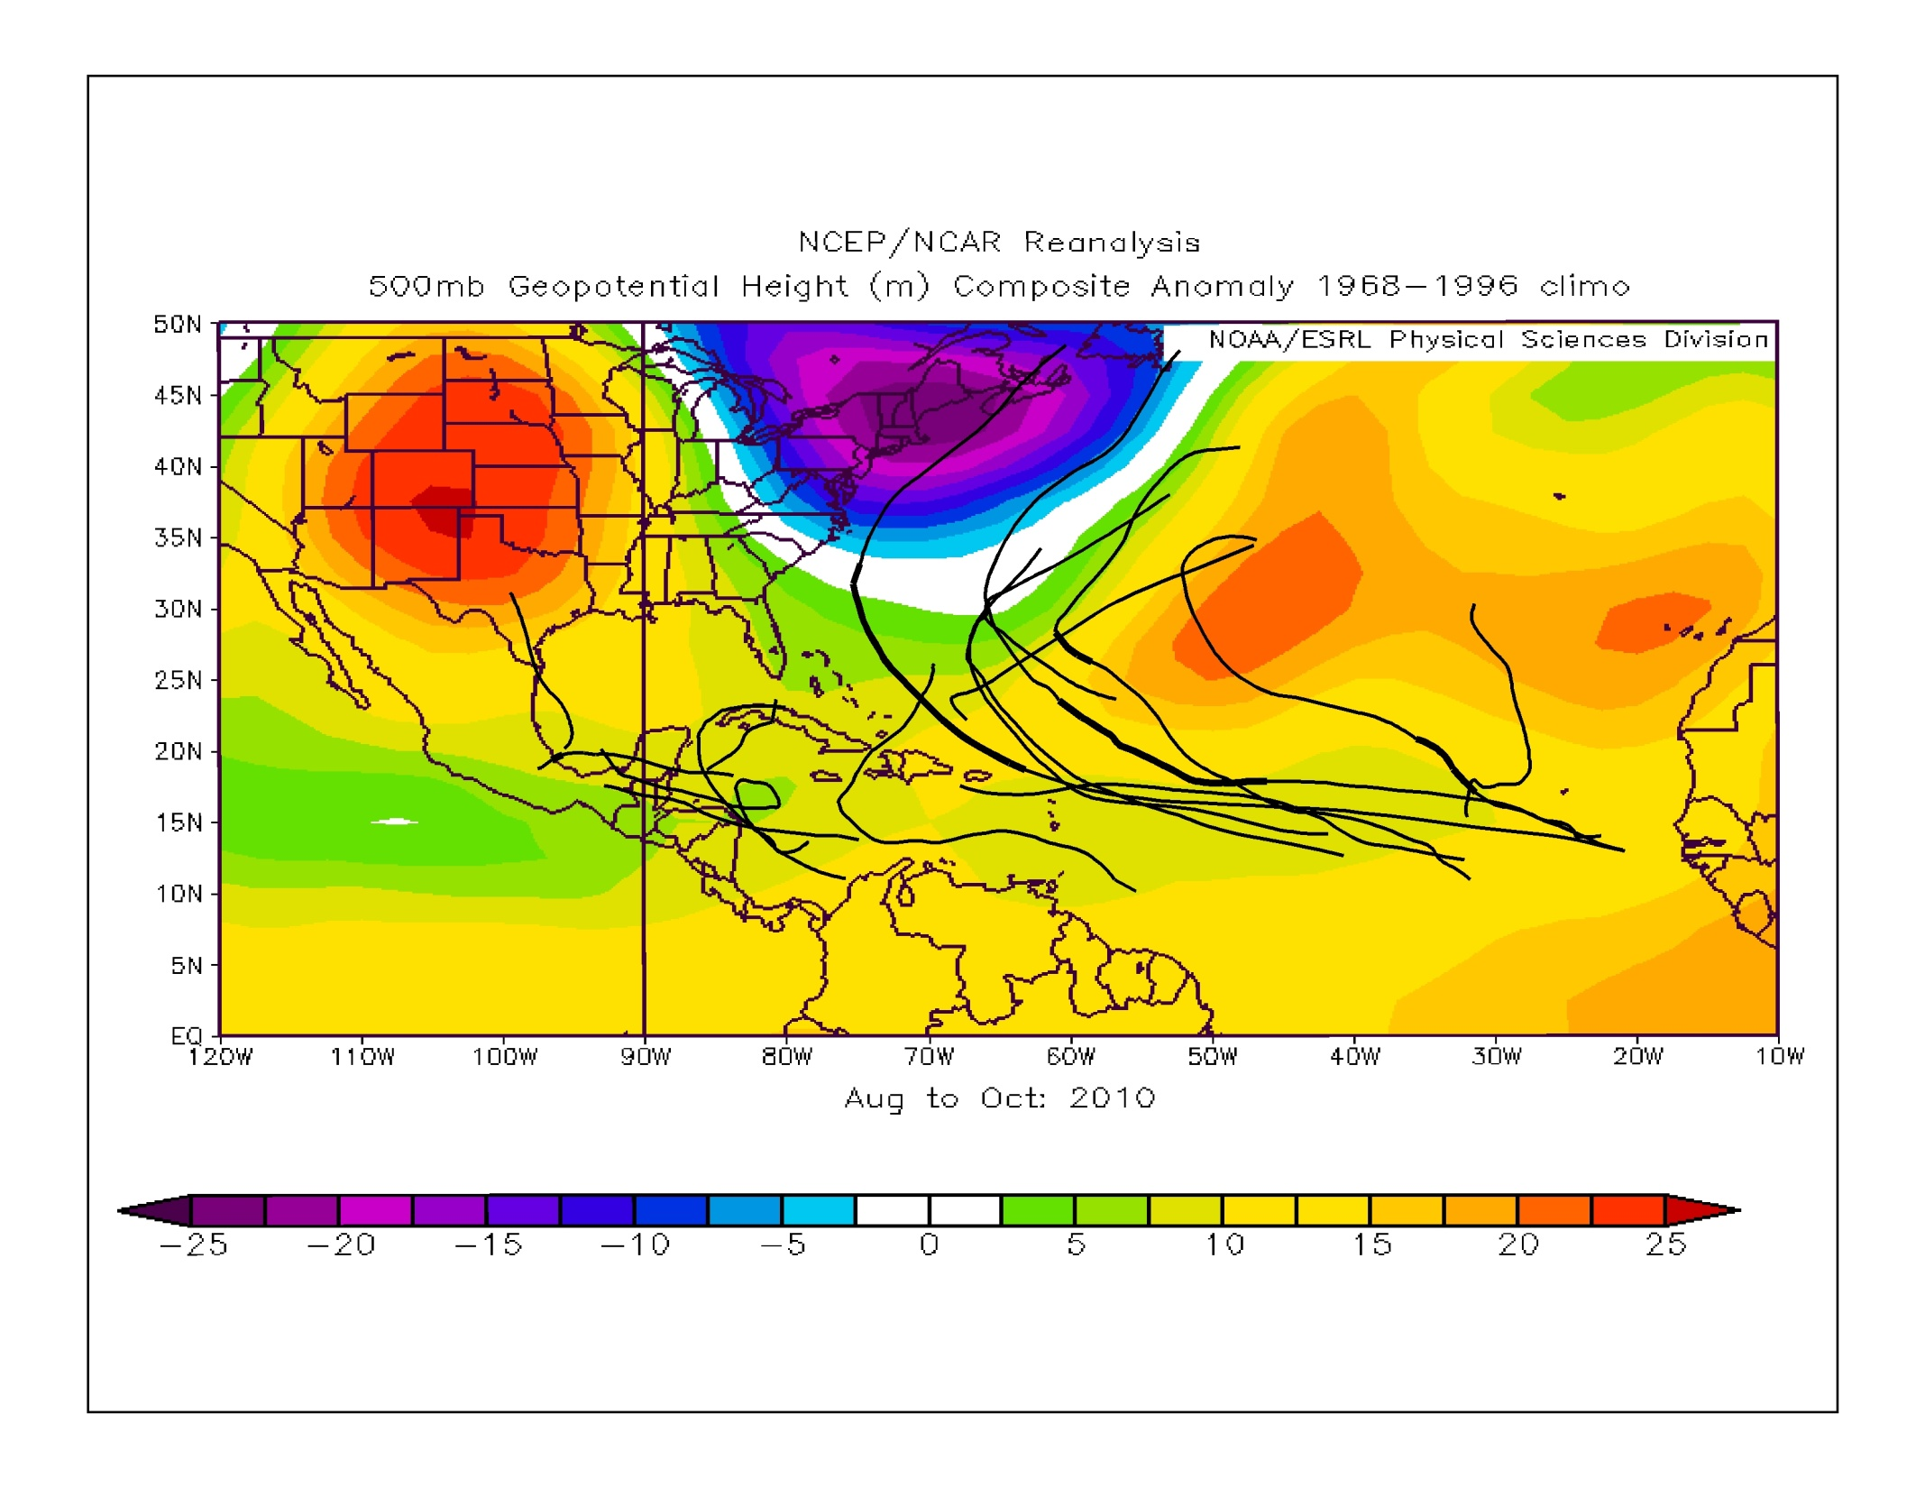
ASO Tracks overlaid with ASO 500 mb height anomalies

Slide 9
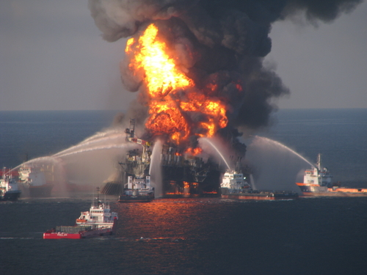
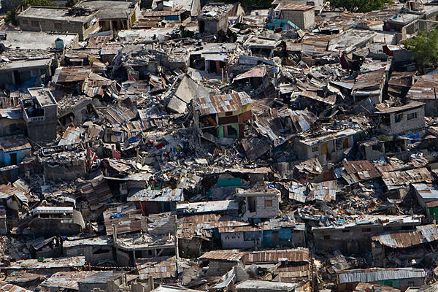
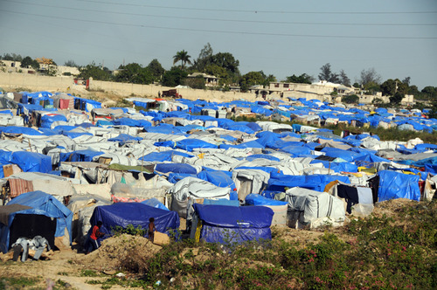
NHC Decision Support for
Deep Water Horizon and Haiti
Provided briefings to DWH incident command center during tropical cyclone threats
Provided briefings to State Department and US AID officials, primarily for Tomas

Slide 10
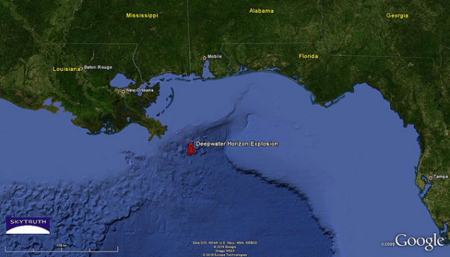
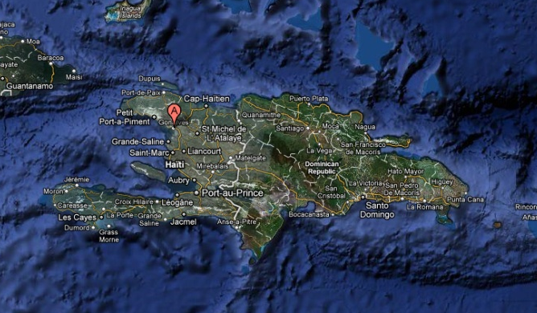
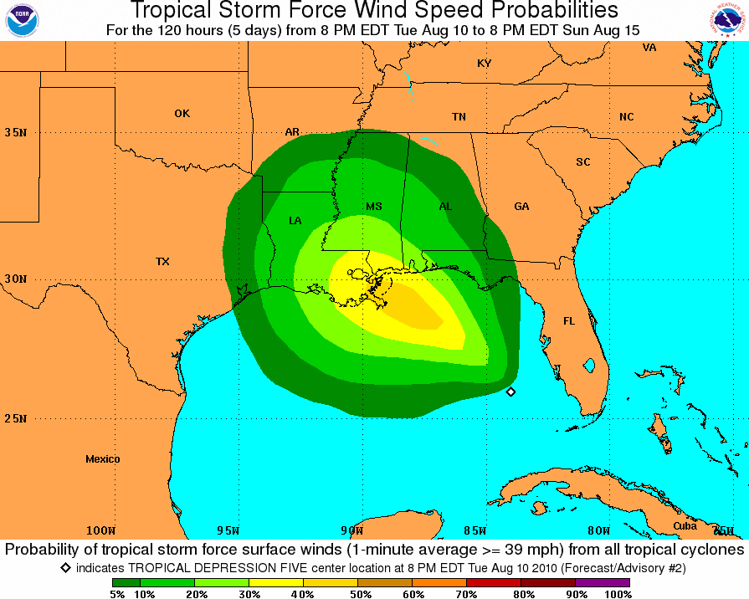
Wind Speed Probabilities-
Key to Decision Support
DWH location and Gonaives, Haiti were added to the text wind speed probability product
During critical pre-TC situations, NHC produced track and intensity forecasts for disturbances that could affect the DWH site
Disturbance forecasts were used in conjunction with 5-day TC genesis probabilities to provide wind speed probabilities for disturbances

Slide 11
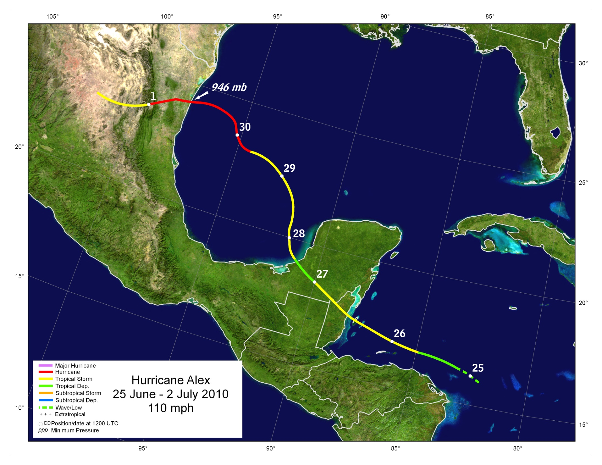
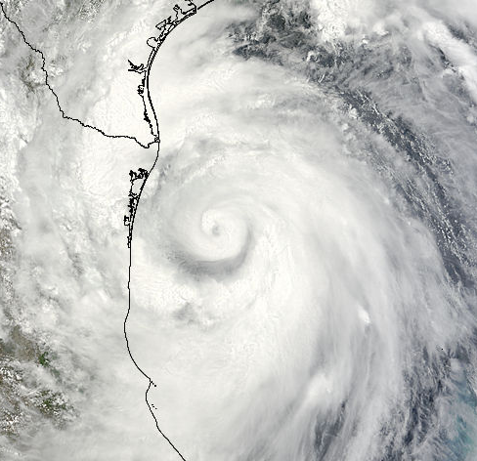
110 mph

Slide 12
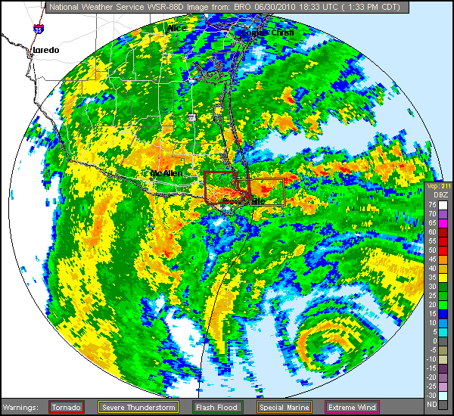
c/o Brian McNoldy

Slide 13
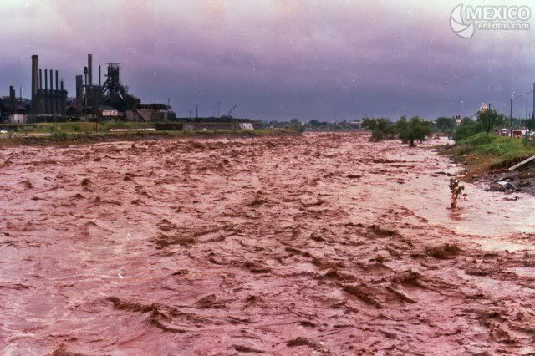
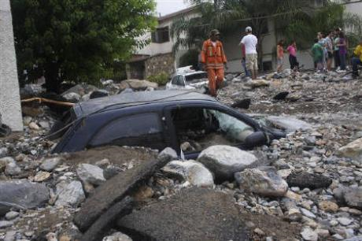
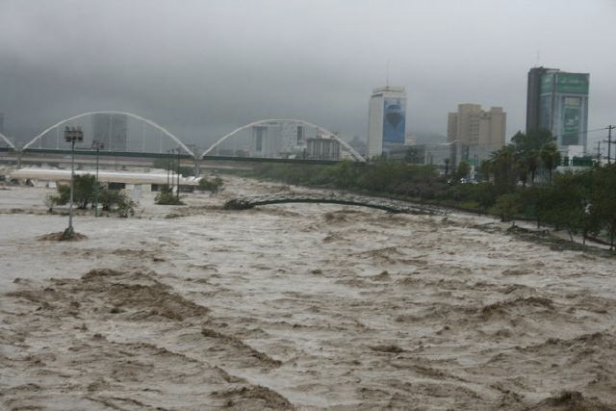
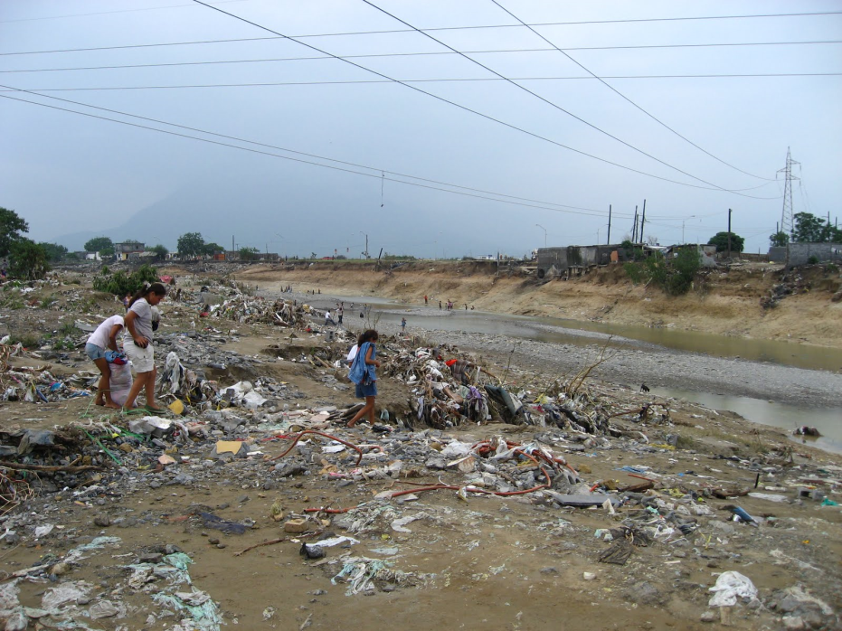
Alex damage pictures near Monterey, Mexico
Reuters and AP photos

Slide 14
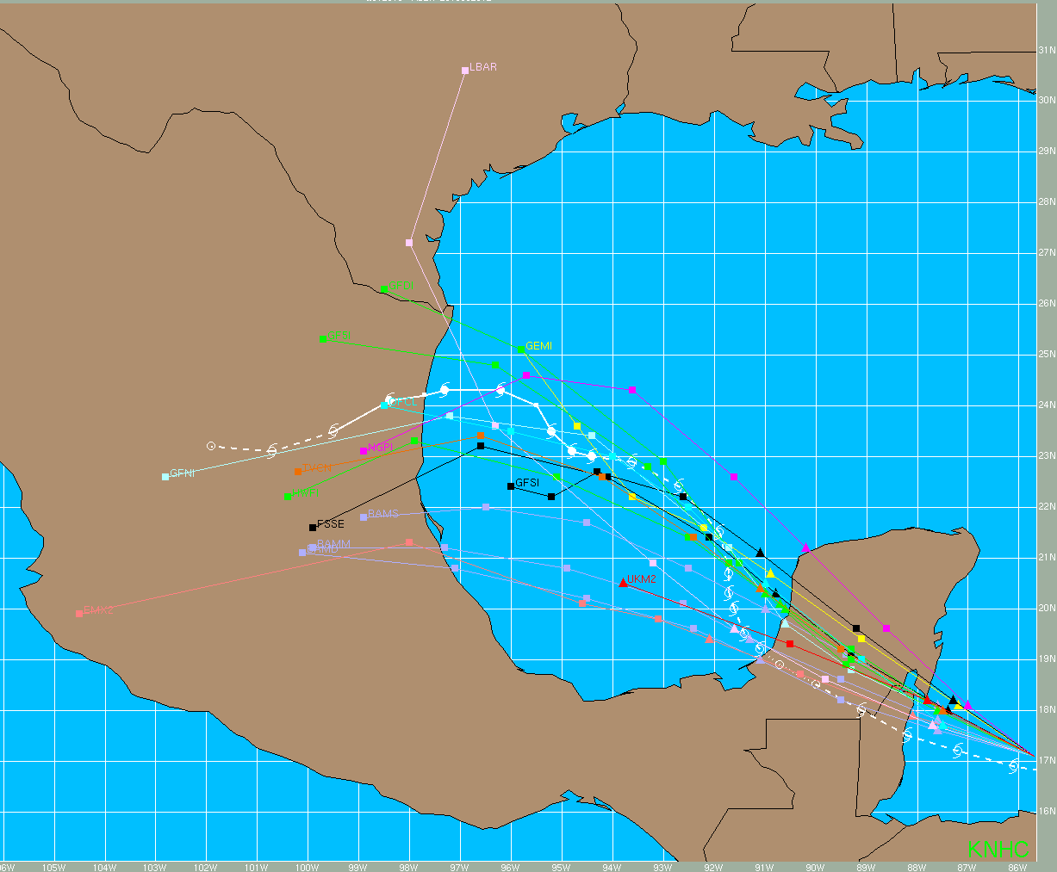
Alex Guidance – 6/26/10 1200 UTC

Slide 15

Six hours later…

Slide 16

6/27/10 0000 UTC…models shift northward

Slide 17
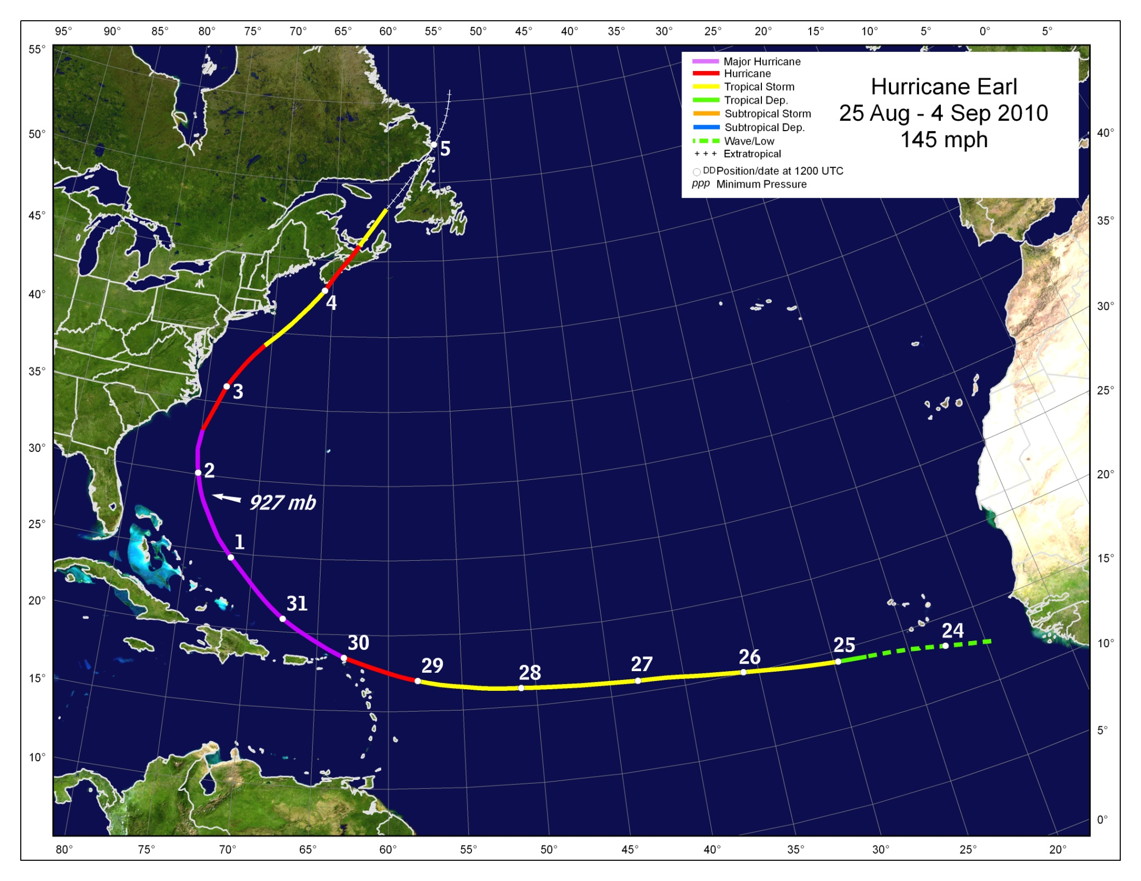
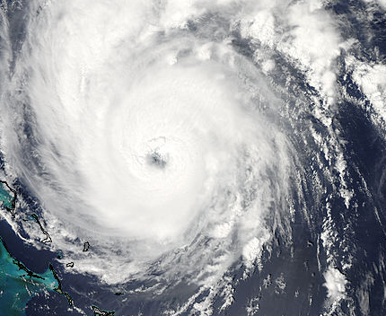

Slide 18
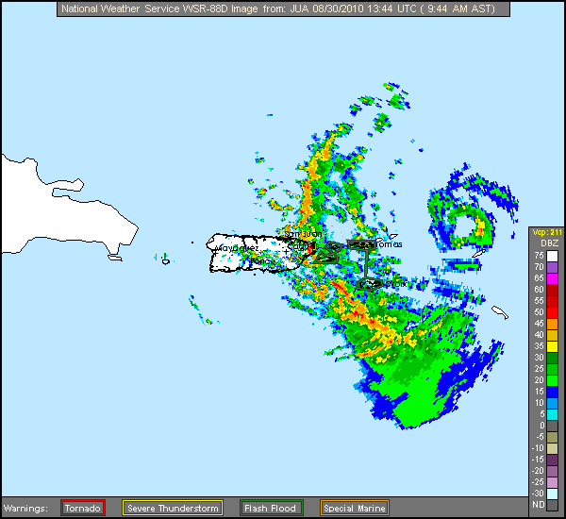
c/o Brian McNoldy

Slide 19
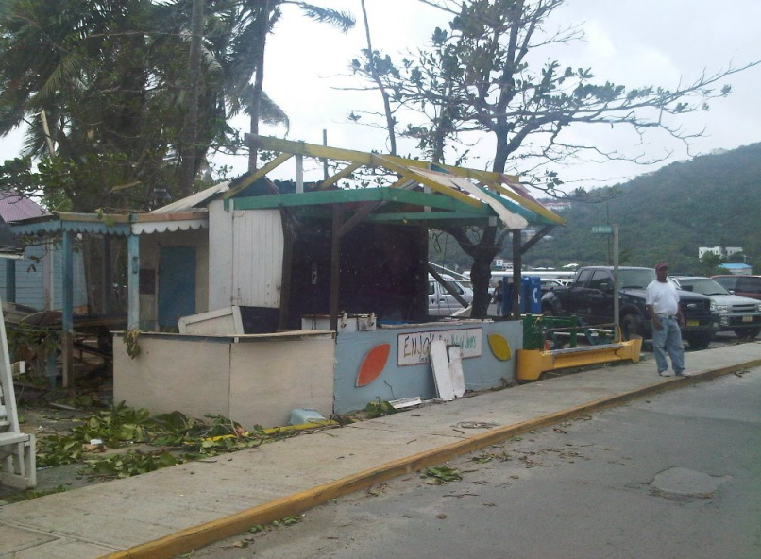
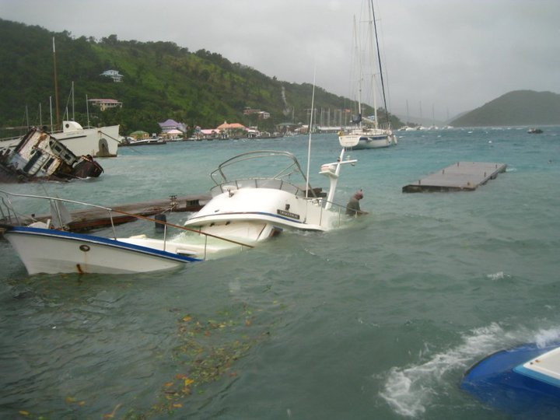
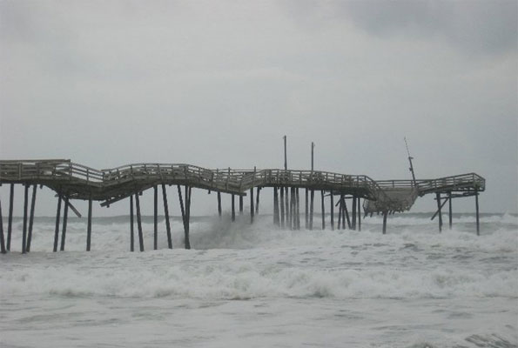
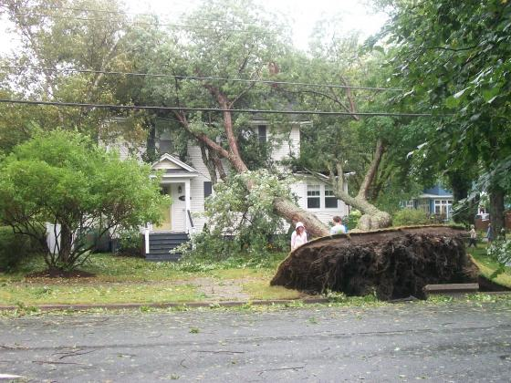
Earl damage photos
Tortola, BVI
Tortola, BVI
Frisco Pier, NC
Westville, NF
Images from shantyvibes.com, thenewsoftoday.com, CTV Robert West

Slide 20
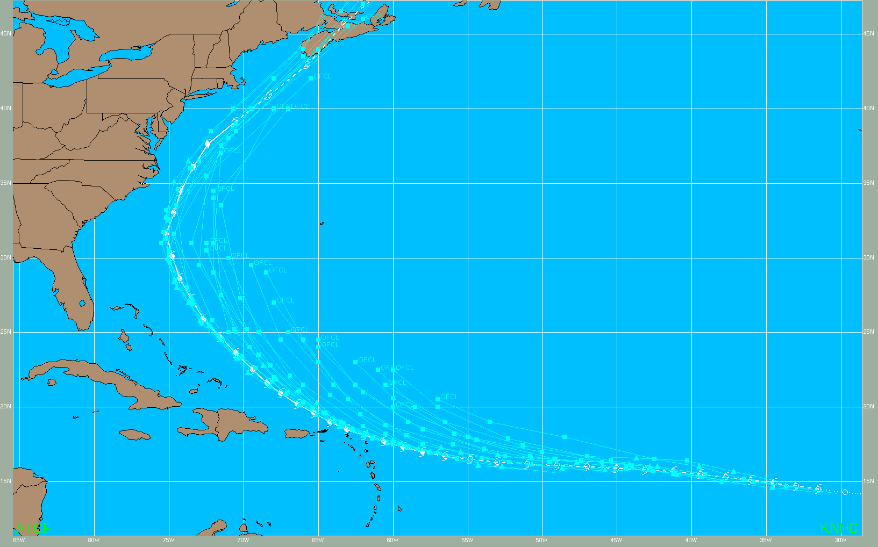
Earl official forecasts had a right bias in the tropics

Slide 21
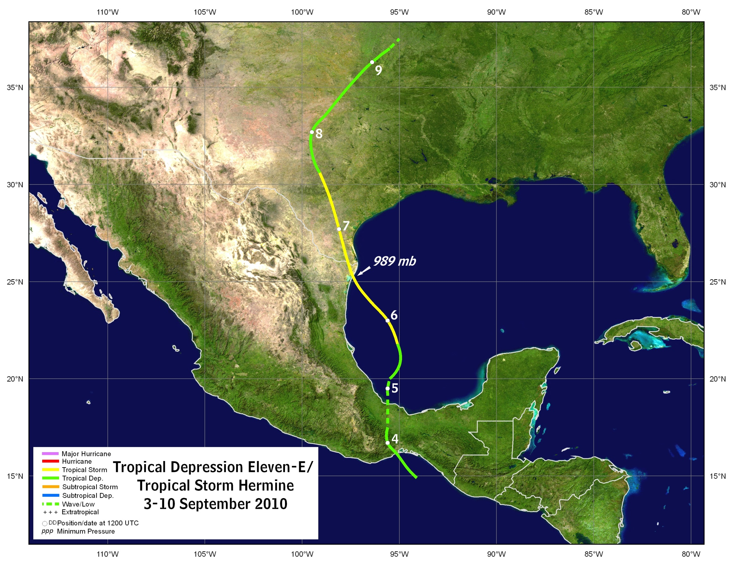
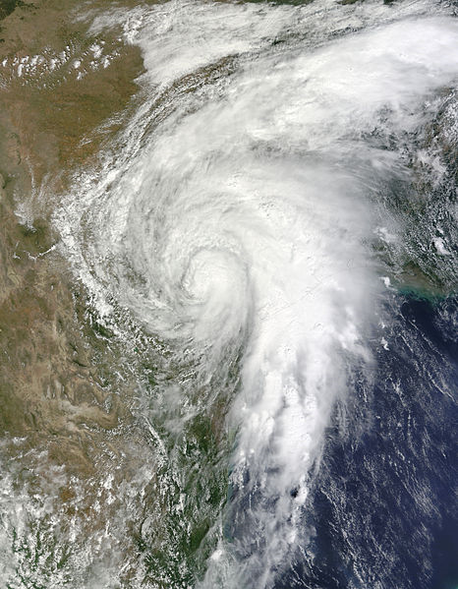

Slide 22
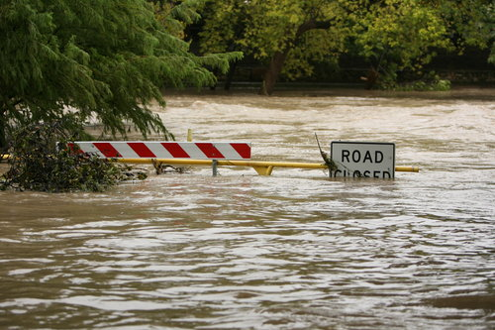
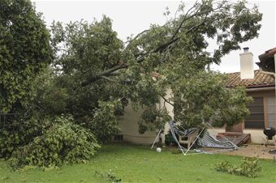
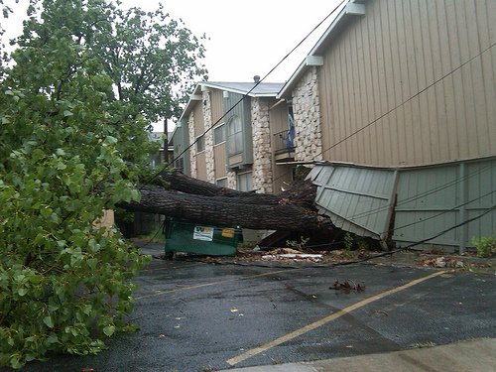
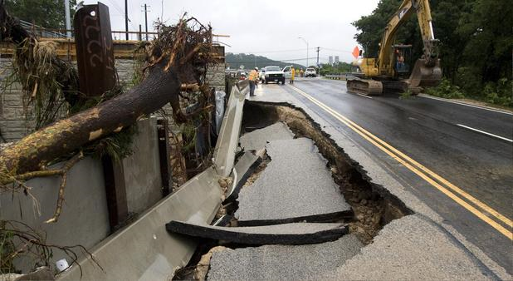
Hermine Damage Photos from Texas

Slide 23
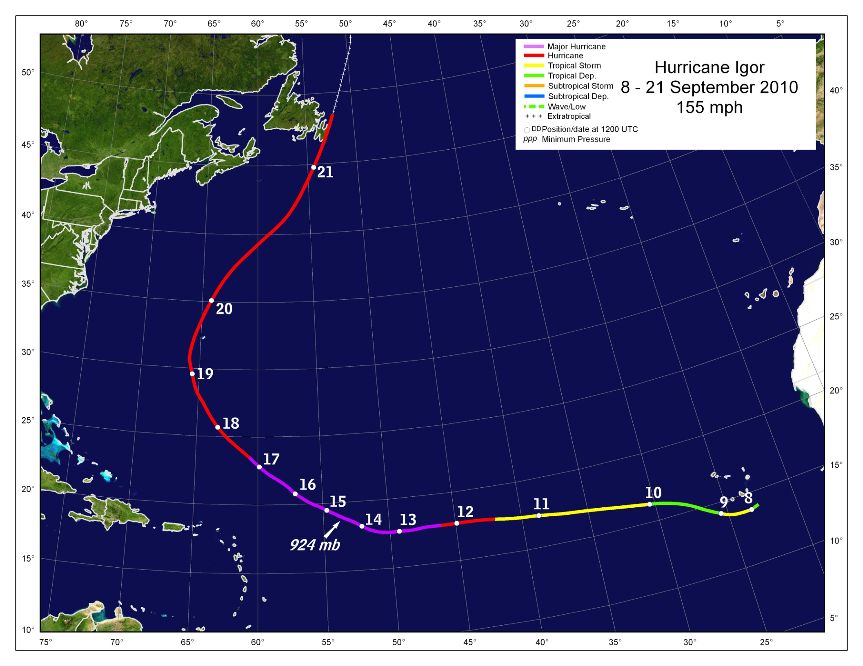
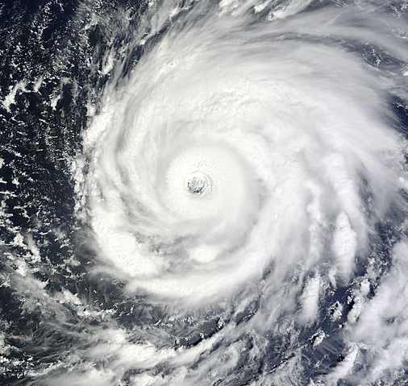

Slide 24
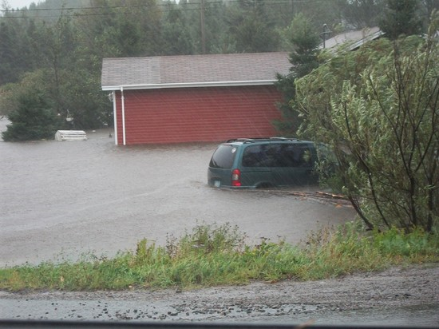
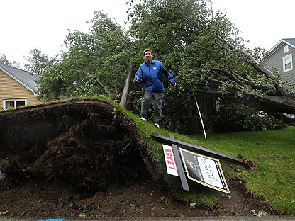
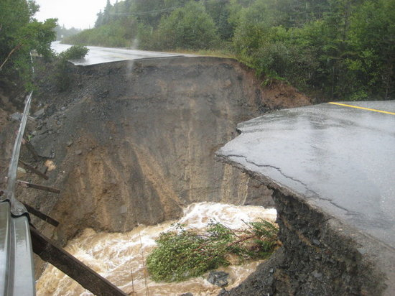
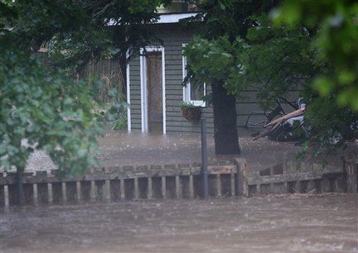
Igor damage in Newfoundland
Images from the Canadian Press, George J.B. Rose

Slide 25
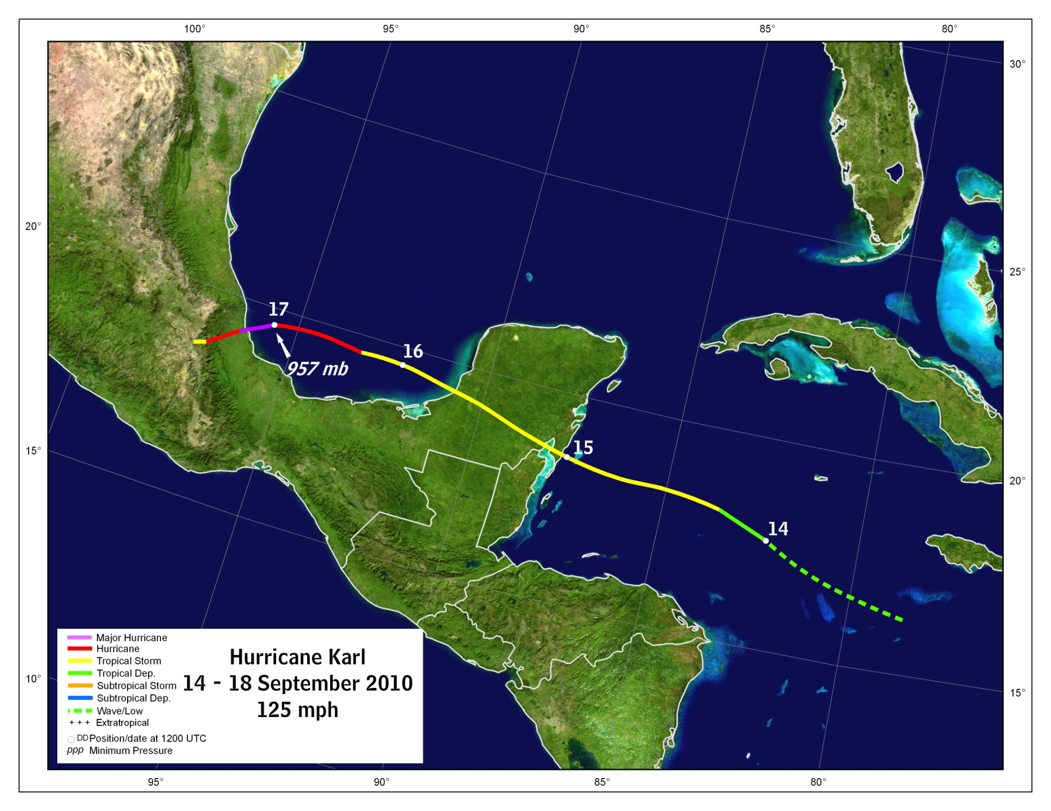
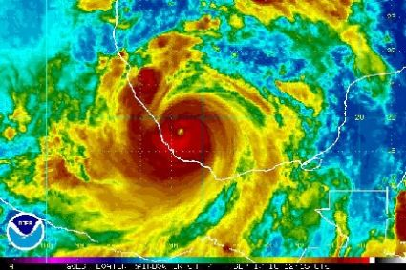

Slide 26
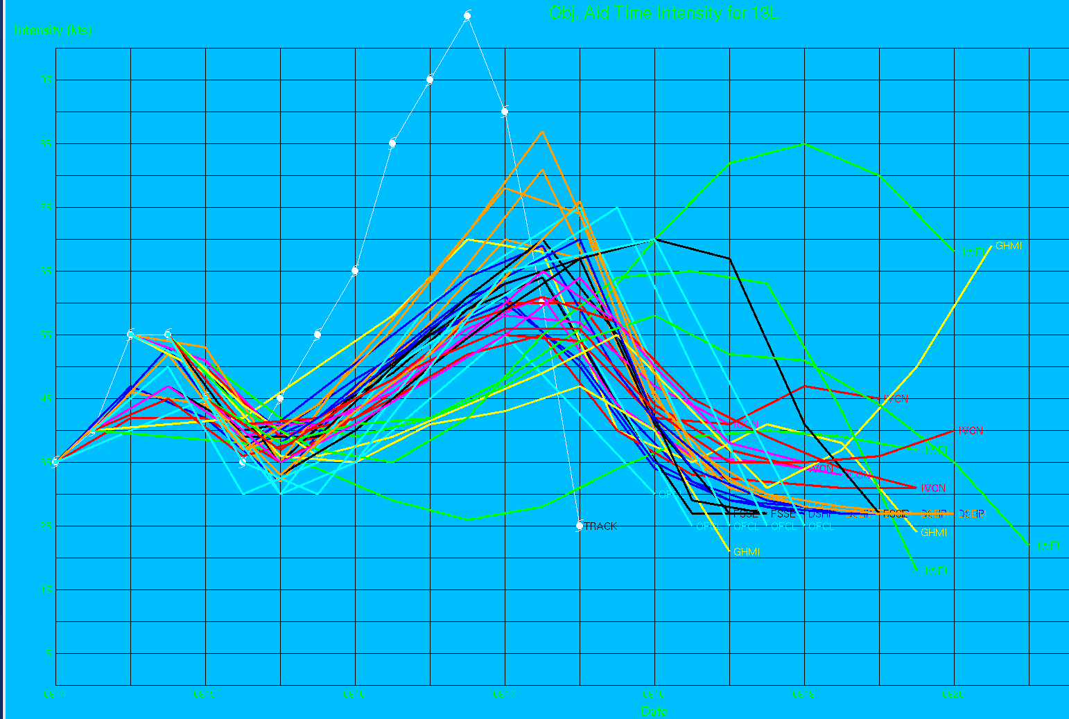
Hurricane Karl Intensity Guidance

Slide 27
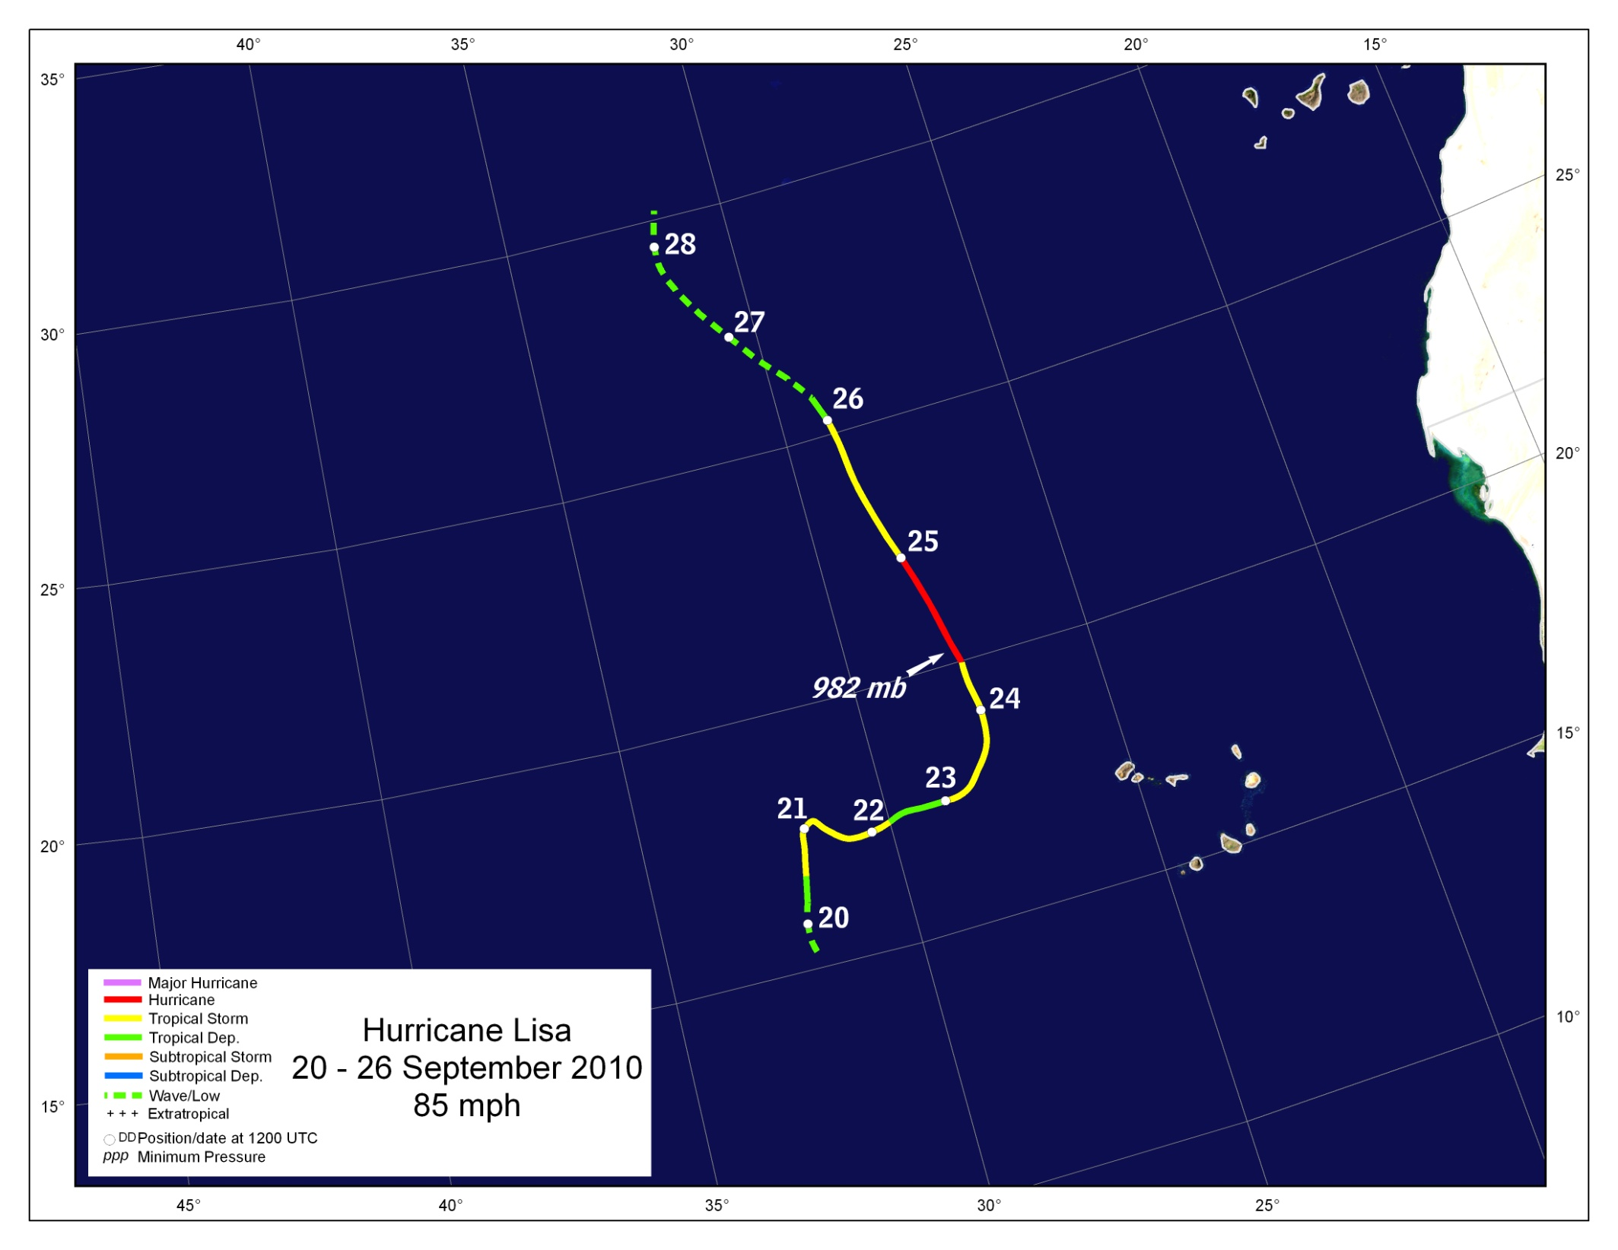
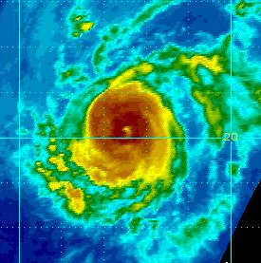

Slide 28
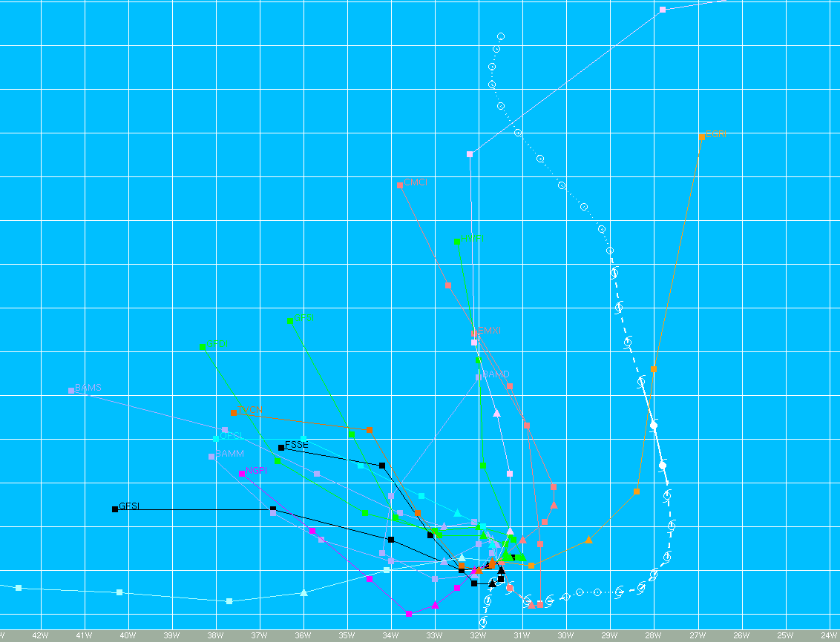
Lisa Track Model Guidance was not Terribly Useful

Slide 29
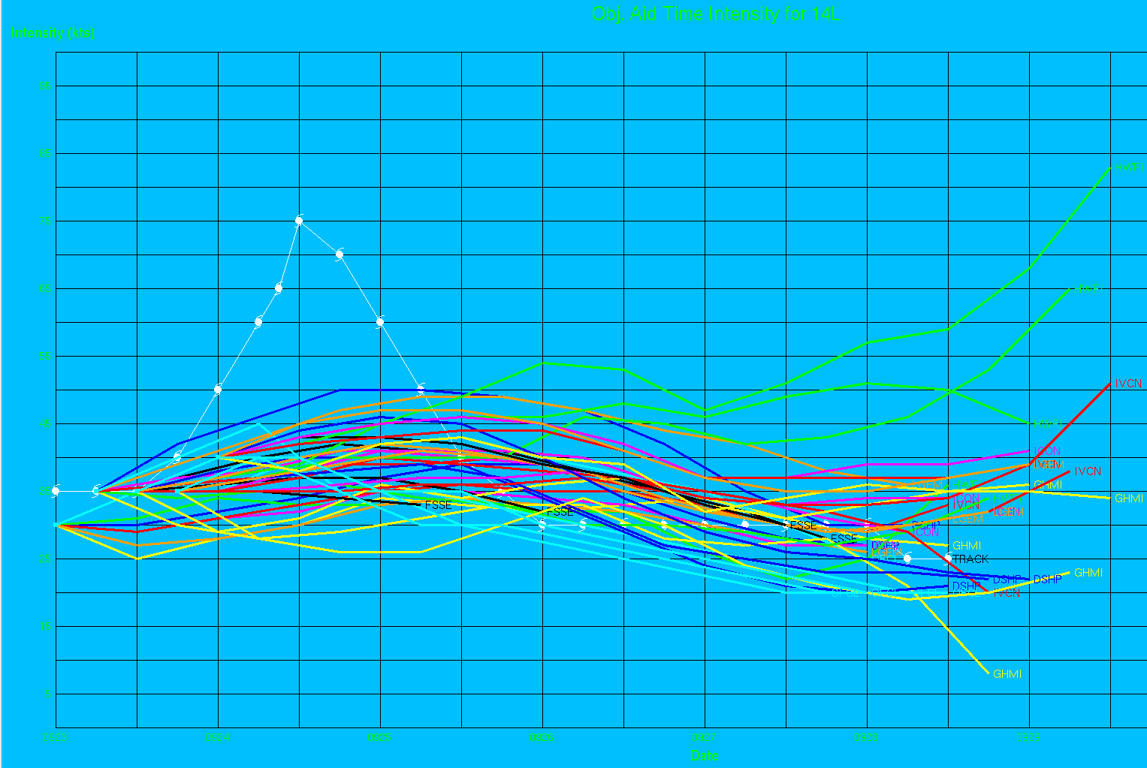
Ditto for Hurricane Lisa Intensity Guidance

Slide 30
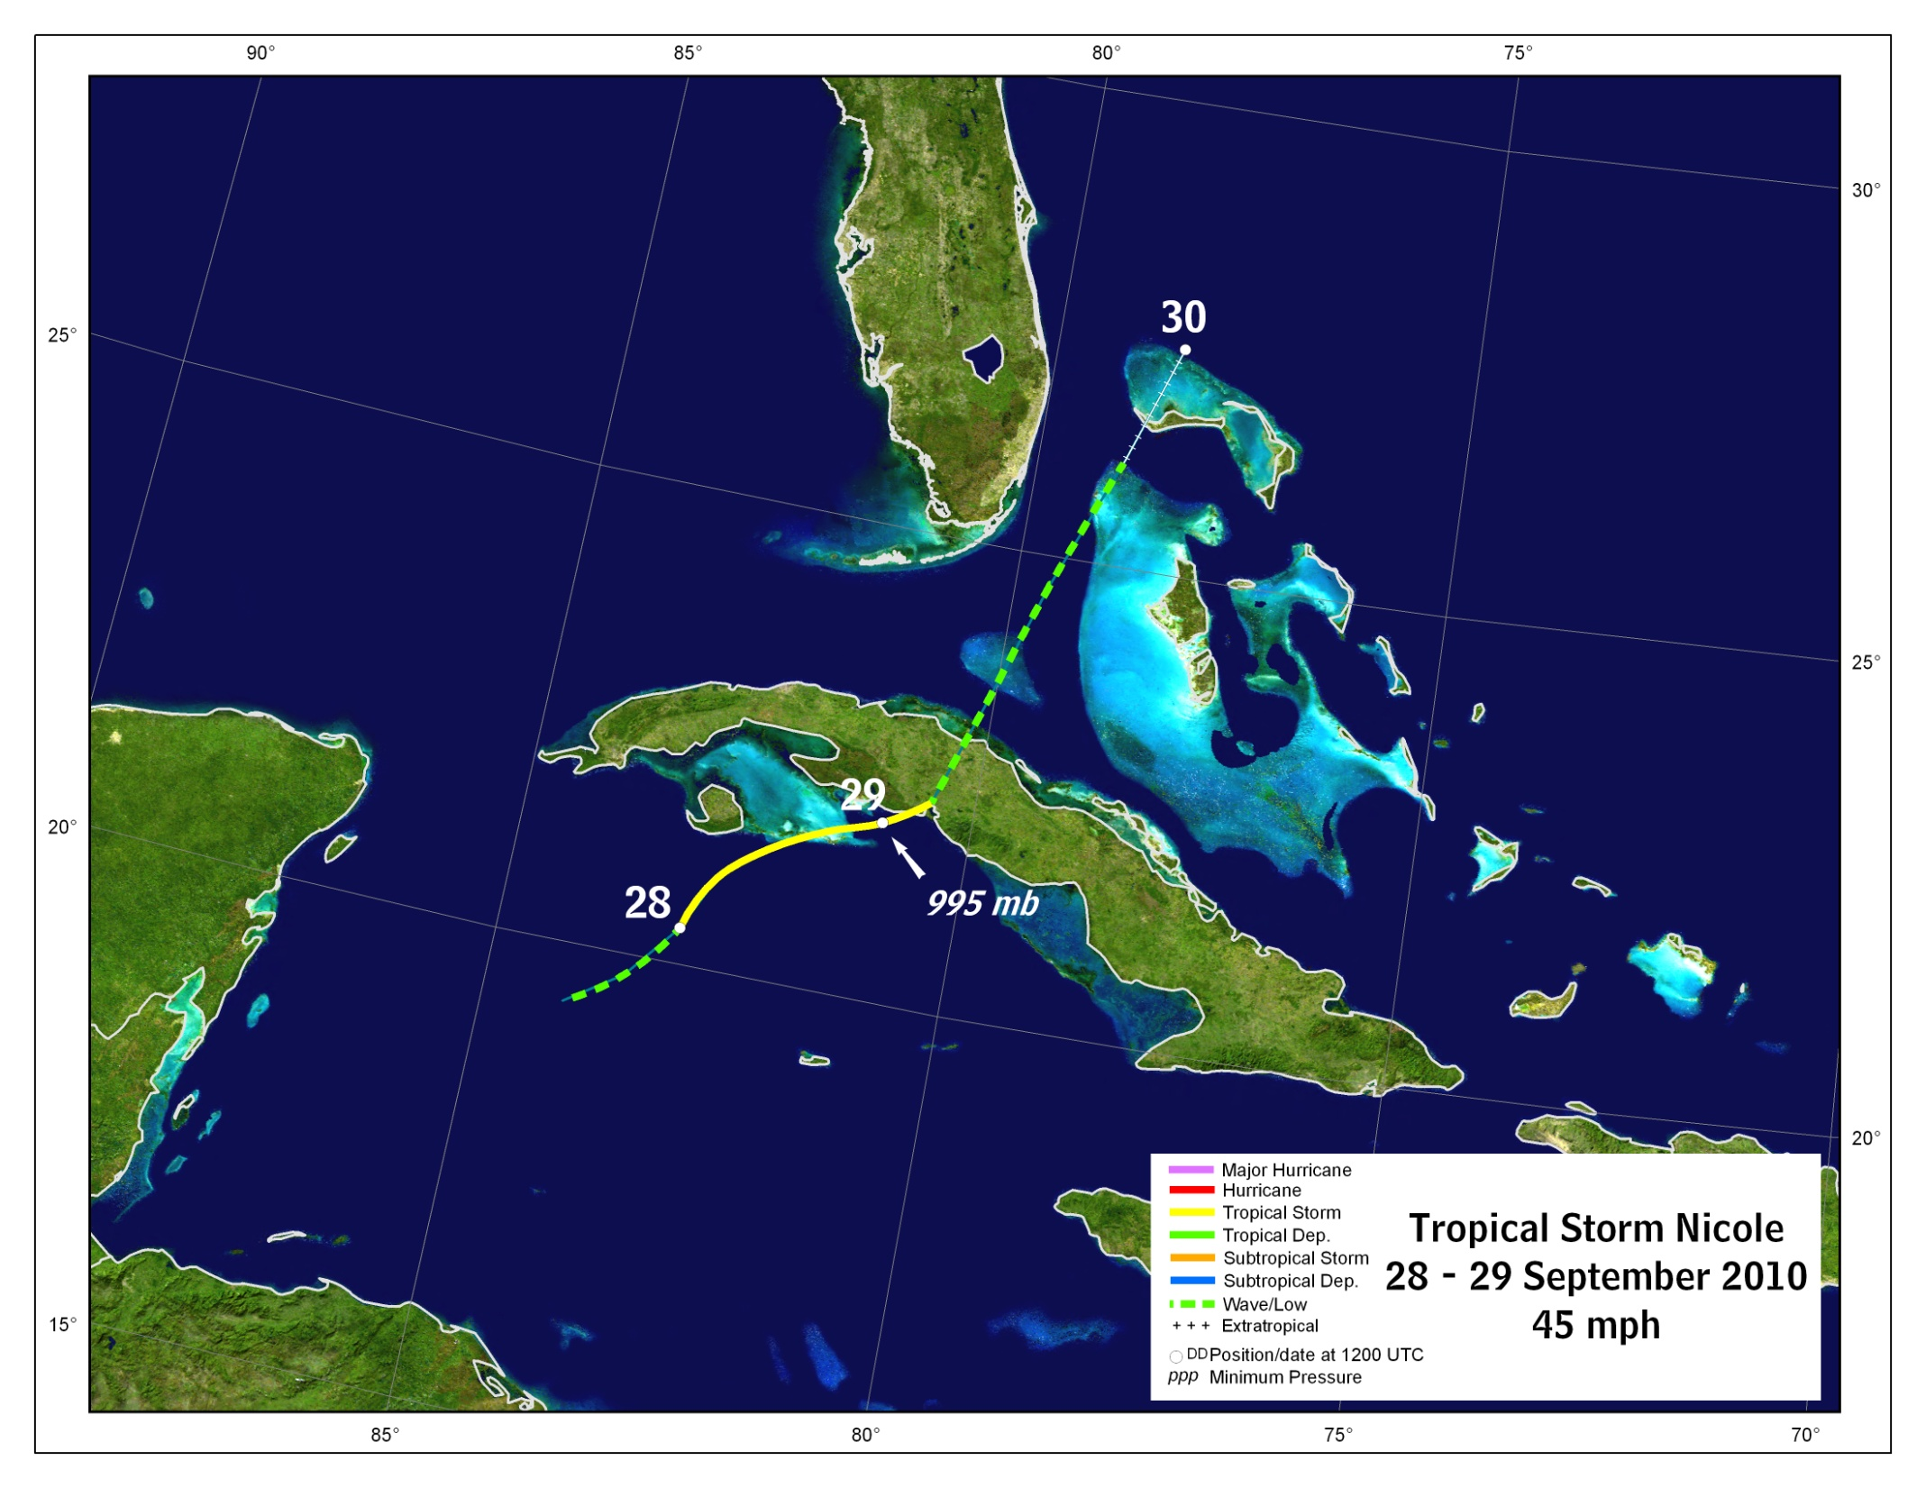
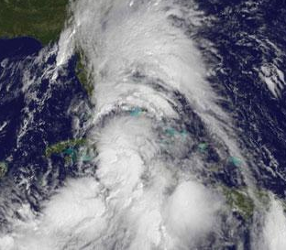

Slide 31
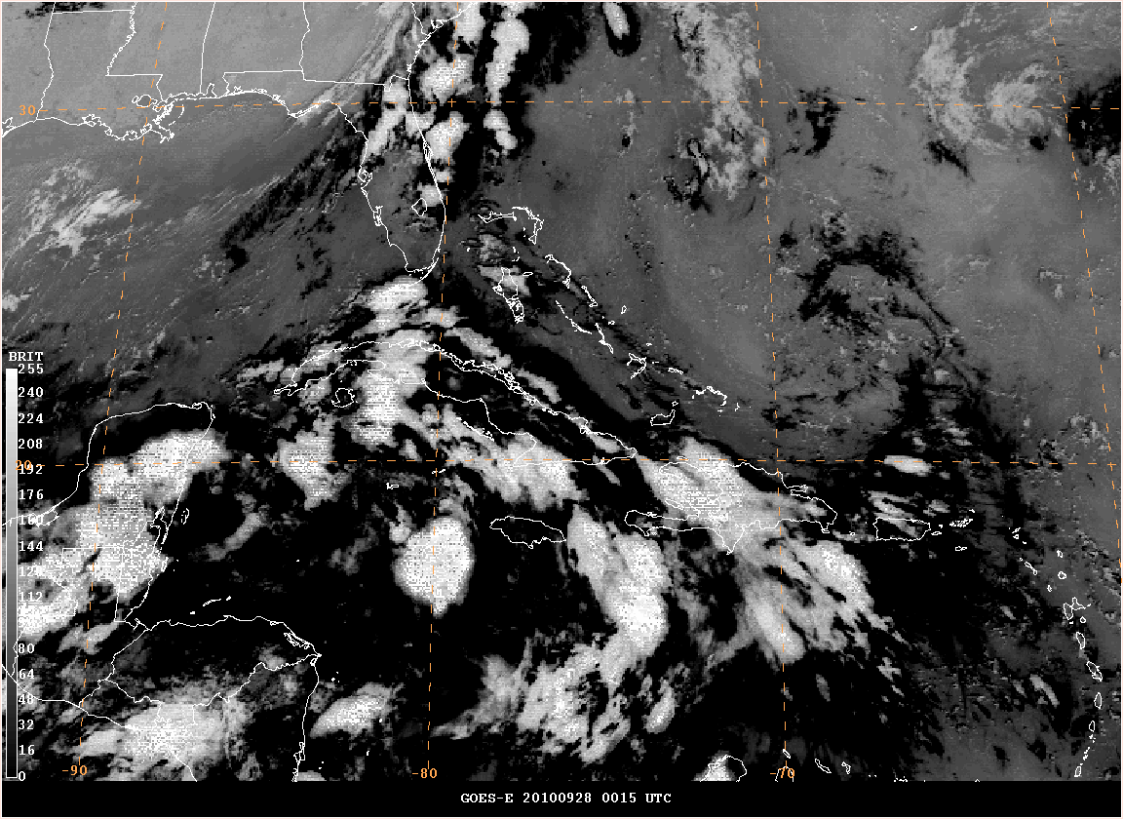

Slide 32
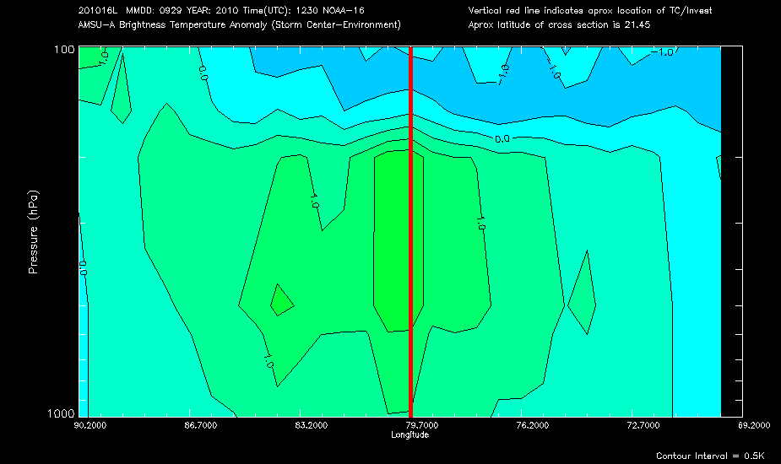
Nicole AMSU data

Slide 33



Slide 34


Slide 35




Tomas Damage Photos
St. Lucia (CBS4)
Haiti (UPI)

Slide 36
Thank You, any Questions?

