Slide 1
Naval Oceanography:
Enabling Decisions through Excellence in Tropical Cyclone Forecasting
CAPT Michael Angove
Commanding Officer, NMFC/JTWC
Presented to
Interdepartmental Hurricane Conference
Miami, FL
28 Feb 2011

Slide 2
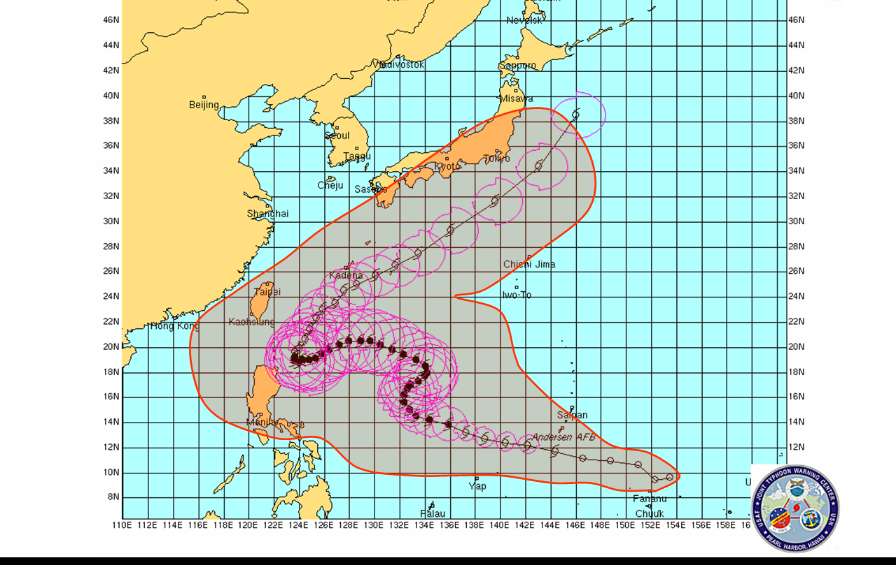
Western Pacific: Active Battlespace
1.4M sq miles of area lost to error swath at 72 hours. A 50% reduction in error would add up to 21M sq miles of sea maneuver per year.
Current uncertainty
Proposed uncertainty
PACOM Goal: Increase US/Coalition Sea Maneuver Space

Slide 3
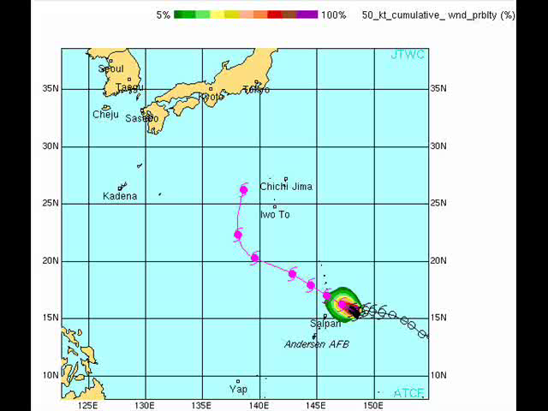
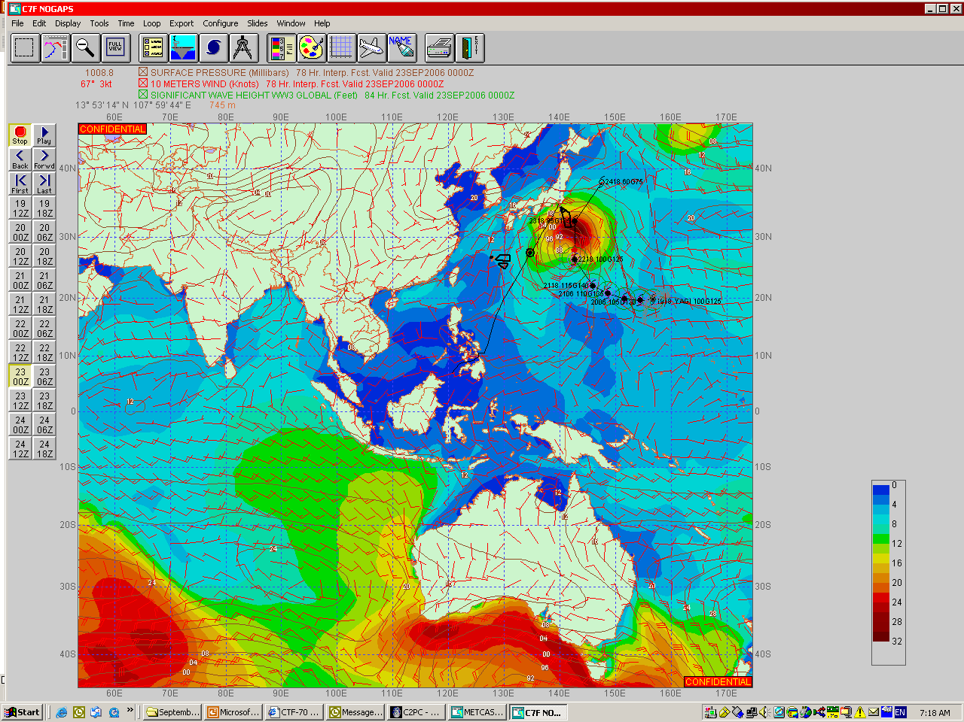
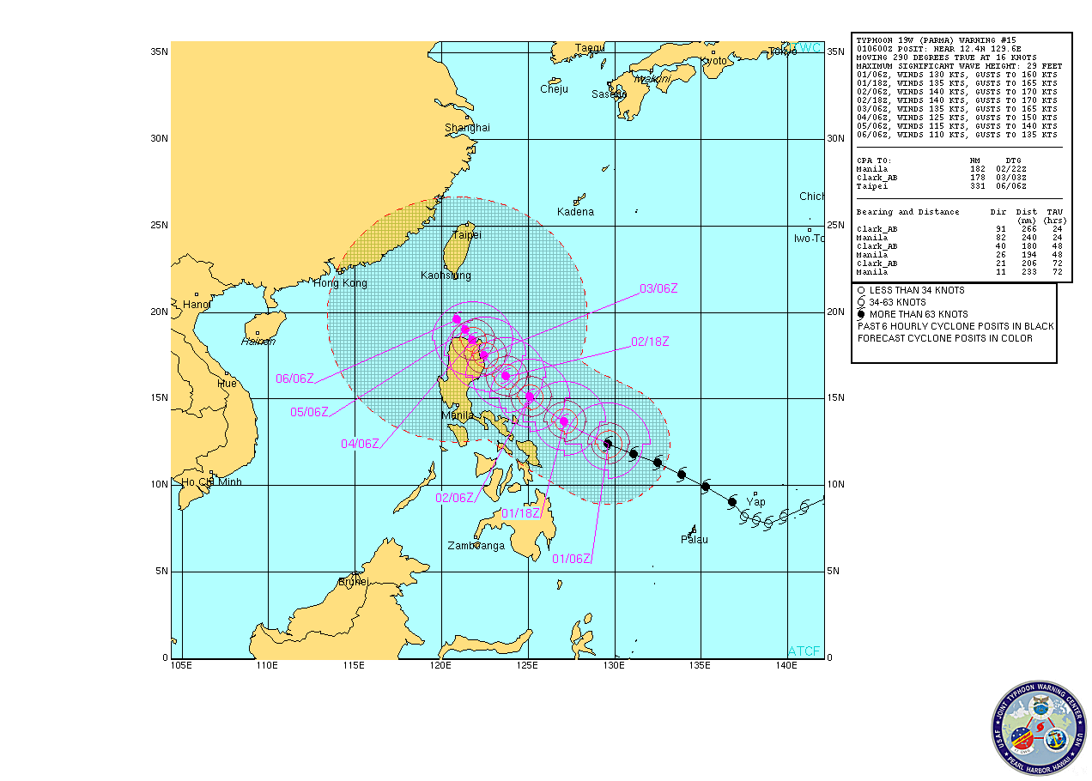

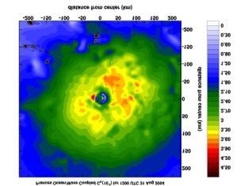

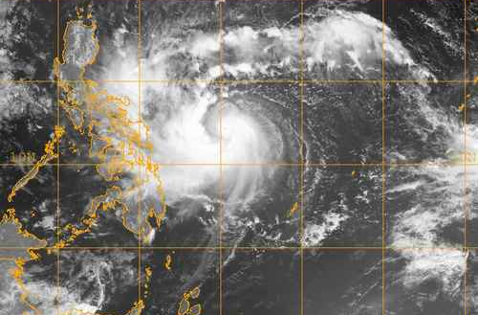
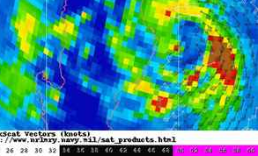
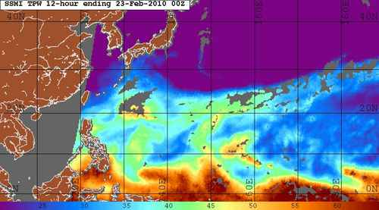
Battlespace on Demand:
“Reclaiming Enemy Territory”
Tier 3 – Decision Layer
Strike Probability
Condition of Readiness
Sortie Options
EXPERIMENTAL TC-COR SETTINGS
SITE TC-COR
Agrihan 2
Alamagan 2
Anatahan 2
Pagan 2
Saipan 3
Tinian 4
Tier 2 – Performance
TC Warnings
Surge/inundation
Tier 1 – Modeling
NUOPC/HFIP
COAMPS - TC
ESPC
~ $1-2M/yr
Tier 0 – Environment
Remote Sensing
In situ Obs
~ $9M/yr
Notes:
Define ESPC

Slide 4
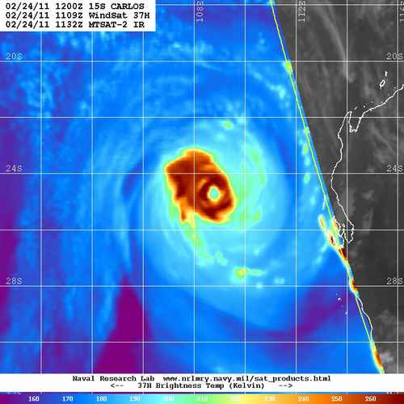
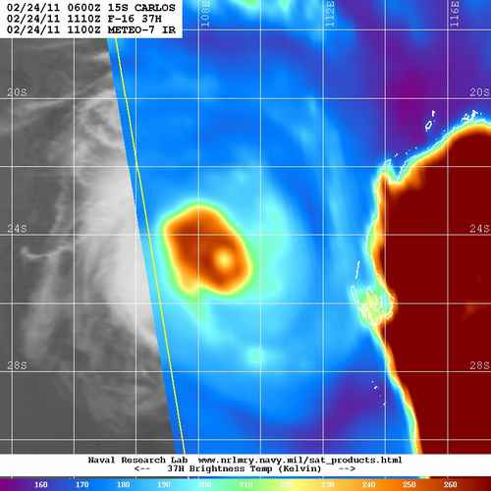
Environment Tier
Remote Sensing and Observations
The Navy is heavily dependent/leveraged upon partnerships for satellite based observational data.
  Advocate access to/expanded use of existing data streams v. building new sensors.
    Support NOAA/NESDIS access to OSCAT
  Navy programmed investments targeted at oceanographic applications (e.g., GFO 2, UUVs)
Key Capability Gaps
  OSVW
    Scatterometer/WindSAT
    Vector capable MIS/DWSS
  Imagers
    WindSAT
    AMSR-E
    TRMM
Notes:
AMSR-E (AQUA)/TRMM—Both NASA: 89/37GHZ imagers. Both EOL…no operational follow-on planned other than JPSS/DWSS

Slide 5
Modeling Tier
Track and Intensity forecasts
Track continues to be a top priority. The Navy views improvements to global modeling capability as best means to improve track forecasts.
  Navy/NOAA/USAF Partnership is key enabler
    NUOPC
    HFIP (NHC / JTWC)
    Earth System Prediction Capability (long term)
Structure and Intensity: Storm Scale modeling initiatives
  HWRF/HFIP
  COAMPS-TC
  Improvements in structure and intensity forecasts dependent on first improving track forecasts
5
Notes:
W. Pacific version of HWRF positive addition to dynamic intensity suite.

Slide 6
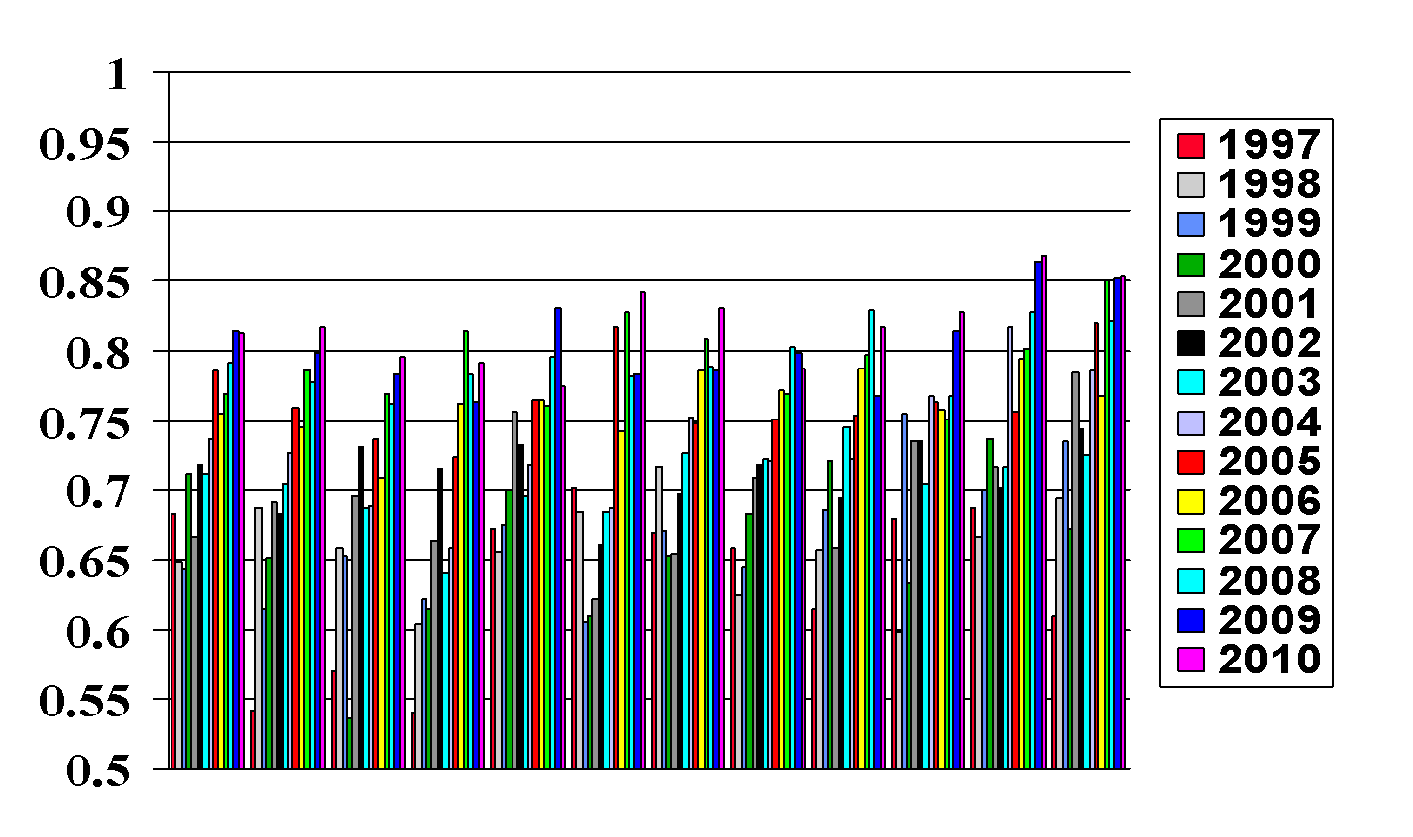
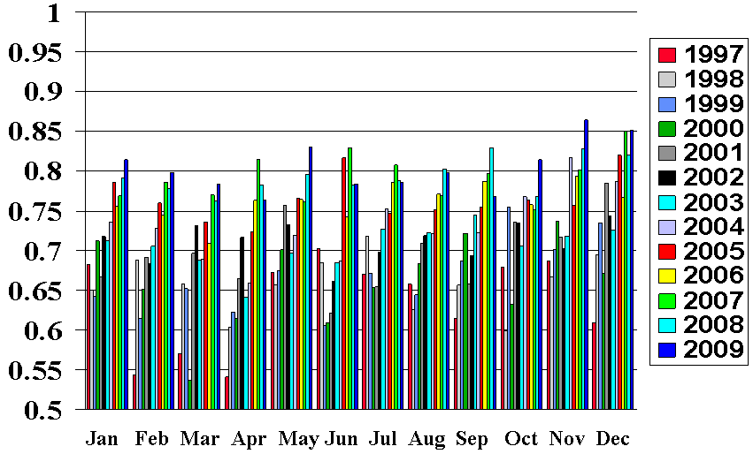
Navy Atmospheric Data Assimilation System-Accelerated Representer (NAVDAS-AR)
The Navy’s 4D-VAR data assimilation has been upgraded four times since the original Sept 2009 installation.
NAVDAS-AR
Effective 28 September
Model Resolution
Increased to 45 km
Satellite Data added
Jan Feb Mar Apr May Jun Jul Aug Sep Oct Nov Dec
All values : 120 hour - 500 mb ht anomaly correlation
Southern Hemisphere (20S – 80S )
Denotes record year
Notes:
(1) Note that FNMOC implemented NAVDAS-AR, 4D-VAR data assimilation, to initialize its global NWP model, NOGAPS, near the end of Sep 2009.
(2) Thus, FNMOC became the first NWP Center in the U.S. to implement 4D-VAR operationally.
(3) Describe the figure, which shows NOGAPS Southern Hemisphere TAU120 (5-day forecast) 500 hPa (hectoPascal, aka millibar) height anomaly correlation, monthly averaged, by month and year. Direct attention to the results for Oct, Nov and Dec of 2009, for which the effect of transition to 4D-VAR data assimilation in NOGAPS is apparent. Note that the results for Nov and Dec 2009 are the best ever for NOGAPS in the SHEM, for any month and for any year.
(4) Note that, with NAVDAS-AR implementation, the skill level of NOGAPS in the southern hemisphere is now on par with that of the northern hemisphere, implying that the model is handling the satellite data (which dominates in the SHEM) very well.
(5) Note that we expect further improvements in NOGAPS skill in the coming year as we: (a) add assimilation of additional satellite data types (e.g., COSMIC, AMSU-B, MHS), (b) increase NOGAPS resolution from T239L42 (~50 km) to T319L42 (~37 km), and (c) gain more experience with the 4D-VAR data assimilation.
(6) Acknowledge NRL-Monterey as the developers of NAVDAS-AR and note the close and productive working relationship between NRL-Monterey and FNMOC.

Slide 7
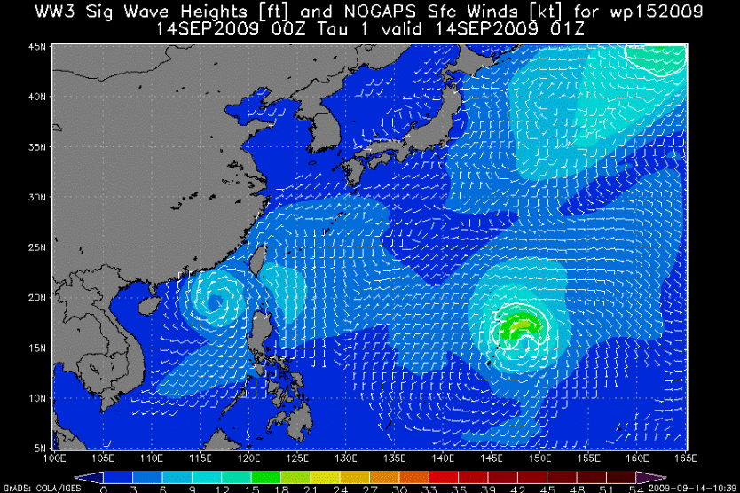
Performance and Decision Tiers
TC warnings
  Planned ATCF Improvements
  Wave Heights
    Matching TC tracks to WW3
  Surge and inundation
    Naval Oceanographic Office
  RTP
    FY01 Improvement to TC Model Forecasts
    FY02 Modeling TC Structure and Track
    FY06 4DVAR for Global Atmospheric Weather Prediction
    FY09 Prediction of TC Track and intensity Using COAMPS-TC
    FY11+ enhanced JHT participation
Probability Based Decision Tools
  TCCOR/Sortie
  Quantifying Uncertainty Reduces Uncertainty
7
Notes:
Some RTP going to tier III decision support—see next slide

Slide 8

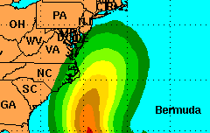
WSP and Hurricane Earl Sortie
This depiction is for
OFFICIAL USE ONLY!
Not for public release
(Norfolk, VA KNGU) Greatest chance for 34 kt wind:
(72hr Incremental period)
12z Thu to 12z Fri
(Norfolk, VA KNGU) Greatest chance for 50 kt wind:
(72 hr Incremental period)
12z Thu to 12z Fri
72 hr Cumulative
Probability for 50 kt winds
5-9%
10-19%
20-29%
72 hr Cumulative Probability
50 kt winds 24 hrs ago
Norfolk, VA 7% 6%
34 kt winds 24 hrs ago
Norfolk, VA 28% 19%
*Experimental Threshold Probability:
Norfolk, VA (KNGU)
50 kt Forecast = NO
34 kt Forecast = YES
Based on 15Z 31 Aug statistical and dynamical
model data and Monte Carlo Wind Speed Probabilities
Notes:
Latest Output Discussion:
Greatest chance for Sustained 34 kt winds over the Naval Base from 12z Thu to 12z Fri...predicted value is just above the 72 hr/34 kt threshold limit. 50 kt probability is well below the threshold value.
Dynamical model consensus spread (GPCE/MCP) is relatively small, resulting in higher along track and smaller cross track probabilities. 12UTC runs of NOGAPS (track over Outer Banks) and GFDN (landfall NC) indicate more ridging and are outliers to the left of the model cluster.
3. MCP Interpretation and deterministic fcst (KNGU): 34 kt WSP value just above threshold, predict gusts to 35-40 kt for KNGU with sustained N 25-30 kt.

Slide 9



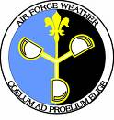



Summary
Partnerships = Success
Navy supportive of and dependent on “Federal Solution” (to include DWSS) for remote sensing needs—OSVW key capability gap. High-resolution imagers nearing end of life.
Accurate track forecasts key to enabling naval operations—global modeling improvements best investment
  Significant IA investment : NUOPC and next-generation modeling in cooperation with NOAA and USAF
Research on intensity and structure needed
  Support OFCM WG/TCR
  Storm-scale modeling initiatives
Operational Center (JTWC/NHC/CPHC) Collaboration
  Expanded JHT partnering/leveraging
Notes:
DWSS mission includes providing TC recon ISO JTWC.
High res imagers include AMSR-E, TRMM, WINDSAT.
Statistical intensity schemes such as STIPS-RI included in applied research.

Slide 10
Back-up

Slide 11
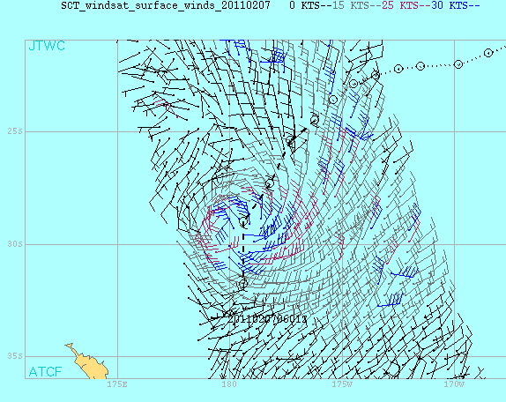
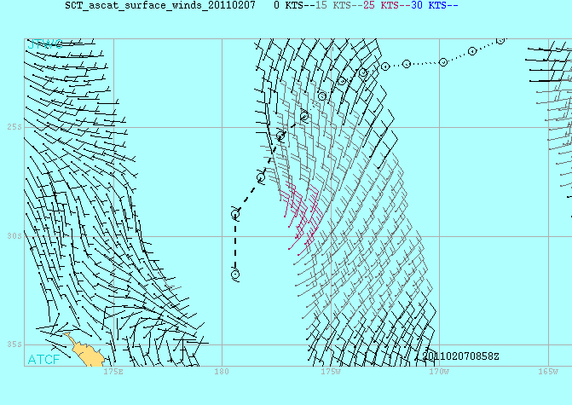
WindSAT/Coriolis
UNCLASSIFIED
WindSAT
TC 12P (ZAKA) 02/07 0900Z
ASCAT
Increased Coverage = Earlier and More
Accurate Warnings → Better Decisions

