Slide 1
USAF
Tropical Cyclone Support
Challenges and Strengths
Air Force
Deputy Director of Weather
28 February 2011

Slide 2
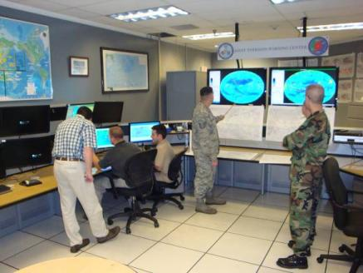
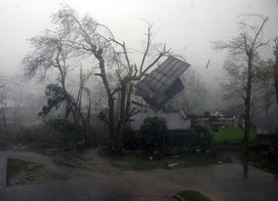
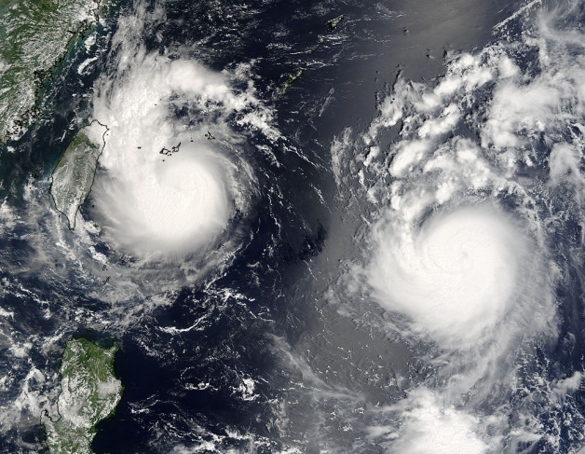
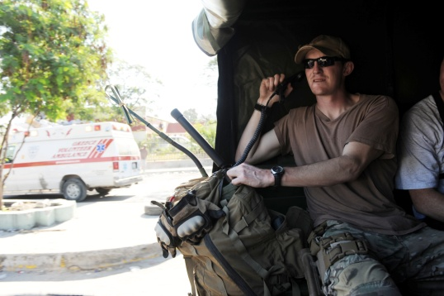
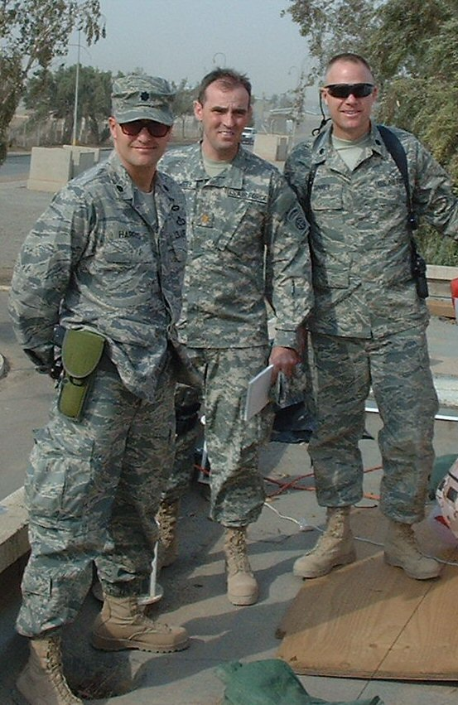
Overview
Tropical Cyclone Support
Challenges and Priorities
Strengths for the Future
Community Teamwork
AFW Focused on Supporting the Joint Warfighters

Slide 3
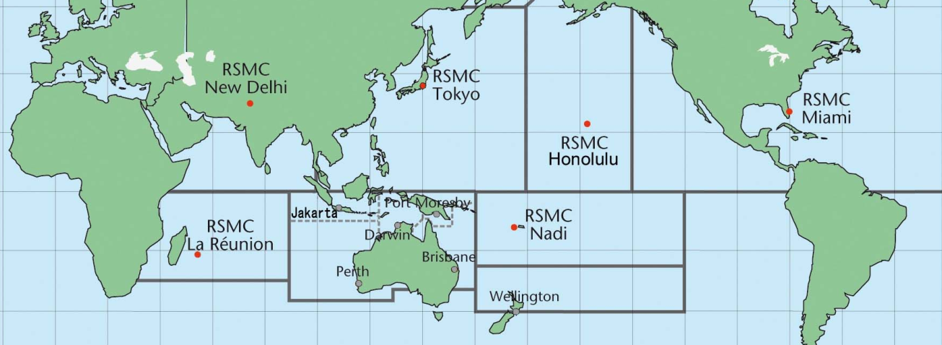
USAF Tropical Cyclone Support
Thank You for Your Tremendous Efforts!
Partnerships
NHC – Great support for DoD operations in CONUS & GOM / Caribbean
JTWC (USAF/Navy) – 51 years supporting Pacific Ops & Nations
NHC, CPHC, JTWC Cooperation – ATCF, Fixes, Personnel & Tech Exchange
NOAA: NWS, NESDIS, OAR – TC Fixes, Training, Funding Advocacy
JTWC

Slide 4
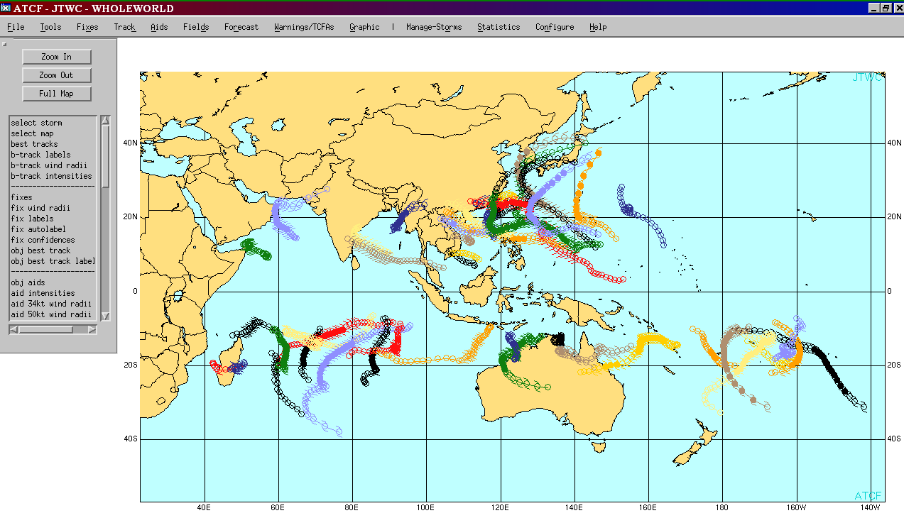
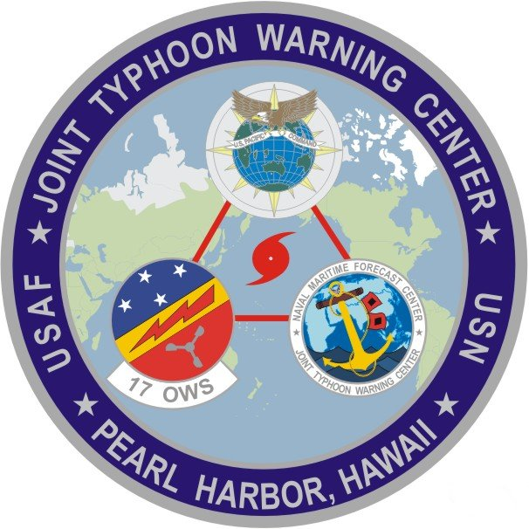
USAF Tropical Cyclone Support
The Warfighter Need
Cyclones are a continuing threat to air, ground and naval operations
Coordinated and concentrated effort necessary to meet ops needs
Increased operating space for Joint and Coalition Forces near cyclones
Improved operational planning for disaster response / force protection
2010 TROPICAL CYCLONES

Slide 5
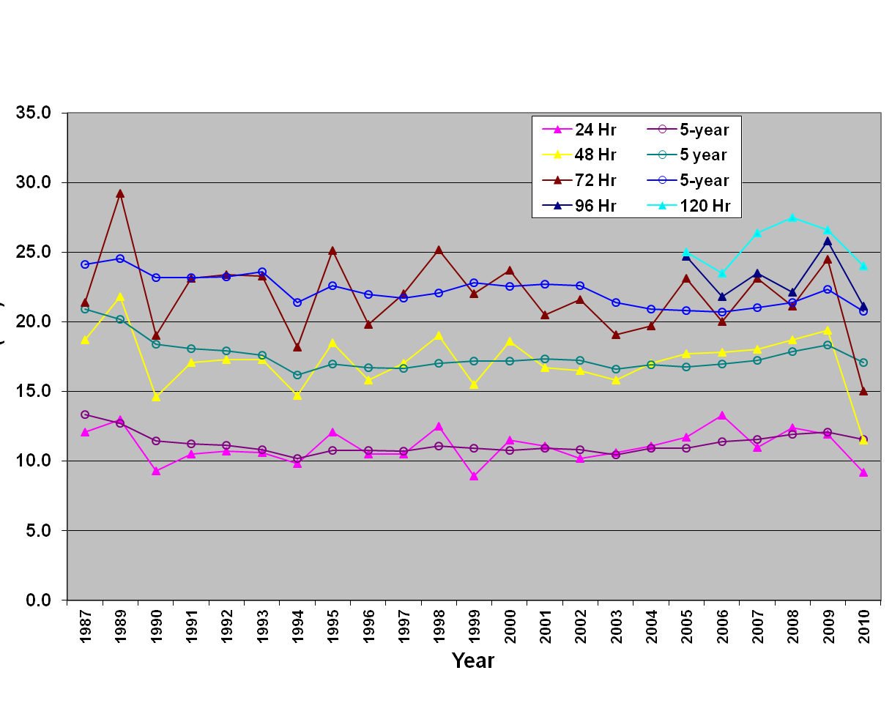
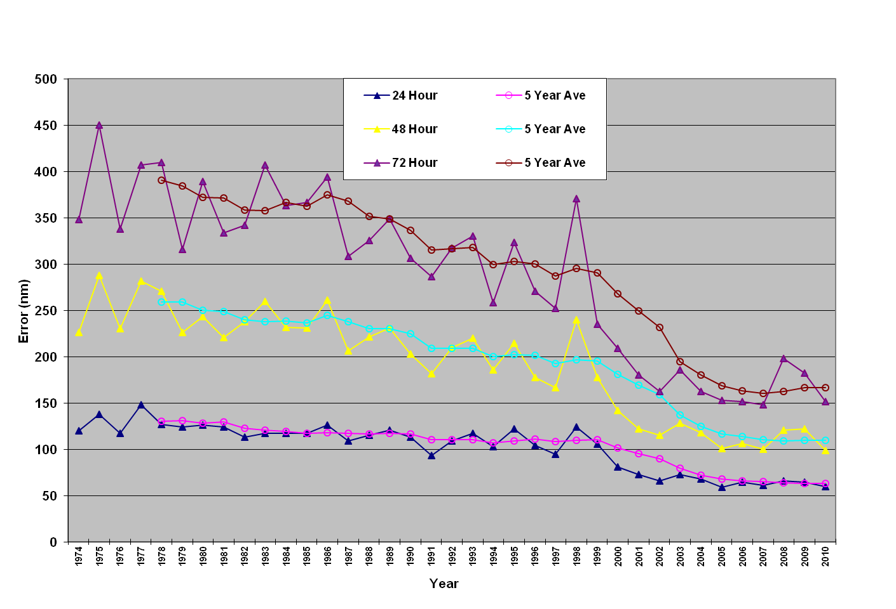
USAF Tropical Cyclone Support JTWC Challenges and Operational Priorities
Progress thus far … 35+ years of focused R&D and T2
WPAC Track Error
WPAC Intensity Error
Significant gains since 1999
42% improvement at 72 Hours
Continues to be a Challenge
We must work this by 2015

Slide 6
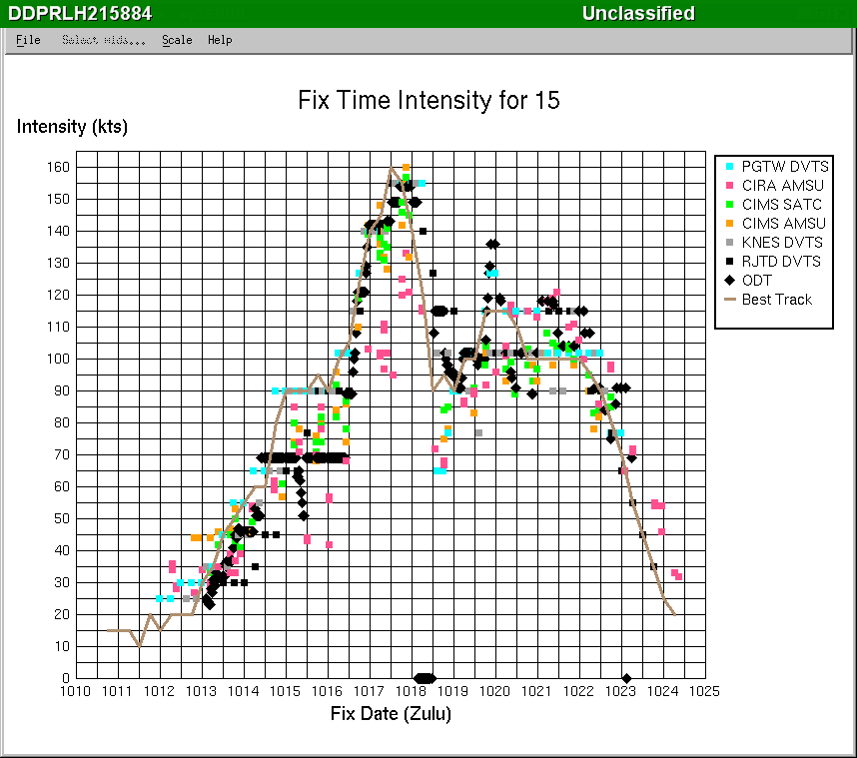
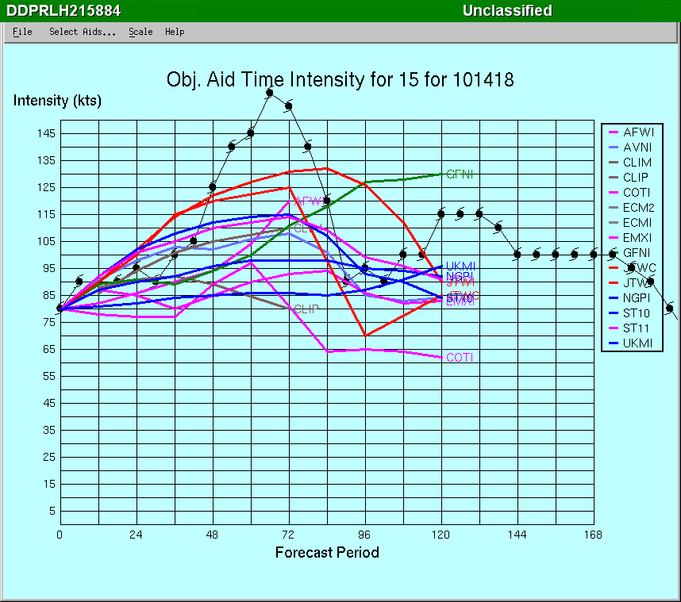
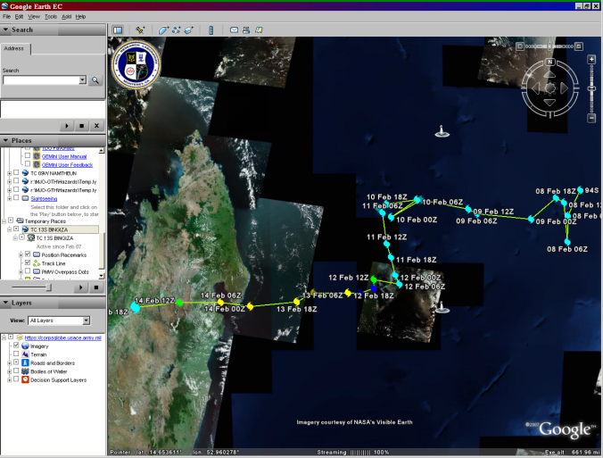
USAF Tropical Cyclone Support
JTWC Challenges and Operational Priorities
Top priority is intensity/structure … we need to improve:
Cyclone intensity and rapid intensification guidance
Specification of cyclone structure (wind strength and distribution)
Satellite-based intensity/structure estimates – including microwave
Tropical Cyclone genesis determination
Continue to enhance forecaster tools
We Need Continued Support from the Research Community

Slide 7
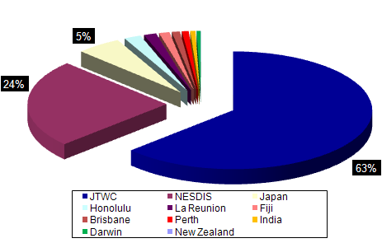
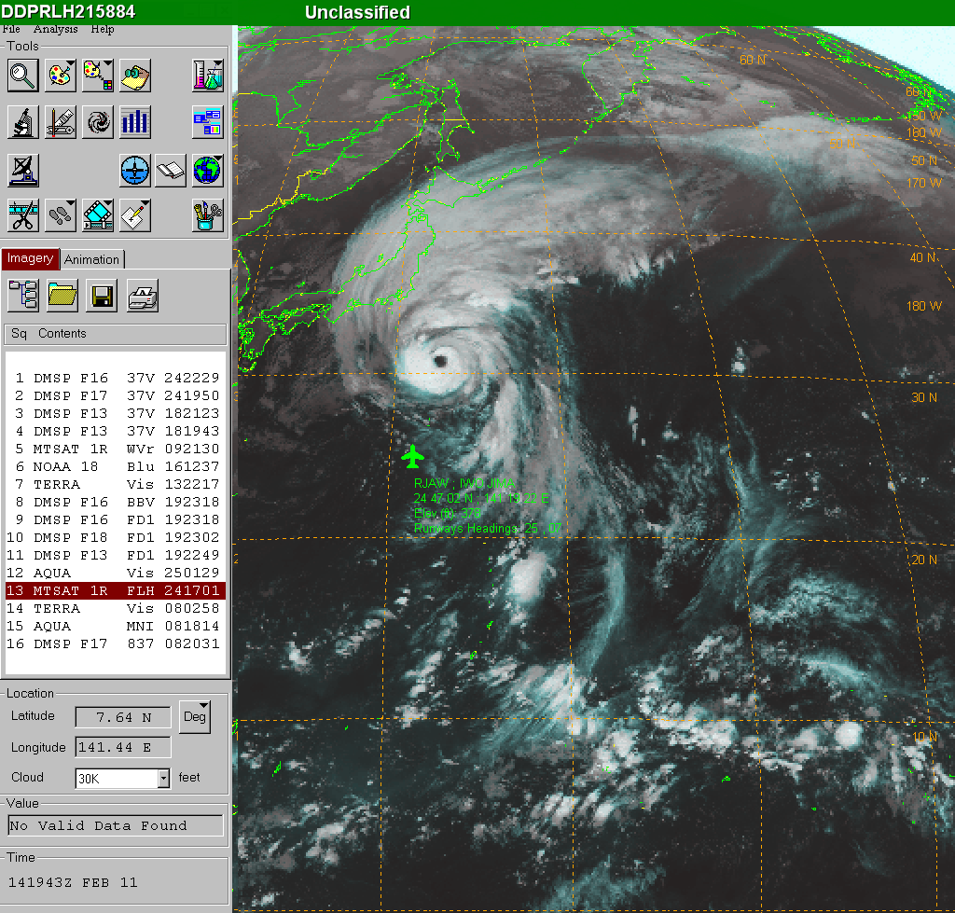
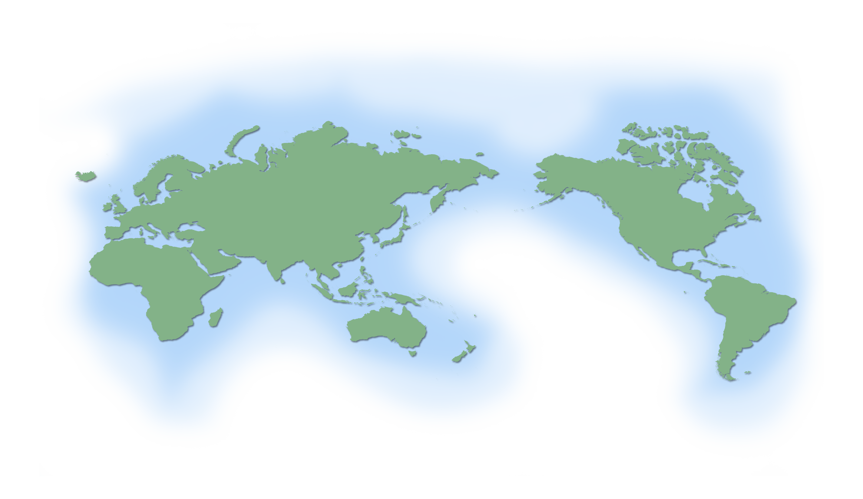
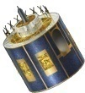
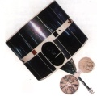
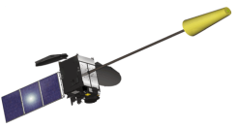
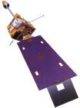
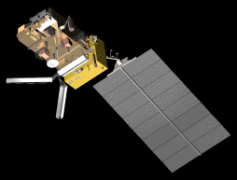
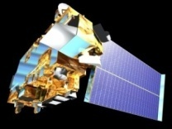
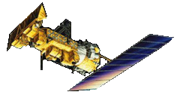
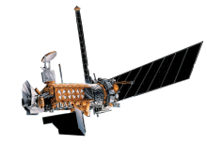
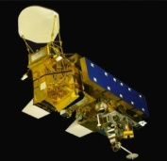
USAF Tropical Cyclone Support Strengths Now and for the Future
Test and transition mature research to operations
Data (fixes, tracks, models) available for research
USAF Mark IVB
X-Band Upgrade adds EOS capability (Aqua & Terra)
Global Geostationary Coverage
Real-time Polar Imagery
METEOSAT
FENG YUN
MTSAT
GOES
Elmendorf AFB Alaska
Kapaun AB Germany
Manas AB Kyrgyzstan
Kadena AB Okinawa
Lajes Field Azores
Hickam AFB Hawaii
Al Udeid AB Qatar
Andersen AFB Guam
MetOp
Terra
NOAA
DMSP
Aqua

Slide 8
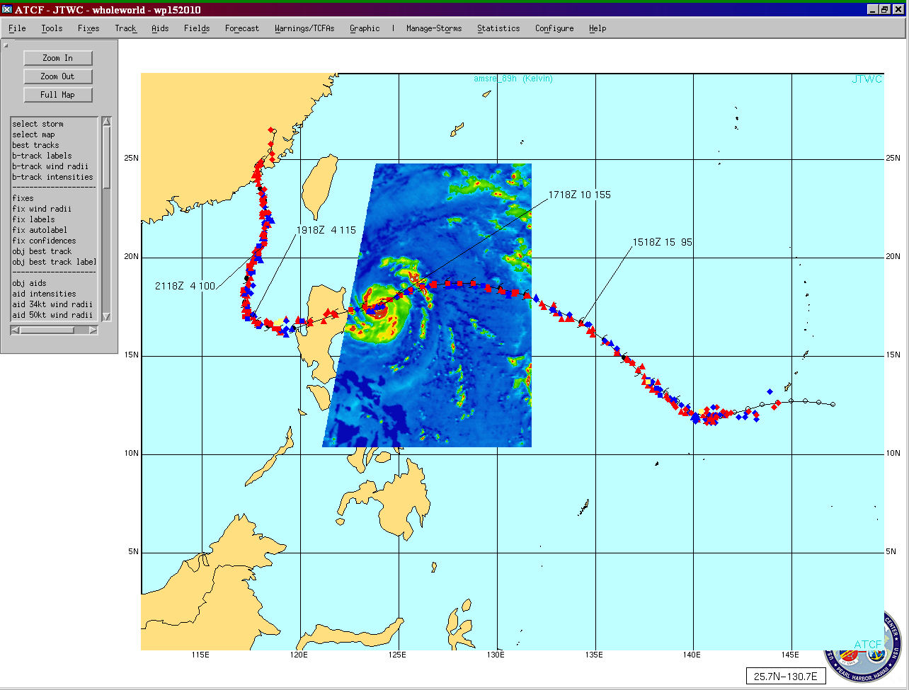
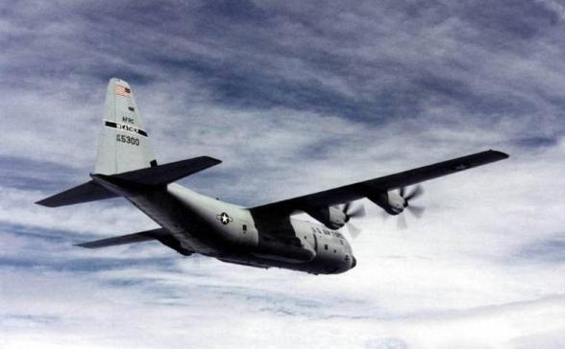
USAF Tropical Cyclone Support Strengths Now and for the Future
Automated Tropical Cyclone Forecast (ATCF) System
Vital for JTWC ops
Access and display of data via single tool optimizes TDOs time in high-tempo operations
Hurricane Hunters – WC130J
AFRC environmental recon mission corrects/validates satellite interrogation techniques

Slide 9
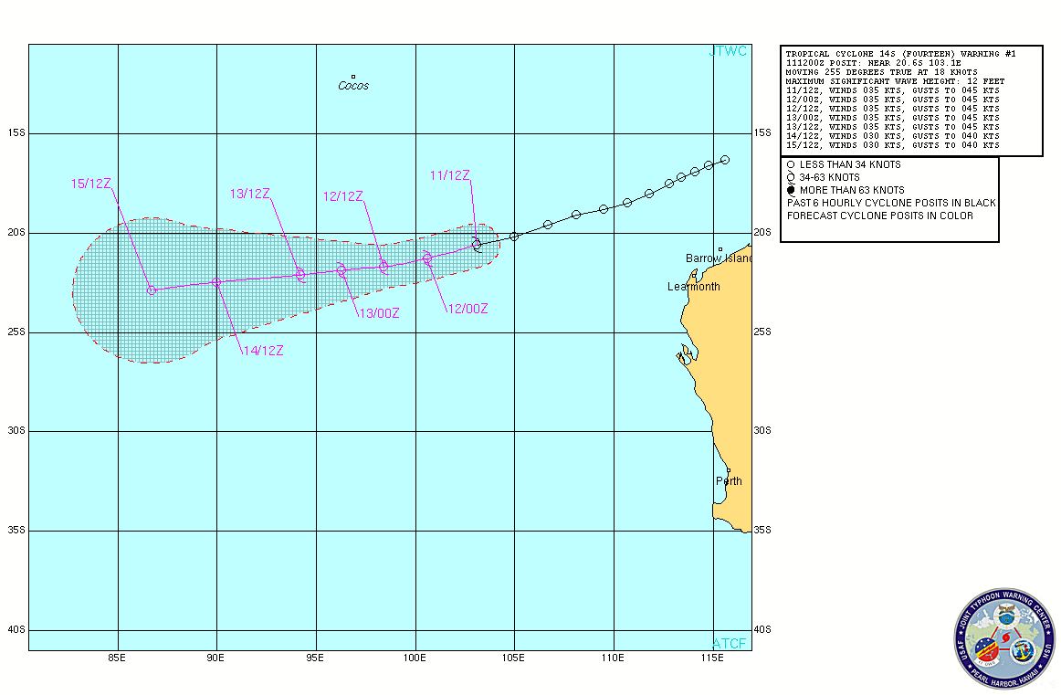
USAF Tropical Cyclone Support Strengths Now and for the Future
AFWA is currently running UKMO UM:
Uses 4DVAR initialization fields from UKMO
25km horiz. res. (future ~17km), 70 vert. levels
4x/day to 240hrs (future 384hrs), 3hr increment
Future – UM global ensemble (~50km) to add to AFWA’s global ensemble product suite
UM provides an additional asset for AFW forecasters supporting AF/Army global operations
UM with Satellite & Spherics Overlay

Slide 10
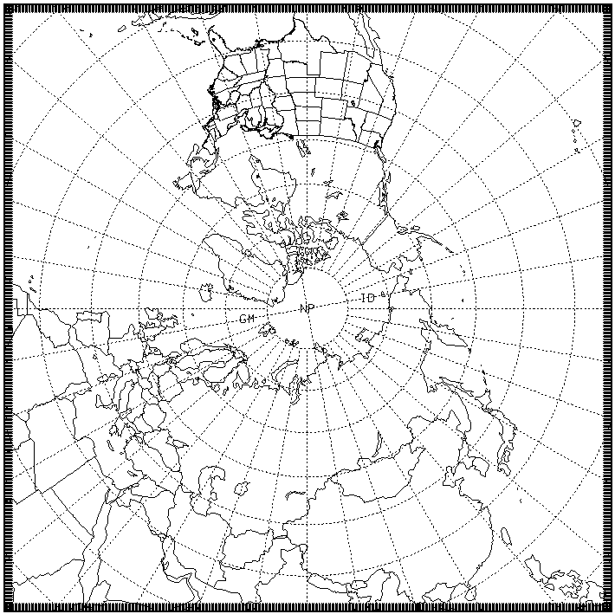
USAF Tropical Cyclone Support Strengths Now and for the Future
AFWA’s future mesoscale ensemble
UM & NAEFS members used for initial and lateral boundary conditions
~20km resolution, 2x/day to 144 hours
“Global” Coverage
N. Hemisphere & Tropical stripe initially
S. Hemisphere added later
Tropical ensemble domain…
…supports AF/Army regional operations
…provides an added, extended-range modeling tool for tropical storm forecasters

Slide 11
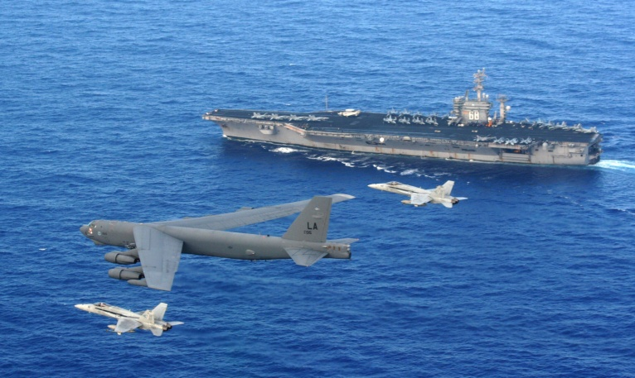
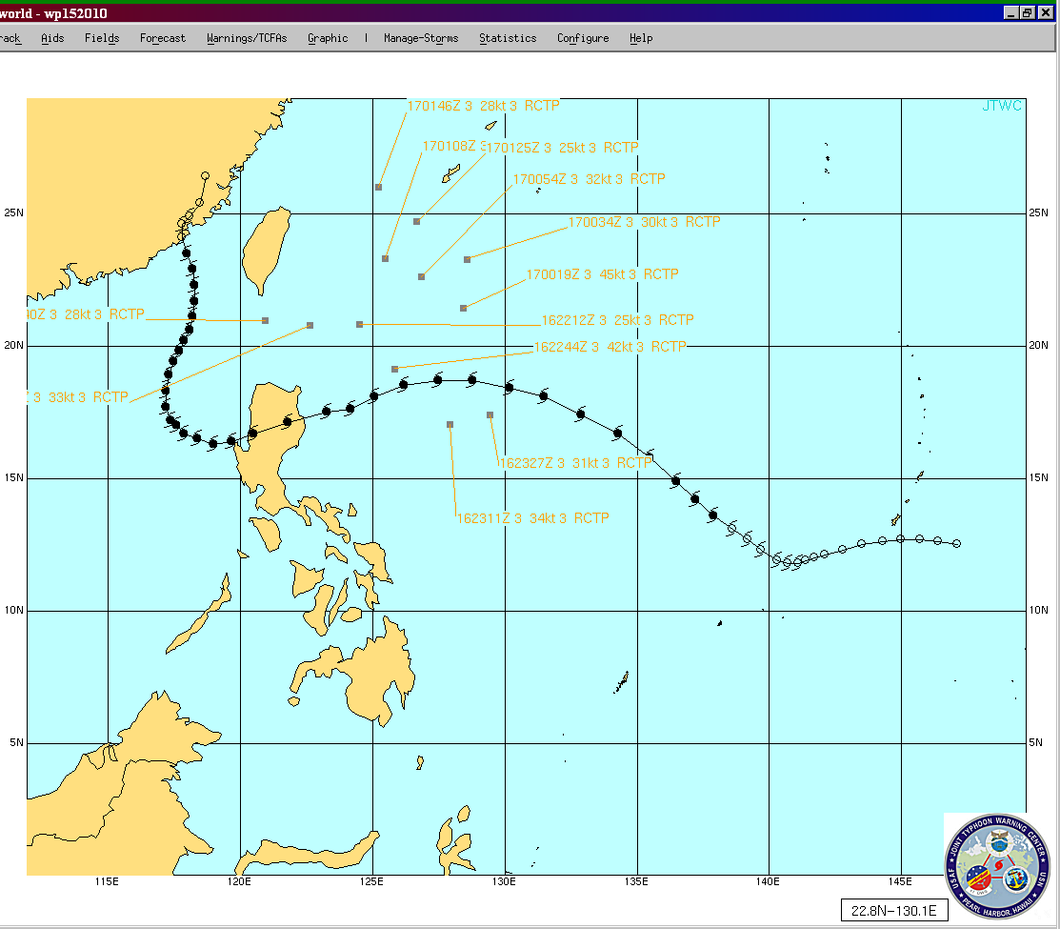
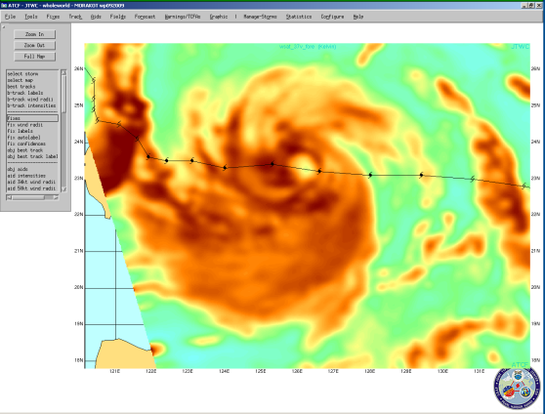
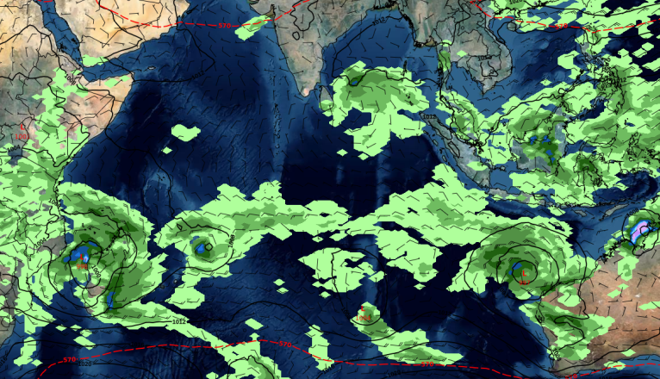
USAF Tropical Cyclone Support Community Teamwork
Operations guiding research decisions
Communications and interoperability
National and international collaboration
Knowledge Sharing & Data exchange
Space-based sensing
Numerical Weather Prediction
ITOP/TCS-10 (WC-130J, DOTSTAR)
JTWC active participation
Taiwan Central Weather Bureau
DOTSTAR Aircraft Dropsonde Data
during Super Typhoon Megi

Slide 12
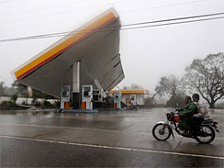
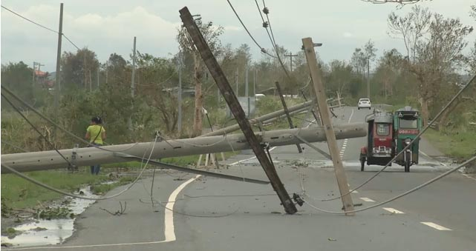
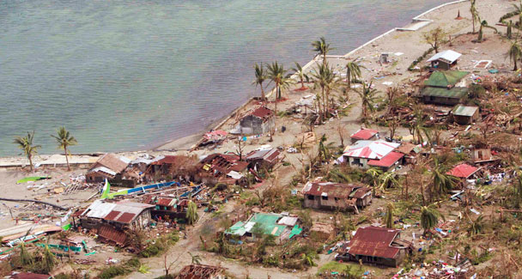
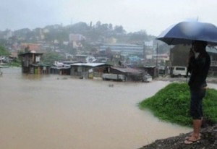
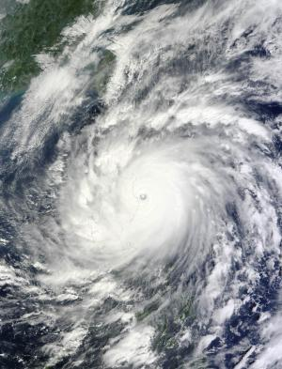
Bottom Line
Tropical cyclone reconnaissance and warning capability critical to warfighters… important to operations and saving lives!
Must continue to work JOINTLY to improve analysis and forecast capability… we need significant improvement to intensity forecasts by 2015!!
This is a TEAM SPORT … Thanks to everyone for the great work!

Slide 13
Questions?
AFW…Supporting Joint Warfighters…24x7!

