Slide 1
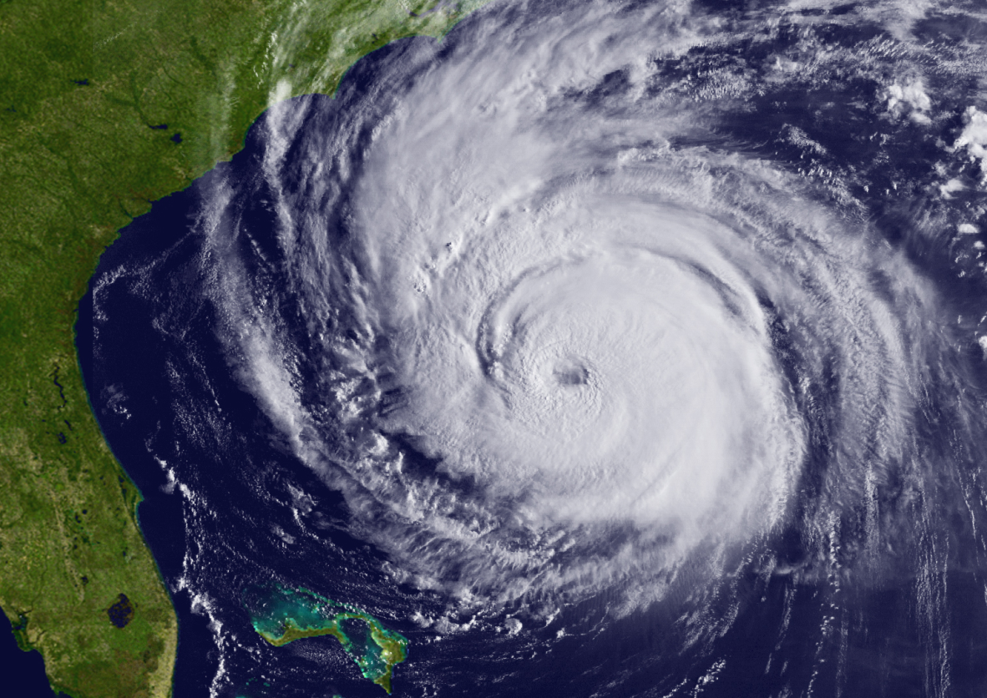
65th Interdepartmental
Hurricane Conference
“Ocean and Atmospheric Influences on Tropical Cyclone Predictions: Challenges and Recent Progress”
February 28 – March 3, 2011
Notes:
This slide is on the screen as the FC walks to podium

Slide 2
Conference Opening
Mr. Samuel P. Williamson
Federal Coordinator for Meteorology
65th Interdepartmental Hurricane Conference
“Ocean and Atmospheric Influences on Tropical Cyclone Predictions: Challenges and Recent Progress”
Sponsored and hosted by:
The Office of the Federal Coordinator for Meteorological Services
and Supporting Research
Notes:
Good afternoon and welcome the 65th annual Interdepartmental Hurricane Conference.
Our theme this year as you can see on the slide is: “Ocean and Atmospheric Influences on Tropical Cyclone Predictions: Challenges and Recent Progress”
We are absolutely delighted to be here in Miami!

Slide 3
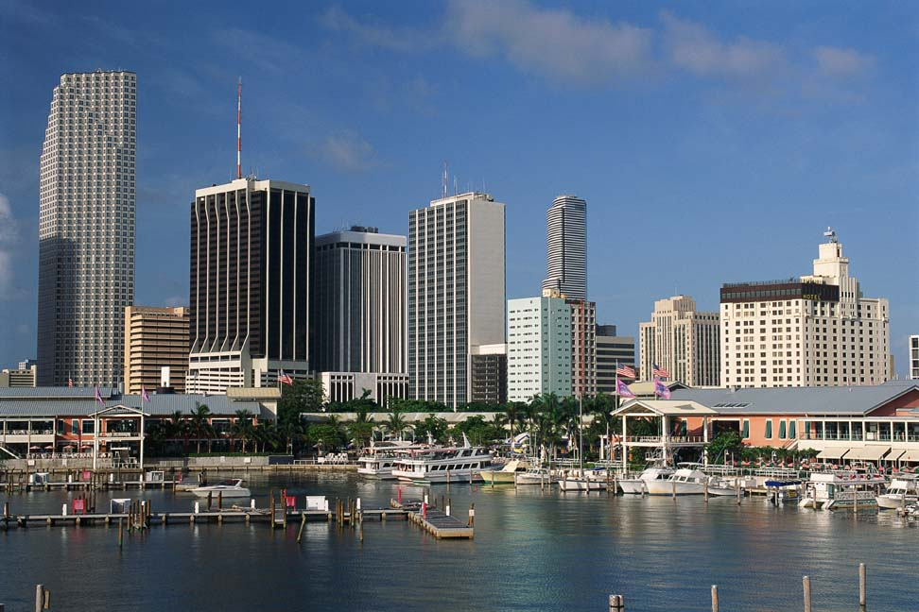
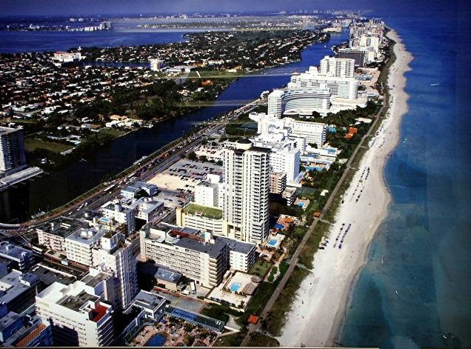
Welcome / Opening Remarks
The Honorable Carlos Alvarez
Mayor, Miami-Dade County
65th Interdepartmental Hurricane Conference
Notes:
The Honorable Carlos Alvarez, the Mayor of Miami-Dade County, was expecting to join us, but last Thursday learned of a conflict so he’s not able to be here this afternoon. However, on behalf of Mayor Alverez, Assistant County Manager, Alina Hudak, is here to help kick-off the conference and provide some welcoming remarks.
Ms. Hudak is responsible for the effective management of Miami-Dade County government and its more than 30,000 employees. She continues to serve as one of the highest ranking female executives for Miami-Dade County government. She was also the first woman ever appointed Director of a large operational department when she served as Director of the General Services Administration Department.
Please welcome, Alina Hudak.
--------------------------------------------------------------------------------------------------------------------------
- Mayor Carlos Alvarez was re-elected overwhelmingly to a second term on August 26, 2008. Under his leadership, Miami-Dade County is a leaner, more efficient organization. - The Mayor is responsible for the management of all administrative departments within Miami-Dade County, following a decision made by voters in January 2007, to change the way Miami-Dade County government was run. He oversees more than 27,000 employees and operates a budget of more than $7 billion dollars. - His priorities include keeping the County's two largest economic engines—the Airport and Seaport –competitive; stimulating the economy by championing public infrastructure projects; and holding the Urban Development Boundary to prevent urban sprawl.
Mayor Alvarez first entered elected office on November 16, 2004, after a distinguished 28-year public service career in the Miami-Dade Police Department.

Slide 4
Notes:
4

Slide 5
Introductory Comments
Mr. Samuel P. Williamson
Federal Coordinator for Meteorology
65th Interdepartmental Hurricane Conference
“Ocean and Atmospheric Influences on Tropical Cyclone Predictions: Challenges and Recent Progress”
Notes:
5
- During my introductory comments, I will review the status of action items from last year’s IHC, provide a brief reminder of why we’re here, review the conference objectives, and briefly highlight some of the agenda items for the remainder of the week.

Slide 6
Status of Actions from 64th IHC
Update the National Hurricane Operations Plan by May 1, 2010
Act on Tropical Cyclone R&D issues
Convene the OFCM-sponsored Working Group for Tropical Cyclone Research and work with agencies to gather and analyze the FY2010 data
Brief the Interdepartmental Committee, then Federal Committee for Meteorological Services and Supporting Research (ICMSSR, FCMSSR)
As required, provide updates to the Office of Science and Technology Policy
Publish in Bulletin of the AMS or other similar publications
Report update at 65th IHC next year
Session 1, later this afternoon
On-going
-
Notes:
6

Slide 7
Status of Actions from 64th IHC
Act on Understanding Hurricane Response
Briefed ICMSSR meeting on August 6, 2009
Highlighted broader scope and need to expand social science effort to other natural hazards
Organize two mini-workshops to develop an initial set of priorities (mini-workshop took place May 3-4, 2010)
Present results of the mini-workshops to the ICMSSR and FCMSSR (briefed ICMSSR on June 25, 2010)
Establish a working group, likely under the Committee for Environmental Services, Operations, and Research Needs (CESORN)
Use working group to execute agreed-upon priorities
On-going
There will be an update on Thursday morning
Notes:
7

Slide 8
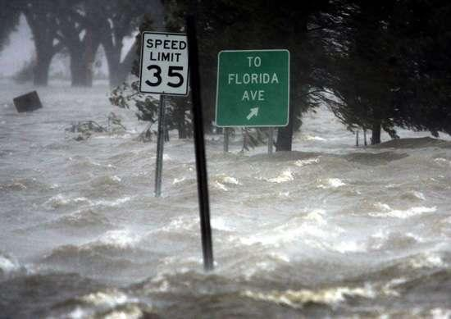
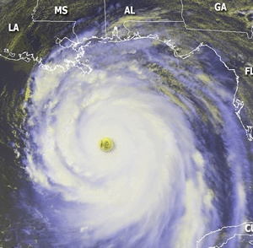
Reminder of Why Are We Here
Continue to exchange information to ultimately aid in improved services to help prevent loss of life and injuries
Minimize the nation’s vulnerability to natures most destructive forces
Enable a strong homeland defense through a safe overseas presence
Build upon synergies / collaboration in the tropical cyclone community
Notes:
8

Slide 9
Conference Objectives
Review the Nation’s tropical cyclone forecasting and warning program
Address actions from previous IHC
Update the National Hurricane Operations Plan for 2011
Review comparison of 2008 and 2010 snapshots of tropical cyclone R&D activities, including their contributions toward forecasting and warning center’s operational priorities
Review Joint Hurricane Testbed (JHT) projects, and recognize candidates that may be successfully transitioned into operations
Build upon tropical cyclone partnerships, leveraging agency capabilities to meet the operational needs of the tropical cyclone forecasting and warning centers

Slide 10
Conference Agenda
This Afternoon
SPECIAL OPENING
SESSION
PRESENTATION
(1:00 PM – 1:10 PM)
Notes:
10
- I will now highlight some of the agenda items for the remainder of the week.

Slide 11
Conference Agenda
This Afternoon
Invited Comments
(1:10 PM – 1:20 PM)
Major Phillip May
Region IV Administrator
Notes:
11

Slide 12
Conference Agenda
This Afternoon
Panel Discussion: Advances in Tropical Cyclone Predictions: A Senior Leader Perspective (1:20 PM – 2:15 PM)
Moderator: Dr. Kerry Emanuel, Director, Program in Atmospheres, Oceans, and Climate, and Professor of Atmospheric Science, MIT
Panelists:
Dr. John “Jack” Hayes, Assistant Administrator for Weather Services, NOAA
Col John Egentowich, Air Force Deputy Director of Weather
CAPT Bill Nisley, Commanding Officer, Fleet Weather Center, Norfolk

Slide 13
Conference Agenda
Later This Afternoon
Session 1: Comparisons of the 2008 and 2010 Snapshots of Tropical Cyclone R&D 3:00 PM – 3:30 PM
Session Leader: Dr. Haiyan Jiang, Department of Earth & Environment, Florida International University
Dr. Frank Marks, Co-Chair, Working Group for Tropical Cyclone Research and Director, Hurricane Research Division
Dr. Ronald Ferek, Co-Chair, Working Group for Tropical Cyclone Research and Program Officer, Marine Meteorology Program

Slide 14
Conference Agenda
Later This Afternoon and Evening
Session 2: The 2010 Tropical Cyclone Season in Review 3:30 PM – 5:15 PM
Session Leaders: Mr. Bill Birkemeier (USACE) and
Dr. Richard Pasch (NCEP/NHC)
Poster Session: 6:30 PM - 8:30 PM
(North Foyer)

Slide 15
Conference Agenda
Tuesday Morning
7:45 AM – 8:00 AM: Invited Presentation
- Mr. Bill Proenza (NOAA/NWS)
----------------------------------------------------------------------------------------
Wednesday Evening – Conference Banquet
Cash Bar Open | 6:30 PM
Banquet Starts | 7:00 PM
Banquet Address | ~7:45 PM
Presentation of the Hagemeyer Award | ~ 8:15 PM
Presentation of Award | ~ 8:25 PM
Banquet Address:
- Mr. Scott B. Gudes, Vice President, Legislative Affairs, Space
Systems & Operations, Lockheed Martin Corporation
Notes:
15

Slide 16
Conference Agenda
Thursday Morning
7:30 AM – 8:00 AM: Invited Presentation
- Dr. Brenda Phillips
Professor of Political Science
Fire and Emergency Management Program
Oklahoma State University
----------------------------------------------------------------------------------------
Thursday Afternoon – Final Plenary Session
12:00 – 12:30 PM
WG/HWSOR: Action Item Review | Dr. Edward Rappaport (NHC) Chairperson, WG/HWSOR
Final Wrap-up | Mr. Samuel P. Williamson Federal Coordinator

Slide 17
Conference Logistics
Conference Chair: Mr. Samuel P. Williamson
Conference Technical Director | Mr. Mark Welshinger
Media Coordinators | Mr. Mike Babcock Mr. Dennis Feltgen
Assistant Coordinators for Conference Arrangements | Ms. Erin McNamara Ms. Christina Bork
Audiovisual Specialists | Mr. Ken Barnett Mr. Tony Ramirez
Registrars | Ms. Erin McNamara Ms. Christina Bork
Presentation Timer | Mr. Ken Barnett
Session Coordinators | Mr. Floyd Hauth Mr. Mike Babcock Mr. Mark Welshinger
Notes:
17

Slide 18
Special Opening
Session Presentation
65th Interdepartmental Hurricane Conference
“Ocean and Atmospheric Influences on Tropical Cyclone Predictions: Challenges and Recent Progress”
Notes:
18
It gives me great pleasure to introduce an individual that I had the pleasure of meeting back in September 2000. I met the next speaker in Galveston, Texas, at the Centennial Remembrance event of The Galveston Storm of 1900.
And who am I talking about…(next slide)

Slide 19
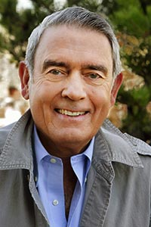
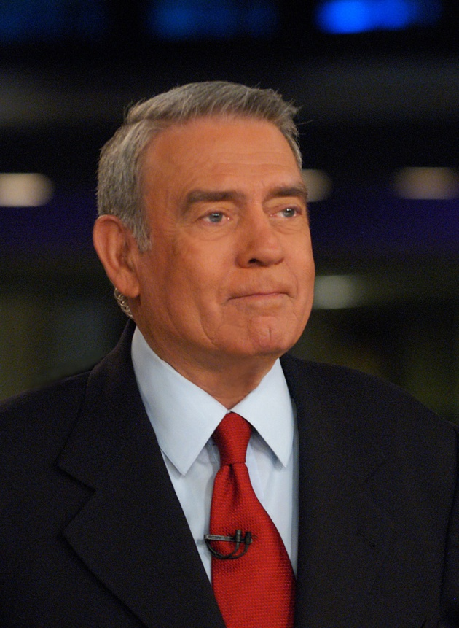
Special Opening Session Presentation
Mr. Dan Rather
Anchor and Managing Editor of HDNets’s Dan Rather Reports
65th Interdepartmental Hurricane Conference
“Ocean and Atmospheric Influences on Tropical Cyclone Predictions: Challenges and Recent Progress”
Notes:
19
Given his distinguished record and his long exposure on television around the globe, Dan Rather may be the best-known journalist in the world. He has covered virtually every major event in the world in the past 60 years. His resume reads like a history book, from his early local reporting in Texas on Hurricane Carla to his unparalleled work covering the assassination of President John F. Kennedy; the civil rights movement; the White House and national politics; wars in Vietnam, Afghanistan, the Persian Gulf, Yugoslavia and Iraq. From his first days as the Associated Press reporter in Huntsville, Texas, in 1950, Mr. Rather has more than earned his reputation as the “hardest working man in broadcast journalism.”
He has interviewed every United States president from Dwight D. Eisenhower to George W. Bush and Barack Obama, and virtually every major international leader of the past 30 years. Most recently, this fall Dan Rather Reports was honored with an Emmy award for investigative business reporting.
Mr. Rather began his career in journalism in 1950 as an Associated Press reporter in Huntsville, Texas. Prior to joining CBS News, he was news director at KHOU-TV, the CBS affiliate in Houston. He was a correspondent for 60 Minutes from October 1975 to September 1981, and again from March 2005 to the summer of 2006. Mr. Rather served as anchor and managing editor of the CBS Evening News from March 9, 1981 to March 9, 2005, the longest such tenure in broadcast journalism history. He also helped to found and served as a correspondent for 60 Minutes II from its debut on Jan. 13, 1999, to its final edition in September 2005. In 2006, Mr. Rather founded the company News and Guts and became anchor and managing editor of HDNet’s Dan Rather Reports, which specializes in investigative journalism and international reporting.
Please welcome Mr. Dan Rather.

Slide 20
Notes:
20

Slide 21
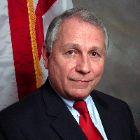
Invited Comments
Major Phillip May
Region IV Administrator
65th Interdepartmental Hurricane Conference
“Ocean and Atmospheric Influences on Tropical Cyclone Predictions: Challenges and Recent Progress”
Notes:
21
It give me great pleasure to introduce the Adminiostrator of FEMA Region IV, Major Phillip [Phil] May.
Mr. May coordinates preparedness, response, recovery, and mitigation activities in the eight states in Region IV; Alabama, Florida, Georgia, Kentucky, Mississippi, North Carolina, South Carolina, and Tennessee. Mr. May also manages three transition recovery offices throughout the region: Alabama, Florida, and Mississippi.
May served as Region IV Administrator for 13 years from1981-1994. With more than 21 years at FEMA, May left to pursue opportunities working with U.S. Senator Jeff Sessions of Alabama, and to serve in the Alabama Emergency Management Agency. May returned for his second tour as Region IV Administrator in October 2006 to lead the restructuring of the new FEMA.
During his tenure with FEMA, Mr. May has coordinated FEMA’s preparation and response to some of the nation’s worst disasters, including Hurricane Hugo in 1989 and Andrew in 1992. His work during the recovery from Hurricane Andrew earned Mr. May both the Distinguished Meritorious Service Award and the Distinguished Civil Service Medal.
Mr. May is a native of Alabama and attended the University of Montevallo. He received his commission as an officer in the U.S. Air Force in 1971 and served as a member of the Alabama National Guard from 1971 to 1983.
Please welcome Mr. Phil May to this year’s IHC.

Slide 22
Notes:
22

Slide 23
Panel Discussion
Advances in Tropical Cyclone Predictions: A Senior Leader Perspective
Moderator: Dr. Kerry Emanuel, Director, Program in Atmospheres, Oceans, and Climate, and Professor of Atmospheric Science, MIT
Panelists:
Dr. John “Jack” Hayes, Assistant Administrator for Weather Services, NOAA
Col John Egentowich, Air Force Deputy Director of Weather
CAPT Bill Nisley, Commanding Officer, Fleet Weather Center, Norfolk
Notes:
23
Dr. Kerry Emanuel is Director, Program in Atmospheres, Oceans, and Climate and professor of atmospheric science at the Massachusetts Institute of Technology, where he has been on the faculty since 1981, after spending 3 years as a faculty member at UCLA. He earned his SB from MIT in 1976 and his PhD in meteorology from MIT in 1978. Professor Emanuel's research interests focus on tropical meteorology and climate, with a specialty in hurricane physics. His interests also include cumulus convection, and advanced methods of sampling the atmosphere in aid of numerical weather prediction.
Dr. Emanuel is working on various aspects of moist convection in the atmosphere, and on tropical cyclones. He is interested in fundamental properties of moist convection, including the scaling of convective velocities and the nature of the diurnal cycle of convection over land.
He is the author or co-author of over 100 peer-reviewed scientific papers, and two books:
- Divine Wind: The History and Science of Hurricanes, recently released by Oxford University Press and aimed at a general audience
- What We Know about Climate Change, published by the MIT Press.

Slide 24
Notes:
24

Slide 25
Federal Agency Lead Reps
NOAA Dr. John “Jack” Hayes
NOAA Assistant Administrator for
Weather Services/Director, NWS
DHS Major Phillip May
Administrator, FEMA Region IV
Navy Captain Bill Nisley
Commanding Officer, Fleet Weather Center, Norfolk
NSF Dr. Michael Morgan
Director, Division of Atmospheric and
Geospace Sciences
DOI Mr. Robert Mason
Deputy Chief, Office of Surface
Water, USGS
Army Mr. Bill Birkemeier
Field Data Collection Program
USACE Field Research Facility
Air Colonel John Egentowich
Force Deputy Director of Weather
AF/A3O-W, HQ USAF
NASA Dr. Scott Braun
Research Meteorologist, Goddard Space Flight Center
DOT Mr. John Mineo
Manager , Oceanic & Offshore Operations FAA National Headquarters
USDA Mr. Brad Rippy
Office of the Chief Economist
Weather and Climate

Slide 26
Ground Rules
Questions welcomed...time permitting
Significant agency issues worked through lead agency reps
User community & agency reps are welcome to raise issues for discussion during Q&A periods and at Thursday workshops
Significant issues reviewed daily at OFCM staff meeting
Results of discussions and any action items
Summarized during the Final Plenary Session
Notes:
Questions welcomed...time permitting
Significant agency issues worked through lead agency representatives. User community and agency representatives are welcome to raise issues for discussion during the Forecaster / Operations Forum or Workshops
Significant issues will be reviewed daily at the afternoon OFCM Staff Meeting. Results of discussions and any action items will be summarized during the Final Plenary Session

Slide 27
Afternoon
Break
Notes:
27

Slide 28
Session 1
Coordinator: Mr. Mark Welshinger, OFCM
Comparisons of the 2008 and 2010 Snapshots of Tropical Cyclone R&D
(3:00 PM – 3:30 PM)
Session Leader: Dr. Haiyan Jiang, Department of Earth & Environment, Florida International University
Dr. Frank Marks, Co-Chair, Working Group for Tropical Cyclone Research and Director, Hurricane Research Division
Dr. Ronald Ferek, Co-Chair, Working Group for Tropical Cyclone Research and Program Officer, Marine Meteorology Program

Slide 30
Session 2
Coordinator: Mr. Mark Welshinger, OFCM
The 2010 Tropical Cyclone Season in Review
(3:30 PM – 5:15 PM)
Session Leaders
Mr. Bill Birkemeier (USACE) and Dr. Richard Pasch (NCEP/NHC)
Notes:
30

Slide 32
Poster Session
North Foyer
6:30 PM – 8:30 PM

