Slide 1

NWS Decision-Support:
A Strategic Initiative
An NWS vision that delivers expanding local/state hurricane decision-support for… a more resilient homeland !
64th Interdepartmental Hurricane Conference
Savannah, GA – March 2, 2010
Bill Proenza, Regional Director
National Weather Service – Southern Region

Slide 2
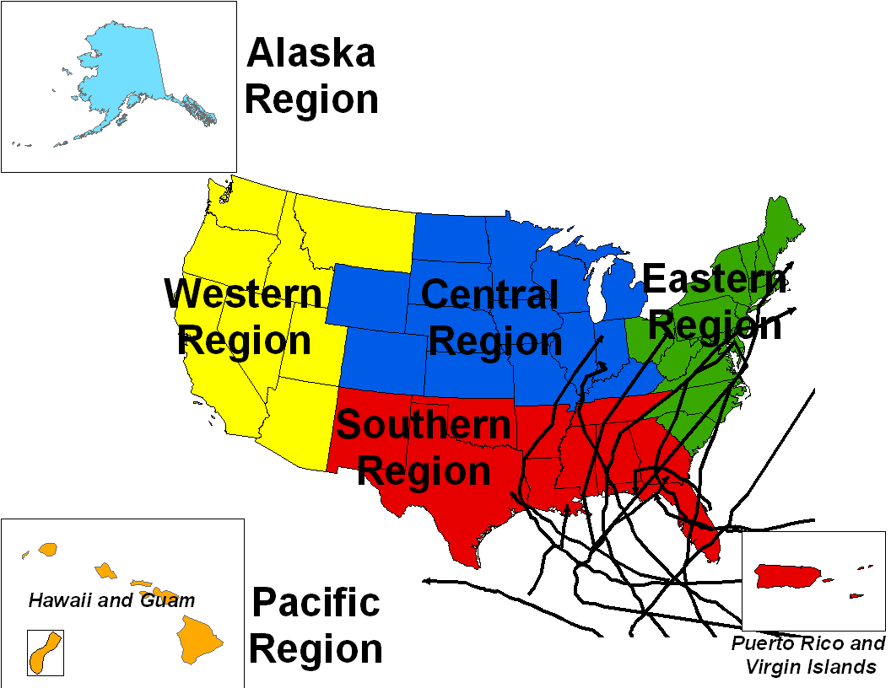
NWS: has largest government service regions: 4 contiguous and 2 “oconus”
Notes:
Just how active are we as Southern States? All the US hurricane landfalls in 2004 and 2005 were in our group of Southern States.

Slide 3
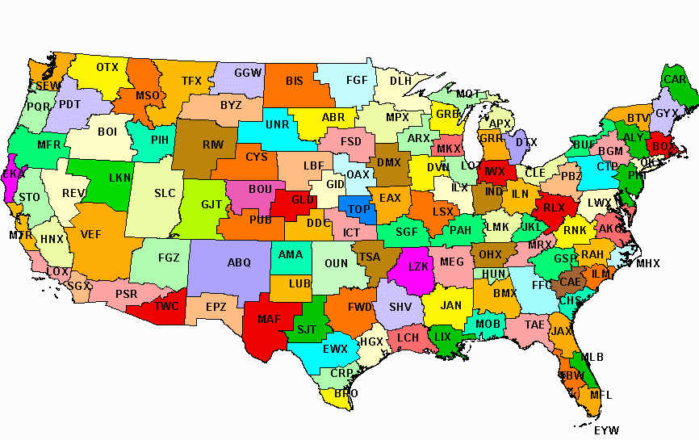
EMs & local/state govts are best served by their nearby WFO for local impact decision-making !
NWS: 122 WFOs, 13 RFCs, 21 CWSUs
6 ROs, 25 WSOs, NCEP Centers

Slide 4
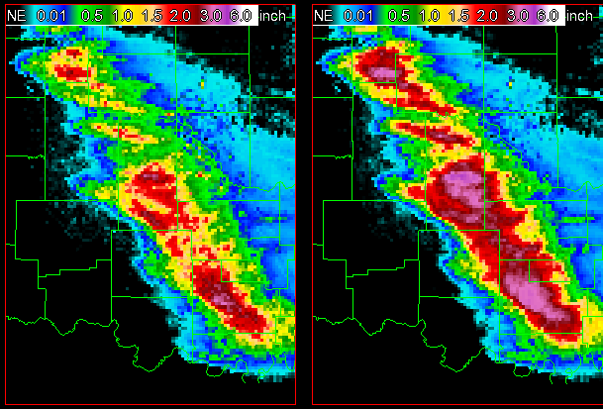
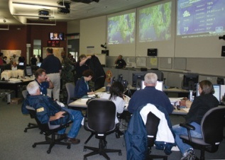
Our closest mission partners, the Local/State EM community increasingly is asking NWS for Decision Support !
Indeed our nation’s resiliency is depended on weather info to mitigate natural & unnatural life-threatening events
Local/state/federal EMs (other govt officials)
tell us they vitally need decision-assisting focused / on-site weather info
We’ve had many high-impact seasons:
  Hurricanes of 2004, 2005 & 2008
  Tornadoes of 2003, 2004 & 2008
  Southern & Western fires of 2005, 2006, 2007, 2008, 2009

Slide 5
NWS Decision Support is Critical to effective protection of life!
WFO decision support can be nearly immediate, 24x7, provided to an EM office, command center or field sites via the ER-MET capability.
What is an Emergency Response MET (ER-MET)?
  Who: An “all-hazard” event trained meteorologist.
  From: From nearby WFO.
  To: Local, State, Federal EOCs, 1st Responder sites.
  What: Provide decision support hydro-meteorological information and impacts tailored to the event.

Slide 6
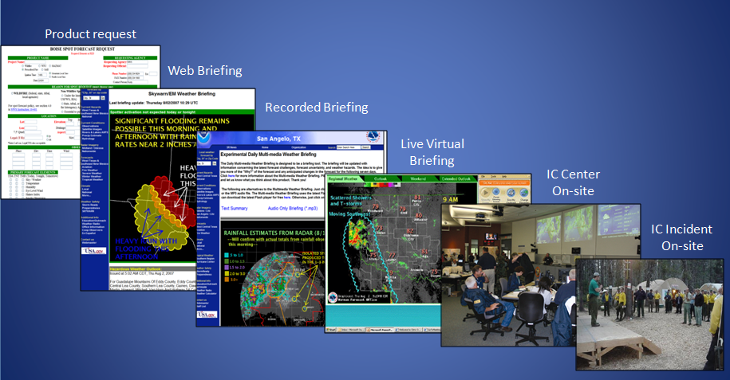
So NWS, with its NHC (CPHC) and WFOs, seamlessly meet the EM needs
Specifically, local WFOs provide area focused/direct on-site decision-assisting tropical cyclone info.

Slide 7
WFO Services for Decision Support
Hurricane Local Statement (HLS)
Extreme Wind Warning (EWW)
Post Tropical Cyclone Report (PSH)
WFO Tropical Cyclone Hazard Graphics
Storm Surge Improvements

Slide 8
NWS Hurricane Local Statement
Purpose
  Provide a single NWS product inclusive of all WFO and NHC watches & warnings for land falling tropical cyclones.
  One stop source for locally specific impacts further divided into finer scale areas as local WFO expertise enables.
  WFO issues in consonance with and right after the NHC Advisory. Its augmented by each WFO’s current CWA watches and warnings down to the finer WFO’s geographic areas.

Slide 9
NWS WFO Hurricane Local Statement
Highlights Local Impacts
  Watches/Warnings in Effect
  Storm information in finer scale
  Precautionary actions / EM evacuation orders
  Expected storm surge & tide by county/local geography
  Onset / Ending of TS / Hurricane winds by county
  Probability of TS / Hurricane conditions by county
  Flooding potential by county or finer geographic division
  Tornado Potential by polygon and/or county

Slide 10
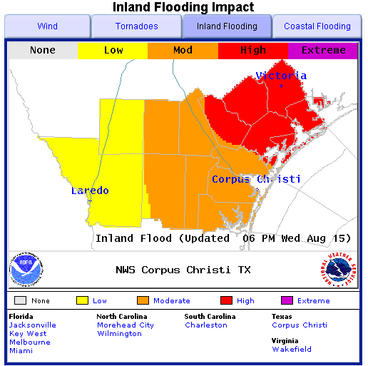
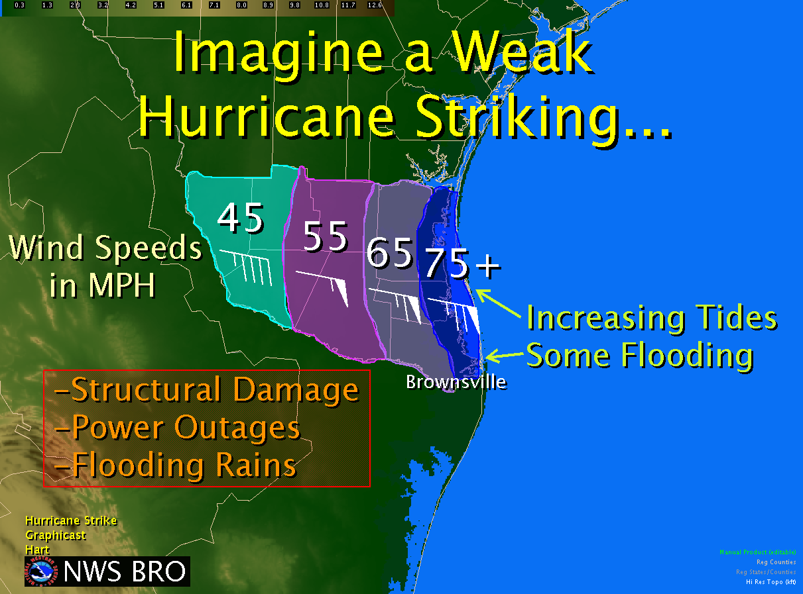
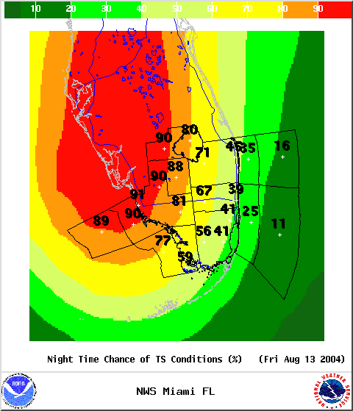
WFOs transpose HLS’ into Graphics and Grids!
Slide courtesy of Barry Goldsmith, WFO Brownsville

Slide 11
Extreme Wind Warning
(EWW)
A County Based, WFO Issued
  Imminent or occurring sustained one minute winds of 100 knots (115 mph) or greater (at least CAT 3 wind) expected within an hour.
  Issued once per county, valid normally up to two hours and updated with severe weather statements.
Product Purpose
  Designed for EM, media and the public of the need to take immediate shelter from an area and time specific high wind event.

Slide 12
Post Tropical Cyclone Report
(PSH)
WFOs CWA historical record of tropical cyclone conditions.
NWS WFOs compile this in a standardized format five days after the last HLS issuance.
Data summary includes . . . Wind, Rainfall, Pressure, Storm Surge, Flooding, Tornado, Fatality, Injury and Damage Information.
Also important for disaster documentations and declarations by emergency management.

Slide 13
WFO Tropical Cyclone Hazards Graphics
Present tropical cyclone text products in a graphical format
  Wind
  Inland Flooding (from Rainfall)
  Coastal Flooding (from Storm Surge)
  Tornadoes

Slide 14
WFO Corpus Christi

Slide 15
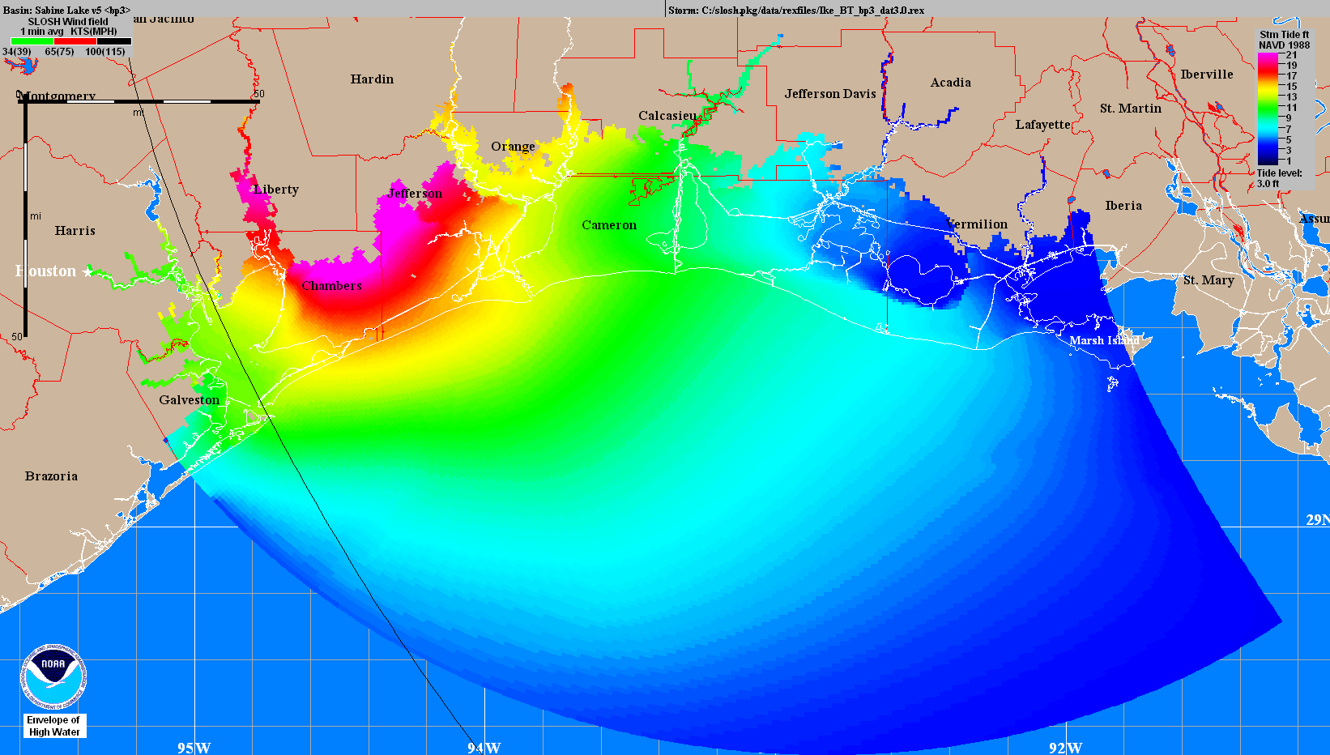
Legacy Method of Display
Height above sea level reference
Slide courtesy of Jamie Rhome, NHC

Slide 16
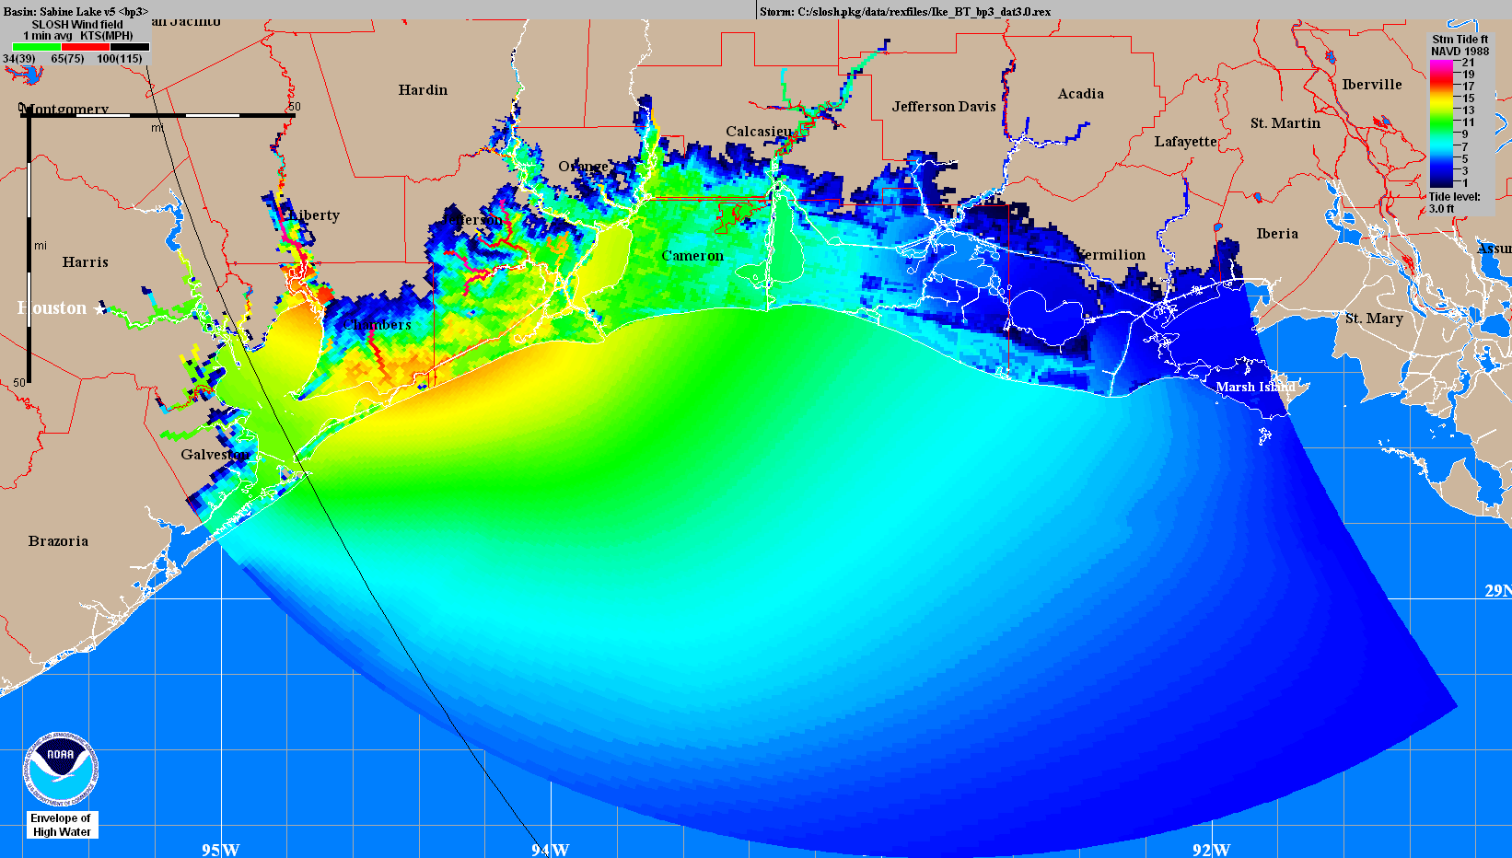
New Inundation Depiction
Height Above Ground Level
Slide courtesy of Jamie Rhome, NHC

Slide 17
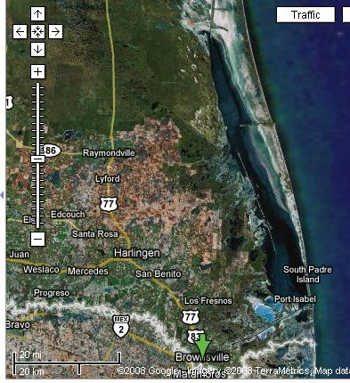
Storm Surge on GIS graphic..
Storm Surge GIS example, <12 hours from impact
12
Extreme
7
High
Moderate
8
12
5
Slide courtesy of Barry Goldsmith, WFO Brownsville

Slide 18
Dual-Polarization Doppler Radar
Dual- Pol results demonstrate much improvement (NSSL documented reports):
  Finer imaging & better data for…
  rainfall estimation
  storm structure & pinpointing tornadoes
  And more…
Dual-Pol WSR-88D 1-hr rainfall est. left)
vs. legacy WSR-88D estimate (right).
The right-hand image was a significant
overestimate but the Dual-Pol product provided a much better estimate.

Slide 19
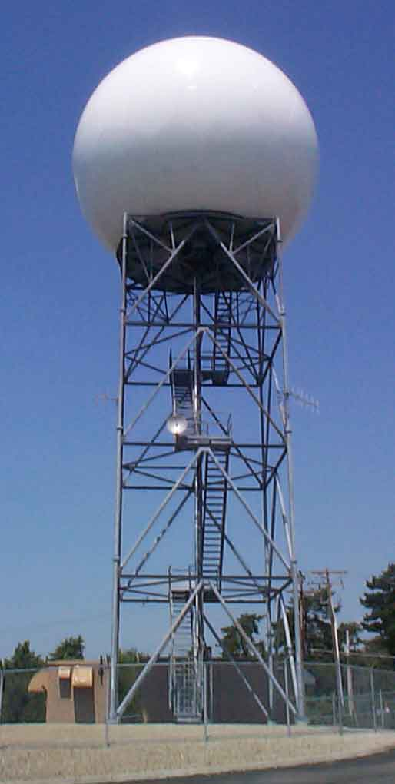
New Radar Technology
Recent Radar Enhancements
  Improved elevation scans
  Faster “volume scans”
Dual-Pol Radar (1 to 5 yrs)
  Improved resolution, storm structure imaging & velocity data
  Longer severe weather leadtimes
  Improved precipitation detection and flood warning lead-times
Phased Array Doppler(10+ yrs)
  With 30 second “volume scans” adding 4+ minutes to tornado lead-times.
  Highest resolution on velocity data, imaging, precip type !

Slide 20
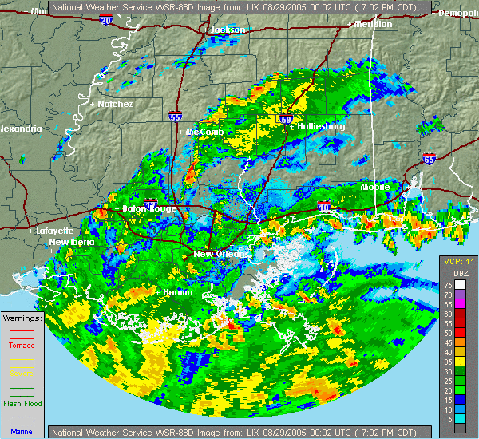
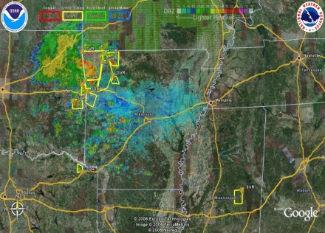
The NWS most sought after web product is your GIS-based NWS radar network…its there for EMs & public
National Weather Service WFO GIS radar graphics include the latest watches and storm-based warning boxes right on the radar loops.
The NWS GIS radar gives you the distance and direction of approaching weather to any geographic point of interest to you.
Our data gives you a running tally of local rainfall amounts.
You can superimpose our radar data unto your own GIS EM awareness and response program.
Example of NWS radar & warnings in Google Earth
www.SRH.weather.gov

Slide 21

NWS can DELIVER 24x7 direct and immediate decision-support for local/state/government emergency decision-makers
…Towards a More Resilient All- Hazards Homeland…
Such local WFO services epitomizes the concept:
…government closest to the people, serves best.
Notes:
Closing Statements

Slide 22
“A nation committed to such
an investment today…
Saves countless lives in the future”
Bill Proenza, Regional Director
National Weather Service, Southern Region
www.SRH.weather.gov

