Slide 1
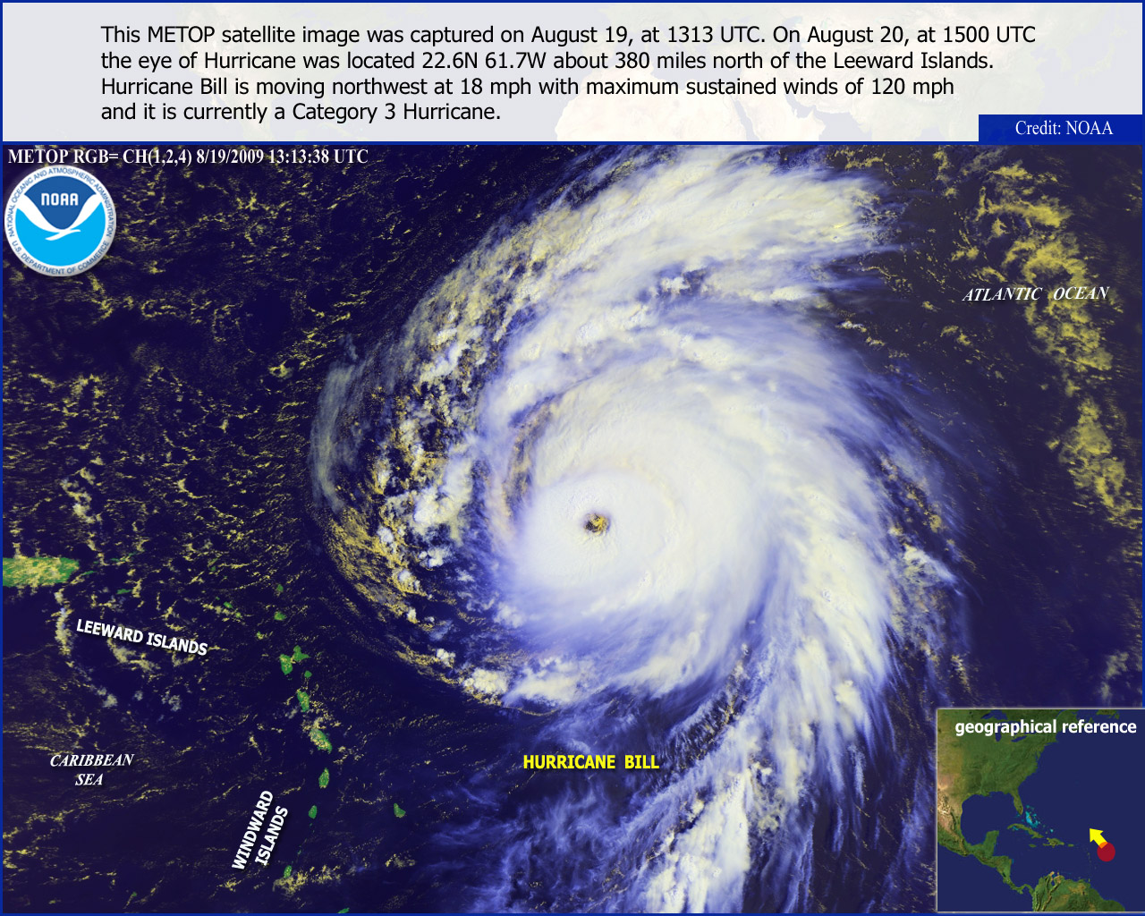
64th Interdepartmental
Hurricane Conference
“Meeting Operational Needs through Comprehensive Tropical Cyclone Research and Development”
March 1 - 4, 2010
Notes:
This slide is on the screen as the FC walks to podium

Slide 2
Closing Remarks
Mr. Samuel P. Williamson
Federal Coordinator for Meteorology
Conference sponsored and hosted by:
The Office of the Federal Coordinator for Meteorological Services
and Supporting Research
64th Interdepartmental Hurricane Conference
“Meeting Operational Needs through Comprehensive Tropical Cyclone Research and Development”

Slide 3
Overview
Motivation and Objectives
Conference Highlights
Next Steps
Conference Materials
Special Recognition
Location of the Next IHC

Slide 4
Why Are We Here?
Improve operational capability to provide services to help prevent loss of life and injuries
Minimize the nation’s vulnerability to nature’s most destructive forces
Enable a strong homeland defense through a safe overseas presence
Build upon synergies and collaboration in the tropical cyclone community
Continue to improve observations, modeling, forecaster tools, and incorporation of social science results into operations to improve services to myriad stakeholders
Notes:
4

Slide 5
Conference Objectives
Review the Nation’s tropical cyclone forecasting and warning program
Address actions from previous IHC
Update the National Hurricane Operations Plan for 2010
Review an assessment of tropical cyclone research and development activities and their contributions toward the forecasting and warning centers’ operational priorities
Review Joint Hurricane Testbed (JHT) projects and recognize candidates that may be successfully transitioned into operations

Slide 6
Conference Objectives
Examine aspects of the hurricane forecasting and warning process and ongoing social sciences-related research to aid in improved stakeholder / user response
Build upon tropical cyclone partnerships, leveraging agency capabilities to meet the operational needs of the tropical cyclone forecasting and warning centers

Slide 7
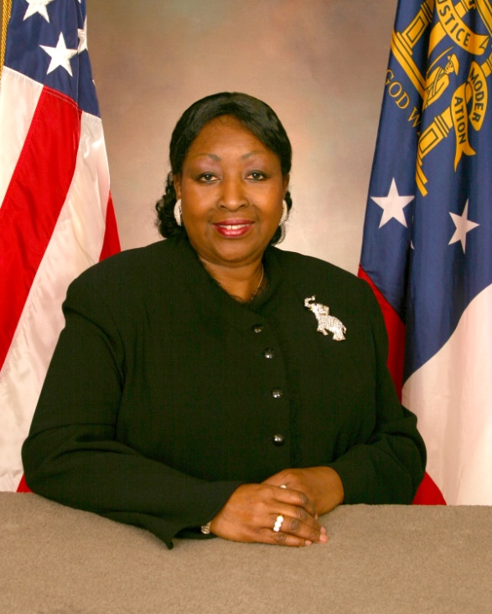
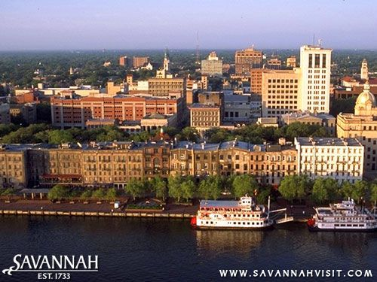
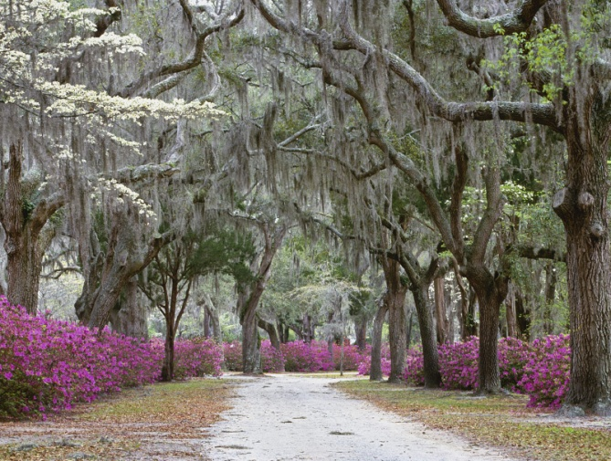
Conference Highlights
The Honorable Edna Jackson
Mayor Pro Tem, Savannah, Georgia
Welcome from the City of Savannah

Slide 8
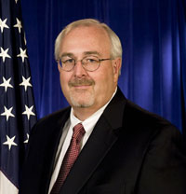
Conference Highlights
Mr. William Craig Fugate
Administrator of the Federal Emergency Management Agency (DHS/FEMA)
Notes:
8

Slide 9
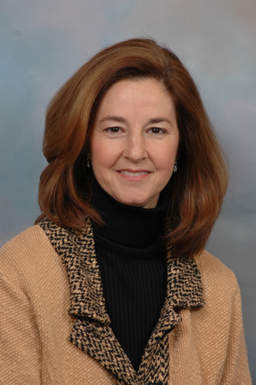
Conference Highlights
Ms. Monica Medina
Principal Deputy Under Secretary of Commerce for Oceans and Atmosphere (DOC/NOAA)
Notes:
9

Slide 10
Conference Highlights
Panel Discussion: The Power of Partnerships to Meet Operational Priorities
Moderator: Dr. Elbert W. (Joe) Friday, Professor Emeritus of Meteorology, University of Oklahoma
Panelists:
Dr. Ramesh Kakar, NASA Weather Focus Area Lead and Program Manager for Atmospheric Dynamics, NASA Headquarters
Dr. Fred Lewis, Air Force Director of Weather, HQ Air Force
RADM David Titley, Oceanographer and Navigator of the Navy
Dr. John “Jack” Hayes, Assistant Administrator for Weather Services, NOAA

Slide 11
Conference Highlights
Workshop/Panel: Assessment of the Tropical Cyclone R&D Activities in Contributing to the Operational Priorities of the Tropical Cyclone Forecasting and Warning Centers
Moderator: Dr. Elizabeth Ritchie, Associate Professor of Atmospheric Sciences, University of Arizona
Panelists:
Dr. Frank Marks, Co-chair, Working Group for Tropical Cyclone Research and Director, Hurricane Research Division, NOAA/AOML
Mr. James Franklin, Branch Chief, Hurricane Specialists Unit, NOAA/NWS/NHC
Mr. Robert Falvey, Director, Joint Typhoon Warning Center
Dr. Ronald Ferek, Co-chair, Working Group for Tropical Cyclone Research and Program Officer, Marine Meteorology Program, Office of Naval Research

Slide 12
Conference Highlights
Workshop/Panel: Understanding Hurricane Response for Improved Stakeholder / User Reaction
Moderator: Mr. Max Mayfield, Sr. Executive Vice President of Governmental Relations, America’s Emergency Network, and WPLG-TV Hurricane Specialist
Panelists:
Mr. David Caldwell, Director, Office of Climate, Water, and Weather Services, NOAA/NWS
Dr. Brenda Phillips, Sr. Researcher, Center for the Study of Disasters and Extreme Events, Oklahoma State University
Dr. Jeffrey Lazo, Director, Societal Impacts Program, NCAR
Ms. Jenniffer Santos-Hernandez, Graduate Research Assistant, Dept of Sociology and Criminal Justice, University of Delaware Mr. Walter Dickerson, President, Diversified Emergency Management Associates, LLC

Slide 13
Conference Highlights
Richard H. Hagemeyer Award
Congratulations to Dr. James Goerss Naval Research Laboratory, Monterey, California!
2010 winner of the Richard H. Hagemeyer Award

Slide 14
Next Steps
Update the National Hurricane Operations Plan, reflecting changes accepted by the Working Group for Hurricane and Winter Storms Operations and Research, by May 1, 2010
Potential for further engagement concerning the eastern boundary for aircraft weather reconnaissance from 55 deg W to 52.5 deg W

Slide 15
Next Steps
Act on Tropical Cyclone R&D issues
Convene the OFCM-sponsored Working Group for Tropical Cyclone Research and work with agencies to gather and analyze the FY2010 data
Brief the Interdepartmental Committee, then Federal Committee for Meteorological Services and Supporting Research (ICMSSR, FCMSSR)
As required, provide updates to the Office of Science and Technology Policy
Publish in Bulletin of the AMS or other similar publications
Report update at 65th IHC next year

Slide 16
Next Steps
Act on Understanding Hurricane Response
Briefed ICMSSR meeting on August 6, 2009
Highlighted broader scope and need to expand social science effort to other natural hazards
Organize two mini-workshops to develop an initial set of priorities
Present results of the mini-workshops to the ICMSSR and FCMSSR
Establish a working group, likely under the Committee for Environmental Services, Operations, and Research Needs (CESORN)
Use working group to execute agreed-upon priorities

Slide 17
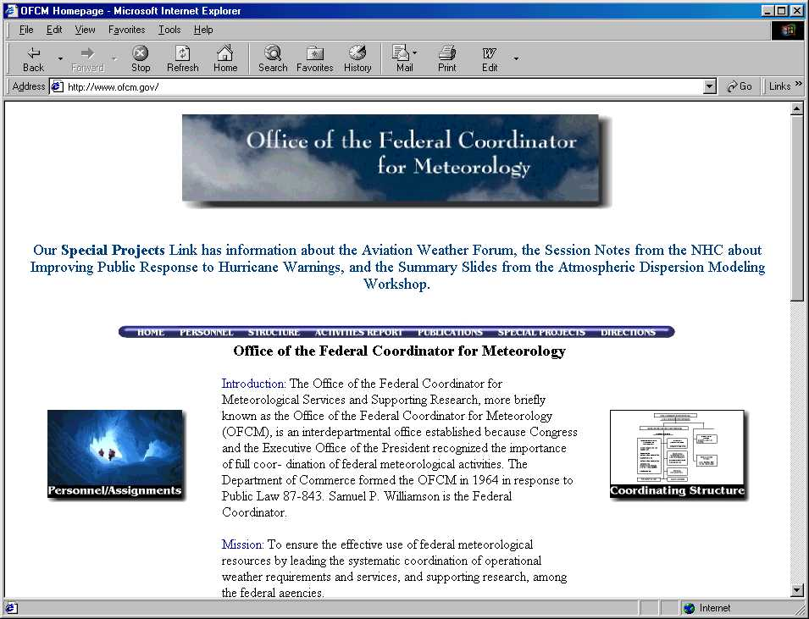
Conference Materials Available
Presentations and other material will be available on the OFCM web site shortly after the IHC.
Click on “Special Projects” and navigate to the 64th IHC.
http://www.ofcm.gov/

Slide 18
Special Recognition
WG/Tropical Cyclone Research (Frank Marks, Ron Ferek, and members)
WG/Hurricane and Winter Storms Ops
Bill Read, Director, NHC
Speakers, Session Leaders, Moderators, and Panelists
OFCM and STC Staff (Vicki Babcock and Pat Welshinger)
Hilton Savannah Desoto Hotel Beth Cowgill and the Staff
Mayor Pro Tem Edna Jackson and Bret Bell, Public Information Director, for the City of Savannah, GA

Slide 19
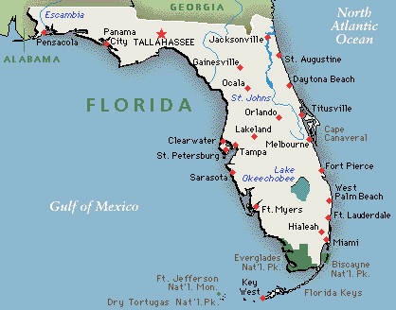
Next IHC
65th Interdepartmental Hurricane Conference
Greater Miami, FL, Area

Slide 20
The 64th IHC is adjourned
Thank you for attending and participating in the 64th Interdepartmental Hurricane Conference!
On behalf of the Office of the Federal Coordinator for Meteorology,
Have a safe trip home!

Slide 21
Notes:
21

