Slide 1
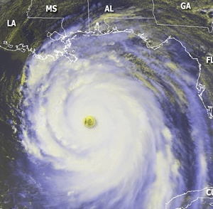
Working Group/Tropical Cyclone Research
Final Plenary Session

Slide 2
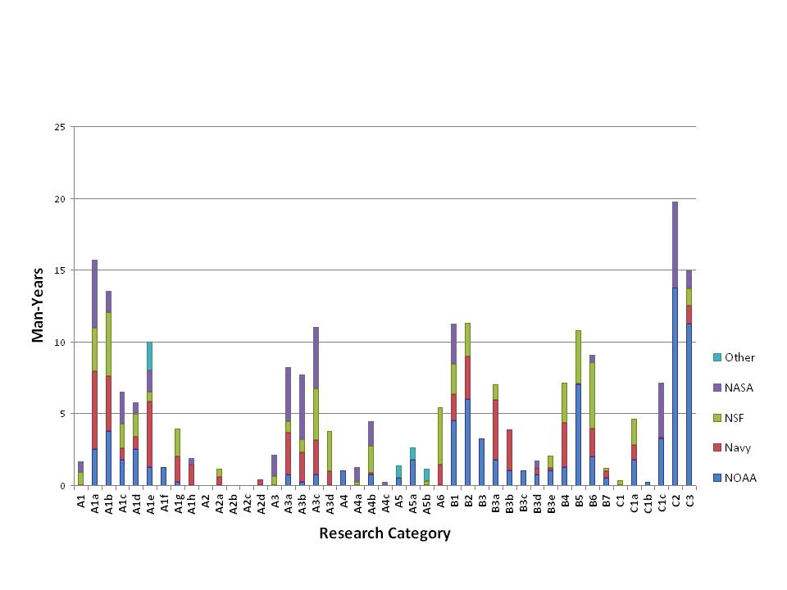
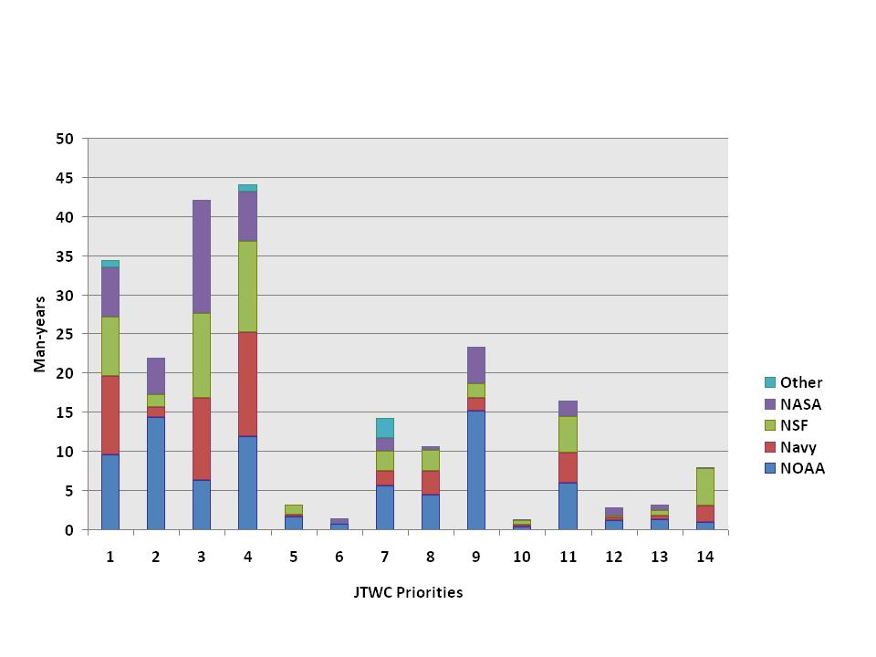
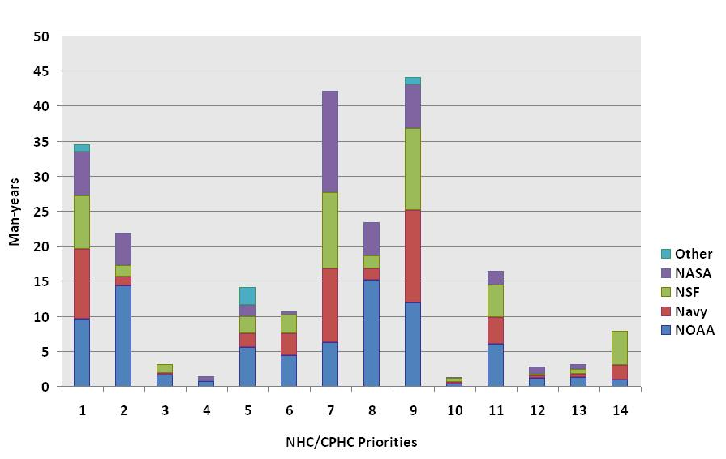
Tropical Cyclone R&D
Was first-ever snapshot analysis of all identified agency R&D efforts mapped against:
Research needs (Table 2)
Operational priorities of TC forecasting and warning centers (Table 1)
JTWC Priorities
NHC / CPHC Priorities
Periodic process needed and useful
TC community attending IHC supported work of the WG/TCR
Engages operational and research communities
Next compilation of TC projects and mapping will use FY10 data
Need to raise awareness of WG/TCR work

Slide 3
QUESTIONS

Slide 4
BACKUPS

Slide 5
Analysis of Tropical Cyclone R&D
Intensity / Structure
Track
Genesis
QPF
Surge
Model Development
Obs
[Seasonal]
Figure above summarizes the amount of research activity for each of the detailed research need categories described in Table 2
Investment from multiple agencies for most research areas
Members of the Working Group did not attempt to evaluate whether there was sufficient research being conducted in each of the research categories

Slide 6
Closing Comments
and
Way Ahead for WG/TCR
Dr. Ronald Ferek
Co-Chair, Working Group for Tropical Cyclone Research
and
Program Officer, Marine Meteorology Program, ONR

Slide 7
Analysis of Tropical Cyclone R&D
Closing Comments
There are differences in operational priorities between JTWC and NHC / CPHC due to customer base
Prioritized operational needs (Table 1) was not readily available and widely known when previous investment decisions were made
Some of the apparent “mismatch” is understandable
As HFIP rolls out much of this will be addressed
Communication of ops priorities to research community is a good thing
Need to strengthen the processes by which research investments are aligned to operational priorities
JTWC Priorities
NHC / CPHC Priorities

Slide 8
Analysis of Tropical Cyclone R&D
Closing Comments
Does not appear to be enough total investment to adequately address all priorities
Advanced development funding (“6.4” in DoD) is inadequate to ensure that the discoveries of basic and applied research are efficiently transitioned to operations
Would like research community to take more of an interest in the operational models (e.g., guidance on guidance, diagnostics, model improvement)
JTWC Priorities
NHC / CPHC Priorities

Slide 9
WG/TCR Way Ahead
Interagency TC Research Assessment Strategy
Keep Tables 1 and 2 updated
Table 1: Ops priorities
Table 2: Research needs
Biennially map agency research efforts against TC research needs and operational priorities
Will do FY10 next
WG/TCR meets as required to analyze, assess, and help inform agency research investments
Brief ICMSSR / FCMSSR, as required
Update information at IHC
Publish results & analysis of agency research

