Slide 1
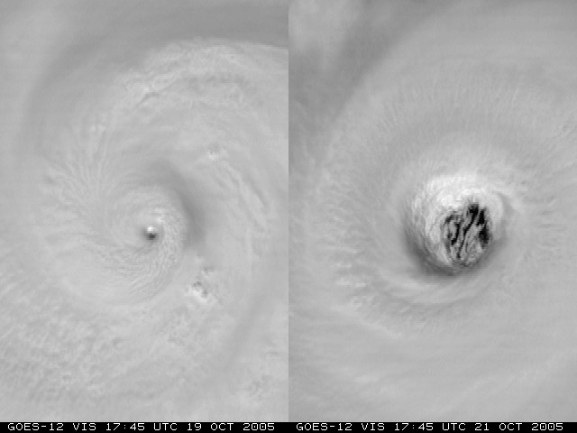
Advanced Applications of the Monte Carlo Wind Probability Model: A Year 1 Joint Hurricane Testbed Project Update
Mark DeMaria¹, Stan Kidder², Robert DeMaria²,
Andrea Schumacher², Daniel Brown³, Michael Brennan³,
Richard Knabb⁴, Pablo Santos⁵ and David Sharp⁶
¹NOAA/NESDIS, Fort Collins, CO
²CIRA, Colorado State University, Fort Collins, CO
³NCEP National Hurricane Center, Miami, FL
⁴Central Pacific Hurricane Center, Honolulu, HI
⁵NOAA/National Weather Service, Miami, FL
⁶NOAA/National Weather Service, Melbourne, FL
Interdepartmental Hurricane Conference
March 2010

Slide 2
Outline
Brief overview of the MC model
Summary of current project tasks
Progress report
Plans for Year 2

Slide 3
Monte Carlo Wind Probability Model
Estimates probability of 34, 50 and 64 kt wind to 5 days
1000 track realizations from random sampling of NHC/CPHC or JTWC track error distributions
Intensity of realizations from random sampling of NHC/CPHC or JTWC intensity error distributions
Special treatment near land
Wind radii of realizations from radii CLIPER model and its radii error distributions
Serial correlation of errors included
Probability at a point from counting number of realizations passing within the wind radii of interest
Replaced NHC strike probability program in 2006

Slide 4
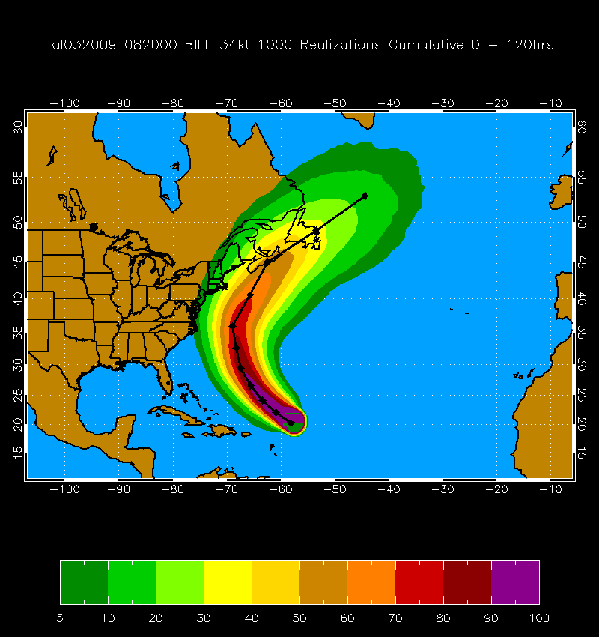
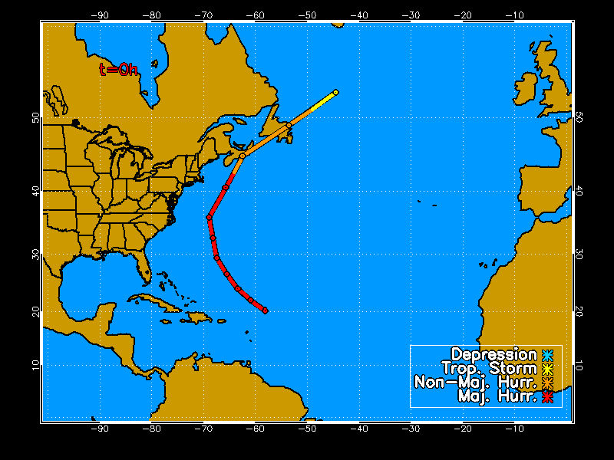
MC Probability Example
Hurricane Bill 20 Aug 2009 00 UTC
1000 Track Realizations 34 kt 0-120 h Cumulative Probabilities

Slide 5
Forecast Dependent Track Errors
Use GPCE input as a measure of track uncertainty
GPCE = Goerss Predicted Consensus Error
Divide NHC track errors into three groups based on GPCE values
Low, Medium and High
GPCE version under evaluation by NHC

Slide 6
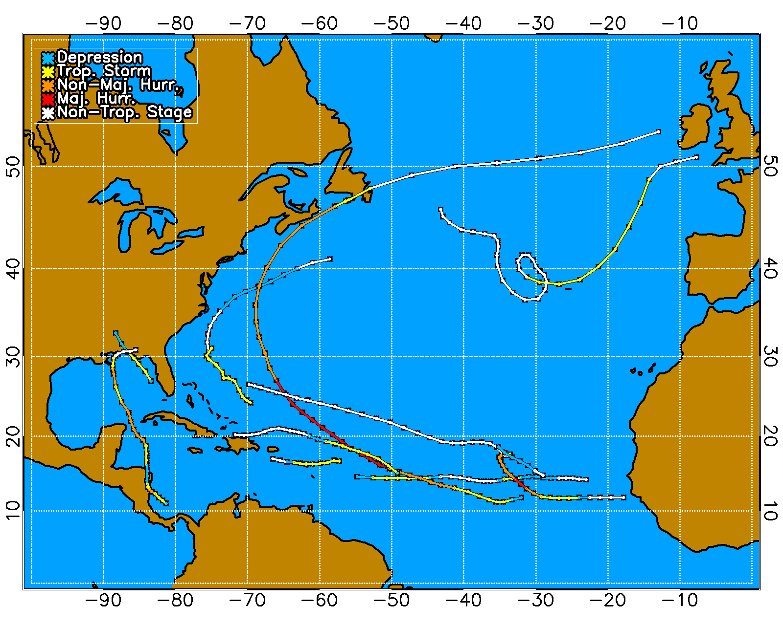
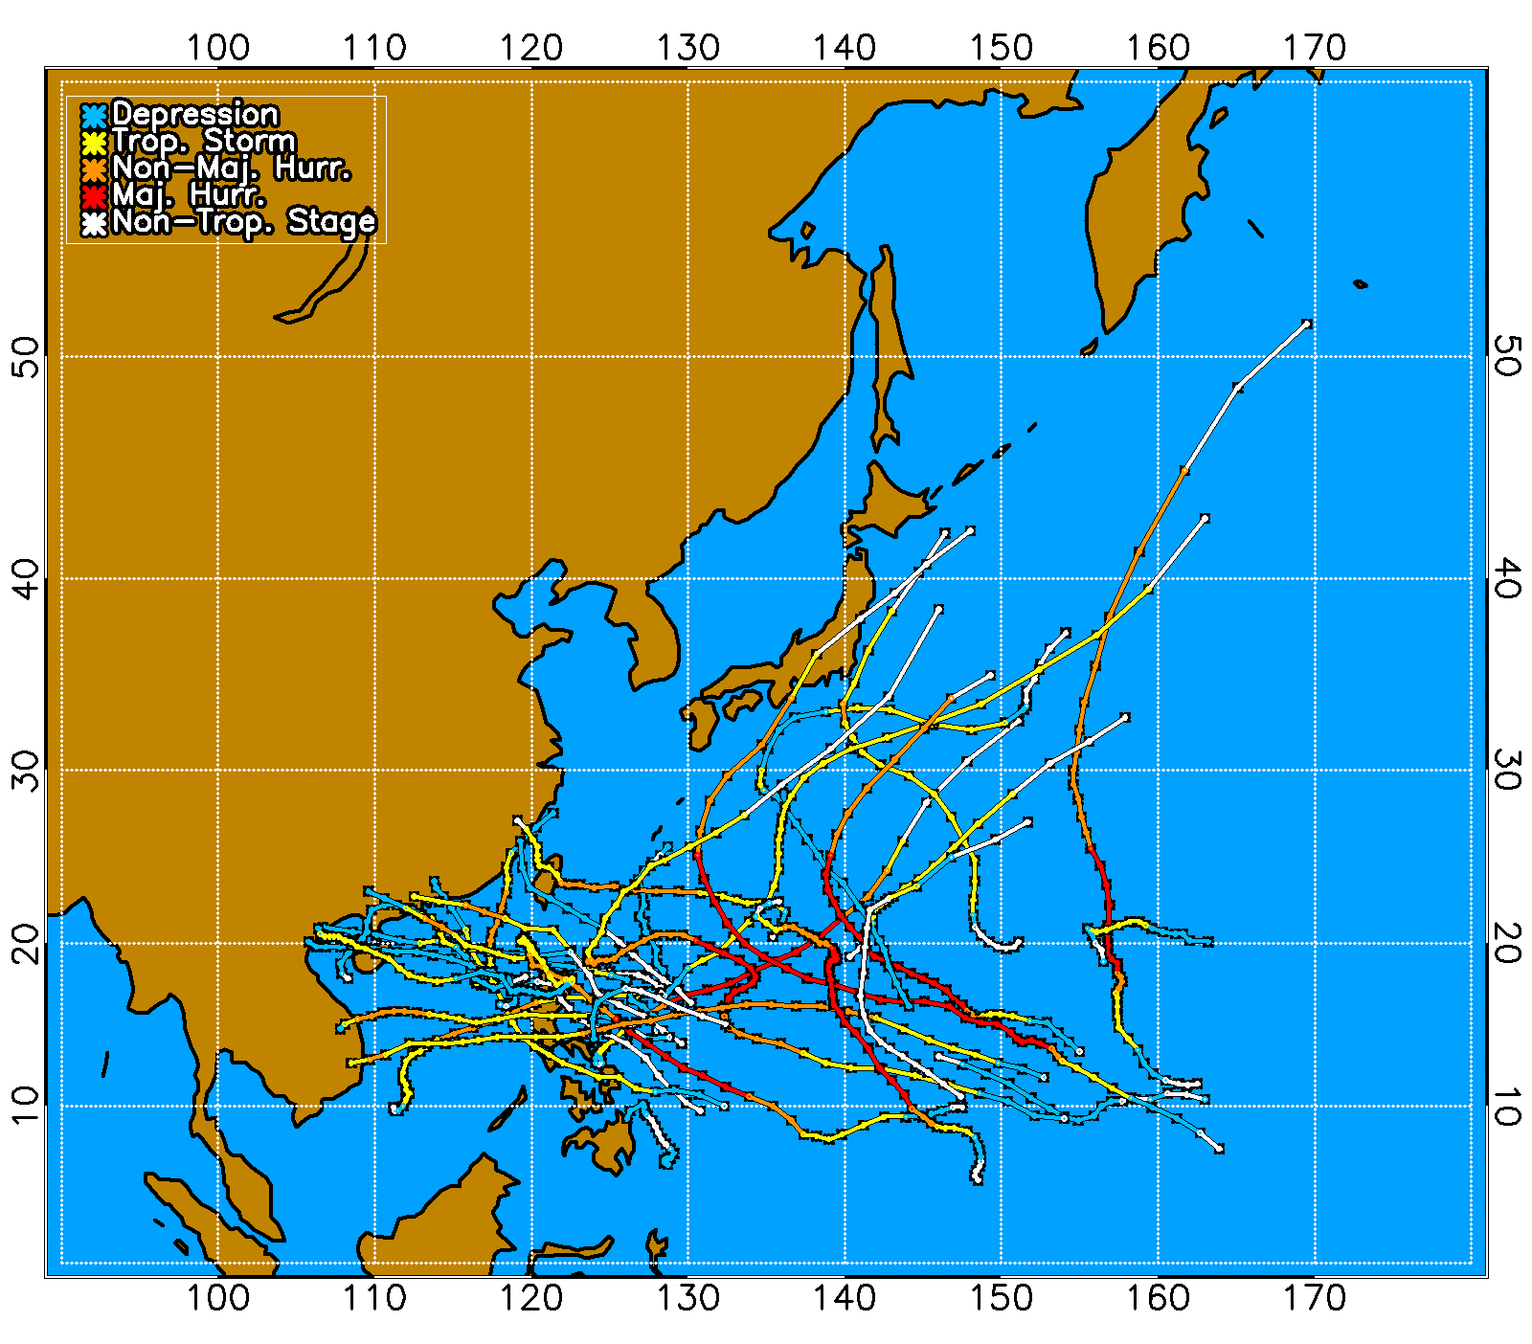
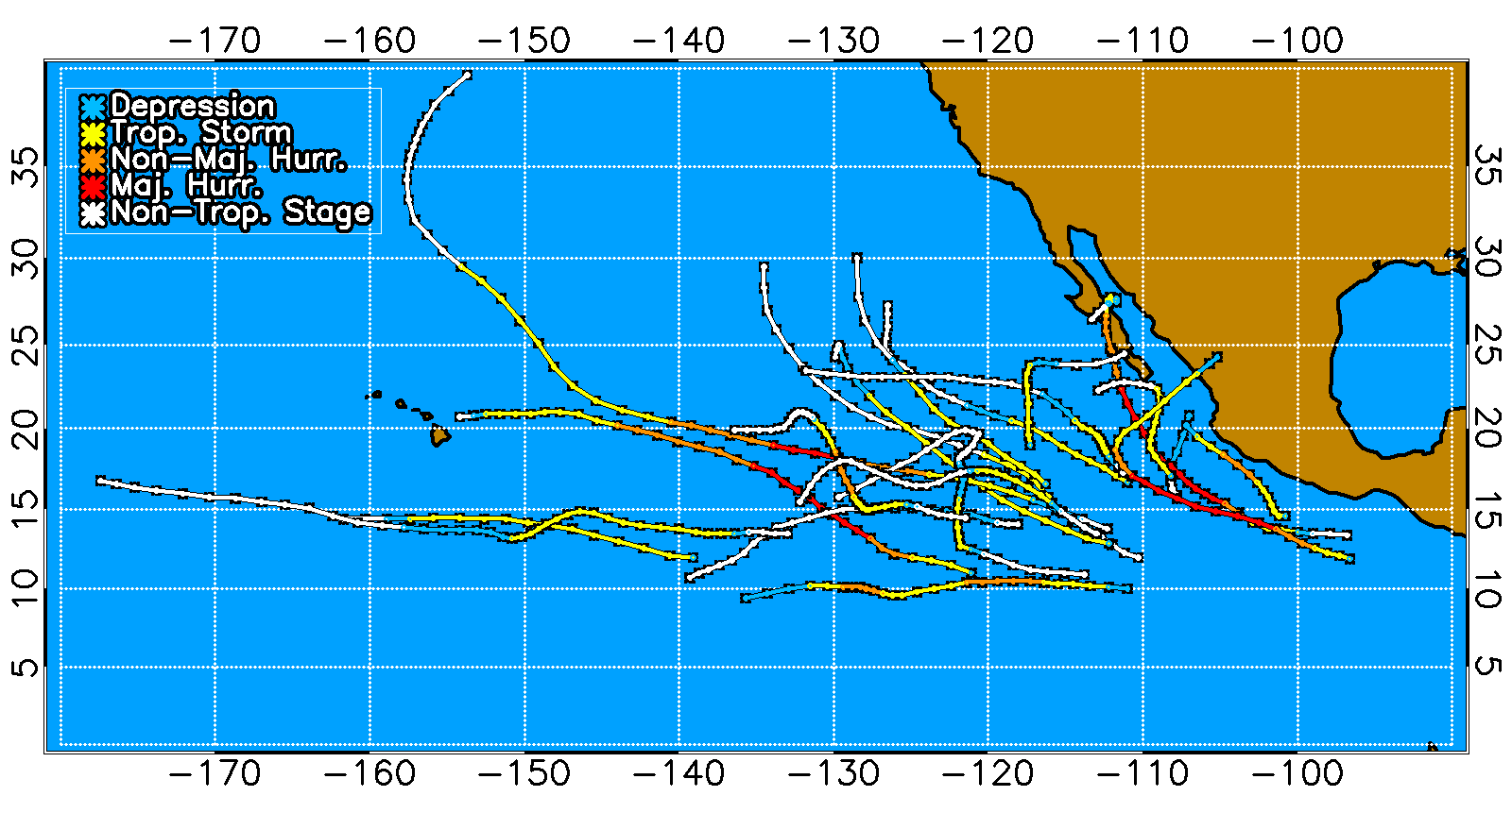
Evaluation of GPCE Version in 2009
Two evaluation metrics: Brier Score, Threat Score
Compare operational and GPCE versions
AL01-AL11
WP01-WP28
EP01-EP20

Slide 7
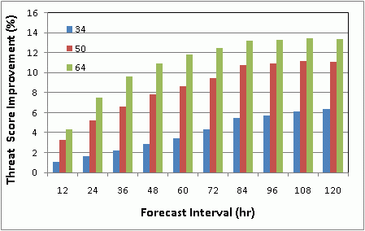
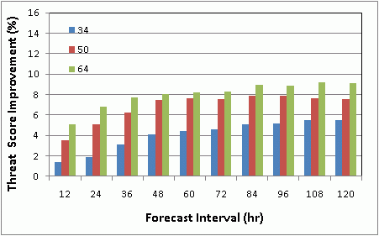
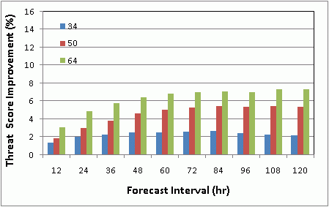
Threat Score Improvements with GPCE version
Atlantic
West Pacific
East Pacific

Slide 8
Current JHT Project Tasks
Advanced Applications
Landfall timing and intensity distributions
Application to WFO local products
Probabilities integrated over coastal segments
Automated guidance for watch/warnings
Model Improvements
Adjust time step for small/fast storms
Improve azimuthal interpolation of wind radii
Improve spatial interpolation for text/grid product consistency
Evaluate wind radii model

Slide 9
A1. Landfall timing/intensity distributions
New output file with track, intensity, radii of all 1000 realizations
User interface written for coastal point selection
Hurricane Landfall Probability Applications (HuLPA)
Java program as ATCF prototype
Algorithm for landfall timing distributions completed
Algorithm for timing of 34, 50, 64 kt winds under development

Slide 10
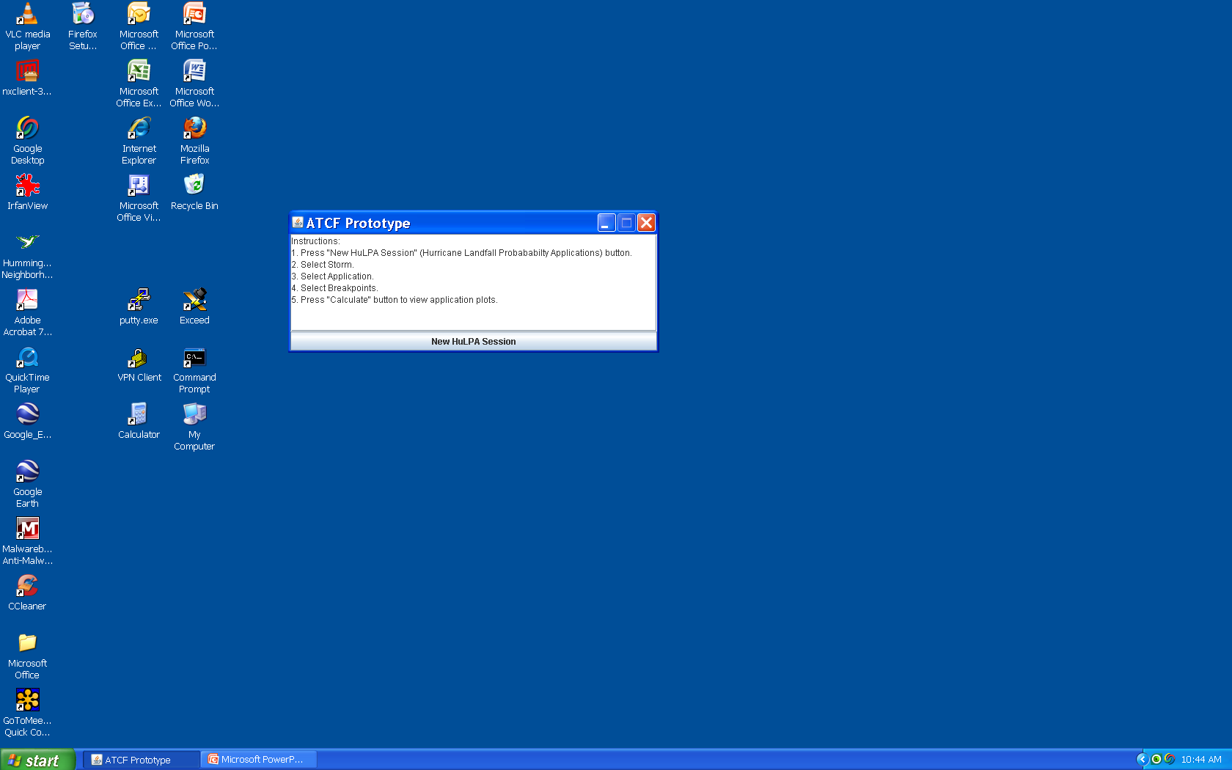

Slide 11
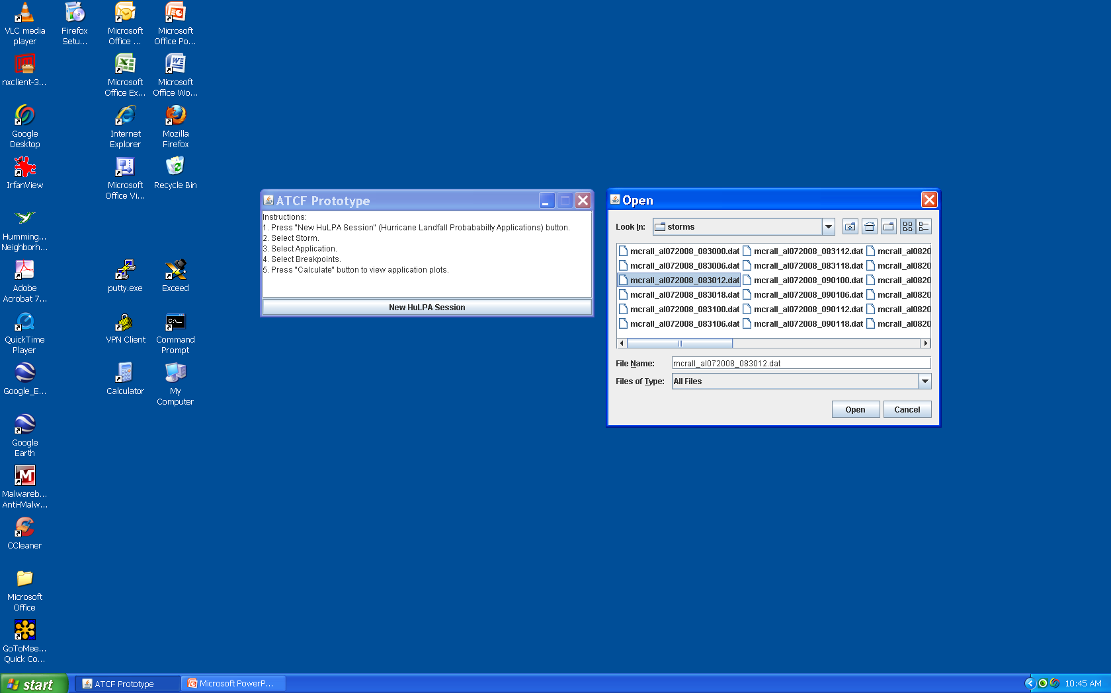

Slide 12
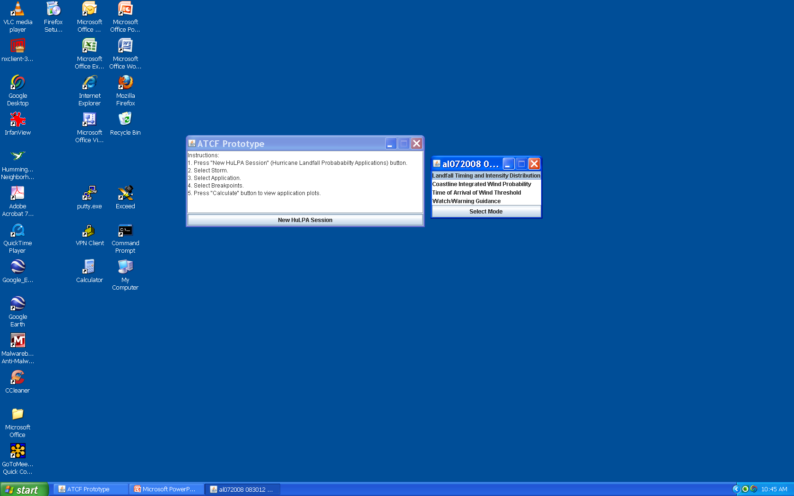

Slide 13
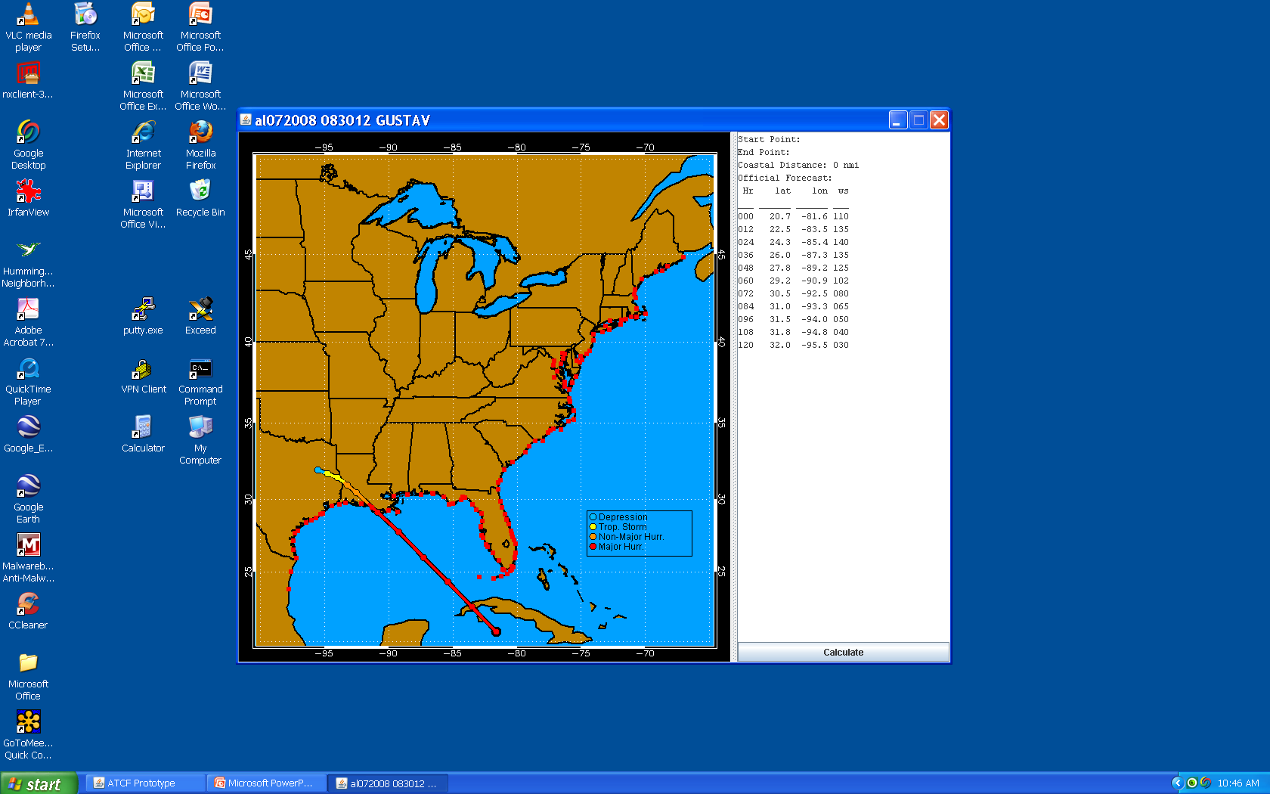

Slide 14
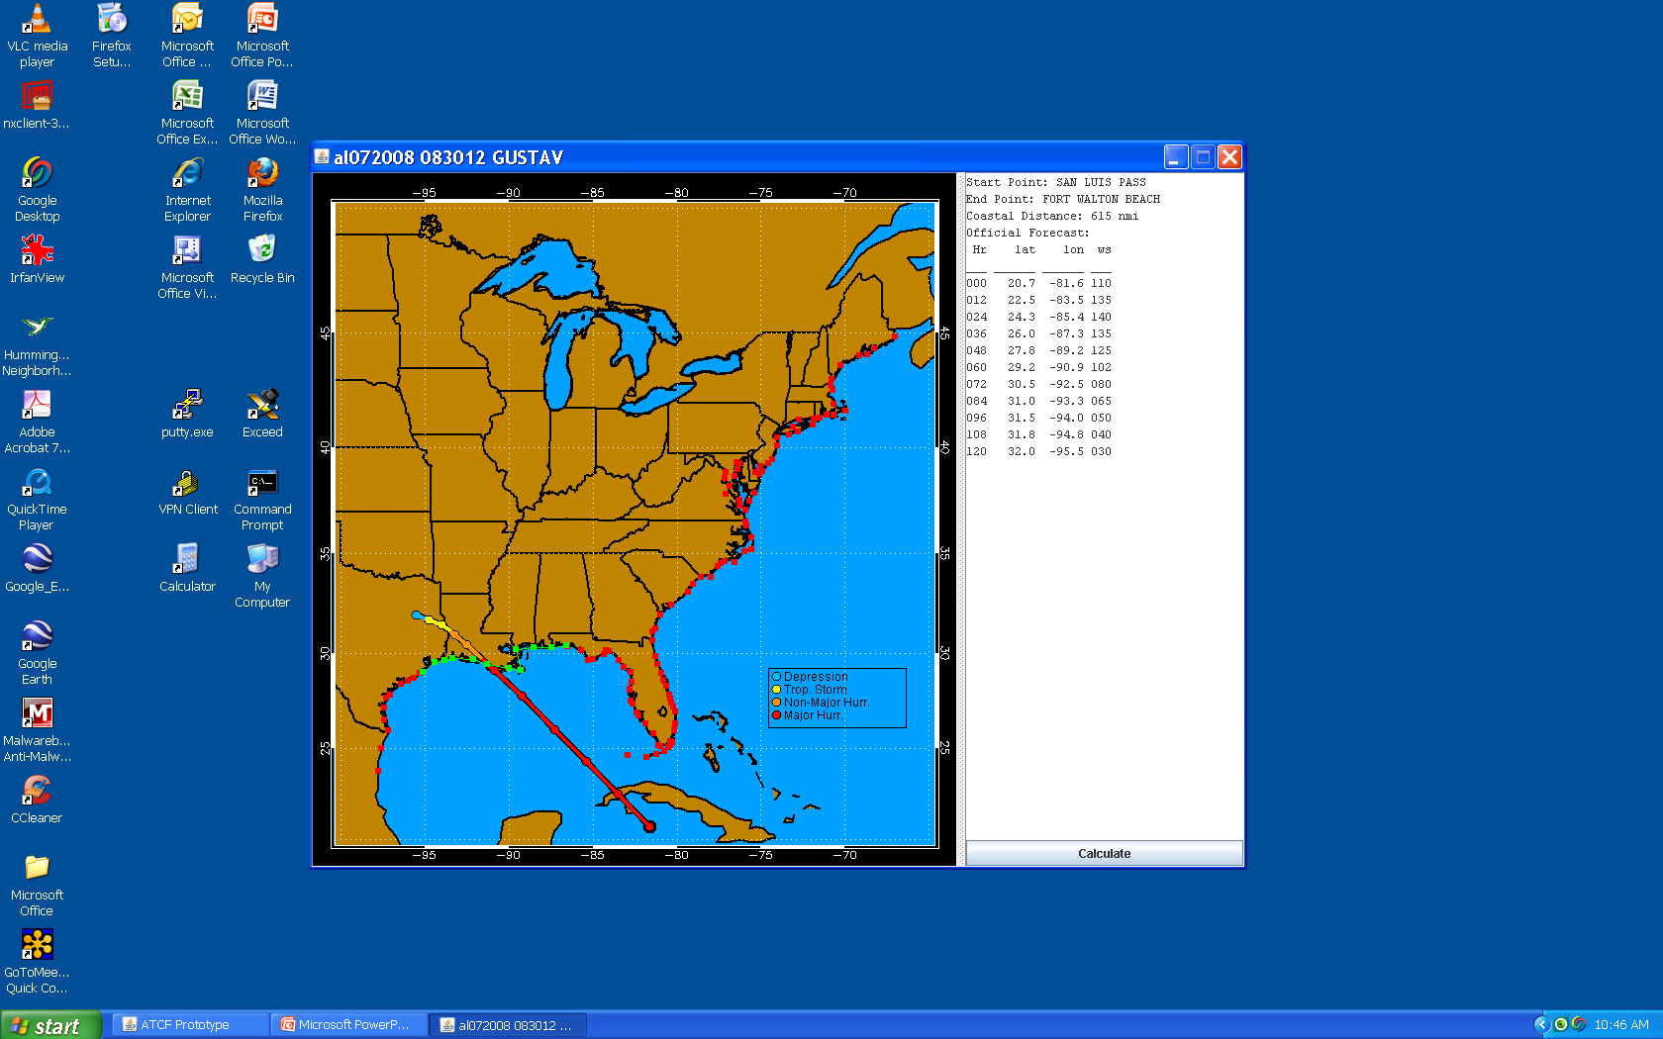

Slide 15
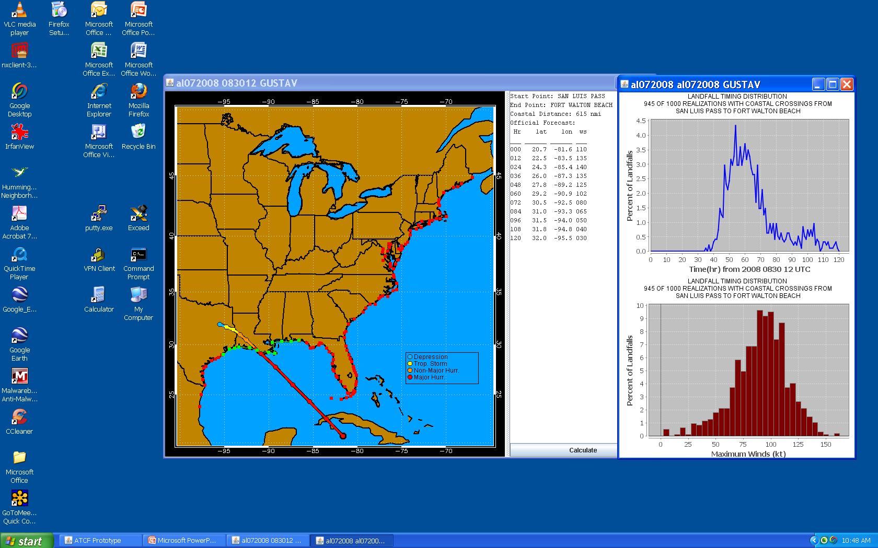

Slide 16
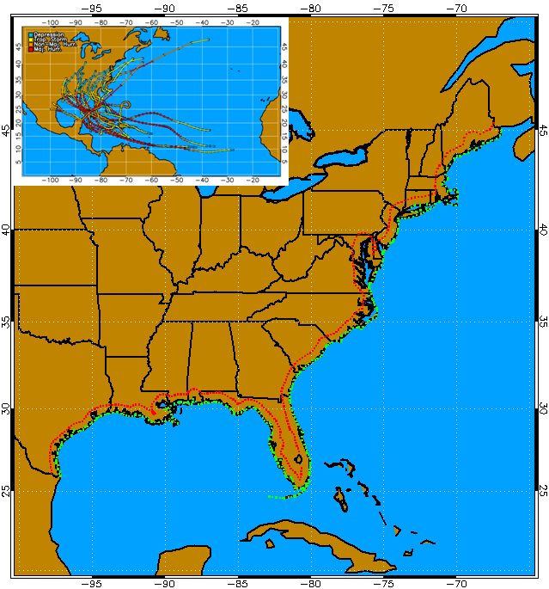
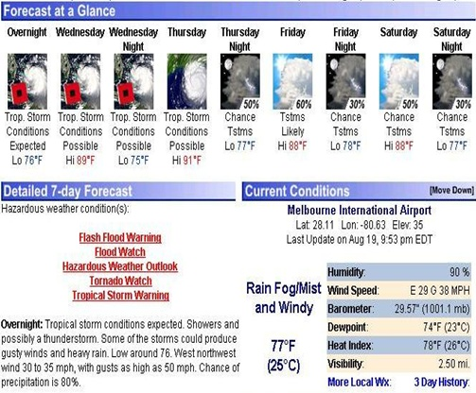
A2. WFO Local Products
Coordinated with P. Santos and D. Sharp on coastal and inland verification
Presented by P. Santos at 2010 AMS Conference
Used to define thresholds for product generation
Threat score the most useful
2004-08 cases
400 forecasts
20 TCs

Slide 17
A3. Coastal integrated probabilities A4. Watch/Warning guidance
Coastal integrated probabilities included in HuLPA
Algorithm not complete yet
Preliminary development of W/W guidance
Threshold method developed for hurricane warnings and watches
Tropical storm watches and warning under development
Logic needed to decide between TS, Hurricane watches and warning
Will be incorporated into HuLPA for testing

Slide 18
M1. Time Step Adjustment
Rule of thumb
∆t ≤ R₆₄/c
R64 = 40 nmi, c=20 kt,
∆t = 2 hr
2 hr too long for small, fast storms
Code modified for variable time step
∆t = 1 hr improves noisy probability fields
Only increases run time by 10%
∆t = 1 hr needed for landfall probabilities
Suggest using 1 hr time step for all runs

Slide 19
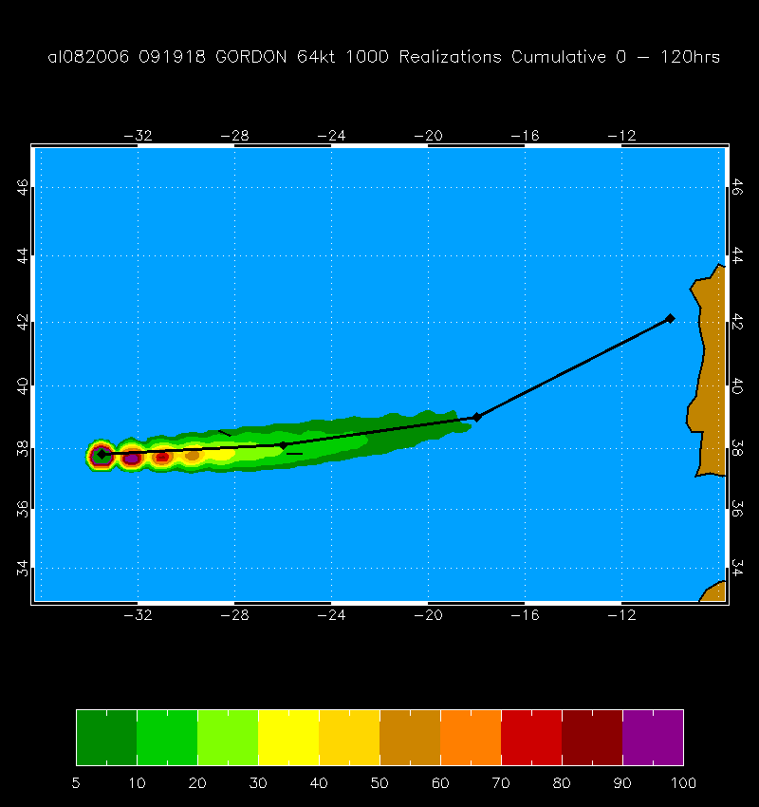
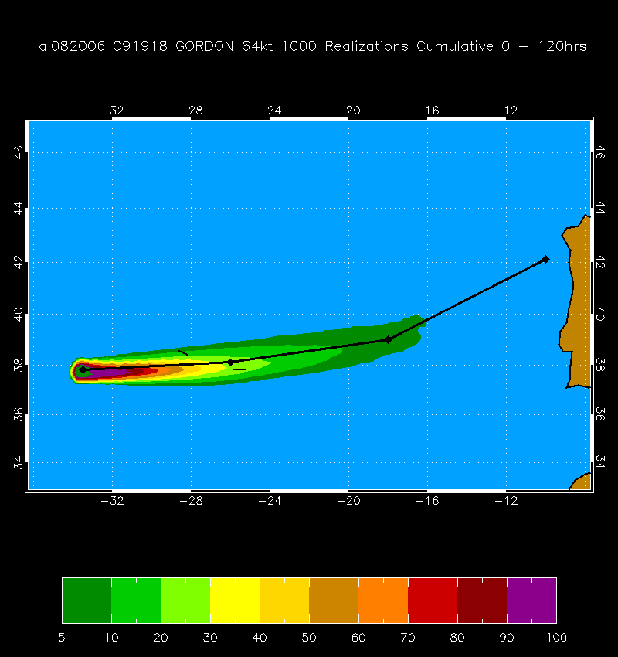
M1. Time Step Adjustment
Hurricane Gordon, 19 Sept 2006 18 UTC
R₆₄ ~ 25 to 30 nmi, c = 28 kt
∆t = 2 hr ∆t = 1 hr

Slide 20
M2. Improve azimuthal radii interpolation M3. Improve spatial interpolation
Azimuthal interpolation
Results in inconsistent 34 and 50 kt probabilities in rare cases
Large RMW, 34 and 50 kt wind zero in most quadrants
Use extrapolation instead of interpolation
Spatial interpolation
Inconsistency between gridded and text products in regions of high gradients
Increase grid resolution or include coastal points in grid interpolation routine

Slide 21
M4. Evaluation of Wind Radii Model
Wind radii from climatology and persistence model and its error distributions
Only input are track and max wind
Should produce realistic radii distributions
Compare 5000 MC model radii and 1988-2008 “observed” distributions
Model radii from 5 representative MC model runs

Slide 22
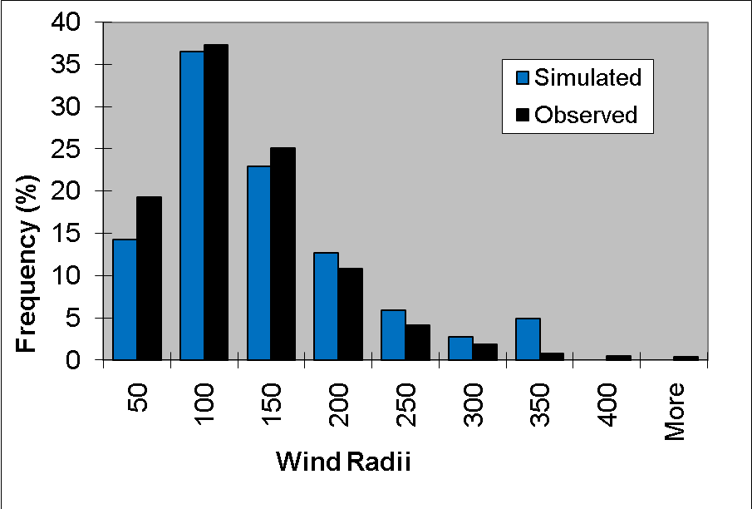
M4. Evaluation of Wind Radii Model
MC model (t=72 hr) and observed distributions of 34 kt wind radii

Slide 23
Future Plans
2010 Season
Test 2 of 3 HuLPA products in 2010 season
Landfall distributions, Integrated probabilities
Implement reduced time step, improved azimuthal interpolation
Additional verifications for WFO applications
Continue wind radii model evaluation
2011 Season
Test watch/warning guidance
Improved spatial interpolation
Refine HuLPA as needed

