Slide 1
Progress and plans for the development of a unified dropsonde quality assurance and visualization capability
Principal Investigators:
Michael L. Black, NOAA/AOML Hurricane Research Division, Miami, FL
Charles L. Martin, Earth Observing Laboratory, NCAR, Boulder, CO
Collaborators:
Paul Flaherty and Jackie Almeida, Aircraft Operations Center, MacDill AFB, FL
Joseph E. Latham, USAFR, 53rd Weather Reconnaissance Squadron, Keesler AFB, Biloxi, MS

Slide 2
Background:
Two software packages have been used on operational aircraft missions to date:
HRD’s Editsonde package on all P3 missions and G-IV flights prior to 2005
NCAR’s ASPEN software on AFRC C-130 missions
HRD, NCAR, and NHC determined that substantial differences in the products (TEMP DROP messages, ASCII files) between the two packages could occur due to differences in the algorithms and capabilities of the two software suites
Both software packages are for single computer platforms- ASPEN: Windows,
Editsonde: HP Unix
The JHT decided to fund an effort to reconcile the differences in the software, improve on the capabilities, and convert the code and graphics packages to work on multiple computer operating systems

Slide 3
Progress:
A formal meeting was held in 2009 among the primary users of dropsonde quality assurance software users to identify the major requirements of the project which include:
Retain the basic structure and graphical capabilities of ASPEN while adding additional capabilities that are available in Editsonde
The highest priority of these capabilities are the use of synoptic maps to more easily analyze and correct observations from individual flights and more control of the data editing features
The new software package should have multi-platform capability
Reconciliation of quality control algorithms between the Aspen and Editsonde software

Slide 4
Progress (cont’d)
Significant progress has been made in the reconciliation of the algorithms, especially for the critical near-surface region of the sounding. Differences between Aspen and Editsonde were carefully studied and the causes of discrepancies were documented. Aspen was modified so that the near-surface processing produces results very close to the output from Editsonde
A prototype software package has been built that is multi-platform capable. The package uses the Nokia-Trolltech Qt graphical user interface system, along with utilization of the “scons” software build environment that makes this possible. An initial scons configuration has been completed, and the AspenV3 prototype is now operating on three platforms: Windows, Linux , and Mac OSX operating systems. The initial prototypes have been tested for basic functionality and will be soon be available to JHT point of contacts and collaborators for further testing.
NCAR-EOL has recently hired an additional software engineer to work on this project. The software engineer holds Master’s degrees in both computer science and meteorology and thus is ideal suited for this project. He will devote about half of his time to the unified dropsonde software package

Slide 5
Near-term Goals
A synoptic analyses and visualization feature will be added to ASPENV3. This functionality is currently found in Editsonde, and is the most often requested new feature for ASPEN.
An “auto-save” feature, which automatically saves the quality control output products, will be added to ASPENV3.
Additional editing capability of ASPEN V3 will be developed based upon recommendations from the collaborators and JHT point of contacts.
Work will begin on the development of an automated validation system, which will provide an objective method for comparing processing results between Editsonde and ASPENV3. It will also provide a method for validating software modifications to the unified software package as development continues in future years.

Slide 6
2010 Hurricane season plans for ASPENV3:
The prototype software will NOT be used operationally this summer except for:
Ground processing of the raw dropsonde files from the NASA Global Hawk dropsonde system (research flights)
Possibly for the NASA DC-8 dropsondes as well*
Possibly for NOAA P3 operational and research missions*
* To date plans have not been finalized for dropsonde processing for aircraft involved in field campaigns this summer (PREDICT, GRIP, IFEX). Other factors besides the availability and functionality of ASPENV3 are involved

Slide 7
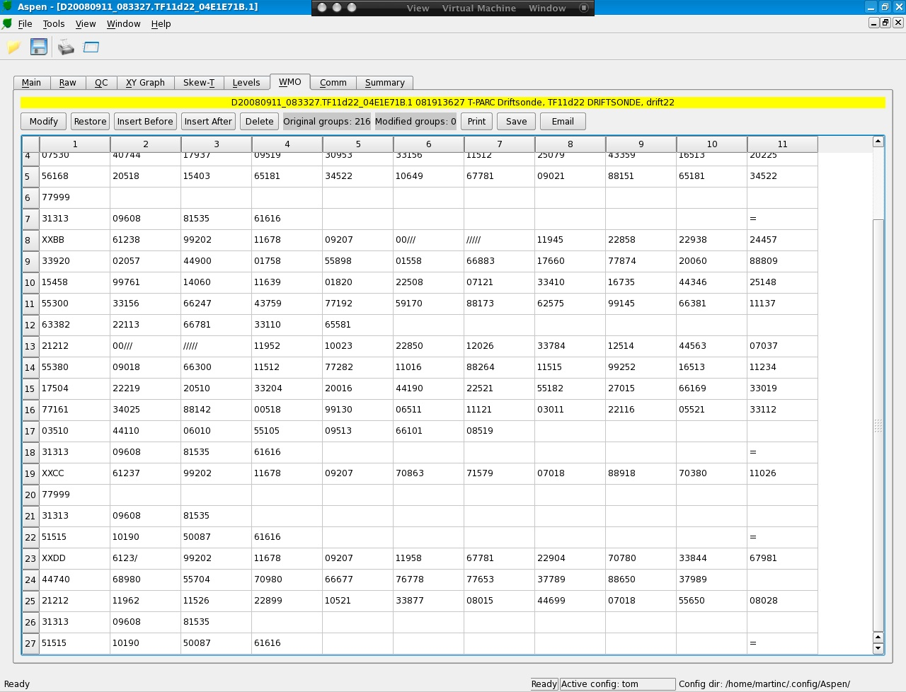
ASPENV3 screen shots: Linux

Slide 8
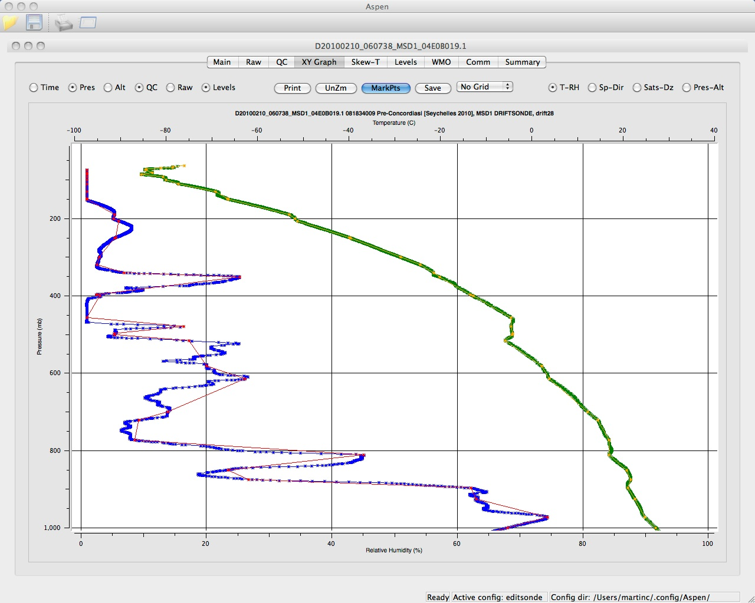
ASPENV3 screen shots: Mac OSX

Slide 9
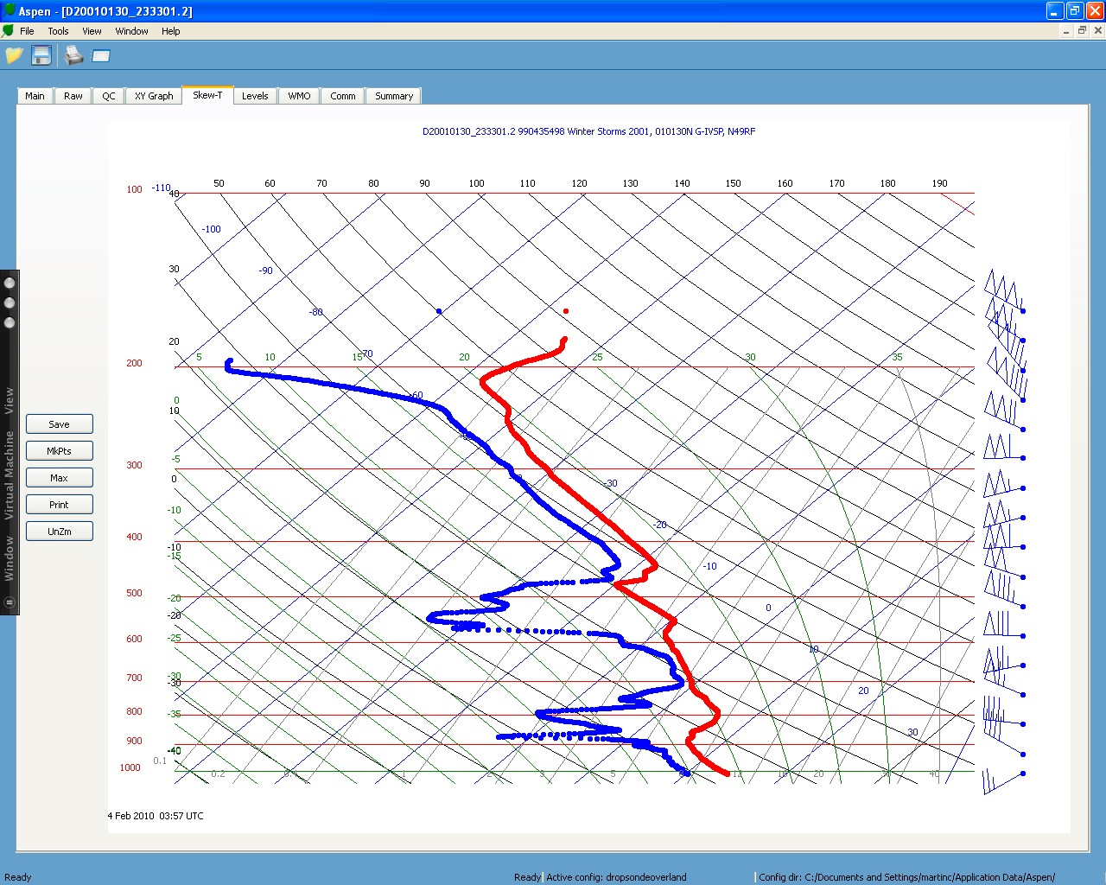
ASPENV3 screen shots: Windows XP

Slide 10
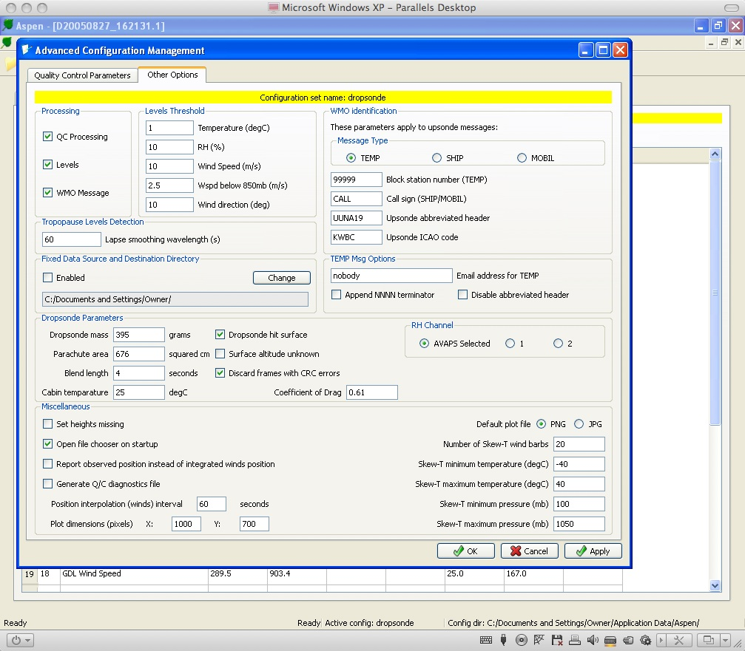
ASPENV3 screen shots: Windows XP

Slide 11
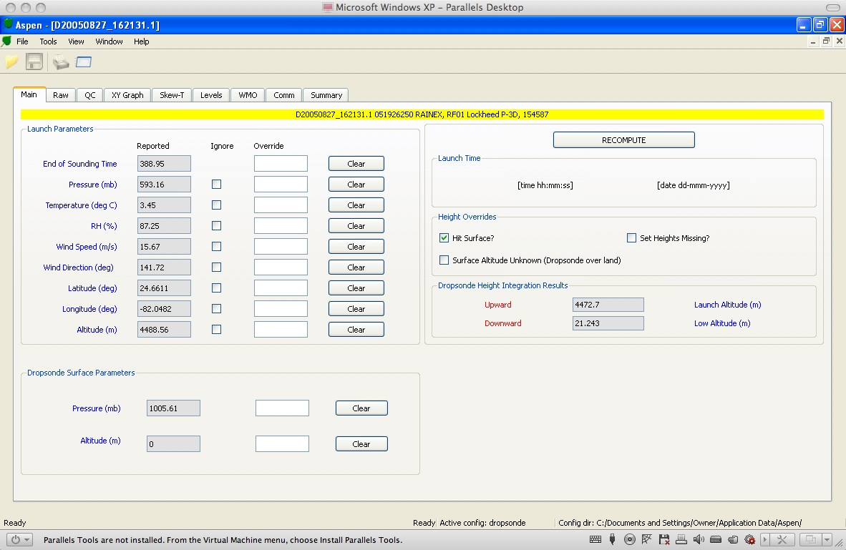
ASPENV3 screen shots: Windows XP

Slide 12
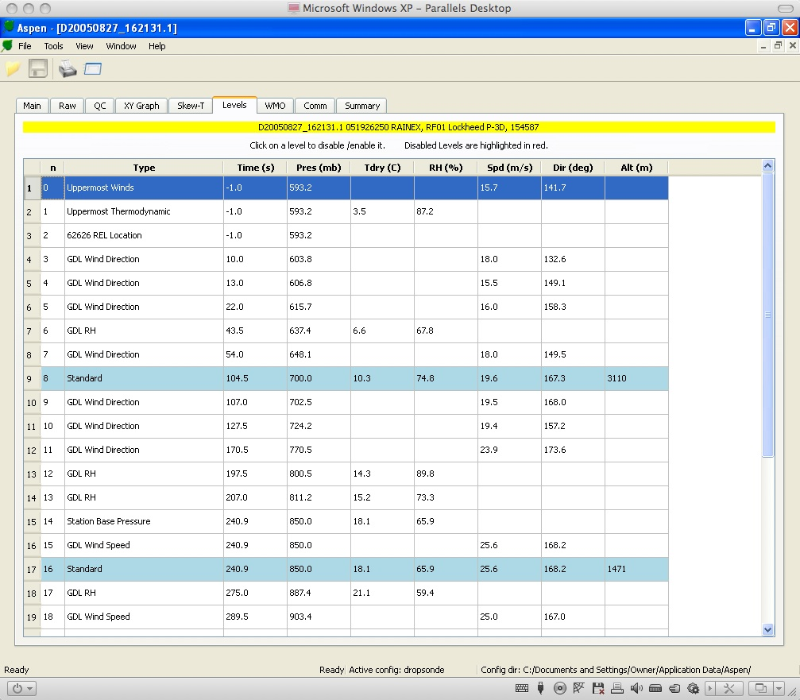
ASPENV3 screen shots: Windows XP

