Slide 1
John Kaplan (NOAA/HRD), J. Cione (NOAA/HRD), M. DeMaria (NOAA/NESDIS), J. Knaff (NOAA/NESDIS), J. Dunion (U. of Miami/HRD), J. Solbrig (NRL), J. Hawkins(NRL), T. Lee (NRL), E. Kalina (FSU), J. Zhang(U. Miami/HRD), J. Dostalek (CIRA), and P. Leighton (NOAA/HRD)
Enhancements to the Operational SHIPS Rapid Intensification Index
Acknowledgements
Funding: NOAA/JHT
Project coordination: Lixion Avila, Eric Blake, Todd Kimberlain, Chris Sisko, and Chris Landsea (NHC)

Slide 2
Background
Operational SHIPS rapid intensification index (RII) estimates the 24-h probability of RI for three RI thresholds (25-kt ,30-kt , and 35-kt ) utilizing linear discriminant analysis (see Kaplan et al. 2010 for details)
Current RII uses 8 SHIPS predictors
Large scale/persistence predictors (6)- Vertical shear, upper-level, divergence, low-level RH, potential intensity, ocean heat content, and persistence
GOES inner-core predictors (2) - Std. dev. of IR brightness T and areal-coverage of -30° C brightness T within 200 km radius
SHIPS discriminant RII adopted for operational use in Atlantic and E. Pacific basins prior to 2008 Hurricane season
Current JHT project seeks to improve operational RII using predictors from 3 new sources:
Total precipitable water, boundary-layer predictors derived from GFS analyses, and GOES-IR predictors derived from principle component (PC) analysis

Slide 3
Operational RI intensity guidance evaluation (2008-2009)
SHIPS RII assumed to forecast RI if forecasted probability exceeded previously determined probability cut-offs (see Kaplan et. al 2010):
Atlantic- 30, 20, and 21% for 25, 30 and 35 kt thresholds
E. Pacific- 35, 31, and 28% for 25, 30 and 35 ktthresholds
Model forecast RI if intensity change > RI threshold
Homogenous comparison made for all over-water 24-h time periods for tropical and subtropical systems (i.e. extra-tropical and landfall cases excluded)
NHC best track data (as of Jan 26) used for validation

Slide 4
RI index (RII) predicted vs observed RI probabilities (2008-2009 operational forecasts)
Atlantic Basin
E. Pacific basin
N(25-kt) 40 112 92 24 19 6
(30-kt) 144 104 25 13 3 4
(35-kt) 248 23 12 8 2
N(25-kt) 157 45 113 92 9 7 10 5 3
(30-kt 212 87 105 10 5 3 6 2 2 2
(35-kt) 260 98 64 3 4 3 5 2 2

Slide 5
Skill of the 2009-2009 operational RII forecasts Atlantic (N=293) E. Pacific (N=441)

Slide 6
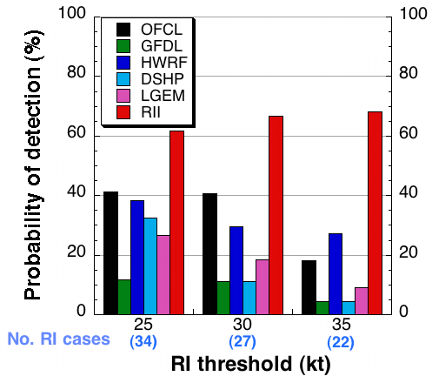
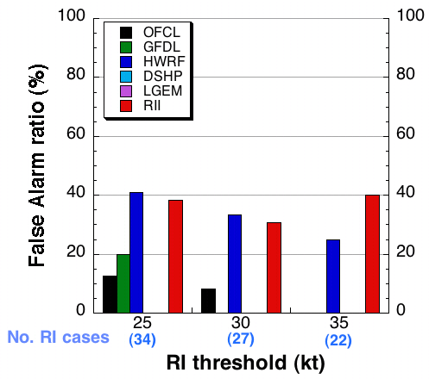
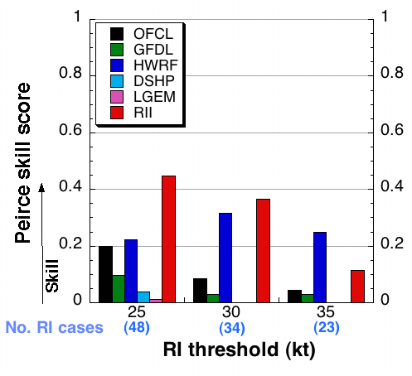
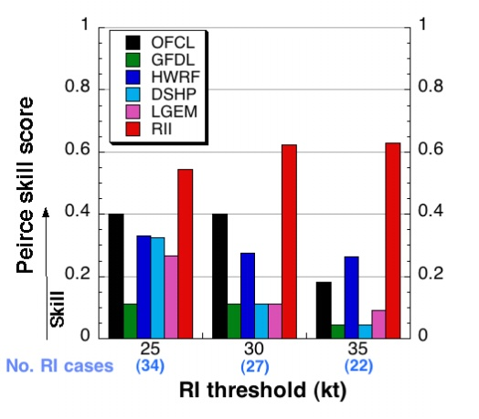
Operational RI intensity guidance performance (2008 and 2009)
Atlantic basin
E. Pacific basin
Probability of detection
False alarm ratio
Peirce skill score

Slide 7
Current JHT Efforts to improve operational RII
Predictors from three new sources tested for inclusion in new experimental Atlantic RII:
Total precipitable water (TPW)
Boundary-layer (BL) predictors from GFS fields
GOES-IR predictors from principle component (PC) analysis
New predictors that yielded largest increase in skill of RII when used in place of current RI predictors when tested on 1995-2008 dependent sample chosen for inclusion in experimental RII
Slightly modified use of current potential intensity and persistence predictors also introduced
New Atlantic RII for 40 kt RII threshold developed (Eric Blake)

Slide 8
IR Principle Component Methodology
Storm motion is UPWARD
Principle components (PCs) for motion relative imagery calculated from CIRA IR image archive (1995-2008)
IR brightness temperatures are analyzed on a cylindrical grid (5 degrees by 440 km)
Means are removed
Standard EOF analysis was performed and first nine PCs were examined
PC2 used as new RI predictor in place of areal-coverage of -30° C brightness T
Spatial Weightings of EOF 2

Slide 9
Hurricane Wilma 17 October 1745 UTC
PC2 = -1.32
Notes:
Circle has a 150 km radius

Slide 10
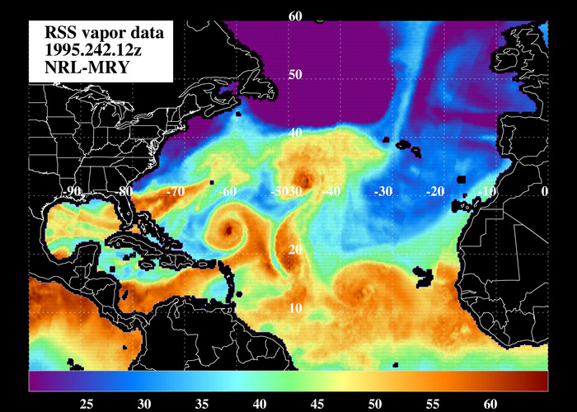
Total Precipitable Water (TPW) RII Predictor
TPW Dataset
-Remote Sensing Systems
-14 yr dataset (1995-2008)
-1/4 degree global grid
-6 hourly images (~+/- 9 hr data windows)
-SSM/I, TMI (TRMM) and AMSRE-E (Aqua)
-derived using the 19/22/37 GHz channels
21 Atlantic TPW predictors tested & identified
Atlantic TPW Predictor chosen-
%TPW pixels <45 mm
(r=0-500 km, 90 deg quad centered upshear)
replaces old 700-850 hPa RH predictor

Slide 11
Boundary-layer predictors
GFS moisture and temperature analyses and Reynolds SST data used to derive new thermo-dynamic boundary-layer RI predictors (Total of 22 predictors developed and tested; 28 others also developed and partially tested)
Inner-core dry air predictor worked best (replaced heat content)
Inner-core dry air predictor = (q10_{layer}-q10)*Vmx
- q10 is the inner-core 10 m specific humidity estimated using the 1000
mb 200- 800 km environmental RH and T
- q10_{layer} is the 10m inner-core specific humidity estimated using 200-800 km environmental layer-mean RH between 1000 mb and 300 mb
-Vmx is the NHC maximum surface wind
Small values of this predictor (indicating less potential for the mixing of
dry air down to surface) favored for RI

Slide 12
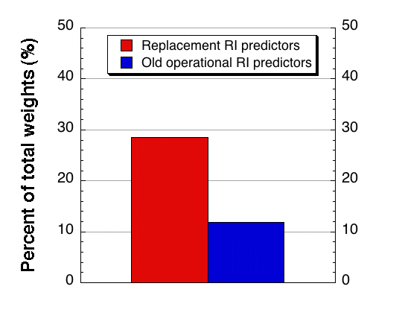
Discriminant weights of the experimental Atlantic RII
Relative weights of RI predictors
for experimental Atlantic RII
Comparison of contribution of new replacement and old operational
predictors to the sum of discriminant weights of all 8 RII predictors
Inner-core dry air

Slide 13
Skill of Atlantic RII for the cross-validated 14 year (1995-2008) sample

Slide 14
Summary
Operational RII exhibited skill for the 2008-2009 sample for both the Atlantic and E. Pacific basins when tested in a probabilistic and deterministic manner
Experimental Atlantic RII developed using three new RI predictors exhibited an average improvement of 4% (33% relative improvement) for the 4 RI thresholds examined with improvements as high as 6.5 % (50% relative improvement) for the cross-validated 14 yr sample
New version of the RII developed for the 40 kt RI threshold also showed some skill for that same sample

Slide 15
Future work
Continue to refine experimental Atlantic RII
- Perform real-time tests of new Atlantic RII during2010 season
(August 15?)
TPW data
- generate TPW predictors for E. Pacific
-correct offset of RSS vs NESDIS TPW
-set up real-time access of NESDIS TPW for 2010 season
GOES PC analysis
- Perform PC analysis on E. Pacific cases (1995-2008)
Boundary-layer predictors
- Refine boundary-layer predictors f or Atlantic and E. Pacific basins
Develop new experimental RII for E. Pacific basin
Explore potential of using microwave imagery in RII as part of GOES-R proposal

