Slide 1
Improved Near Real-Time Hurricane Ocean Vector Winds Retrieval using QuikSCAT
PI: W. Linwood Jones
Central Florida Remote Sensing Lab. (CFRSL)
University of Central Florida
CoI’s: Eric Uhlhorn
NOAA/AOML/HRD
Paul Chang & Zorana Jelenak
NOAA/NESDIS/STAR
Presented by
Pete Laupattarakasem - CFRSL

Slide 2
JHT Project Overview
Two-year development to provide improved QuikSCAT hurricane wind retrievals in Near Real-Time (NRT)
Year-1
Optimize new Extreme-Winds (X-Winds) algorithm to process NRT Merged Geophysical Data Record (MGDR)
Develop operational software to be ported to NOAA/STAR computers for testing during 2010 hurricane season
Year-2
Validate X-Winds hurricane product using 2010 data
Demonstrate as prototype operational OVW product for TPC/NHC & JTWC centers during 2011 season

Slide 3
Background: NASA Funded Research
NASA Ocean Vector Winds Science Team sponsored CFRSL to develop improved QuikSCAT wind retrieval algorithm for extreme wind events
This PI OVW product is known as Q-Winds
Combines active/passive measurements from SeaWinds
Tuned to HRD’s H*Wind surface wind analysis from hurricanes
Provides rain effects correction

Slide 4
Q-Winds Example: Hurricane Fabian 2003
Q-Winds
QuikSCAT L2B-12.5 km
H*Wind
Q-Winds with rain flags
QuikSCAT L2B-12.5 km with rain flags

Slide 5
Q-Winds & SeaWinds L2B-12km Validation
Wind Speeds Comparison
Without rain flags With rain flags

Slide 6
Wind Speed Radii Comparisons: Q-Winds / H*Wind
H*Wind
Fabian 2003
(#21898)
Ivan 2004
(#27217)
H*Wind
Q-Winds
Q-Winds
H*Wind
H*Wind
Q-Winds
Q-Winds

Slide 7
JHT: X-Winds Algorithm Development
Storm Detection
Near Real Time algorithm for autonomous storm detection
Locates clusters of high sigma-0 in MGDR
Storm Eye Location
Locates center of circulation by searching for the minimum gradient of σ⁰ differences
Initial Wind Direction Estimation
Estimates wind direction field from σ⁰ contrast
Provides initial Wind direction estimation for ambiguity selection
Rain Correction
Uses QuikSCAT Radiometer (QRad) brightness temperatures

Slide 8
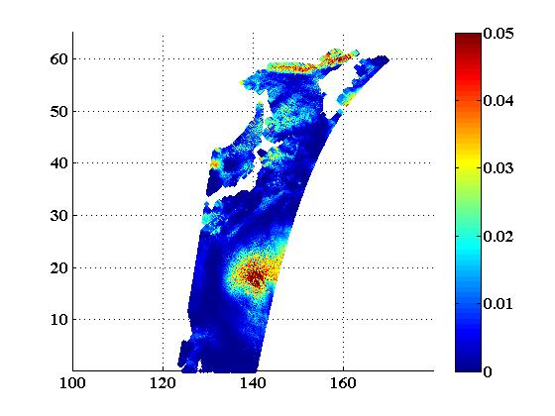
Example: Storm Detection & Center Location
Super Typhoon Melor, 2009
σ^{0 , power ratio}
σ^{0 , power ratio}
X-winds
Lat
Lat
NHC
Lng
Lng

Slide 9
Wind Direction Initialization
Parma
Retrieved Q-Winds
Initial directions

Slide 10
Validation of X-Winds Algorithm through Comparisons with NASA developed Q-Winds
Super Typhoon Melor

Slide 11
X-Winds Comparison with QuikSCAT NRT MGDR
Super Typhoon Melor

Slide 12
Summary
QuikSCAT NRT & non-NRT OVW retrievals significantly underestimate hurricane peak winds
Preliminary results for CFRSL X-Winds NRT MGDR are encouraging
X-Winds peak wind speeds are 10 – 15 m/s greater than conventional QuikSCAT MGDR
Future effort to compare X-Winds with H*Wind
CFRSL active/passive algorithm is candidate for future NOAA/NASA dual frequency scatterometry missions

Slide 13
CFRSL‘2010

