Slide 1
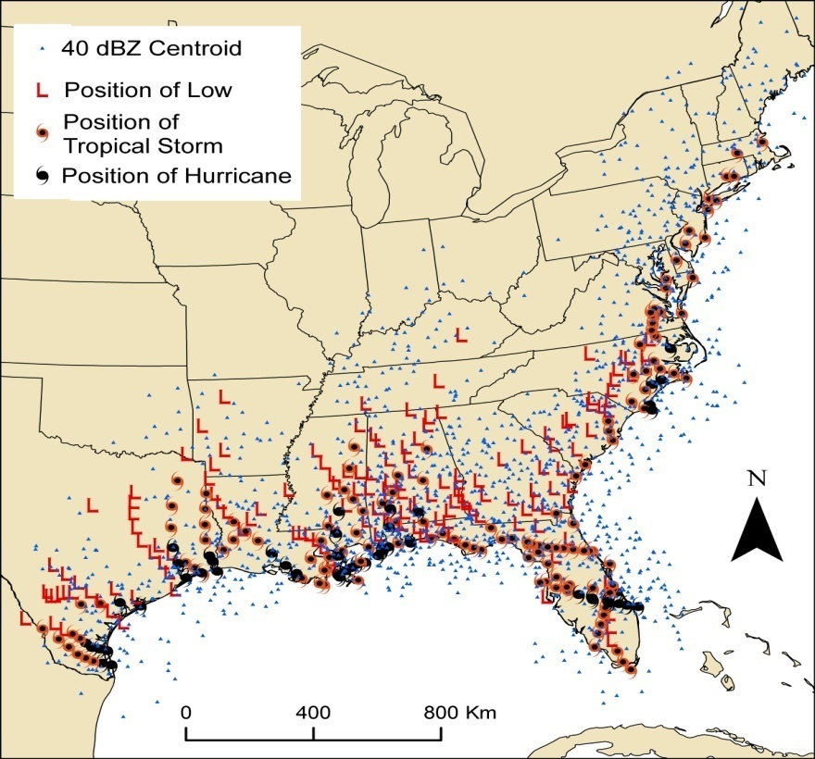
Using geospatial analysis techniques to investigate the spatial properties of tropical cyclone rain fields
Corene J. Matyas
Department of Geography, University of Florida

Slide 2
Use of GIS for Spatial Analysis
Raster and polygon-based data formats
Calculate spatial attributes: position, compactness, orientation, elongation, fragmentation, etc.
Ability to scale and rotate polygons
Matyas, C.J. 2010. Associations between the size of hurricane rain fields at landfall and their surrounding environments. Meteorology and Atmospheric Physics, 106:3-4, 135-148.
Matyas, C.J. 2009. A spatial analysis of radar reflectivity regions within Hurricane Charley (2004). Journal of Applied Meteorology and Climatology, 48:1, 130-142.
Matyas, C.J. 2008. Shape measures of rain shields as indicators of changing environmental conditions in a landfalling tropical storm. Meteorological Applications, 15:2, 259-271.
Matyas, C.J. 2007. Quantifying the shapes of U.S. landfalling tropical cyclone rain shields. The Professional Geographer, 59:2, 158-172.

Slide 3
Research Questions
For the 24-hour period following landfall examining separately TCs that do and do not become extratropical within 3 days of landfall
How large are the rain fields and how do their sizes change after landfall?
How much of the rain field is comprised of lighter and heavier rainfall regions?
What characteristics exhibit statistically significant relationships to rain field composition and the growth/ loss of areal coverage?

Slide 4
Techniques
GIS analysis of Level III WSR-88D reflectivity data
Lighter rainfall regions: 20-35 dBZ
Heavier rainfall regions: 40+ dBZ
Temporal period: 24 hours after U.S. landfall
Identify location and size of heavy rainfall regions every 3 hours
Determine total area covered by rain field and calculate the percentage occupied by heavy rainfall every 6 hours

Slide 5
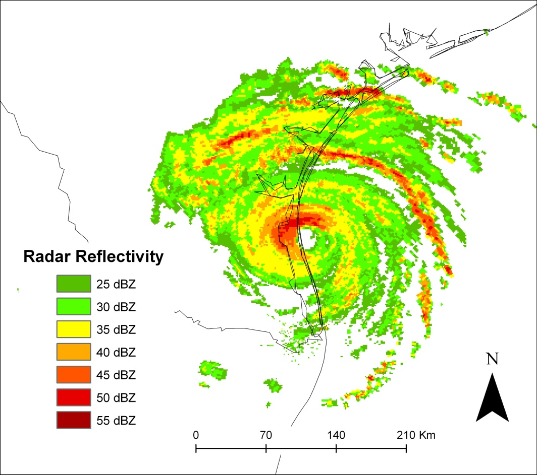
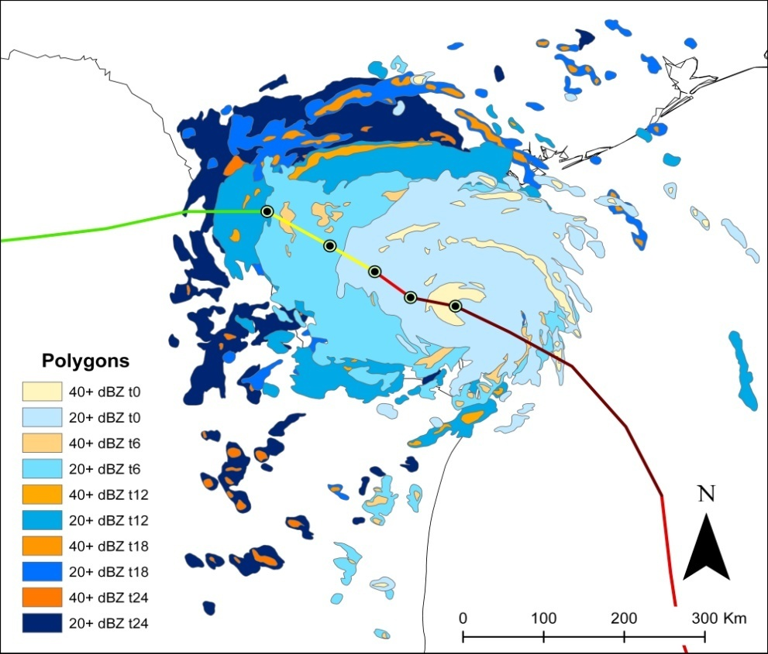
Radar Analysis in GIS
Hurricane Bret (1999)
Polygons analyzed t0-t24

Slide 6
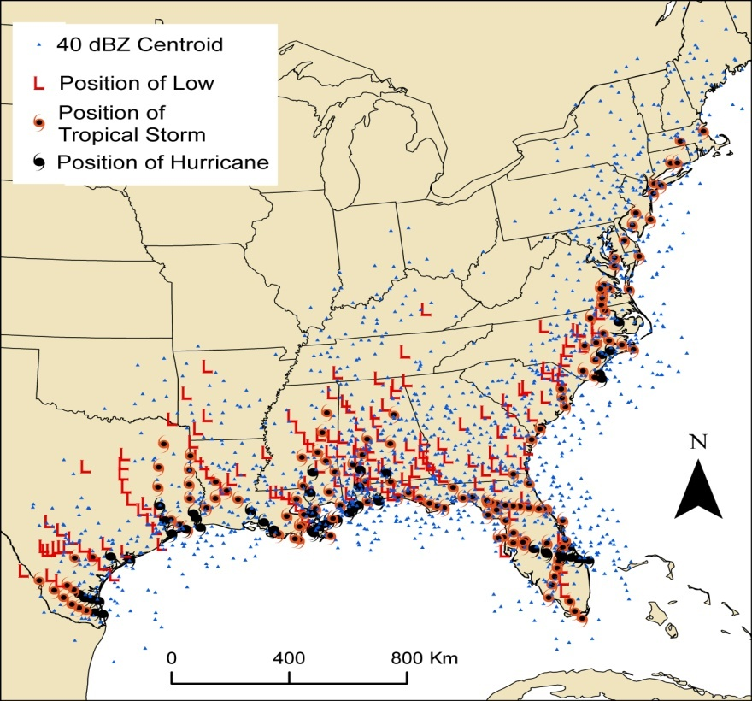
Locations of 40 dBZ Regions (500+ km²)

Slide 7
Positions of 40 dBZ Regions Relative to
Storm Motion Vertical Wind Shear

Slide 8
Statistical Testing
Nonparametric tests required
Mann-Whitney U: significant difference between two groups (ET vs. non ET)
Spearman’s Rank Correlation Coefficients: variables exhibiting similar rank patterns

Slide 9
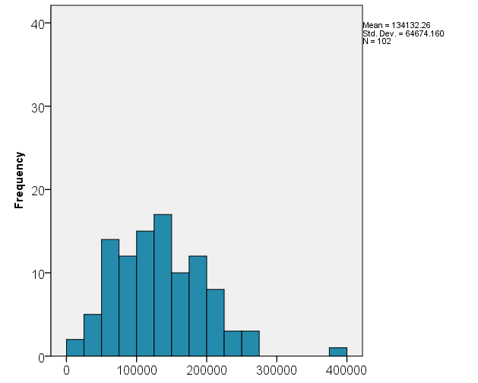
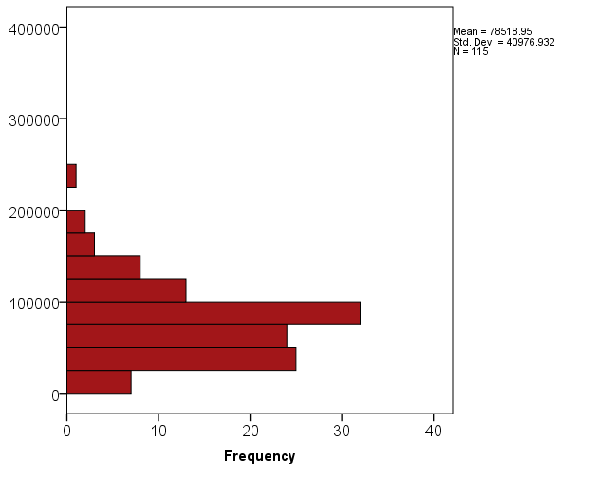
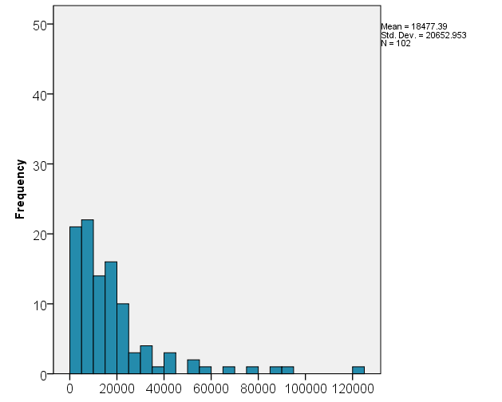
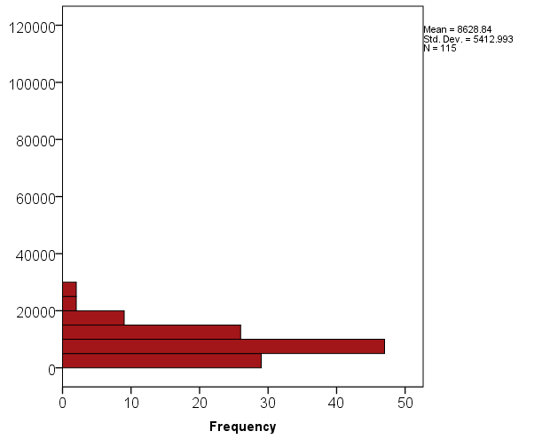
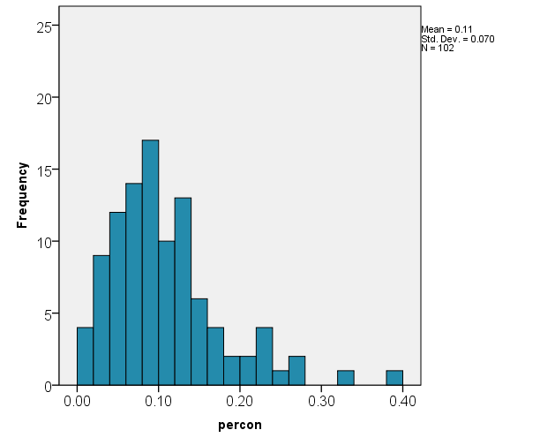
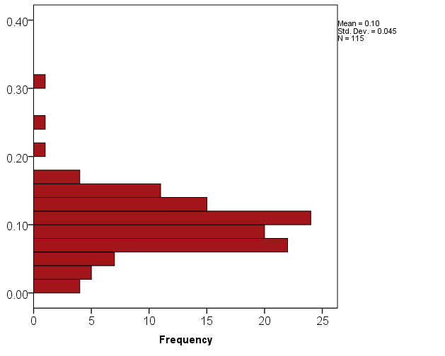
Mann-Whitney U Test Results
ET
No ET
20-35 dBZ
areas (km²)
Significant at
α = 0.000
Mean rank = 121.8
Mean rank = 79.7
Mean rank = 105.7
Mean rank = 87.6
40+ dBZ
areas (km²)
Significant at
α = 0.000
Mean rank = 85.8
40
30
20
10
0
Mean rank = 97.3
% area
40+ dBZ
No difference

Slide 10
Spearman’s Rank Correlation Coefficients
Significant at α = 0.01
Significant at α = 0.05
20-35 dBZ area
 | T150 | U200 | dShE | speed | Z850 | E000 | T000 | R000 | Vmax | ROCI
ET | 0.44 | 0.34 | 0.56 | 0.34 | 0.51 | -0.51 | -0.45 | 0.14 | 0.24 | 0.59
Non-ET | 0.30 | 0.55 | 0.56 | 0.19 | 0.19 | -0.45 | -0.51 | 0.38 | 0.19 | 0.54
40+ dBZ area
 | T150 | U200 | dShE | speed | Z850 | E000 | T000 | R000 | Vmax | ROCI
ET | 0.29 | 0.41 | 0.39 | 0.34 | 0.25 | -0.30 | -0.27 | 0.11 | 0.39 | 0.44
Non-ET | 0.09 | 0.34 | 0.38 | -0.04 | -0.01 | -0.12 | -0.30 | 0.34 | 0.32 | 0.46
% of area 40+ dBZ
 | Dist | U200 | dShN | speed | Z850 | E000 | RhLo | ShrG | Vmax
ET | -0.28 | 0.26 | 0.21 | 0.22 | -0.02 | -0.05 | 0.05 | 0.26 | 0.30
Non-ET | -0.38 | -0.10 | -0.25 | -0.31 | -0.25 | 0.26 | -0.23 | -0.08 | 0.22

Slide 11
Future Research
Calculate attributes of shape and orientation for convective regions
Quantify the characteristics of stratiform precipitation that encompasses these convective regions
Consider angle TC crosses coastline, interaction with topography, diurnal cycles, etc.

Slide 12
Thank You
Matyas, C.J. 2010. A geospatial analysis of convective rainfall regions within tropical cyclones after landfall. International Journal of Applied Geospatial Research, 1:2 (April-June), 69-89.
Matyas, C.J. 2010. Analyzing areas of heavy and light rainfall within landfalling tropical cyclones. (In preparation)

