Slide 1
Rapidly Weakening of Non-Landfalling Hurricanes
John Knaff and Mark DeMaria
NOAA/NESDIS
Fort Collins, CO
Notes:
It should be noted that this is a typical preliminary study and while informative, the results and predictors used in this study are likely to change in the future.

Slide 2
Motivation
“Actions” by “stakeholders” depend on the expected intensity of a tropical cyclone event.
Rapid changes in the forecast intensity are often poorly forecast by existing forecast models.
Timing of events in numerical models
Large magnitude changes in statistical models
While there has been justified emphasis on the development of probabilistic forecast tools for rapid intensification, similar tools do not exist for rapidly weakening events.

Slide 3
Examples: Hurricane Lili (2002)

Slide 4
Methodology
Develop a straw man definition for 24-h rapid weakening
Identify conditions related to rapid weakening
Storm State
Satellite presentation (IR, TPW)
Forecasts of environmental conditions
Using those conditions, perform a linear discriminant analysis
Using the dependent discriminant function develop a probabilistic rapid weakening guidance tool

Slide 5
Definition: Atlantic (1982-2008, allow maximum of 3h over land)

Slide 6
Linear Discriminant Analysis vs. Principle Component Analysis
LDA (linear discriminant analysis) is an example of a dimensionality reduction technique
Other examples include principle component analysis (PCA or EOF)
LDA seeks vectors that best describe the differences between classes after projection.
The discriminant function is a new variable created by the linear combination of input variables that maximize class differences.
Principle components are new variables created from linear combination of the input variables that best describe the data.
LDA vector
PCA vector
Notes:
Here we use LDA to create a discriminant function with two classes, rapid weakening and none rapid weakening. PCA is used to reduce the dimensionality of the infrared dataset. For this work PC 4 from a storm/direction relative analysis is used to indicate eye type features in the initial imagery.

Slide 7
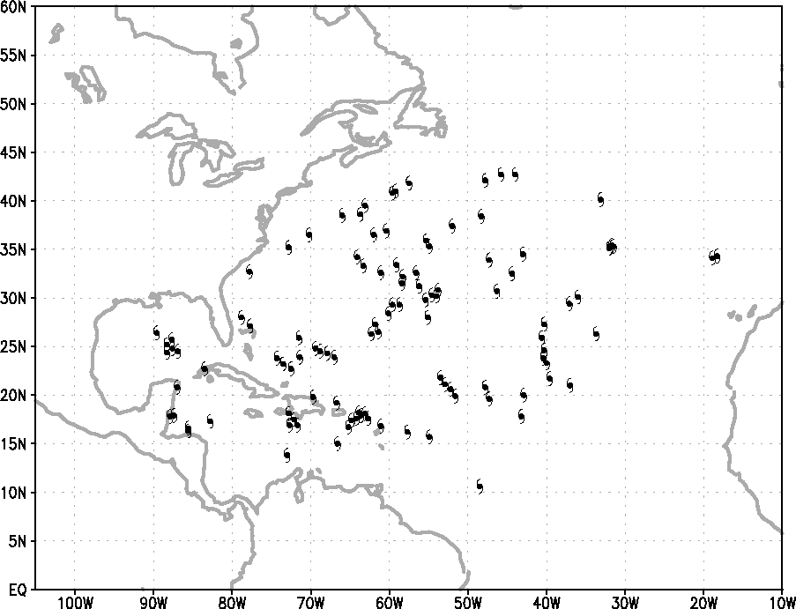
Dependent Dataset (1995-2008)
Non-Rapid Weakening
1797 cases
Rapid Weakening
110 cases
SHIPS developmental dataset with IR predictors is used as the dependent dataset
Notes:
Location indicates the starting point for the 24-h change in intensity

Slide 8
Most Important (5) Discriminators
Current Conditions (t=0)
Forecasted Quantities (0-24h)
12-intensity change (persistence)
Storm & Direction Relative IR Principle Component #4 (8.4%) – warm central feature
Potential intensity (empirical on SST along TC track)
850 to 500-hPa wind shear
200-hPa Northerly winds
Notes:
We wanted to keep this simple… other combinations of predictors were tried, but were more difficult to interpret.
SST, 850 to 500 hPa wind shear and the Northerly winds are averaged over the 24-h forecast period.
SSTs come from Reynolds SSTs at the storm center. 850-500 hPa wind shear is calculated in a 200 to 800 km annulus. The Northerly winds are averaged over 500 km. The PC4 value is a six hour average from available imagery prior to the onset of rapid weakening.

Slide 9
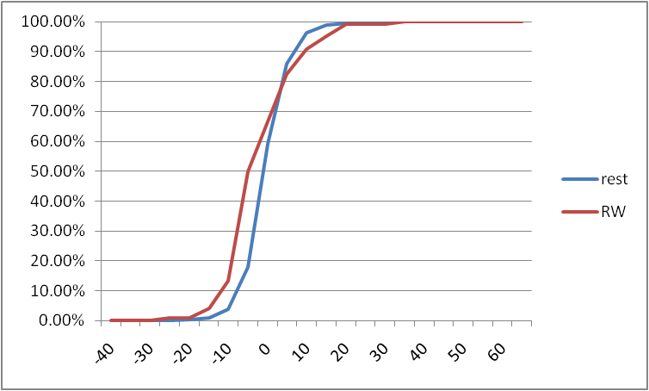
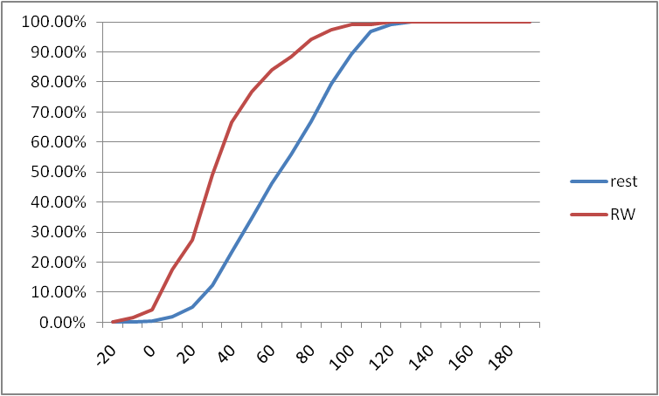
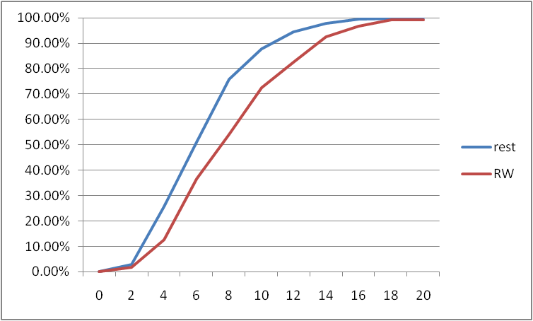
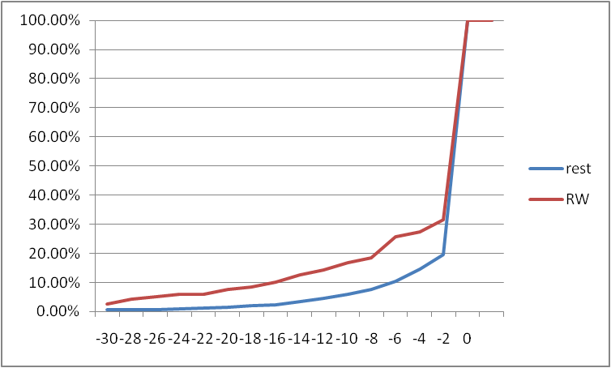
Persistence
Intensity Potential
η =1.76 kt
σ = 6.25 kt
η =62 .1kt
σ = 28.6kt
850-500 hPa Shear
200 hPa Northerly
η =-2.0 kt
σ = 5.3 kt
η =6.4 kt
σ = 3.2 kt
Notes:
Means and standard deviations of each sample is provided since data input to the discriminant analysis is first standardized.

Slide 10
IR Principle Component Methodology
Images are analyzed in a storm and direction relative manner
Storm motion is UPWARD
IR brightness temperatures are analyzed on a cylindrical grid (5 degrees by 4 km out to r=440 km)
Means are removed
And a standard EOF analysis is performed
motion
180 km
Spatial Weightings of EOF 4
Notes:
Principle components are based on the CIRA/RAMMB Tropical Cyclone IR image archive 1995-2008.

Slide 11
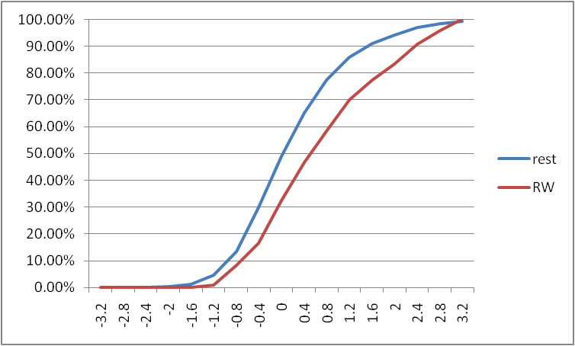
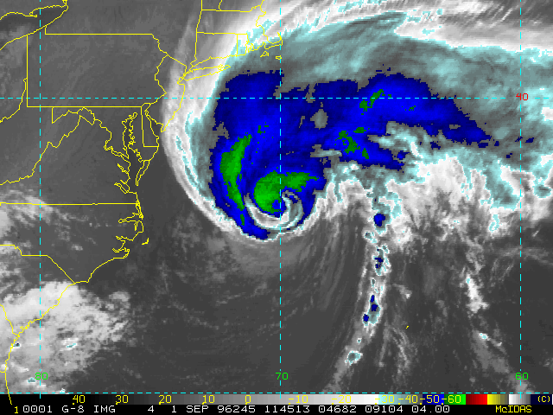
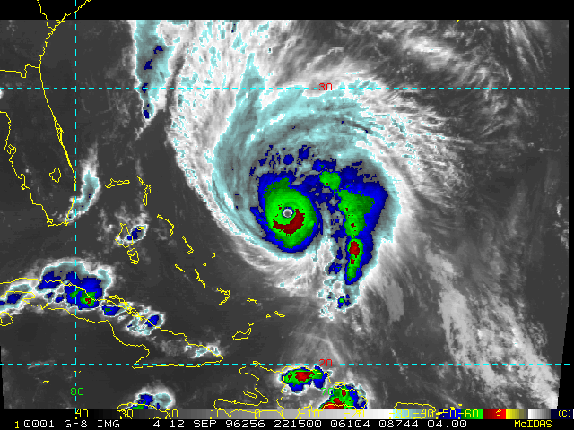
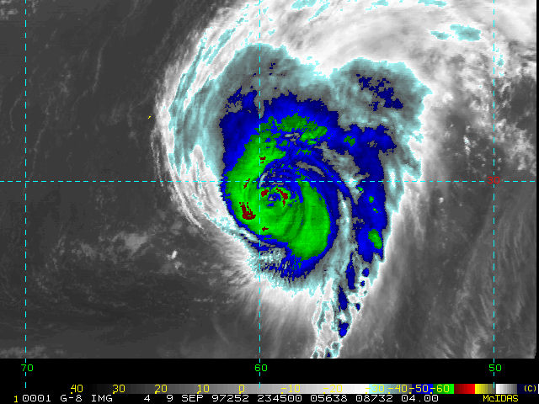
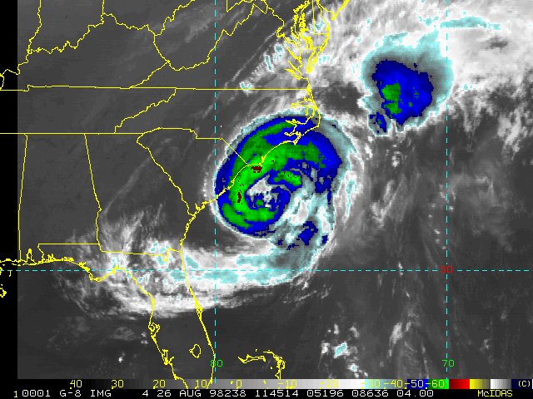
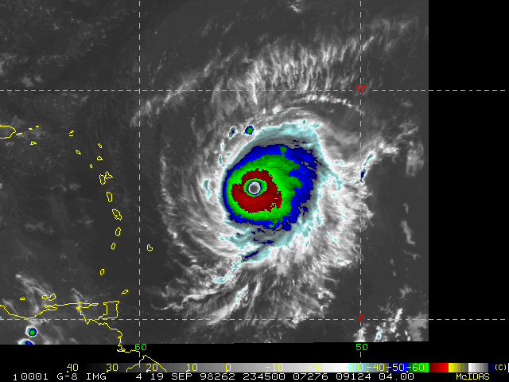
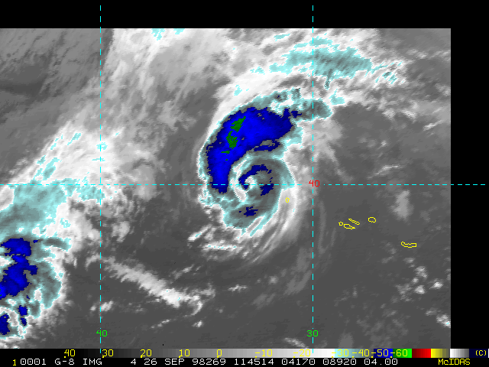
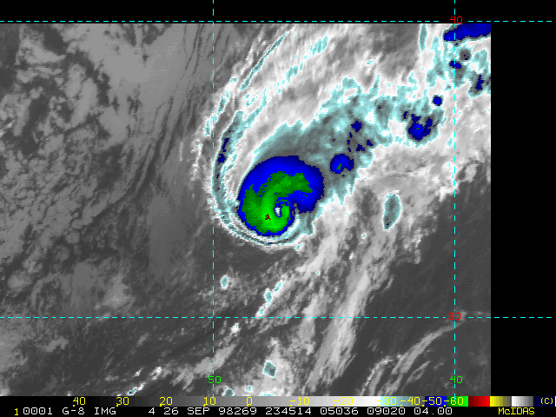
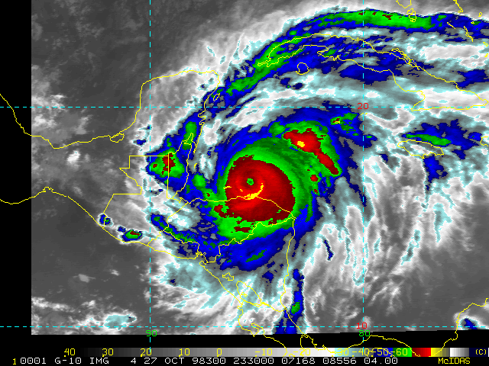
IR PC 4
η =0.20
σ = 1.0
EDOUARD 1996
HORTENSE 1996
ERIKA 1997
BONNIE 1998
GEORGES 1998
IVAN 1998
KARL1998
MITCH 1998
Notes:
IR image examples of the RW cases 1995 to 1998. Imagery shows the tendency for an eyewall to exist at the beginning of rapid weakening. Roughly 2/3 of the cases have an indication of a warm central feature in the IR imagery.

Slide 12
Discriminant Function Weights (Positive values tend toward RW)
Notes:
These are normalized weights. The normalization is based on the sample means and standard deviations.

Slide 13
Interpretation
Favorable for RW
Indicative
Moderate or greater Vertical wind shear extending to the mid-levels ( > 6 kt)
Northerly flow at 200 hPa
Reduced SST/potential intensity (values less than 60 kt)
Often a warm central feature exists in the IR imagery
Storm has often peaked or has begun to weaken.
Rapid weakening often involves the collapse of the existing eyewall complex in an environment characterized by decreasing intensification potential/SST, increasing vertical wind shear and occasionally strong northerly flow.
Notes:
Eye collapse seems important to rapid weakening.

Slide 14
Dependent Discriminant Frequencies
N=1797
N=110

Slide 15
Dependent Probability Function

Slide 16
Dependent Reliability

Slide 17
Dependent Performance
ROC Diagram
0%
5%
10%
15%

Slide 18
Examples: Hurricane George (1998)
Predictor | 9/20 00 UTC | 9/20 06 UTC
PER | 5 | -5
POT | 26 | 29
SHRS | 7.0 | 5.4
200hPa North | -7.6 | -13.3
IR PC 4 | 2.6 | 1.5
Discriminant | 2.2/ 21% | 2.4/ 23%
Positive factors
Negative factors

Slide 19
Examples: Hurricane Lili (2002)
Predictor | 10/2 12 UTC
PER | 10
POT | 33
SHRS | 5.5
200hPa North | 0
IR PC 4 | 0.4
Discriminant | 0.5/ 6%
Positive factors
Negative factors

Slide 20
Examples: Hurricane Felix (2007)
Predictor | 9/3 00 UTC
PER | 35
POT | 6.2
SHRS | 3.7
200hPa North | -3.2
IR PC 4 | 0.82
Discriminant | 0.99/ 9%
Positive factors
Negative factors

Slide 21
Examples: Hurricane Gustav (2008)
Predictor | 8/31 00 UTC
PER | -5
POT | 49
SHRS | 6.7
200hPa North | 0
IR PC 4 | 1.4
Discriminant | 0.69/ 7%
Positive factors
Negative factors

Slide 22
Summary
A simple rapid weakening definition was developed for the Atlantic
Using that definition and a archive of satellite and environmental data, a probabilistic rapid weakening forecast method has been developed
Dependent results suggest that the hit rate could be about 3 times the false alarm rate using a conditional probability close to 7%

Slide 23
Future Work
Improve on this preliminary study
Improved use of TPW
Different RW definitions
Different scaling of inputs
Pre-screening of developmental data.
Independent test on 2009
Apply a similar approach for identifying extra-tropical transition

Slide 24
Questions?

