Slide 1
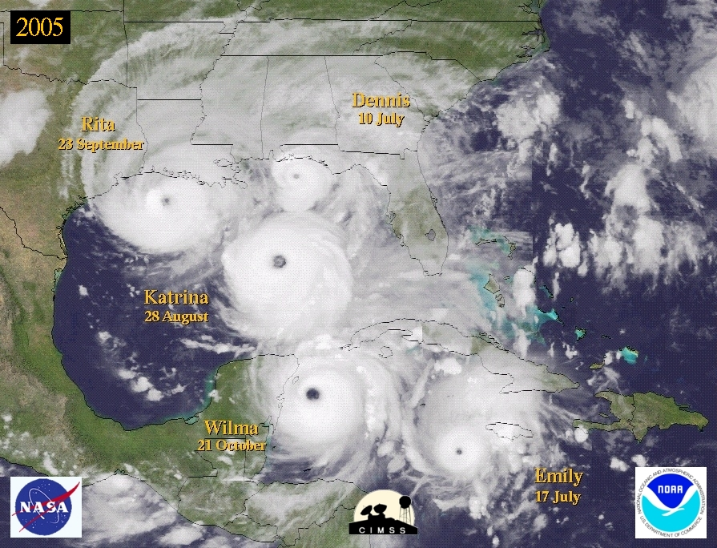

The Visiting Scientist Program at the National Hurricane Center
March 2010
Interdepartmental Hurricane Conference
Chris Landsea National Hurricane Center

Slide 2
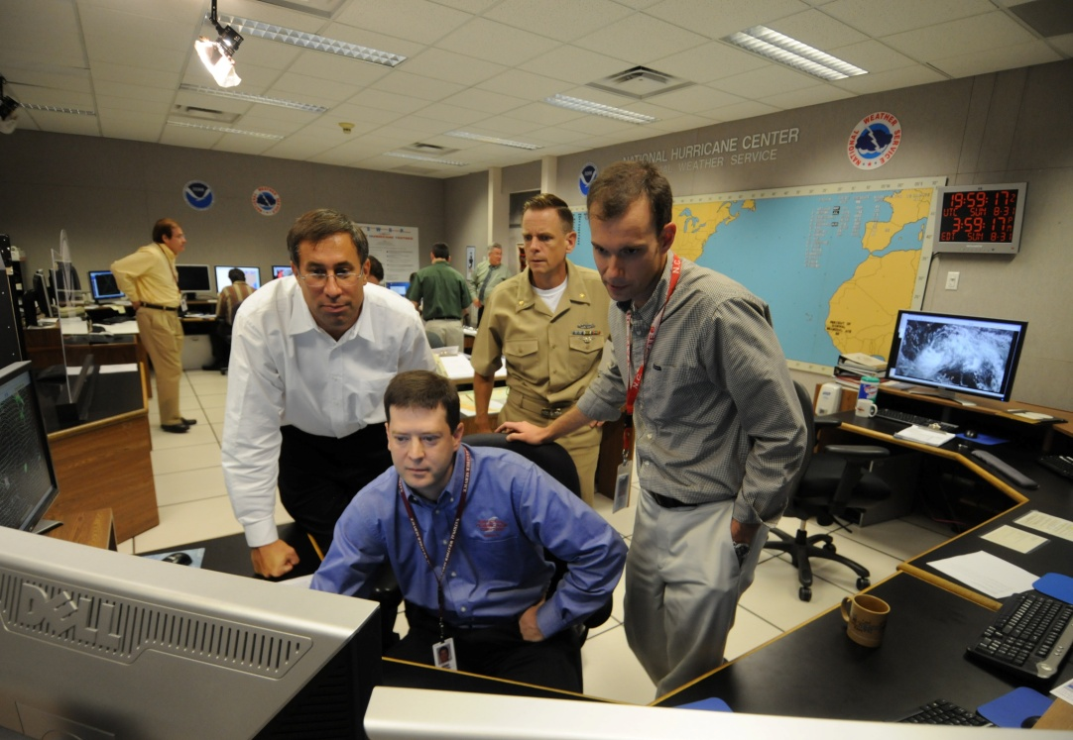
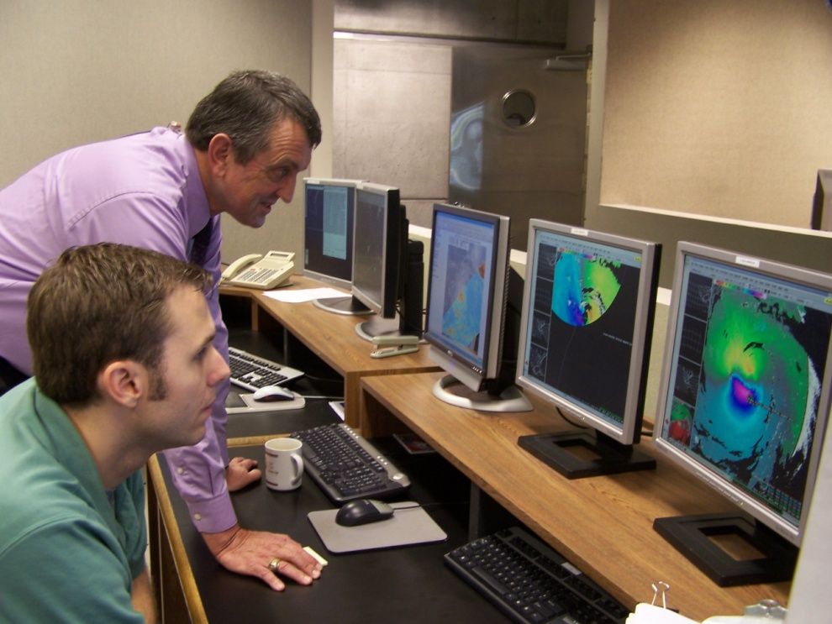
How does NHC analyze and forecast hurricanes?
How do the forecasters blend the various (surface obs, satellite, and aircraft) observations to derive the TC Vitals? How is a working best track derived? What models are relied upon? What are the time constraints? What is the process of the genesis, track, intensity, and size predictions?...

Slide 3

Visiting Scientist Programs within
HFIP and NWS/NCEP
Summer of 2008, the HFIP plan included: “to support research and technology development and training activities for external community at NOAA operational facilities (e.g., visiting scientists, Post-Docs, graduate students, professors)”
Spring of 2008, the NCEP Strategic Plan included: “expand the visiting scientist program at NCEP to leverage from the external community”

Slide 4
Goals for the NHC Visiting Scientist Program
To facilitate better understanding by researchers/outside forecasters of the NHC hurricane forecasting process including the tools and techniques utilized by the Hurricane Specialists;
To open additional dialog between NHC and the research/outside forecast community that could lead to improvements in our analysis predictions methodologies

Slide 5
Visiting Scientist Program Guidelines
Program restricted to scientists that have interest/expertise in day-to-day hurricane forecasting operations
VS shadows the Hurricane Specialists during the swing shift from 7-11pm
  7-7:30pm: Digest new model guidance
  7:30-8pm: Prepare Tropical Weather Outlooks (and graphics)
  8-9pm: Analyze the tropical cyclone (position, intensity, size, structure)
  8:30pm: Receive Tropical Analysis and Forecast Branch and Satellite Analysis Branch Dvorak analyses
  9pm: Initialize guidance
  9-10pm: Generate track, intensity, size, and structure forecasts
  10pm: Conference call (for Atlantic tropical cyclones)
  10-11pm: Refine analyses and forecasts; write Public Advisory and Discussion
  11pm: Release Advisory package and produce graphics

Slide 6
Visiting Scientist Program Guidelines
Program restricted to scientists that have interest/expertise in day-to-day hurricane forecasting operations
VS shadows the Hurricane Specialists during the swing shift from 7-11pm
VS participated with representatives from WFOs, RFCs, NCEPs, government labs, academia, and international forecasting centers
Each VS would participate for one to five days
Scheduled developed for participants from late July to October peak of the season
VS would not be performing any operational duties

Slide 7
Visiting Scientist Program Guidelines
If a major hurricane threatened the US, the shadowing would be postponed/canceled
If there were no active tropical cyclones, the shadowing could be postponed and/or shifted to be with forecasters in our Tropical Analysis and Forecast Branch (NHC’s marine prediction and Dvorak classifications)
VS that are in Miami for the full five days spend at least one evening with TAFB forecasters
VS given opportunity to give a seminar on topic of their choosing
VS encouraged to visit WFO Miami/HRD/U Miami/FIU if opportunity and interest allowed

Slide 8
Visiting Scientist Program Guidelines
Funding through HFIP made available in 2009 to support NHC Visiting Scientist Program (travel and per diem costs for out of towners)

Slide 9
2009 Participants
  Robbie Berg (Hurricane Specialist) and John Cangialosi (then TAFB Forecaster), and I selected the 12 participants to maximize the variety of groups represented:
  Shuyi Chen - University of Miami (professor - hurricane modeler)
  Jesse Feyen - National Ocean Services (storm surge modeler)
  Kimberley Zuill - Bermuda Weather Service (deputy director)
  John Knaff - NOAA/NESDIS/RAMM (structure and satellite researcher)
  David Novak - Hydrometeorological Prediction Center (SOO)
  Mark Jelinek - Georgia Tech (genesis researcher)
  Mike Turk - Satellite Analysis Branch (lead for tropical)
  Rob Rogers - NOAA/Hurricane Research Division (hurricane modeler)
  Jeral Estupiñán - Brownsville WFO (SOO)
  Jim Hudgins - Blacksburg WFO (senior forecaster)
  Tom Birchard - Honolulu WFO/CPHC (senior forecaster)
  Greg Waller - West Gulf RFC (senior hydrometeorology and support forecaster)

Slide 10
2009 Presentations
  Shuyi Chen - "Large-scale control or convective upscaling? That is the question."
  Jesse Feyen – “An Evaluation of SLOSH and ADCIRC for Two Storm Surge Events: Hurricanes Ivan and Isabel”
  Kimberley Zuill - "Weather and Marine Forecasting in Bermuda:
  Our Experiences with Hurricane Bill and Other Cyclones"
  John Knaff - "Improving Intensity Estimates using Operational Information"
  David Novak – “The HPC Tropical Cyclone Program and Associated Collaborative Opportunities”
  Mark Jelinek – “Tropical Cyclone Forecastability - How far out can we really forecast?”
  Mike Turk - "On the NESDIS Reorg and Changes to Satellite Analysis Branch (SAB) Ops"
  Jeral Estupiñán - "Societal Vulnerability and Response to Hurricane Dolly
  in the Lower Rio Grande Valley"
  Jim Hudgins – “Climatology of Heavy Rainfall associated with Tropicla Cyclones affecting the Central Appalachians”
  Greg Waller - "River Forecasting at the West Gulf River Forecast Center:
  Tools/Products, Operations during Hurricane Ike, and Future Changes"

Slide 11
2009 Visiting Scientist Comments
“I am very grateful to have had this opportunity, and I sincerely hope that the Visiting Scientist program becomes a firmly established program. It seems I was very fortunate to be able to not only be there during a week of tropical cyclone activity but to be able to sit in on the HRD de-brief of Ana & Bill, as well as hear the presentations by RSMAS Graduate students and get to chat with professors... I offer no ideas of enhancements, because the week I had far exceeded my expectations!” – Kimberley Zuill
“My visit with TAFB was very instructional - I was able to learn about
their range of responsibilities, what data and techniques they use (e.g.
NAWIPS, GFE), and about the value of Dvorak classifications. I found
sitting in with the Hurricane Specialists' shifts was very exciting and
interesting despite the low activity (which was fine as I appreciated
the opportunity to ask questions, but could easily imagine the intensity
- no pun intended - during a big event.) It was very illustrative to
observe all the data that goes into the forecasts, and how they are
generated. Also, I understand more clearly the role of the models by
seeing them in use will directly tie in to our storm surge modeling
efforts.” – Jesse Feyen

Slide 12
2009 Visiting Scientist Comments
“My stay at NHC was superb. It was very valuable for me to see the different steps involved in creating the NHC forecasts. I learned a lot of the importance of the use of the microwave imagery and the importance of QuikScat and ASCAT. Now I have a better appreciation of the difficulties involved with ocean storm forecasting both at the Hurricane Specialist Unit and at TAFB. This information is extremely important for me at an early stage in my career at the NWS. Now I have a real appreciation of the different tools and techniques used.” –Jeral Estupinan
“The best part of the shadowing involved working alongside the specialists during advisories for TS Henri. During a couple of these shifts I was able to go through the Dvorak technique, and then the entire process of updating the evening advisory package including the TWO. This allowed me to get a feel for the range of science and modeling involved to how these products are produced/disseminated.” – Rob Hudgins

Slide 13
2009 Visiting Scientist Comments
“The program you have designed is an excellent opportunity for both the visiting scientist and NHC personnel to benefit. At its core, the forecast shift periods offer a forum for the visitor to observed both the skills of the NHC forecasters and the challenges they face. This time gives the visitor not only a greater level of appreciation, but also an increased understanding of how their work can benefit the NHC. My impression is it also serves as a great chance for the NHC forecasters to learn more about their forecasts are utilized and interpreted by various end users.” – Mark Jelinek
“First, I think getting to know a few of the specialists a bit better will allow for better communication. I certainly feel more comfortable bouncing ideas off of some of these folks more than I did in the past. I think this will allow me personally to show things to the specialists at a earlier period of development. It has always been my opinion that the hurricane forecasting community often does not know what they want, but rather knows what they don't like when they finally see it. While this causes a difficult position for those developing new applications, it is understandable. Better communication, which I think this program definitely will inspire, can only help.” – John Knaff
Notes:
13

Slide 14
The Visiting Scientist Program at the National Hurricane Center
March 2010
Interdepartmental Hurricane Conference
Chris Landsea National Hurricane Center
Notes:
14

