Slide 1
On the Role of the Saharan Air Layer in the Suppression of Development of a Prominent African Wave Disturbance
Scott A. Braun
NASA/GSFC
Goals of this talk:
• Illustrate difficulties/errors in determining SAL impacts
• Highlight unique capabilities of NASA satellite products

Slide 2
Studies finding a negative impact of the SAL
Dunion and Velden (2004)—Suggested that negative impacts were associated with increased:
Deep-layer shear associated with the AEJ
High stability associated with the elevated SAL
Cold downdrafts due to dry SAL air
Jones et al. (2007), Wu (2007), Shu and Wu (2009), Reale et al. (2009) among others all suggested negative SAL impact, but with very weak evidence and some false assumptions

Slide 3
Common Incorrect Assumptions
Braun (2010) found little evidence for a frequent negative impact in a composite analysis of 41 storms.
Satellite data analysis suggests common assumptions in previous studies:
Dry tropical air is SAL air
The SAL is dry throughout its depth
Guilt by proximity
Braun, S. A., 2010: Re-evaluating the role of the Saharan Air Layer in tropical cyclone genesis and evolution. Mon. Wea. Rev., (in press).

Slide 4
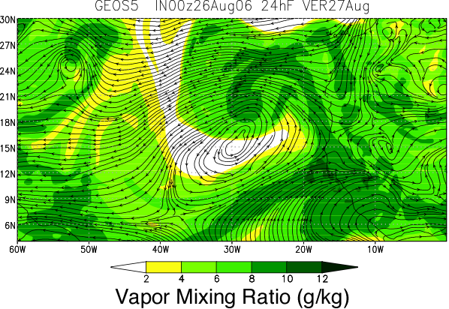
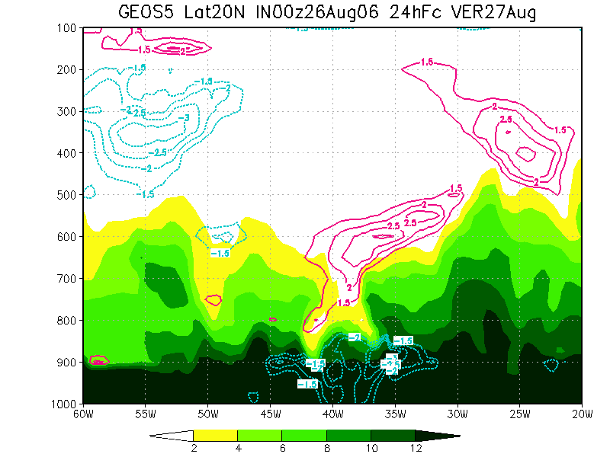
An Example
A recent study by Reale et al. (JAS, 2009) suggested that the SAL prevented development of a promising tropical wave
Mid-
latitude
air
SAL
Core
Of W1

Slide 5
Is The Dry Tongue SAL?
Data used for analysis
• TRMM multi-satellite precipitation (0.25° resolution, 3-hourly)
• MODIS (Terra and Aqua) Level-3 aerosol optical depth (AOD) (1° resolution, daily)
• AIRS/AMSU Level-2 temperature and relative humidity profiles (54 km resolution, twice daily)
• NCEP Global Forecast System (GFS) final analyses (1° resolution, 6-hourly)

Slide 6
Evolution of the SAL
August 27, 2006
August 25, 2006
August 26, 2006
August 28, 2006

Slide 7
AIRS Data
August 27, 2006
600 hPa Temperature
700 hPa Temperature
700-600 hPa Relative Humidity
850 hPa Temperature
600-500 hPa Relative Humidity
850-700 hPa Relative Humidity

Slide 8
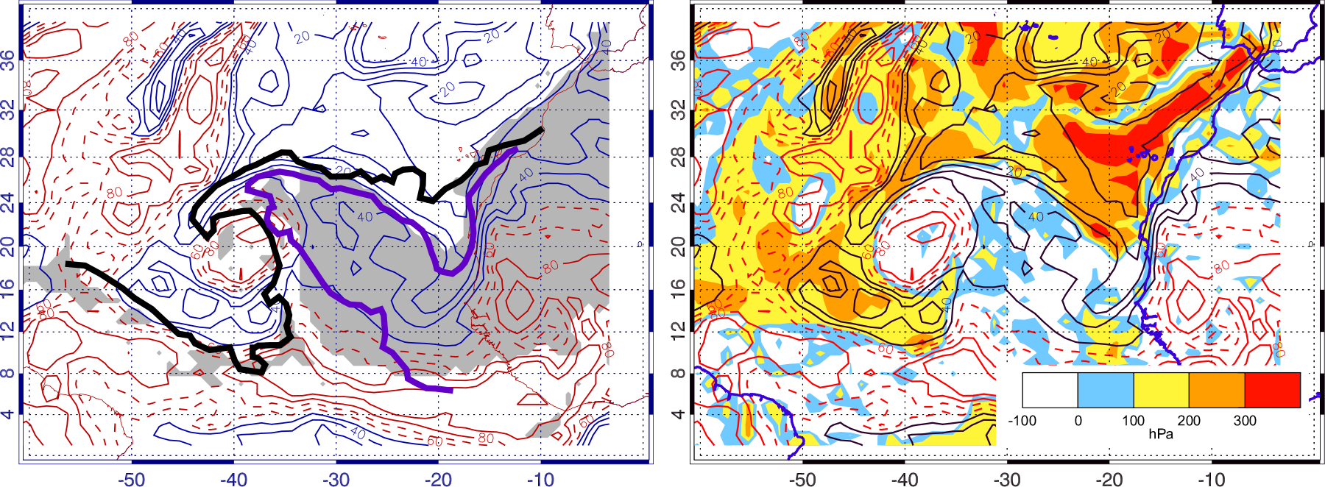
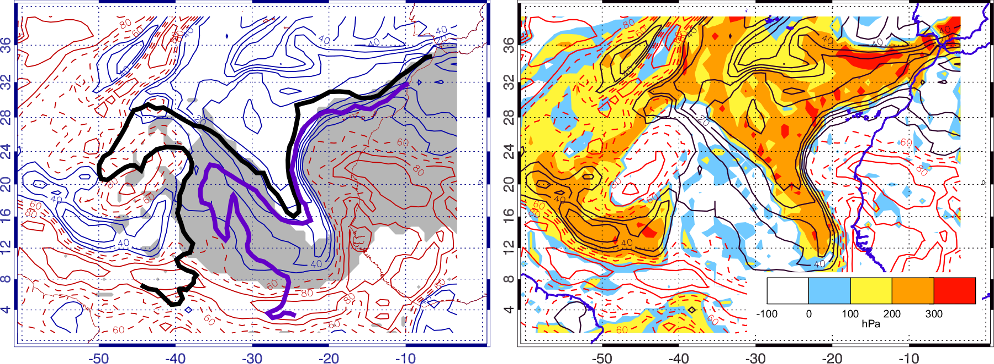
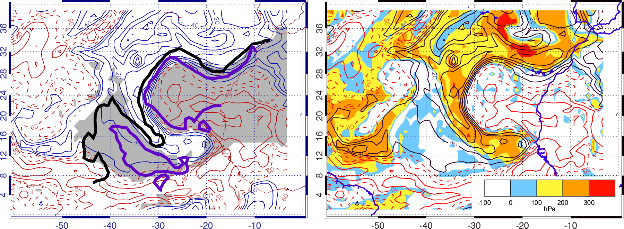
Trajectory Calculations
6-Day backward air trajectories at every grid point using 1°, 6-
hourly GFS data
Air parcels traced back to the Sahara are shaded gray (left).
Total descent along trajectories is shaded (right)
August 26, 2006
August 24, 2006
August 25, 2006
Thick black curve: AOD=0.2
Thick purple curve: AOD=0.4
Contours: RH
<50 blue/black, 60-70 dashed red, >80 red

Slide 9
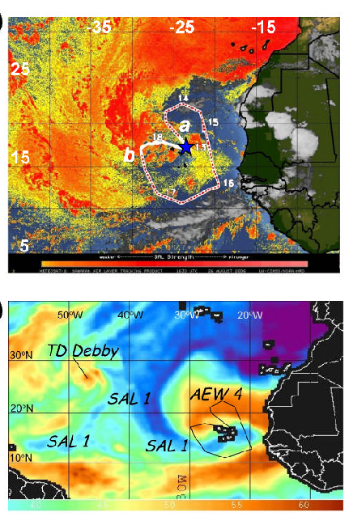
Interpretation of Satellite Imagery
Role of the SAL:
SAL impacts or dry subsiding air?
The SAL is not necessarily always dry
Dry tropical air is not necessarily SAL air
GOES SAL analyses do not necessarily uniquely identify SAL air

Slide 10
Conclusions
Beware the false assumptions
Warm and dry air masses can be caused by subsidence as well as, or instead of, the SAL
GOES and TPW imagery not sufficient to diagnose SAL air
More comprehensive approach combining MODIS, AIRS, CALIPSO, and even trajectories may often be needed to diagnose SAL air
Proximity of the SAL is insufficient evidence for impact—direct evidence of causation is needed
Scott.A.Braun@nasa.gov

Slide 12
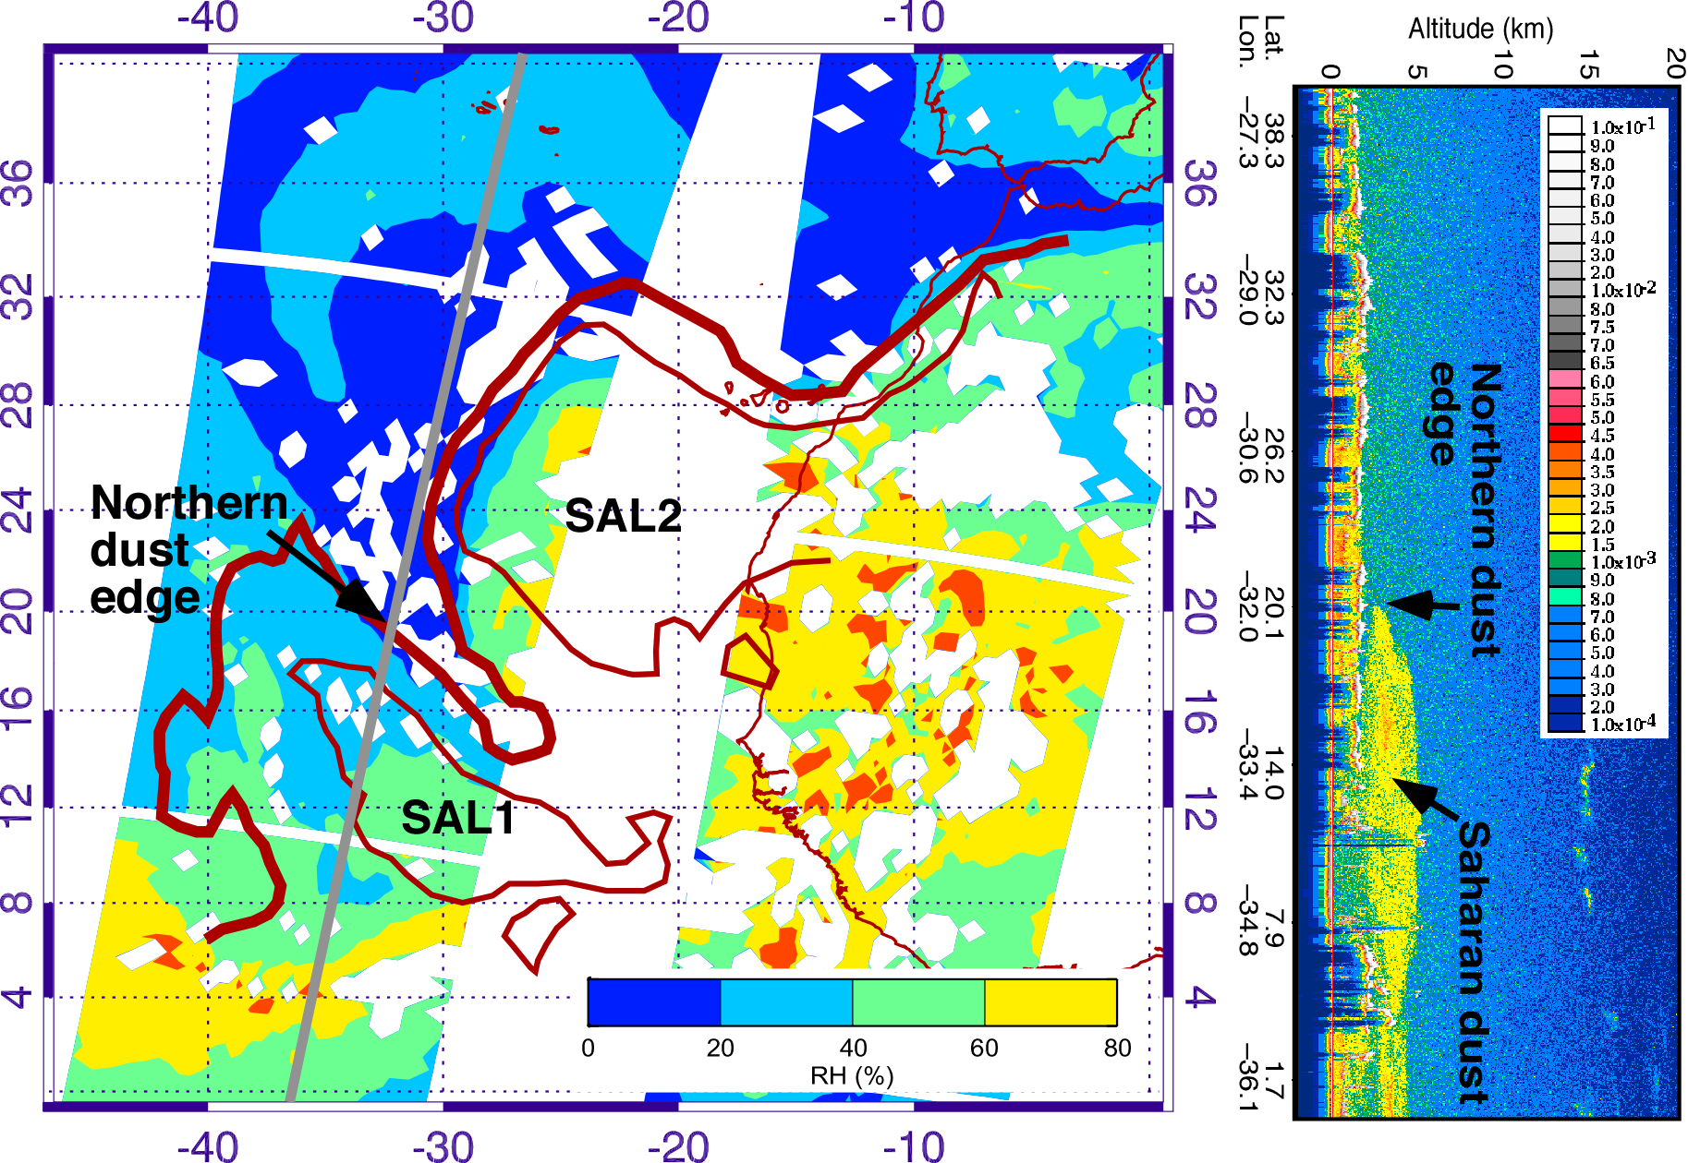
AIRS and CALIPSO Data August 26
AOD=0.4
AOD=0.2

Slide 13
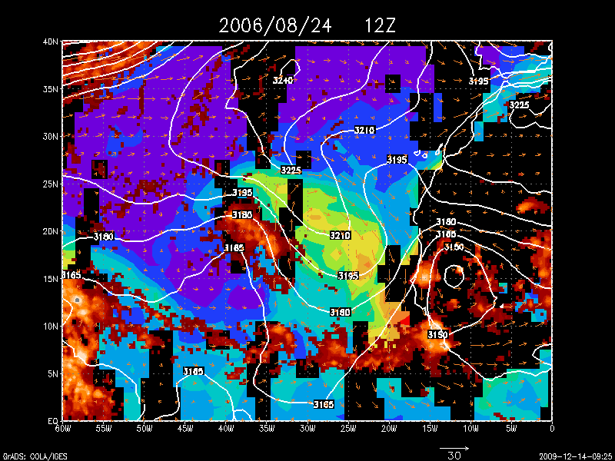
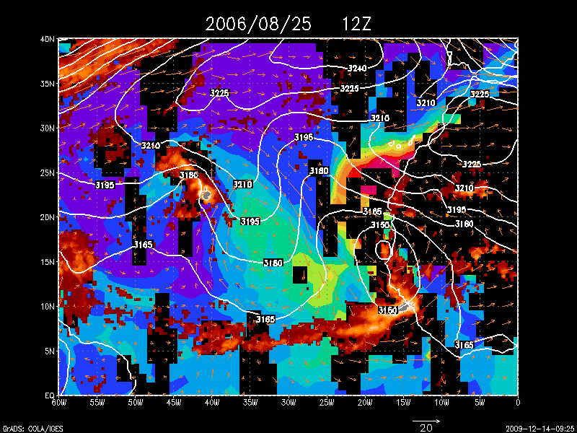
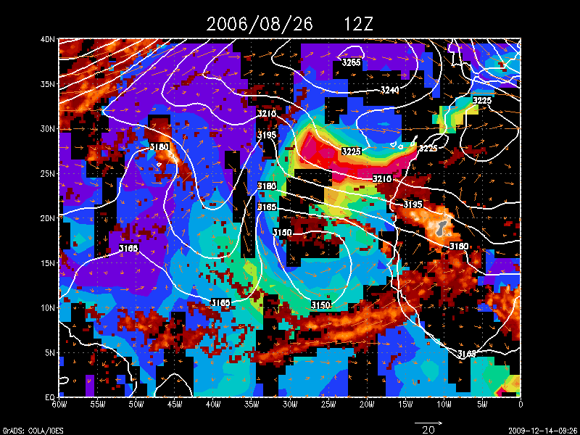
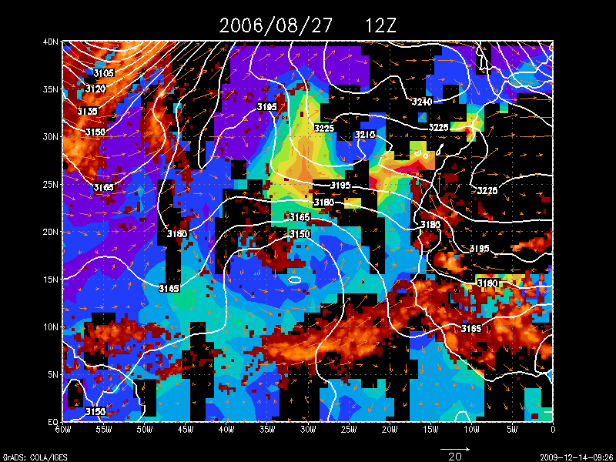
Evolution of the MODIS AOD, TRMM precipitation, and
GFS 700-hPa heights and wave-relative winds
SAL2
SAL2
Debby
SAL2
Debby
SAL1
Debby
SAL1
SAL1
SAL1

