Slide 1
An Update on NHC’s
Storm Surge Program and Future Direction
Jamie Rhome
Storm Surge Specialist/Team Lead
National Hurricane Center

Slide 2
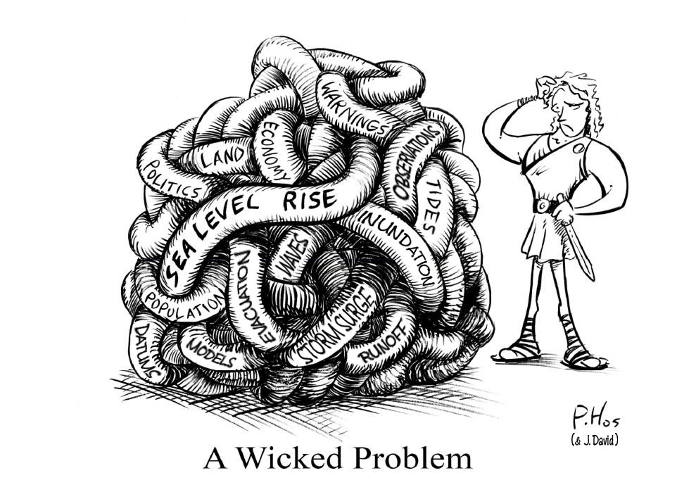
The Storm Surge Gordian Knot

Slide 3
Ongoing Challenges
GIS
Modeling
Cartography
Statistics
Meteorology
Remote Sensing/Lidar
Sociology
Geology
What agency/line office houses all this expertise?
Storm surge/coastal inundation requires a “community approach”
Instrumentation
Oceanography
Coastal Morphology
Emergency management
Physics
Geodesy
Bathymetry

Slide 4
Storm Surge Does Not Fit Into a Single Box
Storm surge/inundation
Atmospheric Sciences
Oceanography

Slide 5
Roadmap Goals
Total Water Level:
  Establish observational networks that measure—and produce water level analyses and forecasts that include—all contributions to surge
  Total water = Surge + tides + waves + fresh water + background water anomaly
Inundation Products:
  provide information about the water depth over the land (inundation)
Communicate Actionable Information
  Addresses uncertainty, supports risk assessment, describes impacts

Slide 6
Total Water Level
Current Technology: SLOSH
  Predicts surge
  Does not explicitly predict tide (must be added manually to SLOSH output by forecasters)
  Does not explicitly resolves physics of waves
  Does not incorporate fresh water input
  No real time data assimilation (background water level anomaly must be added manually)
Result:
  Forecasters must add components of water level rise to SLOSH forecasts
  Customers forced to piecemeal together real water level rise via multiple disjointed NOAA products

Slide 7
Ongoing Efforts
Working with federal partners and academia to evaluate advanced SLOSH modeling system including:
  DHS/JHU reengineered SLOSH code (object oriented C++)
  Working with FEMA on SLOSH + Waves prototype
  Working with NOS to add tidal constituents to SLOSH
  Working with NWS WFOs to develop improved operational procedures for adding tide
  Working with NOS to better define/estimate background water anomaly (impacts SLOSH initialization)
Next generation storm surge prediction system
  Ongoing research project for evaluating readiness of research models

Slide 8
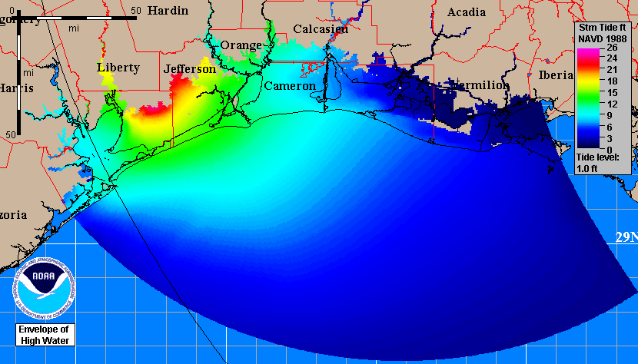
Height Above Reference Level

Slide 9
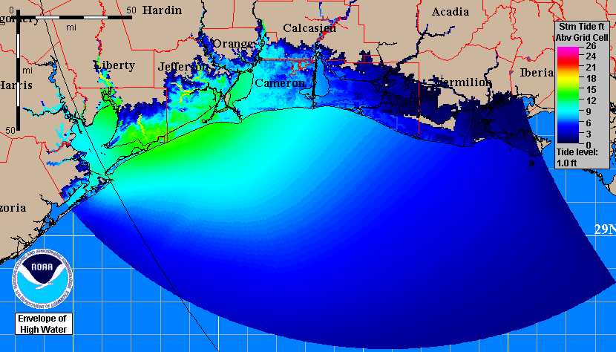
Height Above Ground Level
(Inundation)

Slide 10
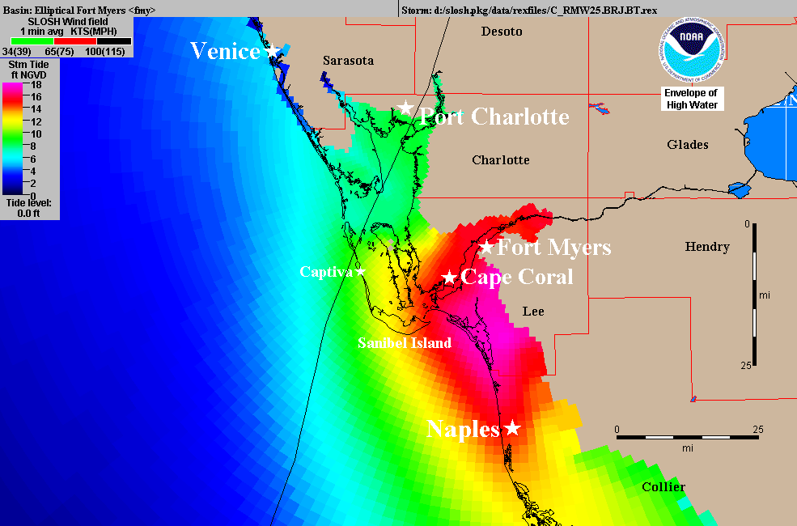
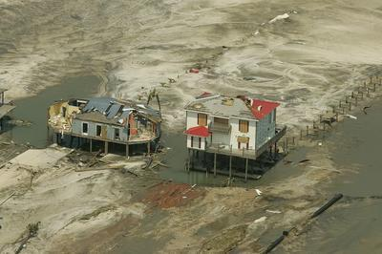
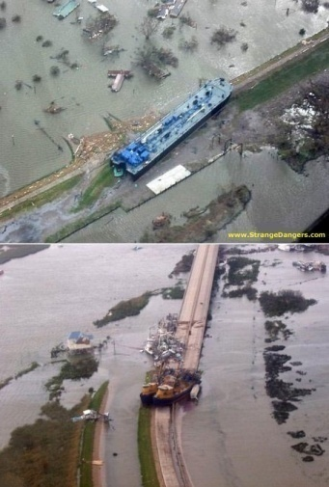
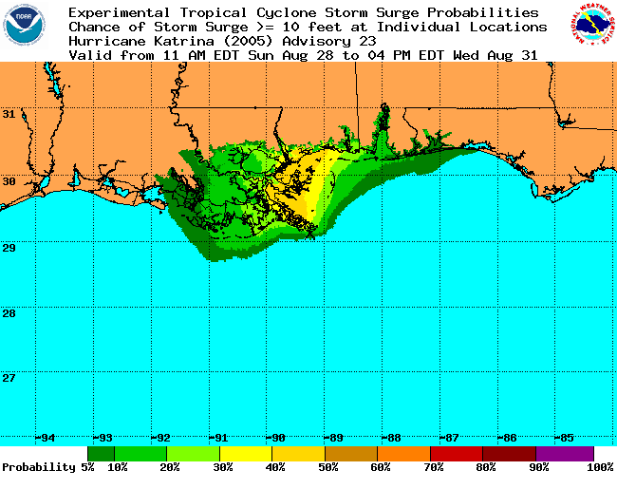
New NHC Surge Statement
Old Statement:
Storm surge flooding of 2 to 4 feet above normal tide levels can be expected along the west coast of Florida in areas of onshore flow south of Venice and in Florida Bay. Storm surge should begin to decrease along the east coast of Florida.
New Statement:
STORM SURGE WILL RAISE WATER LEVELS BY AS MUCH AS 4 FEET ABOVE GROUND LEVEL ALONG THE WEST COAST OF FLORIDA IN AREAS OF ONSHORE FLOW SOUTH OF VENICE AND IN FLORIDA BAY ... WITH LARGE AND DANGEROUS BATTERING WAVES ... THE SURGE COULD PENETRATE AS FAR INLAND AS ABOUT 10 MILES FROM THE SHORE WITH DEPTH GENERALLY DECREASING AS THE WATER MOVES INLAND. STORM SURGE SHOULD BEGIN TO DECREASE ALONG THE EAST COAST OF FLORIDA.

Slide 11
Actionable Information: Storm Surge Warning
Why consider a storm surge warning?
  Current criteria for TC watches and warnings is wind-based
  Significant coastal flooding can occur prior to the initialization of TC watches/warnings and well beyond the extent of current TC watches/warnings
    Example: Ike along central Gulf coast
  Customer feedback indicates significant confusion and need for actionable information
  WMO has recommended it
  FEMA has requested it
  Current NWS coastal flooding warning system is ineffective for high-impact events
  Other countries have successfully implemented similar warnings

Slide 12
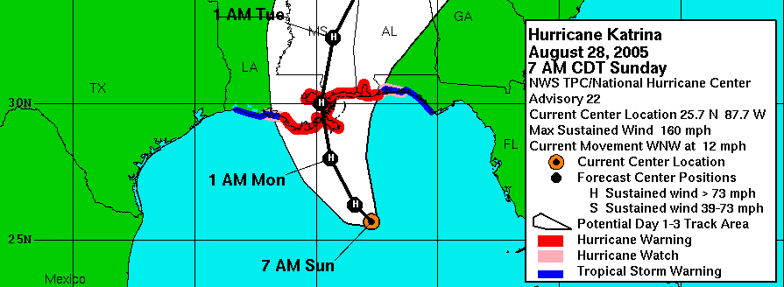
Current Product
(Inland) Hurricane Warning
Proposed Product
H
H
Storm Surge Warning

Slide 13
Progress on Warning
NHC has authored a white paper highlighting need and distributed to users and partners for initial feedback
NWS has established a team to further investigate the feasibility of a storm surge warning including:
  Leading an agency-wide discussion on how to proceed
  Soliciting feedback from selected users (emergency managers, emergency planners, local government leaders, media, etc.)
  Gathering social science inputs and leveraging existing social science efforts

Slide 14
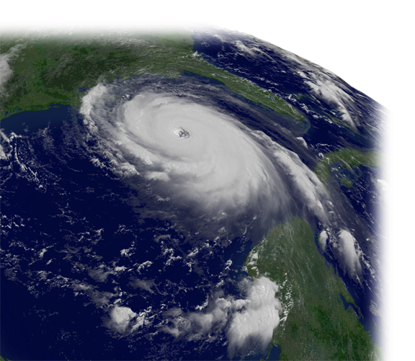
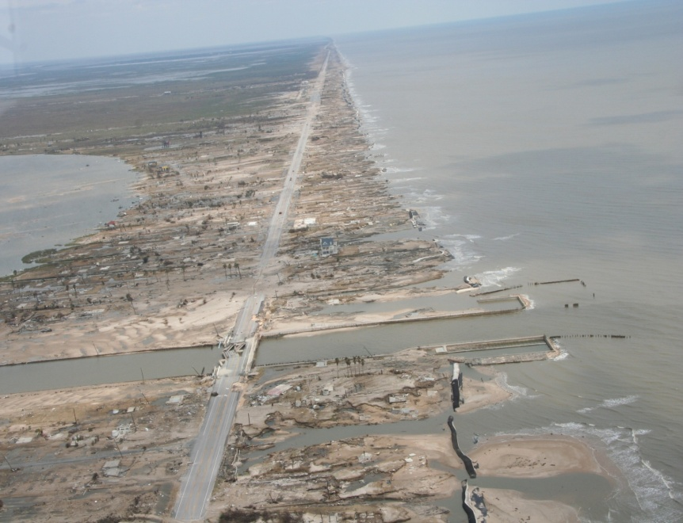
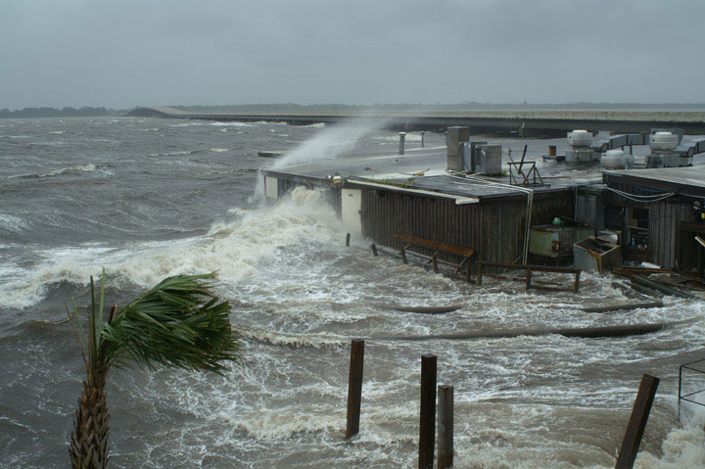
NHC’s Vision
The objective is to:
provide the right information
in the right format
at the right time
to the right people
to make the right decisions

Slide 15
NOAA Storm Surge Roadmap
National Ocean Service (Oceanography)
Water level gauges
Coastal modeling R&D
Promotes community resiliency
Develops planning and risk assessment tools (GIS)
National Weather Service (Meteorology)
Real-time storm surge simulation and guidance during landfall events
Vulnerability mapping
Post-storm assessments/studies
Historical Storm/Hypothetical Storm Simulations
Working together to support the Nation’s efforts in planning, evacuation, response, recovery

Slide 16
SLOSH Basin Update
FY09: Mobile (MO2), Savannah (SV3), Buzzards Bay (PV2), New Orleans (MS4), Tampa Bay (TP3), Virgin Islands (VI2), Pensacola (PN3), Delaware (DE3)
FY10 (to date): Panama City (PA2), Cape Canaveral (CO2), Palm Beach (PB3), Apalachicola (AP2), Cedar Key (CD2), Biscayne Bay/Miami (MI3)
Basins currently under development: Florida Keys, Lake Okeechobee, Galveston, Fort Myers, Jacksonville, New York
Basins awaiting resources or higher priority: Penobscot, Vermillion Bay
18 of 37 converted from NGVD29 to NAVD88

Slide 17
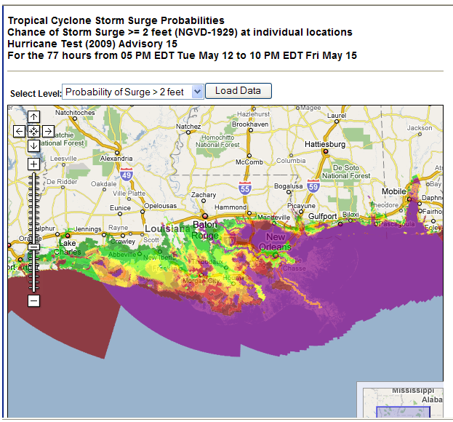
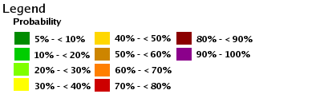
Probabilistic Surge Product
Operational for 2009
User-selectable heights from 2-25 ft in 1 foot increments
Available whenever a hurricane watch/warning is in effect
New web/Google interface
Still tied to NGVD29

Slide 18
Recent Accomplishments
Accelerated the rate of SLOSH basin updates
  Completed 8 SLOSH basin simulation studies in FY09 (milestone = 6)
  Already completed 6 SLOSH basins in FY10
Expanded NHC’s storm surge outreach/education program
Made the switch to inundation
  Revised statement in public advisory
  SLOSH graphics available in height above ground level
Probabilistic storm surge transitioned to operational status with new web/Google interface
Increased lead time for deterministic SLOSH runs from 24 to 36 hours

Slide 19
Current Efforts
Expand/Enhance storm surge content on NHC’s web page
Test/Verify the concept of a mini-MEOW SLOSH ensemble approach in real-time
Improve NOS/NWS coordination during landfalling cyclones
Work with WFOs and NWS OCWWS to develop an initial CONOPS for a NWS storm surge warning
Verification of operational SLOSH guidance/forecasts
Improve R2O
  Solicit/encourage participation in the JHT
  Surge modeling testbed

Slide 20
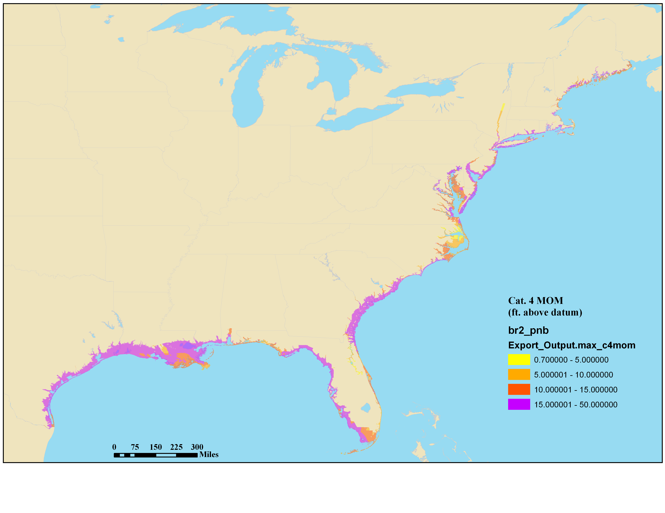
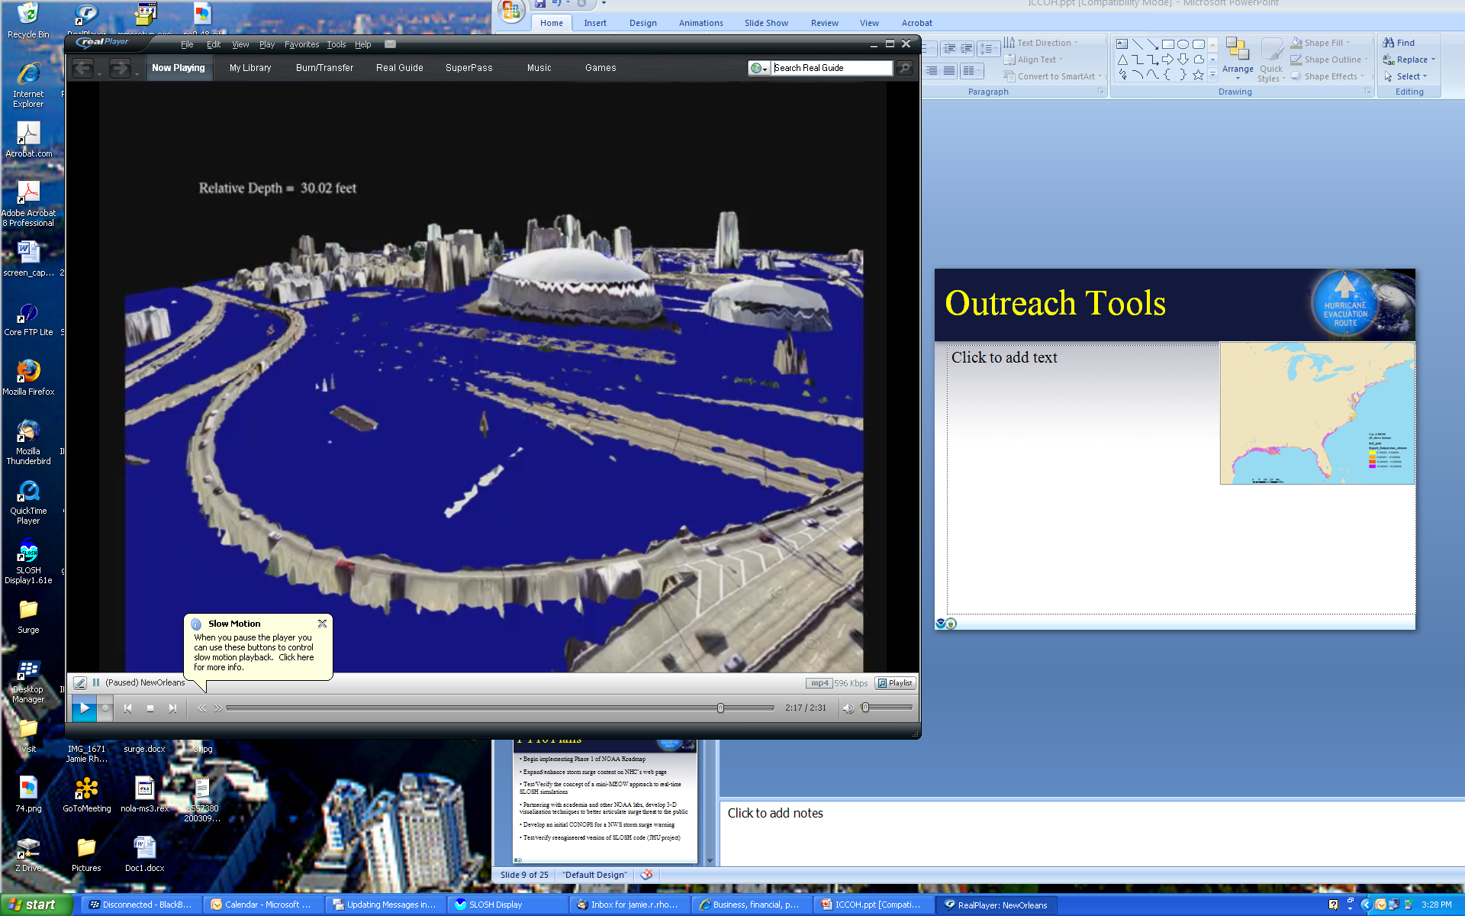
Experimental Outreach Tools
3-D Visualization
National MOM Product

Slide 21
