Slide 1
Satellite and Model Database in Support of the NASA GRIP Field Campaign and for Improved Operational Hurricane Forecasting
64th Interdepartmental Hurricane Conference
S. Hristova-Veleva, P. P. Li , F. J. Turk,
B. Knosp , Q. Vu, W. Poulsen, S. Licata
B. Lambrigtsen, Y. Chao, Z. Haddad, D. Vane
H. Su, S. Tanelli
March 3, 2010

Slide 2
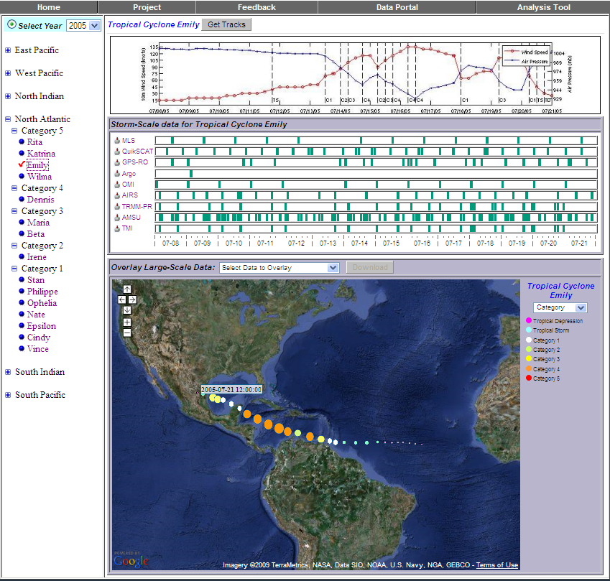
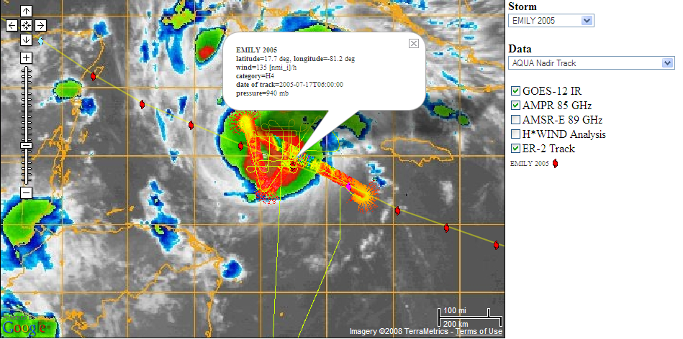
Tropical Cyclone – Integrated Data Exchange and Analysis System (TC-IDEAS)‏
Joint NASA Jet Propulsion Lab and Marshall Space Flight Center Project
Funded by the Hurricane Science Research Program
Objective: To provide fusion of multi-parameter hurricane observations (satellite, airborne and in-situ) and model simulations with the purpose of:
supporting both research and field campaigns (incorporating RTMM)‏
understanding the physical processes
improving hurricane forecast by facilitating model validation and data assimilation
enabling the development of new algorithms, sensors and missions.
RTMM
Select by basin, name, or category with
corresponding data availability timelines
ER-2 /AMPR data over GOES IR

Slide 3
Joint NASA JPL and MSFC Project
RTMM
Remote Presence
GRIP Data System
Waypoint
Planning
Collaborative Portal
NRT
Satellite/Model
Archive & Analysis System

Slide 4
GRIP Scientific Questions
Do environmental stability and moisture play key roles in determining whether disturbances develop or fail to develop into tropical cyclones? Or is the key factor related to dynamic processes and interaction with environmental vertical wind shear?
What environmental (e.g., vertical wind shear, upper-level outflow jets, low to mid-level moisture, upper-level troughs), oceanic (e.g. warm ocean eddies) and inner core (e.g., hot towers) factors govern rapid intensification?
Do hot towers and convective bursts play a major role or are they merely an indicator of energy conversion processes (e.g., associated with movement over a warm ocean eddy)?
What is the predictability of rapid intensification and what observations are most critical to its prediction?
What is the role of the Saharan Air Layer, in terms of the impact of its mid-level dry air, mid-level easterly jet and suspended African dust on intensification?
What is the role of internal structure changes, including rainbands, eyewall replacement cycles, and storm asymmetries on tropical cyclone intensity change?
Does the formation of cyclonic vorticity at the surface originate from midlevel cyclonic vorticity that builds downward, or does it originate at low levels and grow upward? What is the role of deep convection in this process?
How does the thermal structure within the vortex evolve from cold to warm core? What physical processes are important for generating and maintaining the warm anomaly?

Slide 5
GRIP Scientific Questions – what data
Large-scale model and satellite 3D winds derived from cloud motion
environmental vertical wind shear
upper-level troughs and outflow jets
Observations (AIRS, GPS-RO, MLS, AMSU) AND Large-scale model ‏
environmental stability and moisture
low to mid-level moisture
Ocean Heat Content and SST from Observations
high-resolution SSTs and warm ocean eddies
Active and Passive Microwave and IR Observations: TRMM, CloudSAT, AMSR-E, SSM/I, AMSU, QuikSCAT, ASCAT, GOES
inner core structure - hot towers and convective bursts
Role of internal structure changes, including rainbands, eyewall replacement cycles, and storm asymmetries on tropical cyclone intensity change?
Predictability of rapid intensification and what observations are most critical? Evolution of cyclonic vorticity – does midlevel cyclonic vorticity build downward, or does vorticity originate at low levels and grow upward? What is the role of deep convection ?
Observations of Aerosols, midlevel humidity; Flow from Large-scale model
Saharan Air Layer - mid-level dry air, mid-level easterly jet and suspended African dust How does the thermal structure within the vortex evolve from cold to warm core?
What physical processes are important for generating and maintaining the warm anomaly?

Slide 6
NRT Satellite/Model Data http://tropicalcyclone.jpl.nasa.gov/grip
GOAL
To provide a near-real time basin-scale view of the atmospheric and surface conditions, characterizing large-scale and storm scale processes, as depicted by satellites and models
Objective
To provide environmental context and temporal continuity for the field campaign observations to help:
- mission planning
- understanding of the physical processes
- improving models through validation and data assimilation

Slide 7
NRT Satellite/Model Data – DATA TYPES http://tropicalcyclone.jpl.nasa.gov/grip
DATA TYPES
Environment
SST
Total Precipitable Water (TPW)
Temperature/Moisture Profiles and analysis (LI, CAPE, Skew-T)
Surface Convergence/Vorticity
Storm scale Data
IR/VIS/Water Vapor
Brightness Temperatures (TB) at 85 GHz
Rain Indicator (RI) – multi-frequency TB-based rain index
Radar Profiles
Surface Convergence/Vorticity
Storm Tracks and Intensity

Slide 8
NRT Satellite/Model Data – DATA TYPES http://tropicalcyclone.jpl.nasa.gov/grip

Slide 9
NRT Satellite/Model Data – DATA TYPES http://tropicalcyclone.jpl.nasa.gov/grip
Offers 10 (14) NRT satellite image products in the GRIP domain.
Except for the SST and the IR image, the products are generated hourly with 6 hour-composite observations.
The Rain Indicator is a JPL product computed from the brightness temperatures observed by TMI, AMSR-E and SSM/I.
Stability indices (CAPE, LI) of the atmosphere. They, and the Skew-T plots, are produced at JPL from AIRS retrievals of vertical profiles of temperature and humidity.
The GOES IR, VIS and Water Vapor channels are an hourly composite generated by the Naval Research Lab at Monterey.
SST is a 1KM global daily product developed at JPL. It is blended using the GHRSST L2P products and in-situ observations.

Slide 10
NRT Satellite/Model Data – DESIGN http://tropicalcyclone.jpl.nasa.gov/grip
Products | Instruments | Satellites | Source | Latency
1KM Sea Surface Temperature (SST) | GHRSST L2P from PODAAC and in-situ | MODIS, AVHRR, GOES11+12, TMI, AMSR-E, SEVIRI | JPL derived product | 12 hrs
Total Precipitable Water (TPW) | AMSU-A | NOAA-15/16/17/18/ 19 and MetOp-A | NOAA-NESDIS Realtime DDS data server | 3 hrs
85 GHz Brightness temperature | SSMI, SSMIS, AMSR-E, TRMM TMI | DMSP F-15/16/17, AQUA, TRMM | NOAA-NESDIS, LANCE NASA GSFC PPS | 3 hrs
Rain Indicator | SSMI, SSMIS, AMSR-E, TRMM TMI | DMSP F-15/16/17, AQUA, TRMM | JPL derived product | 3 hrs
IR, VIS and WV hourly composite | GOES |  | Naval Research Lab – Monterey (NRL) | 0.5 hrs
Surface Wind vector plots | QuikSCAT | QuikSCAT | JPL PoDAAC | Stopped operation since 11/23/2009
AIRS CAPE (Convective Available Potential Energy) | AIRS | Aqua | NASA GSFC/JPL AIRS Science Facility
AIRS Lifting Index (LI) and SkewT diagrams | AIRS | Aqua | NASA GSFC/JPL AIRS Science Facility
Radar Reflectivity converted from L1B Received Echo Poser | CloudSat | CloudSat | Colorado State CloudSat Data Processing Center
Best Track |  |  | JPL | 6 hr

Slide 11
NRT Satellite Data – DATA TYPES http://tropicalcyclone.jpl.nasa.gov/grip
GOES and Meteosat IR – 4km resolution; NRL product

Slide 12
NRT Satellite Data – DATA TYPES http://tropicalcyclone.jpl.nasa.gov/grip
SST – 1km resolution; Observations-based; JPL daily product

Slide 13
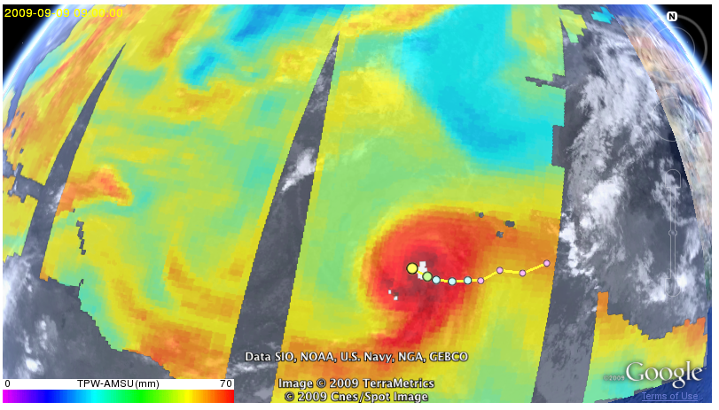
NRT Satellite Data – DATA TYPES http://tropicalcyclone.jpl.nasa.gov/grip
Total Precipitable Water (TPW) from AMSU observations

Slide 14
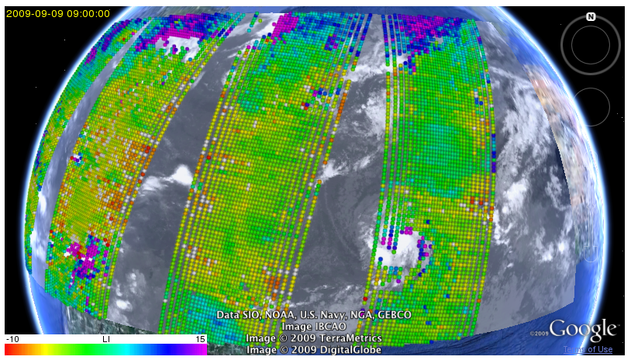
NRT Satellite/Model Data – DATA TYPES http://tropicalcyclone.jpl.nasa.gov/grip
Lifted Index (LI);
JPL product from AIRS retrievals of Temperature and humidity profiles

Slide 15
NRT Satellite Data – DATA TYPES http://tropicalcyclone.jpl.nasa.gov/grip
Convective Available Potential Energy (CAPE);
JPL product from AIRS retrievals of Temperature and humidity profiles

Slide 16
NRT Satellite Data – DATA TYPES http://tropicalcyclone.jpl.nasa.gov/grip
Convective Available Potential Energy (CAPE);
JPL product from AIRS retrievals of Temperature and humidity profiles

Slide 17
NRT Satellite Data – DATA TYPES http://tropicalcyclone.jpl.nasa.gov/grip
Skew-T;
JPL product from AIRS retrievals of Temperature and humidity profiles

Slide 18
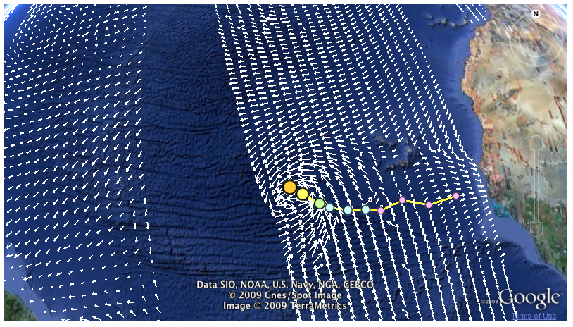
NRT Satellite Data – DATA TYPES http://tropicalcyclone.jpl.nasa.gov/grip
Near-surface wind retrieved from QuikSCAT observations

Slide 19
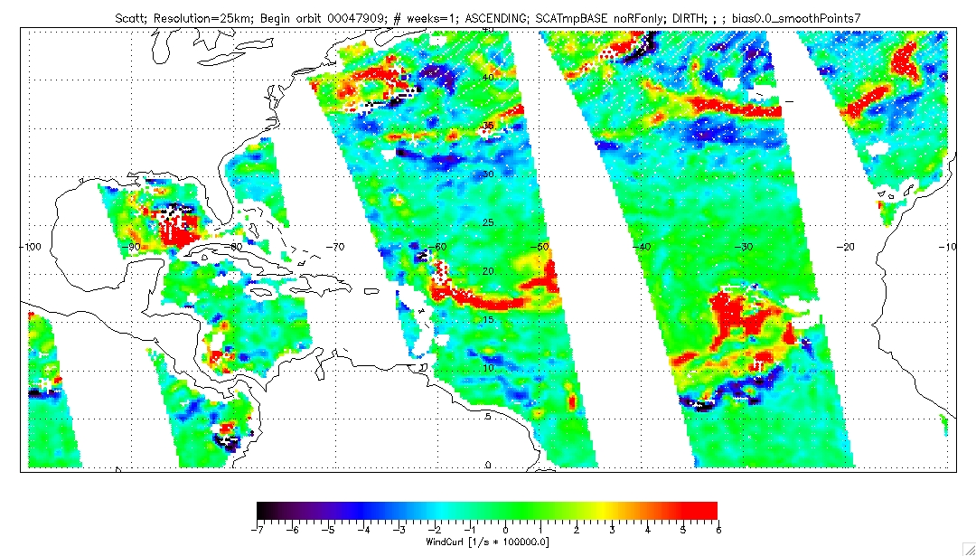
NRT Satellite/Model Data – DATA TYPES Vorticity computed from QuikSCAT winds

Slide 20
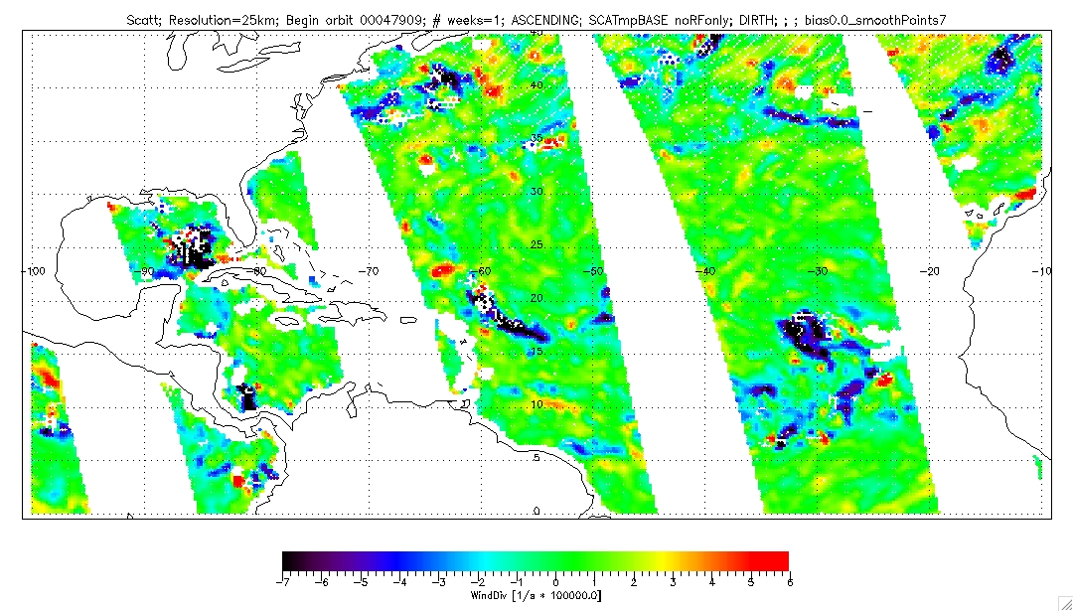
NRT Satellite/Model Data – DATA TYPES Divergence computed from QuikSCAT winds

Slide 21
NRT Satellite/Model Data – DATA TYPES http://tropicalcyclone.jpl.nasa.gov/grip
Overlay of IR and 85 GHz brightness temperatures

Slide 22
NRT Satellite Data – DATA TYPES http://tropicalcyclone.jpl.nasa.gov/grip
Overlay of IR and 85 GHz brightness temperatures

Slide 23
NRT Satellite Data – DATA TYPES http://tropicalcyclone.jpl.nasa.gov/grip
Overlay of IR,
Rain Indicator (JPL multi-frequency product) and CloudSAT tracks
Notes:
The Rain Indicator (RI) – this is a product that has been developed at JPL as part of our AMSR rain retrieval algorithm. It uses observed brightness temperatures to compute emission and scattering indices and combines them into a single measure, the RI, which serves three purposes: to discriminate rainy vs. non-rainy conditions; to give a first order estimation of rain intensity; to provide a measure of the spatial variability of the rain to help classify the rain type (e.g. convective vs. stratiform) with the goal to help select the most appropriate database for use during rain retrieval (Hristova-Veleva et al., 2009 - submitted to JAMC). The RI is computed from brightness temperatures observed by TMI, AMSR-E and SSM/I.

Slide 24
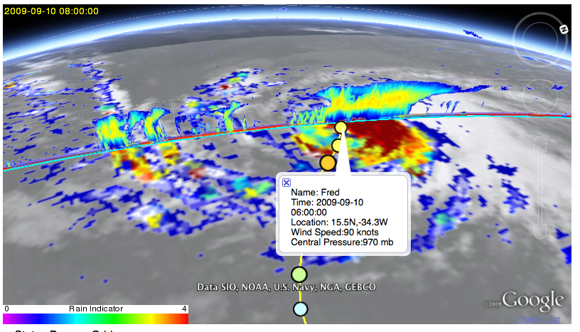
NRT Satellite – DATA TYPES http://tropicalcyclone.jpl.nasa.gov/grip
Overlay of IR,
Rain Indicator (JPL multi-frequency product) and CloudSAT data

Slide 25
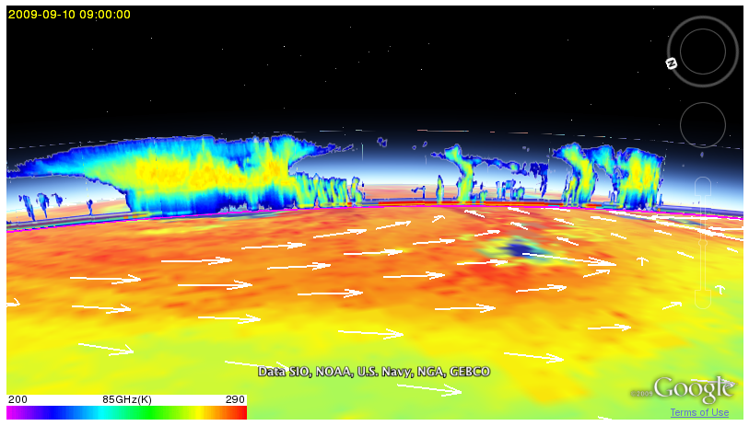
NRT Satellite Data – DATA TYPES http://tropicalcyclone.jpl.nasa.gov/grip
Overlay of Rain Indicator (JPL multi-frequency product)
CloudSAT reflectivity profile and QuikSCAT surface winds

Slide 26
NRT Satellite/Model Data – Data Types http://tropicalcyclone.jpl.nasa.gov/grip
COMMING SOON
SATELLITE DATA
TRMM-PR vertical profiles of reflectivity
2D maps of Relative humidity at several levels
Near-surface winds from ASCAT and ISRO’s OceanSAT-2
CALIPSO
GOES VIS and WV
Ocean Heat Content
Storm Tracks from hurricane forecast models

Slide 27
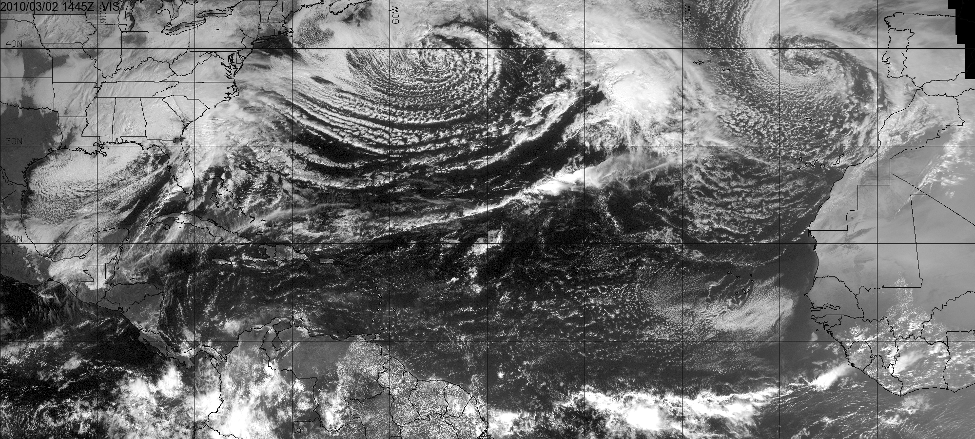
Coming soon – GOES Visible http://tropicalcyclone.jpl.nasa.gov/grip

Slide 28
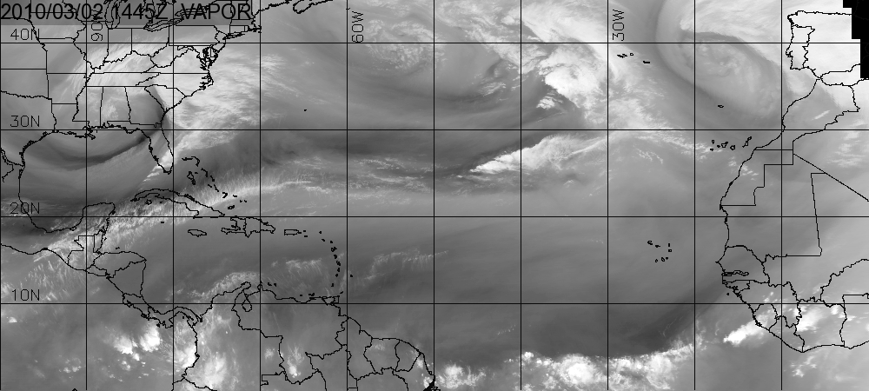
Coming soon – GOES Water Vapor http://tropicalcyclone.jpl.nasa.gov/grip

Slide 29
NRT Satellite/Model Data – Data Types http://tropicalcyclone.jpl.nasa.gov/grip
COMING SOON in collaboration with PREDICT, IFEX
Large-Scale and Regional MODEL fields
GFS, UK Met, HWRF, possibly ECMWF 0.25deg
PARAMETERS- Geopotential Height, Vorticity , OW, Earth-relative and wave-relative Horizontal wind, Relative Humidity, Temperature
LEVELS - 925mb, 850, 700, 500, 400, 250
OTHER parameters - SLP, SST, Shear, TPW, Liquid and Ice Water Path, Tropopause – temperature, height, Cloud Top Height

Slide 30
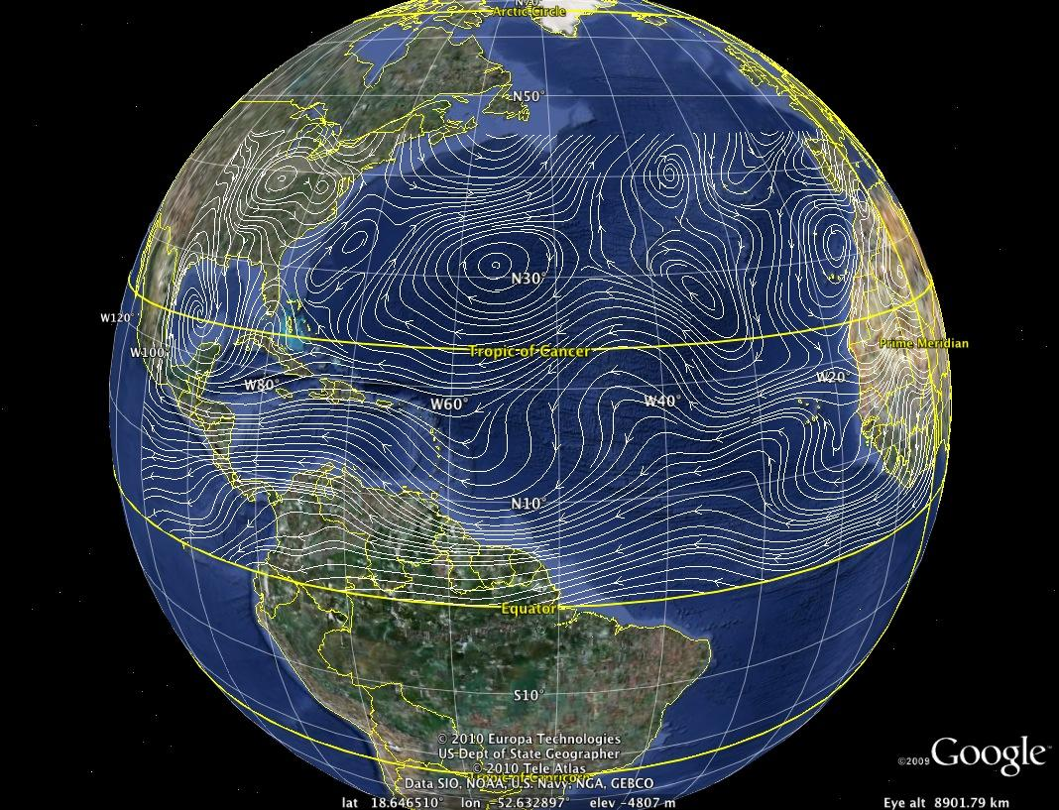
Coming soon – MODEL DATA - 700mb Earth-relative http://tropicalcyclone.jpl.nasa.gov/grip

Slide 31
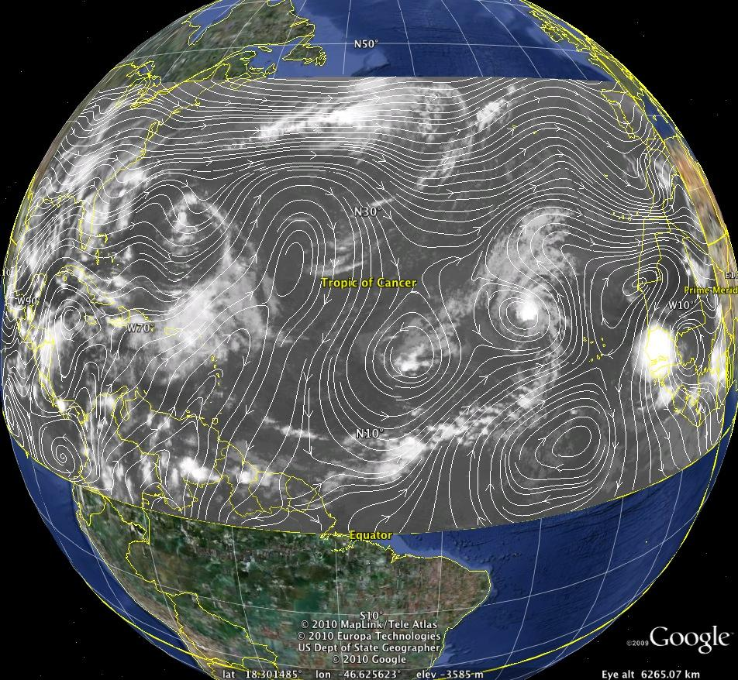
Coming soon – MODEL DATA - 700mb Co-moving http://tropicalcyclone.jpl.nasa.gov/grip
COMING SOON – MODEL fields

Slide 32
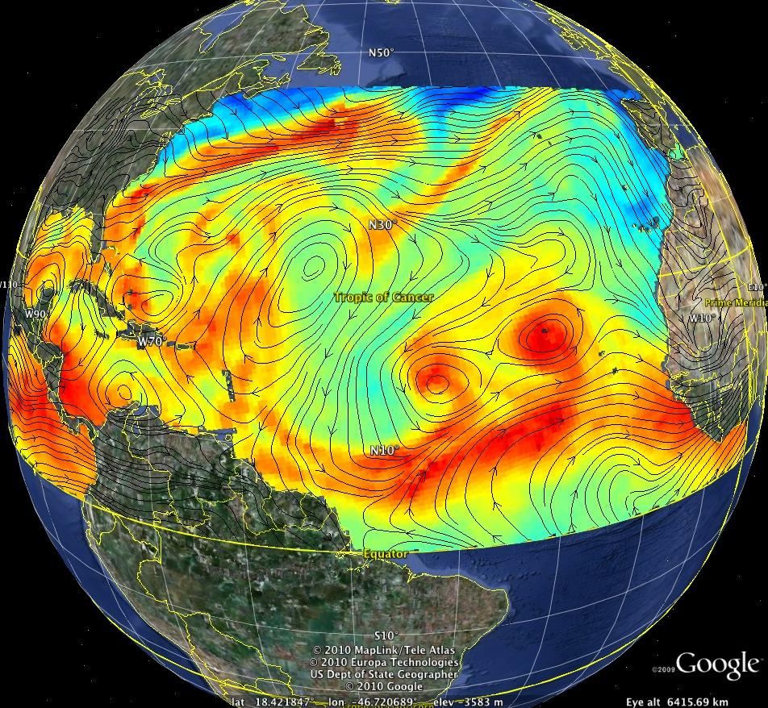
Coming soon – MODEL DATA - 925mb Co-moving http://tropicalcyclone.jpl.nasa.gov/grip
COMING SOON – MODEL fields

Slide 33
NRT Satellite/Model - ADVANTAGES http://tropicalcyclone.jpl.nasa.gov/grip
svetla.veleva@jpl.nasa.gov
Features
basin-scale view
large-scale and storm-scale data
includes 3D data (2D and curtain plots)
analysis (LI, CAPE, Skew-T ,RI , vorticity , divergence)
“Best Track” (possibly also forecast tracks)
overlays on demand, transparency
Animations, calendar, with hurricane days marked
uses Google Earth – ability to zoom and navigate

Slide 35
BACKUP

Slide 36
NRT Satellite/Model - ADVANTAGES http://tropicalcyclone.jpl.nasa.gov/grip
Can accommodate the displaying of new data
Dropsondes
Airborne radar data
Responsive also to some of the requirements expressed during a recent PREDICT telecon
Satellite data with overlays
Inclusion of Invests - Have all data, including all “INVEST” data
Planned inclusion of large-scale Model data (however, envisioned is the use of GFS instead of ECMWF)
Planned inclusion of hurricane model forecasted tracks.

Slide 37
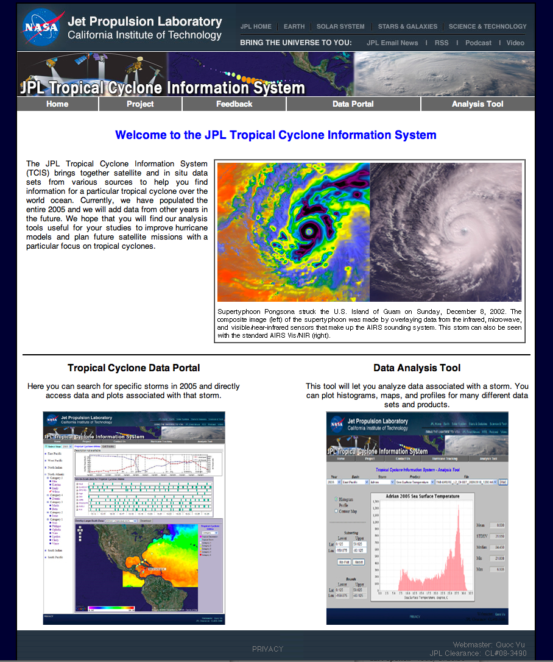
2 main components
In the current
JPL TCIS
37
Notes:
37

Slide 38
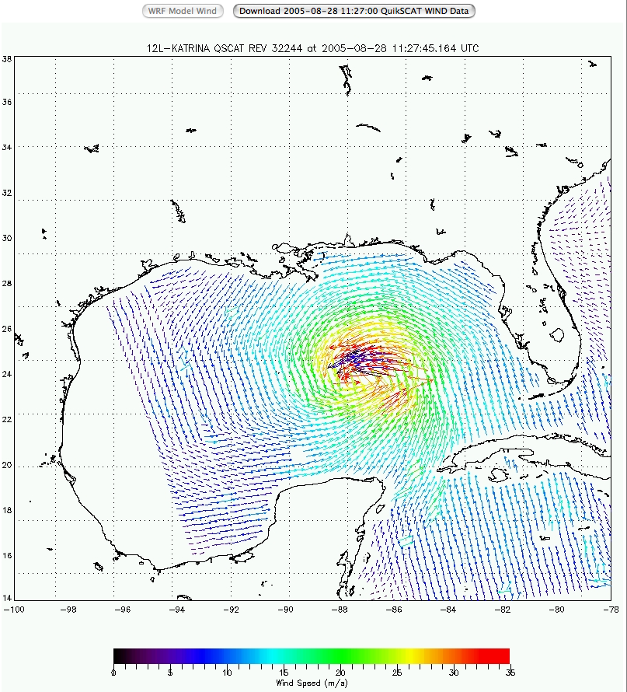
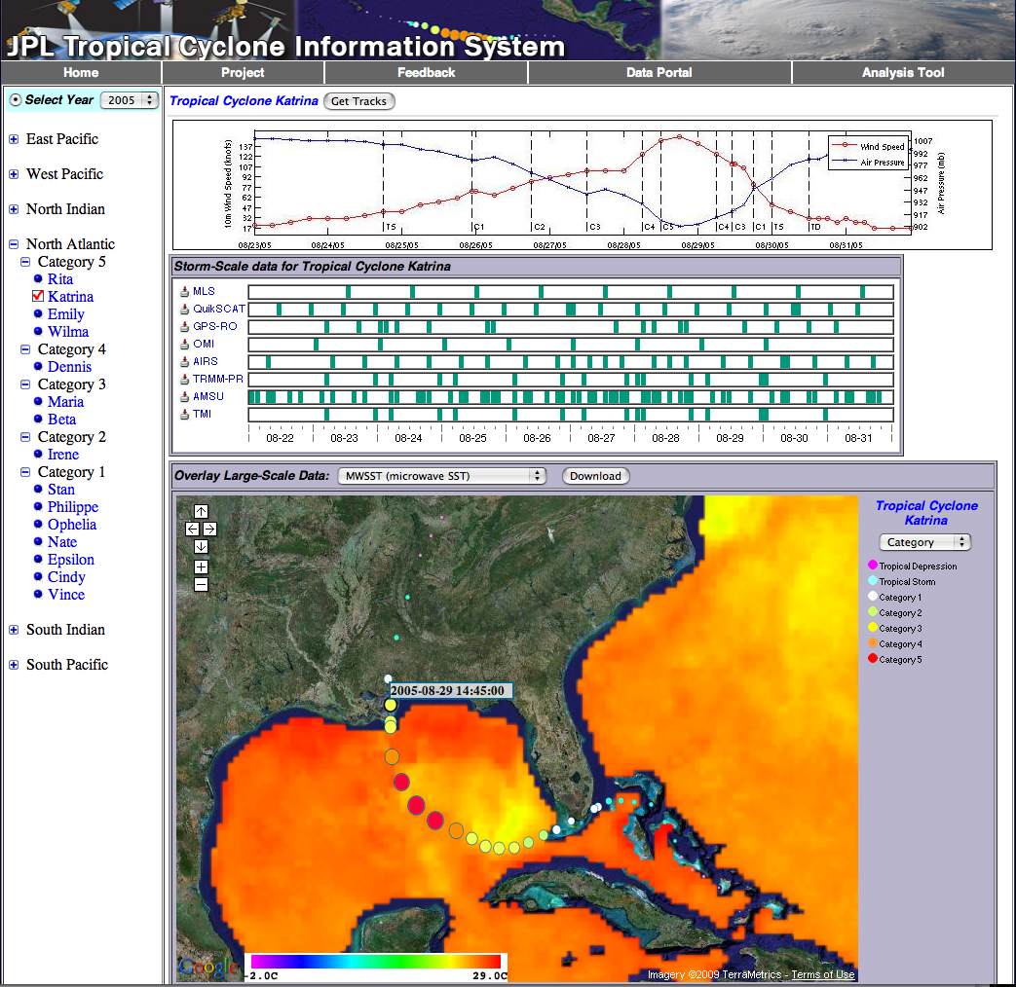
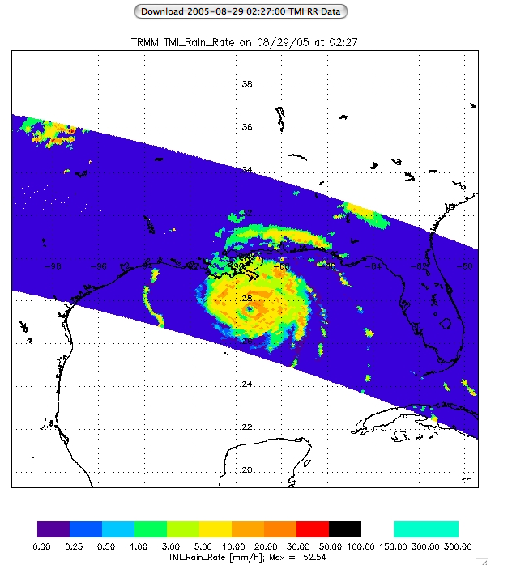
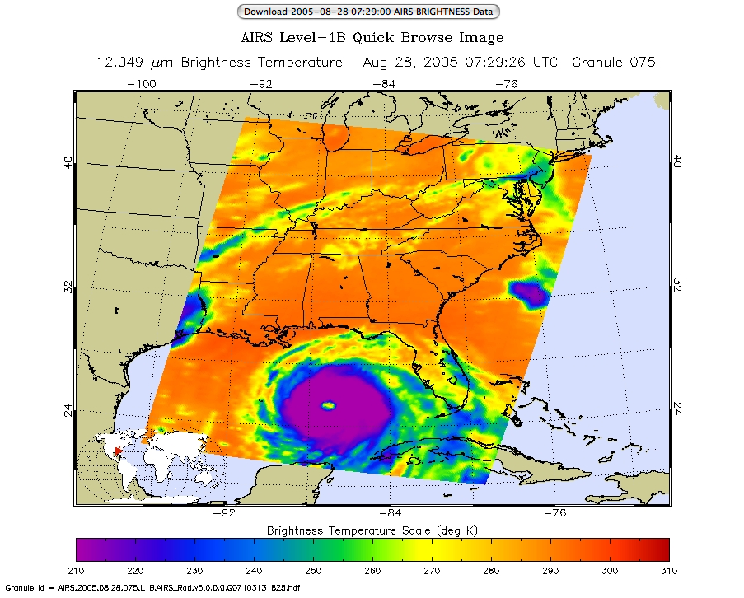
Tropical Cyclone Data Portal – Current Status
1/8/09
38
Notes:
38

Slide 39
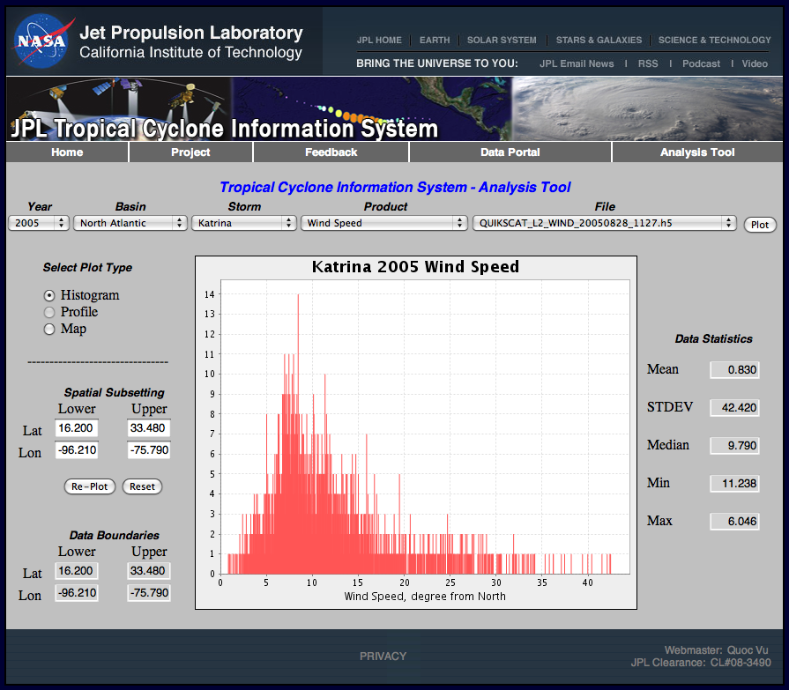
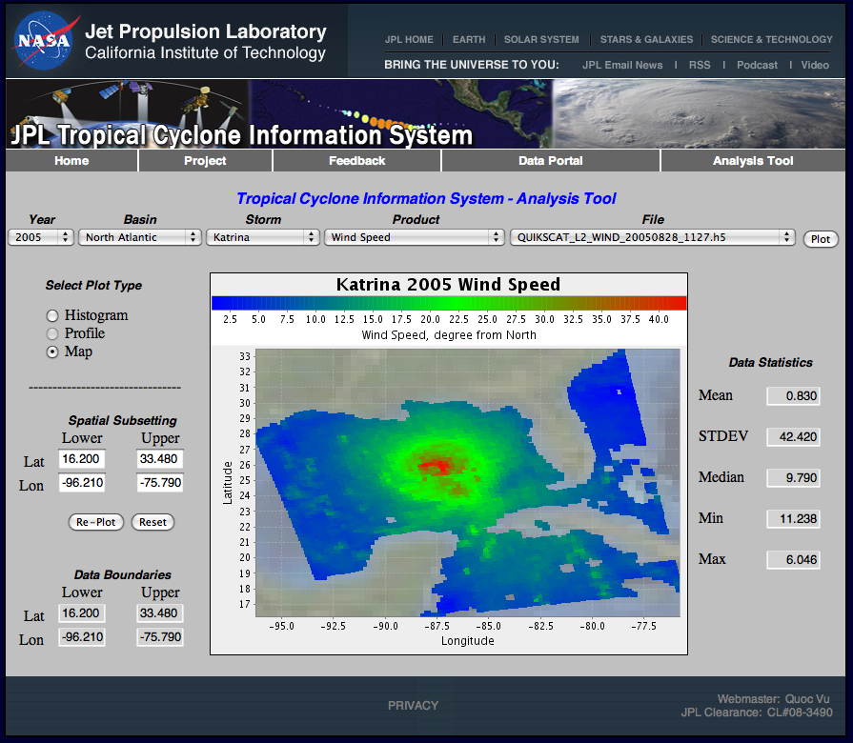
Analysis Tools – Current Status
Single Parameter Statistics
Notes:
39
A very important component of the TC-IDEAS is the set of analysis tools that will allow for comprehensive: - model-data comparison
-comparison between retrievals from different observing platforms and instruments
- development of mulltiparameter covariances that are essential for designing effective data assimilation strategies.
The current system supports the computation of single-parameter statistics. During the four-year project which is just starting , we will expand the analysis system to include multiparameter statistics, including covariances, and the ability to query the data.

Slide 40
TC-IDEAS – historical database and analysis http://tropicalcyclone.jpl.nasa.gov/hurricane
Data Portal
Data organized by year, basin, storm
A wider variety of data types (MLS, OMI, ARGO floats, Ocean Heat Potential, Multi-frequency brightness temperatures, full set of radar observations, retrieved precipitation parameters, Aerosol Optical Depth)
Analysis System
Will communicate with satellite and airborne data
Space and time sub-sectioning and aggregation
Stability, Skew-T, EOFs, WRF simulations, instrument simulators

Slide 41
How it all started …
The Hurricane Group
Awareness phase: - Sept. 06-Dec. 06
Multiple JPL satellite missions measure various aspects of hurricanes
Several NRC decadal survey recommended mission concepts are related to hurricanes
Three groups run hurricane models
Formulation phase - Jan. 07 – Yi Chao
A virtual group has been established with bi-weekly meetings
Hurricane Lecture Series
Notes:
41
41

Slide 42
How it all started …
The TCIS and GRIP portals
Design phase
May 07: ISC R&TD proposal submitted and funded
Sept. 07: Successfully delivered the database/web-portal prototype and submitted the ISC R&TD final report and poster
Development phase
Dec. 08: Released the portal for public use with one full year of globally observed tropical cyclones.
Dec. 09: GRIP portal became operational, populated with graphics covering the period since September 09.
Notes:
42
42

Slide 43
How it all started …
Funding
4-year funding under the ROSES08-Hurricane Science Research program.
Internal JPL support – THANK you ALL !!
ISC R&TD
Funding support from the CloudSAT project
Hardware and IT support from AIRS
New funding support from MLS
Heritage from the QuikSCAT hurricane portal
Notes:
43
43

Slide 44
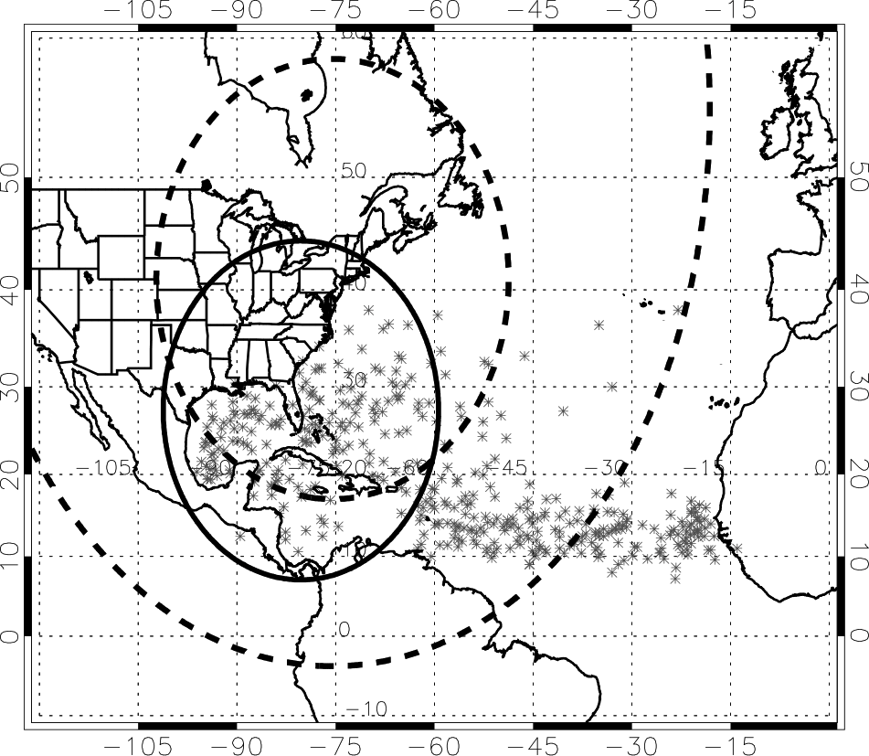
Fig. 1. Initial locations of tropical cyclones (depressions, storms, and hurricanes) for August and September during the years 1940-2006, according to the National Hurricane Center's best track files. The solid range ring shows the maximum range of the DC-8 for a 12-h flight with 6 h on station. The dashed lines show range rings for the Global Hawk for 30-h flights with 15 (outer circle) and 22.5 h (inner circle) on station.

Slide 45
GRIP Scientific Questions
Do environmental stability and moisture play key roles in determining whether disturbances develop or fail to develop into tropical cyclones? Or is the key factor related to dynamic processes and interaction with environmental vertical wind shear? Do vertical wind shear and dry air act together in a nonlinear manner to weaken insipient tropical disturbances and tropical cyclones?
What environmental (e.g., vertical wind shear, upper-level outflow jets, low to mid-level moisture, upper-level troughs), oceanic (e.g. warm ocean eddies) and inner core (e.g., hot towers) factors govern rapid intensification?
Do hot towers and convective bursts play a major role or are they merely an indicator of energy conversion processes (e.g., associated with movement over a warm ocean eddy)?
What is the predictability of rapid intensification and what observations are most critical to its prediction?
What is the role of the Saharan Air Layer, in terms of the impact of its mid-level dry air, mid-level easterly jet and suspended African dust on intensification?
What is the role of internal structure changes, including rainbands, eyewall replacement cycles, and storm asymmetries on tropical cyclone intensity change?
Does the formation of cyclonic vorticity at the surface originate from midlevel cyclonic vorticity that builds downward, or does it originate at low levels and grow upward? What is the role of deep convection in this process?
How does the thermal structure within the vortex evolve from cold to warm core? What physical processes are important for generating and maintaining the warm anomaly?

Slide 46
NRT Satellite/Model Data http://tropicalcyclone.jpl.nasa.gov/grip
GOAL
To provide a near-real time basin-scale view of the atmospheric and surface conditions, characterizing large-scale and storm scale processes, as depicted by satellites
DOMAIN
Current - Atlantic basin
During GRIP – Atlantic and East Pacific

Slide 47
NRT Satellite/Model Data – DATA TYPES http://tropicalcyclone.jpl.nasa.gov/grip
Overlay of IR and 85 GHz brightness temperatures

Slide 48
NRT Satellite/Model Data – DATA TYPES http://tropicalcyclone.jpl.nasa.gov/grip
Lifted Index (LI);
JPL product from AIRS retrievals of Temperature and humidity profiles

Slide 49
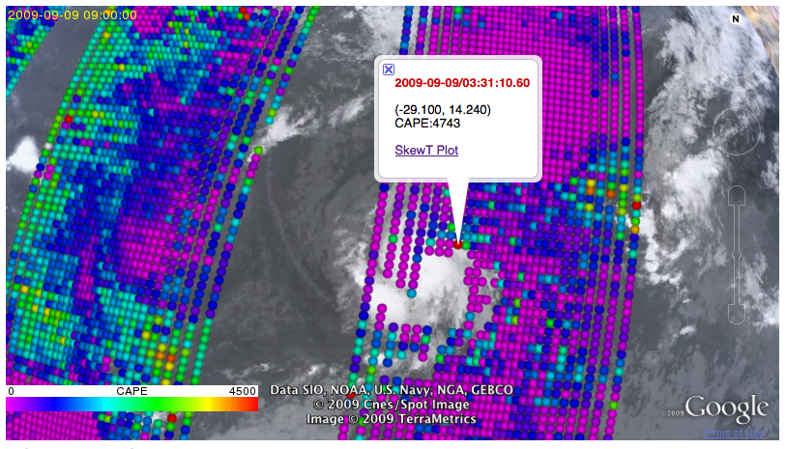
NRT Satellite/Model Data – DATA TYPES http://tropicalcyclone.jpl.nasa.gov/grip
Convective Available Potential Energy (CAPE);
JPL product from AIRS retrievals of Temperature and humidity profiles

Slide 50
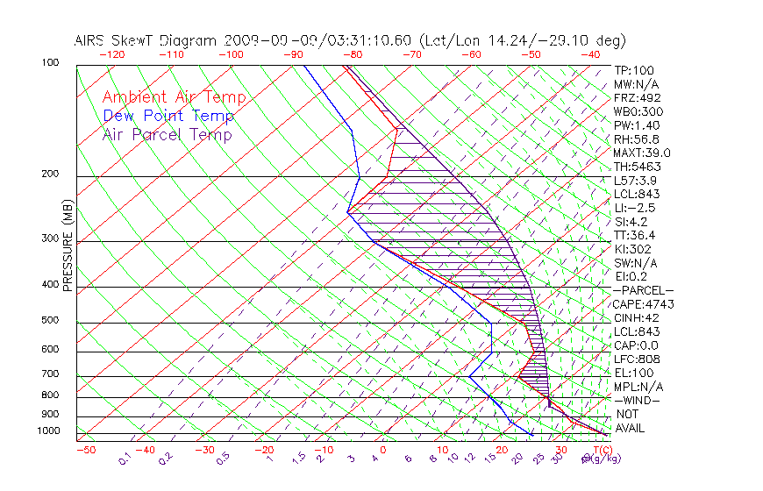
NRT Satellite/Model Data – DATA TYPES http://tropicalcyclone.jpl.nasa.gov/grip
Skew-T;
JPL product from AIRS retrievals of Temperature and humidity profiles

Slide 52
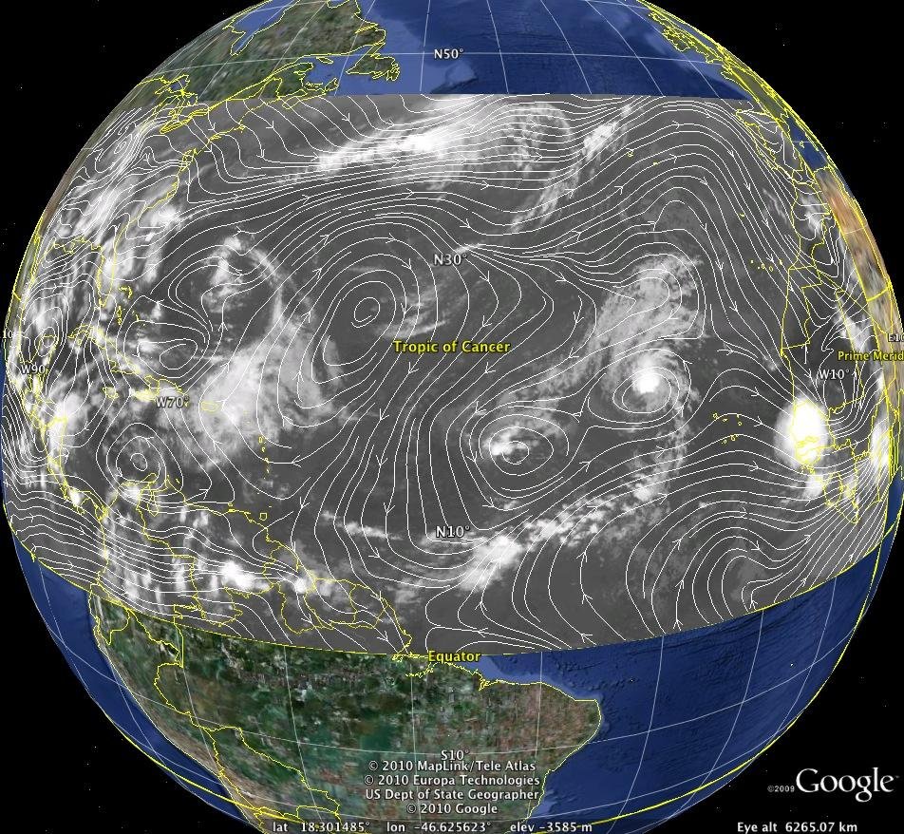
Coming soon - Model Data http://tropicalcyclone.jpl.nasa.gov/grip
COMING SOON – MODEL fields

