Slide 1
NASA-GRIP Field Experiment
Ramesh Kakar
Weather Focus Area Leader
TRMM, Aqua and GPM Program Scientist
March 3,2010

Slide 3

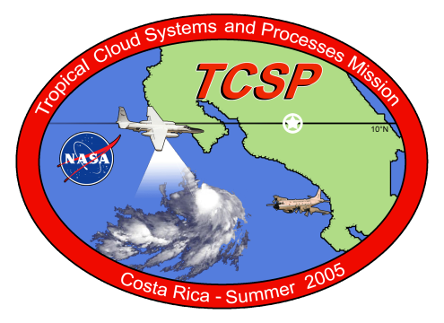
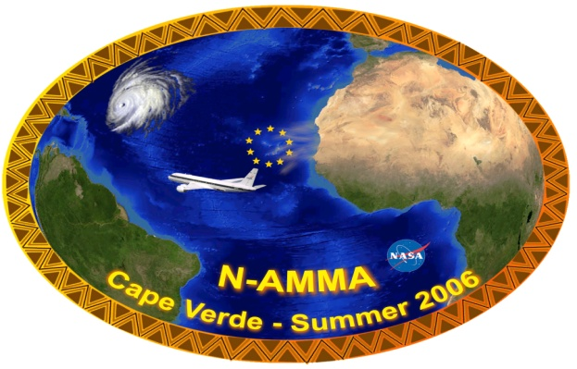
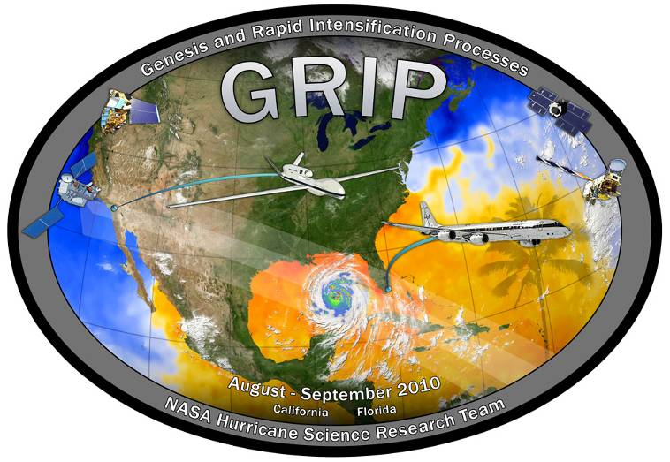
NASA Hurricane Field Experiments
Field programs coordinated with other Federal Agencies
1998
2001
2005
2006
2010 GRIP
NASA sponsored field campaigns have helped us develop a better understanding of many hurricane properties including inner core dynamics, rapid intensification and genesis
Notes:
3

Slide 4
Summary of GRIP Science Objectives
(…any resemblance to those of IFEX and PREDICT is purely coincidental…)
Genesis: Distinguish the role of the larger-scale environment vs. meso-convective processes near the putative developing center.
Rapid Intensification: Relative role of environmental vs. inner core processes? Is RI predictable?
Test-bed: Evaluate candidate technologies for remote sensing from aircraft and from satellites. Wind lidar, high frequency passive microwave, dual-frequency radars, Global Hawk itself.

Slide 5
NASA Hurricane Research Science Team
(selected competitively)
ROSES 08 (Science Team) ROSES 09 (Field/Instrument Team)
Scott Braun NASA GSFC Richard Blakeslee NASA MSFC
Shu-Hua Chen U. of California, Davis Paul Bui NASA ARC
William Cotton Colorado State U. Stephen Durden NASA JPL
Robert Hart Florida State U. Michael Goodman NASA MSFC &
Gerald Heymsfield NASA GSFC Svetla Hristova-Veleva NASA JPL
Robert Houze U. of Washington Jeffrey Halverson UMBC/JCET
Haiyan Jiang U. of Utah (to FIU) Andrew Heymsfield NCAR
Tiruvalam Krishnamurti Florida State U. Gerald Heymsfield NASA GSFC
Greg McFarquhar U. of Illinois Syed Ismail NASA LARC
John Molinari U. of Albany Michael Kavaya NASA LARC
Michael Montgomery Naval Postgrad School Tiruvalam Krishnamurti Florida State U.
Elizabeth Ritchie U. of Arizona Bjorn Lambrigtsen NASA JPL
Robert Rogers NOAA/AOML
Nick Shay U of Miami
Eric Smith NASA GSFC
Christopher Thorncroft U. of Albany
Edward Zipser U. of Utah

Slide 6
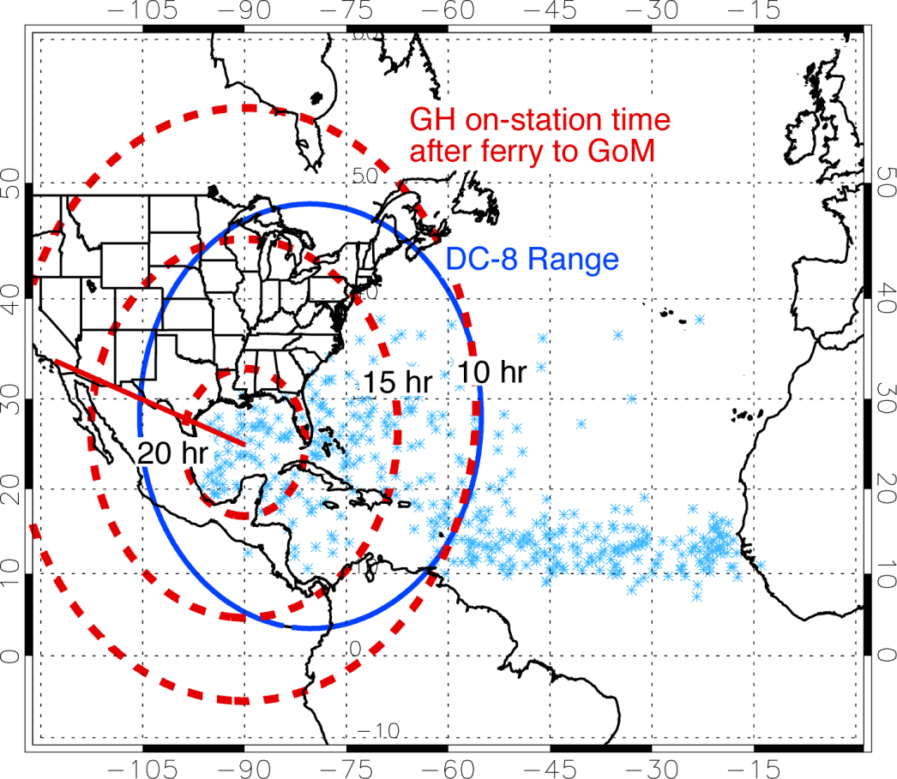
GRIP: (Hurricane) Genesis and Rapid Intensification Processes Field Experiment
Global Hawk (UAV) (240 hours)
Radar (Heymsfield/GSFC), Microwave Radiometers (Lambrigtsen/JPL), Dropsondes (NOAA), Electric Field (Blakeslee/MSFC)
Geosynchronous Orbit Simulation
DC-8 four engine jet (120 hours)
  Dual frequency precipitation radar (Durden/JPL)
  Dropsondes (Halverson/UMBC), Variety of microphysics probes (Heymsfield/NCAR)
  Lidars for 3-D Winds (Kavaya/LaRC) and for high vertical resolution measurements of aerosols and water vapor (Ismail/LaRC)
  In-situ measurements of temperature, moisture and aerosols (Bui/ARC)
Six to Eight week deployment centered on September 1, 2010
RED= IIP, GREEN= IIP+AITT
Blue line: DC-8 range for 12-h flight, 6 h on station
Red lines: GH range for 30-h flight with 10, 15 and 20 h on station
Light blue X: Genesis locations for 1940-2006

Slide 7

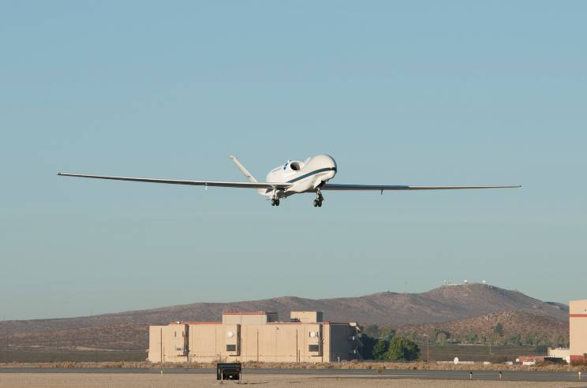
NASA Global Hawk 10/23/09

Slide 8
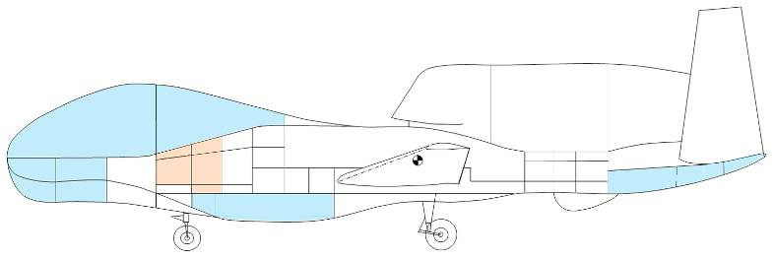
GRIP GH Payload
HIWRAP
High Altitude Imaging Wind and Rain Profiler
(Horizontal wind vectors and ocean surface winds)
Driftsondes
High Altitude Lightweight Dropsonde
(Vertical profiles of temp, humidity, pressure & winds)
HAMSR
High Altitude MMIC Sounding Radiometer
(Temp, H2Ov, Cloud liquid & ice distribution)
LIP
Lightning Instrument Package
(Lightning and Electrical Storm observation)

Slide 9
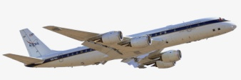
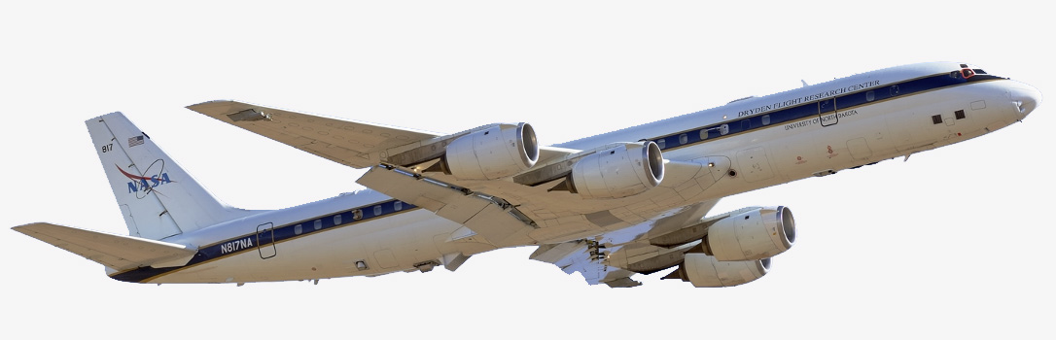
GRIP DC-8 Payload
Dropsondes
(Vertical Profiles of Temp, Press, Humidity and Winds)
DAWN
Doppler Aerosol Wind Lidar
(Vertical Profiles of Vectored Horizontal Winds)
MMS
Meteorological Measurement System
(Insitu Press, Temp, 3D Winds and Turbulence)
CAPS, CVI, PIP
(Cloud Particle Size distributions, Precip Rate, Rain & Ice water content)
LASE
Lidar Atmospheric Sensing Experiment
(H2Ov, Aerosol profiles and Cloud distributions)
APR-2
Airborne Precipitation Radar Dual Frequency
(Vertical Structure Rain Reflectivity and Cross Winds)

Slide 10
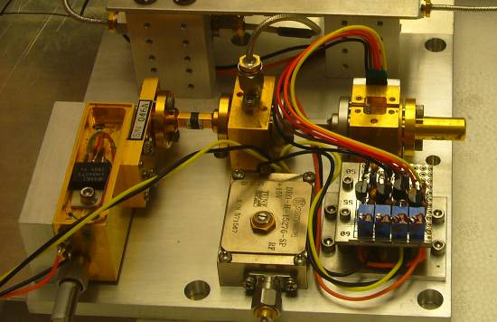
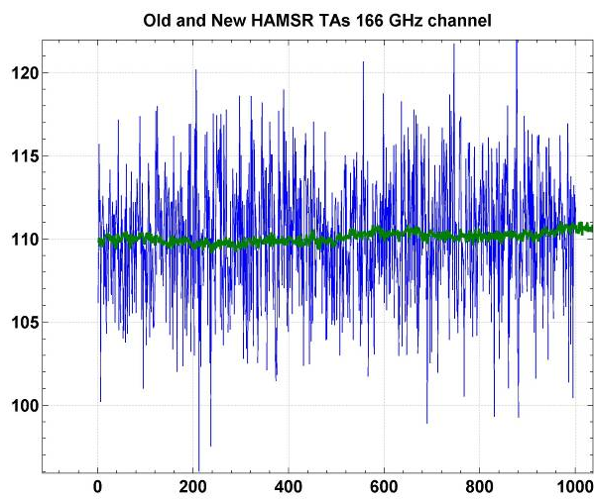
JPL High Altitude MMIC Sounding Radiometer (HAMSR)
JPL High Altitude MMIC Sounding Radiometer (HAMSR)
  Microwave radiometer for 3-D all-weather temperature and water vapor sounding, similar to AMSU on NOAA platform
  25 sounding channels in three bands:
  50-60 GHz, 118 GHz, 183 GHz
Cross track scanning
  + 45º off nadir
  40 km swath at 20 km
  2 km resolution
Flew in CAMEX-4, TCSP and NAMMA
Upgraded for Global Hawk operations under NASA AITT
  New state of the art receiver technology (developed under ESTO/ACT)
  Upgraded data system for real time communication
  Compact instrument packaging
Noise reduced from 2 K to 0.2 K
Notes:
10

Slide 11
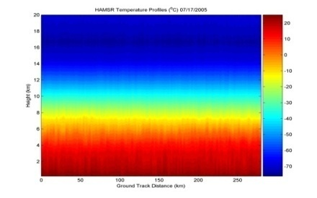
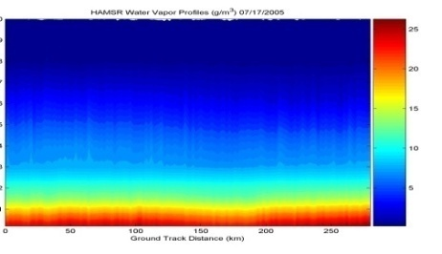
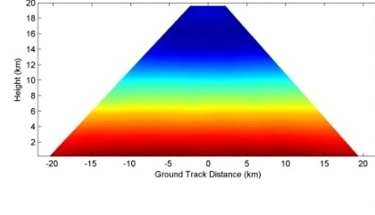
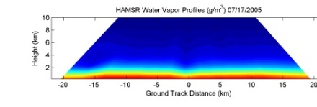
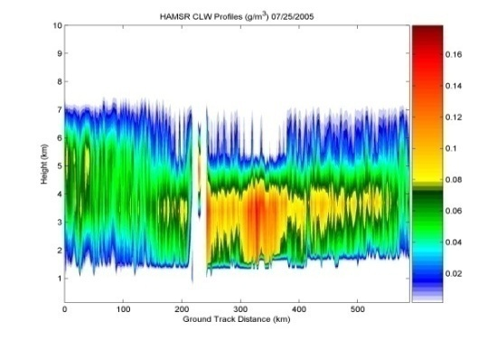
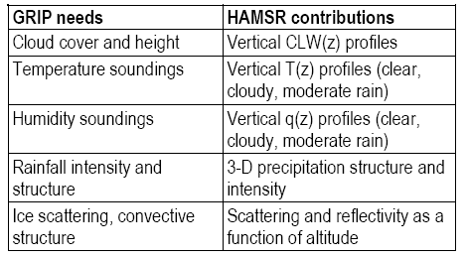
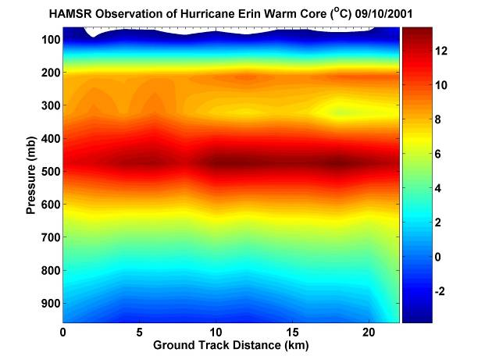
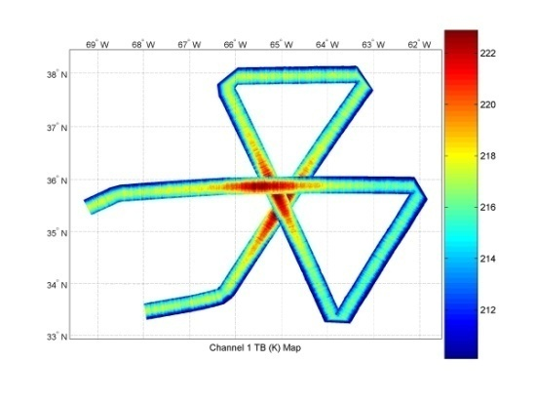
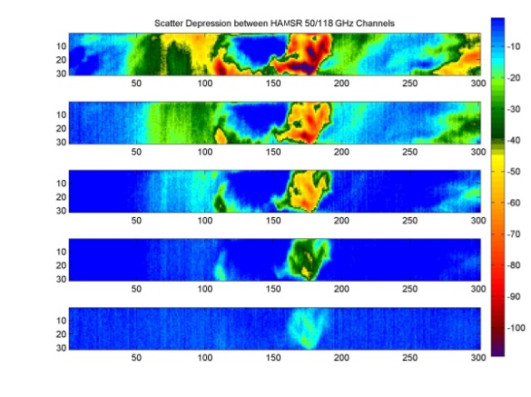
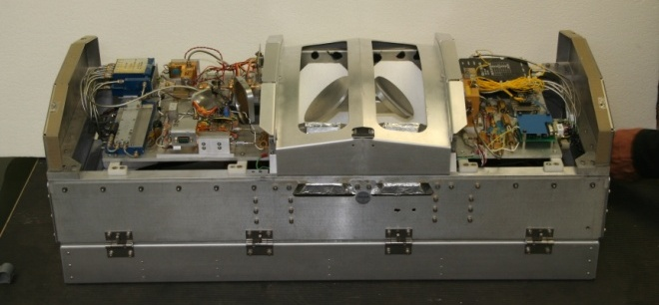
HAMSR Measurements
T(z): Cross-track
Flight path
q(z): Cross-track
T(z): Along-track
q(z): Along-track
HAMSR derived warm-core in Hurricane Erin
CLW(z):
Along-track
Precipitation Structure/Imagery

Slide 12
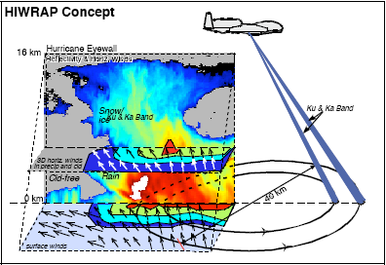
High-Altitude Imaging Wind and Rain Airborne Profiler (HIWRAP)
MEASUREMENTS GOALS:
Map the 3-dimensional winds and precipitation within hurricanes and other severe weather events.
Map ocean surface winds in clear to light rain regions using scatterometry.
NASA Global Hawk:
  19 km altitude, 30 hours
HIWRAP Characteristics:
  Conically scanning.
  Simultaneous Ku/Ka-band & two beams @30 and 40 deg
  Winds using precipitation & clouds as tracers.
  Ocean vector wind scatter-ometry similar to QuikScat.
Notes:
12

Slide 13
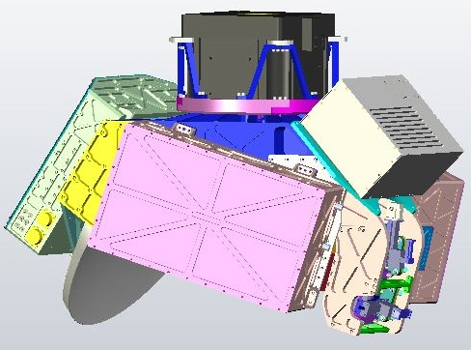
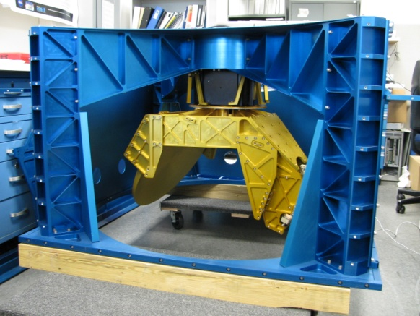
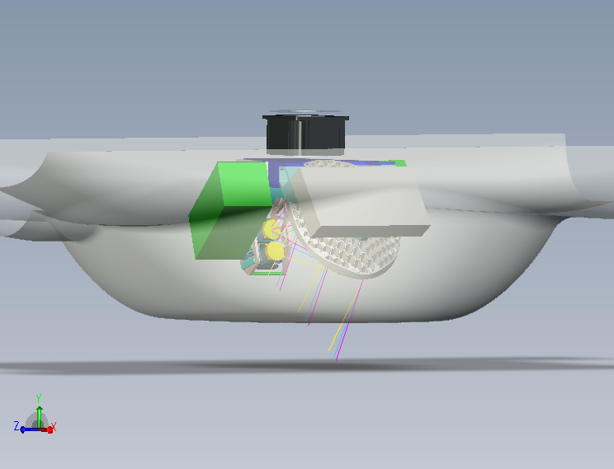
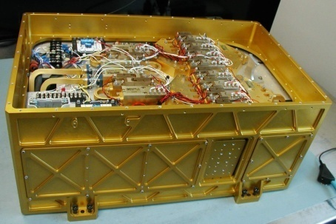
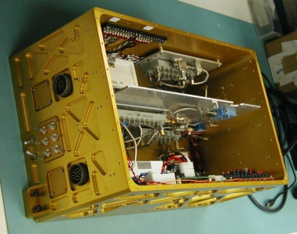
HIWRAP Global Hawk Configuration
One of first weather radars utilizing low power solid state transmitters with pulse compression
Digital Receiver
IF/LO Subsystem
Scanner in preparation for WB-57 test flights.
Reflector
HIWRAP scanner
HIWRAP in “deep” radome
Ka-band Transceiver
Ku-band Transceiver
Notes:
13

Slide 14
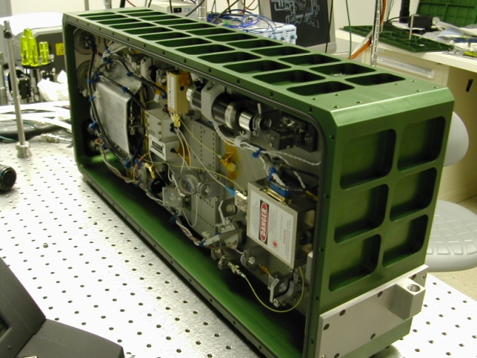
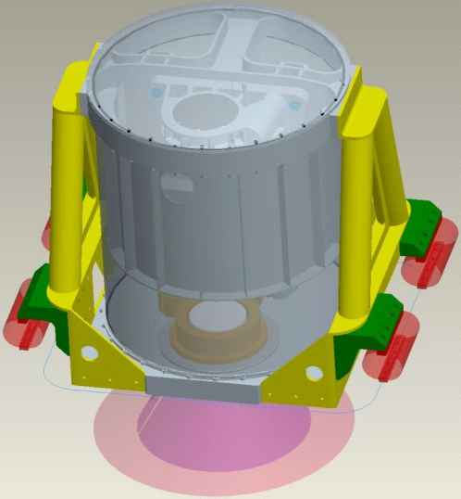
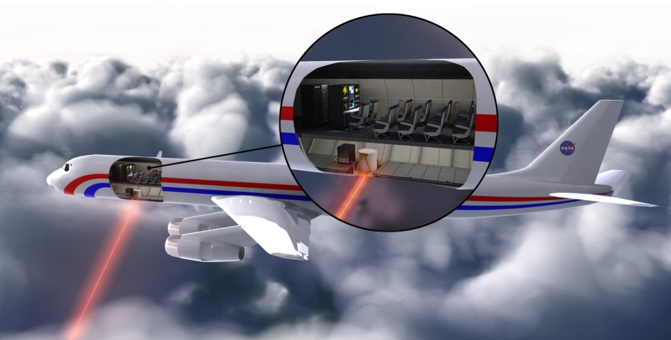
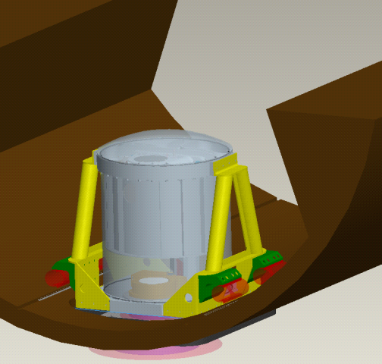
GRIP
Coherent Pulsed Doppler Wind Profiling Lidar System
1. World’s Most Capable Transceiver
Packaged, Compact, Robust
2. Complete System Utilizing Transceiver
3. Ground-based Wind Measurement Performance
RMS wind difference from balloon sonde, 0 – 6 km altitude, = 1.1 m/s and 5.8°
No alignment needed after interstate travel in trailer
Overnight unattended operation
Vertical winds to 11 km altitude
Horizontal vector winds to 7 km altitude
Data processing choice of multiple values of vertical and horizontal resolution
Same technology as anticipated space mission
0.25 J pulse energy, 10 Hz pulse repetition frequency (PRF)
15 cm receiver optical diameter, 34 kg (75 lbs.)
15.2 x 29.5 x 67.3 cm (6 x 11.6 x 26.5 inches)
4. Enclosure for All Lidar Optics
Robust Aircraft Design
5. Optics in DC-8
6. Lidar System in DC-8

Slide 15
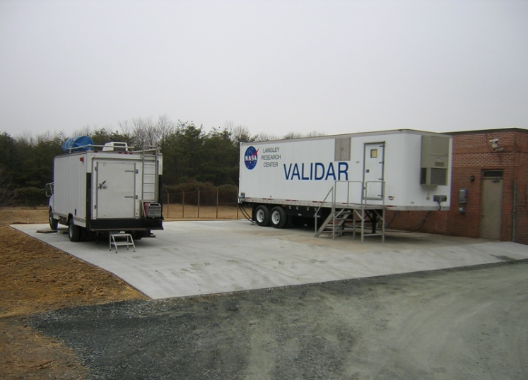
VALIDAR and Wind Sonde Comparison: Wind Profile and direction and RMS Difference
Ground-Based Hybrid Wind Lidar Demo
All data shown above were taken on February 24, 2009, sonde was launched at 17:59 local (Feb. 25, 2009 00:59 UTC)
Wind sondes are balloons carrying aloft a GPS receiver—the receiver radios back the balloon’s position to determine the horizontal wind vector
VALIDAR using 3-minute integration time. Jumps off the scale above 5.5-km are due to “bad” points where wind is not being measured from low SNR (Fig 1 a & c)
Root-mean-square of difference between two sensors for all points shown = 1.06 m/s ( Fig 1b)
Root-mean-square of difference between two sensors for all points shown = 5.78 deg (Fig 1d)
GSFC 355-nm
Doppler lidar
“GLOW”
LaRC 2-μm
Doppler lidar
“VALIDAR/DAWN”
Fig 1 (a)
Fig 1 (b)
Fig 1 (c)
Fig 1 (d)
Notes:
15

Slide 16
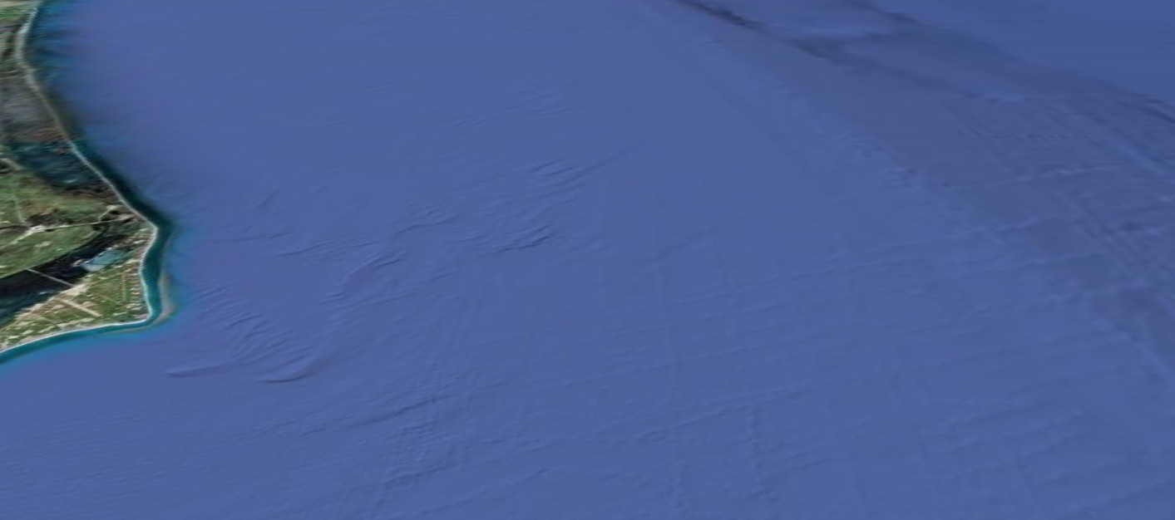

GRIP
Coherent Pulsed Doppler Wind Profiling Lidar System
Nominal Parameters
Laser beam nadir angle = 45 degrees (unchangeable)
Laser beam azimuth angle = 45, 135, 225, and 315 degrees
60 laser shots per LOS wind profile (12 sec)
LOS wind profiles 8.8 km from track
Aft LOS profile begins 71 s after Fore began
Fore and Aft LOS wind profile = 1 horizontal wind profile (83 s measurement time)
Left and Right of track horizontal wind profiles = 1 scan pattern
Pattern repeat = horizontal resolution = 12.5 km (50 sec)
Vertical profile of horizontal wind magnitude and direction
“= balloonsonde launch or very tall anemometer tower”
DC-8: 425 – 490 knots True Air Speed (cruise) = 218 - 252 m/s (250). 41,000 ft = 12.5 km

Slide 17
LASE Measurements of Water Vapor and Aerosol Profiles and Cloud distributions During the GRIP Field Experiment
Syed Ismail, Rich Ferrare, John Hair (NASA Langley)
In collaboration with Ed Browell (LaRC) and Jason Dunion (NOAA)
Water vapor profiles
  - daytime and nighttime
  - surface to upper trop.
  - 0.01 to 25 g/kg
  - accuracy: 6% or 0.01 g/kg
  - resolution (variable)
    vertical: 330 m
    horizontal: 14 km (1 min)
Aerosol/cloud profiles
  - daytime and nighttime
  - 0.03 to 25 km
  resolution (variable)
    vertical: 30 m
    horizontal: 200 m
Airborne Water Vapor DIAL
Laser
  - 5 Hz doubled-pulsed Ti:sapphire
  - 100 mj at λ_{on} and λ_{off}
Wavelengths
  - 815 nm (λ_{on}- λ_{off} = 40-70 pm)
  - Two separate line pairs
NASA DC-8 aircraft
Simultaneous nadir, zenith operations
Real-time data analysis and display
Notes:
Information about the LASE system, its capabilities, and the LASE team.
DIAL = Differential absorption lidar
17

Slide 18
Summary
18
NASA sponsored field campaigns have helped us develop a better understanding of many hurricane properties including inner core dynamics, rapid intensification and genesis
GRIP is a very exciting field experiment and took over three years to plan
Hopefully we will have enough “Genesis” and “Rapid Intensification” cases to study during the coming hurricane season

