Slide 1
Model testing, community code support, and transfer between research and operations: The Tropical Cyclone Modeling Testbed (TCMT) and the Developmental Testbed Center (DTC)
B. Brown, L. Nance, T. Jensen, and C. Williams
DTC and NCAR/TCMT
Bill Kuo (and others)
DTC
Interdepartmental Hurricane Conference
Savannah, Georgia
March 2010

Slide 2
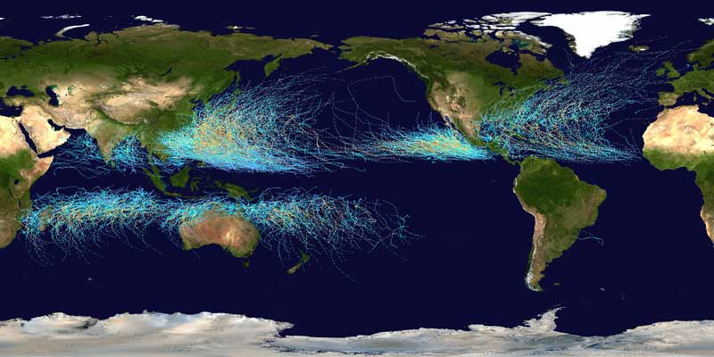
Goal
Describe
Roles of
Developmental Testbed Center (DTC)
Tropical Cyclone Modeling Testbed (TCMT)
TCMT activities and support for HFIP

Slide 3
Developmental Testbed Center (DTC) and Tropical Cyclone Modeling Testbed (TCMT)
DTC is
Distributed activity to facilitate R2O and O2R activities for numerical weather prediction models
Focused on activities close to the transfer “connection”
TCMT is
A model testing and community support facility
Focused on models in earlier stages
DTC and TCMT are closely related
TCMT has broader objectives
Both have important roles in HFIP
Many HFIP testing (and other) activities are beyond the scope of DTC
DTC and TCMT share many staff and capabilities
RESEARCH
TCMT
HFIP Stream2
HFIP Stream 1
DTC
OPERATIONS

Slide 4
Purpose of DTC
To serve as a bridge between research and operations to facilitate the activities of both halves of the NWP Community
Research: functionally equivalent operational environment to test and evaluate new NWP methods over extended retrospective periods
Operational: benefits from DTC T & E of strengths and weaknesses of new NWP advances prior to consideration for operational implementation
New Science and Technology
Research
Community
DTC
NCAR/RAL↔NOAA/ESRL
Operational
Community
DTC
Operational Codes
Notes:
Goal – accelerate the improvement in weather forecasts
DTC is a distributed facility that currently has 2 nodes in Boulder – one located at NCAR and one located at NOAA

Slide 5
DTC Goals for Hurricane Forecasts
Current focus: HWRF
Facilitate transfer of research to operations by creating a framework for NCEP and the research community to collaborate
Support the community in using HWRF (the current NCEP operational hurricane model)
Repository, Help-email, Tutorials, Documentation
Develop and maintain a hurricane testing and evaluation infrastructure at DTC
Perform HWRF tests to assure integrity of code and evaluate new developments for potential operational implementation

Slide 6
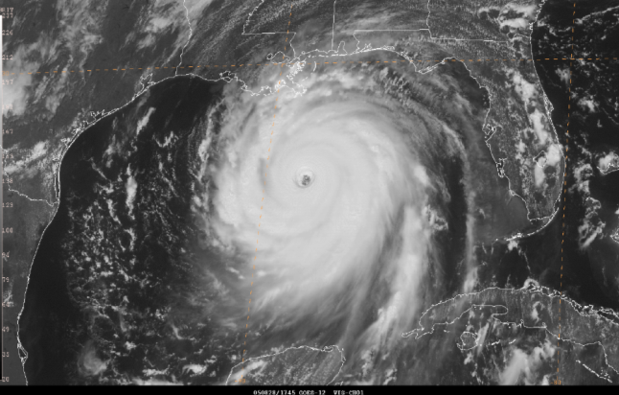
Tropical Cyclone Modeling Testbed (TCMT) Goals
Testing and evaluation of (research) model forecasts for tropical cyclones
Current focus: HFIP
Regional, Global, Ensemble
Design experiments, collect data, analyze and present results
Investigate, implement, and share new statistical tools for TC forecast evaluation
TCMT and DTC expertise in statistics and verification
Examples: Storm structure, precipitation, ensembles
Provide model and observation data sets to community through a “Data Service”
Provide links to additional data
Other support for Hurricane Forecast Improvement Project (HFIP)

Slide 7
Testing & Evaluation Philosophy (DTC and TCMT)
Independent of development process
Carefully designed test plan
Large number of cases
Broad range of weather regimes
Extensive diagnostic, objective verification, including assessment of statistical significance
Is the performance of Model A really better than the performance of Model B?

Slide 8
DTC Testing & Evaluation
Purposes
Asses integrity of repository code as it evolves
Assist NCEP with pre-implementation testing
Evaluate skill of new developments funded by HFIP
Protocol
Code to be tested must be in community repository
Preferably test official release code
Testing environment functionally equivalent to NCEP’s
National Hurricane Center forecast verification system and testing protocol
Additional verification metrics developed by DTC and TCMT

Slide 9
TCMT Testing & Evaluation
Purposes
Objective and independent assessment of comparisons of TC forecast skill (between models) and trends in forecast skill through time
Identify models that may be approaching readiness for transition to operational demonstration (e.g., Stream 1.5)
Protocol
For HFIP, modeling groups participating in HFIP Demo or Retrospective studies
Testing environment functionally equivalent to NCEP’s
National Hurricane Center forecast verification system and protocol
Additional verification metrics developed by DTC and TCMT

Slide 10
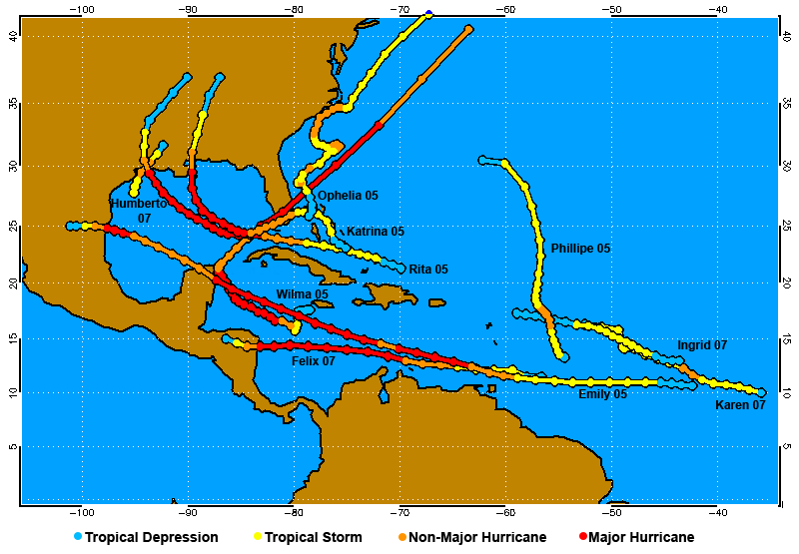
High-resolution hurricane (HRH) model test
Experimental design
6 modeling teams; multiple model resolutions (nested)
Consistent (mostly) initial conditions
69 cases; 10 hurricanes
Independent evaluation by DTC
Evaluation Foci:
Track
Intensity
RI, RW
Consistency
Project led by L. Nance and L. Bernardet

Slide 11
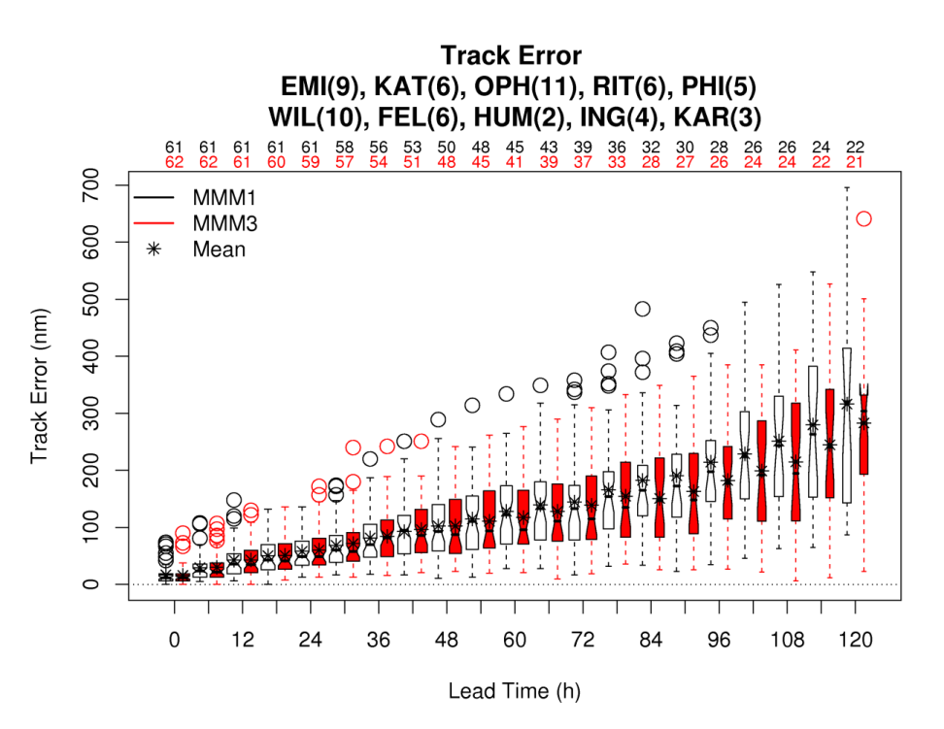
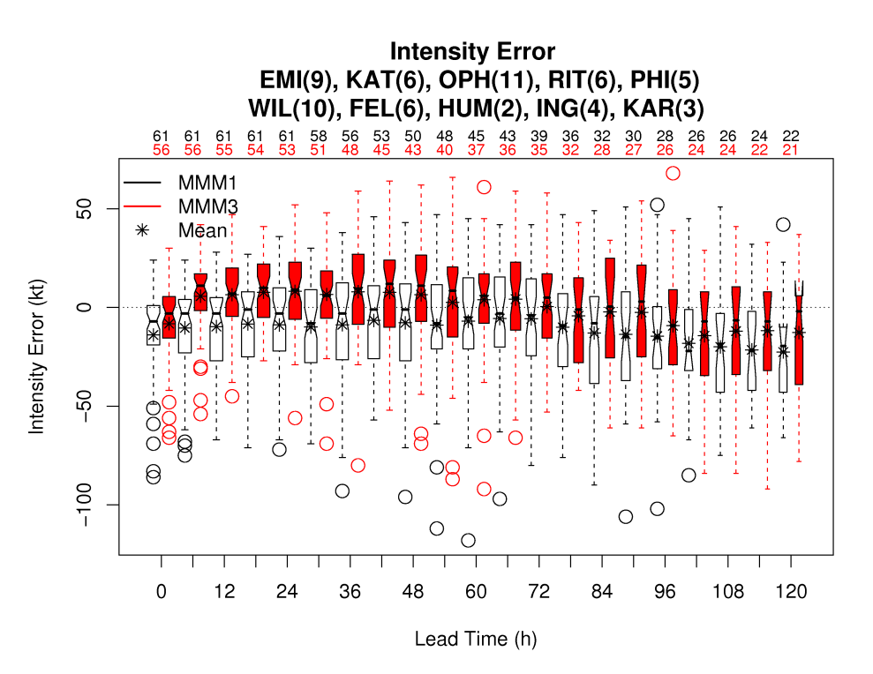
HRH (example) results
Overall conclusions
Increased resolution did not improve track or intensity forecasts except in a few isolated situations
The majority of results showed no differences from using high resolution
A few, notably wind radii, presented consistent degradation when using high resolution
Full report available at http://www.dtcenter.org/plots/hrh_test/HRH_Report_30Sept.pdf

Slide 12
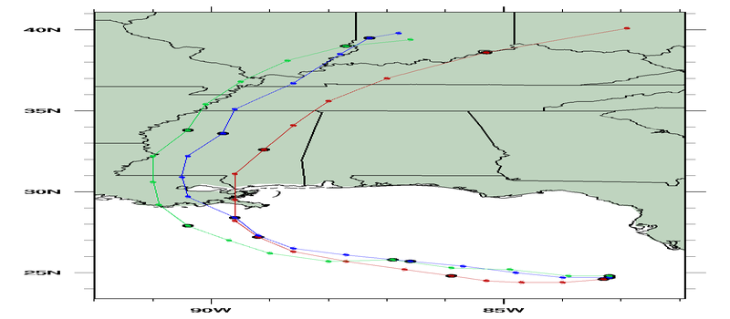
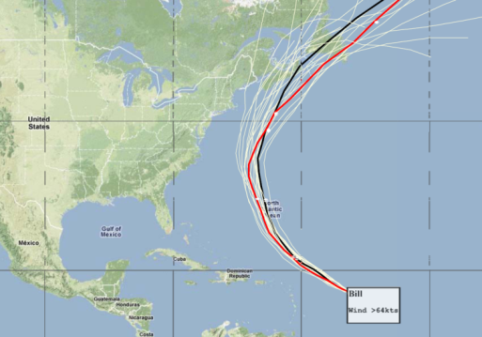
TCMT Participation in HFIP
Current activities
Evaluate 2009 Demo forecasts
Model-specific tracks (Tier 1)
Gridded forecasts; common tracker (Tier 2)
Global and regional models
7-day forecasts
Plan and evaluate Retrospective forecasts
Help select Stream 1.5 forecast model(s) for 2010 season – to be demonstrated for NHC forecasters
Develop and implement tools for ensemble TC forecasts
Collaboration with WMO TIGGE TC project
Community support for the testing activity
10-km FIM Ensemble (NOAA/ESRL/GSD)
Current status: Collecting lots of data!!

Slide 13
HFIP Challenges for TCMT and Verification Team
How do we measure success?
Forecast improvements over time – but how measured?
Single season only provides a few storms/forecasts…
Retrospective studies are critical, but intensive for modeling groups and forecast evaluation
Meaningful methods for
Genesis
Precipitation and flooding
Storm structure

Slide 14
THANK YOU!
QUESTIONS?

Slide 15
Joint Numerical Testbed
Joint Numerical Testbed
Director: B. Brown
Science Deputy: L. Nance
Engineering Deputy: L. Carson
Developmental Testbed Center (DTC) National Office
Director: B. Kuo
DTC Project (Nance)
Sponsors: NSF, NCAR base, NOAA, AFWA
Data Assimilation Testbed Project (Huang) Sponsors:
AFWA
Tropical Cyclone Modeling Testbed (Lead TBD)
Sponsors: NOAA
Verification Research (Lead TBD)
Sponsors: AFWA, NOAA, NASA, NSF/NCAR
Other (future)
Shared Staff across Projects: Functions and Capabilities
Community Systems
Testing and Evaluation
Statistics and Evaluation Methods

Slide 16
Community Support of HWRF
In March 2010, DTC will start supporting WRF to the community in collaboration with DTC partners:
WRF V3.2 release (March 2010) will have HWRF features (MMM)
Princeton Ocean Model (URI)
Vortex Initialization (EMC)
Coupler (URI/EMC)
Vortex Tracker (GFDL)
February 2010 Tutorial
Documentation, website, helpdesk, code management

Slide 17
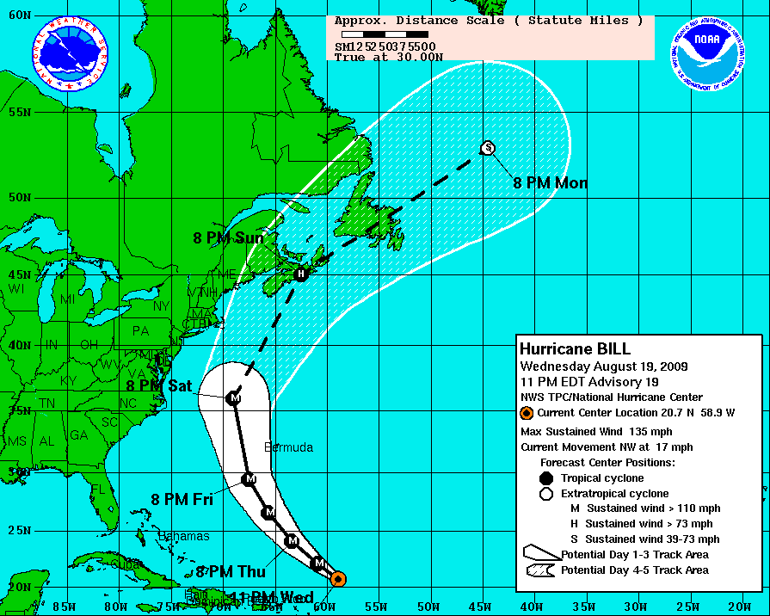
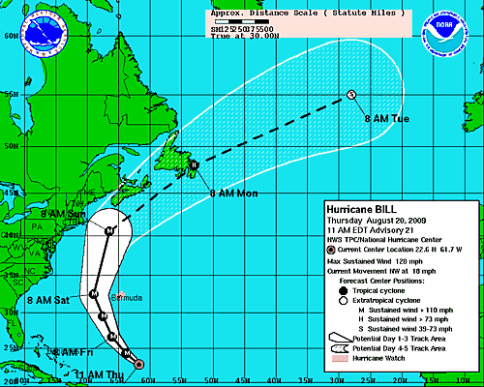
HFIP: Primary goal
The goal of HFIP is to improve the accuracy and reliability of hurricane forecasts and warnings and increase the confidence in those forecasts to enhance mitigation and preparedness decisions by emergency management officials at all levels of government and by individuals.”
(NOAA Research Council, 2008)

Slide 18
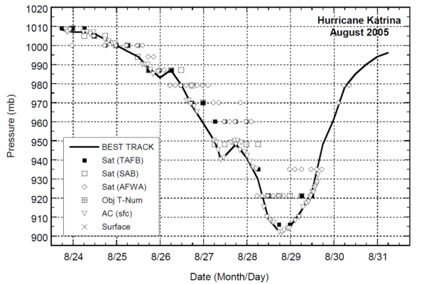
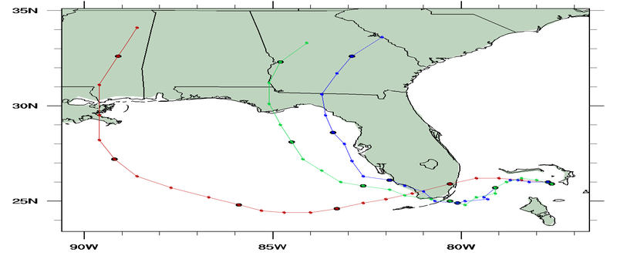
HFIP Goals and Approaches
Forecast improvement goals
Improve track error
Improve intensity error
Improve ability to capture rapid weakening and strengthening events
Reliable probability forecasts (ensembles)
Approaches
Invest in intensive computing capabilities
Engage research and operational communities to test new models and modeling approaches

Slide 19
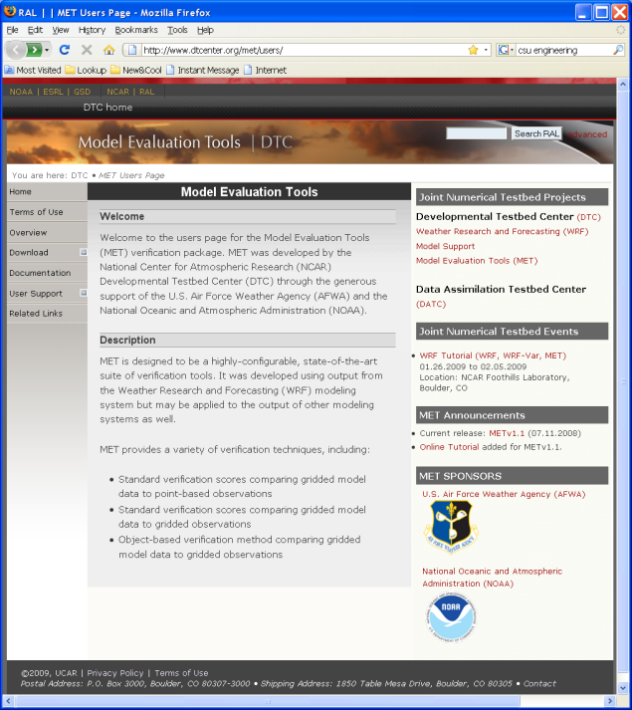
Verification tools
Develop and implement state-of-the-art verification tools
Goals:
Provide tools that previously were not generally available
Include new methods
Provide community support
Model Evaluation Tools (MET)
More than 600 users world wide

Slide 20
JNT projects
Developmental Testbed Center
Cross-lab facility for community code support and model testing
Primary goal: Supporting transition of modeling capabilities from research to operations (same as JNT) with a main focus on mesoscale (regional) weather prediction models
Data assimilation testbed
Verification tools and research
Tropical Cyclone Modeling Testbed

