Slide 1
NOAA Assessment of Unmanned Aircraft Systems for Hurricane Observations
Robbie Hood, Alexander MacDonald, Robert Atlas, Frank Marks, Steve Koch, Jim McFadden, Robert Rogers, Joseph Cione, Michael Black, Eric Uhlhorn, Christopher Landsea, Gary Wick, Paul Neiman, Nikki Prive, Scott Mackaro, Yuanfu Xie, Phil Hall, Nancy Ash, and Phil Eastman

Slide 2
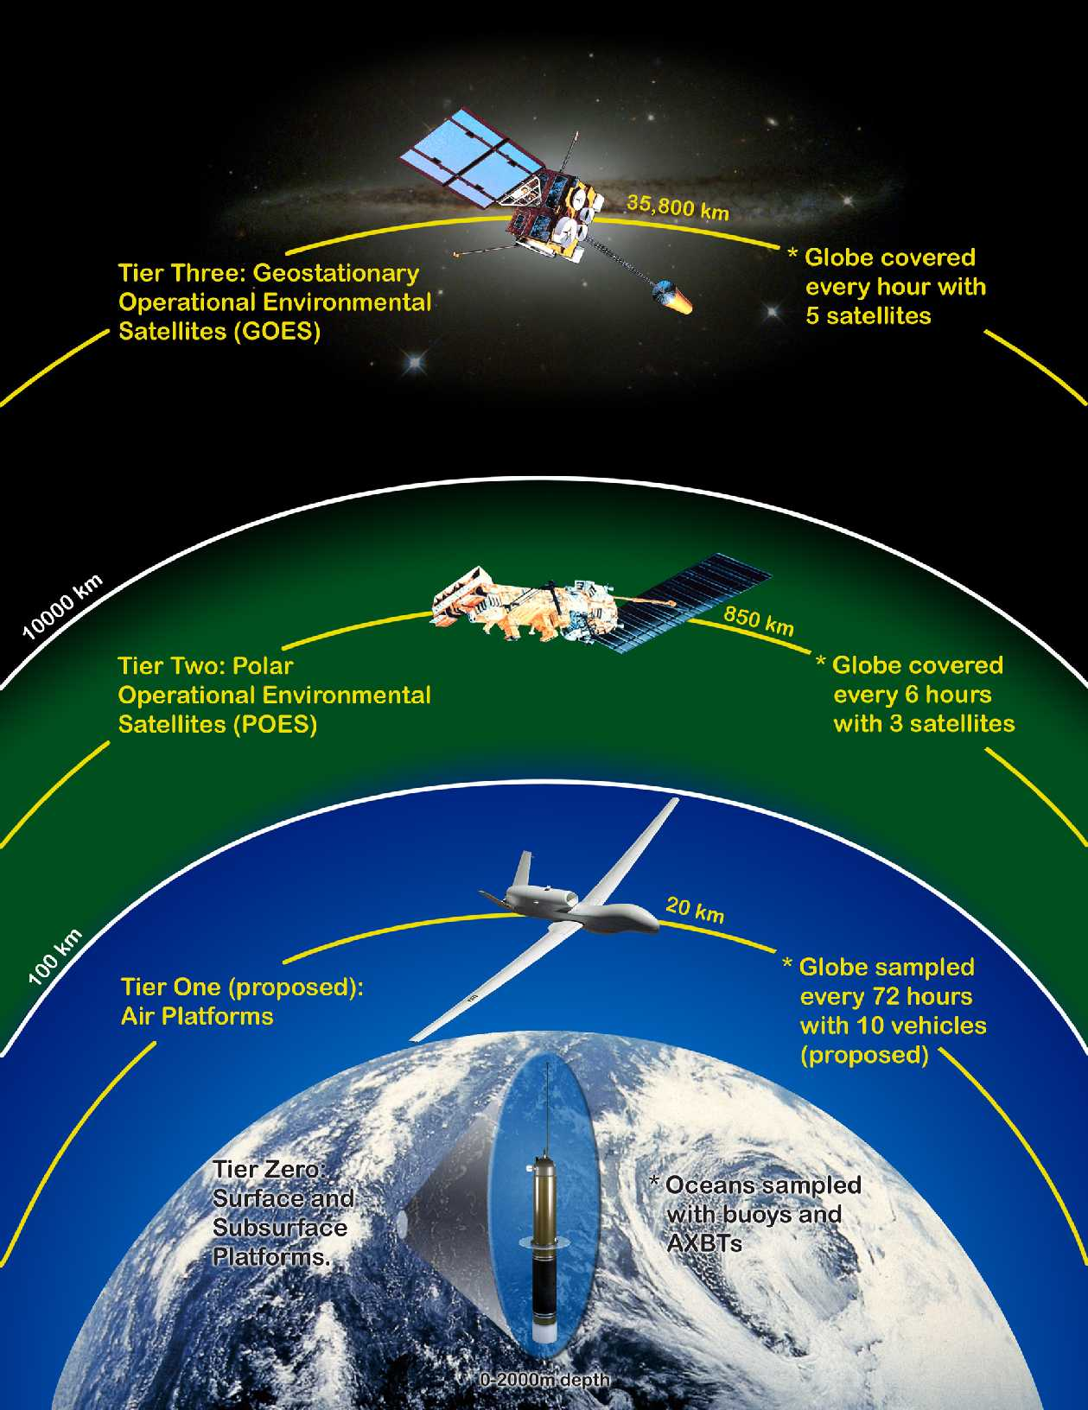
Overview of NOAA UAS Program
The NOAA Unmanned Aircraft Systems (UAS) Program is evaluating the feasibility of UAS platforms to meet the NOAA Mission’s goals in
Climate
Weather and Water
Ecosystems
Commerce and Transportation
using a requirements-driven systems approach to assess technology readiness and operational feasibility

Slide 3
Assessing UAS Technologies
Field Demonstrations and Flight Testing
Observing System Simulation Experiments (OSSE) and Observing System Experiments (OSE)
System Analysis of Technology Readiness:
Current Platforms,
Payloads,
Observing Strategies
Information Management
Applications
Data Assimilation

Slide 4
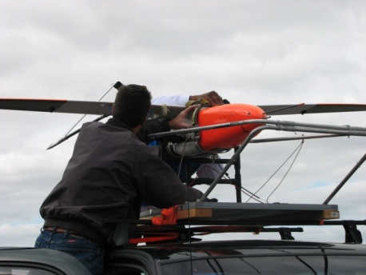
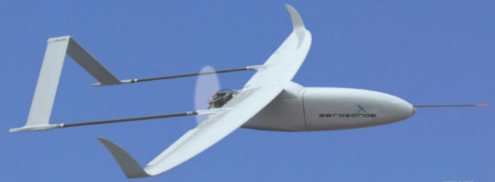
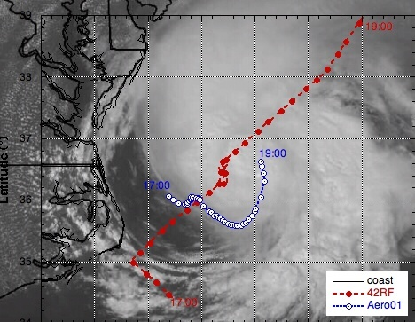
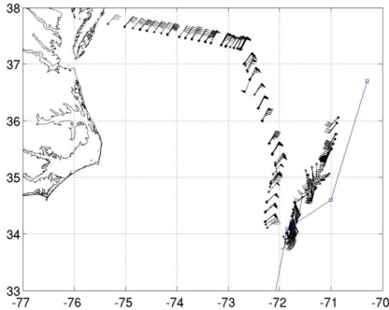
Low Altitude Long Endurance (LALE) Unmanned Aircraft Systems (UAS)
LALE Field Testing
Led by Joe Cione (HRD) and Nancy Ash (AOC)
2005 – Hurricane Ophelia
2007 – Hurricane Noel
Hurricane Ophelia Imagery
Hurricane Noel Wind Data

Slide 5
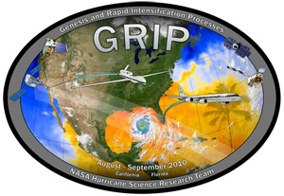
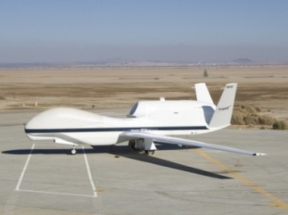
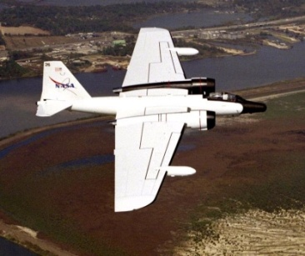
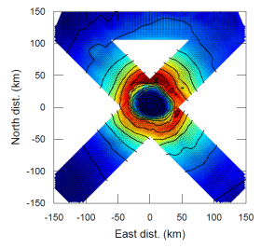
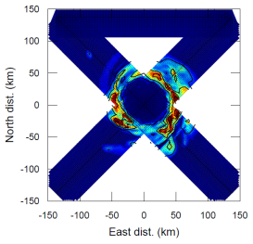
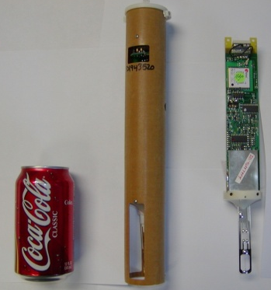
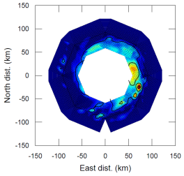
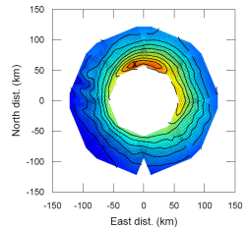
NASA Genesis Rapid Intensification Processes (GRIP) Experiment
NASA Global Hawk Missions
NASA WB-7 Missions
Ocean Wind Speed
Ocean Rainfall
Sea Surface Temperature
Global Hawk dropsonde development in collaboration with NSF and NCAR
Hurricane Imaging Radiometer development in collaboration with NASA

Slide 6
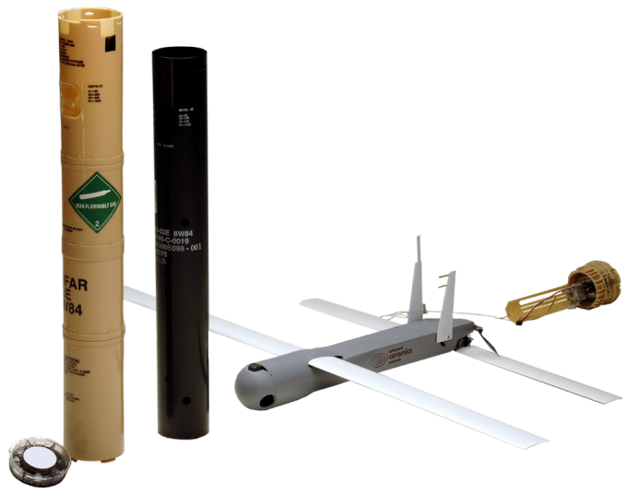
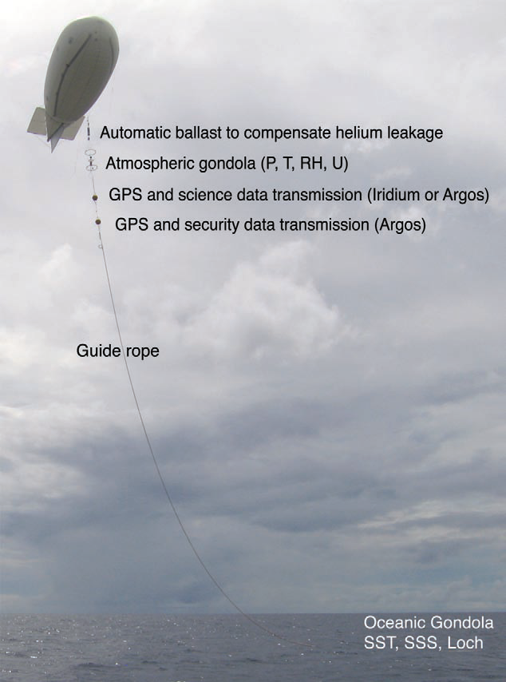
Expendable Platforms
Low Altitude Balloons in partnership with WISDOM
COYOTE UAS
Airspeed: 60 kts cruise, 85 kts dash
Deployment Altitude: up to 20,000 ft MSL
Operational Altitude: 500-2,000 ft AGL
Range: 20nm LOS (extending to 50nm)
Endurance: 1 hr @ cruise (extending to 1.5 hrs)

Slide 7
Observing System Simulation Experiment (OSSE)
An OSSE is a modeling experiment used to evaluate the impact of new observing systems on operational forecasts when actual observational data are not available
UAS OSSE will be used to guide acquisition, flight planning, sensor development decisions
Current efforts include global weather OSSE and regional hurricane OSSE

Slide 8
UAS Technology Readiness Level (TRL) Assessment
TRL DEFINITION
Basic principles observed and reported
Technology concept and/or applications formulated
Analytical and experimental critical function and/or characteristics
Component and/or breadboard validation in laboratory environment
Component and/or breadboard validation in relevant environment
System/subsystem model or prototyping demonstration in a relevant environment (ground or air)
System prototyping demonstration in a flight environment
Actual system completed and “flight qualified” through test and demonstration (ground or air)
Actual system “flight proven” through successful mission operations

Slide 9
Dropsonde Technology Assessment
FY10
FY11
Sondes from low altitude – TRL 9
Sondes from medium altitude – TRL 9
Sondes from high altitude – TRL 7 (system prototype in flight environment)
MIST sondes – TRL 5 (component in relevant environment)
MIST sondes from Global Hawk – TRL 5 (components in relevant environment)
MIST sondes from Global Hawk – TRL 6 (system in relevant environment)
OR
MIST sondes from Global Hawk – TRL 7 (system in flight environment)
Depending on the science objective for hurricanes, atmospheric rivers, or winter storms

Slide 10
Low Altitude UAS Technology Assessment
FY10
FY11
Aerosonde platform in hurricane – TRL5 (component in relevant environment)
Aerosonde payload in hurricane – TRL 4/5 depending on sensor ( components in laboratory/relevant environment)
Manta platform in atmospheric rivers – TRL 5 (component in relevant environment)
Manta platform in atmospheric rivers – TRL 4/5 ( components in laboratory/relevant environment)
Coyote platform from P-3 – TRL 5 (Component in relevant environment)
Manta platform and payload in atmospheric rivers – FY 6 (system prototype in relevant environment)
Coyote platform and payload in hurricanes – TRL 6 (system in relevant environment)
OR
Coyote platform and payload in hurricanes – TRL 7 (system in flight environment)

Slide 11
GRIP Dry Run All Aircraft Schedule
15-19 September 2009
Version: 16Sep09
Flight decision made at 19Z
GH
GH
14Z
Bahamas
18Z
18Z
PG24
00Z
GV
GV
GV
08Z
Bahamas
08Z
ex-Fred
08Z
ex-Fred
18Z
18Z
18Z
DC8
DC8
10Z
18Z
10Z
ex-Fred
18Z
Bahamas
P3-43
P3-42
P3-43
P3-42
P3-43
P3-42
P3-43
20Z
05Z
08Z
17Z
20Z
00Z
08Z
12Z
20Z
05Z
08Z
17Z
20Z
05Z
Bahamas
Bahamas
ferry
ferry
ex-Fred
ex-Fred
ex-Fred tbd
00Z 9-15
Tuesday
00Z 9-16
Wednesday
00Z 9-17
Thursday
00Z 9-18
Friday
00Z 9-19

Slide 12
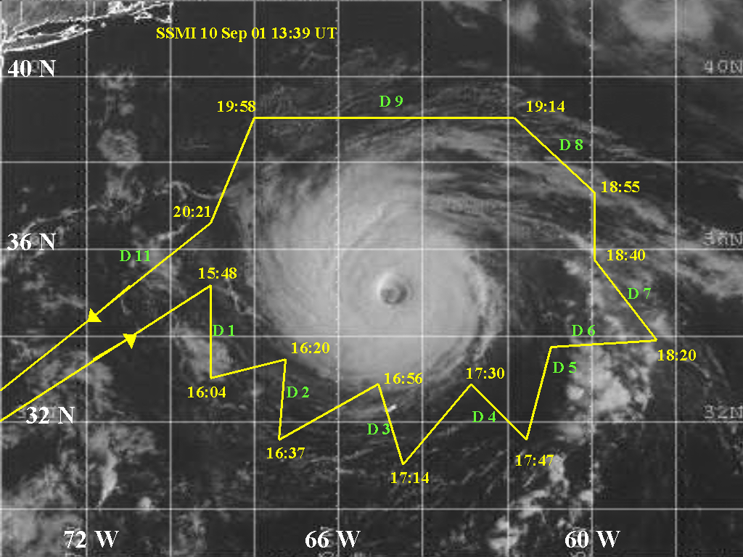
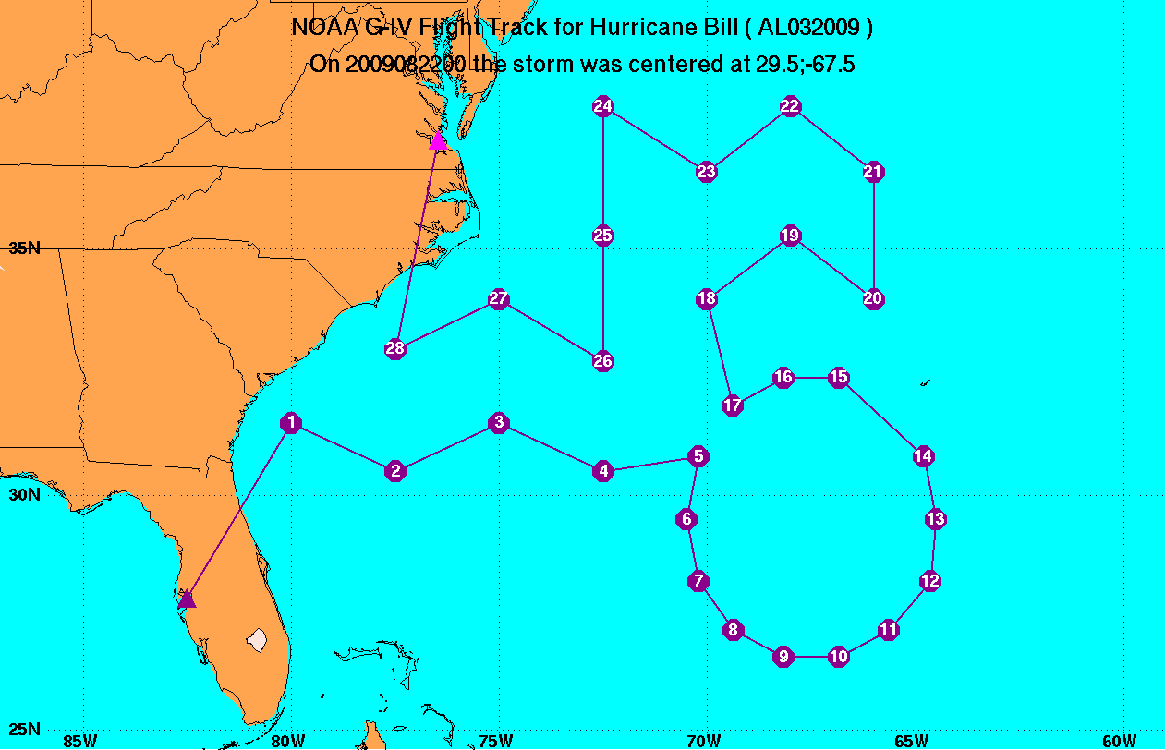
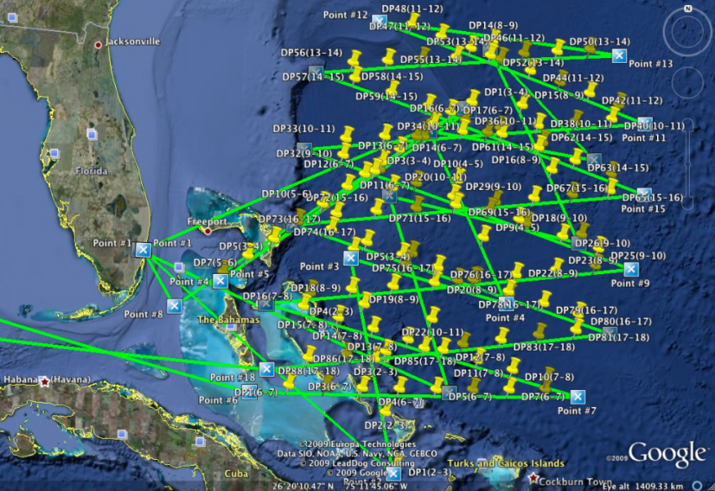
Examples of Dropsonde Coverage
NASA DC-8 flight Hurricane Erin 2001
NOAA G-IV flight for Hurricane Bill 2009
NASA Global Hawk dry run exercise for Extratropical Fred 2009

Slide 13
Contact Information
NOAA UAS Web Site
http://UAS.noaa.gov
NOAA UAS Program Director
Robbie.Hood@noaa.gov
301-734-1102 (office)
303-905-3411 (cell)

Slide 14
MTP
Payloads from NASA GloPac Campaign

