Slide 1
WISDOM System 2009 Proof of Concept Test Results Alexander E. MacDonald, Justyna Nicinska, Yuanfu Xie, Russell B. Chadwick NOAA Office of Oceanic and Atmospheric Research (OAR) 64th Interdepartmental Hurricane Conference Savannah, GA March 2, 2010
WISDOM (Weather In-Situ Deployment Optimization Method)
http://wisdom.noaa.gov

Slide 2
2009 Objectives
WISDOM (Weather In-Situ Deployment Optimization Method)
http://wisdom.noaa.gov
The WISDOM program aims to improve the hurricane track prediction in the 3 to 6 day period before landfall by providing wind and atmospheric data over poorly observed areas of the Atlantic basin.
Proof of Concept Testing:
NOAA, with funding support from the DHS S&T, conducted a successful initial feasibility test during the 2008 hurricane season with balloons reporting wind data in near real-time.
In 2009 with support from DHS S&T, NOAA and the Air Force, the program aims to quantify the forecast improvement provided by ingesting WISDOM data into numerical weather prediction models, including ESRL’s FIM model.

Slide 3
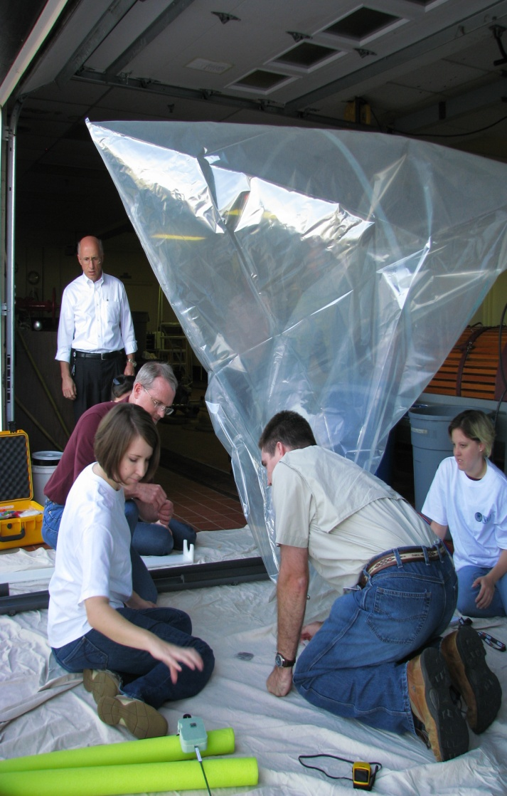
WISDOM 2009 Participants and Partners
WISDOM (Weather In-Situ Deployment Optimization Method)
http://wisdom.noaa.gov
NOAA: OAR/ESRL/ARL; NWS
DHS S&T
Air Force Weather Agency
DoD/JCS
Northern Gulf Institute/MSU
University of Miami
Texas A&M Corpus Christi
Caribbean Institute of Meteorology and Hydrology
Bermuda Weather Service
Simeon Fongang Ecole Superieure Polytechnique Unviversite, Senegal
Near Space Corporation
Engenium Technologies
Raytheon

Slide 4
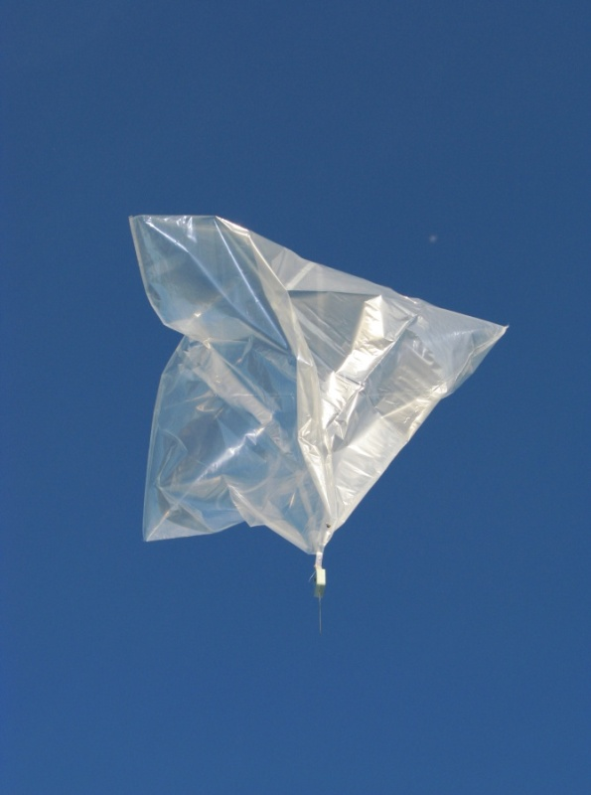
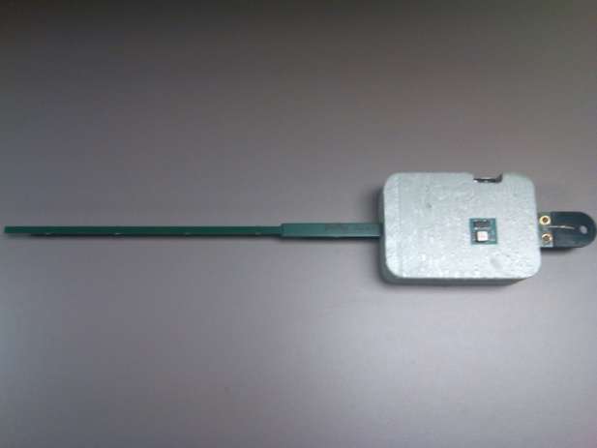
Data Transmission
WISDOM (Weather In-Situ Deployment Optimization Method)
http://wisdom.noaa.gov
The WISDOM system uses small super-pressure balloons carrying 100 gram payloads with GPS
positioning and satellite communications capability (UHFFLEETSATCOM).
Data are transmitted in real time via satellite ground station to the MADIS servers at NOAA/ESRL.
The 2009 WBS collected wind and pressure data; and included flight termination capability.
6 Data Centers were contacted regarding ingest of WISDOM data.
ECMWF, UK Met Office and NHC requested data in real-time (BUFR and NetCDF formats)

Slide 5
WISDOM Balloon System
WISDOM (Weather In-Situ Deployment Optimization Method)
http://wisdom.noaa.gov
Balloon- constant density (Mylar Tetroon) floats 12,000 and 26,000 ft
100 gram payload (GPS, pressure sensor, termination device)
Pressure sensor- will be upgraded next season temp and rel. humidity in testing mode
Median flight 5-7 days, terminated past certain boundary
About 90 Balloons Launched in 2009
Largest launch- Hurricane Ida
Launch Teams: NOAA and NGI, students from MSU, Texas A&M, UM, CIMH
August 2009 Launch Training at NGI in Waveland , MS
Notes:
Tetroon is photodegradable, future generations- will work on developing biodegradable materials
Filed for a categorical exclusion under NEPA
FAA Part One Exempt- always filed NOTAM (Notice to airman) work with local aviation authorities to coordinate flights and report timing.
Pressure sensor- will bring in an improved sensor with greater accuracy – does not need to adjust calibration.

Slide 6
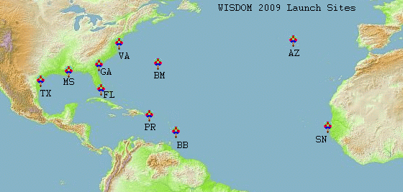
WISDOM 2009 Launch Sites 10 sites in the Coastal US, Caribbean and Africa
WISDOM (Weather In-Situ Deployment Optimization Method)
http://wisdom.noaa.gov

Slide 7
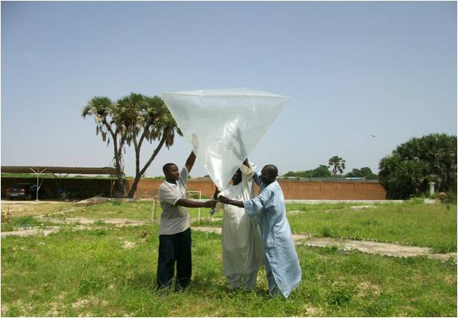
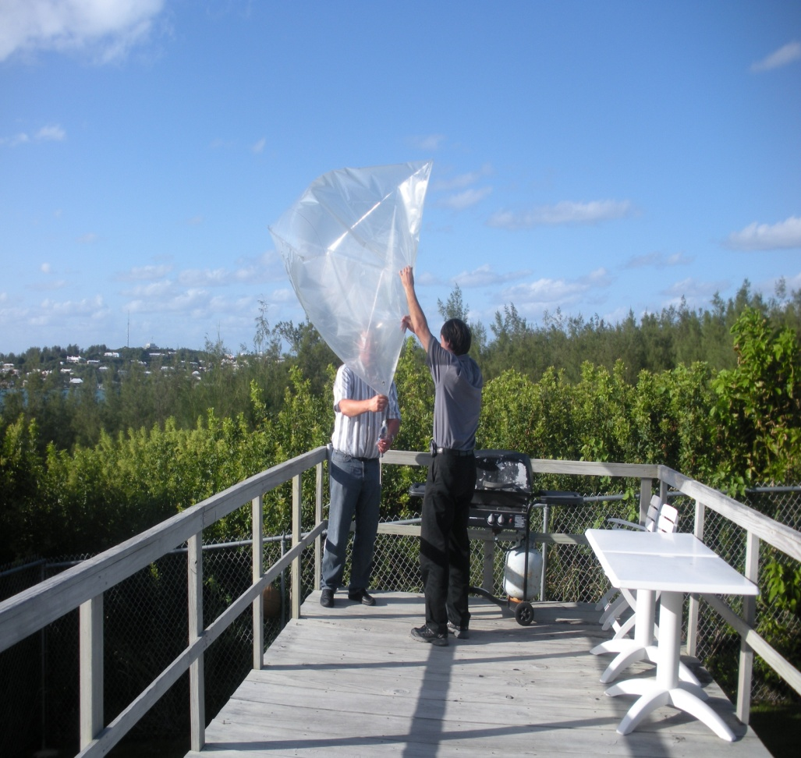
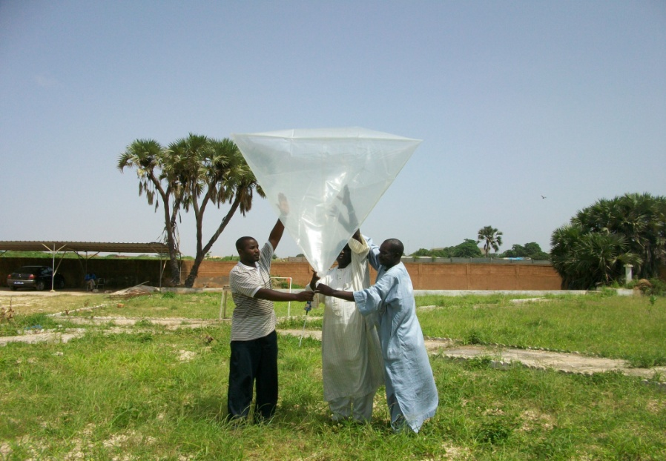
WISDOM (Weather In-Situ Deployment Optimization Method)
http://wisdom.noaa.gov
Dakar, Senegal
Bermuda

Slide 8
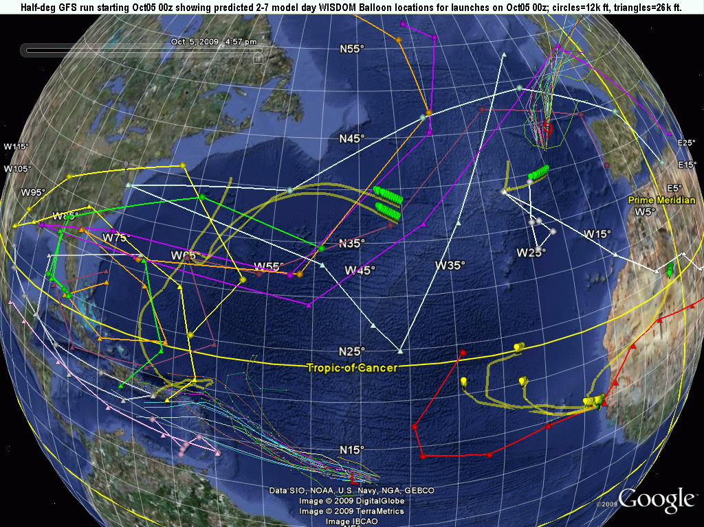
Notes:
Predicted 7 day trajectories prepared by Randy Collander posted on WISDOM website. Available at 0z and 12 Z, for GFS 0.5, 1 degree and FIM 0.5 degree. Forecast tracked daily with weather update and launch recommendations coming out by 1700 UTC and launch announcement posted by 1800 UTC.

Slide 9
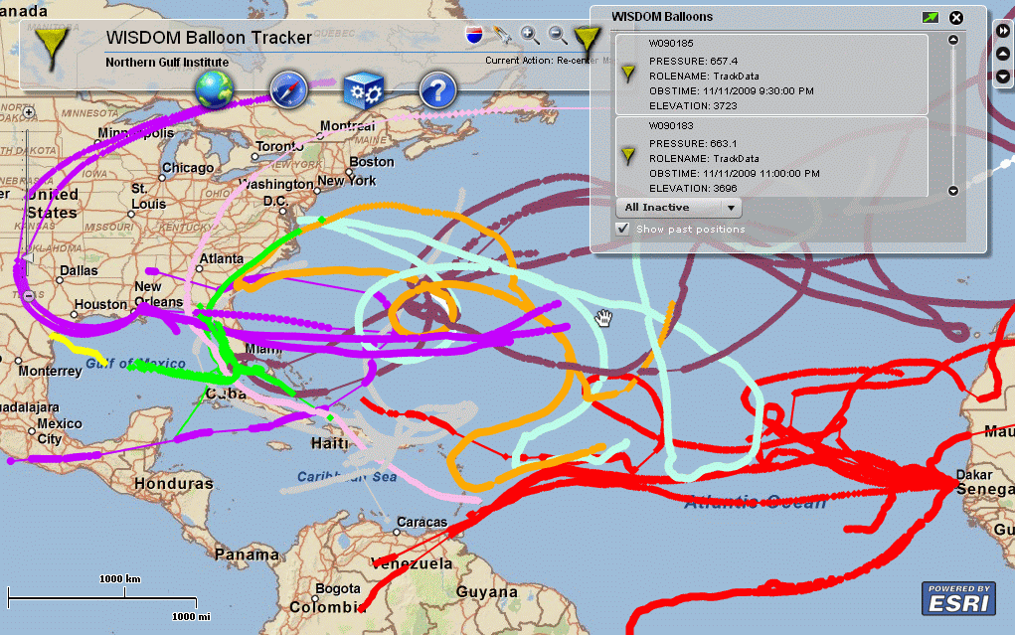
NGI Balloon Tracker 2009 Hurricane Season Launch
WISDOM (Weather In-Situ Deployment Optimization Method)
http://wisdom.noaa.gov

Slide 10
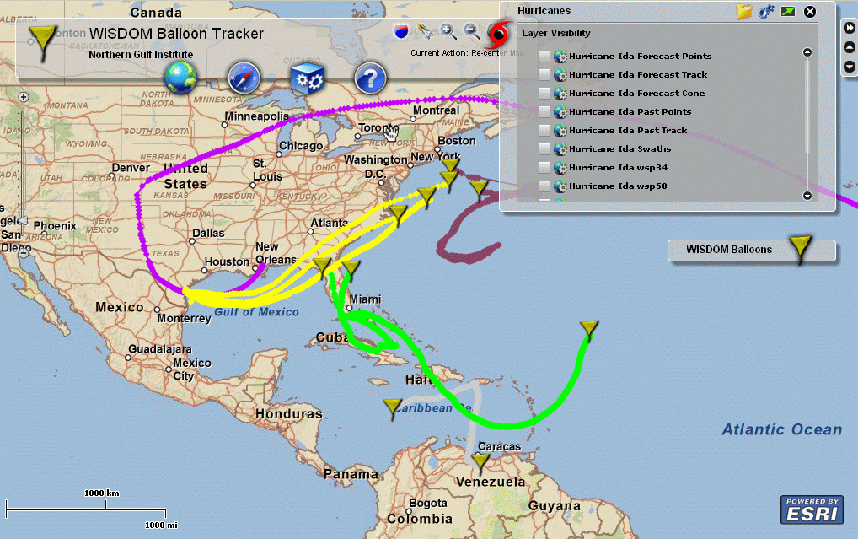
WISDOM 2009 IDA Launch
WISDOM (Weather In-Situ Deployment Optimization Method)
http://wisdom.noaa.gov

Slide 11
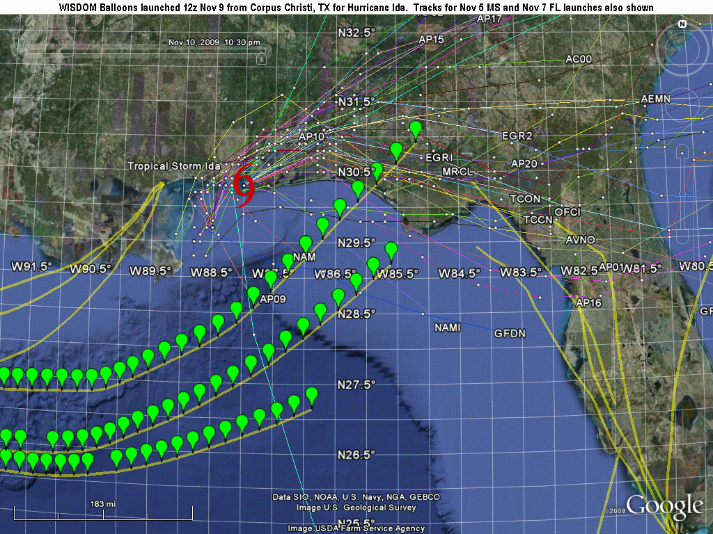
Nov 10 Tropical Storm Ida location and numerous predicted locations; also WISDOM Balloon trajectories for earlier Corpus Christi, TX launches.
WISDOM (Weather In-Situ Deployment Optimization Method)
Notes:
Balloon Icons are 30 minutes apart

Slide 12
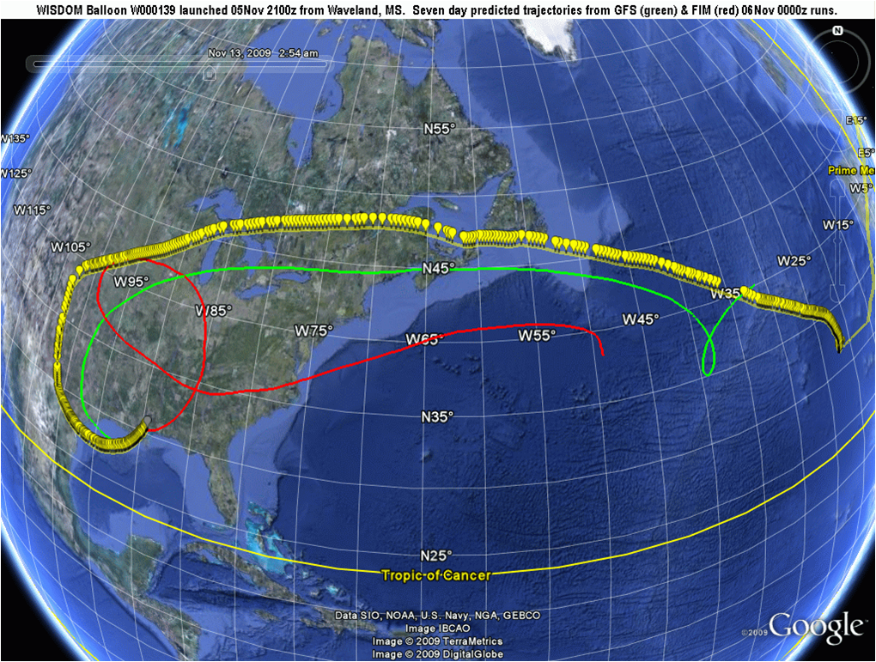
WISDOM Balloon W000139 launched 2100z from Waveland, MS 7 day predicted trajectories from GFS (green) & FIM (red) 06Nov2009 000z model runs.

Slide 13
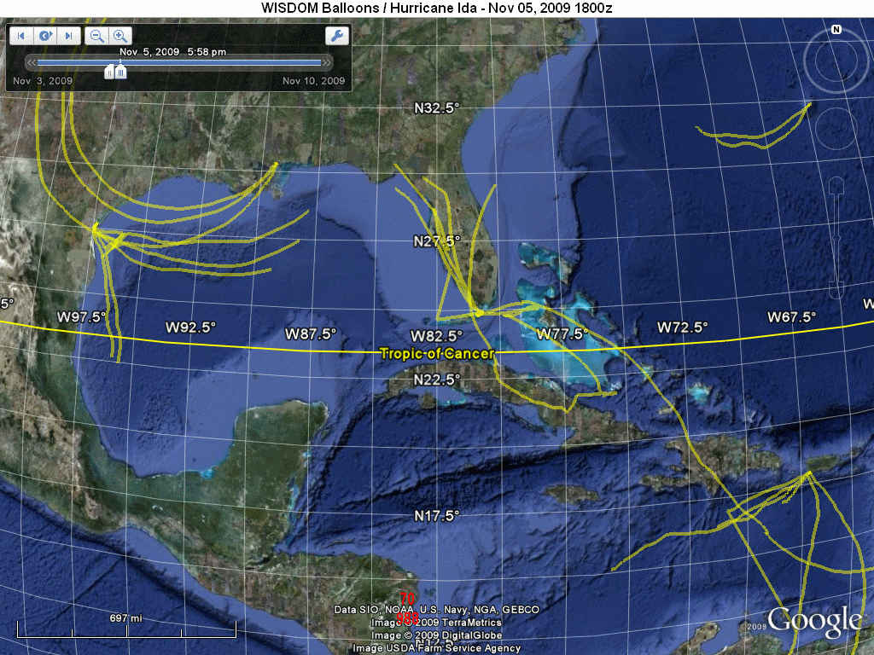
WISDOM Balloon W000139 launched 2100z from Waveland, MS. 7 day predicted trajectories from GFS (green) & FIM (red) 06Nov2009 0000z model runs.

Slide 14
Global OSSE and STMAS real time analysis
ECMWF 13 month free forecast is used for OSSE nature run;
NCEP/EMC operational systems of GFS/GSI are used for forecast and data assimilation;
A calibration of all synthetic observations against real data impact is almost finished;
A preliminary-calibrated OSSE can be used to study WISDOM data impact on hurricane track forecasts.
Notes:
OSSE system in Use
Calibration- making sure system performs similar to reality, real time vs synthetic world

Slide 15
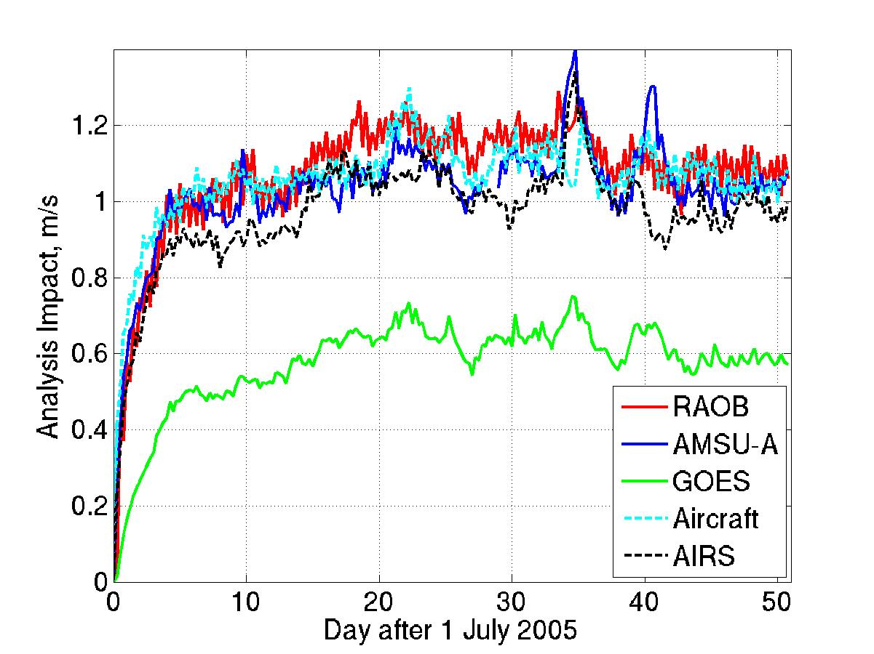
Real data impact of different obs
300 mb U-wind Analysis Impact, July-August 2005
Notes:
Results of preliminary calibration- data impact in real world- obs have diff impact in real world. RAOB is best. Default error added-

Slide 16
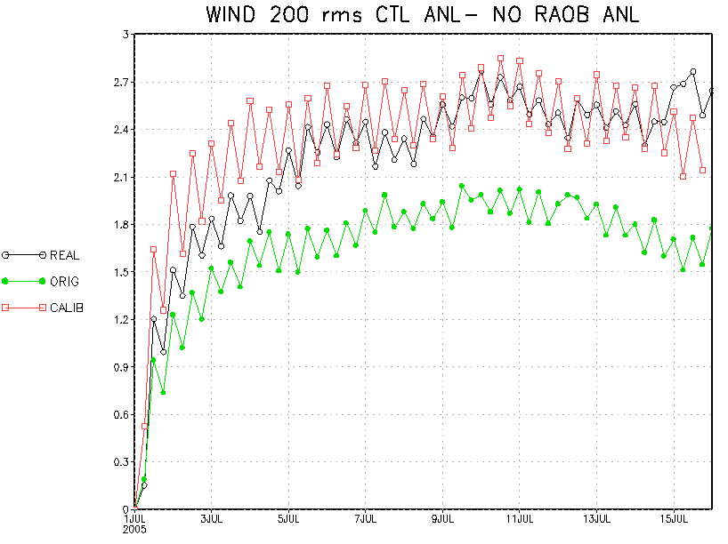
Calibrating synthetic data error so that the synthetic data impact is close to its impact in real world
Successful calibration
RAOB data denial
Notes:
200 mb Wind analysis impact, RAOB denial case
Black line: Real data cases for July.
Green line: analysis impact for data denial case with default error values for RAOB.
Red line: analysis impact for data denial case with adjusted (calibrated) error values on RAOB.
Green-less data impact than black, wwhich is real worls. Adjust deviation in calibration, so red curve has similar pattern to black- real world curve. Change error deviation to “match Scenarioos”

Slide 17
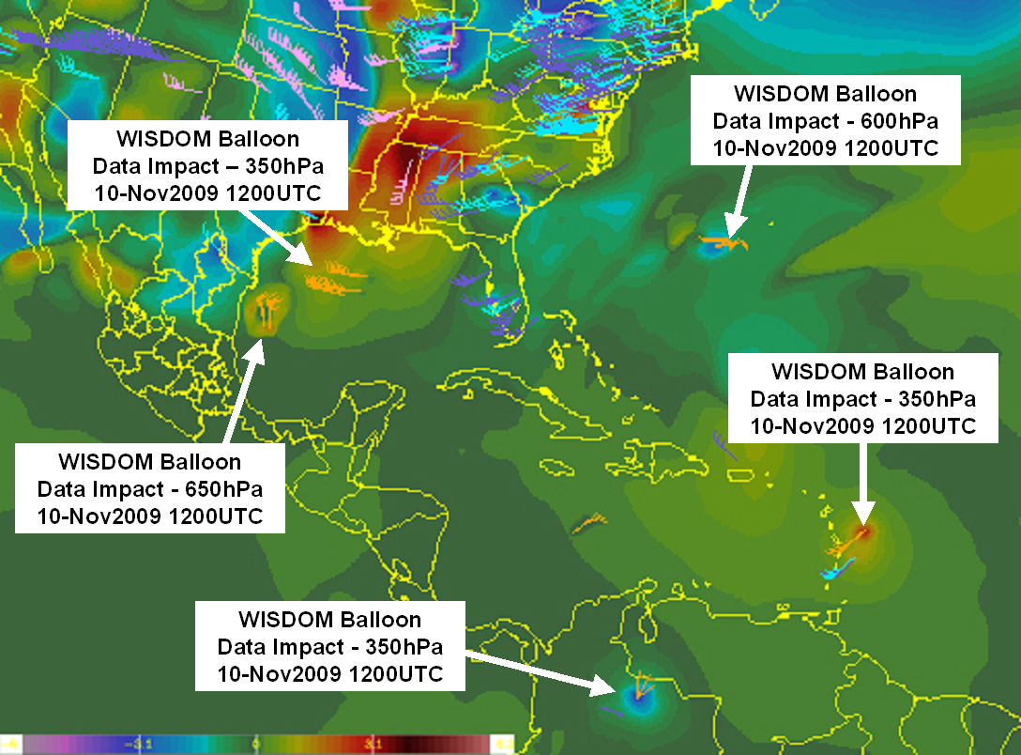
Real time WISDOM STMAS analysis: Analysis increment of windspeed
Notes:
WISDOM OSSE real time analysis system run; show of increment impact of data set. Orange flag is WISDOM data. Blue, Green, is RAOB or other data. Can See around the orange have some. WISDOM data has some impact on forecast. 2-3 knot impact —wind speed; analysis combined WISDOM data and other set, this data shoes 2-3 knots impact increment. Significant where there is no other observational data available, this was an improvement with very few balloons in the area.

Slide 18
OSSE for WISDOM
For a given hurricane identified in the OSSE nature run, OSSE can run several WISDOM deployment plans to identify the one that has strongest data impact in the OSSE world.
Based on this experiment, a real time WISDOM deployment plan can be modified and its impact will be verified.
Repeating this procedure, an “optimal” WISDOM deployment could be gradually formed for real hurricanes.

Slide 19
2009 Season Conclusions
WISDOM (Weather In-Situ Deployment Optimization Method)
http://wisdom.noaa.gov
WISDOM has demonstrated capability to target remote areas for in situ observations.
The WISDOM Balloon System can provide thousands of data points at low cost (estimated at less than a dollar per data point).
Preliminary OSSE analysis shows a positive impact of WISDOM data, with few balloons in a data sparse region.
Future improvements will include improved/additional sensors, termination capability and a targeting algorithm .
Data centers will receive data in real-time from ESRL’s MADIS server.
Additional altitudes (low and high) and balloon design will enhance scope of observations.

Slide 20
Thank you! Questions? Justyna.Nicinska@noaa.gov 240-723-6895
WISDOM (Weather In-Situ Deployment Optimization Method)
http://wisdom.noaa.gov

