Slide 1
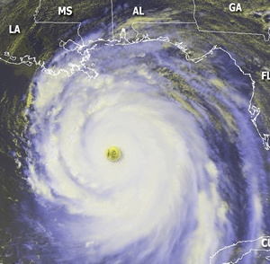
Working Group/Tropical Cyclone Research
Dr. Frank Marks (NOAA) and Dr. Ron Ferek (Navy)
Co-Chairs

Slide 2
WG/TCR
Dr. Frank Marks OAR/AOML/HRD (NOAA/DOC) | Dr. Ronald Ferek ONR (Navy/DOD)
Dr. Bradley Smull Physical & Dynamic Met. (NSF) | Dr. Ramesh Kakar Science Msn Directorate (NASA)
Mr. Frederick Toepfer HFIP Project Manager (NOAA/DOC) | Mr. Michael Mathews Science & Technology (FEMA/DHS)
Dr. Mark DeMaria NESDIS (NOAA/DOC) | Dr. Robert Rogers OAR/AOML/HRD (NOAA/DOC)
Dr. Naomi Surgi NWS/EMC/DTC (NOAA/DOC) | Mr. James Franklin NWS/NHC (NOAA/DOC)
Dr. Chris Landsea NWS/NHC (NOAA/DOC) | Dr. Daniel Melendez NWS/OST (NOAA/DOC)
Dr. Bruce Ebersole U.S. Army COE (Army/DOD) | Dr. James Goerss NRL (Navy/DOD)
Notes:
2

Slide 3
WG/TCR
Ms. Robbie Hood OAR (NOAA/DOC) | Ms. Justyna Nicinska OAR (NOAA/DOC)
Lt Col Jonathan Talbot 53rd WRS (AF/DOD) | Mr. Bob Falvey Director, JTWC (AF/DOD)
Dr. Richard D. Knabb NWS/CPHC (NOAA/DOC) | Dr. Scott Braun GSFC (NASA)
Dr. James McFadden OMAO/AOC (NOAA/DOC) | Colonel Mark Zettlemoyer HQ AF (AF/DOD)
Dr. Gerald Heymsfield GSFC (NASA) | Dr. Alexis Lugo-Fernandez MMS (DOI)
Mr. William (Kim) Curry HQ Navy (Navy/DOD) | Mr. William Laska Science & Technology (FEMA/DHS)
Mr. Mark Welshinger OFCM
Notes:
3

Slide 4
WG/TCR Objectives / Tasks
Keep Tables 1 and 2 updated
Table 1: Ops priorities
Table 2: Research needs
Map agency meteorological research efforts against TC research needs and operational priorities
Analyze results
Update information at IHC
Publish results & analysis of agency research
Notes:
4

Slide 5
Operational Priorities
Table 1

Slide 6
Research Needs
Table 2

Slide 7
Agency Contribution to Research Needs
Man-Years vs. Detailed Research Topic
Mapped using Detailed Research Need in Table 2
Intensity / Structure
Track
Genesis
QPF
Surge
Model Development
Observations
[Seasonal]

Slide 8
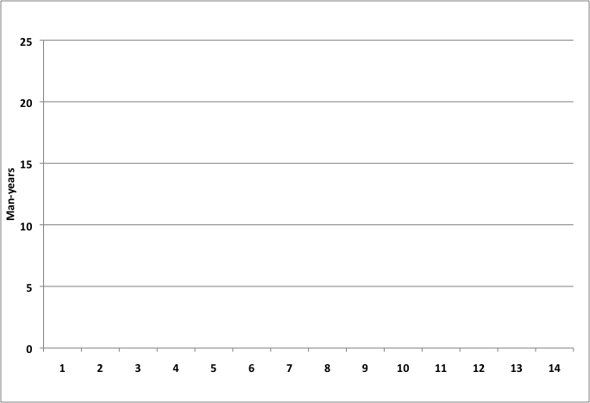
Combined Man-Years Mapped to Operational Priorities
Mapped using last column of Table 1
Intensity
Change
Stat Aids
Genesis
QPF
Track Fcst
Improved Obs
Storm Surge
Size/Structure
SST Gradients
Fcst Efficiency
Wind Analysis
Model Res vs Ensembles
Radar/Sat. Data
Seasonal Progs

Slide 9
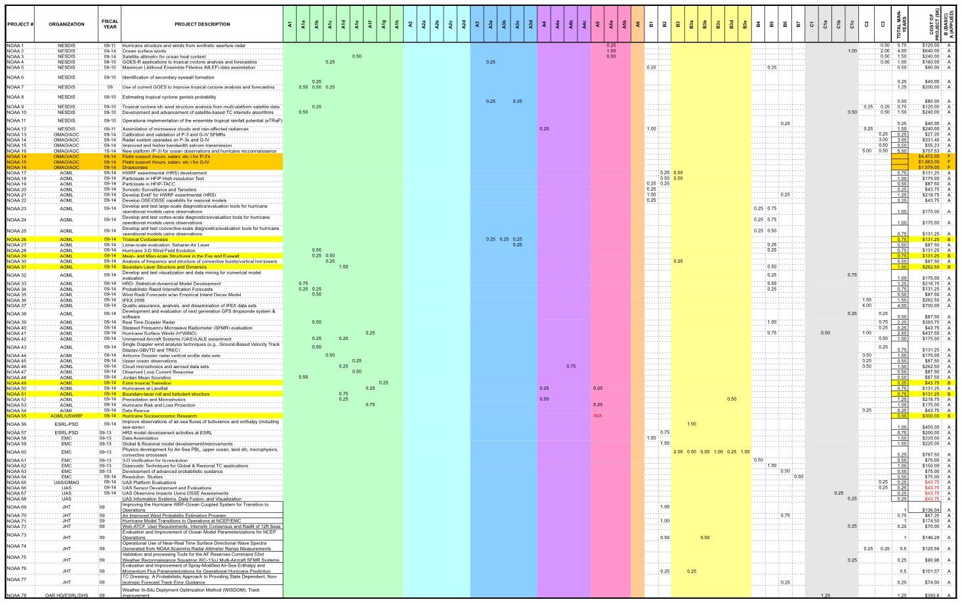
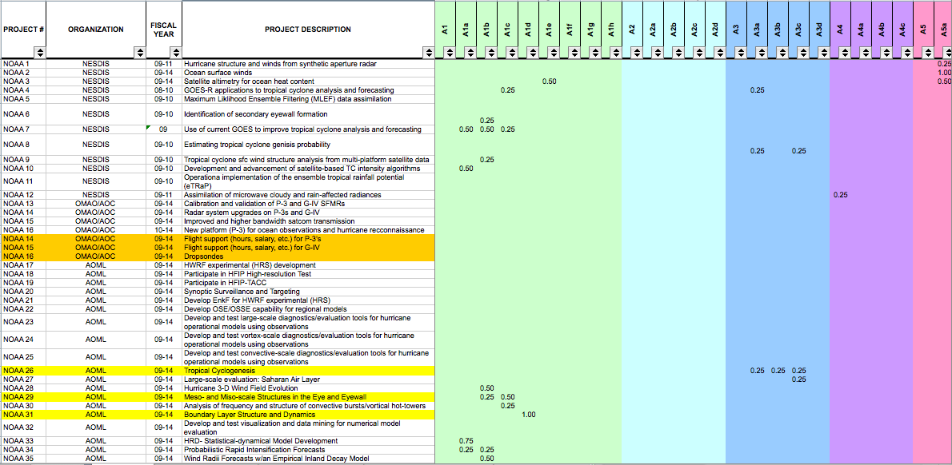
Agency Research Contributions
Tabulated each agency research contribution (Man-year and $)
Notes:
Rules:
For each row/project, complete columns E thru AX, where applicable, with man-year data. Do not fill in a cell with less than .25 man-years.
Try to put your man-year data in the top 3-4 research areas that best match the research

Slide 10
Operational Priorities and Analysis of FY08-09 Mapping
Mr. James Franklin, NOAA/NWS/NHC
Mr. Robert Falvey, JTWC
Dr. Ron Ferek, ONR

Slide 11
Operational Priorities of the Tropical Cyclone Forecasting and Warning Centers
Mr. James Franklin
Branch Chief, Hurricane Specialists Unit
NOAA/NWS/NHC
Mr. Robert J. Falvey
Director, JTWC

Slide 12
NHC / CPHC
Operational Priorities Evolution
Topic | 2001 IHC (informal) | FY-03 AO | FY-05 AO | FY-07 AO | FY-09 AO
Intensity change, especially RI | 1 | 1 | 1 | 1 | 1
Enhanced TC observations | 5 | 5 | 2 | 2 | 2
Guidance on guidance | 2 | 2 | 3 | 3 | 3
Operational environment enhancements |  |  | 4 | 4 | 4
Coastal inundation (storm surge) |  | 13 | 5 | 5 | 5
Improve/extended track guidance | 4 | 4 | 12 | 12 | 6
Genesis guidance |  | 9 | 11 | 11 | 7
Analysis of surface wind field |  | 7 | 6 | 6 | 8
TC size/structure forecasting | 6 | 6 | 7 | 7 | 9
Hi-res deterministic vs low-res ensembles |  |  |  |  | 10
TC precipitation | 3 | 3 | 8 | 8 | 11
Utility of microwave/radar data |  | 14 | 9 | 9 | 12
Intensity estimation over cold water |  | 11 | 13 | 13 | 13
Seasonal forecasting |  |  | 14 | 14 | 14
Probabilistic guidance on surface wind forecasts |  | 8 | 10 | 10 | ✔
Specific track issues (e.g., upper troughs) |  | 10
Generalized strike probability program |  | 12

Slide 13
JTWC
Operational Priorities Evolution
Topic | FY-07 AO | FY-09 AO | Delta JTWC-NHC | Prelim Update
Intensity change, especially RI | 1 | 1 | 0 | 1
Enhanced TC observations | 2 | 2 | 0 | 2
Guidance on guidance | 5 | 5 | +2 | 5
Operational environment enhancements | 6 | 6 | +2 | 4
Coastal inundation (storm surge) | 7 | 7 | +2 | 10
Improve/extended track guidance | 8 | 8 | +2 | 6
Genesis guidance | 3 | 3 | -4 | 3
Analysis of surface wind field | 9 | 9 | +1 | 9
TC size/structure forecasting | 4 | 4 | -5 | 8
Hi-res deterministic vs low-res ensembles | 10 | 10 | 0 | 11
TC precipitation | 11 | 11 | 0 | 12
Utility of microwave/radar data | 12 | 12 | 0 | 10
Intensity estimation over SST gradients | 13 | 13 | 0 | 13
Seasonal forecasting | 14 | 14 | 0 | 14
Probabilistic guidance on surface wind forecasts
Specific track issues (e.g., upper troughs)
Generalized strike probability program

Slide 14
Analysis of
Tropical Cyclone R&D
Part 1
Dr. Ronald Ferek
Co-Chair, Working Group for Tropical Cyclone Research
and
Program Officer, Marine Meteorology Program, ONR

Slide 15
Analysis of Tropical Cyclone R&D
Overview
Was first-ever snapshot analysis of all identified agency R&D efforts mapped against:
Research needs (Table 2)
Operational priorities of TC forecasting and warning centers (Table 1)
Encompassed R&D activities during FY 2008-2009
NOAA, Navy, NSF, NASA, USACE, DOI/MMS, DHS/S&T
Total of 228 man-years
General research: 112
Model development: 70
Observations: 47

Slide 16
Analysis of Tropical Cyclone R&D
General Observations
As indicated in Table 1, most operational priorities are supported by more than one—and in many cases, several—research needs
Refer to right-most column of Table 1
Intensity change is the #1 operational priority
Identified jointly by NOAA’s NHC / CPHC and DOD’s JTWC
Fundamental research is still required, as this is a very difficult and complex problem
Focus of basic research
Major emphasis in HFIP; will be reflected in subsequent mapping

Slide 17
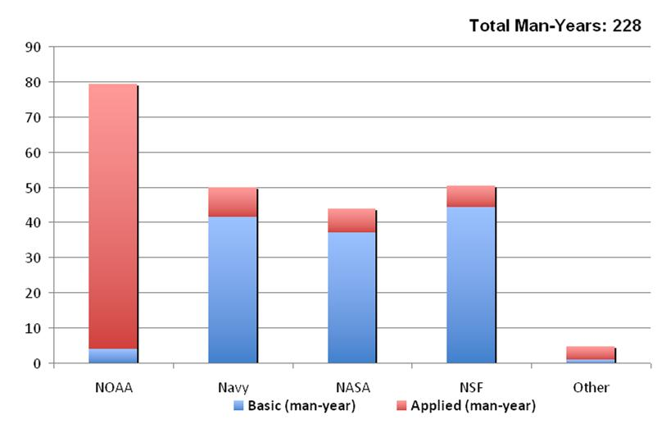
Analysis of Tropical Cyclone R&D
Interagency Partnerships
Strong partnerships exist between federal agencies on tropical cyclone research efforts
Substantial investments from multiple agencies are required to address the research needs that support operational priorities
Addressing operational priorities require both basic and applied research

Slide 18
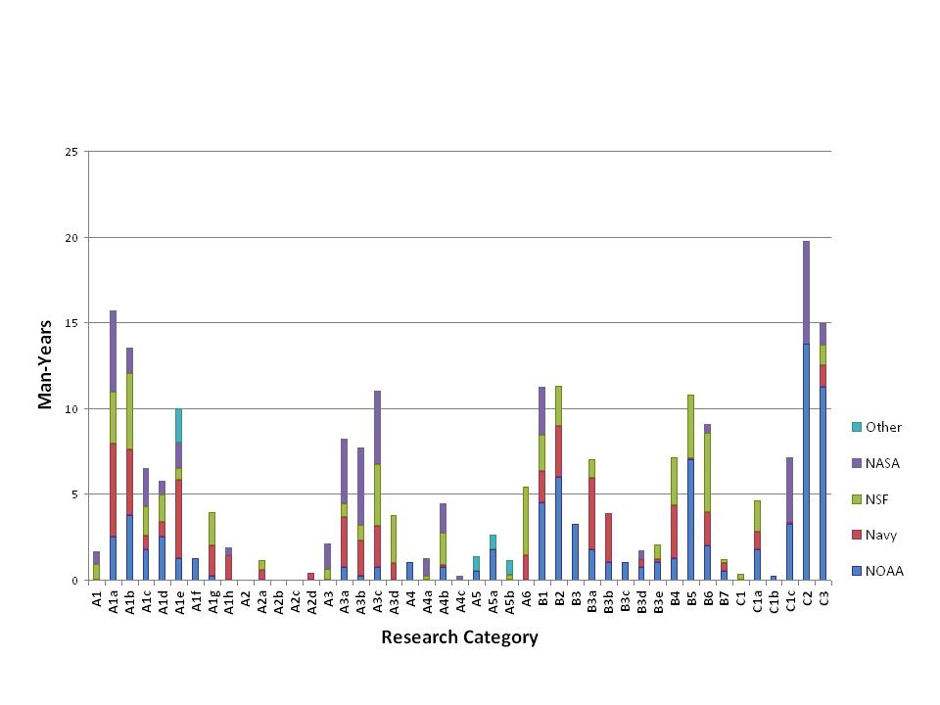
Analysis of Tropical Cyclone R&D
Intensity / Structure
Track
Genesis
QPF
Surge
Model Development
Obs
[Seasonal]
Figure above summarizes the amount of research activity for each of the detailed research need categories described in Table 2
Investment from multiple agencies for most research areas
Members of the Working Group did not attempt to evaluate whether there was sufficient research being conducted in each of the research categories

Slide 19
Analysis of Tropical Cyclone R&D
Intensity / Structure
Track
Genesis
QPF
Surge
Model Development
Obs
[Seasonal]
Some general observations regarding the amount of research being conducted for some research needs compared to others could be made
In reference to the low research contributions in categories A2a-d, we note that improvement in track forecasting is primarily accomplished through research investments in model development (B1-B3, B5-B7)

Slide 20
Analysis of Tropical Cyclone R&D
Intensity / Structure
Track
Genesis
QPF
Surge
Model Development
Obs
[Seasonal]
There is relatively low research investment, annotated with “circles” in above figure, in the following ‘Detailed Research Categories:’
Storm surge and waves response to tropical cyclones (A5a and A5b)
Model development related to physical processes, especially areas B3c, B3d, B3e
Model development related to studies to optimize model resolution and scale dependent parameterization (B7)

Slide 21
Research Needs Mapped onto Ops Priorities
Table 1

Slide 22
Analysis of
Tropical Cyclone R&D
Part 2
Mr. James Franklin
Branch Chief, Hurricane Specialists Unit
NOAA/NWS/NHC
Mr. Robert J. Falvey
Director, JTWC

Slide 23
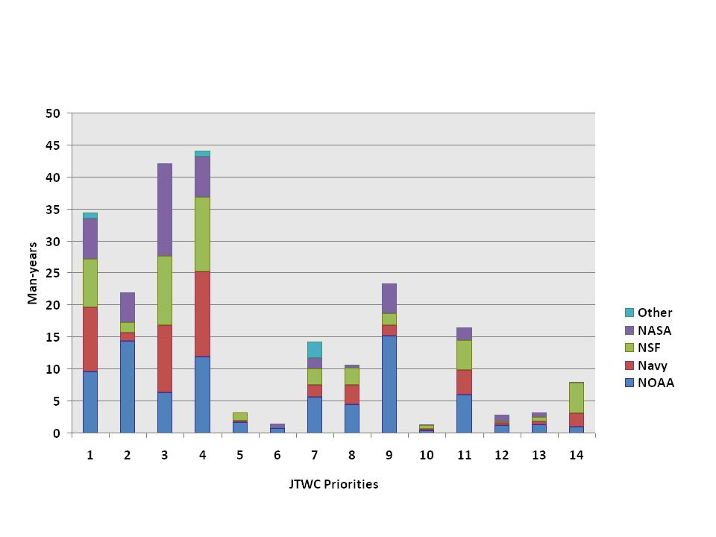
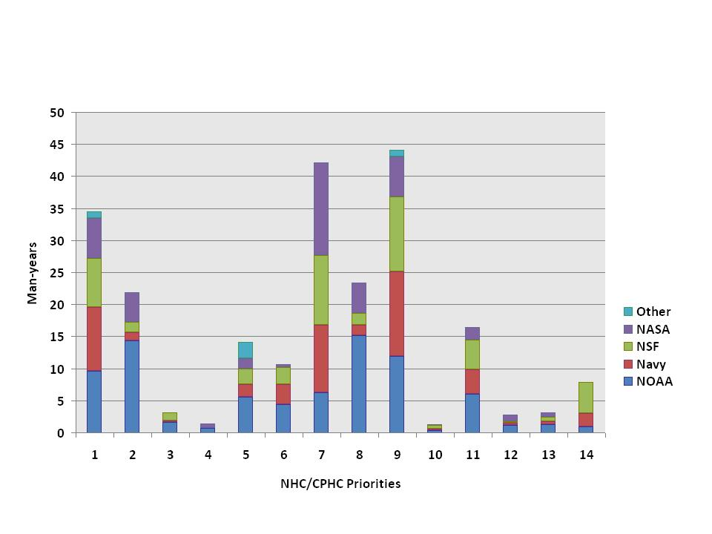
Analysis of Tropical Cyclone R&D
Research Needs Mapped to Operational Priorities
JTWC Priorities
NHC / CPHC Priorities
Research is better aligned to JTWC priorities versus NHC / CPHC priorities
Reviewing the top 10 priorities, there are apparent mismatches to JTWC & NHC / CPHC operational priorities
Circles indicate apparent mismatches with low research investments

Slide 24
Analysis of Tropical Cyclone R&D
Statistically-based Real-time Guidance on Guidance
Apparent mismatch with low TC research investment: JTWC 5 & NHC/CPHC 3
Guidance on guidance: how best to use or blend disparate model tracks/intensities to arrive at a deterministic official forecast
Previous work has not been consistently successful (Systematic Approach, FSSE, Goerss corrected consensus); tough to beat a simple arithmetic average consensus
This remains one of the forecaster’s biggest challenges
JTWC 5 & NHC/CPHC 3
Linkage to research needs associated with these priorities (from right-most column in Table 1) is: B5, B6
JTWC Priorities
NHC / CPHC Priorities

Slide 25
Analysis of Tropical Cyclone R&D
Enhancement to Operational Environment
Apparent mismatch with low TC research investment: JTWC 6 & NHC/CPHC 4
Enhance operational environment to increase forecaster efficiency
Improvements to the systems/environment allow forecasters more time to diagnose the meteorology
Improvements to ATCF, N-AWIPS; development of new platforms
Limited opportunities for research community to assist with the operational platforms
Not surprising that this activity is underrepresented (i.e., not basic or applied research problem)
JTWC 6 & NHC/CPHC 4
Linkage to research needs associated with these priorities (from right-most column in Table 1) is: C1c
JTWC Priorities
NHC / CPHC Priorities

Slide 26
Analysis of Tropical Cyclone R&D
Additional Operational Guidance on Coastal Inundation
Apparent mismatch with low TC research investment: JTWC 7 & NHC/CPHC 5
Coastal inundation (e.g., storm surge and waves) is interdisciplinary problem
Some work in non-meteorological disciplines may not have been fully captured (e.g., coastal geosciences, civil / coastal engineering)
NOAA Storm Surge Roadmap group attempting to make these efforts more productive and operationally directed
Coastal inundation work primarily focused on US, but applicable to DoD in JTWC AOR
JTWC 7 & NHC/CPHC 5
Linkage to research needs associated with these priorities (from right-most column in Table 1) is: A4, A5, B2, B3, B6
JTWC Priorities
NHC / CPHC Priorities

Slide 27
Analysis of Tropical Cyclone R&D
Improved and Extended Track Guidance; Reduction of Outliers
Apparent mismatch with low TC research investment: JTWC 8 & NHC/CPHC 6
Operational staff have traditionally been unavailable to conduct case studies to diagnose model forecast failures
Research community by and large is not effectively engaged with improving operational models, and/or had difficulty gaining access to operational models
Reduction of outliers most important to model consensus => forecast
HFIP is directing some funds to diagnostic team to support this activity
JTWC 8 & NHC/CPHC 6
Linkage to research needs associated with these priorities (from right-most column in Table 1) is: A2, B1-B3, B5-B7
JTWC Priorities
NHC / CPHC Priorities

Slide 28
Analysis of Tropical Cyclone R&D
High-res Model Output vs. Lower Res Ensemble Model Output
Apparent mismatch with low TC research investment: JTWC 10 & NHC/CPHC 10
High HFIP focus area
Research community is involved
Hi-res are still in “research” status and probably not ready for operations
Many components need further development (e.g. air-sea coupling, convective fluxes, parameterizations, etc.)
JTWC 10 & NHC/CPHC 10
Linkage to research needs associated with these priorities (from right-most column in Table 1) is: B6, B7
JTWC Priorities
NHC / CPHC Priorities

Slide 29
Analysis of Tropical Cyclone R&D
Guidance for Tropical Cyclone Cyclogenesis
Priority differences: JTWC 3 & NHC/CPHC 7
NHC / CPHC
Seems over emphasized given the NHC/ CPHC priority
Result of genesis is virtually always a tropical depression or weak tropical storm
Genesis is important, but operational genesis forecasts are of less significance or utility for our users compared to track or intensity forecasts
JTWC
Investment is aligned with JTWC priority
Genesis critical to DoD; genesis regions close to major installations
No aircraft reconnaissance
JTWC 3 & NHC/CPHC 7
Linkage to research needs associated with these priorities (from right-most column in Table 1) is: A3, B1-B3, B5-B7
JTWC Priorities
NHC / CPHC Priorities

Slide 30
Analysis of Tropical Cyclone R&D
Forecast of TC Structure
Priority differences: JTWC 4 & NHC/CPHC 9
NHC / CPHC
Seems over emphasized given the NHC / JTWC priority
Insufficient observations are available to define current wind field (improved observations are NHC / CPHC priority #2)
Track and intensity errors overwhelm uncertainty in structure
JTWC
Investment aligned with JTWC priority
Wind distribution drives ship movements (along with seas)
Forecast at 48-72 hours critical to safety
No aircraft reconnaissance
JTWC Priorities
NHC / CPHC Priorities

Slide 31
Closing Comments
and
Way Ahead for WG/TCR
Dr. Ronald Ferek
Co-Chair, Working Group for Tropical Cyclone Research
and
Program Officer, Marine Meteorology Program, ONR

Slide 32
Analysis of Tropical Cyclone R&D
Closing Comments
There are differences in operational priorities between JTWC and NHC / CPHC due to customer base
Prioritized operational needs (Table 1) was not readily available and widely known when previous investment decisions were made
Some of the apparent “mismatch” is understandable
As HFIP rolls out much of this will be addressed
Communication of ops priorities to research community is a good thing
Need to strengthen the processes by which research investments are aligned to operational priorities
JTWC Priorities
NHC / CPHC Priorities

Slide 33
Analysis of Tropical Cyclone R&D
Closing Comments
Does not appear to be enough total investment to adequately address all priorities
Advanced development funding (“6.4” in DoD) is inadequate to ensure that the discoveries of basic and applied research are efficiently transitioned to operations
Would like research community to take more of an interest in the operational models (e.g., guidance on guidance, diagnostics, model improvement)
JTWC Priorities
NHC / CPHC Priorities

Slide 34
WG/TCR Way Ahead
Interagency TC Research Assessment Strategy
Keep Tables 1 and 2 updated
Table 1: Ops priorities
Table 2: Research needs
Biennially map agency research efforts against TC research needs and operational priorities
Will do FY10 next
WG/TCR meets as required to analyze, assess, and help inform agency research investments
Brief ICMSSR / FCMSSR, as required
Update information at IHC
Publish results & analysis of agency research

Slide 35
QUESTIONS?

