Slide 1
53rd Weather Reconnaissance Squadron 2009 Hurricane Season – Flying Stats
I n t e g r i t y - S e r v i c e - E x c e l l e n c e
Notes:
1
1
1
1
1
1
1
1
1
1
1
1
1
1
1
1

Slide 2
Season Comparison For Tasking
‘04 ‘05 ‘06 ’07 ’08 ‘09
TASKED 273 355 125 139 244 104
CANCELLED 70 102 41 63 60 44
REQUIRED 203 253 84 76 184 60
ACCOMP 199 246 84 74 183 59
RELIABILITY 98% 97% 100% 97% 99% 98%
I n t e g r i t y - S e r v i c e - E x c e l l e n c e
Notes:
1
1
1
1
1
1
1
1
1
1
1
1
1
1
1
1
Numbers are the lowest in 6 years! Still I good rate of reliability.
Hurricane numbers may be way down but winter storm reconn will not be!

Slide 3
NHOP Flight Hours
H
O
U
R
S
Year
Notes:
6
Our average flying hours (including deploy and redeploy, Atlantic and Pacific) over the last 11 years is 1022 hours and is —indicated by the red line.
In 2009 our flying total was 620 (only 361 storm but 258 in support and Deploy/Redeploy Hours) That is 42% off all flying time was actually support flying!! Last year only 16%
TALBOT IF YOU WANT MORE TO THIS CHART OR PERHAPS TWO CHARTS JUST LET ME KNOW.

Slide 4
53rd Flying Hrs by Month
Notes:
4
4
4
4
4
4
4
4
4
4
4
4
4
4
4
4
Not your typical bell curve at all this year!
56 percent of your flying done in August! Nov comes in second with 21% (all Nov attributed to IDA).

Slide 5
% of Flying Hours by Storm
Notes:
BILL and IDA garnered 42% of the business. Bill mid Atlantic, IDA Gulf and Gulf Coast
20% of hours this year spent in the Pacific.

Slide 6
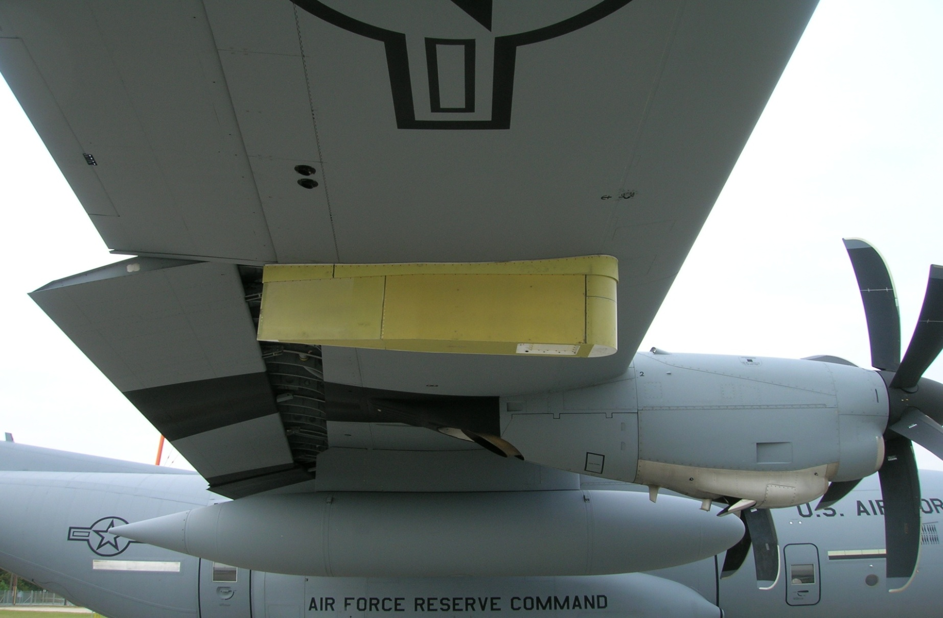
Technological Improvements
Software/Aircraft/Ground Station
- New software install Jun 10
-AVAPS
- -Latest Software upgrade Sep 08
- -Next generation sonde Aug/Sep 09
SFMR
-Operational Learning Curve
-New Radome, water leak
-60-70% missions reliable
Notes:
NEED TO UPDATE THIS ONE
J-Model Satellite Ground Station/Aircraft Software Upgrade: Latest software upgrade in Dec 08
AVAPS (Airborne Vertical Atmospheric Profiling System): Latest AVAPS software upgrade was in Sep 08. Next sonde upgrade Aug/Sep 09??
SFMR: 3rd operational season, new antenna. Water leakage problem on 50% of misssions with heavy rain. Discovered mid season. Fixed late season. Software fix late season, installed Sep 09. Good results in IDA.

Slide 7
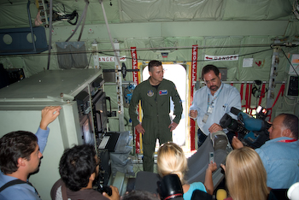
Public Affairs
Media Flights
Airshows
CHAT
www.hurricanehunters.com
Notes:
Update with photo
The 53rd continues to run an active public affairs program.
1. Media Flights: resumed in the 2006 storm season.
2. Airshows/Statics: Dubai was the highlight (Probably can get numbers for these if you think we need them?)
3. CHAT: Caribbean Hurricane Awareness Tour (late March 2009—our busiest event and most important). OG Commander went last year and this year going to tie in humanitarian support.
Website: Hurricanehunters.com no an official “mil” page. Continues to be a valuable source of information.

Slide 8
U.S. AIR FORCE RESERVE
Notes:
Update question comment slide!!

