Slide 1
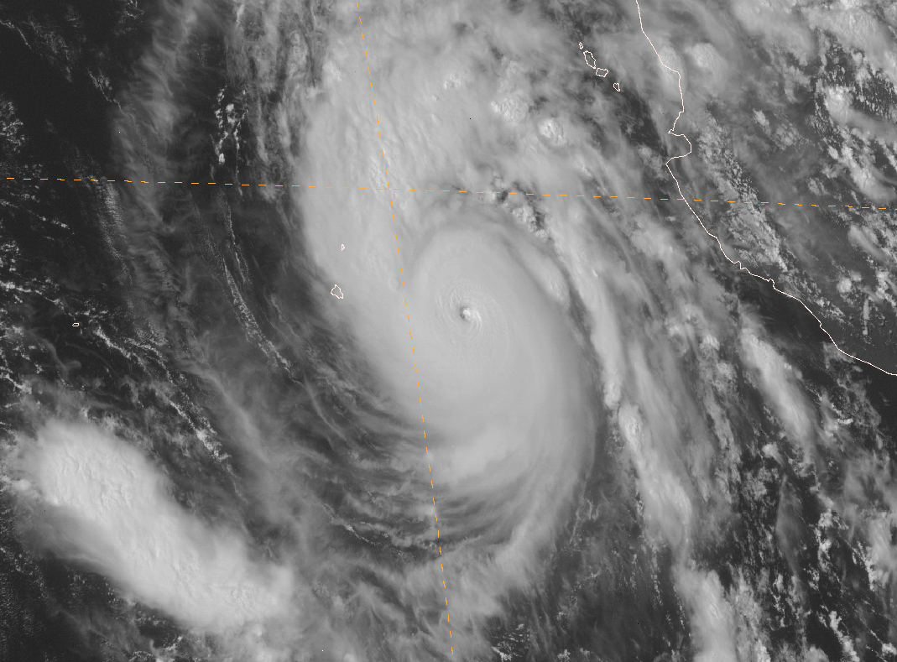
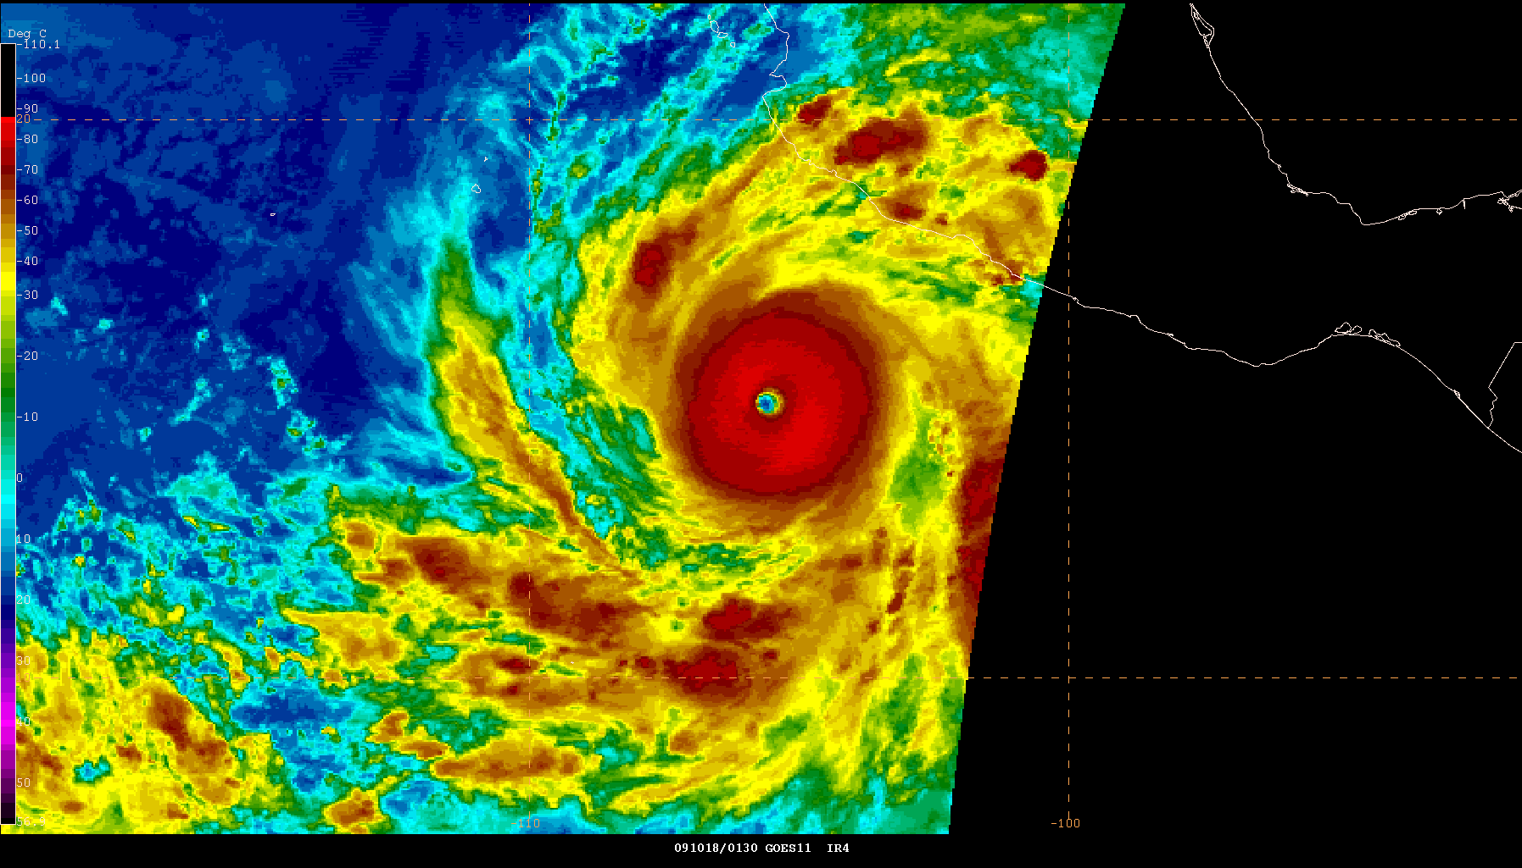
2009 East Pacific Hurricane Season
Todd B. Kimberlain and Michael J. Brennan
National Hurricane Center
March 2010

Slide 2
Summary Table (1/2)
Name | Dates | Min Pressure (mb) | Max Winds (kt) | Direct Deaths
H Andres | 21-24 Jun | 984 | 70 | 1
TS Blanca | 6-9 Jul | 998 | 45 | 0
H Carlos | 10-16 Jul | 971 | 90 | 0
TS Dolores | 15-16 Jul | 997 | 50 | 0
TS Lana* | 30 Jul-2 Aug | 995 | 55 | 0
TS Enrique | 3-7 Aug | 994 | 55 | 0
MH Felicia | 3-11 Aug | 935 | 125 | 0
MH Guillermo | 12-19 Aug | 954 | 110 | 0
TS Hilda | 22-28 Aug | 995 | 55 | 0
*Lana formed in the East Pacific as TD Six-E and was named in the Central Pacific

Slide 3
Summary Table (2/2)
Name | Dates | Min Pressure (mb) | Max Winds (kt) | Direct Deaths
TS Ignacio | 24-27 Aug | 999 | 45 | 0
MH Jimena | 28 Aug-4 Sep | 931 | 135 | 1
TS Kevin | 29 Aug-1 Sep | 1000 | 45 | 0
H Linda | 7-11 Sep | 985 | 70 | 0
TS Marty | 16-19 Sep | 1002 | 40 | 0
TS Nora | 23-25 Sep | 997 | 50 | 0
TS Olaf | 1-3 Oct | 996 | 40 | 0
TS Patricia | 11-14 Oct | 996 | 50 | 0
MH Rick | 15-21 Oct | 906 | 155 | 2

Slide 4
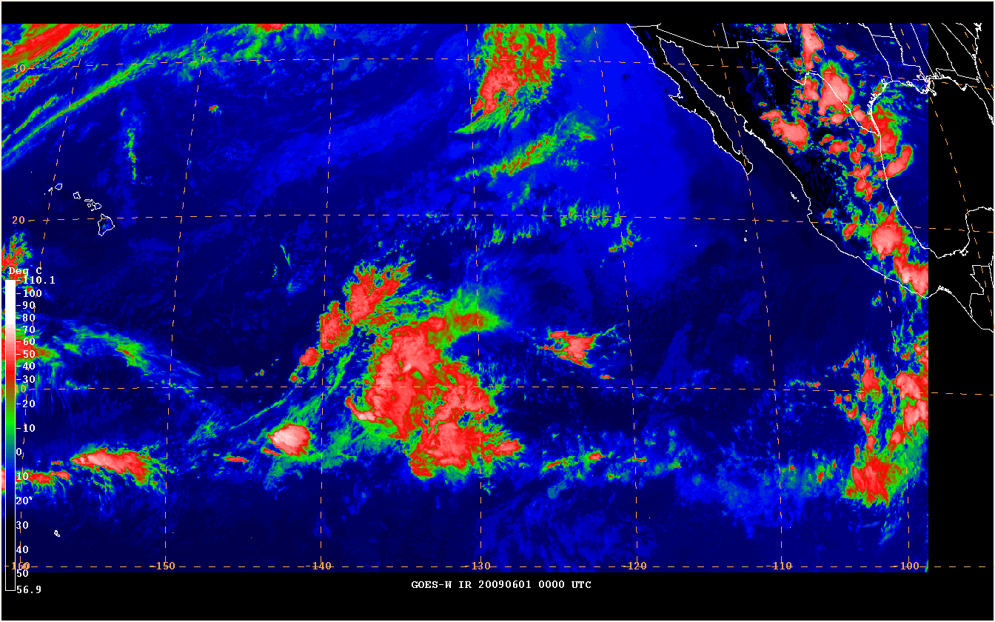
Seasonal IR Loop

Slide 5
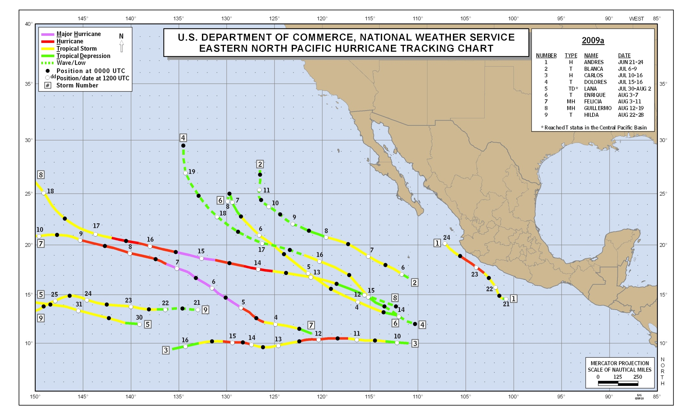
2009 East Pacific Track Map (1/2)

Slide 6
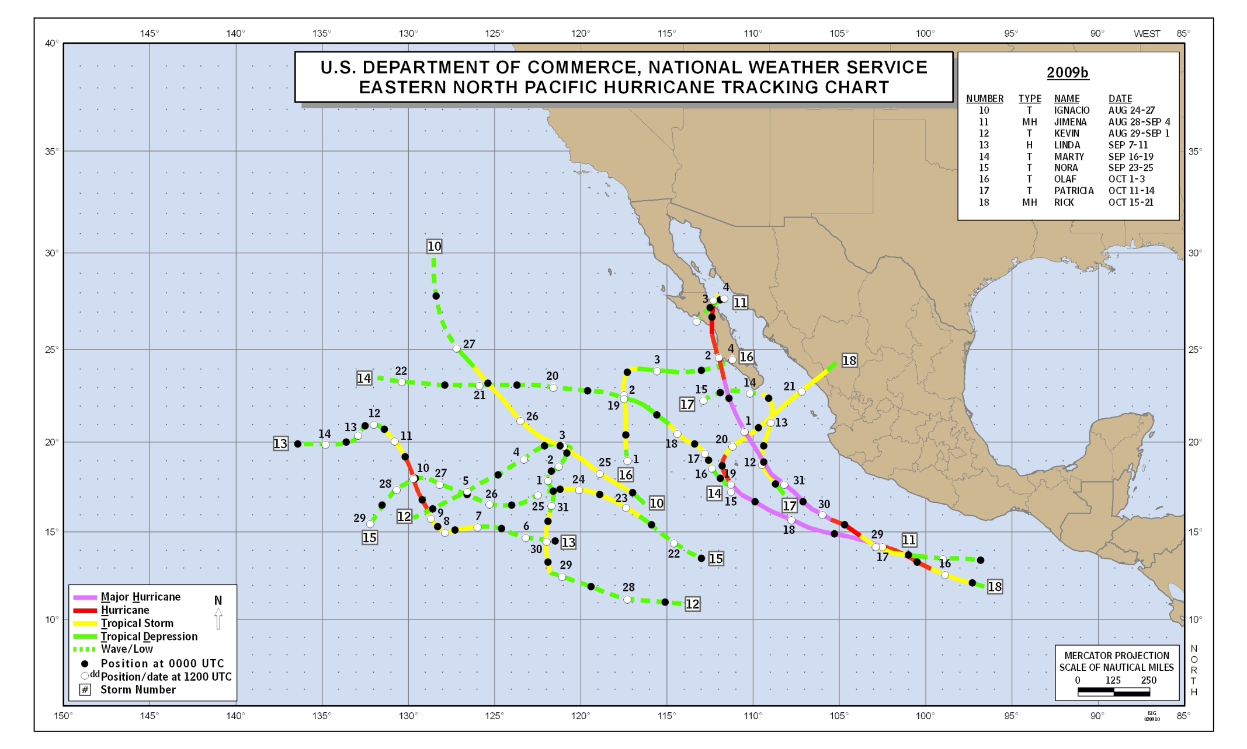
2009 East Pacific Track Map (2/2)

Slide 7
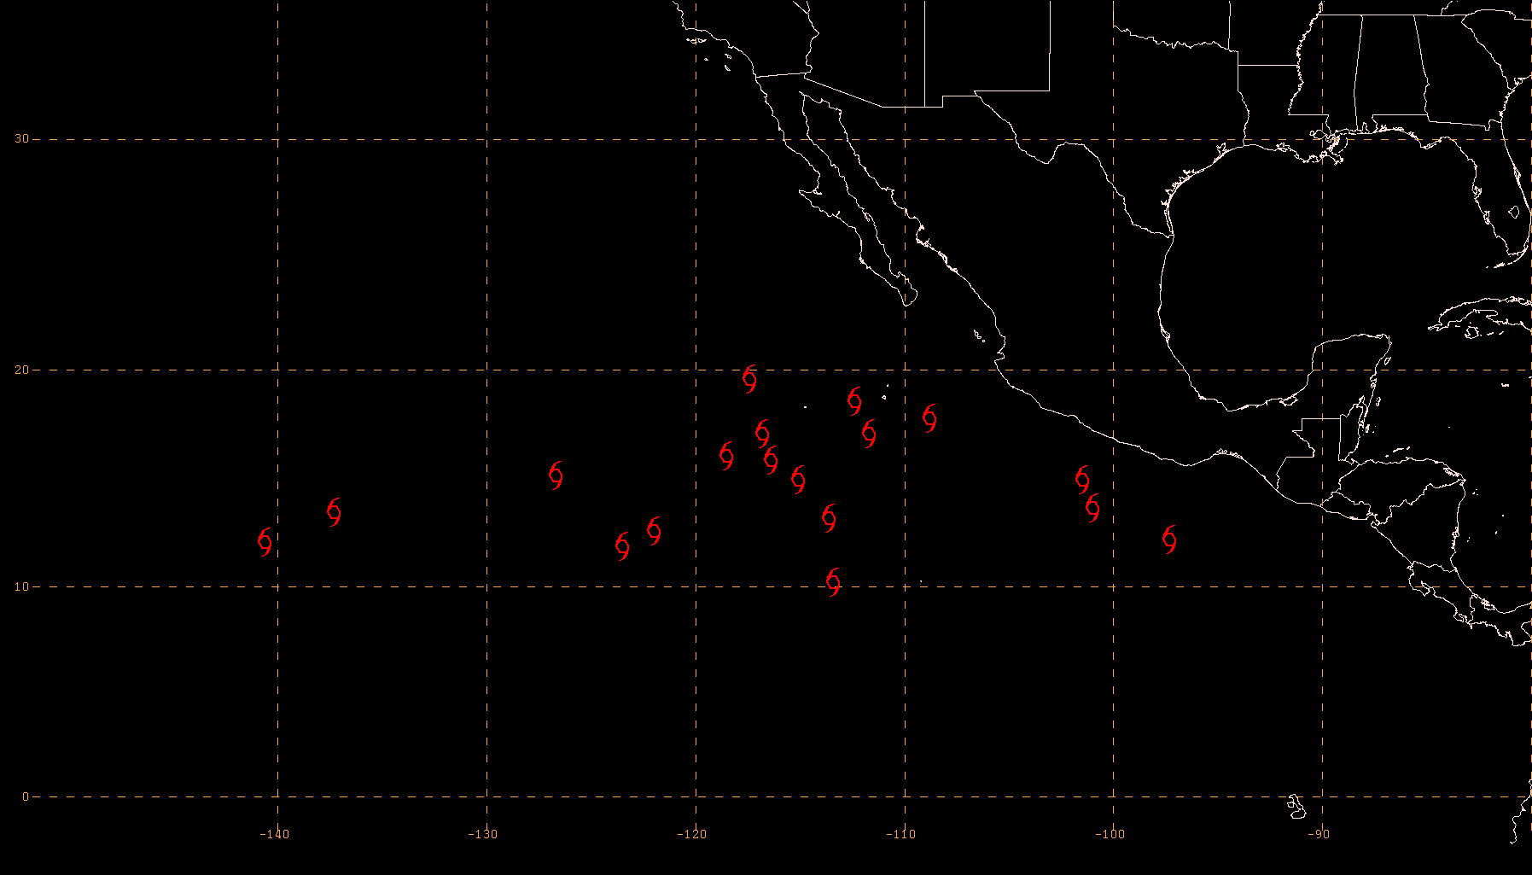
2009 East Pacific Genesis (TS) Locations
76.4% of TS genesis points occurred west of 110°W

Slide 8
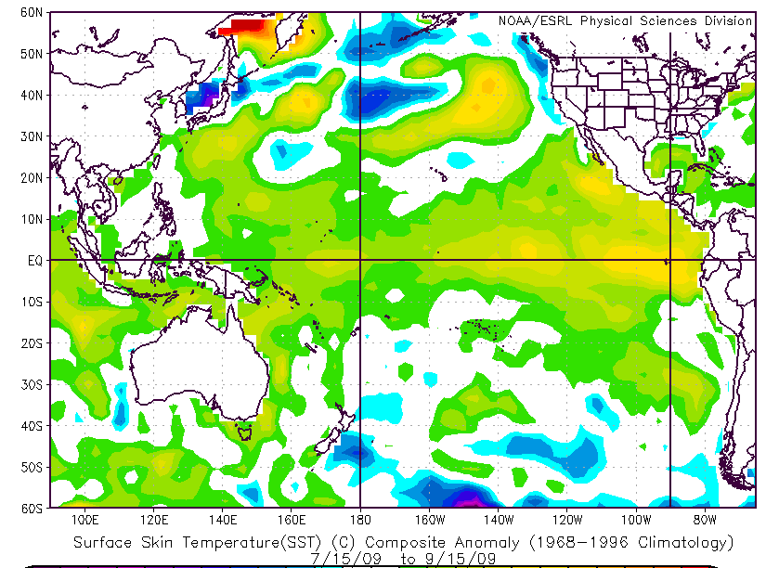
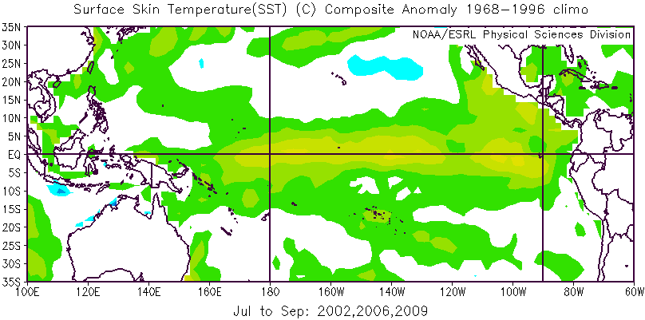
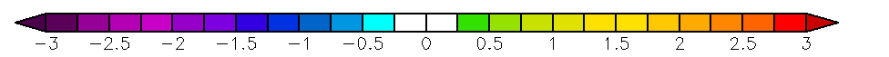
SST Anomalies
2009
2002, 2006, and 2009

Slide 9
Season Summary
Number of named storms (17) above average, number of hurricanes (7) slightly below average, number of major hurricanes (4) average
Two unnamed depressions
Accumulated Cyclone Energy (ACE) for the season was 93, in the “near normal” range of activity
Eight storms had peak intensity ≤ 50 kt
Rick (155 kt) became second-strongest east Pacific hurricane since reliable records began in 1971
  Only Linda (1997) was stronger (160 kt)
2 landfalls (1 TS and 1 H), 4 direct deaths
Three major hurricanes and seven named storms formed in August

Slide 10

Verification of NOAA’s 2009 Eastern Pacific Hurricane Outlook
Season and Climatological
Activity Type Outlook Observed Mean
Chance Above Normal 20% 33%
Chance Near Normal 40% Near Normal 33%
Chance Below Normal 40% 33%
Tropical Storms 13-18 17 15
Hurricanes 6-10 7 9
Major Hurricanes 2-5 4 4
ACE % of Median 70-130 93 ~100

Slide 11
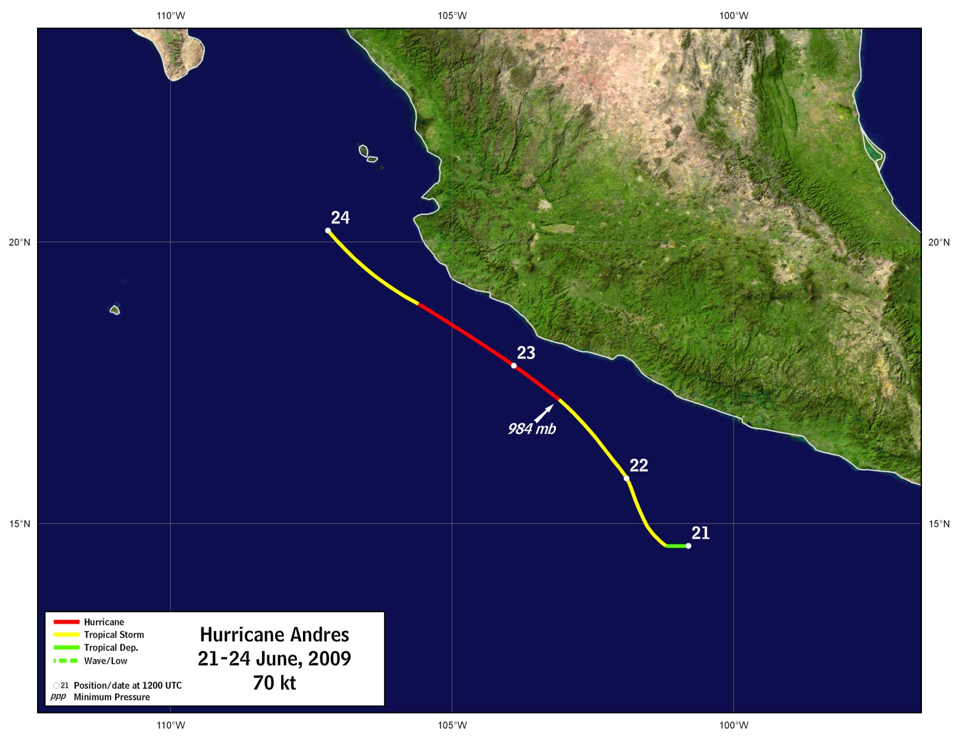
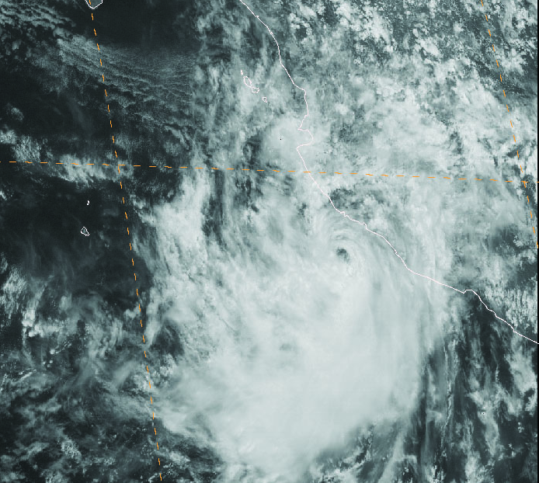
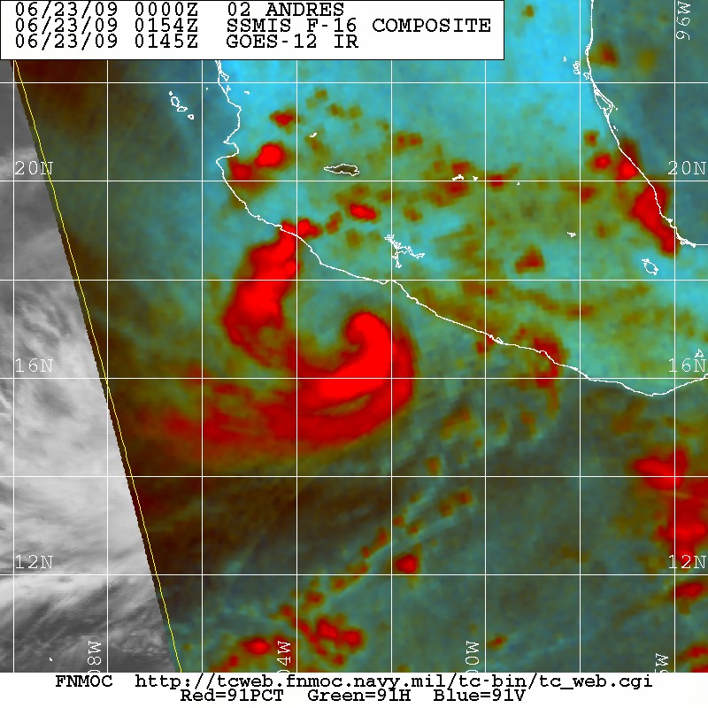
Hurricane Andres
GOES-11 VIS 2000 UTC 23 June
SSMIS 91-GHz color composite – 0154 UTC 23 June – Courtesy FNMOC TC Webpage

Slide 12
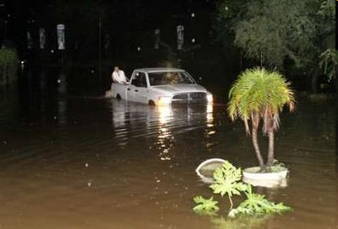
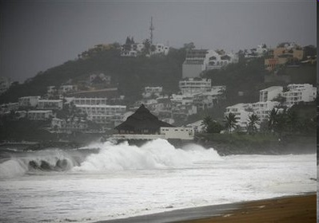
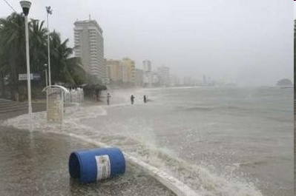
Hurricane Andres
Acapulco - Reuters/Jesus Trigo
Man drowned fishing in rough seas between Acapulco and Zihuatanejo
Damage along southwestern coast of Mexico was minimal
Heavy rainfall from Andres and its precursor disturbance flooded homes in a portion of Acapulco
Resulted in evacuation of about 200 people
Reports of a few trees were blown down along the coast

Slide 13
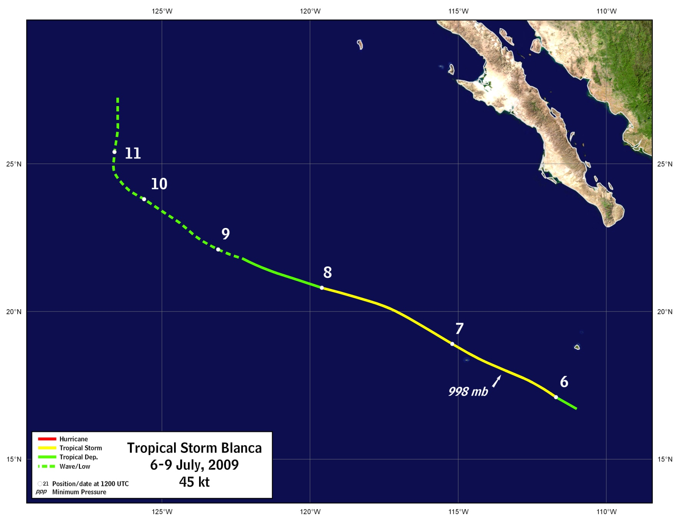
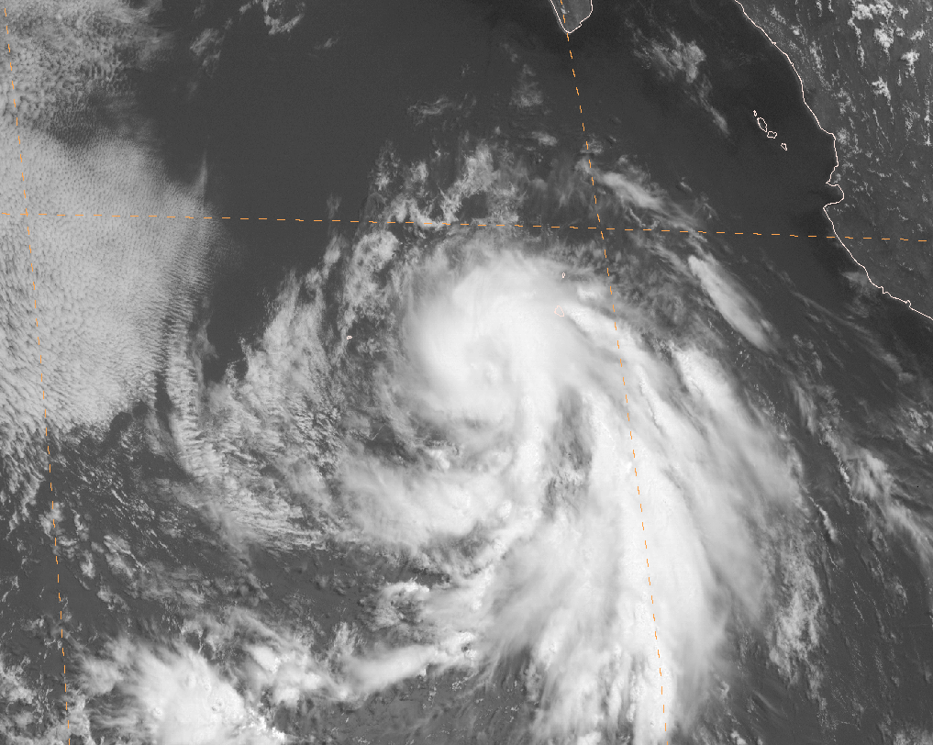
Tropical Storm Blanca
GOES-11 VIS 1800 UTC 6 July

Slide 14
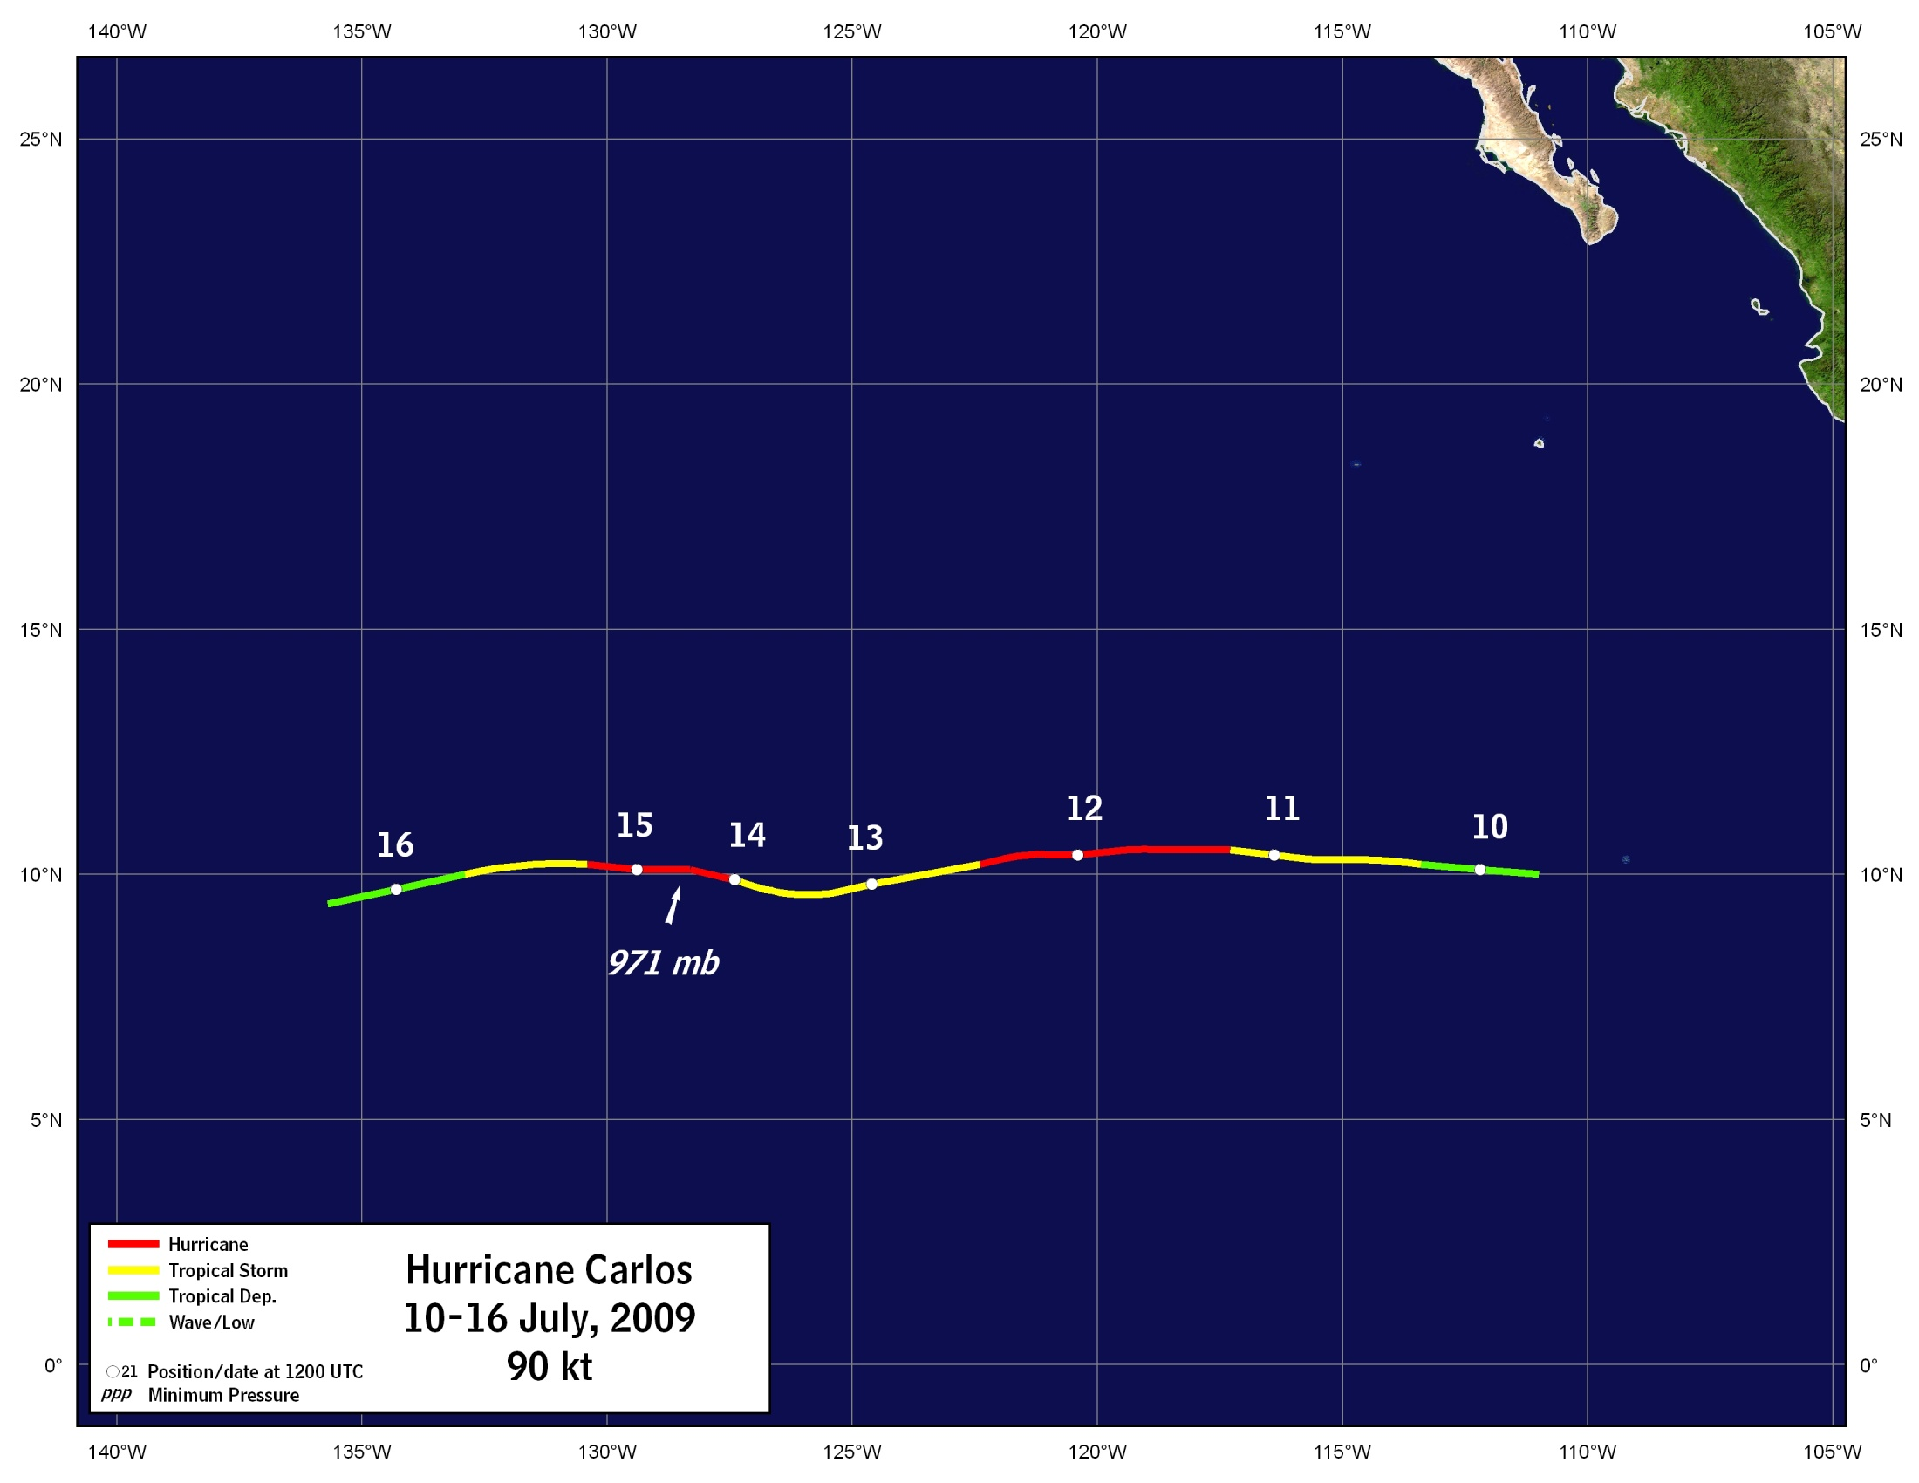
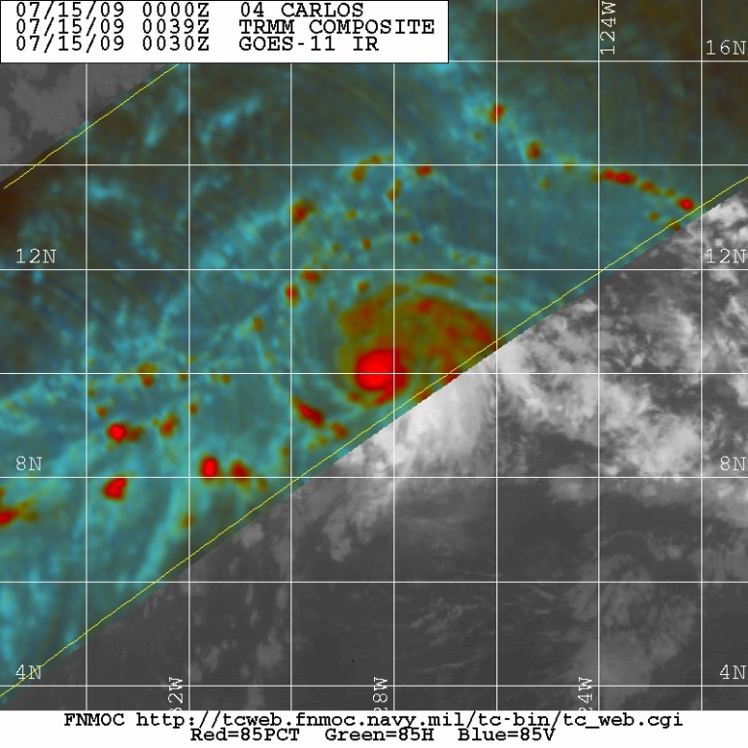
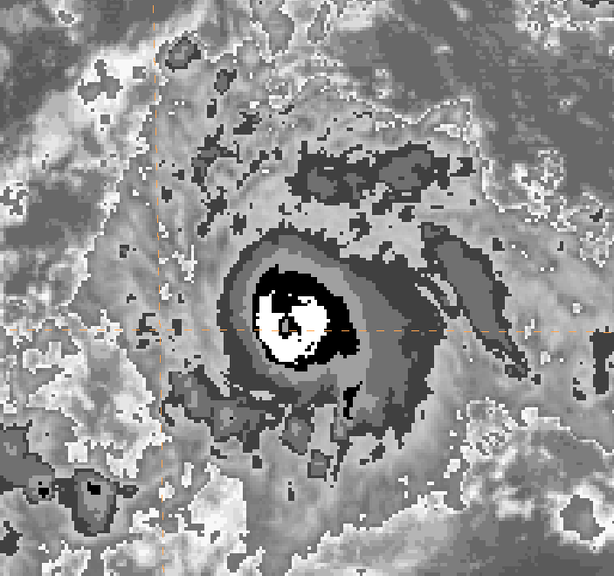
TRMM 85GHz color composite – 0039Z 15 July Courtesy FNMOC TC Webpage
GOES-11 IR 0000 UTC 15 July

Slide 15
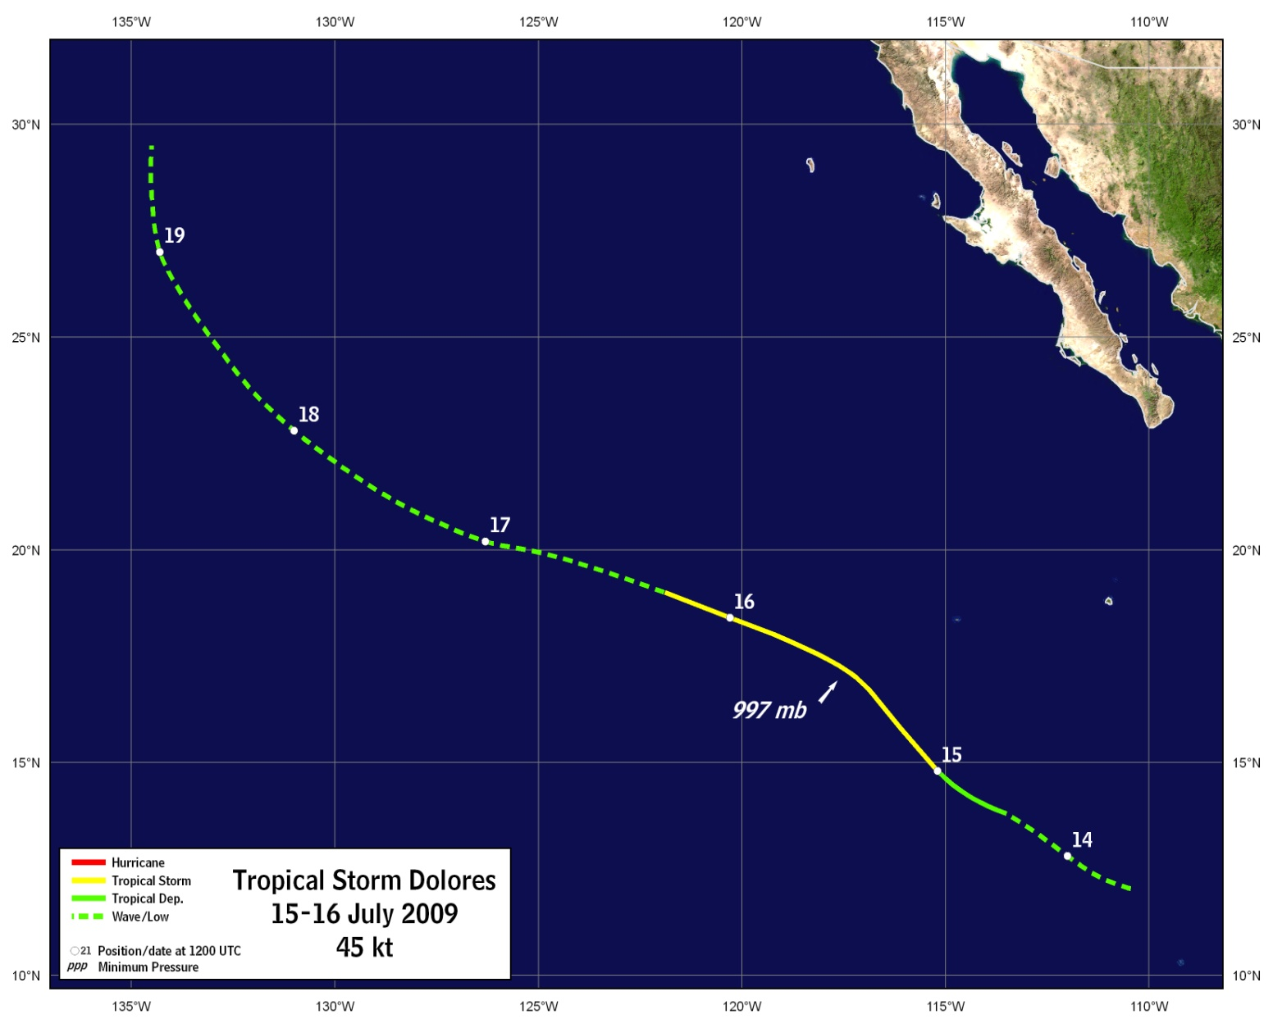
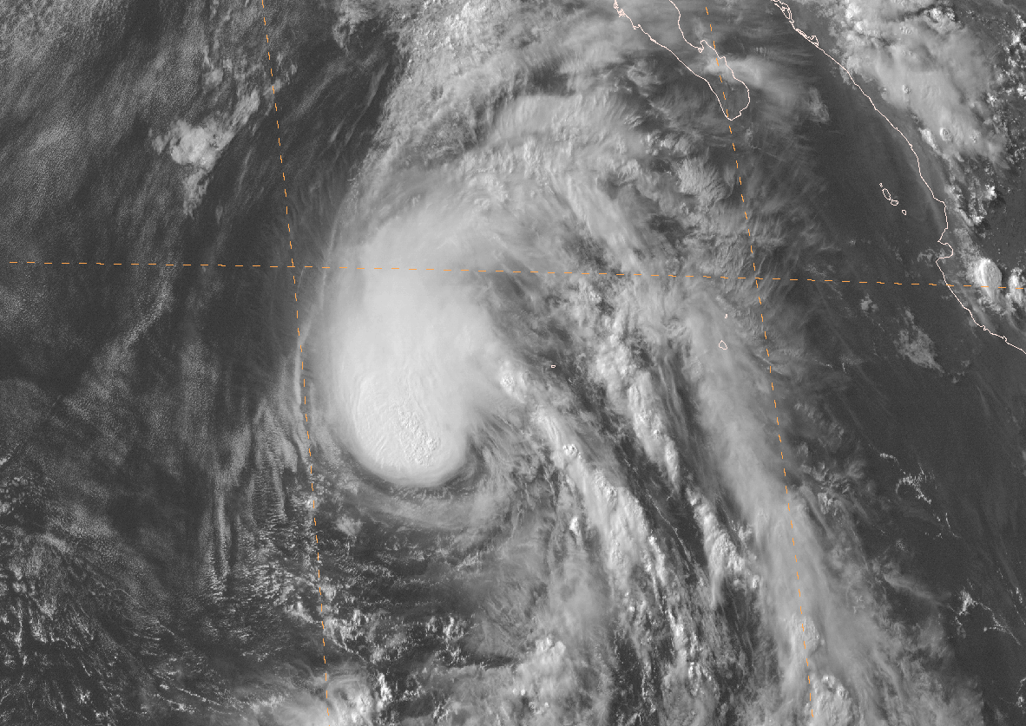
Tropical Storm Dolores
GOES-11 VIS 0000 UTC 16 July

Slide 16
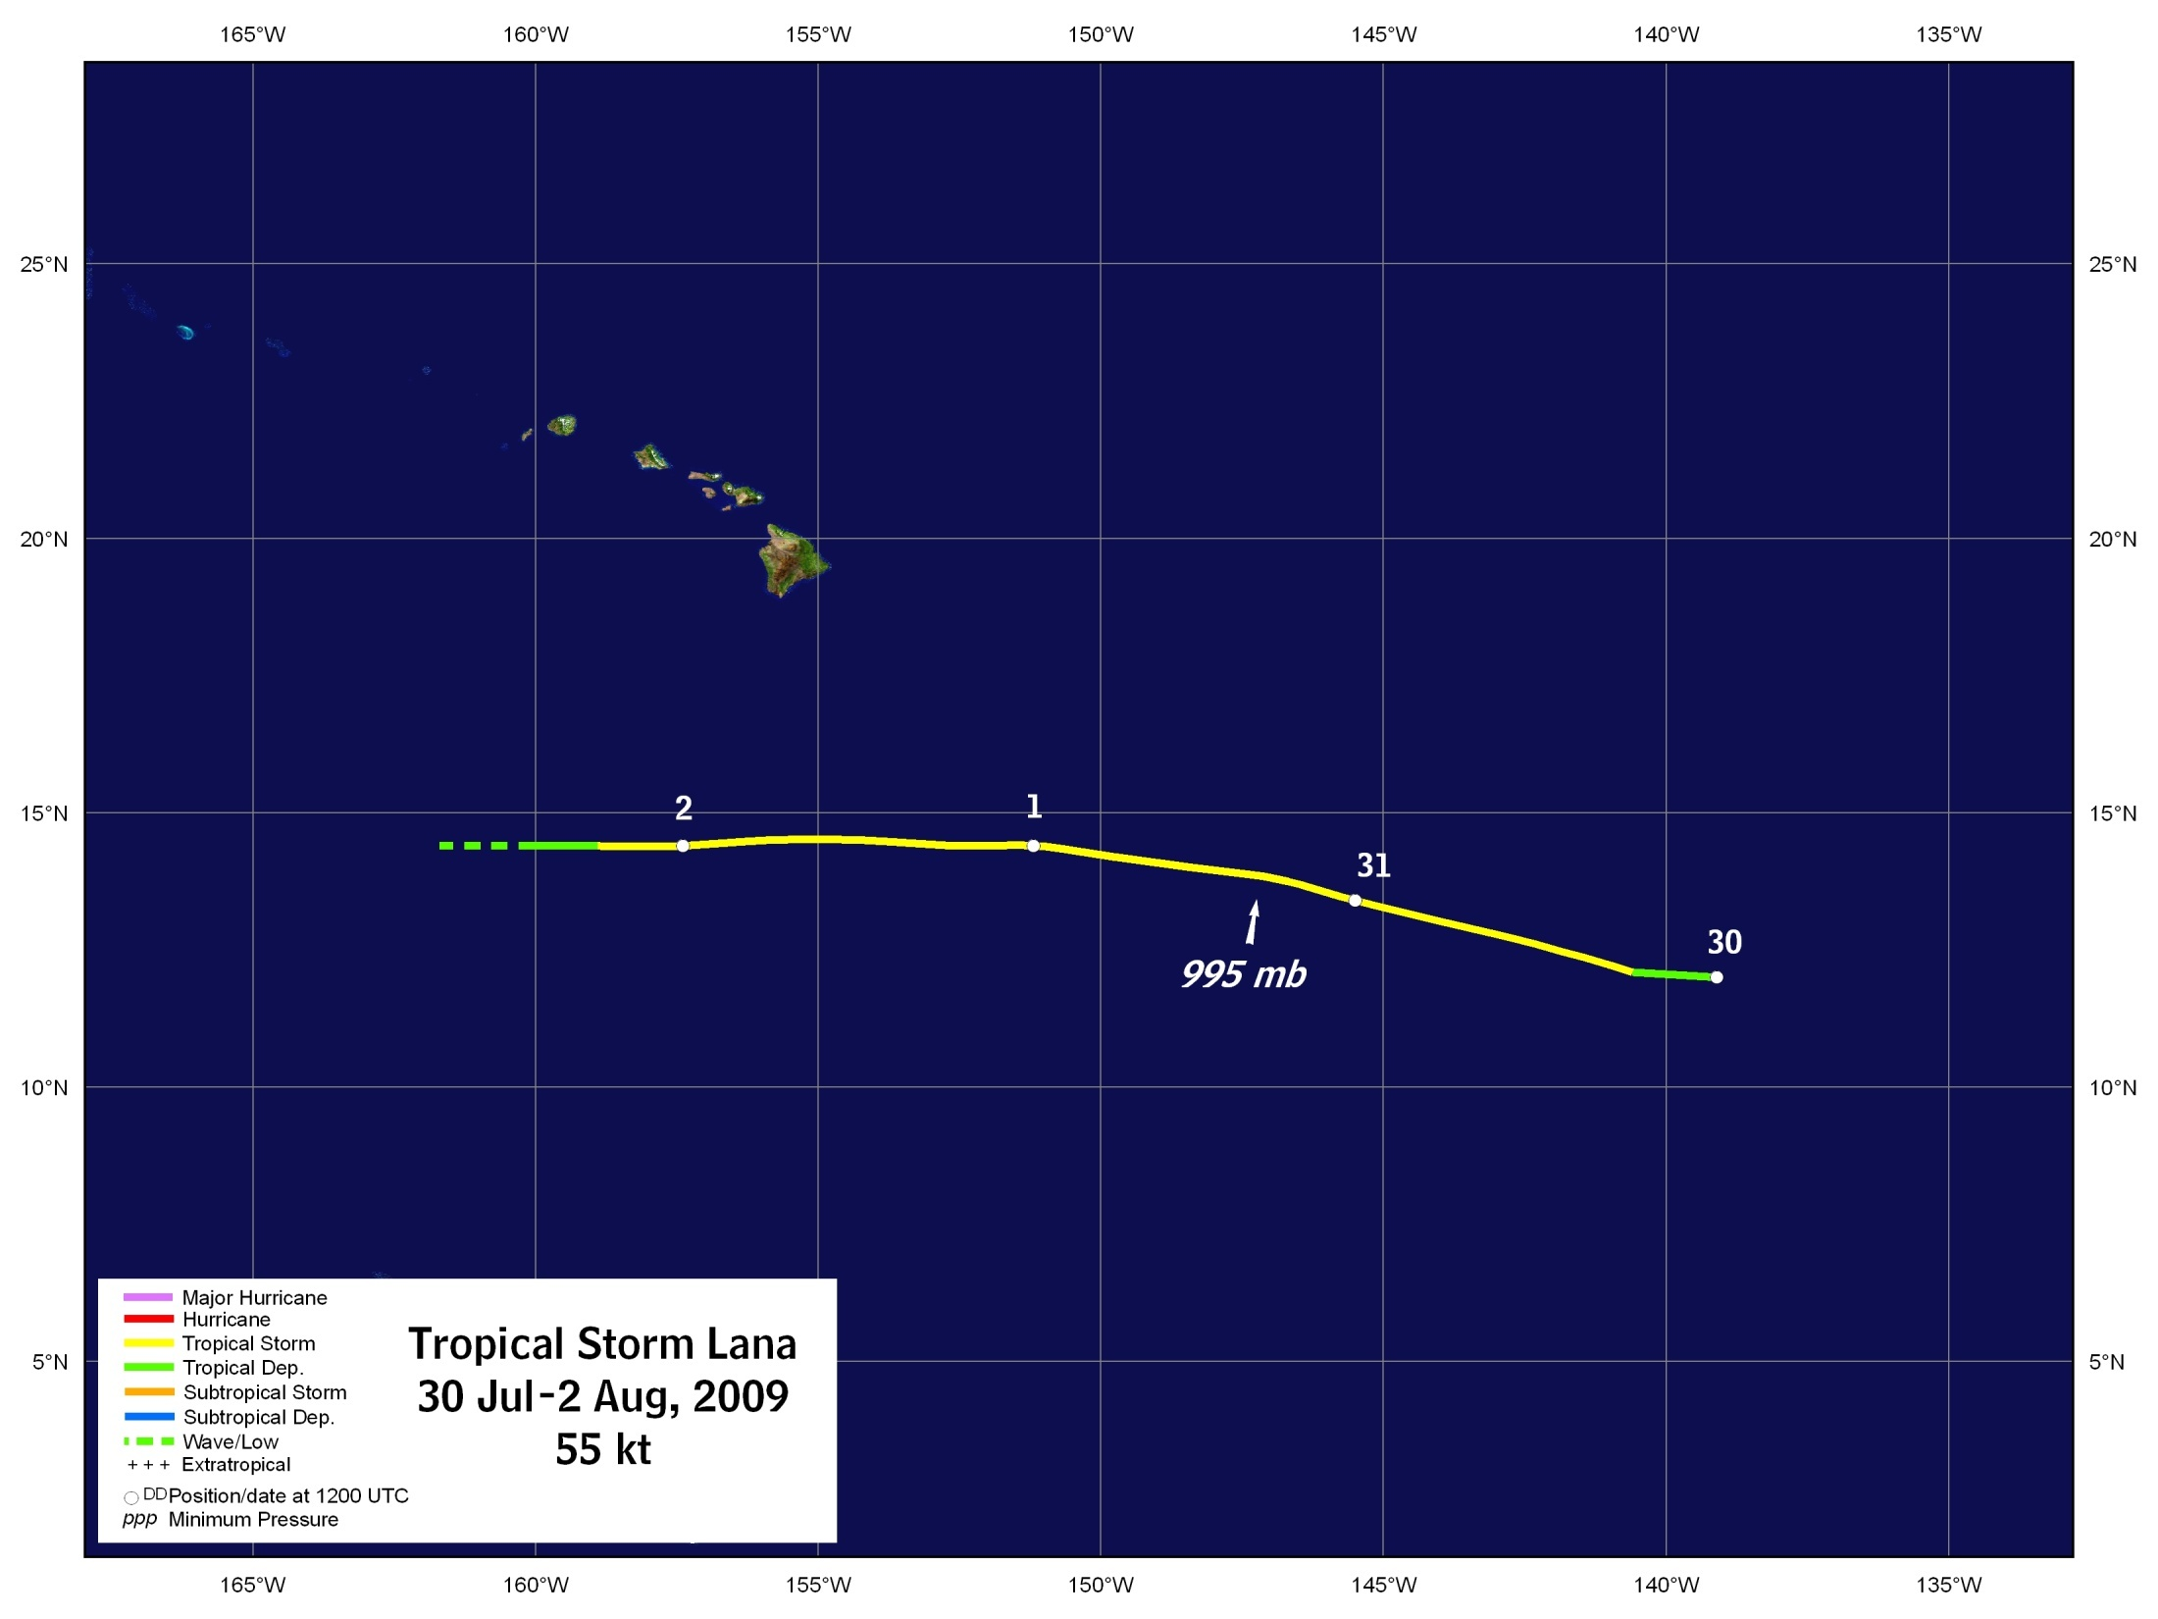
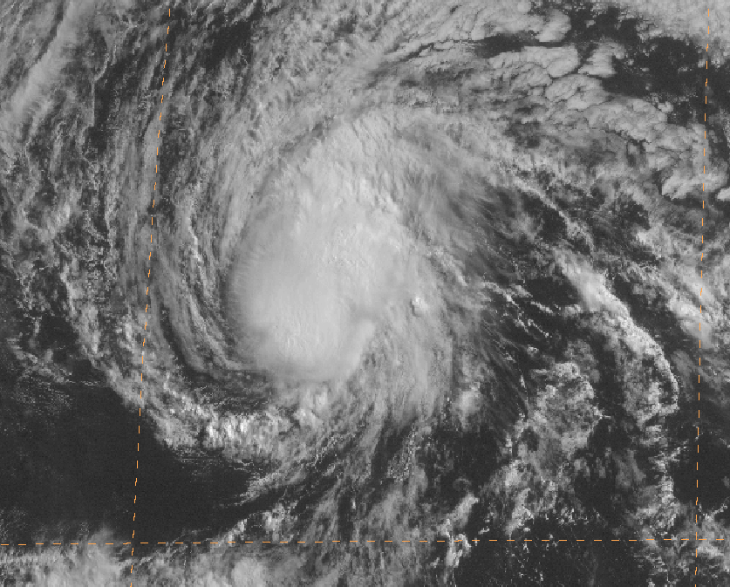
Tropical Storm Lana
GOES-11 VIS 1800 UTC 31 July
TD6-E crossed 140°W before reaching TS status and was given a name from the Central Pacific list

Slide 17
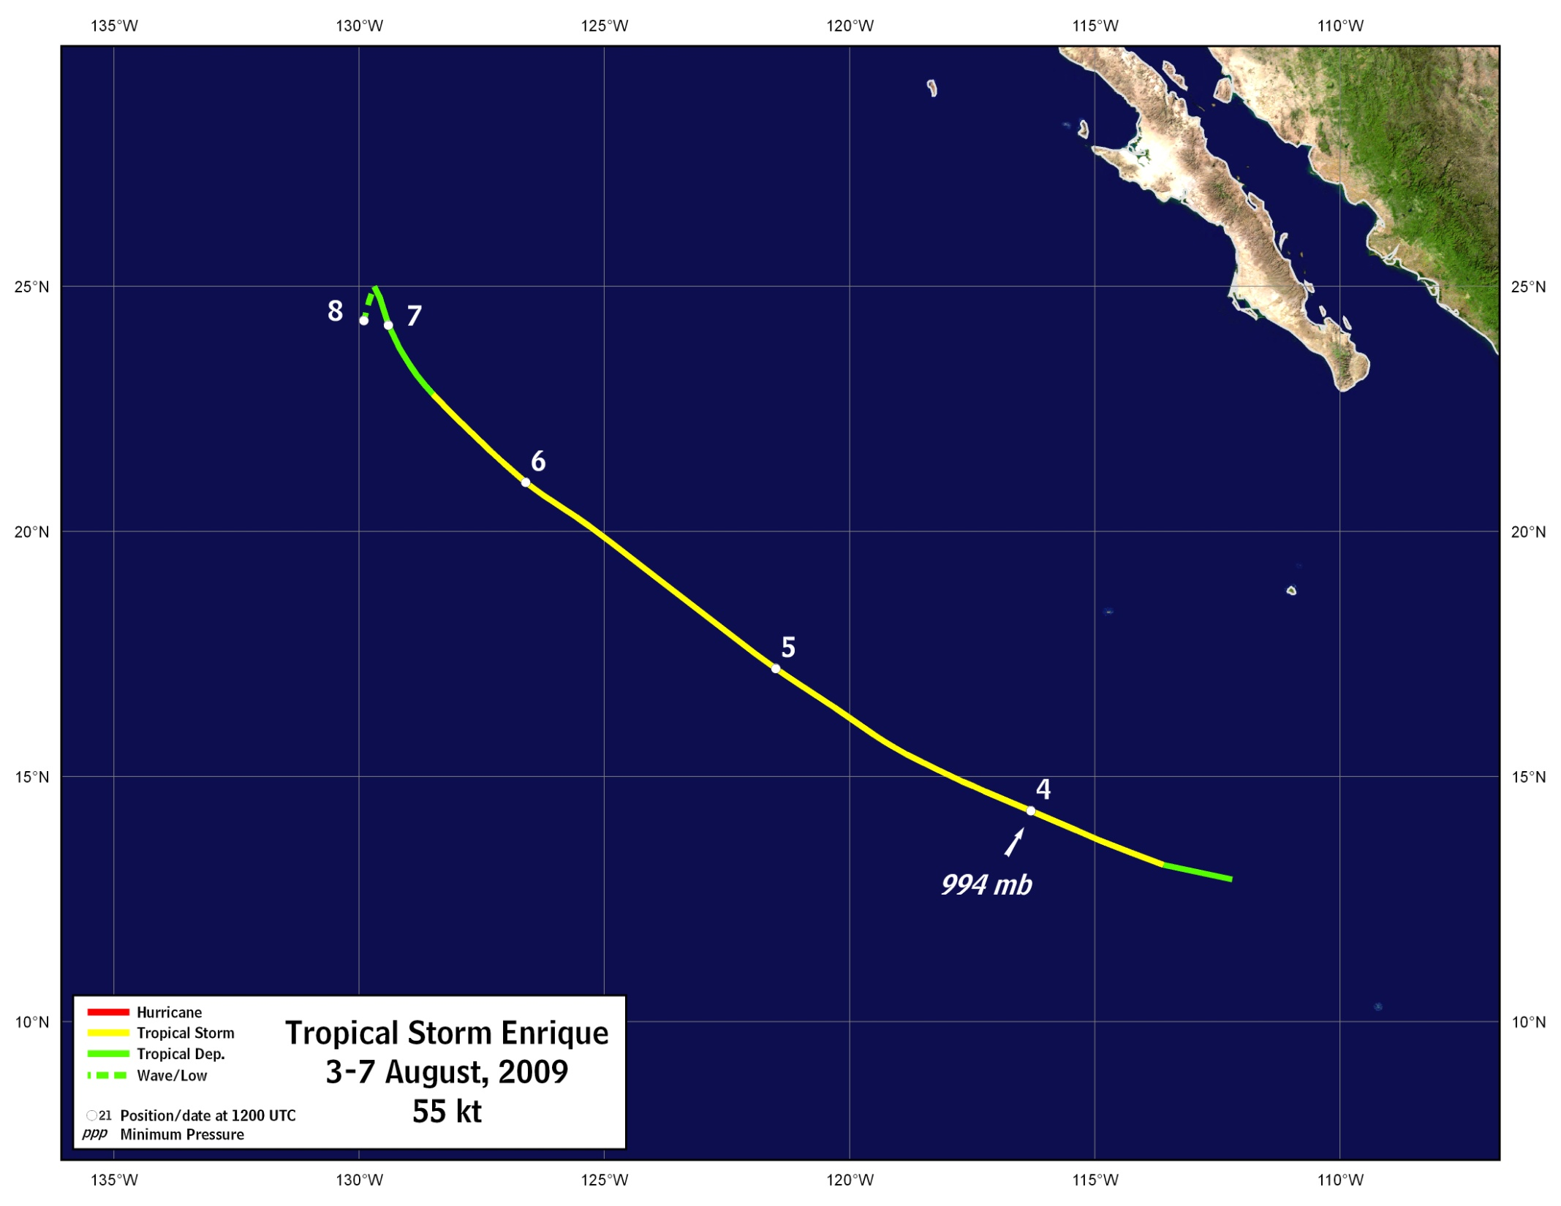
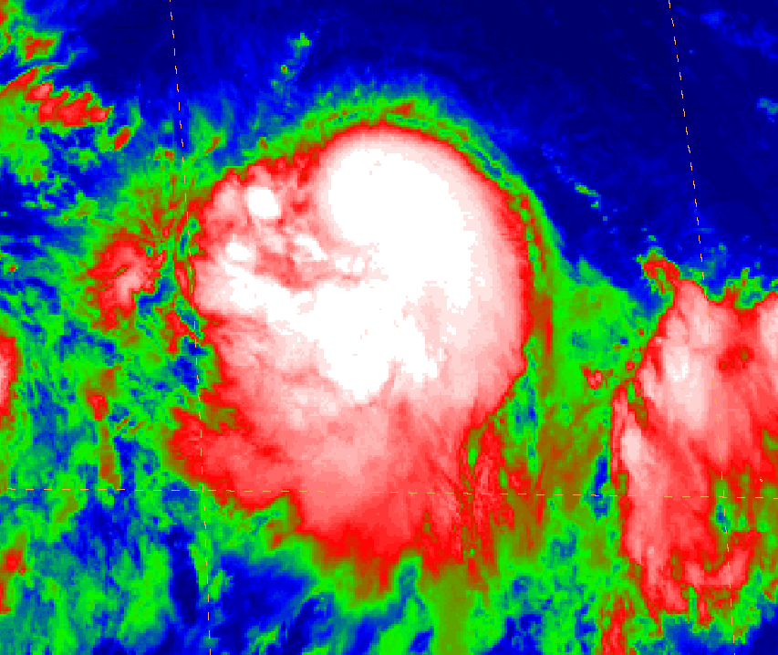
Tropical Storm Enrique
GOES-11 IR 1200 UTC 4 Aug

Slide 18
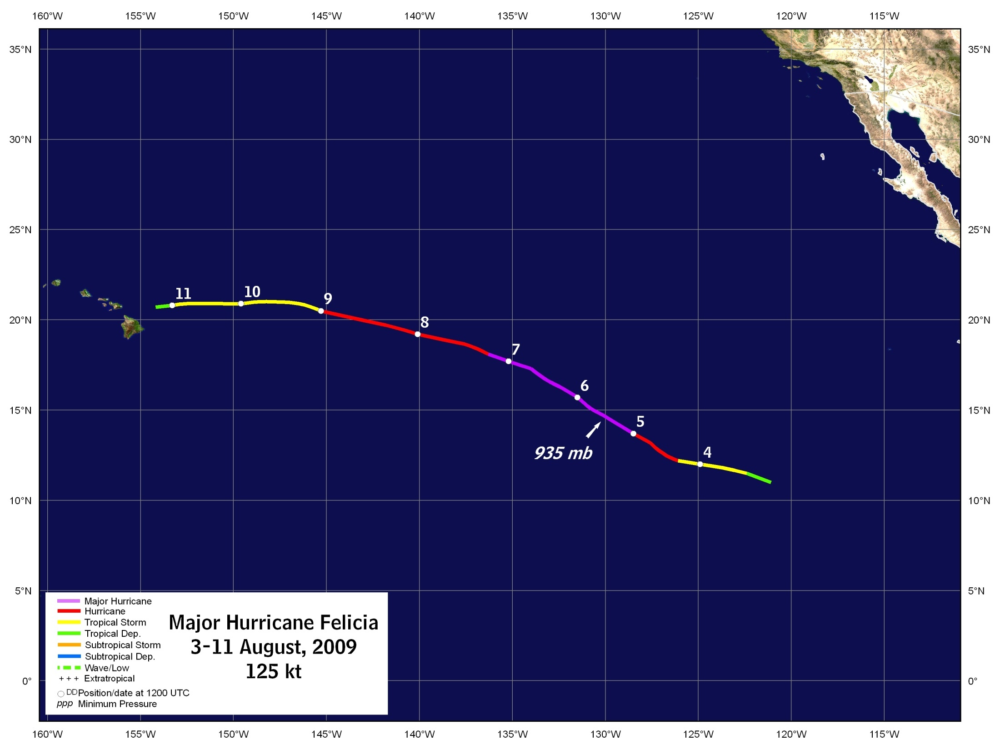
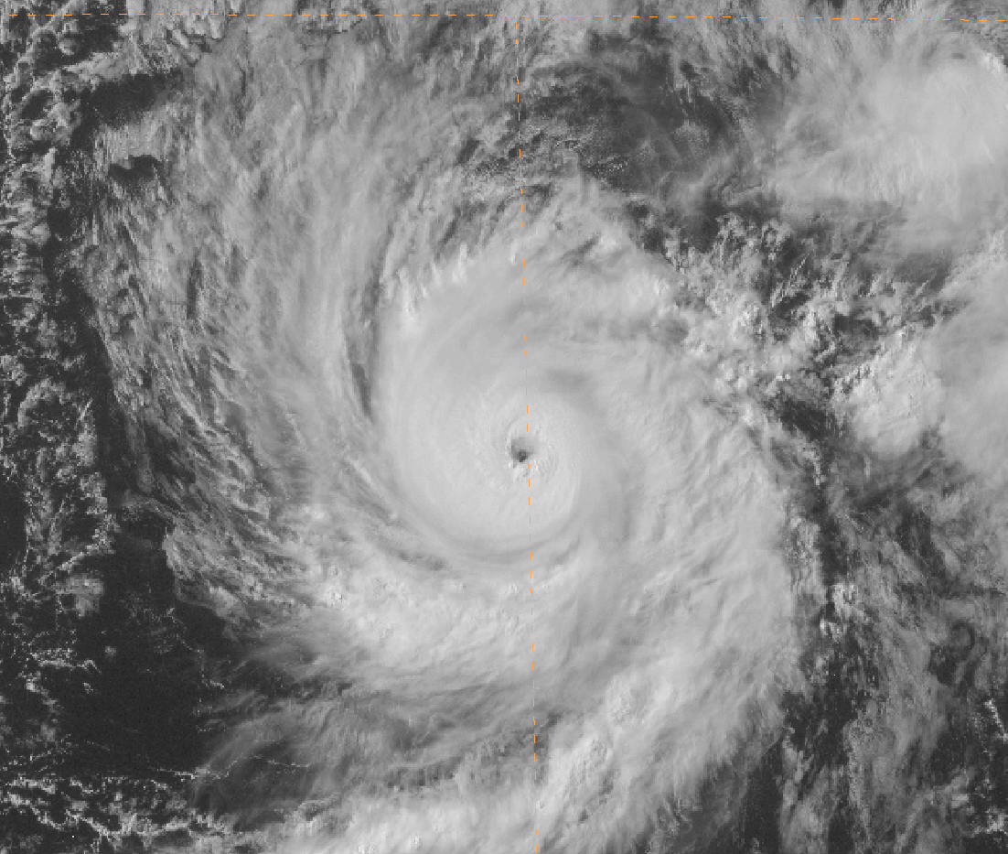

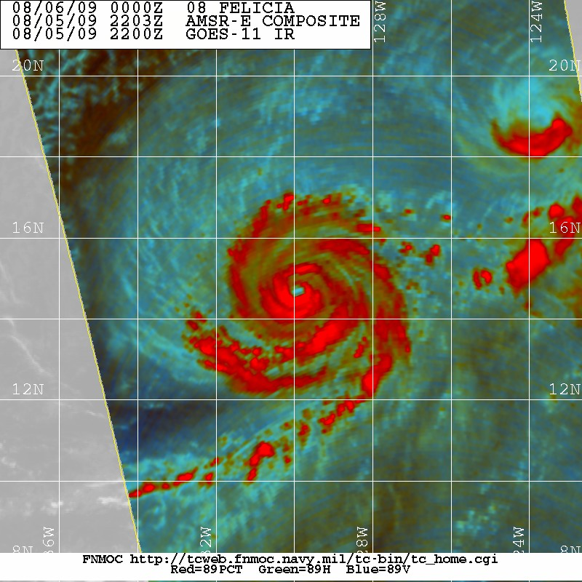
GOES-11 VIS 0000 UTC 6 Aug
AMSR-E 89GHz color composite 2203Z 5 Aug Courtesy FNMOC TC Webpage

Slide 19
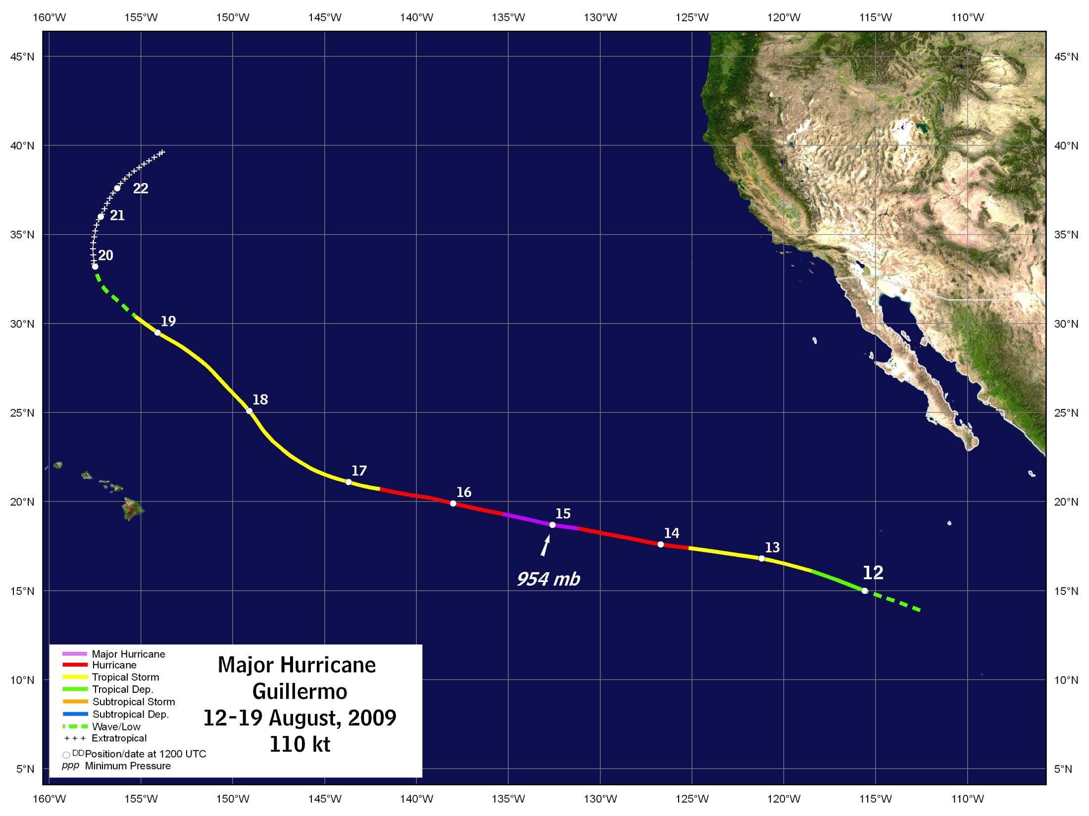
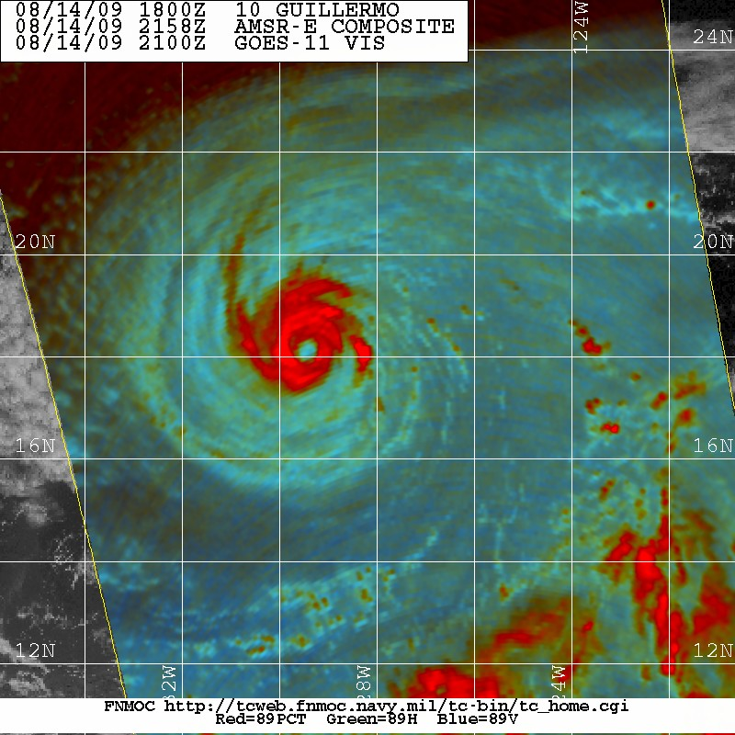
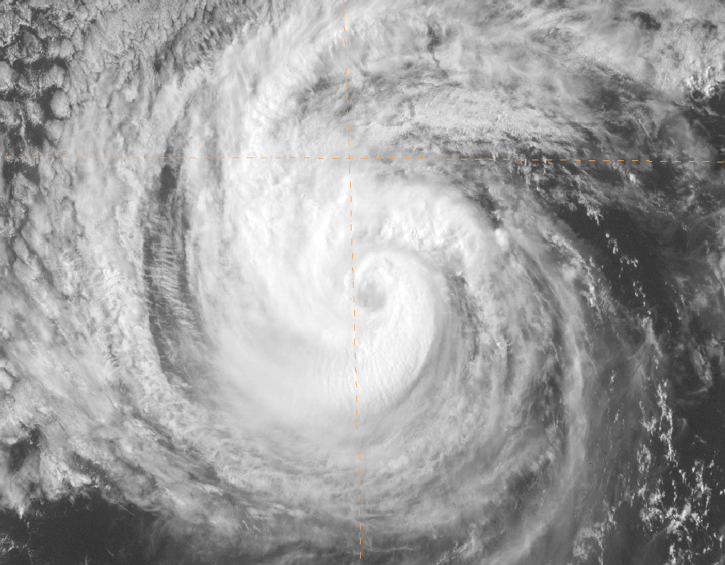
AMSR-E 89GHz color composite 2158Z 14 Aug Courtesy FNMOC TC Webpage
GOES-11 VIS 0000 UTC 15 Aug

Slide 20
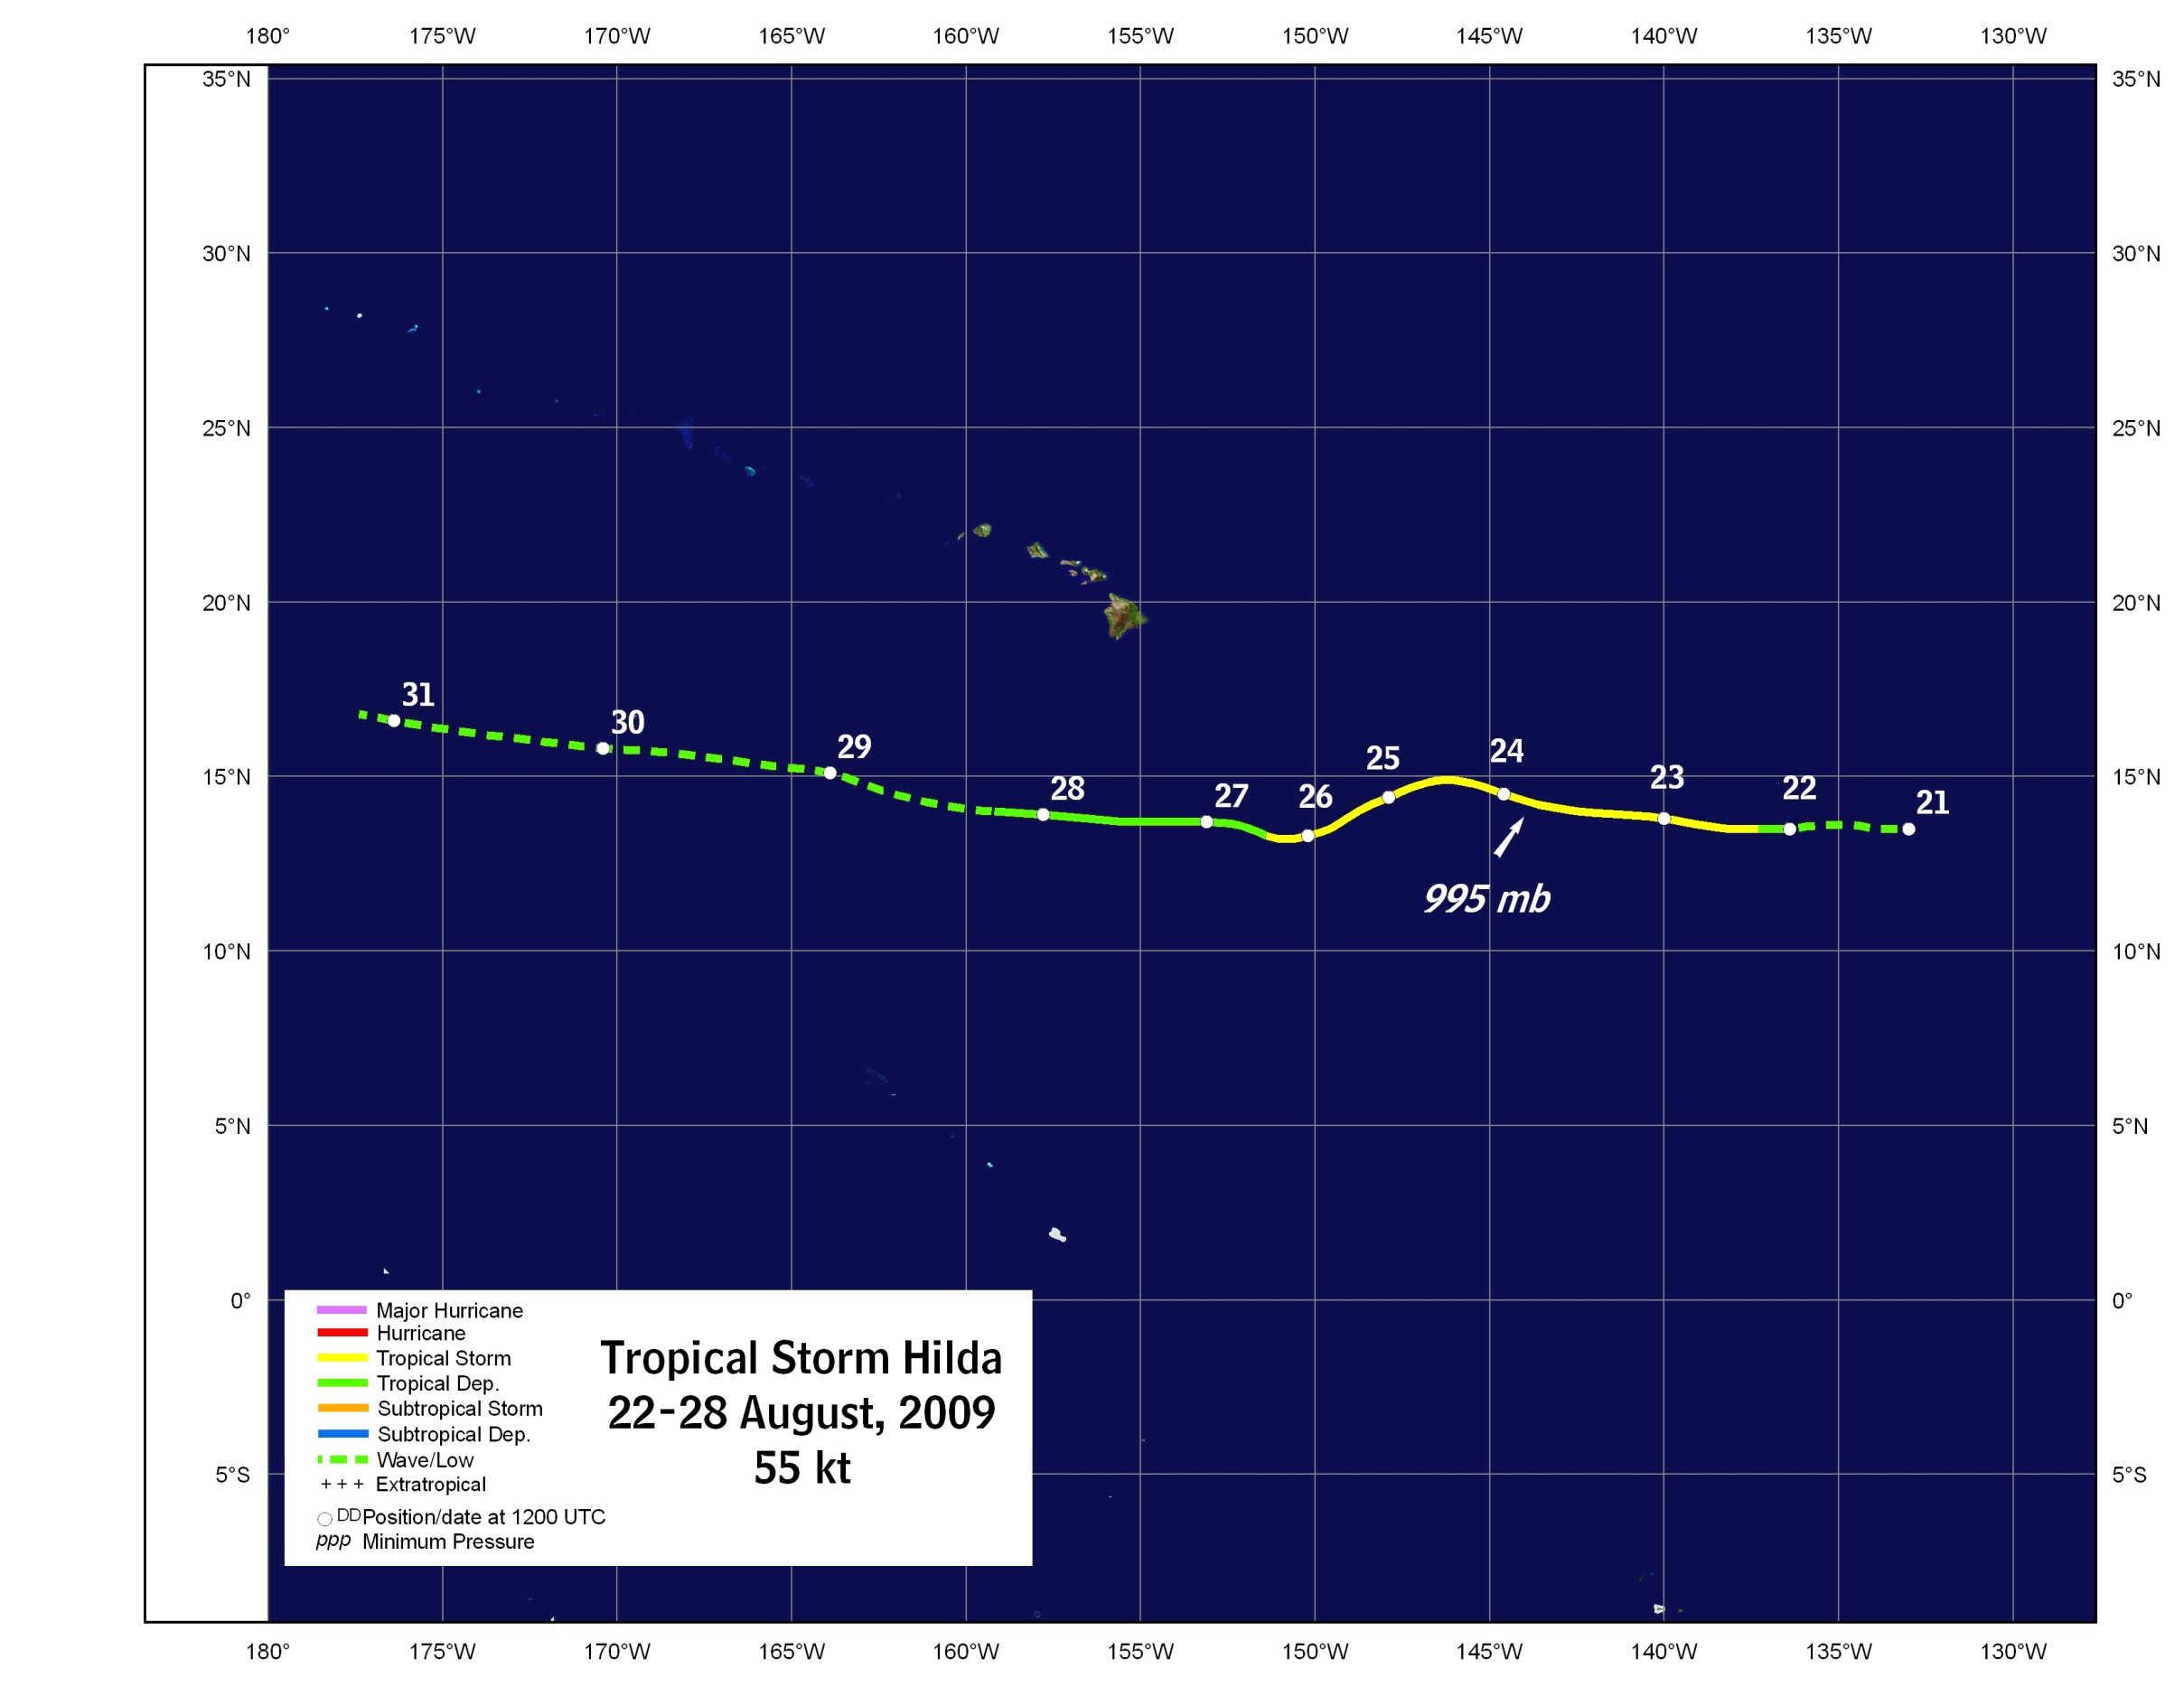
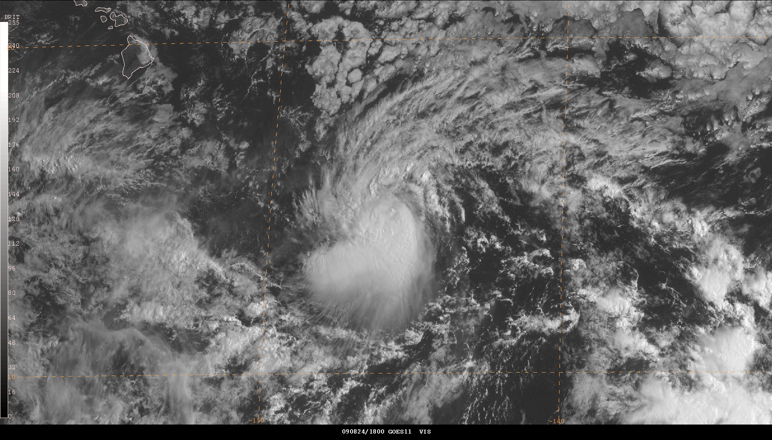
GOES-11 VIS 1800 UTC 24 Aug

Slide 21
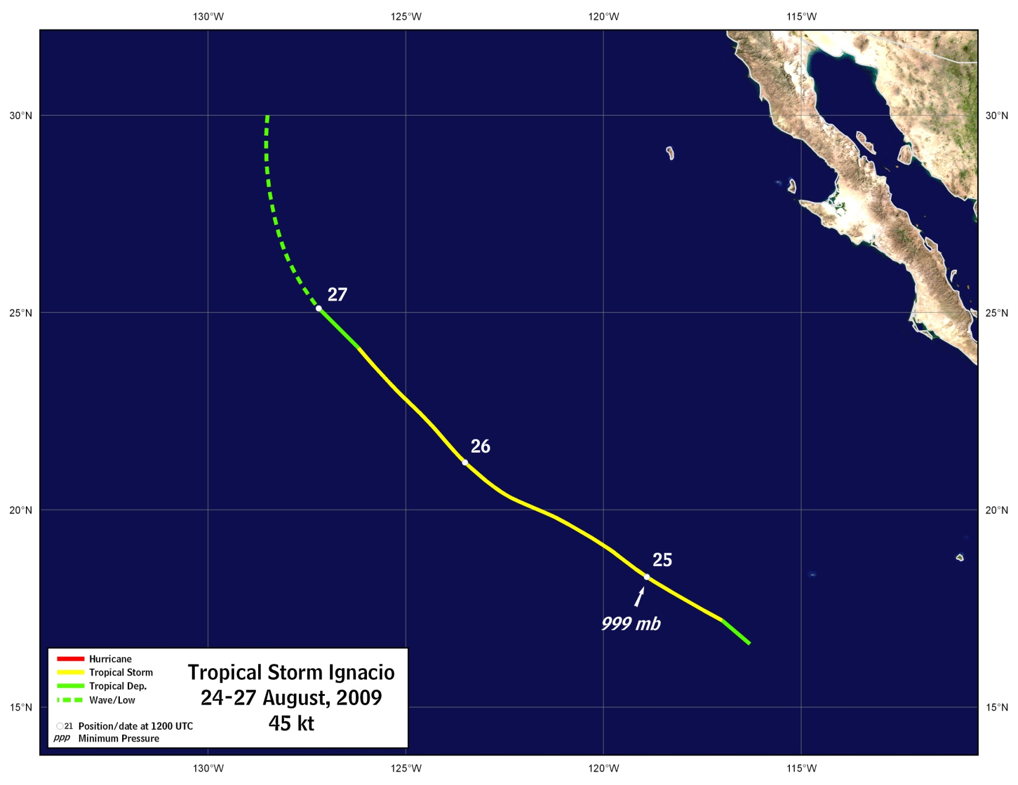
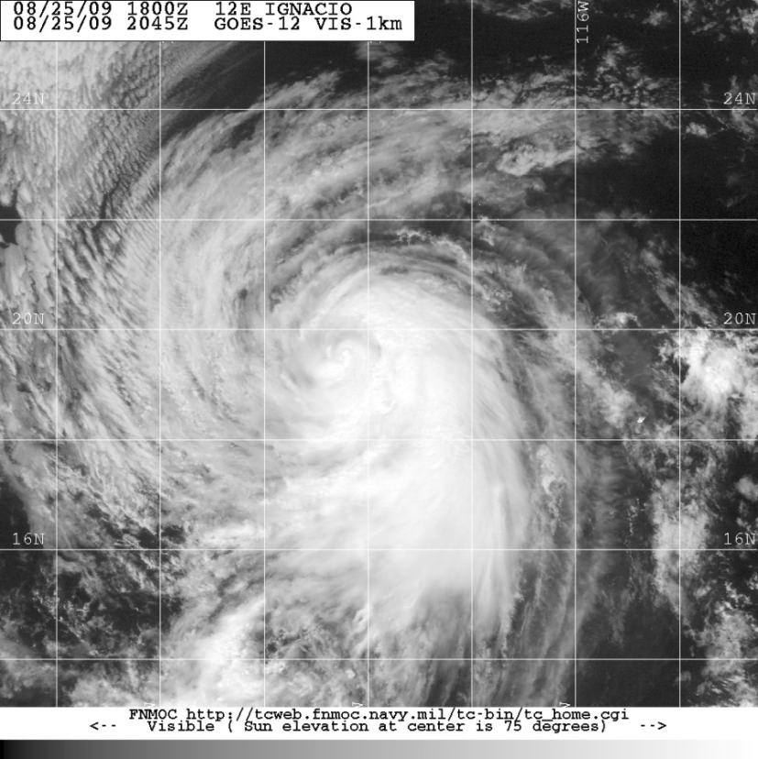
Tropical Storm Ignacio
GOES-12 VIS 2045 UTC 25 Aug 2009
Courtesy FNMOC TC Webpage

Slide 22
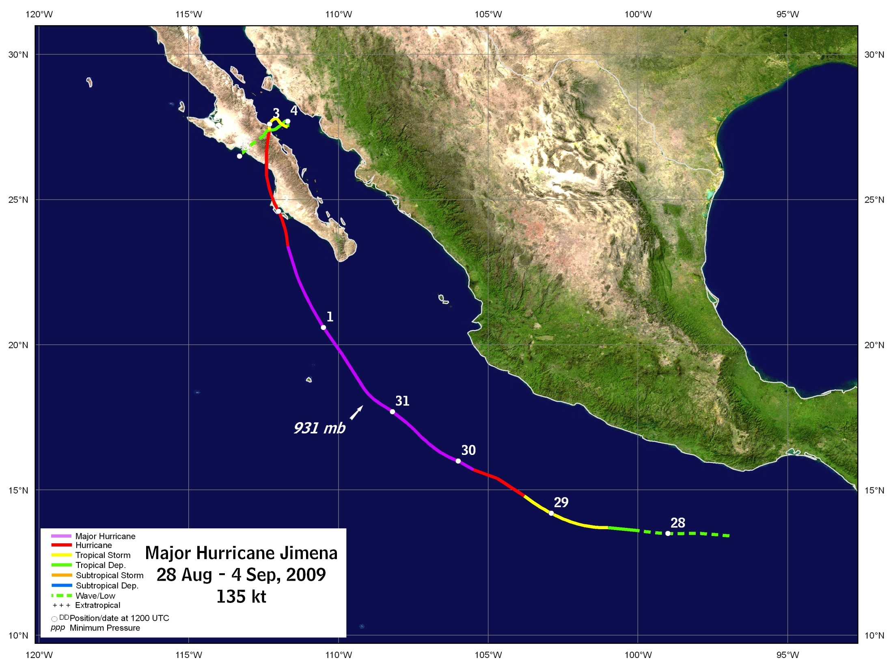
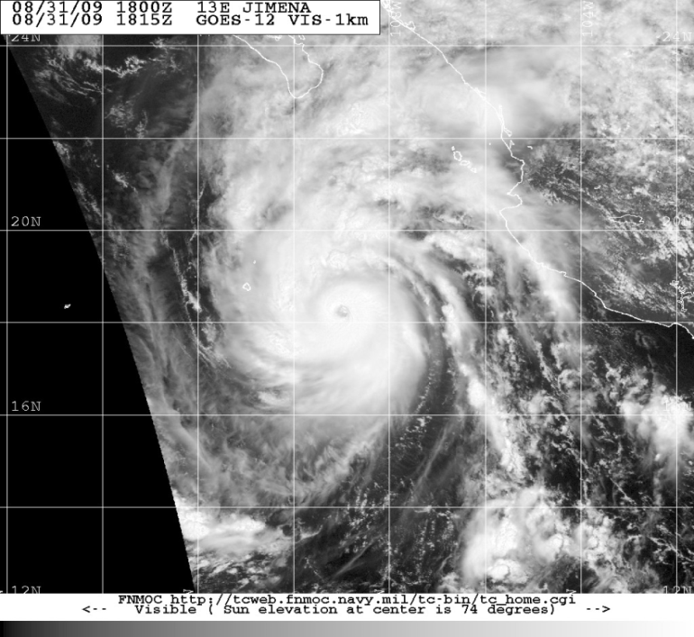
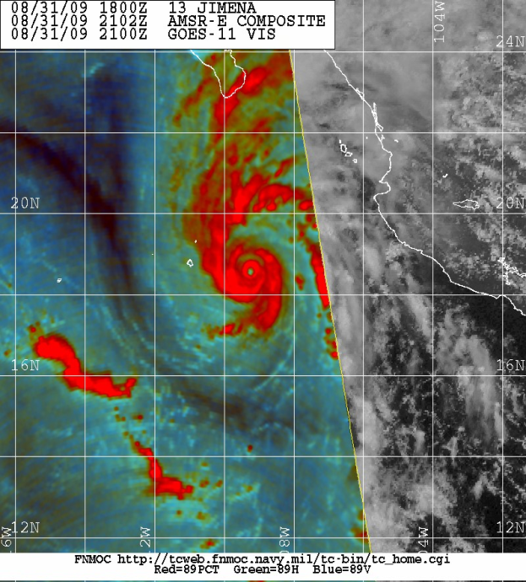


Hurricane Jimena
GOES-12 VIS 1815 UTC 31 Aug
Courtesy FNMOC TC Webpage
AMSR-E 89-GHz color composite
2102 UTC 31 Aug – Courtesy FNMOC TC Webpage

Slide 23
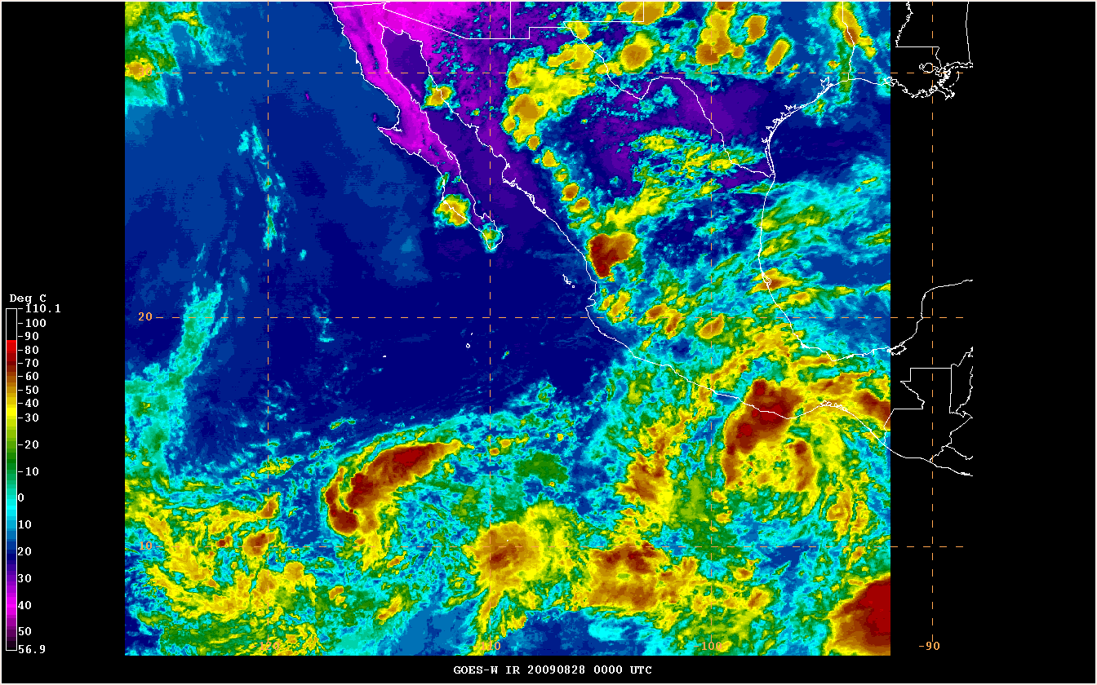
Hurricane Jimena

Slide 24
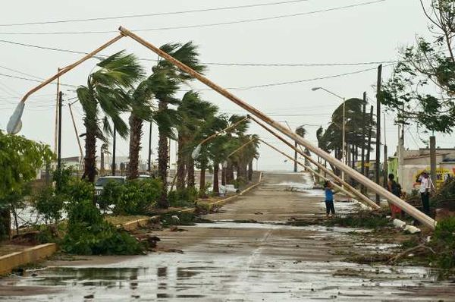
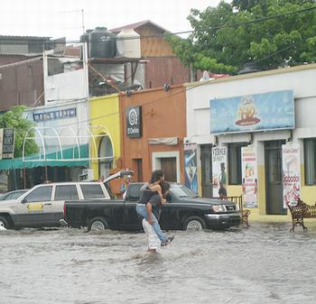
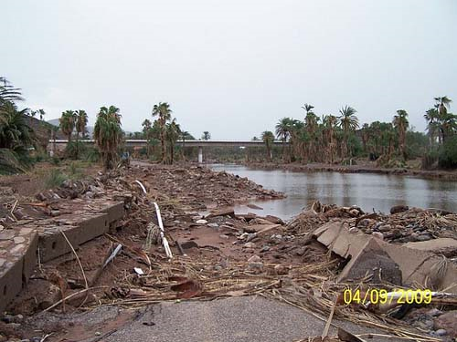
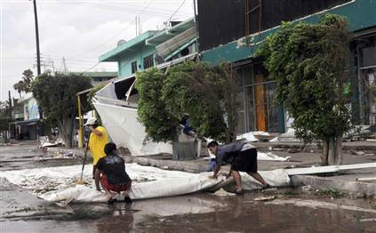
Hurricane Jimena – Impacts
Puerto San Carlos, Baja California Sur
AFP/Getty Images photo by Ronaldo Schemidt
La Paz, Baja California Sur
Photo by Nico De Schuyter
Mulege, Baja California Sur
Photo by Carlos Milton, LasEcomujeres.com
Ciudad Constitución, Baja California Sur Jorge Nuñez / EPA

Slide 25
Hurricane Jimena – Impacts
Extensive damage from wind and rain in central
Baja California, especially in Constitución and Mulege
1 fatality in Mulege –drowning due to freshwater flooding
Damage in Sonora due to freshwater flooding
in and around Guaymas
Number of buildings damaged or destroyed in the tens of thousands

Slide 26
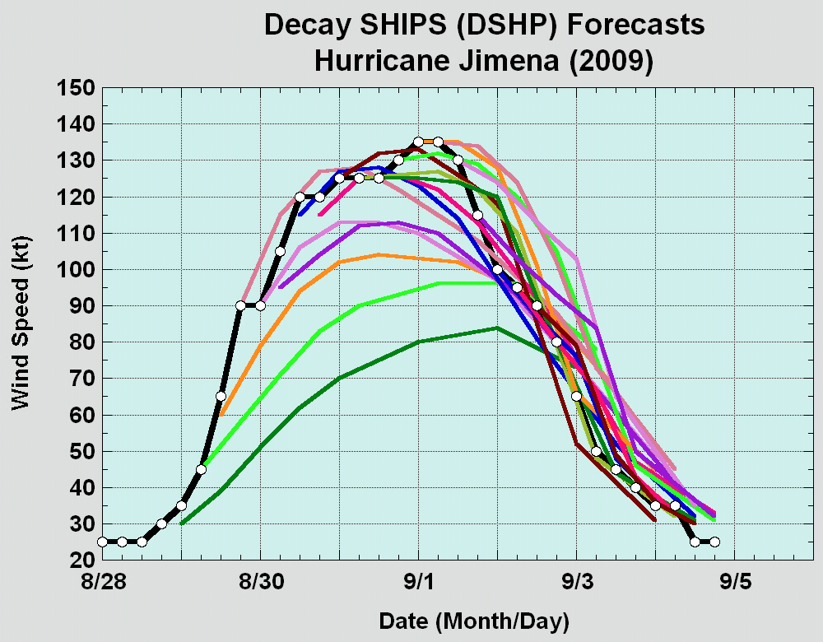
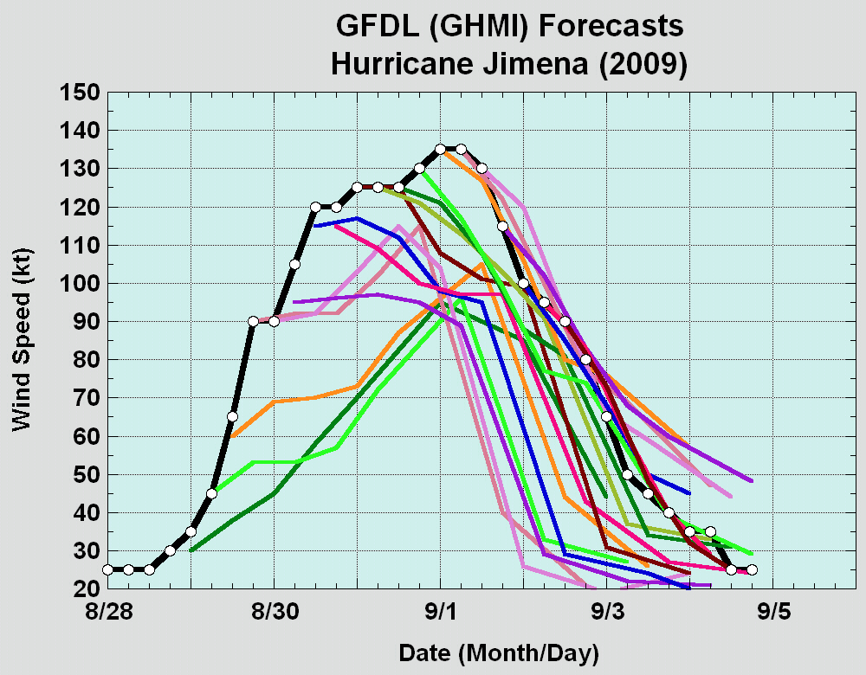
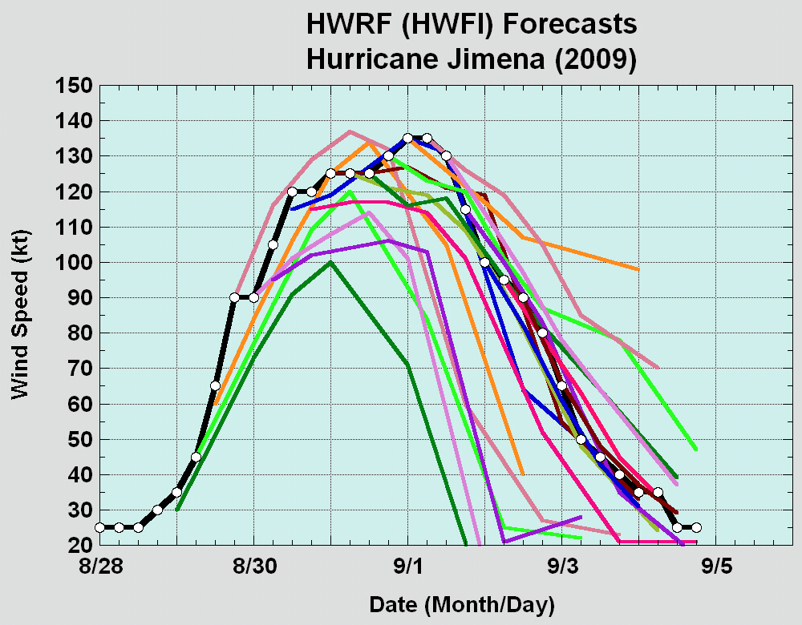
Jimena underwent rapid intensification from 45 kt → 105 kt (+60 kt) in 24-h ending 06Z 8/30
HWRF did best job of showing potential for RI
GFDL badly underforecast initial strengthening
SHIPS 30-kt RI index increased from 44% to 95% between 00Z and 12Z 29 August

Slide 27
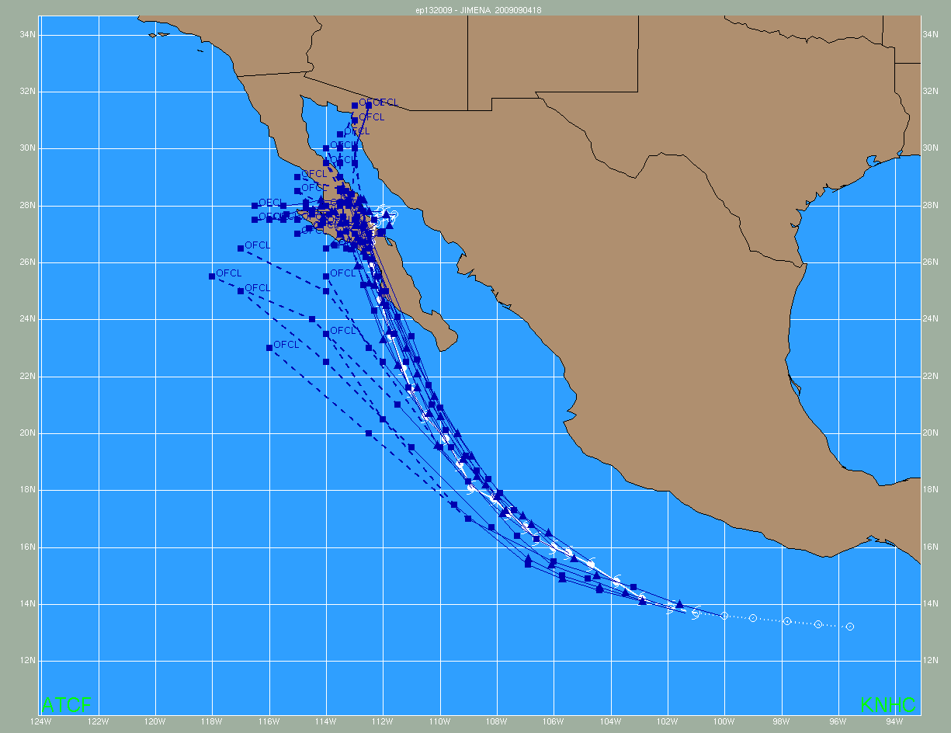
Hurricane Jimena –Forecast Issues
Track
NHC official forecasts had a persistent left of track bias early in Jimena’s life
Later forecasts were better with only a slight right of track bias
However, official forecast took Jimena’s center too far north/west from Baja where it dissipated

Slide 28
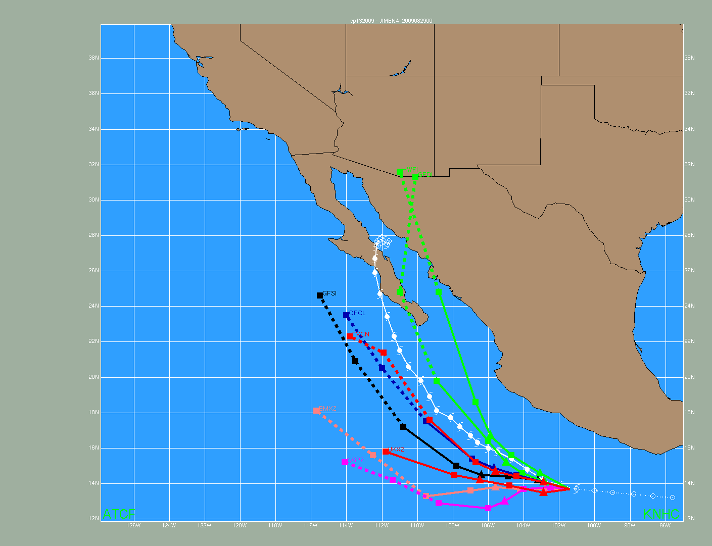
Hurricane Jimena – Track Guidance
Most global models had a significant west (left) bias early in Jimena’s life
HWRF and GFDL picked up on threat to Baja much sooner
Most guidance took Jimena too far north into Gulf California and mainland Mexico
Great example of the power of consensus

Slide 29
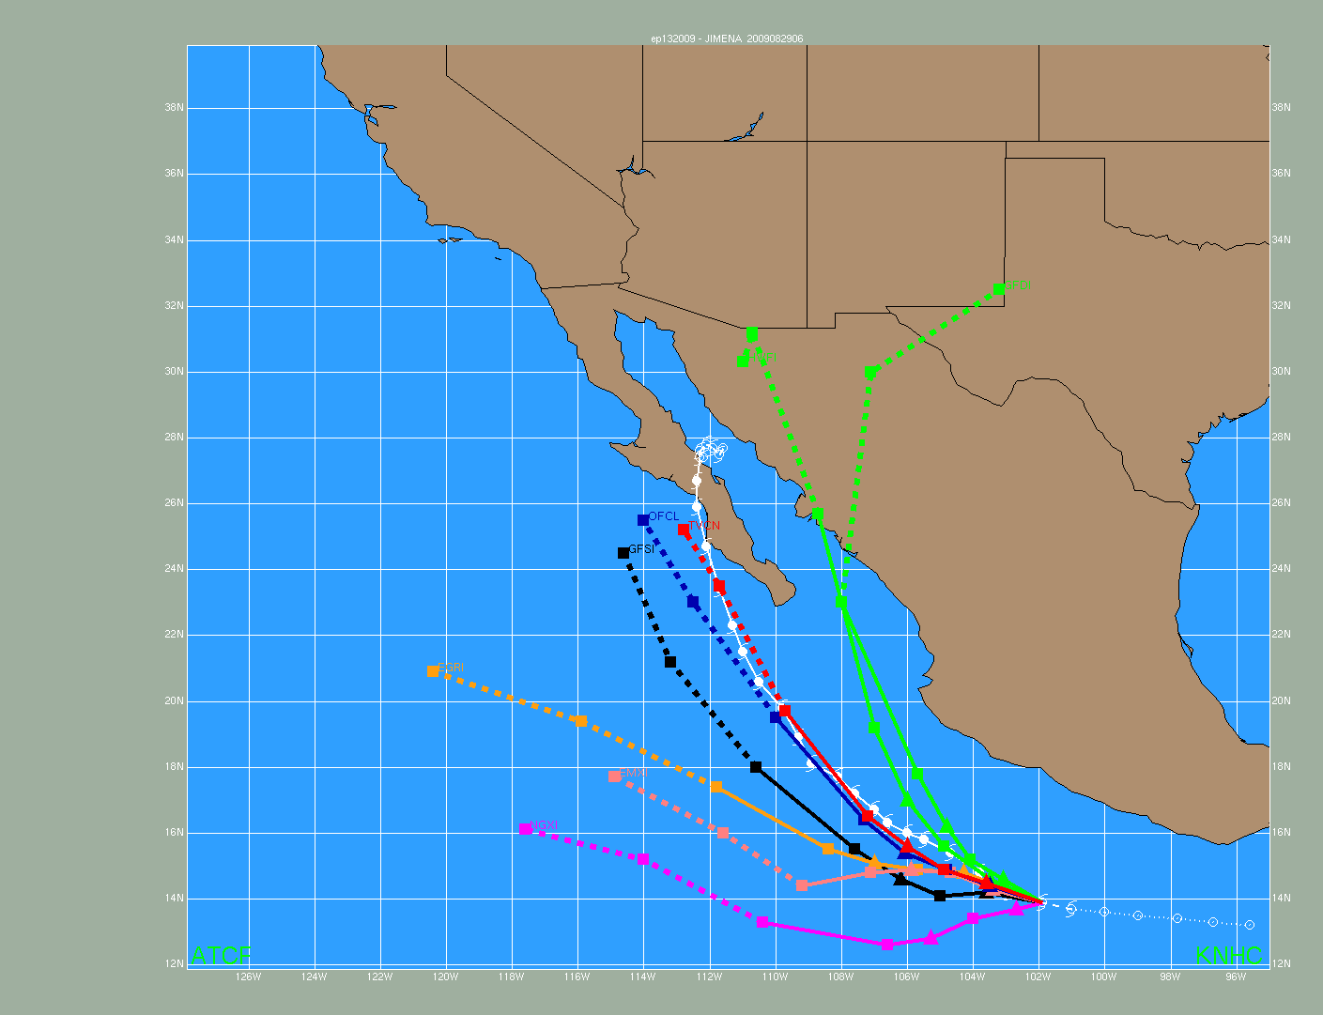
Hurricane Jimena – Track Guidance
Most global models had a significant west (left) bias early in Jimena’s life
HWRF and GFDL picked up on threat to Baja much sooner
Most guidance took Jimena too far north into Gulf California and mainland Mexico
Great example of the power of consensus
Most global models had a significant west (left) bias early in Jimena’s life
HWRF and GFDL picked up on threat to Baja much sooner
Most guidance took Jimena too far north into Gulf California and mainland Mexico
Great example of the power of consensus

Slide 30


Tropical Storm Kevin
GOES-11 IR 1200 UTC 30 Aug

Slide 31


Hurricane Linda
GOES-11 VIS 1930 UTC 9 Aug

Slide 32









Tropical Storm Marty

Slide 33


GOES-11 IR image – 0130 UTC 18 Oct
SSMIS 91-GHz color composite – 0231 UTC
18 Oct - Courtesy FNMOC TC Webpage

Slide 34

Hurricane Rick

Slide 35


Hurricane Rick – Impacts
2 deaths due to large waves
  Man swept out to sea from a
  rocky point in San José del Cabo
  Boy drowned in Cabo San Lucas
Mazatlán, Mexico AP Photos by Guillermo Arias

Slide 36

Hurricane Rick - Forecast Issues
Rapid Intensification
Rick intensified at a remarkable rate
  30 kt → 70 kt (+40 kt)
  in 24-h ending 18Z 10/16
  60 kt → 120 kt (+60 kt) in 24-h ending 12Z 10/17
  90 kt → 155 (+65 kt) kt in 24-h ending 06Z 10/18
First round of RI (intensification to Cat 1 hurricane) was relatively well anticipated in official NHC forecasts
Second more extreme instance of RI was not well forecast
Rapid weakening after peak intensity was not forecast well either

Slide 37



HWRF and SHIPS showed some signal for first period of RI but badly under-forecast later intensification to cat 4/5
GFDL suffered from low bias throughout Rick’s life cycle
SHIPS RI Index (30-kt threshold):
  18Z 10/15: 59%
  12Z 10/16: 74%
  06Z 10/17: 60%

Slide 38

Hurricane Rick - Forecast Issues
Track
Threat to southern Baja
that did not materialize
Official NHC forecasts were
biased left of track and slow,
particularly early on

Slide 39

Hurricane Rick – Track Guidance
Most guidance was biased left of track (west/north) through much of Rick’s life cycle
Rick’s recurvature was much sharper than most models indicated

Slide 40


Notable Forecast Issues – Rapid Weakening
Rapid Weakening
  Jimena: 130 kt → 90 kt
  (-40 kt) in 24 h ending 12Z 9/2
  Rick: 130 kt → 65 kt
  (-65 kt) in 24 h ending 06Z 10/20
  Both systems weakened very quickly from peak intensity
Official forecasts and intensity guidance captured this weakening much better for Jimena than for Rick

Slide 41
Acknowledgements
Ethan Gibney of IMSG/NCDC provided the seasonal track map
Hurricane Specialists Unit

