Slide 1
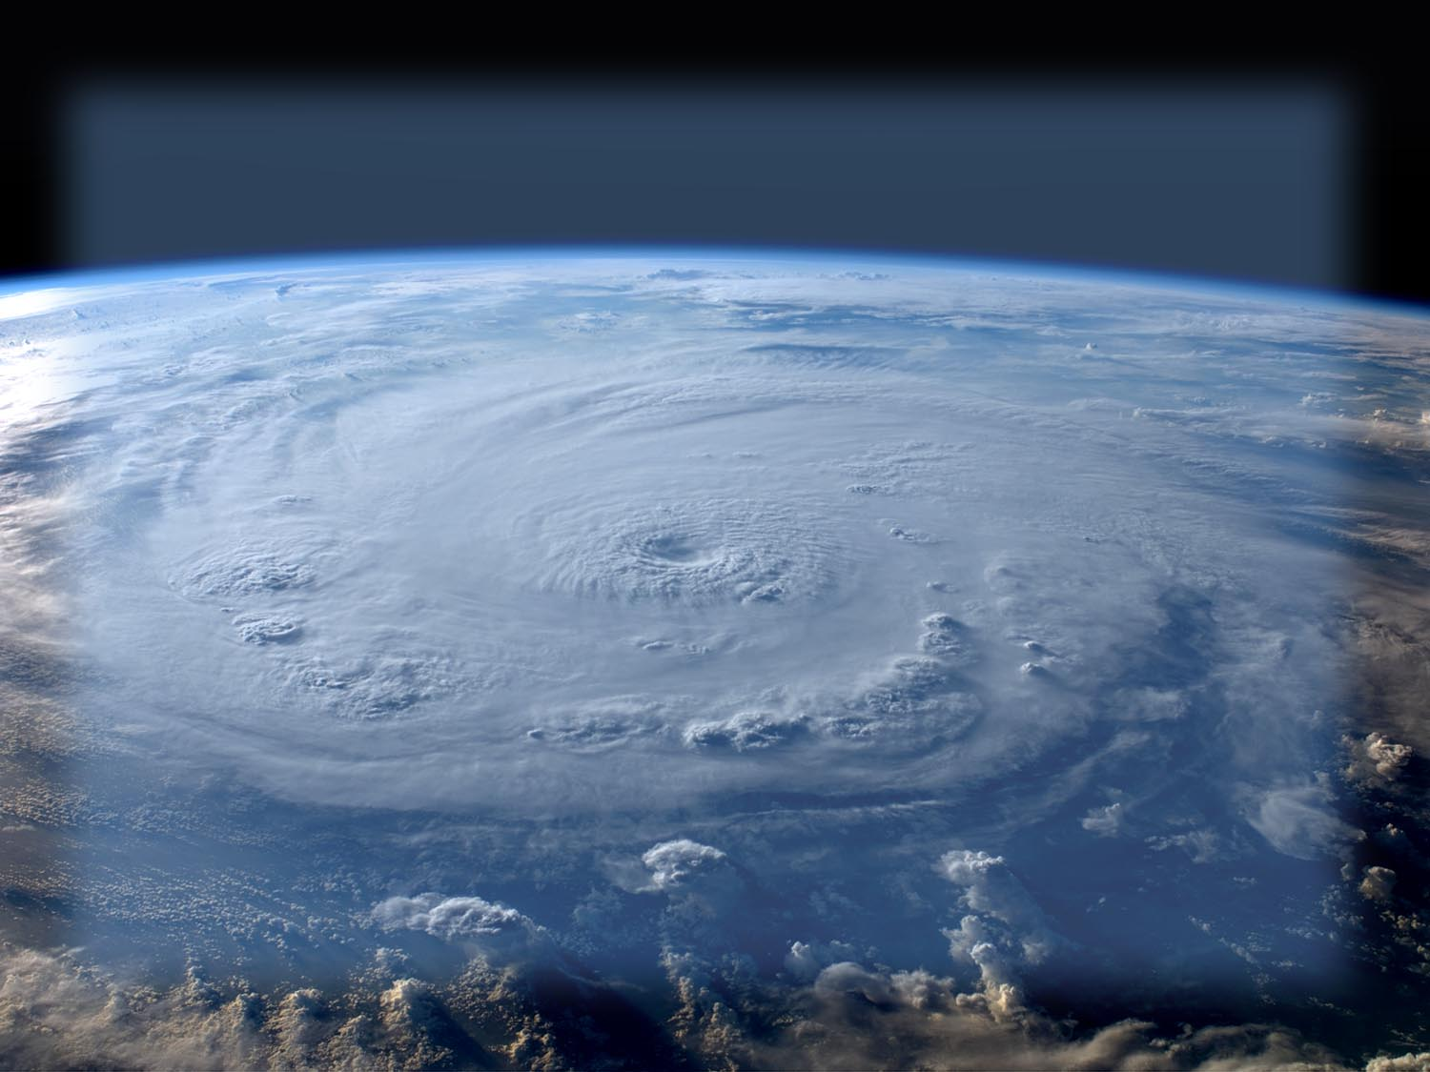

The Quietest Year in More Than a Decade: An Overview of the 2009 Atlantic Hurricane Season
Robbie Berg and Lixion Avila
National Hurricane Center
2010 Interdepartmental Hurricane Conference
Savannah, Georgia
1 March 2010

Slide 2
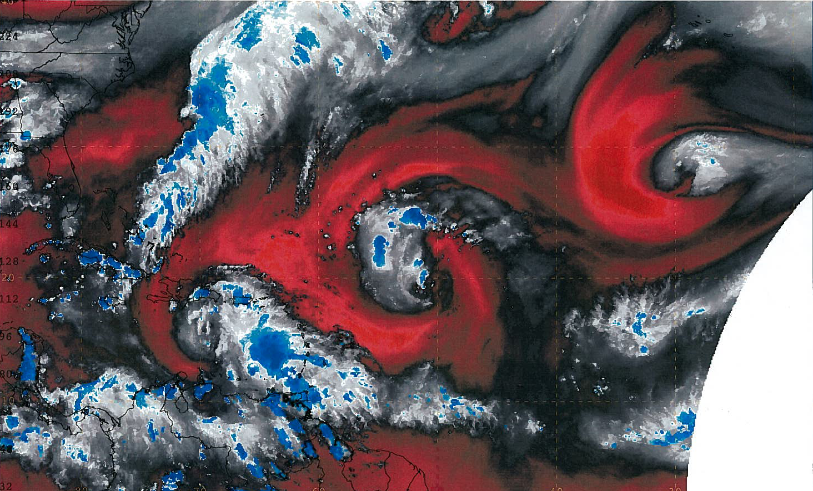
The Cyclones of 2009
L
L
L

Slide 3
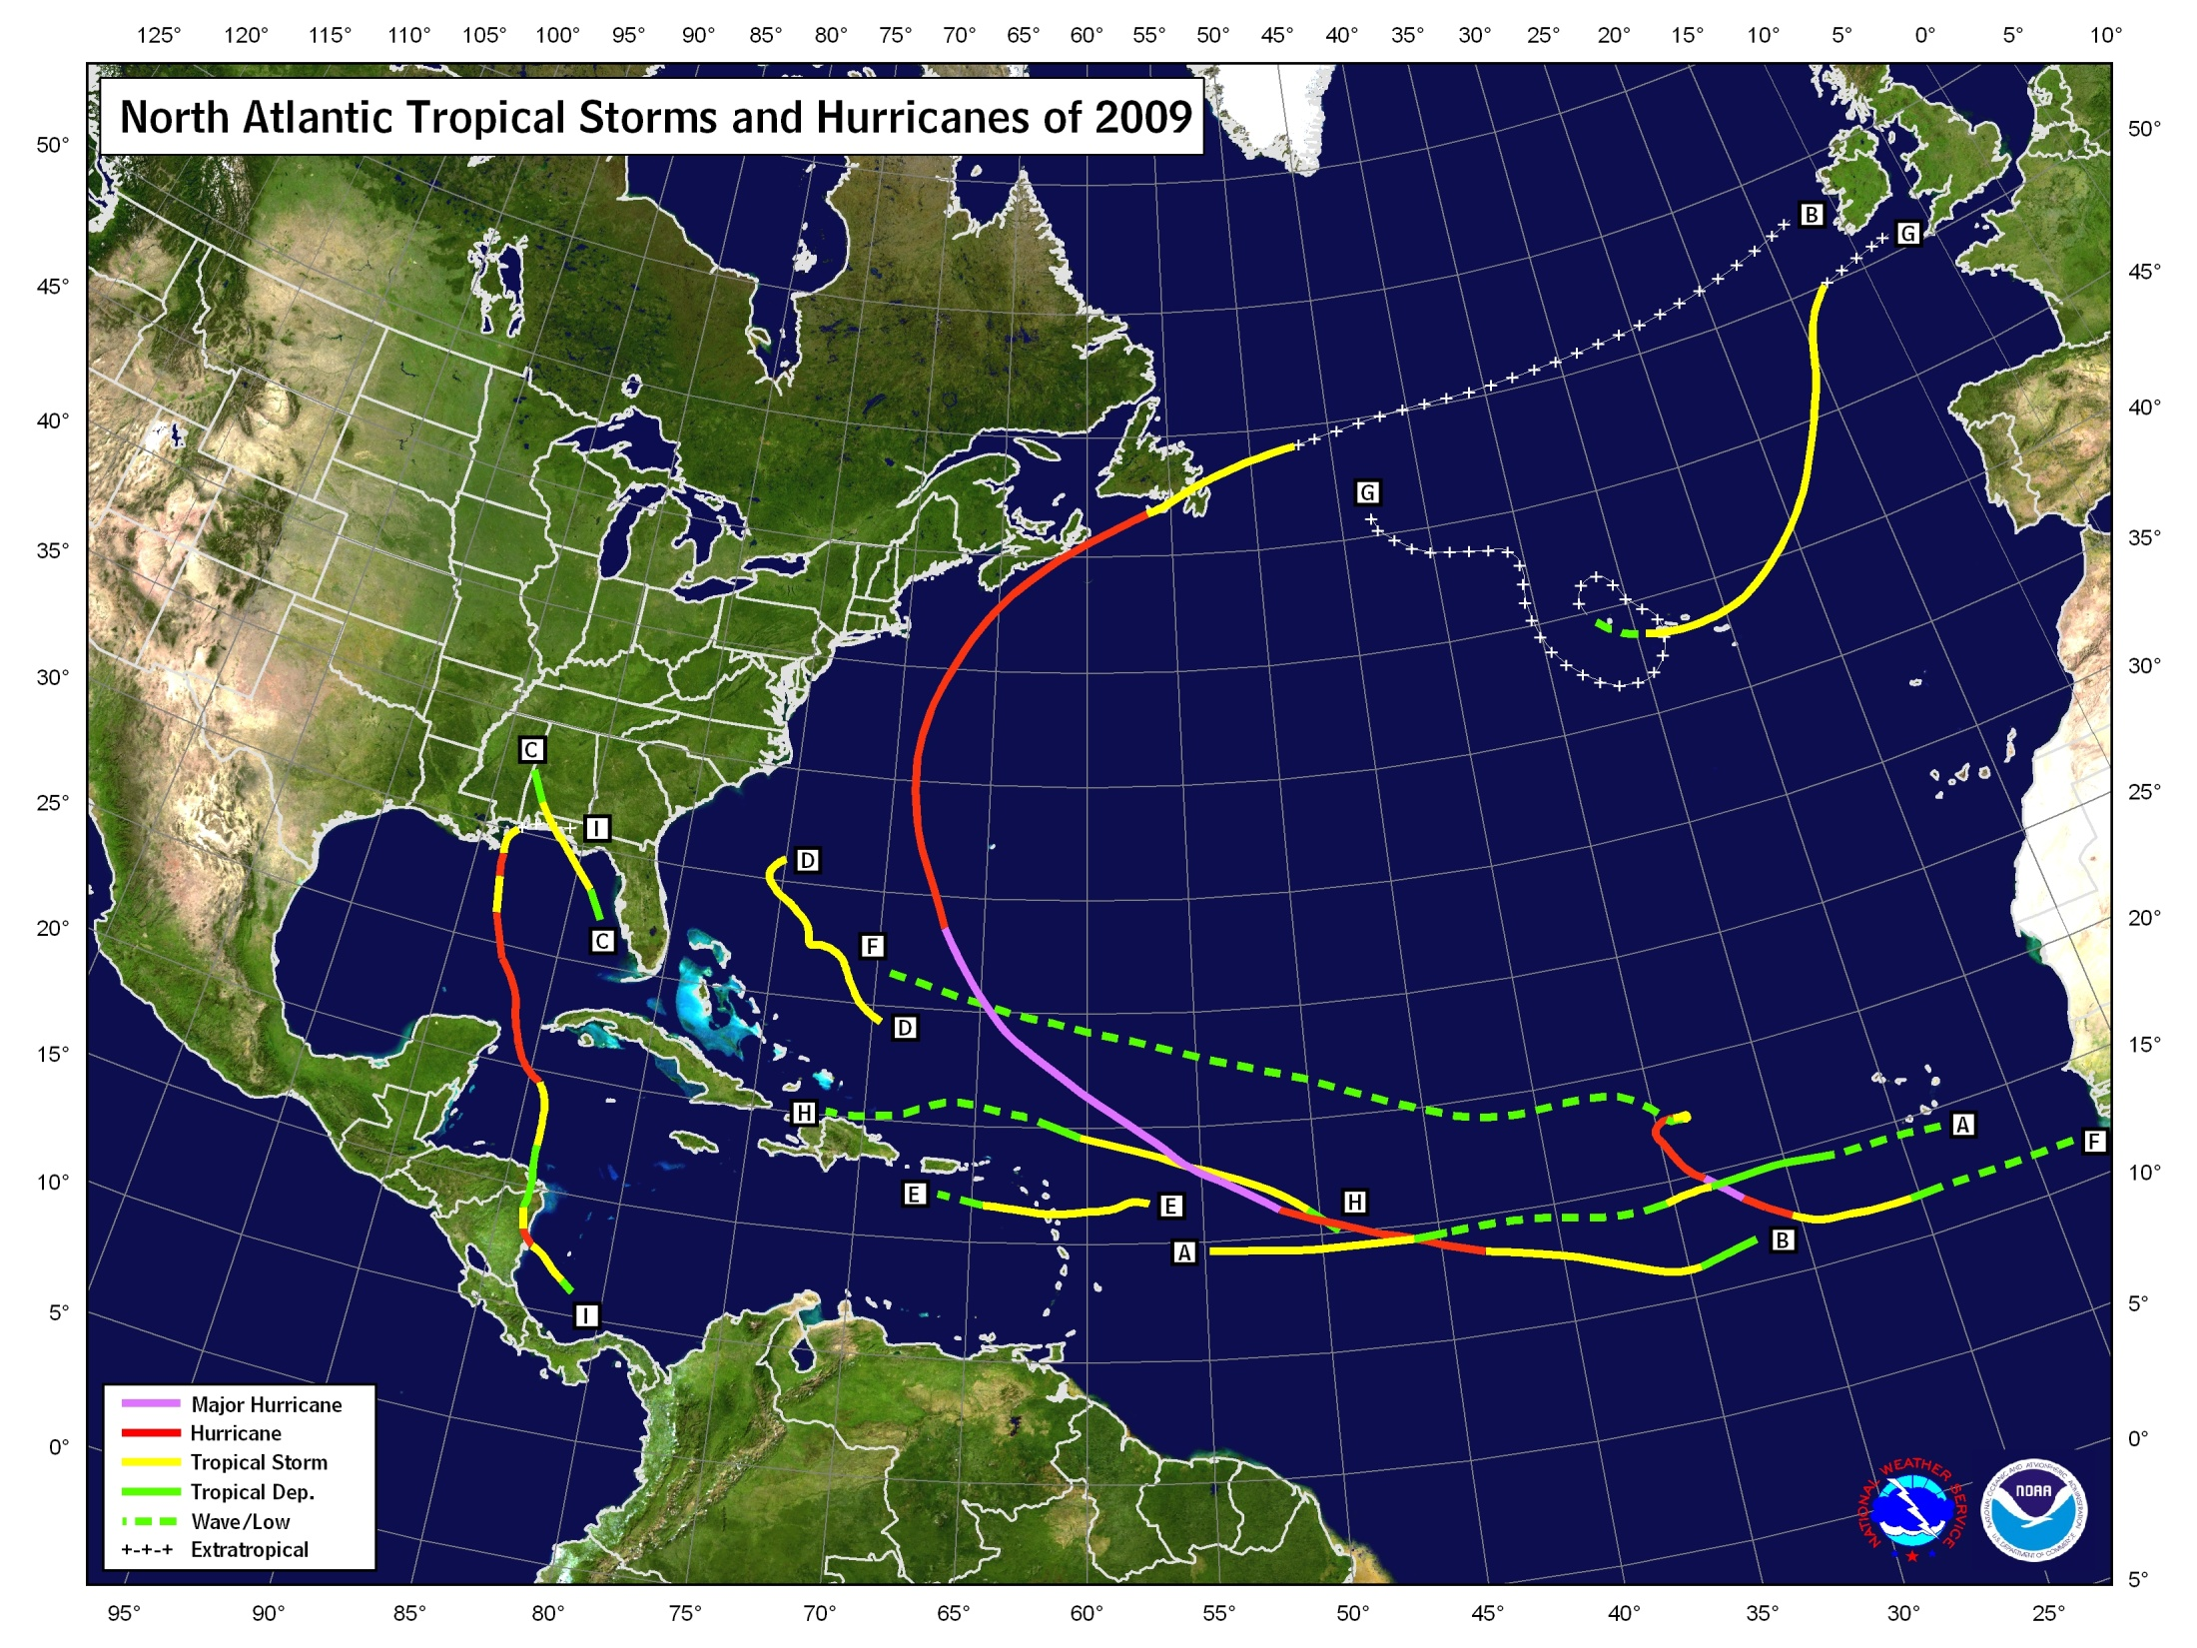

Slide 4
2009 ATLANTIC HURRICANE SEASON STATISTICS
NAME | DATES | MIN PRESS (MB) | MAX WINDS (MPH) | DIRECT DEATHS | U.S. DAMAGE ($ million)
TD ONE | 28 – 29 MAY | 1006 | 35
TS ANA | 11 – 16 AUG | 1003 | 40
MH BILL | 15 – 24 AUG | 943 | 135 | 2
TS CLAUDETTE | 16 – 17 AUG | 1005 | 60 | 2 | minor
TS DANNY | 26 – 29 AUG | 1006 | 60 | 1
TS ERIKA | 1 – 3 SEP | 1004 | 50
MH FRED | 7 – 12 SEP | 958 | 120
TD EIGHT | 25 – 26 SEP | 1008 | 35
TS GRACE | 4 – 6 OCT | 986 | 65
TS HENRI | 6 – 8 OCT | 1005 | 50
H IDA | 4 – 10 NOV | 975 | 105 | 1 | minor
Notes:
4

Slide 5

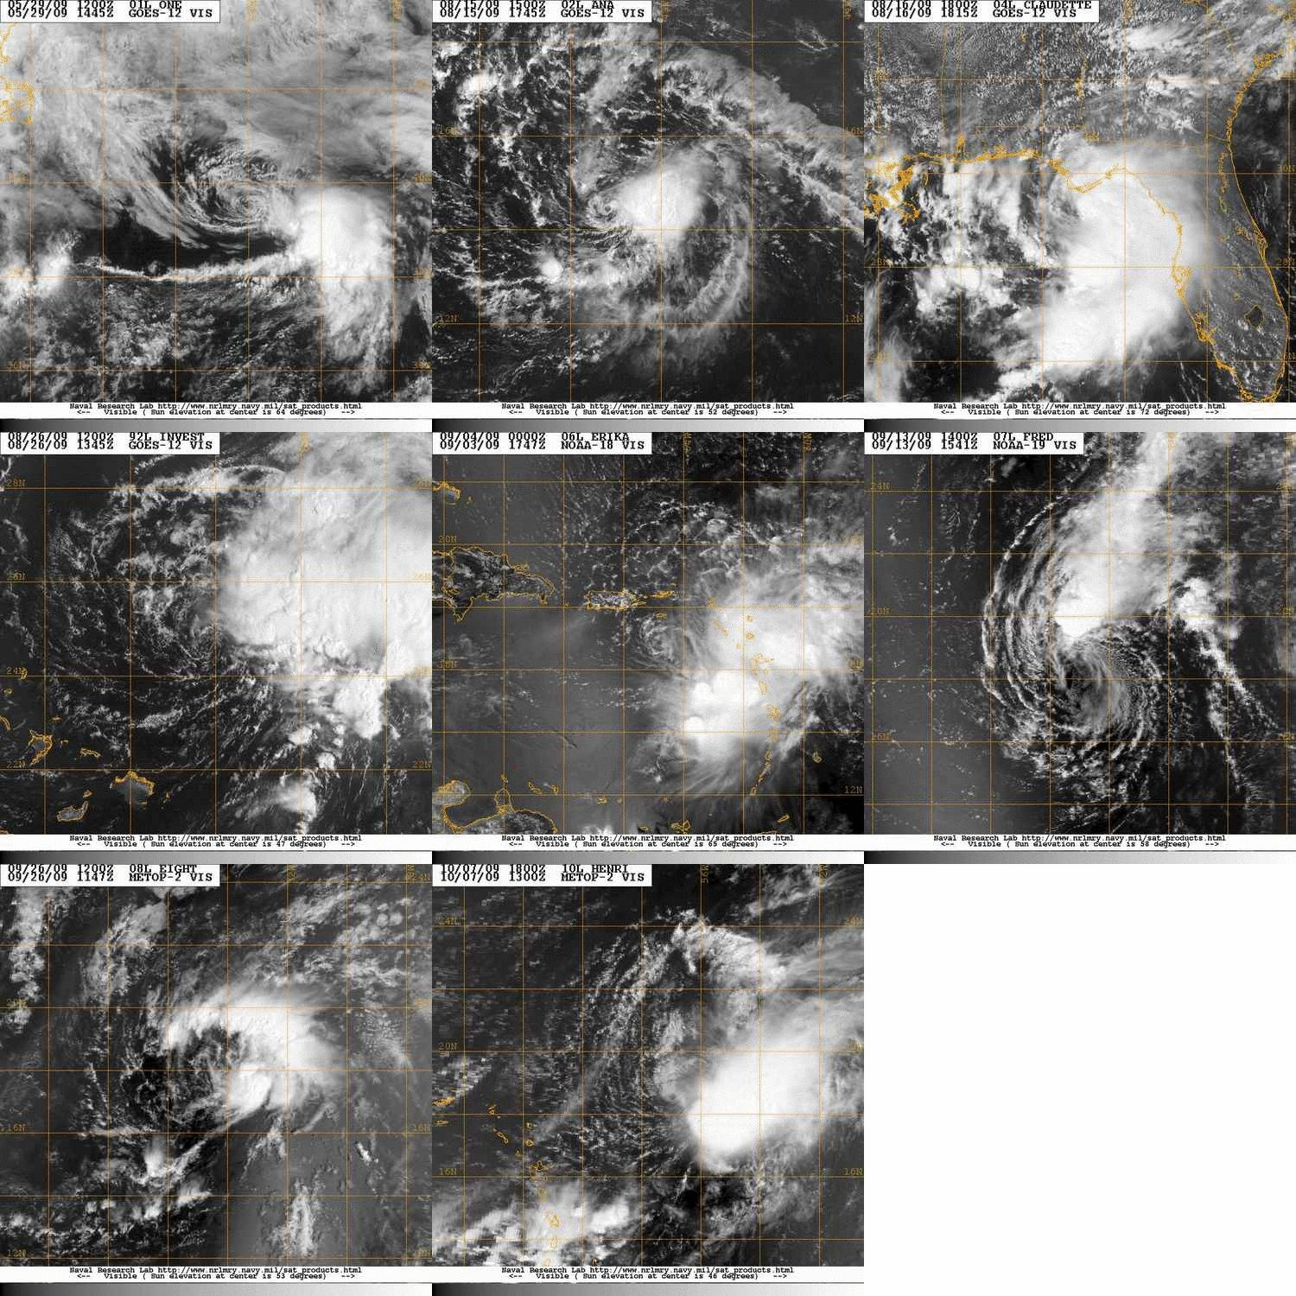
Sheared Cyclones

Slide 6
2009 Season Climatology
9 named storms, 3 of which became hurricanes, including 2 major hurricanes (Bill and Fred)
  Below the long-term averages of 11 named storm and 6 hurricanes
  Average number of major hurricanes
  Two additional tropical depressions
The Accumulated Cyclone Energy (ACE) index for the season was 60% of the long-term median, lowest since 1997
Latest formation of a tropical storm since the 1983 season
(TS Ana – 12 Aug, MH Alicia – 15 Aug)
One tropical storm made landfall in the U.S. (Claudette)
Fred became strongest hurricane on record so far south and east in the Atlantic
Grace formed farther northeast in the Atlantic than any other tropical storm on record
Ida was the first November hurricane in the Gulf of Mexico since Hurricane Kate (1985)

Slide 7
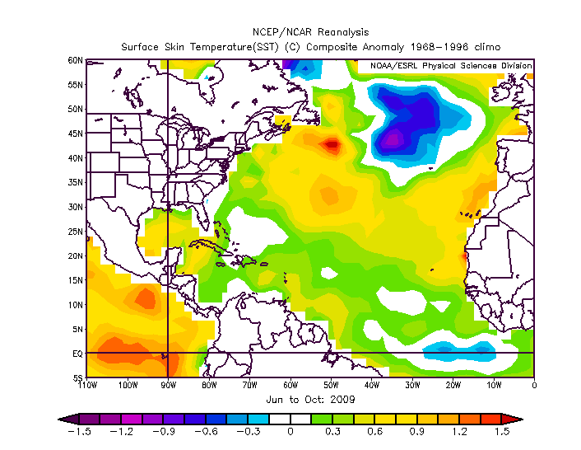
SST

Slide 8
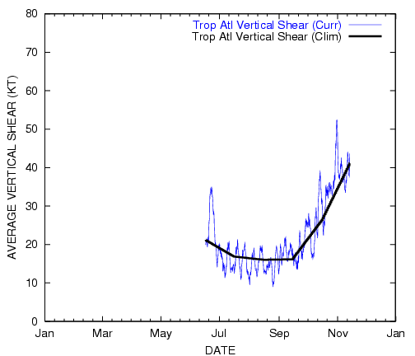
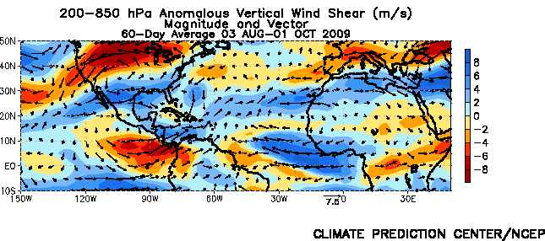
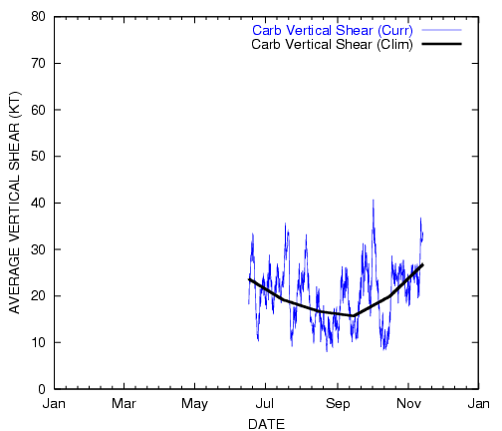
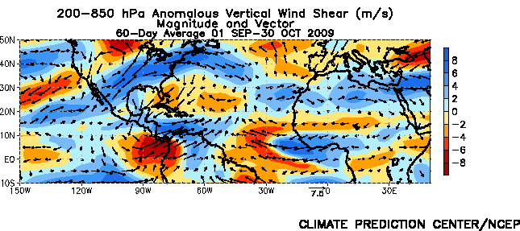
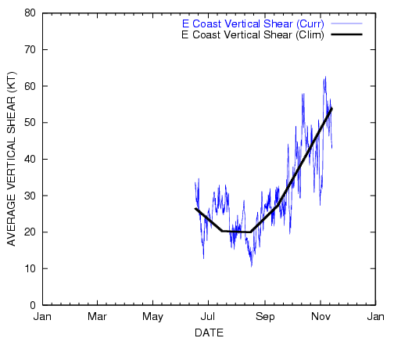
SHEAR

Slide 9
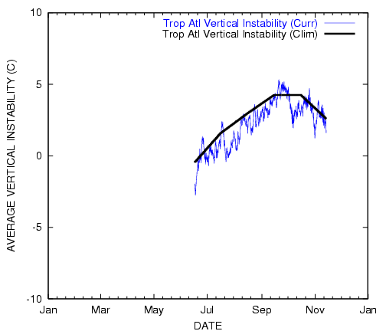
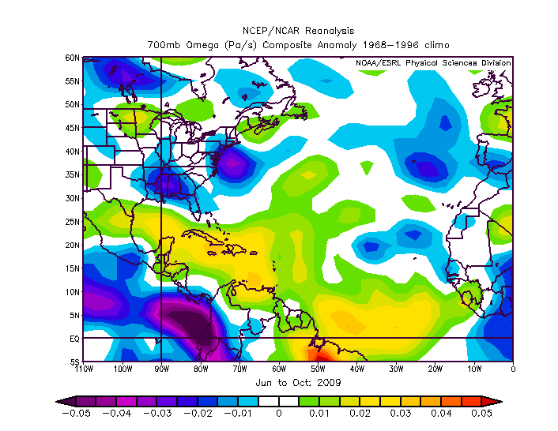
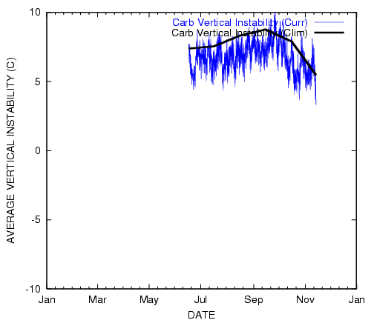
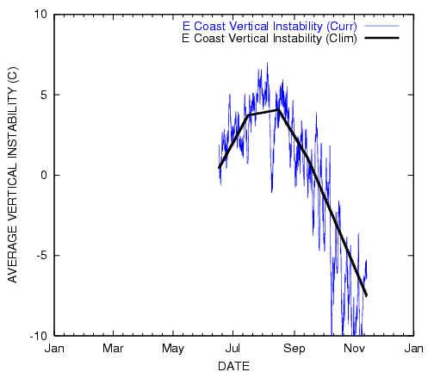
VERTICAL INSTABILITY

Slide 10
Operational Challenges
Sheared systems, some with marginally-defined centers
(Ana, Danny, Erika, Henri)
Unanticipated tropical cyclogenesis
(Claudette, Grace, Henri)
Cyclone classification
(Danny, Grace, early season Gulf low, New Jersey low, central Atlantic low)
Along-track (speed) forecast errors
(Bill, Grace, Ida)
Interpretation and accuracy of SFMR
(Bill, Ida)
High model intensity bias (esp. HWRF) in high-shear environments
(Bill, Erika, Fred)

Slide 11
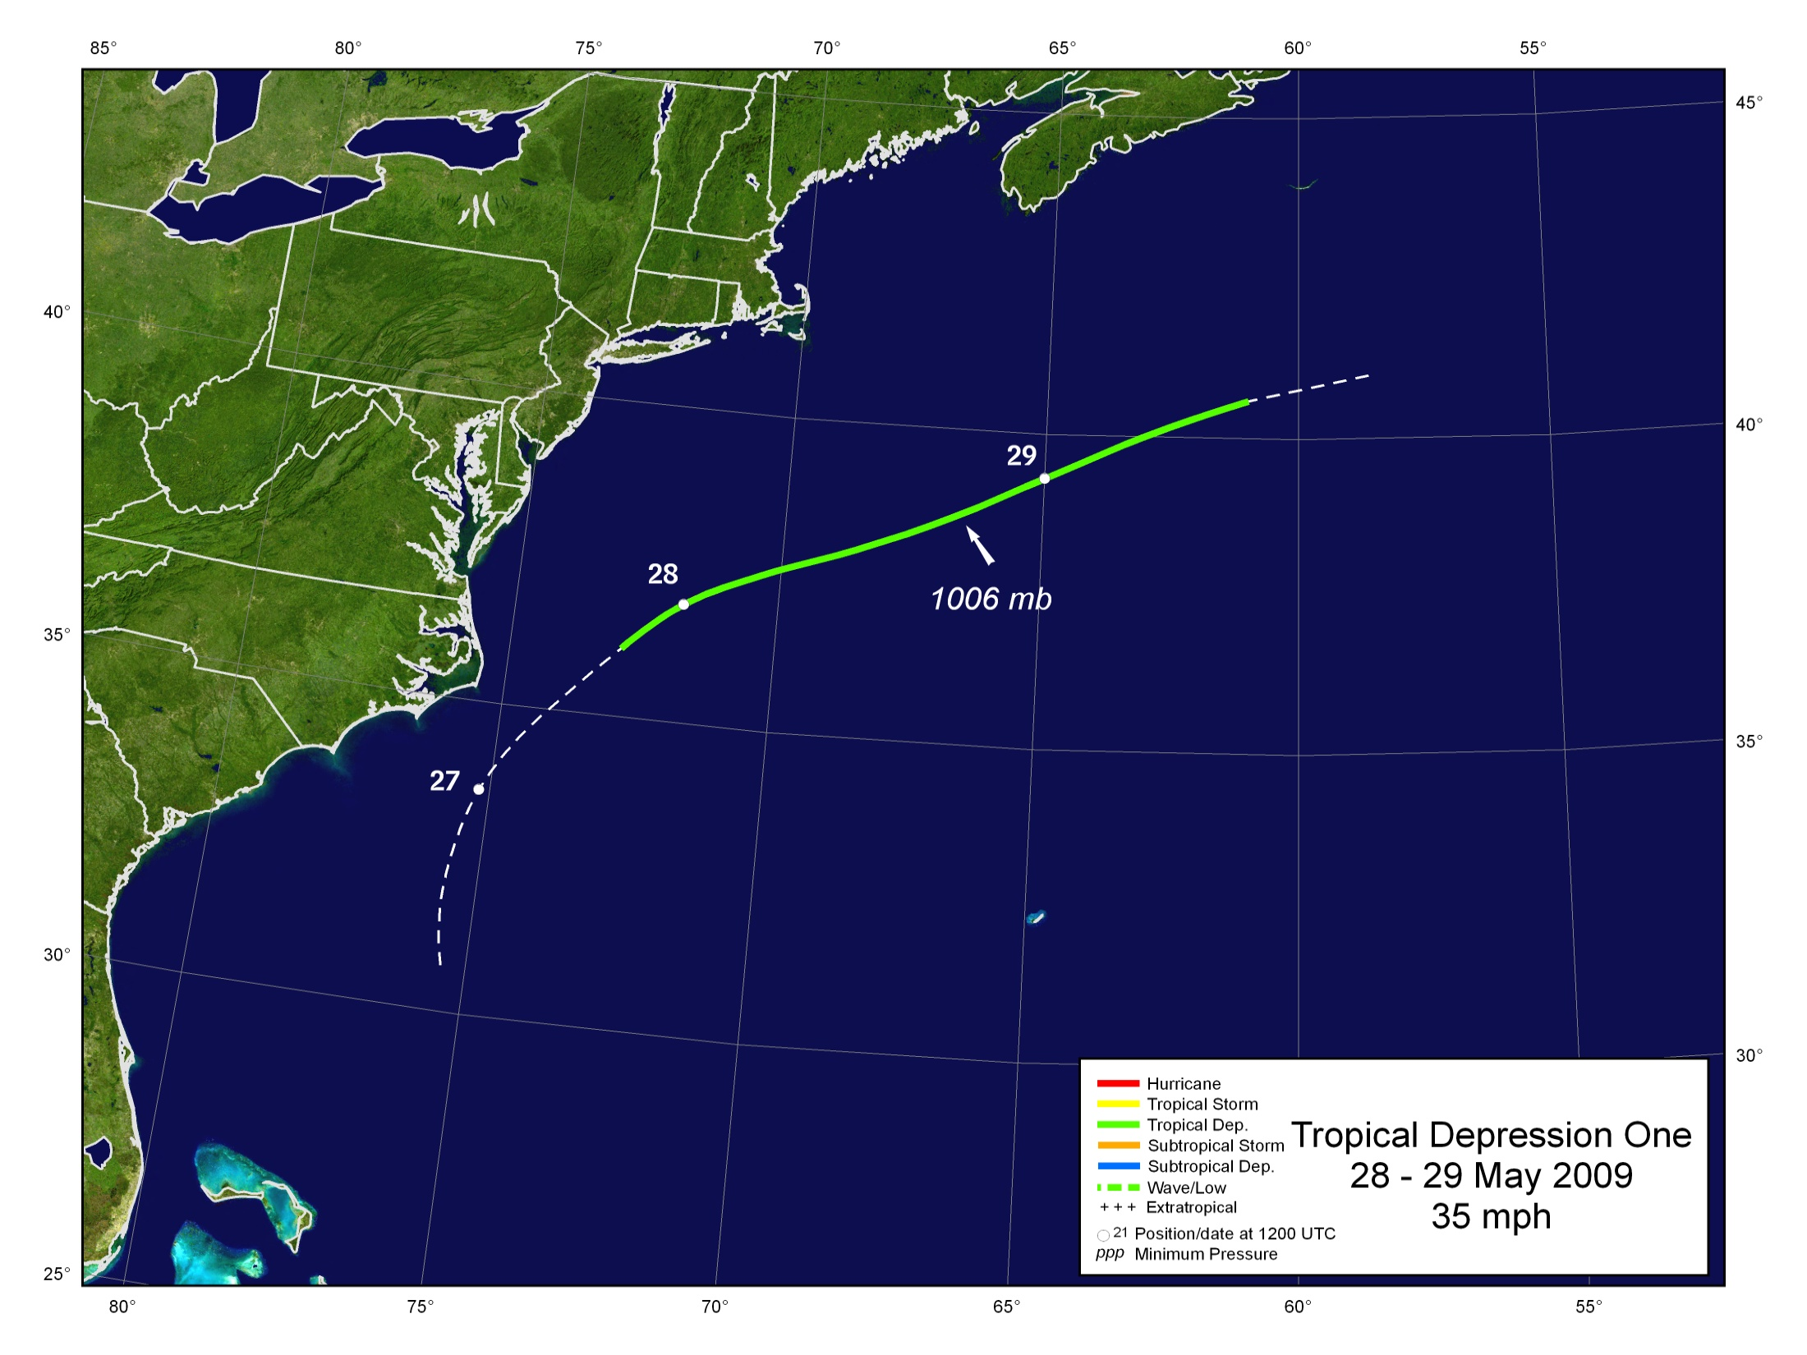
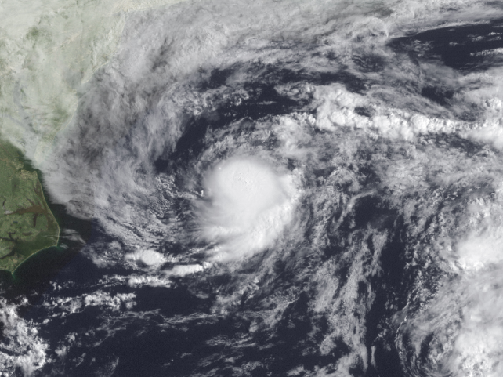

Slide 12
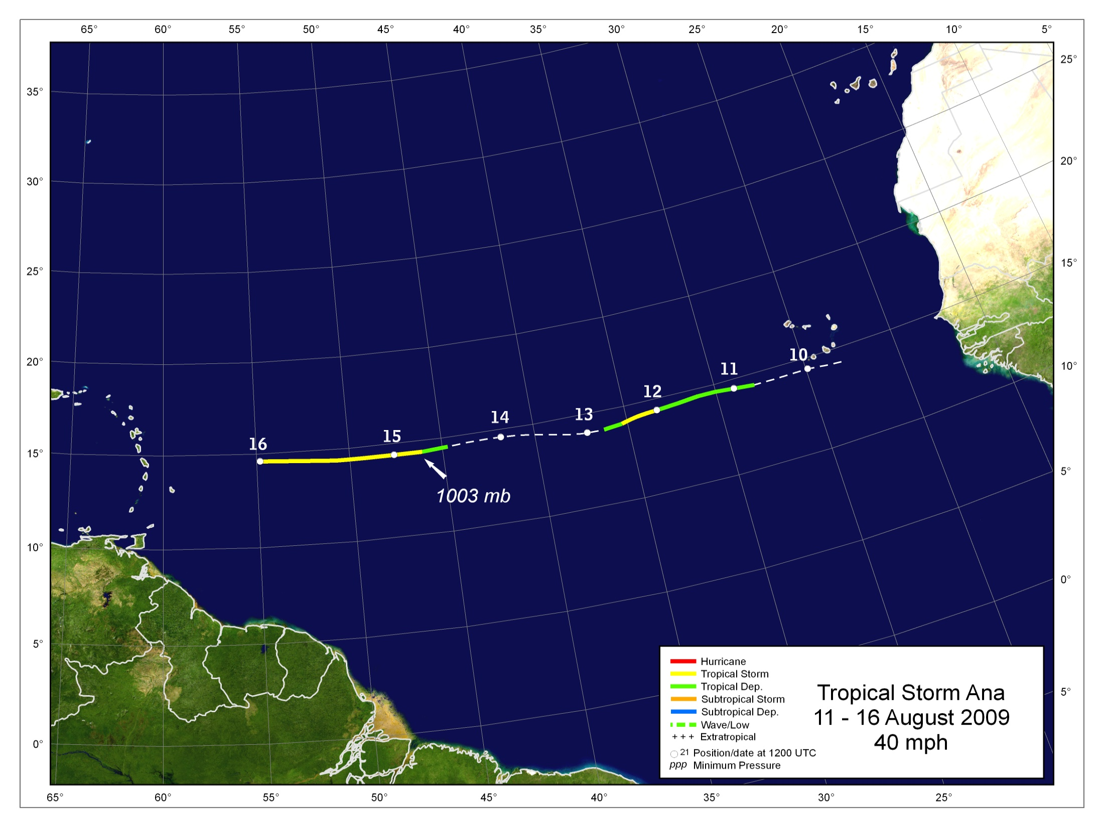
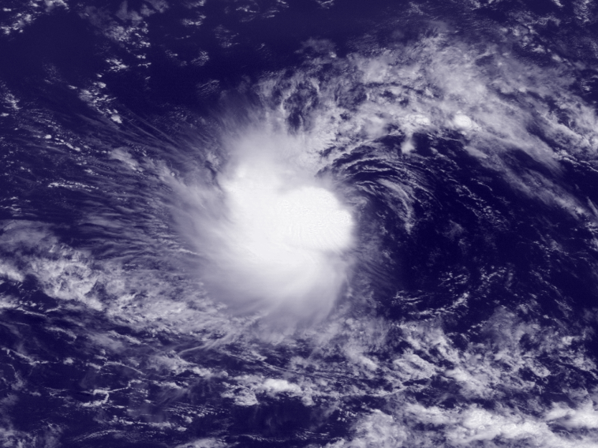

Slide 13
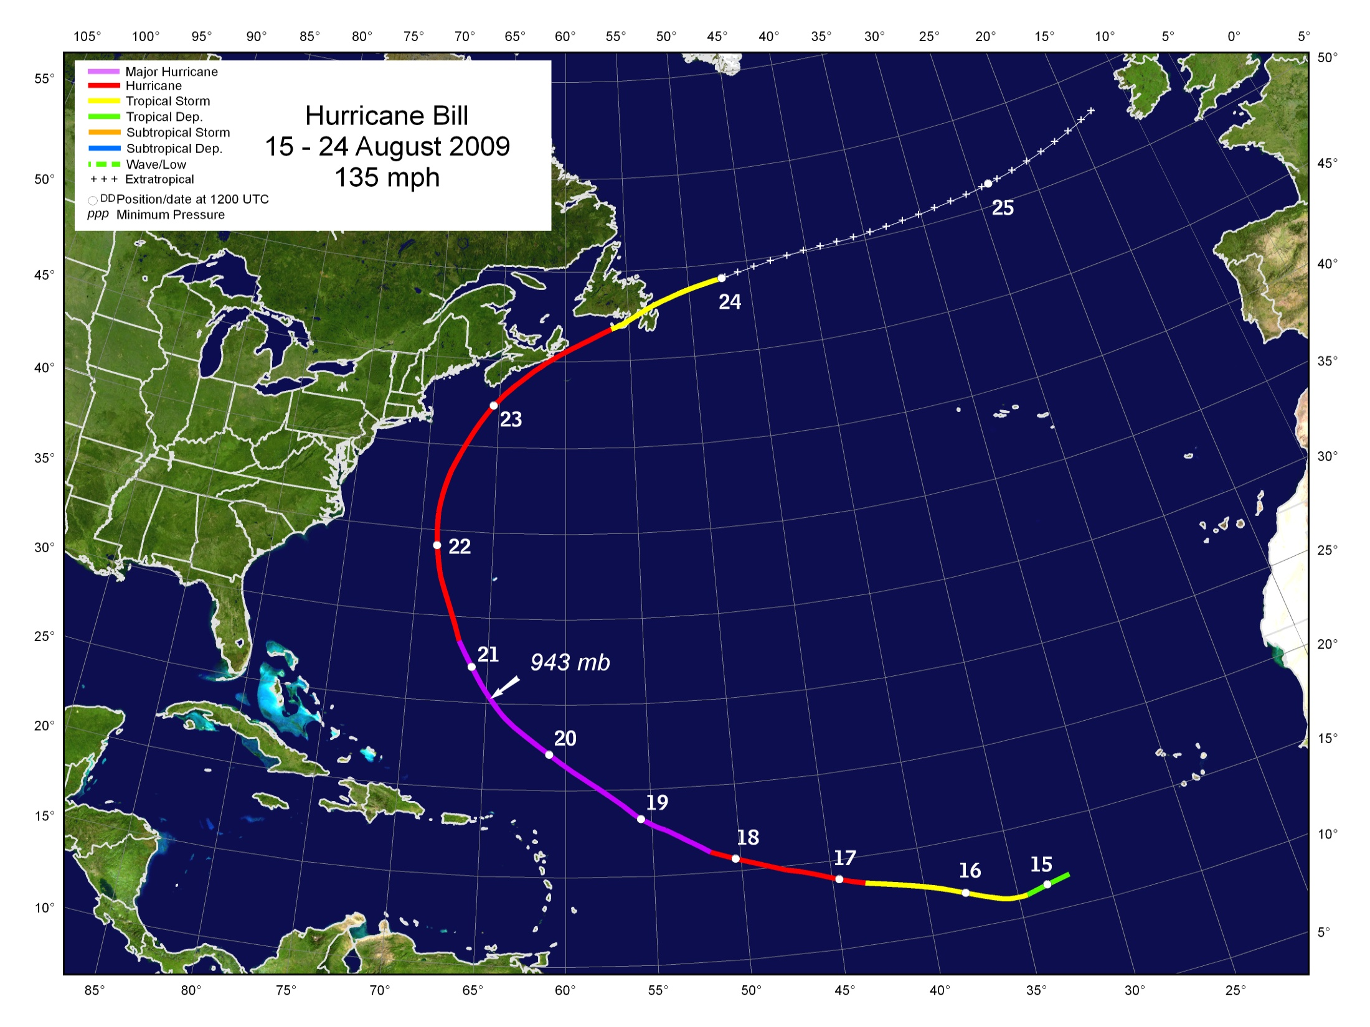
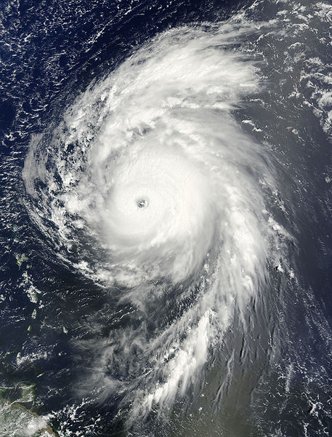
Large swells affected the U.S. East Coast, severe beach erosion
One death in Acadia Nat’l Park, ME; one in FL
Heavy rainfall in Eastern Massachusetts
Minor damage in Bermuda and Atlantic Canada

Slide 14
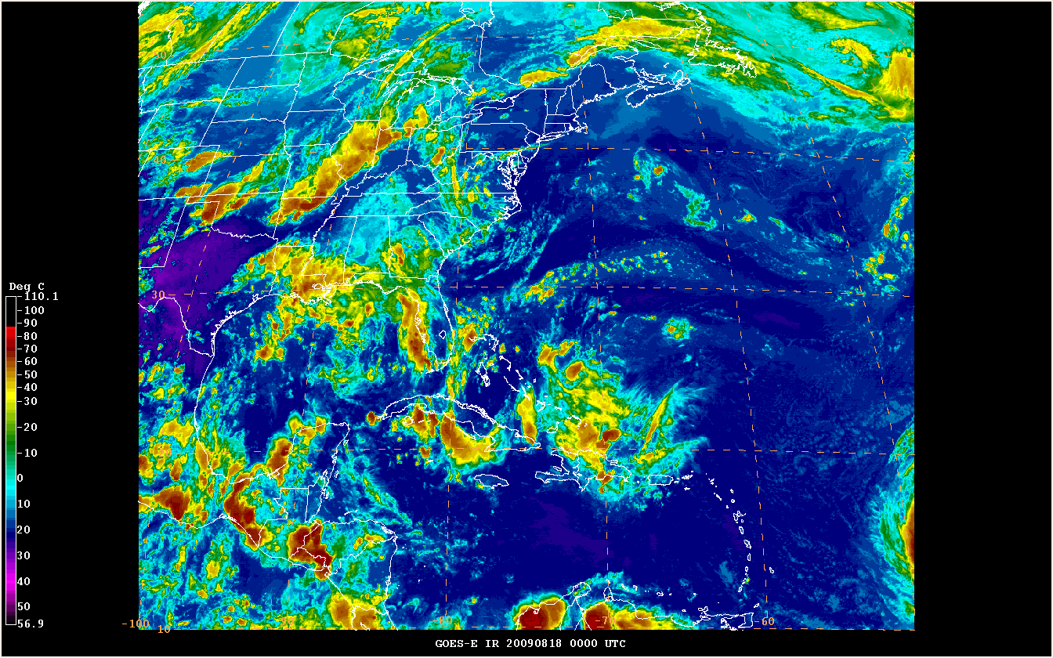

Slide 15
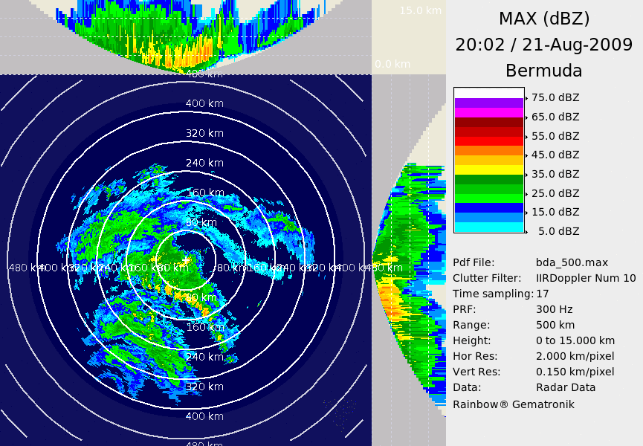

Slide 16
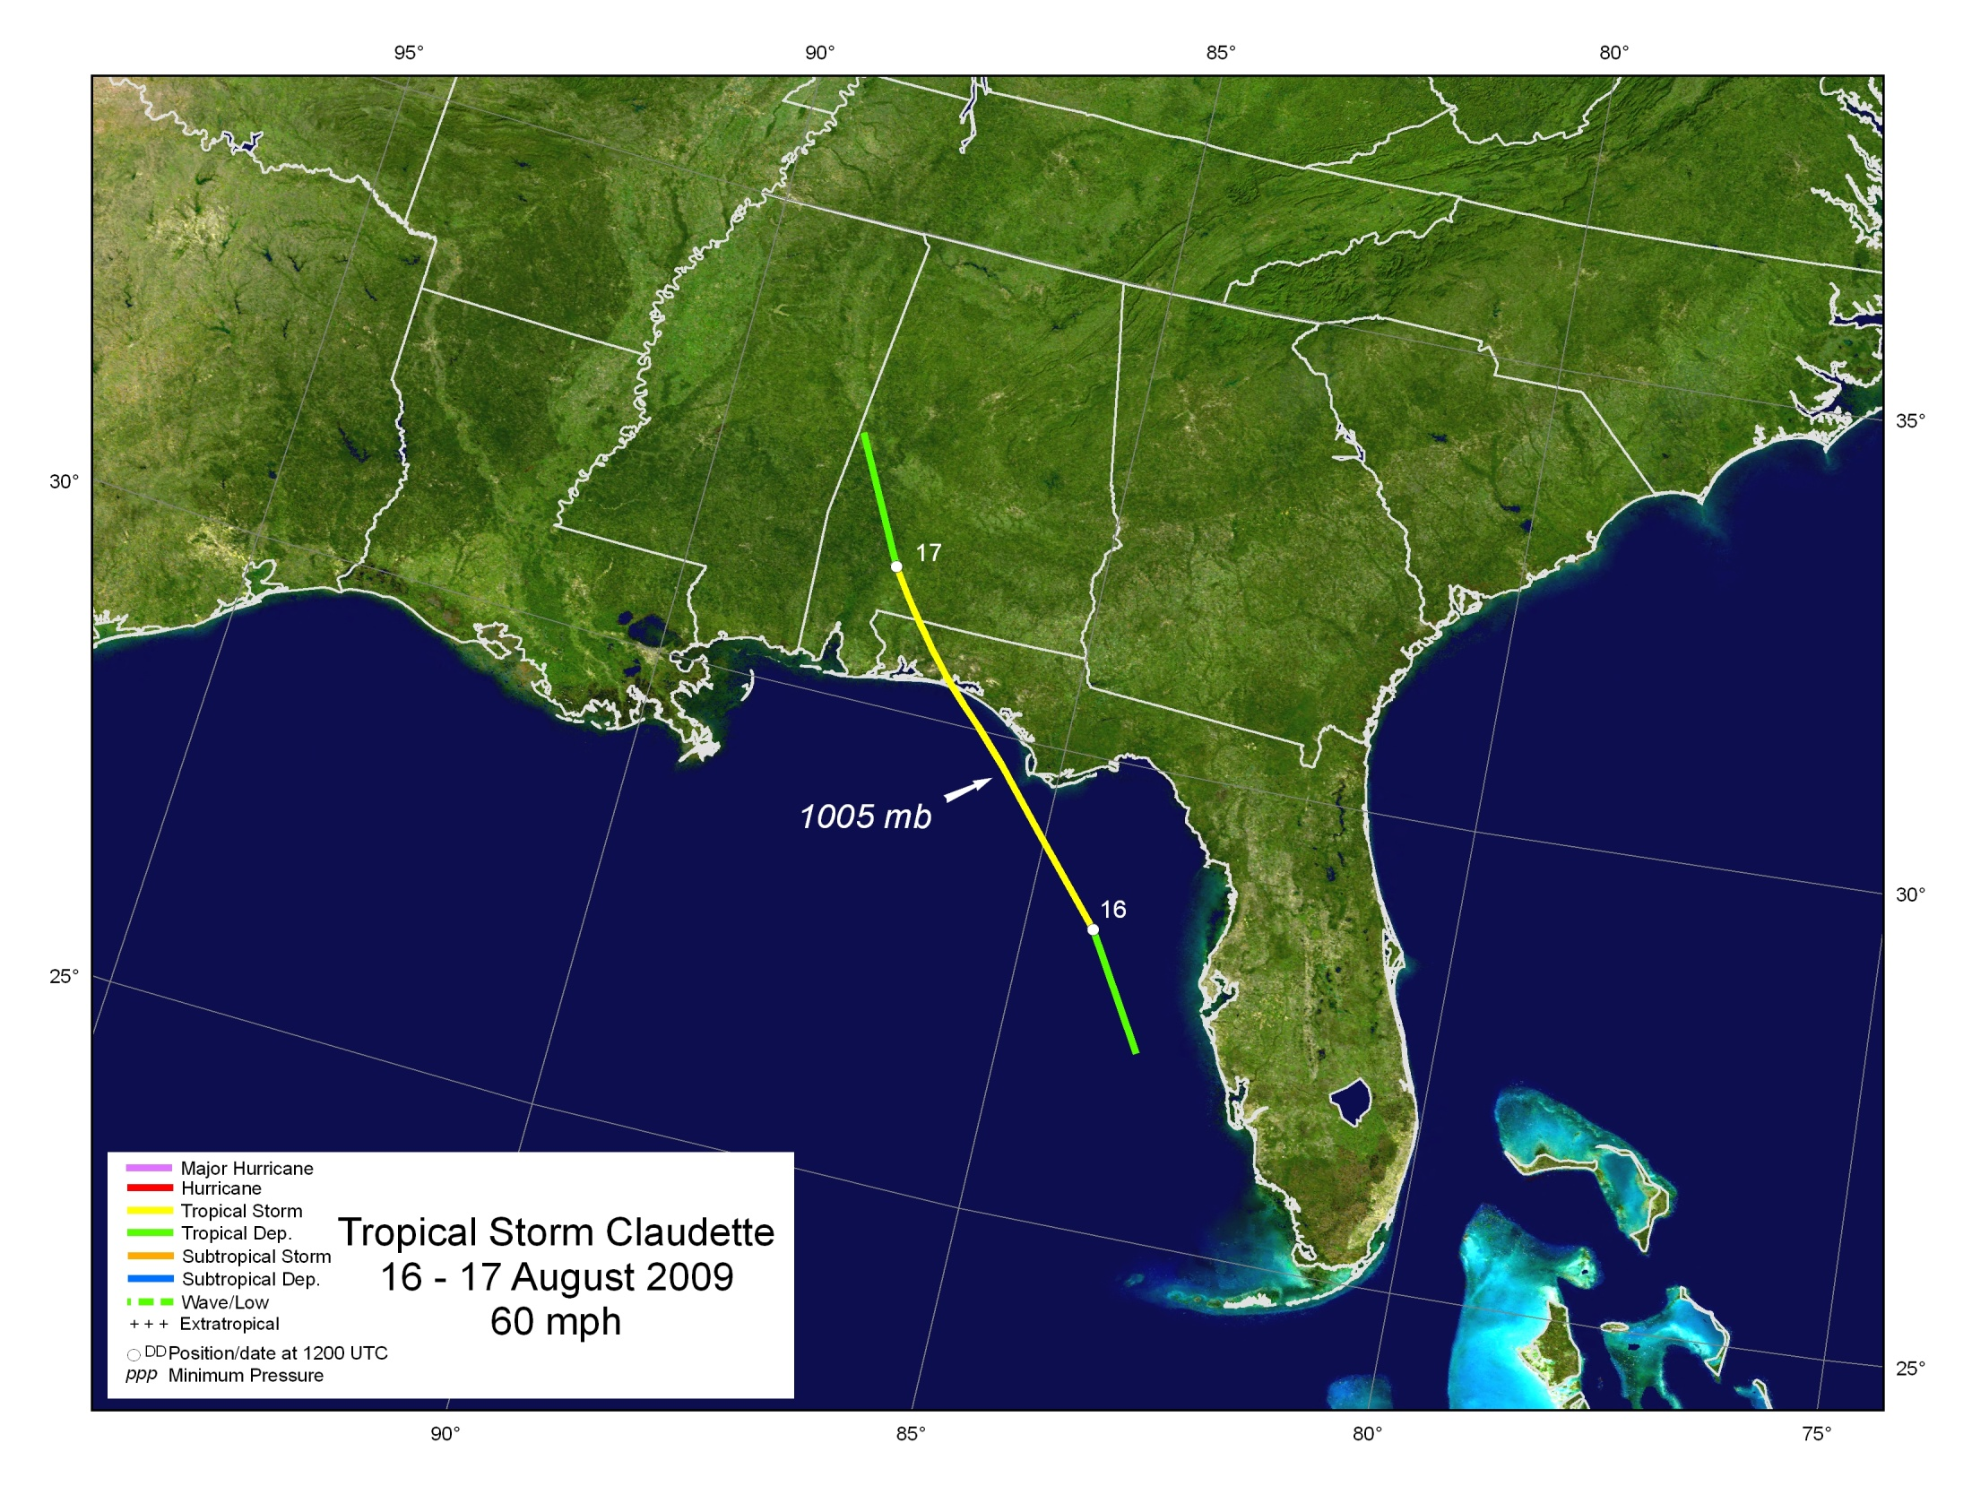
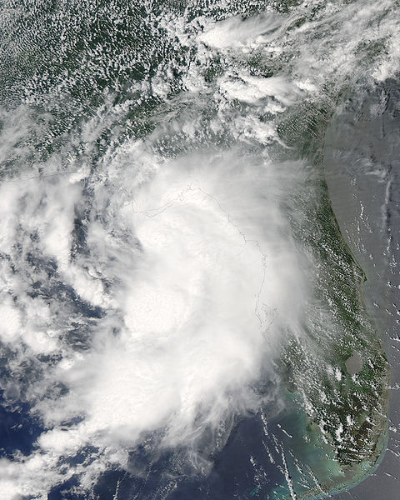
Landfall at Santa Rosa Island, FL
Minor power outages and damage
EF0 tornado near Cape Coral, FL
2 deaths from waves/surf (Panama City, Bay County)

Slide 17
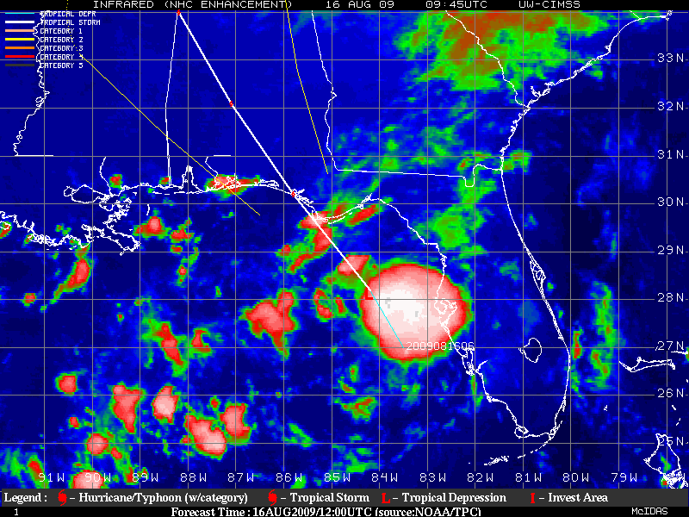
Notes:
Track chart of Tropical Depression Sixteen.

Slide 18
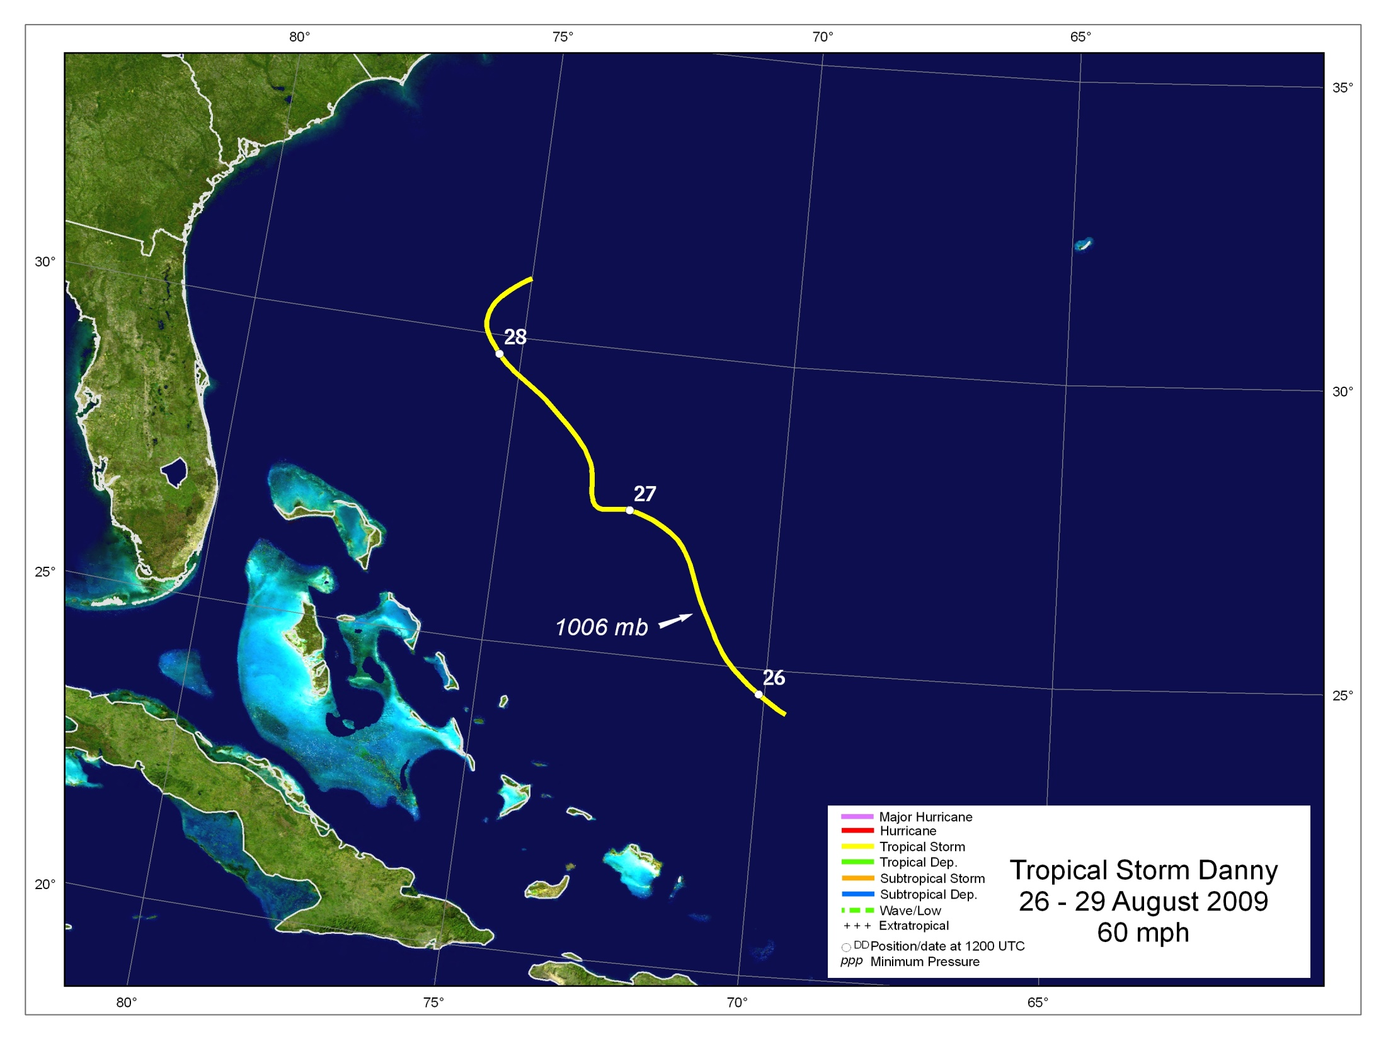
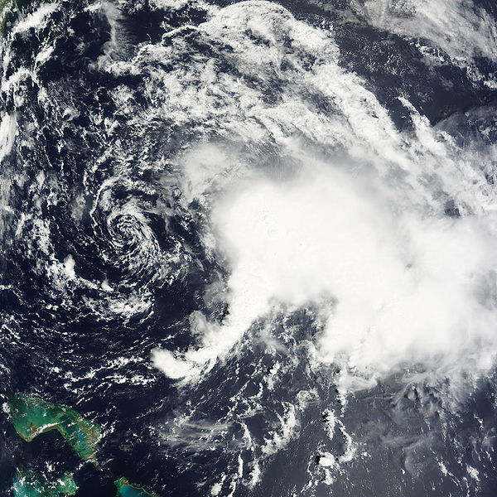
One death in Corolla, NC
Rough surf in Carolinas

Slide 19
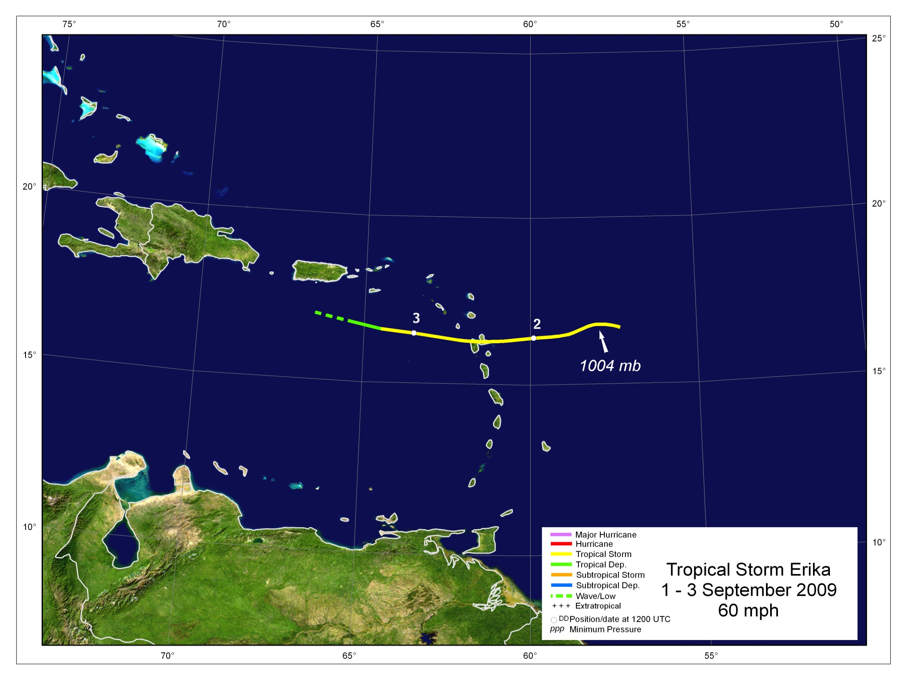
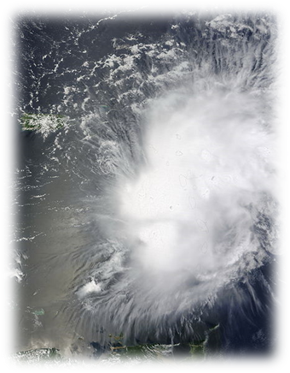
Flooding and landslides in Dominica
Flooding, rockslides, power outages in Guadeloupe
Remnants caused flooding in Puerto Rico and Dominican Republic

Slide 20
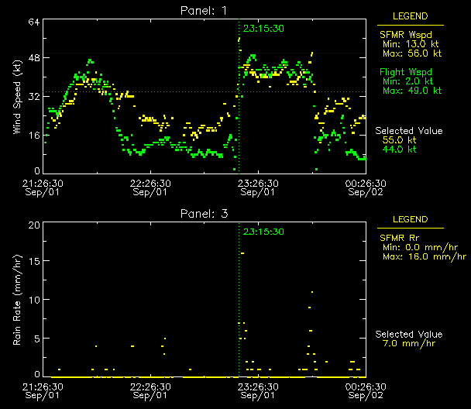

Slide 21
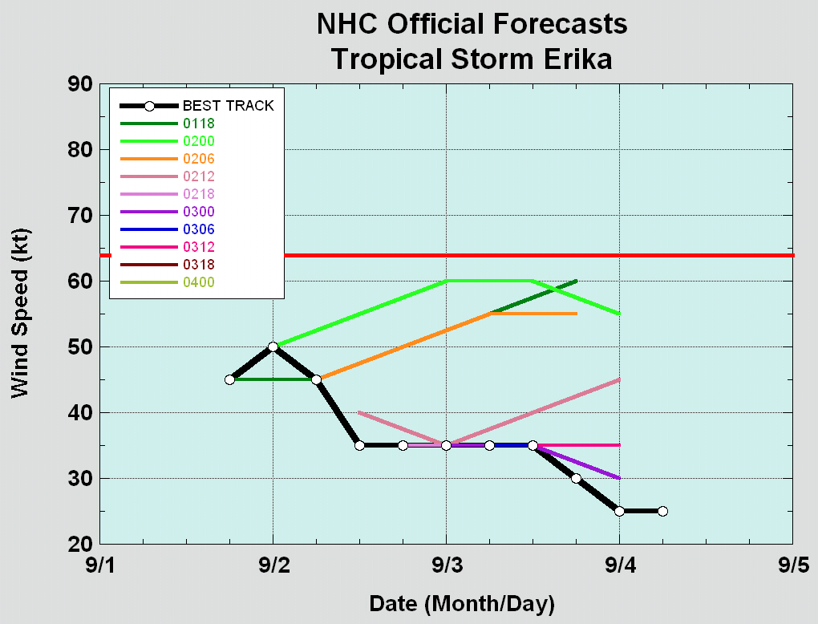
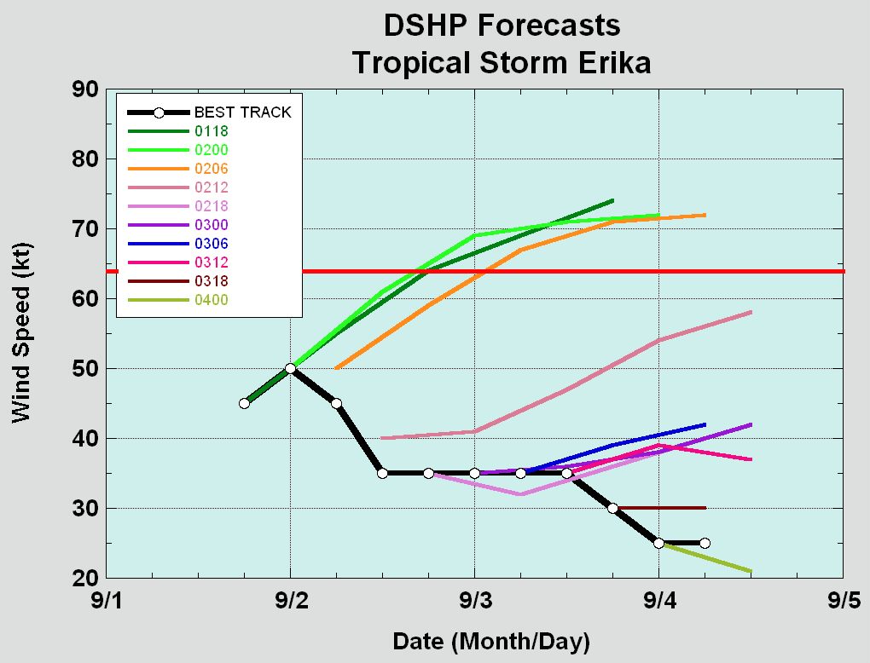
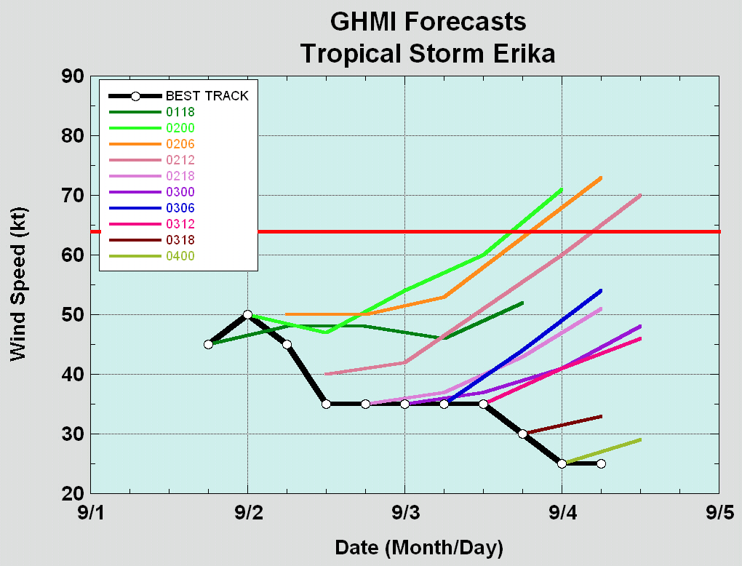
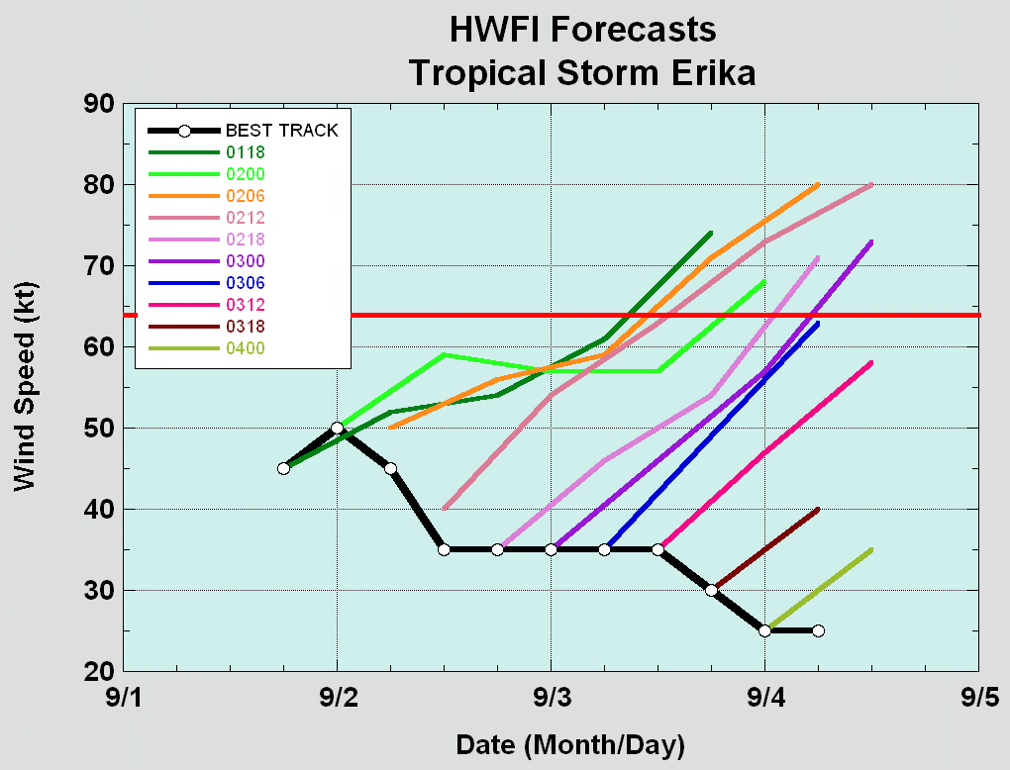

Slide 22
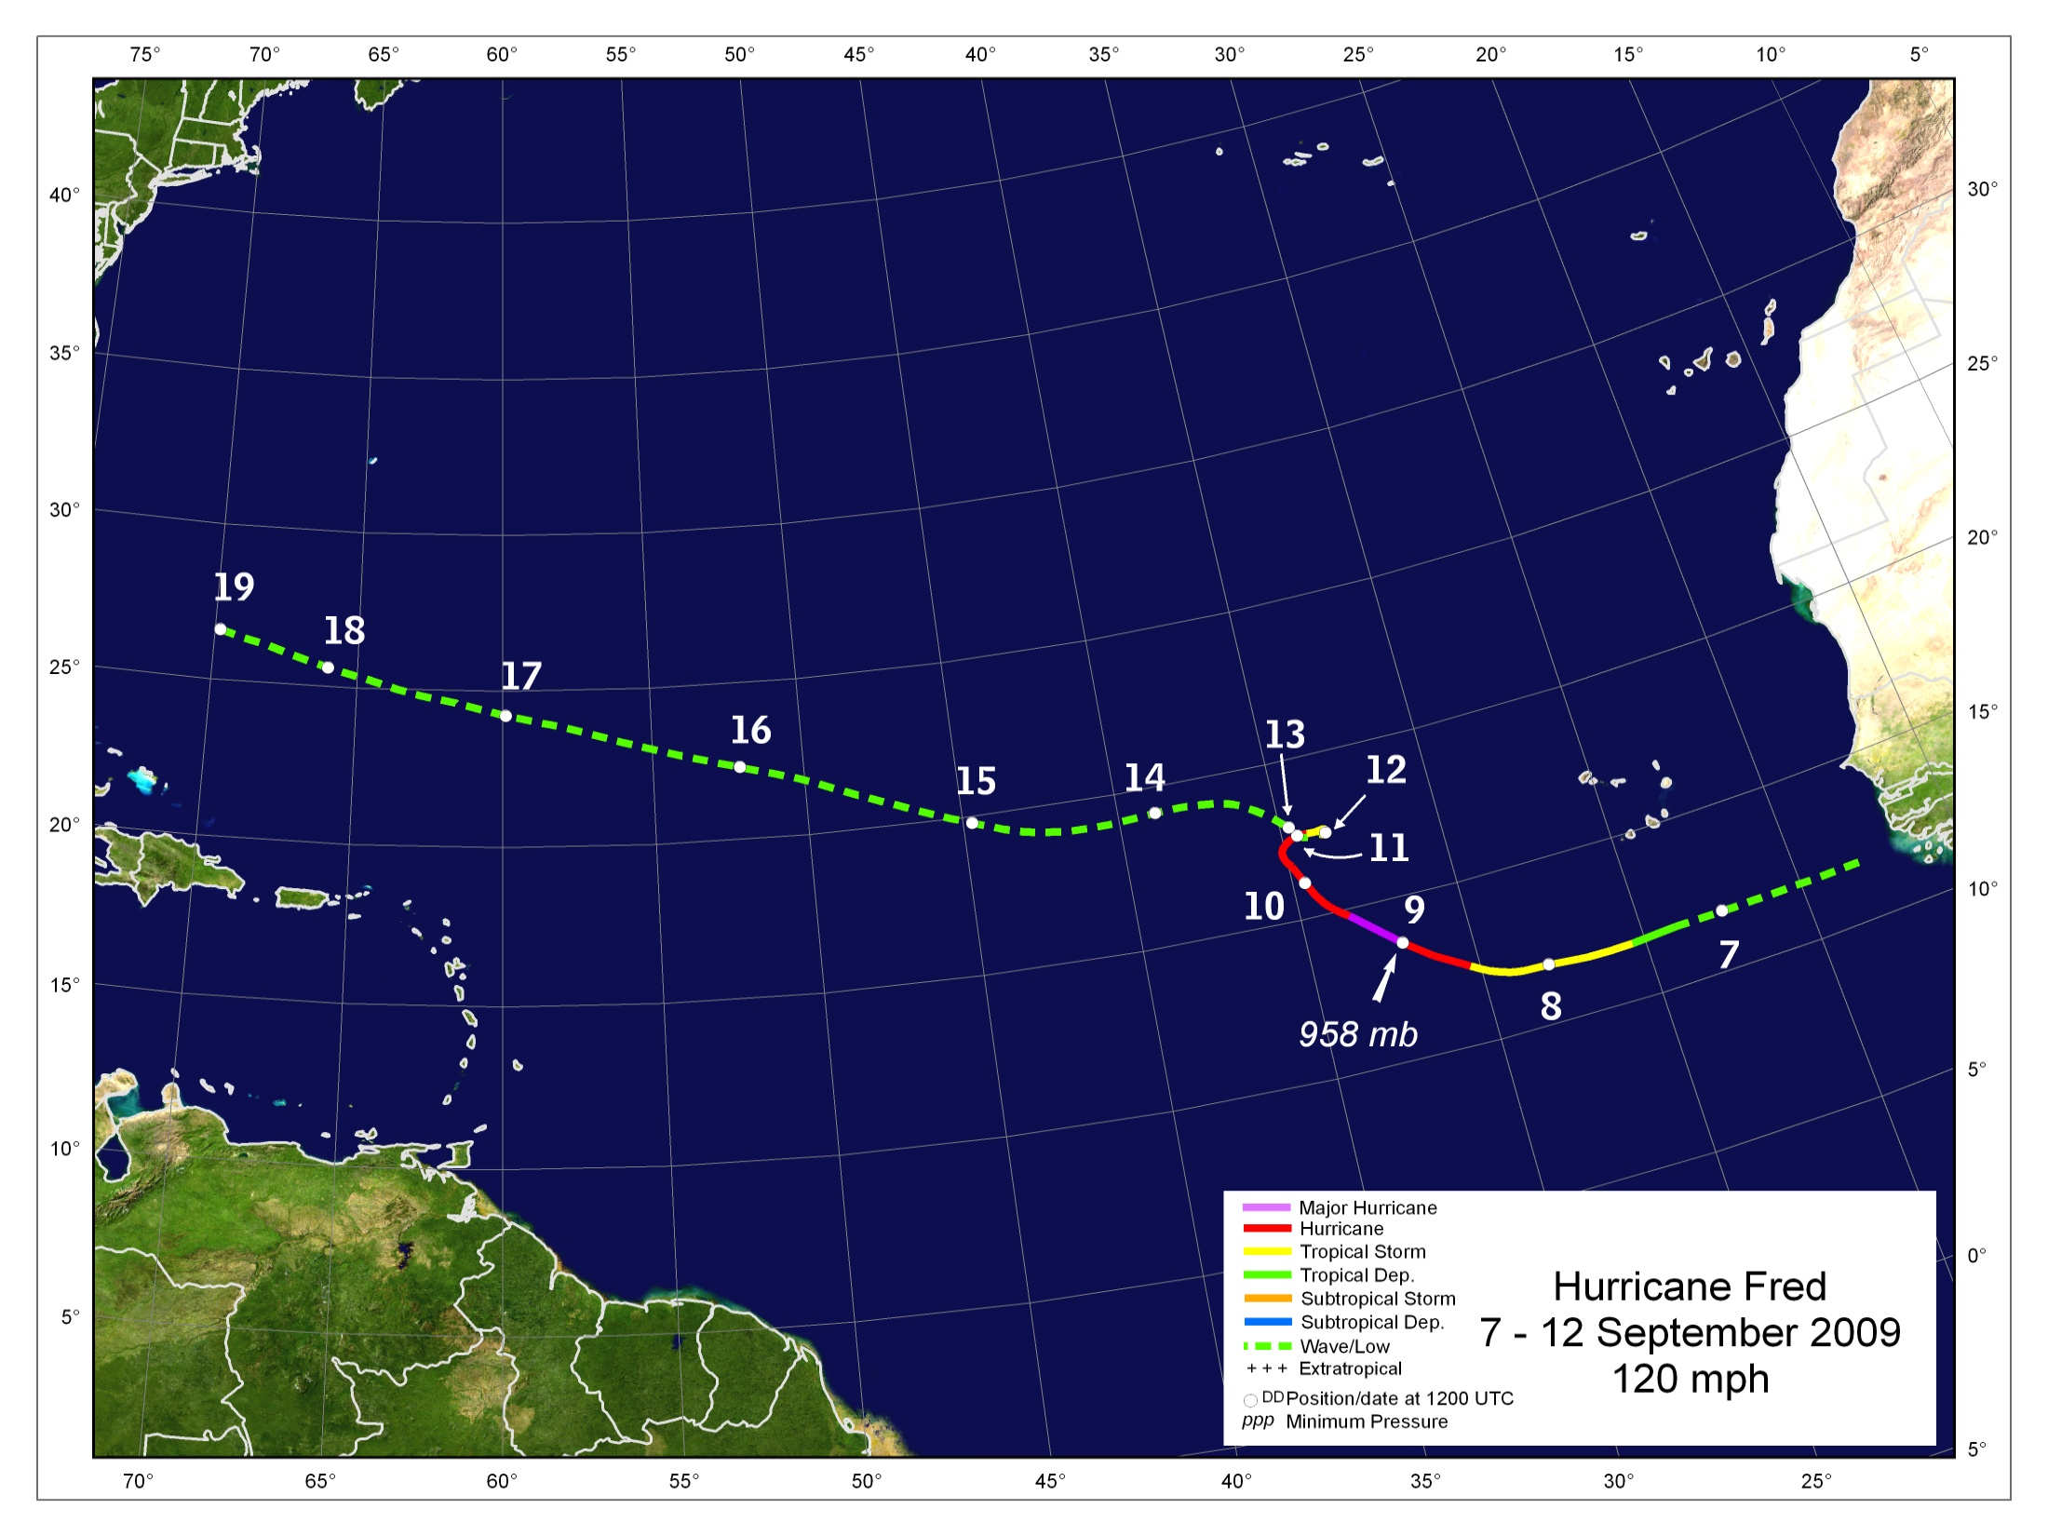
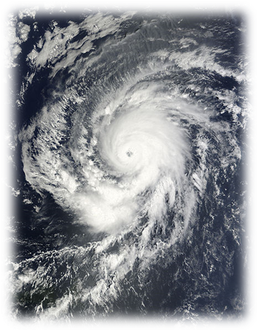

Slide 23
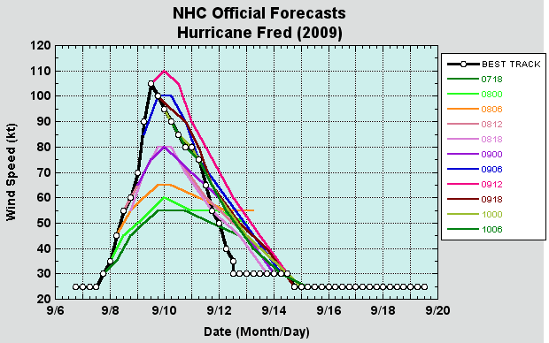
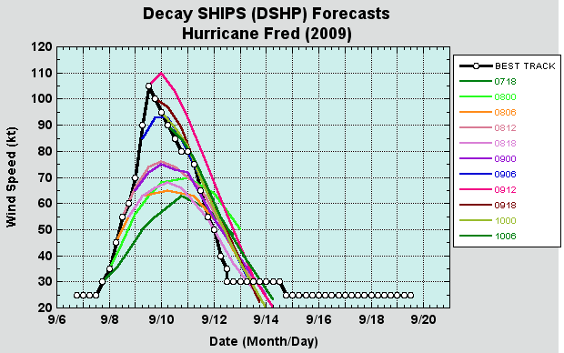
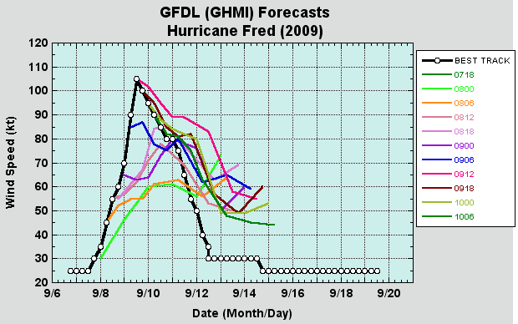
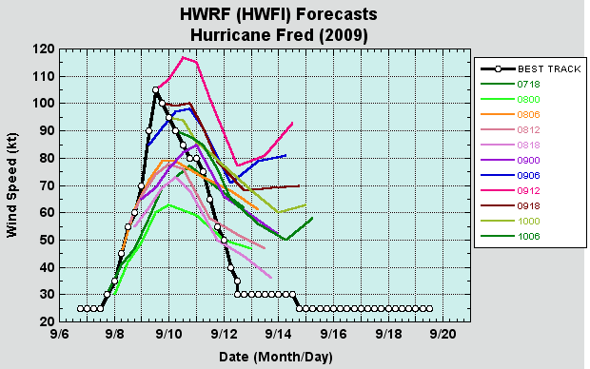

Slide 24
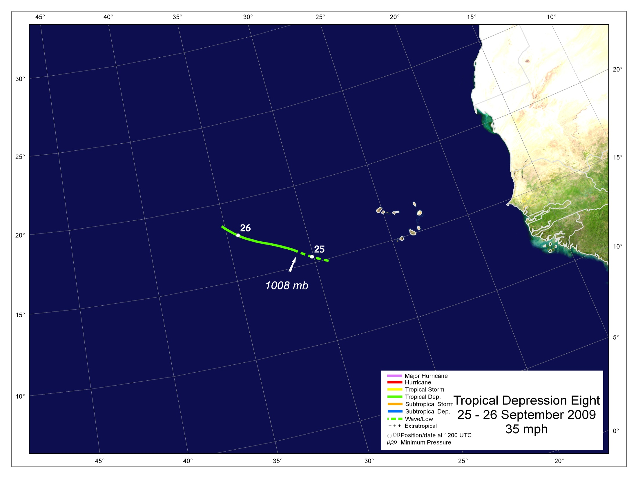
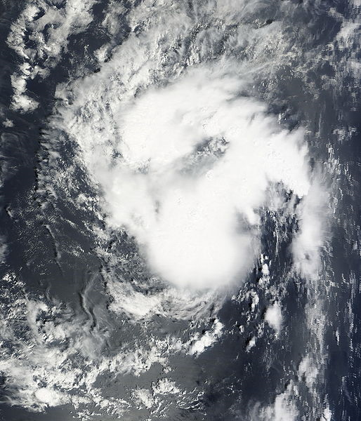

Slide 25
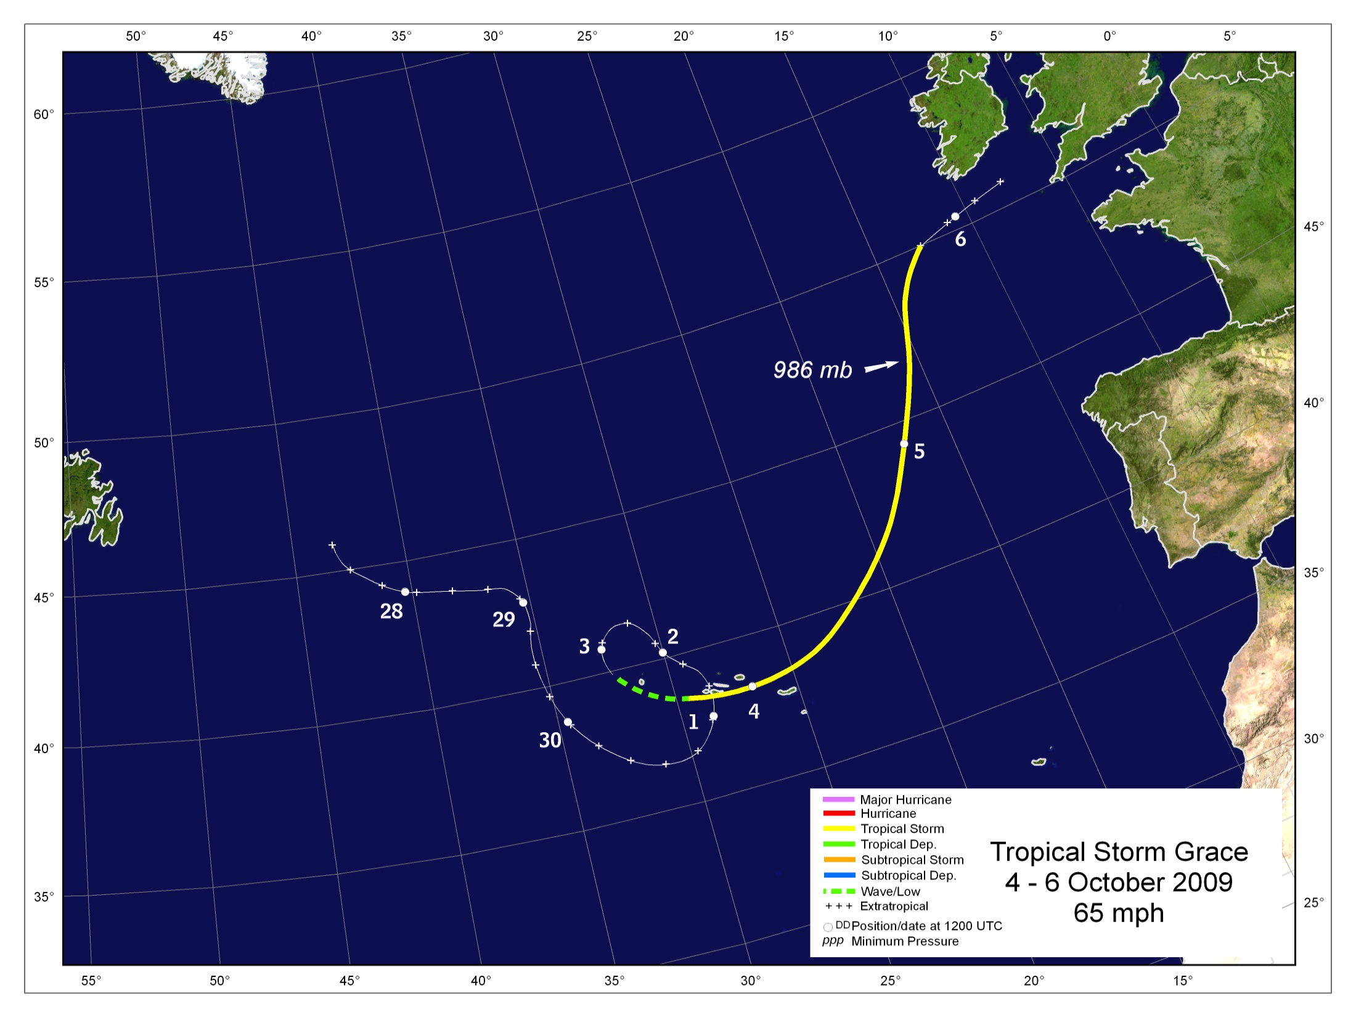
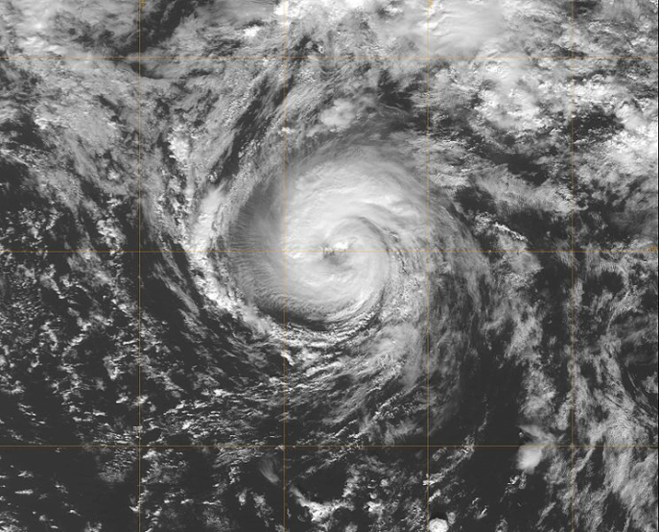

Slide 26
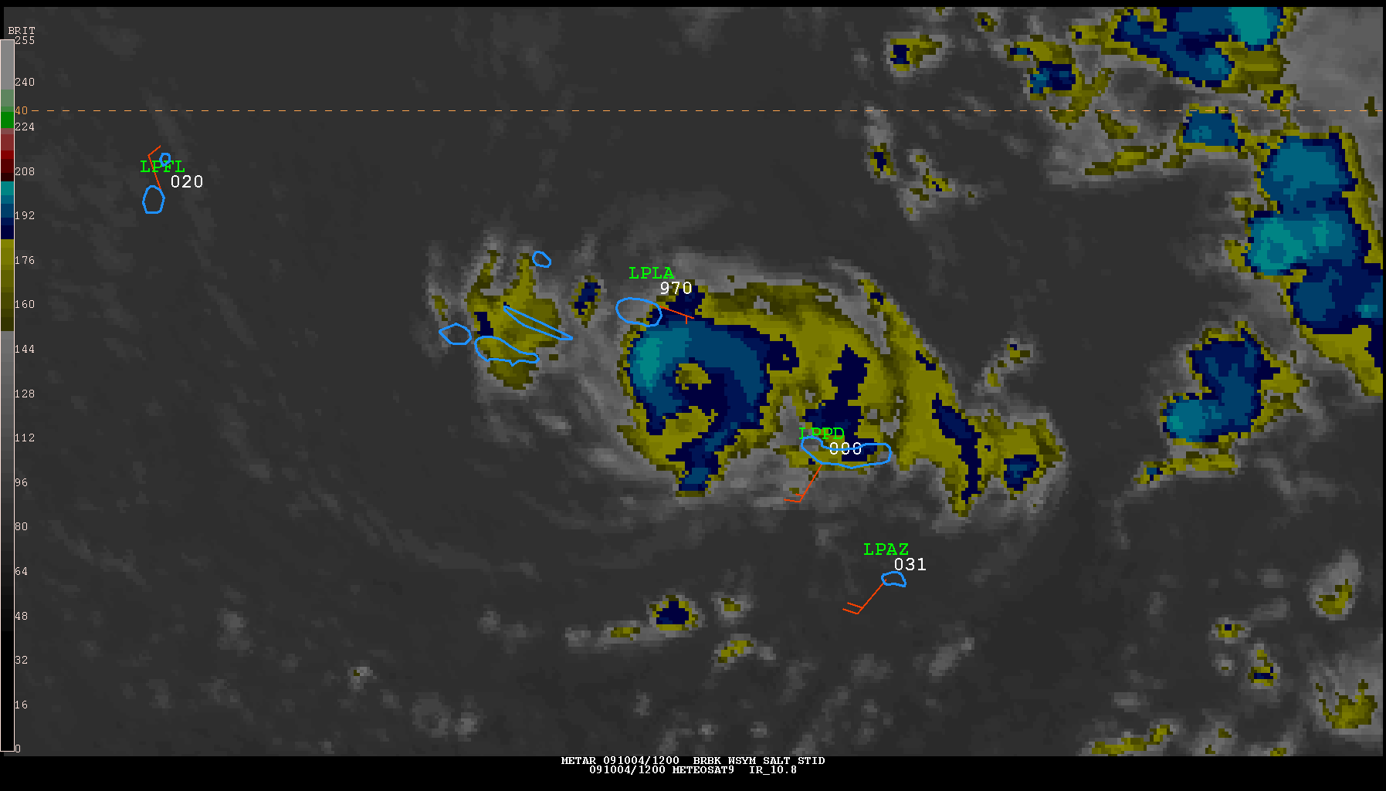

Slide 27
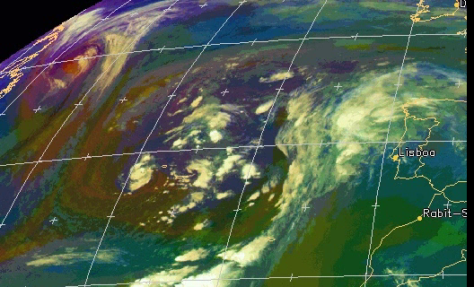

Slide 28
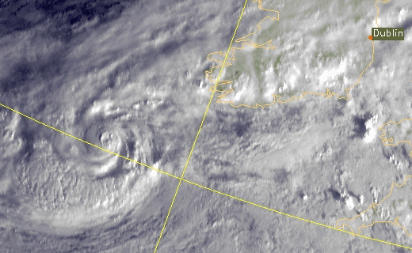

Slide 29
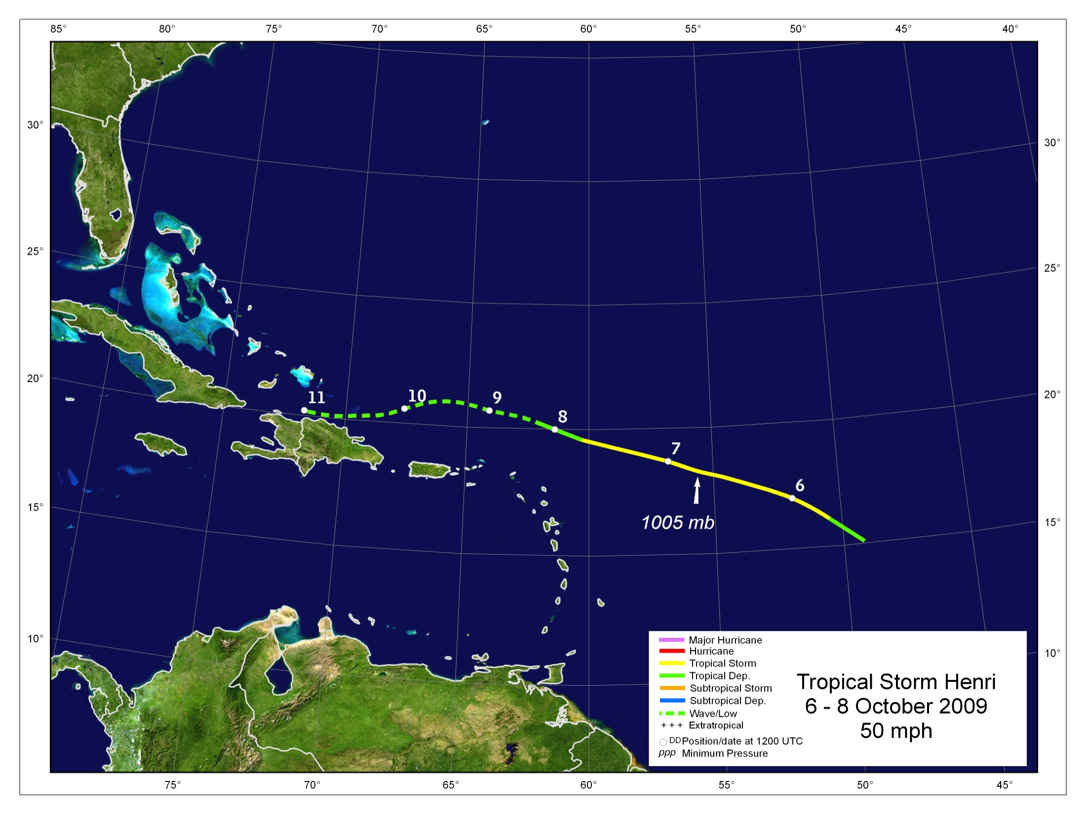
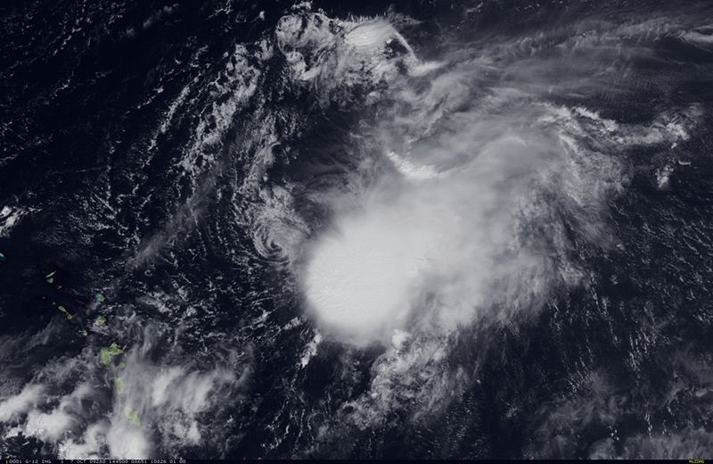

Slide 30
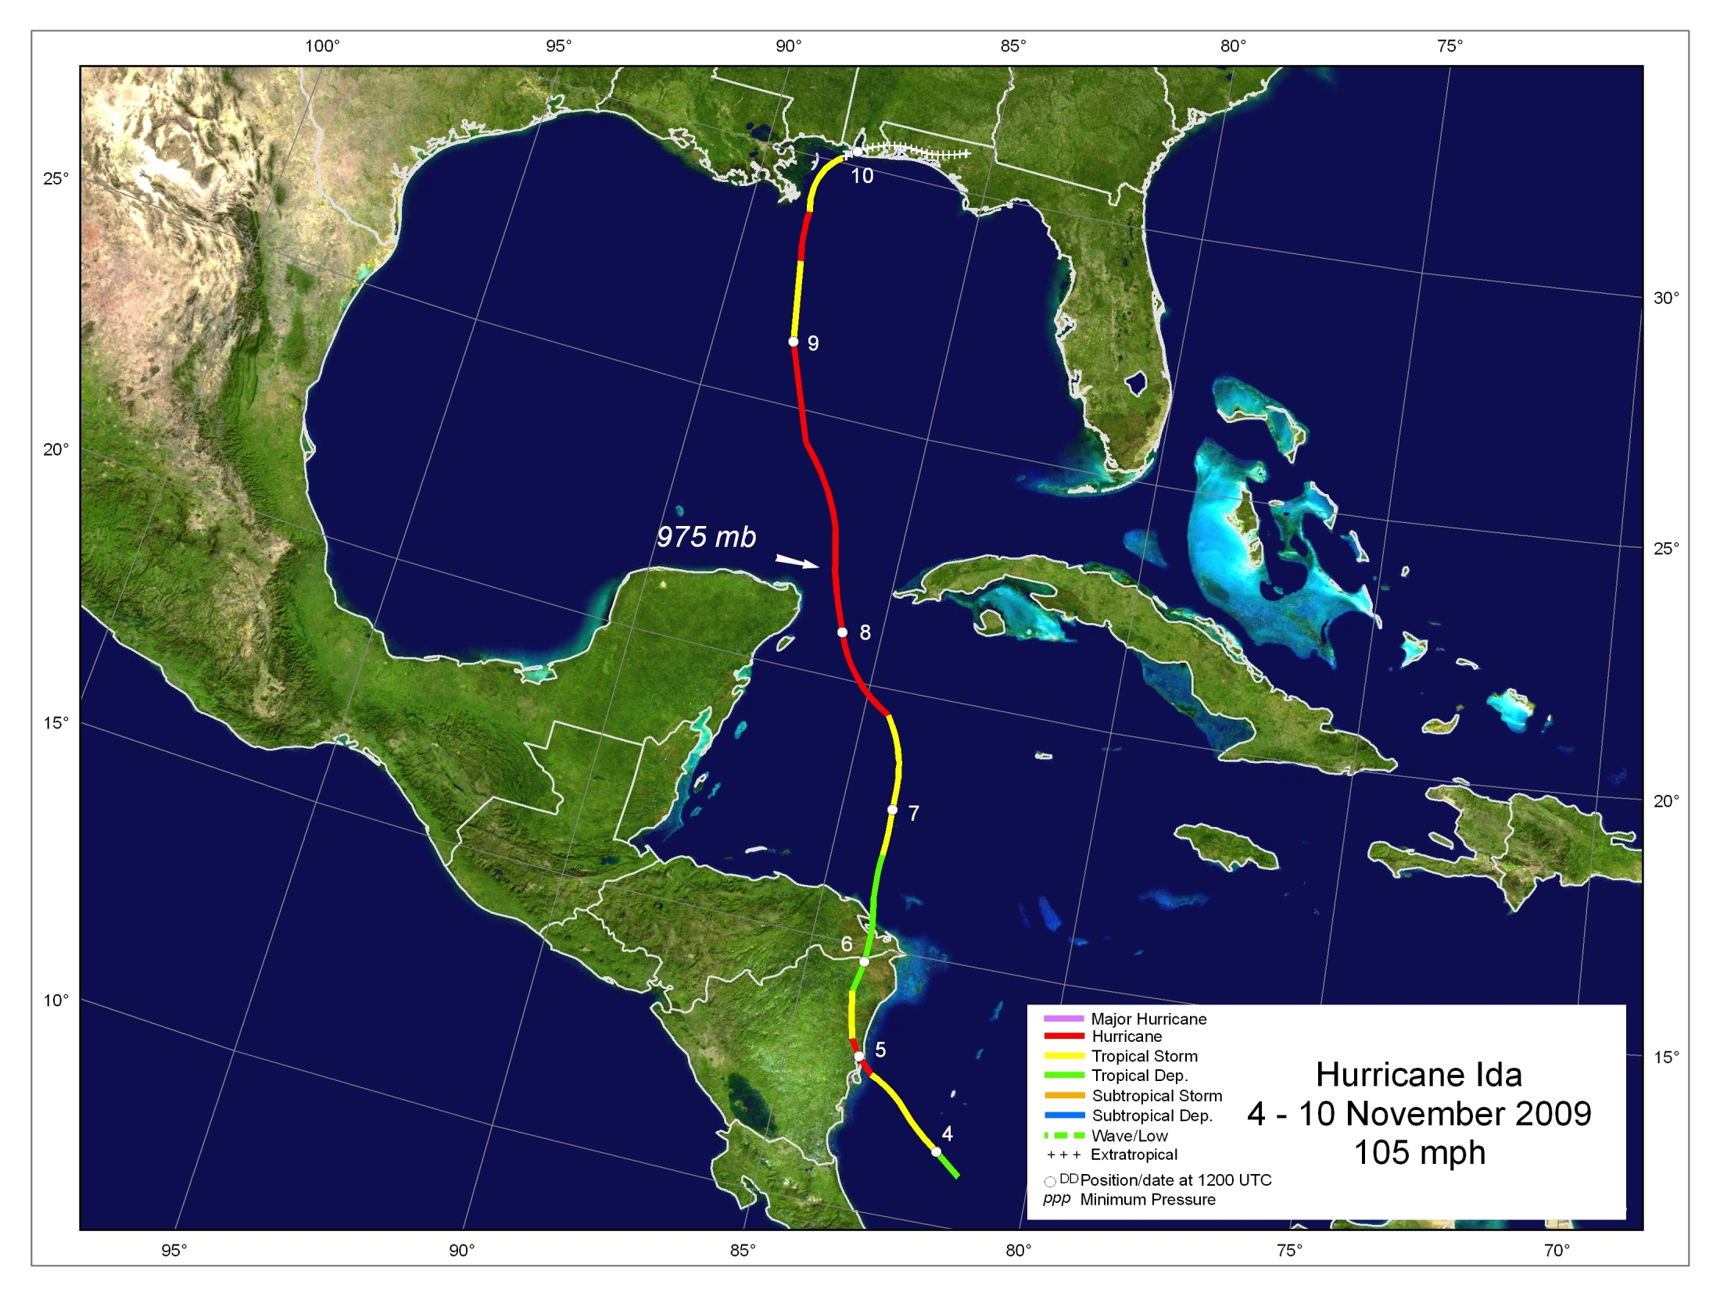

1st landfall near Tasbapauni, Nicaragua
About 80% of structures on Corn Islands destroyed
Unknown number of people missing in Nicaragua
1-min wind of 64 kt reported by NOAA buoy 42056 in NW Caribbean
Extratropical landfalls at Dauphin Island and Bon Secour, AL
Some storm surge flooding, esp. SE Louisiana and Mississippi
Contributed to major Nor’Easter off Mid-Atlantic coast
NOT responsible for flooding in El Salvador

Slide 31




Stringer - Reuters
Elmer Martinez - AFP
Barra del Rio Grande
Corn Islands
Elmer Martinez - AFP
Corn Islands
Stringer - Reuters
Sandy Bay

Slide 32





Navarre Beach, FL
Mari Darr-Welch
Destin, FL
Navarre Beach, FL
Mari Darr-Welch
Mari Darr-Welch
Destin, FL
Mari Darr-Welch
Destin, FL
Mari Darr-Welch

Slide 33


Slide 34


Slide 35


Hurricane Ida Forecasts
NHC Advisory #1
Verifying 5-day
Position of Ida
5-day NHC
Forecast
Track Model Guidance
NHC Forecast

Slide 36




Close Calls
Northern Gulf low
23 May
New Jersey low
11 September
Central Atlantic low
1 – 2 November

Slide 37
Operational Challenges
Sheared systems, some with marginally-defined centers
(Ana, Danny, Erika, Henri)
Unanticipated tropical cyclogenesis
(Claudette, Grace, Henri)
Cyclone classification
(Danny, Grace, early season Gulf low, New Jersey low, central Atlantic low)
Along-track (speed) forecast errors
(Bill, Grace, Ida)
Interpretation and accuracy of SFMR
(Bill, Ida)
High model intensity bias (esp. HWRF) in high-shear environments
(Bill, Erika, Fred)

Slide 38


