Slide 1
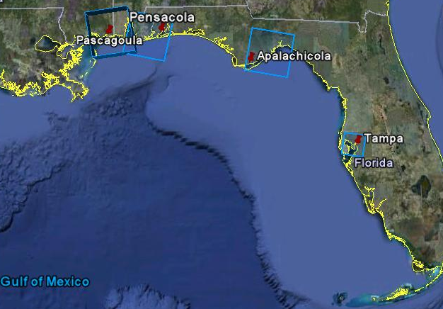
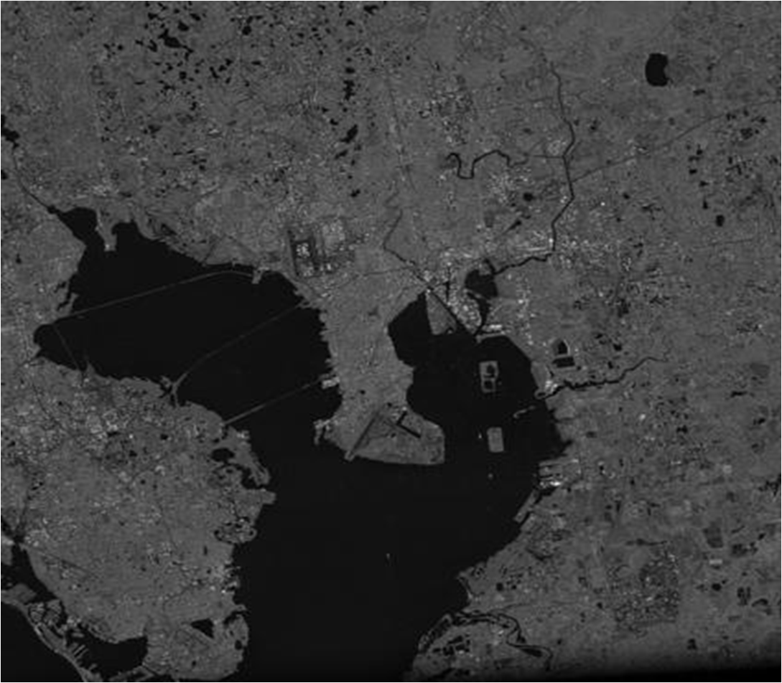
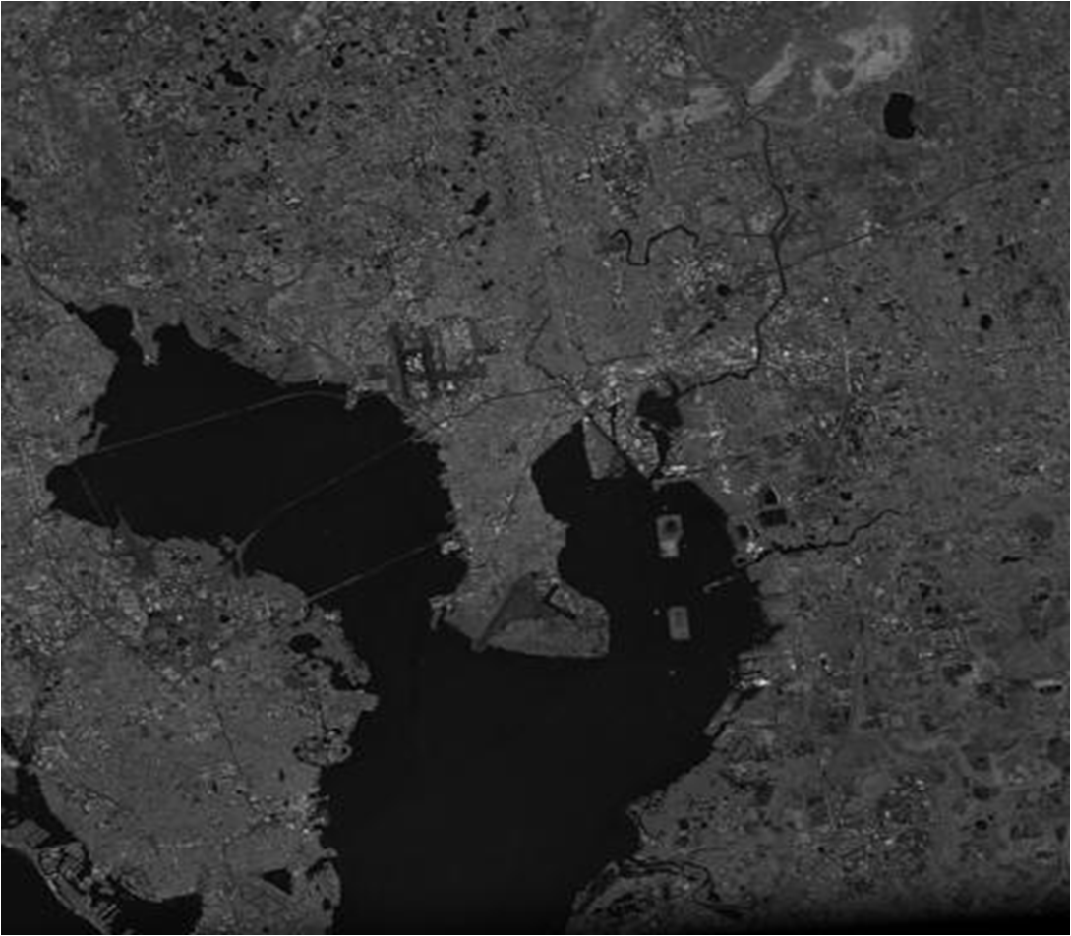
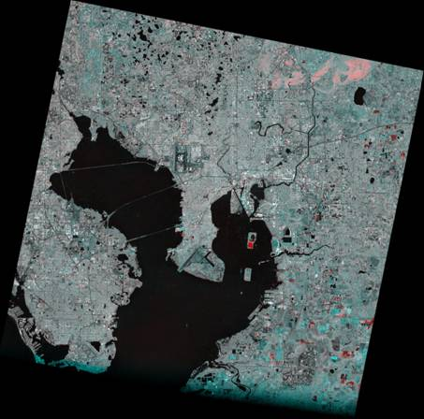
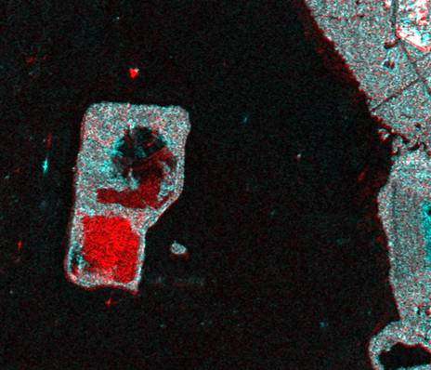
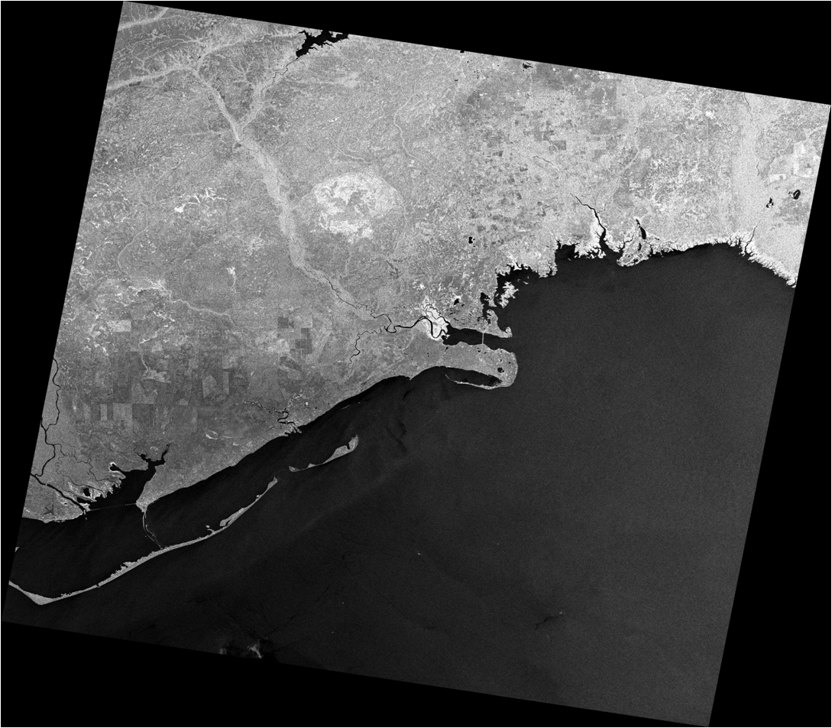
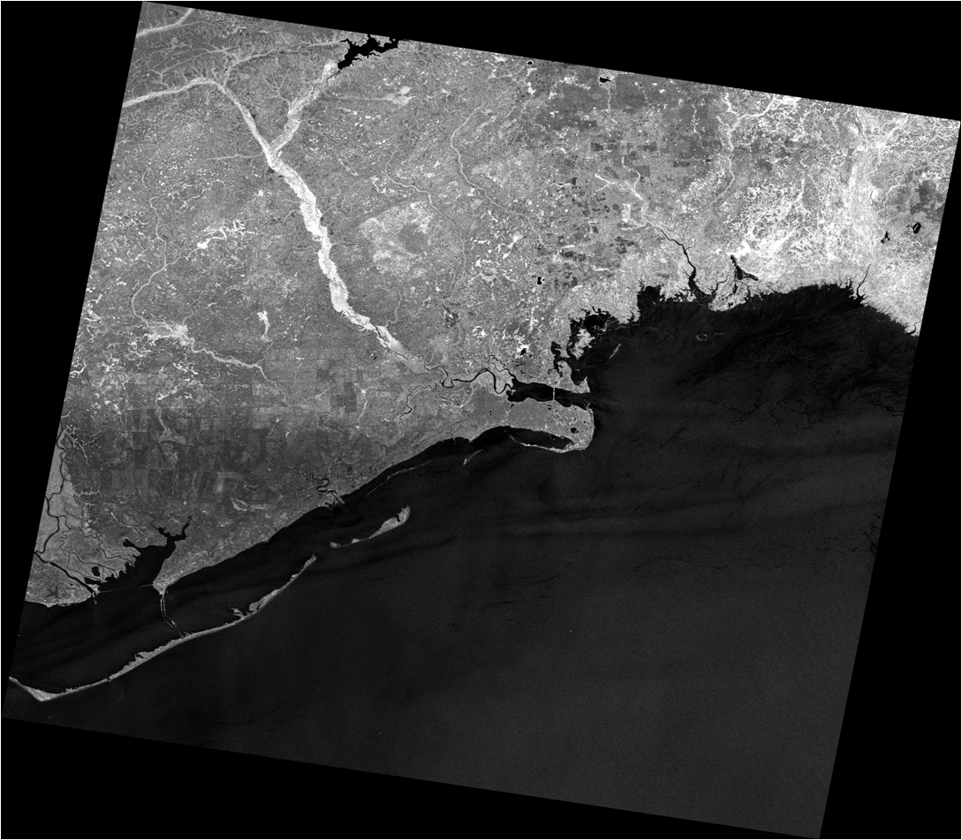
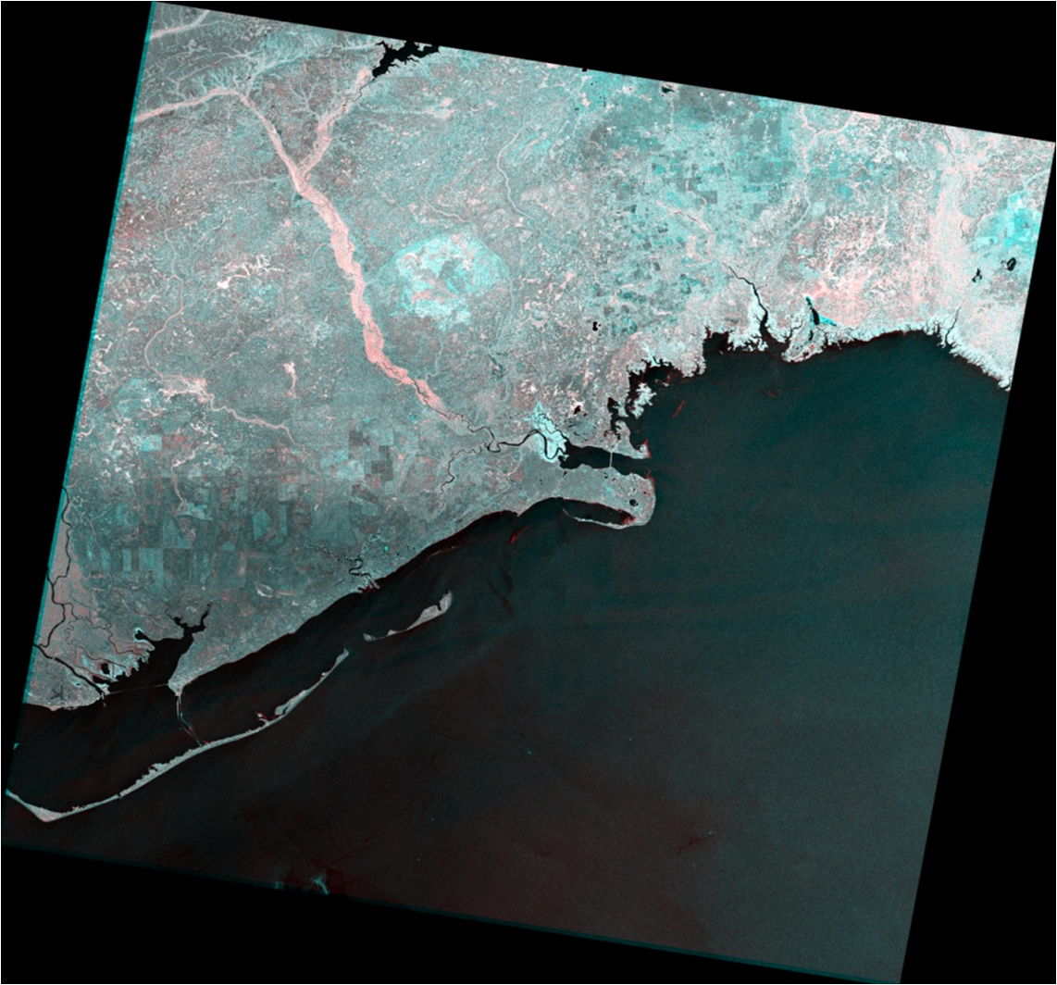

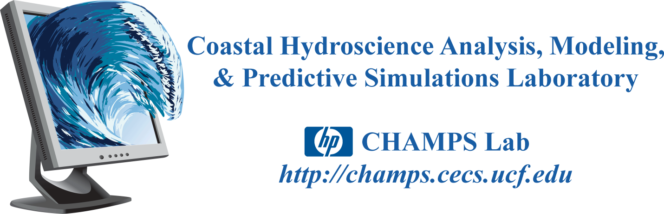

Application of high resolution satellite imagery to assess storm tide-related flooding
Marouane Temimi¹ (temimi@ce.ccny.cuny.edu), Naira Chaouch¹ (nchaouch@ccny.cuny.edu), Scott C. Hagen² (shagen@mail.ucf.edu), Stephen Medeiros² (scm@knights.ucf.edu)
Jesse Feyen³ (jesse.feyen@noaa.gov), Yuji Funakoshi ³(Yuji.Funakoshi@noaa.gov), Reza Khanbilvardi¹ (rk@ce.ccny.cuny.edu), John Weishampel ² (jweisham@mail.ucf.edu)
Frank Aikman III³ (frank.aikman@noaa.gov), Pedro Restrepo ⁴(pedro.restrepo@noaa.gov), Dave Reed⁵ (Dave.Reed@noaa.gov)
¹NOAA-CREST / The City University of New York ²University of Central Florida ³NOAA / NOS / OCS / CSDL ⁴NOAA / NWS / OHD ⁵NOAA / NWS / Lower Mississippi RFC
The ultimate goal of this study is to demonstrate the efficacy of employing high resolution satellite imagery to improve coastal inundation models that are presently employed by NOAA (NWS and NOS), USACE, and FEMA, and those state-of-the-art coastal and estuarine models that are under development and will soon be applied operationally. It is expected that the employment of satellite imagery will break new ground for wetting/drying algorithm verification and overall model validation.
Problem statement
8/15/2004
(right after hurricane Charley 2004)
11/14/2005
(low water level)
Study zones
Tampa, Pensacola, Pascagoula and Apalachicola
One of the two images illustrates normal conditions (reference image) and the second image corresponds to a flood event
Red channel is assigned to normal conditions image
Flood conditions image is presented in the green and blue channels
The hue of the color in the false color composite image indicates the date of the change while the intensity of the color represents the degree of change
The images are coregistred and presented in the UTM projection
Median filter was applied to reduce the speckle noise
The spatial resolution of the obtained image for Tampa zone is 9 m (fine mode)
The spatial resolution of the obtained image for Pensacola, Pascagoula and Apalachicola zones is 25 m (standard mode)
Inundation areas (shaded) for Man_Ctrl (from a control mesh) and Man_VF (from a mesh that defines particular vertical features, shown in blue) in the area of Interstate-75 on the southern bank of the Manatee River
Tampa area
False color image obtained with 8/15/2004 (right after hurricane Charley 2004) and 11/14/2005 (low water level) images
These two figures present an example of two different wetting front extents (shaded dark green) from hurricane storm surge simulations that employ different finite element discretizations. Note the discrepancies as one simulation inundates the majority of the interstate (middle of the graphic on the left) and one does not (graphic on the right). In the lower left portion of each graphic we see more wetted area on the left than on the right. Since both simulations were induced with the exact same wind and pressure forcing and were parameterized identically, one must be “correct” and one must be “wrong”. However, with only a single gage in the open water, both are only qualitatively defensible.
Results
The multi-temporal false color composited image obtained clearly shows flooded areas at both high tide and post- hurricane conditions.
Cyan color presents a negative change while red color corresponds to positive change which is observed during flood events.
The intensity of the red color which corresponds to inundated areas is related to the severity of the flood
These preliminary results show great potential for satellite imagery to monitor coastal flooding, to delineate inundated areas at high spatial resolution and improve hydrodynamic model verification and validation.
Number of historical tide gauges are limited and sparse relative to the huge expanse modeled
The algorithms cannot be sufficiently verified in a natural setting with existing spatial and temporal data that is limited on both accounts
Spatially and temporally varying data are needed in order to validate whether a given hydrodynamic model accurately describes a regular behavior such as a tidal creek filling or an extreme event
07/25/2004
(high tide)
03/03/2004
(low tide)
Satellite imagery is an important issue
Methodology
A change detection approach has been adopted to determine the coastal flood wetting front. It is an active microwave based technique which makes use of satellite images from Radarsat 1 (SAR) obtained from the Alaska Satellite Facility.
The approach consists of comparing two images covering the same scene and taken at two different acquisition dates but with similar radar configurations acquired under two extreme conditions (e.g., low tide vs high tide):
Future work
Determine intertidal zones in Pascagoula and Pensacola
Validate the results obtained with aerial photography
Determine flooded areas with optical remote sensing images obtained from Landsat (spatial resolution 30 m) and Aster (spatial resolution 15 m) satellites
Combine optical (MODIS) and radar (Radarsat1) remote sensing data to determine flooded areas and water level
Evaluate model predictions of inundation and guide improvements in the simulation of the wetting/drying processes
A multi-temporal image enhancement technique was applied to determine flooded areas: This technique assigns red, green and blue color to two different black and white SAR images
Apalachicola area
False color image obtained with 07/25/04 (high tide) and 03/03/04 (low tide) images
NASA Applied Sciences Program

